Slide 1



ONLYOFFICE Docs | DocSpace | Desktop vs WPS Office | 365

Slide 2










Best-in-breed online document editors
Docs, sheets, slides, forms, PDF
Open-source and security
Flexibility
AI support
Web, desktop, mobile
Seamless collaboration
Support for all popular file formats
Unified core technology across all solutions

Slide 3
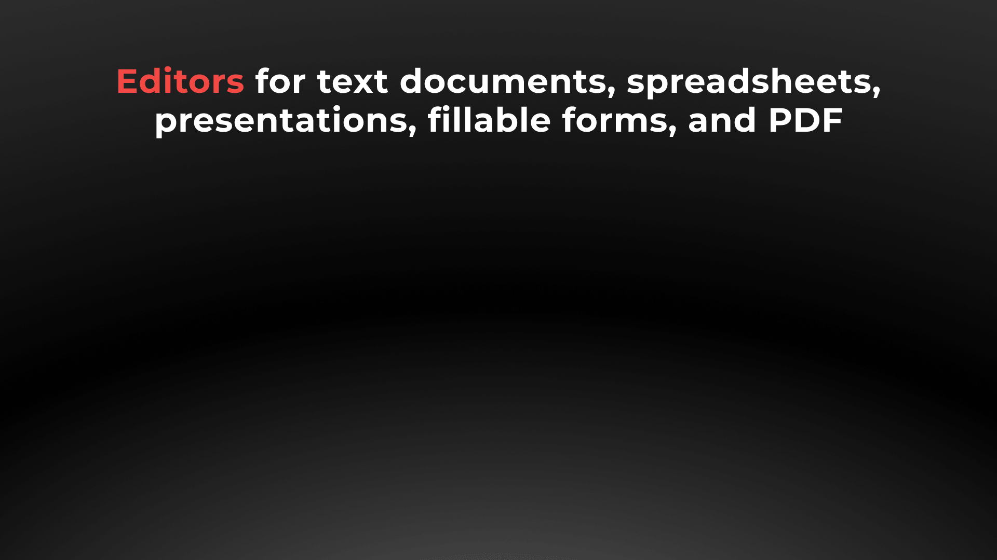






Slide 4


Docs, sheets, slides, forms, PDF
DOCUMENT EDITOR COMPARISON | Docs | DocSpace | Desktop | 365 | Office
Advanced font formatting | ● | ● | ● | ● | ●
Advanced paragraph formatting | ● | ● | ● | ● | ●
Bulleted/numbered/multilevel lists | ● | ● | ● | ● | ●
Columns | ● | ● | ● | ▬ | ●
Section breaks | ● | ● | ● | ● | ●
Creating & editing styles | ● | ● | ● | ▬ | ●
Color schemes | ● | ● | ● | ▬ | ●
Non-printing characters | ● | ● | ● | ● | ●
Format painter | ● | ● | ● | ● | ●
Paste special | ● | ● | ● | ● | ●
Page margins, size, orientation | ● | ● | ● | ● | ●

Slide 5
Docs, sheets, slides, forms, PDF
DOCUMENT EDITOR COMPARISON | Docs | DocSpace | Desktop | 365 | Office
Search & replace tool | ● | ● | ● | ● | ●
Spell checking | ● | ● | ● | ○ only for EN | ●
Headers & footers, page numbers | ● | ● | ● | ● | ●
Table of contents, footnotes | ● | ● | ● | ● | ●
Dark theme | ● | ● | ● | ▬ | ●
External and internal hyperlinks | ● | ● | ● | ○ only external | ●
Bookmarks | ● | ● | ● | ● | ●
Tables | ● | ● | ● | ● | ●
Content controls | ● | ● | ● | ○ limited | ●
Images | ● | ● | ● | ● | ●
Charts | ● | ● | ● | ▬ | ●

Slide 6
Docs, sheets, slides, forms, PDF
DOCUMENT EDITOR COMPARISON | Docs | DocSpace | Desktop | 365 | Office
Text Art objects | ● | ● | ● | ▬ | ●
Drop cap | ● | ● | ● | ▬ | ●
Equations | ● | ● | ● | ● | ●
Align/arrange/group objects | ● | ● | ● | ● | ●
Text wrap | ● | ● | ● | ● | ●
Exact object positioning | ● | ● | ● | ● | ●
Answering questions in AI chatbot | ● | ● | ● | ▬ | ▬
AI writing (generate, rewrite, summarize text, etc.) | ● | ● | ● | ▬ | ○ paid*
AI translation | ● | ● | ● | ▬ | ○ paid*
AI proofreading (spell checking, text analysis, etc.) | ● | ● | ● | ▬ | ○ paid*
*a separate WPS AI subscription required

Slide 7
Docs, sheets, slides, forms, PDF
SPREADSHEET EDITOR COMPARISON | Docs | DocSpace | Desktop | 365 | Office
Inserting images, charts | ● | ● | ● | ● | ●
Inserting autoshapes, text boxes | ● | ● | ● | ▬ | ●
Adding slicers | ● | ● | ● | ● | ●
Sheet View | ● | ● | ● | ▬ | ●
Removing duplicates | ● | ● | ● | ● | ●
Mail Merge | ● | ● | ● | ▬ | ●
Macros | ● | ● | ● | ▬ | ●
Data protection | ● | ● | ● | ● | ●
Color schemes | ● | ● | ● | ▬ | ●
Dark theme | ● | ● | ● | ▬ | ●
Custom functions | ● | ● | ● | ▬ | ●
Answering questions in AI chatbot | ● | ● | ● | ▬ | ▬
AI formula and function generation | ● | ● | ● | ▬ | ○ paid*
AI macro creation and conversion | ● | ● | ● | ▬ | ▬
*a separate WPS AI subscription required

Slide 8
Docs, sheets, slides, forms, PDF
PRESENTATION EDITOR COMPARISON | Docs | DocSpace | Desktop | 365 | Office
Copy / insert a slide | ● | ● | ● | ● | ●
Hide / show a slide | ● | ● | ● | ● | ●
Lists | ● | ● | ● | ● | ●
Inserting images, autoshapes, tables, symbols | ● | ● | ● | ● | ●
Animation and transitions | ● | ● | ● | ● | ●
Inserting SmartArt, charts | ● | ● | ● | ▬ | ●
Inserting headers & footers, date & time, TextArt | ● | ● | ● | ▬ | ●
Password protection | ● | ● | ● | ▬ | ●
Color schemes | ● | ● | ● | ▬ | ●
Presenter mode | ● | ● | ● | ▬ | ●
Dark theme | ● | ● | ● | ▬ | ●
Preview text effects | ● | ● | ● | ● | ●
Answering questions in AI chatbot | ● | ● | ● | ▬ | ▬
AI image generation | ● | ● | ● | ▬ enhancing/editing of images only*
*a separate WPS AI subscription required

Slide 9
Docs, sheets, slides, forms, PDF
PDF FORM EDITOR COMPARISON | Docs | DocSpace | Desktop | 365 | Office
Filling out | ● | ● | ● | ▬ | ●
Creating and editing | ● | ● | ● | ▬ | ▬
Simple fields (text, combo box, drop-down list, check box, radio button) | ● | ● | ● | ▬ | ▬
Special fields (image, email, phone, ZIP code, date&time, credit card, complex field, signature field) | ● | ● | ● | ▬ | ▬
Extended field properties (tips and placeholders, mark as required, lock, group fields, multiline entry, characters limit, comb of characters) | ● | ● | ● | ▬ | ▬
Recipient roles for field filling | ● | ● | ● | ▬ | ▬
Collecting data | ● | ● | ● | ▬ | ▬
Answering questions in AI chatbot | ● | ● | ● | ▬ | ▬
AI writing (generate, rewrite, summarize text, etc.) | ● | ● | ● | ▬ | ▬
AI translation | ● | ● | ● | ▬ | ▬
AI proofreading (spell checking, text analysis, etc.) | ● | ● | ● | ▬ | ▬

Slide 10
Docs, sheets, slides, forms, PDF
PDF EDITOR COMPARISON | Docs | DocSpace | Desktop | 365 | Office
Viewing | ● | ● | ● | ● | ●
Editing | ● | ● | ● | ▬ | ○ (paid)
Annotations - text highlight, underline, strikethrough | ● | ● | ● | ● | ●
Freehand drawings | ● | ● | ● | ● | ●
Inserting and editing objects | ● | ● | ● | ▬ | ○ (paid)
Adding stamps | ● | ● | ● | ▬ | ○ (paid)
Printing PDFs | ● | ● | ● | ● | ●
Adding or deleting pages | ● | ● | ● | ▬ | ○ (limited)
Rotating pages | ● | ● | ● | ● | ●
Reordering pages | ● | ● | ● | ▬ | ●
Duplicating pages/copying pages between PDFs | ● | ● | ● | ▬ | ○ (paid)
Converting PDF to DOCX, picture, e-book | ● | ● | ● | ▬ | ○ (paid)
Answering questions in AI chatbot | ● | ● | ● | ▬ | ▬
AI-powered OCR for PDF pages | ● | ● | ● | ▬ | ○ paid*
*a separate WPS AI subscription required

Slide 11





Slide 12

Web, desktop, mobile
DESKTOP APPS COMPARISON |  |  | Office
Text processor | ● | ●
Spreadsheet editor | ● | ●
Presentation editor | ● | ●
PDF Form creator | ● | ▬
PDF editor | ● | ●
Diagram viewer | ● | ▬
Collaboration | ● | ●
Ready integrations | ONLYOFFICE, Dropbox, OneDrive, kDrive, Nextcloud, ownCloud and other storages via WebDAV | WPS Cloud, Google Drive, Dropbox
Windows, Linux, macOS | ● | ●
Free version | ● | ○ limited

Slide 13

Web, desktop, mobile
MOBILE APPS COMPARISON |  |  | Office
Text processor | ● | ●
Spreadsheet editor | ● | ●
Presentation editor | ● | ●
Form filler | ● | ▬
PDF viewer | ● | ●
Media player | ● | ▬
Online & offline work | ● | ●
Collaboration | ● | ●
Connection to cloud | ONLYOFFICE, Dropbox, OneDrive, kDrive, Nextcloud, ownCloud and other storages via WebDAV | WPS, Box, Dropbox, Google Drive, OneDrive, and other storages via WebDAV
iOS & Android | ● | ●
Free | ● | ○ Ad-free only for paid subscribers

Slide 14







ONLYOFFICE:
COLLABORATION WITHOUT DISRUPTION
Elizabeth Rayen
Henry Milton
Samantha Jones

Slide 15
Collaboration
COLLABORATIVE FEATURES COMPARISON | Docs | DocSpace | Desktop | 365 | Office
Client-side performance | ● | ● | ● | ● | ●
2 co-editing modes (character- and paragraph-level) | ● | ● | ● | ▬ | ▬
Undo/Redo | ● | ● | ● | ● | ●
Track changes, accept/reject changes | ● | ● | ● | ● | ●
Changes display modes (Markup and baloons, Only markup, Final, Original) | ● | ● | ● | ● | ●
Commenting, mentions | ● | ● | ● | ● | ●
Built-in chat | ● | ● | ● | ▬ | ▬
External chats, audio and video calls | ● | ● | ● | ▬ | ▬
Version history | ● | ● | ● | ● | ●
Protecting parts of documents from being edited | ● | ● | ● | ● | ●
Embedding into a web page | ● | ● | ● | ▬ | ▬
Guest names | ● | ● | ● | ▬ | ▬
Document comparison | ● | ● | ● | ▬ | ●
Combine documents | ● | ● | ● | ▬ | ●

Slide 16
Collaboration
SHARING PERMISSIONS COMPARISON | Docs | DocSpace | Desktop | 365 | Office
Sharing files | ● | ● | ● | ● | ●
Access by external link | ● | ● | ● | ● | ●
Editing by external link without authorization | ● | ● | ● | ▬ | ▬
Access rights: Read Only | ● | ● | ● | ● | ●
Access rights: Full Access | ● | ● | ● | ● | ●
Access rights: Review | ● | ● | ● | ▬ | ▬
Access rights: Comment | ● | ● | ● | ▬ | ▬
Access rights: Form Filling | ● | ● | ● | ▬ | ▬
Access rights: Custom Filter (in spreadsheets) | ● | ● | ● | ▬ | ▬
Access rights: Can't download | ● | ● | ● | ● | ●
Access rights: Can't print and copy file | ● | ● | ● | ▬ | ▬
Access rights: Can't change sharing settings | ● | ● | ● | ● | ●

Slide 17

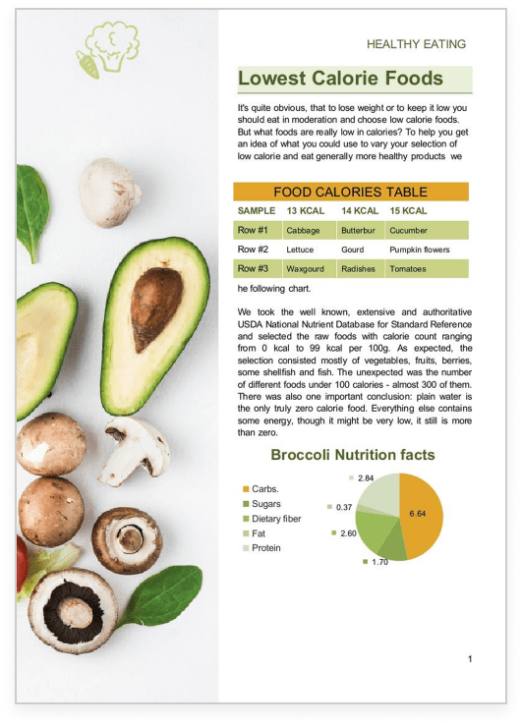

ONLYOFFICE:
MAXIMUM COMPATIBILITY WITH MS OFFICE FILES
MS Office desktop
WPS Office
ONLYOFFICE Docs

Slide 18
Comparison of file formats support
 | Docs | DocSpace | Desktop | 365 | Office
Native formats | DOCX • XLSX • PPTX |  |  | WPS • ET • DPS
Editing DOC, TXT, HTML, ODT | ● | ● | ● | ○ ODT not supported |  | ●
Editing XLS, XLSB, ODS, CSV, XLTX, OTS | ● | ● | ● | ○ CSV for viewing only, ODS, OTS and XLSB not supported |  | ○ saving in original format partially supported
Editing PPT, ODP, POTX, OTP | ● | ● | ● | ○ ODP, OTP not supported |  | ●
Editing DOTX, OTT, RTF, EPUB, FB2 | ● | ● | ● | ○ OTT, EPUB, FB2 not supported, RTF for viewing only |  | ●
Creating and filling out PDF forms | ● | ● | ● | ▬ |  | ▬
Viewing and annotating PDF | ● | ● | ● | ● |  | ●
Editing PDF, PDF/A | ● | ● | ● | ▬ |  | ○ (paid)
Export to PDF | ● | ● | ● | ● |  | ●

Slide 19
Comparison of file formats support
 | Docs | DocSpace | Desktop | 365 | Office
Native formats | DOCX • XLSX • PPTX |  |  | WPS • ET • DPS
Viewing DjVu, XPS | ● | ● | ● | ▬ |  | ●
Viewing Apple formats (.pages, .key, .numbers) | ● | ● | ● | ▬ |  | ▬
Viewing Hancom formats (.hwp, .hwpx) | ● | ● | ● | ▬ |  | ▬
Viewing Visio files (.vsdx) | ● | ● | ● | ▬ |  | ▬
Viewing Markdown files (.md) | ● | ● | ● | ▬ |  | ▬
Viewing OpenDocument Graphic files (.odg) | ● | ● | ● | ▬ |  | ▬

Slide 20

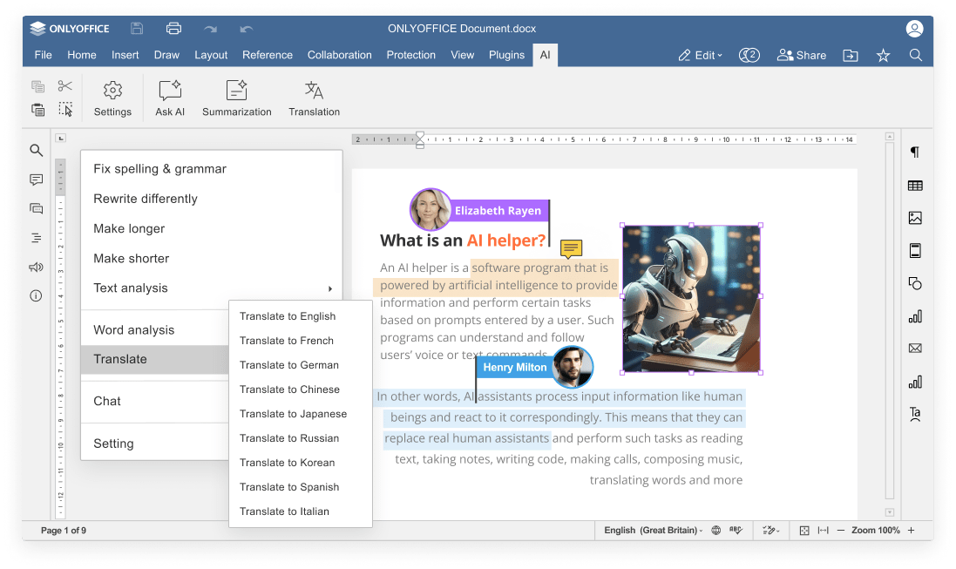
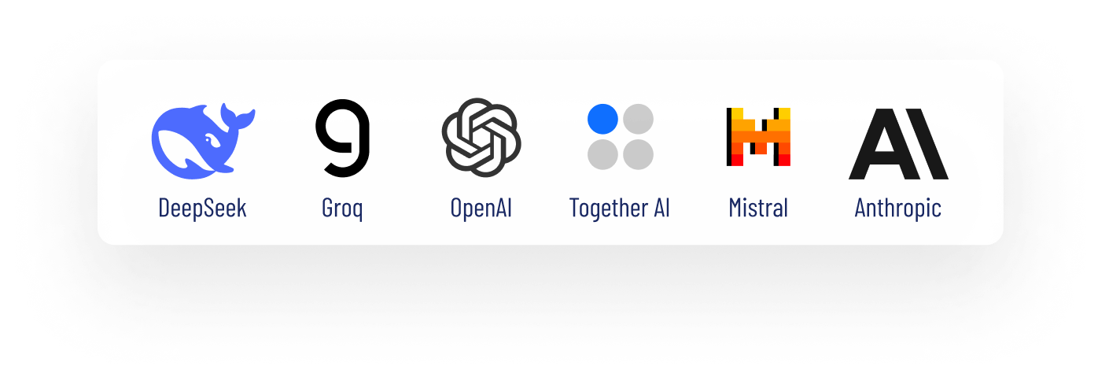

Slide 21
AI integration
COMPARISON OF AI FEATURES | Docs | DocSpace | Desktop | 365 | Office
Answering questions in chatbot | ● | ● | ● | ▬ | ▬
Writing (generate, rewrite, сhange tone/style, etc.) | ● | ● | ● | ▬ | ○ paid*
Translation | ● | ● | ● | ▬ | ○ paid*
Proofreading (spell checking, text analysis, etc.) | ● | ● | ● | ▬ | ○ paid*
Summarization | ● | ● | ● | ▬ | ○ paid*
OCR for PDF files | ● | ● | ● | ▬ | ○ paid*
Formula and function generation | ● | ● | ● | ▬ | ○ paid*
Macro creation and conversion | ● | ● | ● | ▬ | ▬
Images generation | ● | ● | ● | ▬ enhancing and editing of images only
Code review | ● via chatbot |  |  | ▬ |  | ▬
*a separate WPS AI subscription required
to access these capabilities

Slide 22
AI integration
COMPARISON OF AI CUSTOMIZATION AND FLEXIBILITY | Docs | DocSpace | Desktop | 365 | Office
Selecting among AI providers (ChatGPT, Deepseek, Ollama, Together AI, Groq AI, Mistal AI, etc.) | ● | ● | ● | ▬ WPS AI only | ▬ WPS AI only
Selecting among AI models | ● | ● | ● | ▬ WPS AI only | ▬ WPS AI only
Self-hosted AI support | ● | ● | ● | ▬ | ▬
Custom AI configuration (assigning different AI models for different tasks) | ● | ● | ● | ▬ | ▬
API keys & access control | ● | ● | ● | ▬ | ▬
Integration into enterprise environments | ● | ● | ● | ▬ | ▬
Availability | free AI plugin available in all editors |  |  | additional subscription to WPS AI required; not available in WPS 365

Slide 23

ONLYOFFICE:
REINFORCED SECURITY

Slide 24
Data security
COMPARISON OF MAIN SECURITY ASPECTS | Docs | DocSpace | Desktop | 365 | Office
Open-source code | ● | ● | ● | ▬ | ▬
Self-hosting | ● | ● | ● | ▬ | ▬
SSL | ● | ● | ● | ● | ●
JWT | ● | ● | ● | ▬ | ▬
Cache lifetime configuration | ● | ● | ● | ▬ | ▬
Watermarking | ● | ● | ● | ▬ | ●
Data encryption | data is transferred via secure channel with ability to edit/co-edit in the encrypted form |  |  | proprietary solutions with undisclosed source code
End-to-end encryption | ● | ● | ● | ▬ | ▬
Restrictions support | ● | ● | ● | ▬ | ▬

Slide 25
Data security
COMPARISON OF SECURITY FEATURES FOR FILES | Docs | DocSpace | Desktop | 365 | Office
Support for advanced access permissions | Commenting • reviewing • filling forms • custom filtering in spreadsheets |  |  | ● | ●
Password protection for docs, sheets, slides | ● | ● | ● | ○ editing restrictions for specific area only; not available in presentations | ●
Password protection for workbook structure | ● | ● | ● | ▬ | ●
Password protection for separate sheets | ● | ● | ● | ○ editing restrictions only | ●
Locked cells | ● | ● | ● | ▬ | ●
Hidden formulas | ● | ● | ● | ▬ | ●
Digital signatures | ▬ | ▬ | ● | ▬ for PDFs only | ○ limited for free users

Slide 26




























Flexibility
ONLYOFFICE is integrated
in more than 40 well-known platforms (ready-to-use connectors)

Slide 27

Flexibility
ONLYOFFICE is embedded
in more than 300 web services
(API & WOPI)

Slide 28

Accessibility
UI tweaks
Various color modes
Hotkeys
Screen readers
Useful plugins in the editors
  AI helpers
  Translator (Google, DeepL)
  Text-to-speech
  Speech input
  Typograf
  OCR

Slide 29
Licensing and customization:
COMPARISON
Free personal version | ● fully featured and ad‑free | ● limited features and ads for free users
Free version for businesses | ● | ▬
Enterprise version | ● | ●
Developer version & white label | ● | ▬
Integration with other platforms | ● | ▬
Deployment options | ● cloud / on‑premises | ▬
License | AGPL V3 / Proprietary | Proprietary
One-time purchase option | ● | ▬ subscription-based only

Slide 30
Cloud Editors for integration | Docs Enterprise from $ 8 user / month |  | no integration or on-premises options
On-Premises Editors for integration | Docs Enterprise from $ 1500 / server |  | no integration or on-premises options
Cloud Collaboration Platform | DocSpace Business |  | WPS 365 free no options for business and teams
 | free for small teams | from $ 20 admin / month
On-Premises Collaboration Platform | DocSpace Enterprise |  | no on-premises options
 | free for small teams | $ 6550 per server
Desktop Editors | free |  | WPS Pro for Teams from $ 2.49 user/month
Pricing:
BUSINESS & TEAMS
For reference only. Prices as of July 14, 2025, and may be subject to change.

Slide 31
On-Premises Editors for integration | Docs Community free | no integration or on-premises options
Cloud Collaboration Platform | DocSpace Startup free | WPS 365 free
On-Premises Collaboration Platform | DocSpace Community free | no on-premises options
Desktop Editors | free fully featured and ad‑free | No subscription | WPS Pro | WPS Pro + AI
 |  | free limited features & ads | from $ 2.99 month | from $ 10.83 month
Pricing:
INDIVIDUALS
For reference only. Prices as of July 14, 2025, and may be subject to change.

Slide 32
Cloud Editors for integration | Docs Developer from $ 12 user / month |  | no developer options
On-Premises Editors for integration | Docs Developer from $ 1950 / per year
On-Premises Collaboration Platform | DocSpace Developer
 | Get a quote
Pricing:
DEVELOPERS
For reference only. Prices as of July 14, 2025, and may be subject to change.

Slide 33






Want to try ONLYOFFICE?
Download Docs
Get Desktops
Join DocSpace

Slide 34

SALES REQUESTS
sales@onlyoffice.com
OFFICIAL WEBSITE
www.onlyoffice.com

