Slide 1



ONLYOFFICE Docs | DocSpace | Desktop VS Adobe Acrobat

Slide 2


Best-in-breed online document editors for working with forms
Complete functionality in one editor
Open-source and security
Flexibility
AI support
Web, desktop, mobile
Seamless collaboration

Slide 3
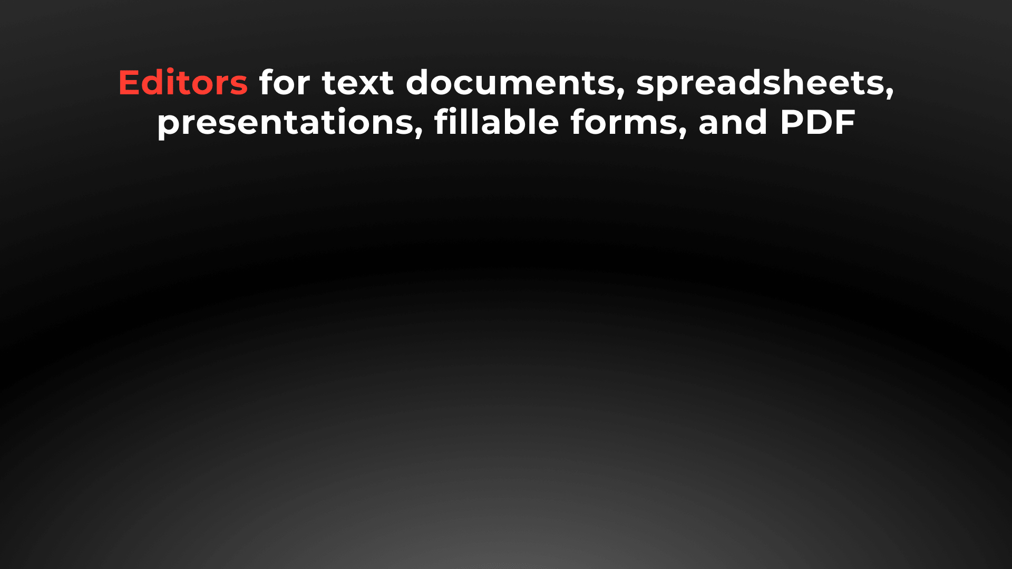






Slide 4

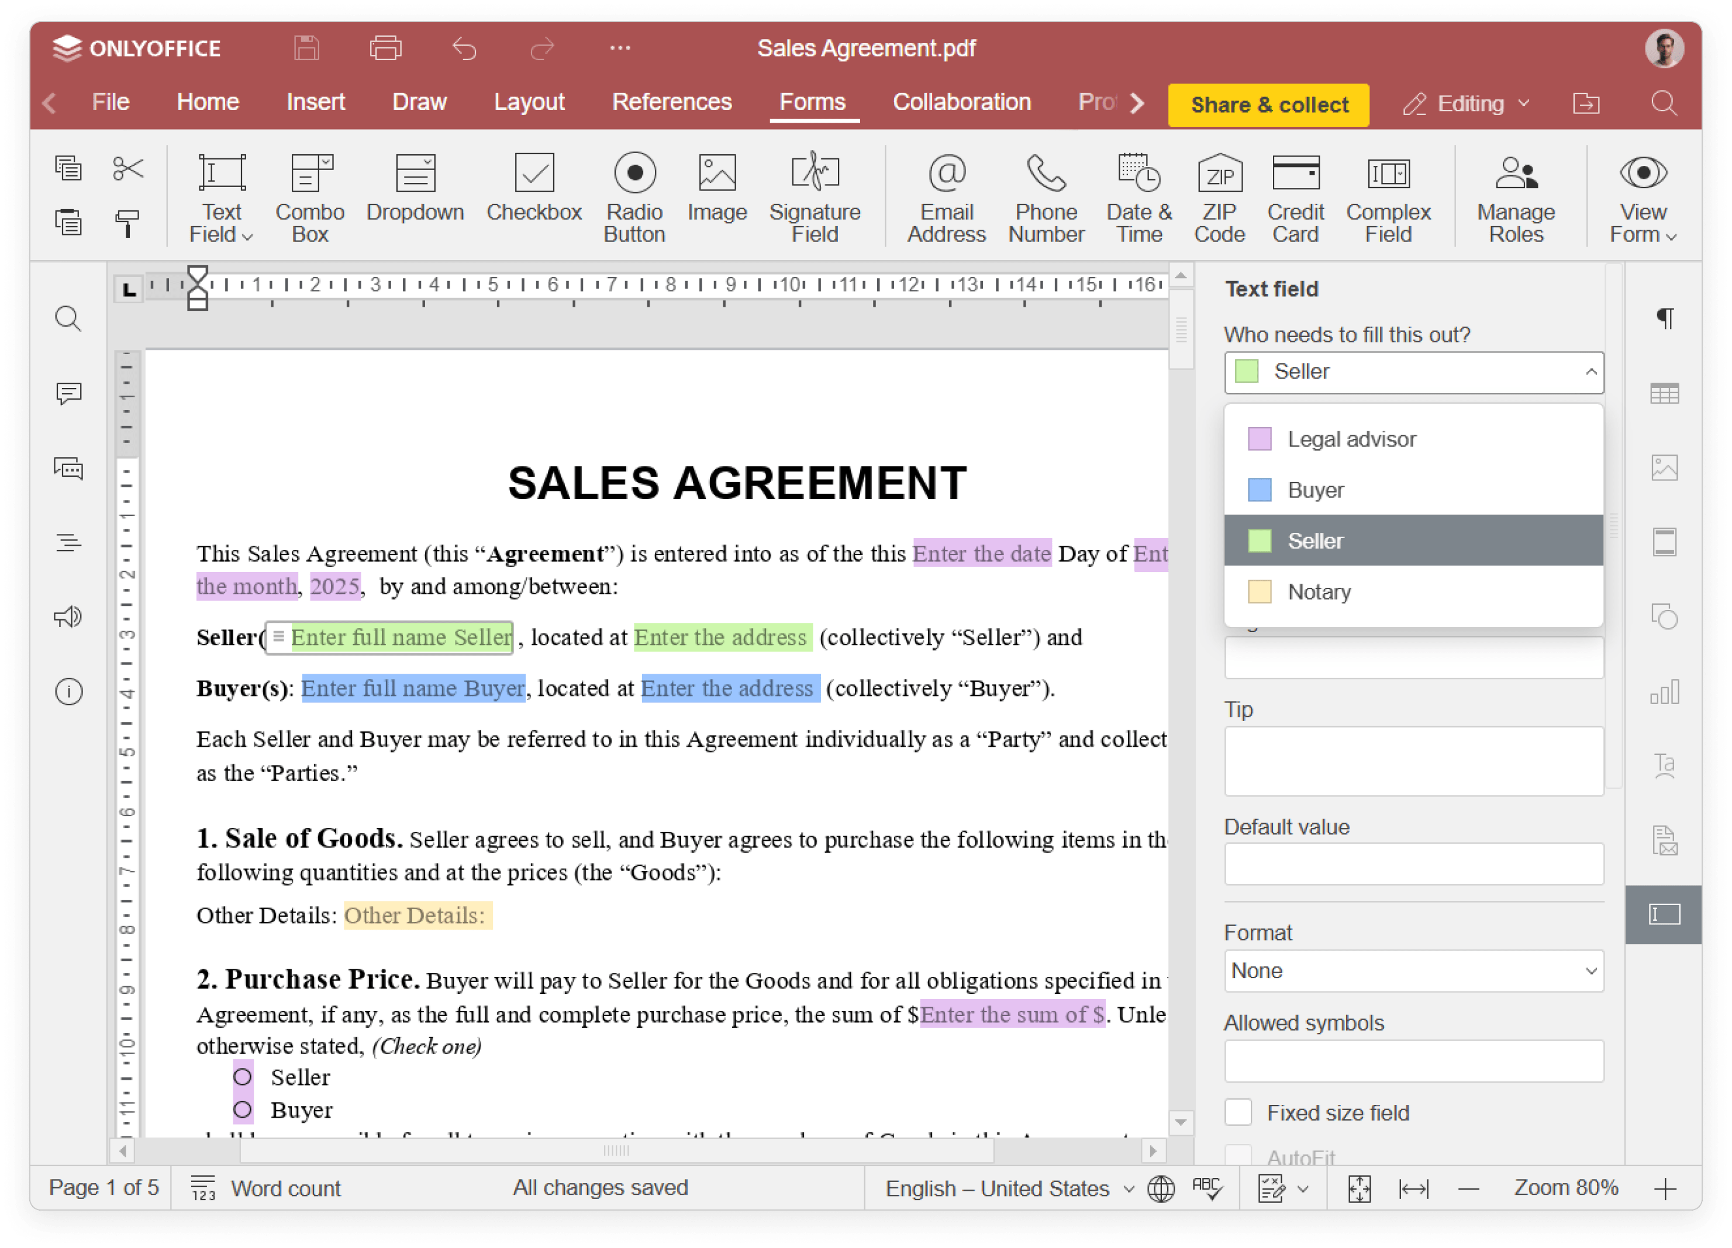
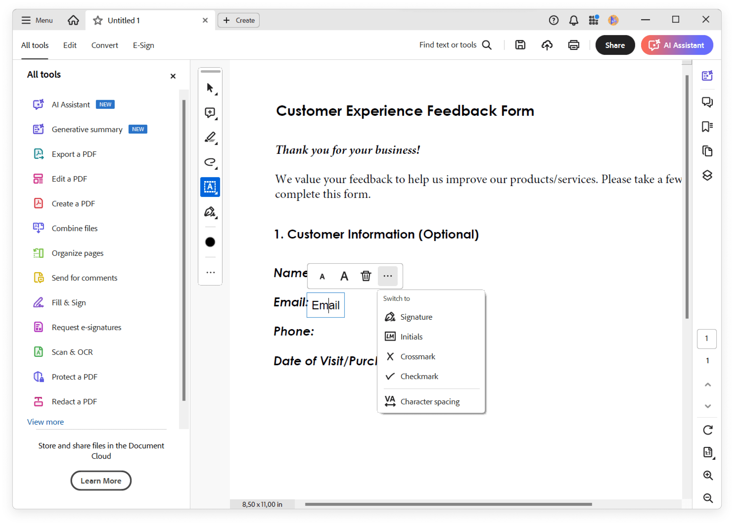
Form creator
ONLYOFFICE PDF form editor
Adobe Acrobat

Slide 5


Form creator comparison
BASIC ASPECTS | Docs | DocSpace | Desktop | Adobe Acrobat
Creating a form template from blank | ● | ● | ● | ●
Creating a form template from the existing DOCX file | ● | ● | ● | ▬
Editing and formatting text in the form template | ● | ● | ● | ●
Adding tables to the form template | ● | ● | ● | ▬
Filling out forms | ● | ● | ● | ●
Viewing PDF | ● | ● | ● | ●
Editing PDF | ● | ● | ● | ●
Saving forms as PDF | ● | ● | ● | ●
Recipient roles for field filling | ● | ● | ● | ●
Collecting data | ● | ● | ● | ●
Form library | ● Completely free, No registration required |  |  | ▬

Slide 6
Form creator comparison
SIMPLE FORM FIELDS | Docs | DocSpace | Desktop | Adobe Acrobat
Text area | ● | ● | ● | ●
Combo box | ● | ● | ● | ●
Drop-down list | ● | ● | ● | ●
Check box | ● | ● | ● | ●
Radio button | ● | ● | ● | ●
Image | ● | ● | ● | ●
List box | ▬ | ▬ | ▬ | ●

Slide 7
Form creator comparison
SIMPLE FORM FIELDS | Docs | DocSpace | Desktop | Adobe Acrobat
Date | ● | ● | ● | ●
Barcode field | ▬ | ▬ | ▬ | ●
Print or Clear button | ▬ | ▬ | ▬ | ●
Signature | ● | ● | ● | ●
Email | ● | ● | ● | ▬
Phone | ● | ● | ● | ▬
ZIP code | ● | ● | ● | ▬
Credit card | ● | ● | ● | ▬
Complex field | ● | ● | ● | ▬

Slide 8
Form creator comparison
TEXT FIELD PROPERTIES | Docs | DocSpace | Desktop | Adobe Acrobat
Allowing multiline entry | ● | ● | ● | ●
Specifying characters limit | ● | ● | ● | ●
Automatically resizing fields to fit the text | ● | ● | ● | ▬
Applying the comb of characters | ● | ● | ● | ●
Adjusting cell width | ● | ● | ● | ▬

Slide 9
Form creator comparison
EXTENDED FIELD PROPERTIES | Docs | DocSpace | Desktop | Adobe Acrobat
Adjusting border/background colors | ● | ● | ● | ●
Changing highlighting colors | ● | ● | ● | ▬
Moving and rotating form fields | ● | ● | ● | ▬
Adding tips and placeholders | ● | ● | ● | ●
Adjusting the field position | ● | ● | ● | ●
Marking a form field as required | ● | ● | ● | ●
Grouping fields to fill out simultaneously | ● | ● | ● | ●
Locking any form field | ● | ● | ● | ●
Fixed size field | ● | ● | ● | ●
Tags | ● | ● | ● | ▬

Slide 10





Slide 11

Web, desktop, mobile
DESKTOP APPS COMPARISON |  | Adobe Acrobat
Text processor | ● | ▬
Spreadsheet editor | ● | ▬
Presentation editor | ● | ▬
Form creator, form filler | ● | ●
PDF reader, PDF editor | ● | ●
Collaboration | ● | ▬
Ready integrations | ONLYOFFICE, Nextcloud, ownCloud, Seafile, kDrive, Liferay, Moodle | Adobe Cloud Storage
Windows, Linux, macOS | ● | ● / ▬ / ●
Free version / Enterprise version | ● / ▬ | ● / ▬

Slide 12

Web, desktop, mobile
MOBILE APPS COMPARISON |  | Adobe Acrobat
Text processor | ● | ▬
Spreadsheet editor | ● | ▬
Presentation editor | ● | ▬
Form filler | ● | ●
PDF viewer | ● | ●
Media player | ● | ▬
Online & offline work | ● | ●
Collaboration | ● | ▬
Connection to cloud | ONLYOFFICE and other storages via WebDAV | Adobe Document Cloud and other cloud storages
iOS/Android | ● | ●
Free | ● | limited functionality

Slide 13






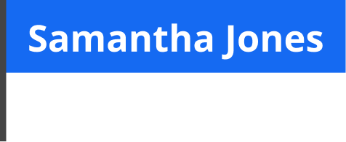
ONLYOFFICE:
COLLABORATION WITHOUT DISRUPTION
Elizabeth Rayen
Henry Milton
Samantha Jones

Slide 14
Form creator comparison
COLLABORATIVE FEATURES | Docs | DocSpace | Desktop | Adobe Acrobat
Collaborating on form template online | ● | ● | ● | ▬
Access rights: Form Filling | ● | ● | ● | ▬
2 co-editing modes (character- and paragraph-level) | ● | ● | ● | ▬
Undo/Redo | ● | ● | ● | ▬
Track changes, accept/reject changes | ● | ● | ● | ▬
Changes display modes (Markup, Final, Original) | ● | ● | ● | ▬
Commenting, mentions | ● | ● | ● | ▬
Built-in chat | ● | ● | ● | ▬
External chats, audio and video calls | ● plugins such as Jitsi, Rainbow |  |  | ▬
Version history | ● | ● | ● | ▬

Slide 15
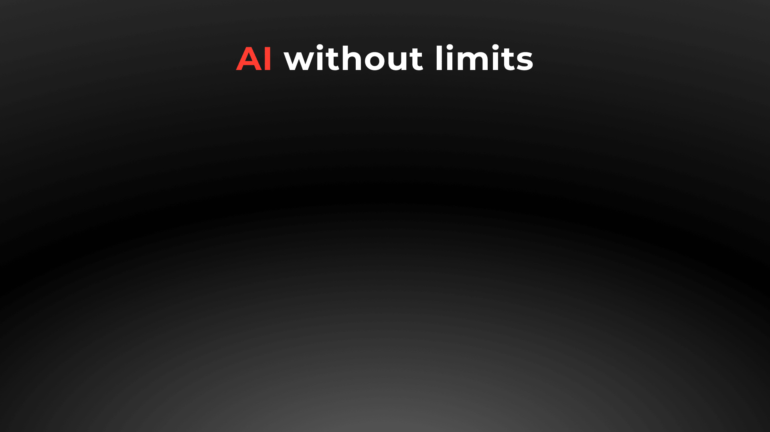
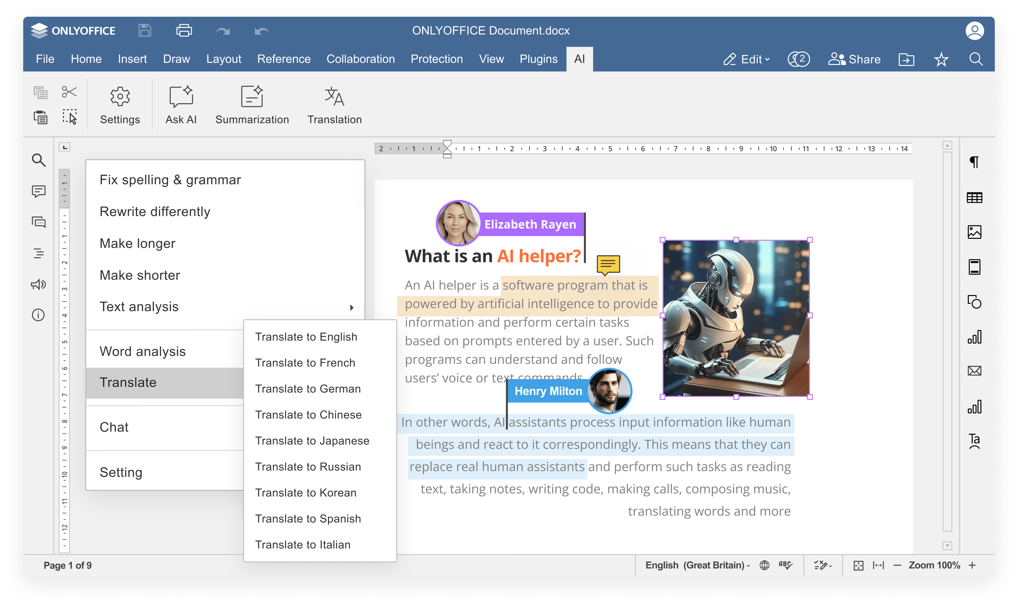


Slide 16
Comparison of AI features
 | Docs | DocSpace | Desktop | Adobe Acrobat
Answering questions in chatbot | ● | ● | ● | ●
Writing (generate, rewrite, summarize, expand text, etc.) | ● | ● | ● | ●
Translation | ● | ● | ● | ●
Proofreading (spell checking, sentence analysis, etc.) | ● | ● | ● | ●
Summarization | ● | ● | ● | ●
Images generation | ● | ● | ● | ●
Code review | via chatbot |  |  | via chatbot
Formula suggestions & explanations | ● | ● | ● | via chatbot
AI for macros | ● | ● | ● | ▬
OCR for scanned PDFs | ● | ● | ● | ▬

Slide 17
Comparison of AI features and flexibility
 | Docs | DocSpace | Desktop | Adobe Acrobat
Selecting among AI providers (ChatGPT, Gemini, Deepseek, Ollama, Together AI, Groq AI, Mistal AI, etc.) | ● | ● | ● | AI Assistant for Adobe Acrobat
Selecting among AI models | ● | ● | ● | ▬
Self-hosted AI support | ● | ● | ● | ▬
Custom AI configuration (assigning different AI models for different tasks) | ● | ● | ● | ▬
API keys & access control | ● | ● | ● | ▬
Integration into enterprise environments | ● | ● | ● | ●
Availability | free AI plugin available in all editors |  |  | requires separate subscription

Slide 18

ONLYOFFICE:
REINFORCED SECURITY

Slide 19
Data security
COMPARISON OF SECURITY ASPECTS | Docs | DocSpace | Desktop | Adobe Acrobat
Open-source code | ● | ● | ● | ▬
Self-hosting | ● | ● | ● | ▬
SSL | ● | ● | ● | ●
JWT | ● | ● | ● | ●
Watermarking | ● | ● | ● | ●
Signing field groups & entire form | ● | ● | ● | ●
Customizing recipient roles | ● | ● | ● | ●
Encrypting data fields & entire form | ● | ● | ● | ●

Slide 20




























Flexibility
ONLYOFFICE is integrated in more than 40 well-known platforms ready-to-use connectors

Slide 21

Flexibility
ONLYOFFICE is embedded in more than 300 web services API & WOPI
You can bring the form creator functionality to your customers within your own platform under your brand

Slide 22
Pricing and licensing
COMPARISON | Docs | Adobe Acrobat
Free version | ● | ○ Limited functionality (only viewing, commenting, printing)
Enterprise version | ● | ●
License | AGPL V3 | Proprietary
Pricing model | Per connection* | Per user
*How many browser tabs with documents can be opened for editing at the same time.

Slide 23

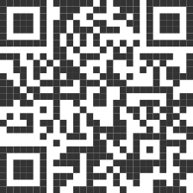
Ready to try ONLYOFFICE forms?

Slide 24

SALES REQUESTS
sales@onlyoffice.com
OFFICIAL WEBSITE
www.onlyoffice.com

