Slide 1



ONLYOFFICE Docs | DocSpace | Desktop VS Hancom Office (formerly ThinkFree Office)

Slide 2


Best-in-breed online document editors
Docs, sheets, slides, forms, PDF
Open-source and security
Flexibility
AI support
Web, desktop, mobile
Seamless collaboration
Support for all popular file formats
Unified core technology
across all solutions

Slide 3
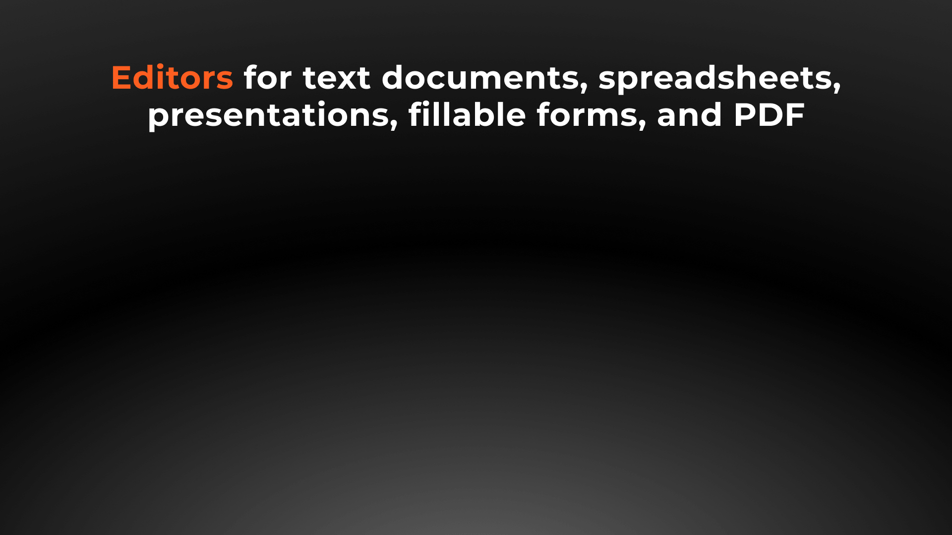






Slide 4


Docs, sheets, slides, forms, PDF
DOCUMENT EDITOR COMPARISON | Docs | DocSpace | Desktop | Office
Advanced font formatting | ● | ● | ● | ●
Advanced paragraph formatting | ● | ● | ● | ●
Advanced settings for Asian languages | ▬ | ▬ | ▬ | ●
Bulleted/Numbered/Multilevel lists | ● | ● | ● | ●
Columns | ● | ● | ● | ●
Section breaks | ● | ● | ● | ●
Creating & editing styles | ● | ● | ● | ●
Color schemes | ● | ● | ● | ●
Non-printing characters | ● | ● | ● | ●
Format Painter | ● | ● | ● | ●
Paste Special | ● | ● | ● | ●
Page margins, size, orientation | ● | ● | ● | ●
Search & Replace tool | ● | ● | ● | ●
Spell checking | ● | ● | ● | ●
Dark theme | ● | ● | ● | ●

Slide 5
Docs, sheets, slides, forms, PDF
DOCUMENT EDITOR COMPARISON | Docs | DocSpace | Desktop | Office
Headers & footers, page numbers | ● | ● | ● | ●
Table of contents, footnotes, endnotes | ● | ● | ● | ●
External and internal hyperlinks | ● | ● | ● | ●
Bookmarks | ● | ● | ● | ●
Tables, Images, Charts | ● | ● | ● | ●
Content controls | ● | ● | ● | ●
Compare documents | ● | ● | ● | ▬
Line numbers | ● | ● | ● | ●
Text boxes, Drop cap | ● | ● | ● | ●
Plugins | ● | ● | ● | ▬
Equations | ● | ● | ● | ●
Align/Arrange/Group objects | ● | ● | ● | ●
Text wrap | ● | ● | ● | ●
Table of Figures | ● | ● | ● | ▬

Slide 6
Docs, sheets, slides, forms, PDF
SPREADSHEET EDITOR COMPARISON | Docs | DocSpace | Desktop | Office
Data filtering and sorting | ● | ● | ● | ●
Freeze panes | ● | ● | ● | ●
Merge cells | ● | ● | ● | ●
Manage sheets | ● | ● | ● | ●
Pivot tables | ● | ● | ● | ●
Named range | ● | ● | ● | ●
Data validation | ● | ● | ● | ●
Conditional formatting | ● | ● | ● | ●
External and internal hyperlinks | ● | ● | ● | ●
Autosum | ● | ● | ● | ●
Formulas | ● | ● | ● | ●
Selecting external data | ● | ● | ▬ | ●

Slide 7
Docs, sheets, slides, forms, PDF
SPREADSHEET EDITOR COMPARISON | Docs | DocSpace | Desktop | Office
Inserting images, charts, sparklines, autoshapes | ● | ● | ● | ●
Inserting text boxes, equations, headers & footers, symbols | ● | ● | ● | ●
Trace Dependents | ● | ● | ● | ●
Adding slicers | ● | ● | ● | ▬
R1C1 style | ● | ● | ● | ▬
Sheet View | ● | ● | ● | ●
Removing duplicates | ● | ● | ● | ●
Mail Merge | ● | ● | ● | ●
Macros | ● | ● | ● | ●
Custom functions | ● | ● | ● | ●
Data protection | ● | ● | ● | ●
Import data | ● | ● | ● | ●

Slide 8
Docs, sheets, slides, forms, PDF
PRESENTATION EDITOR COMPARISON | Docs | DocSpace | Desktop | Office
Choosing presentation layout | ● | ● | ● | ●
Copy / insert a slide | ● | ● | ● | ●
Hide / show a slide | ● | ● | ● | ●
Slide templates | ● | ● | ● | ●
Inserting images, autoshapes, text boxes tables, footers, charts, date & time, symbols | ● | ● | ● | ●
Lists | ● | ● | ● | ●
Transitions | ● | ● | ● | ●
Animation | ● | ● | ● | ●
Hyperlinks | ● | ● | ● | ●
Setting parameters of demonstration | ● | ● | ● | ●
Presenter mode | ● | ● | ● | ●

Slide 9
Docs, sheets, slides, forms, PDF
PRESENTATION EDITOR COMPARISON | Docs | DocSpace | Desktop | Office
Align and arrange objects | ● | ● | ● | ●
Add notes | ● | ● | ● | ●
Search and replace | ● | ● | ● | ●
Spell checking | ● | ● | ● | ●
Insert audio and video | ● | ● | ● | ●
External and internal hyperlinks | ● | ● | ● | ●
Plugins | ● | ● | ● | ▬
View settings | ● | ● | ● | ●
Dark theme | ● | ● | ● | ●
Macros | ● | ● | ● | ●
Preview text effects | ● | ● | ● | ●

Slide 10
Docs, sheets, slides, forms, PDF
PDF EDITOR COMPARISON | Docs | DocSpace | Desktop | Office
Viewing | ● | ● | ● | ●
Editing | ● | ● | ● | ▬
Annotations - text highlight, underline, strikethrough | ● | ● | ● | ●
Freehand drawings | ● | ● | ● | ●
Inserting and editing objects | ● | ● | ● | ▬
Adding stamps | ● | ● | ● | ▬
Printing PDFs | ● | ● | ● | ●
Adding or deleting pages | ● | ● | ● | ▬
Copying pages between PDFs | ● | ● | ● | ▬
Rotating pages | ● | ● | ● | ●
Converting PDF to DOCX | ● | ● | ● | ●
Converting PDF to picture | ● | ● | ● | ●
Converting PDF to e-book | ● | ● | ● | ▬

Slide 11
Docs, sheets, slides, forms, PDF
FORMS EDITOR COMPARISON | Docs | DocSpace | Desktop | Office
Online & Offline editors | ● | ● | ● | ● / ▬
Create a form from a text document | ● | ● | ● | ▬
Form templates library | ● | ● | ● | ▬
Various types of fillable fields | ● | ● | ● | ○ limited number of options
Settings for each of the fallible form types | ● | ● | ● | ○ limited number of options
Make a field obligatory | ● | ● | ● | ●
Preview a form | ● | ● | ● | ●
Adding a title, subtitle, description | ● | ● | ● | ●
Navigate between fillable fields | ● | ● | ● | ●
Insert autoshapes, tables, charts, symbols, equations, Text Art, comments, hyperlinks | ● | ● | ● | ▬
Features available in the document editor | ● | ● | ● | ▬
Statistics on form responses | ● | ● | ● | ●
Limit number of respondents | ● | ● | ● | ●
Post-survey message | ● | ● | ● | ●

Slide 12

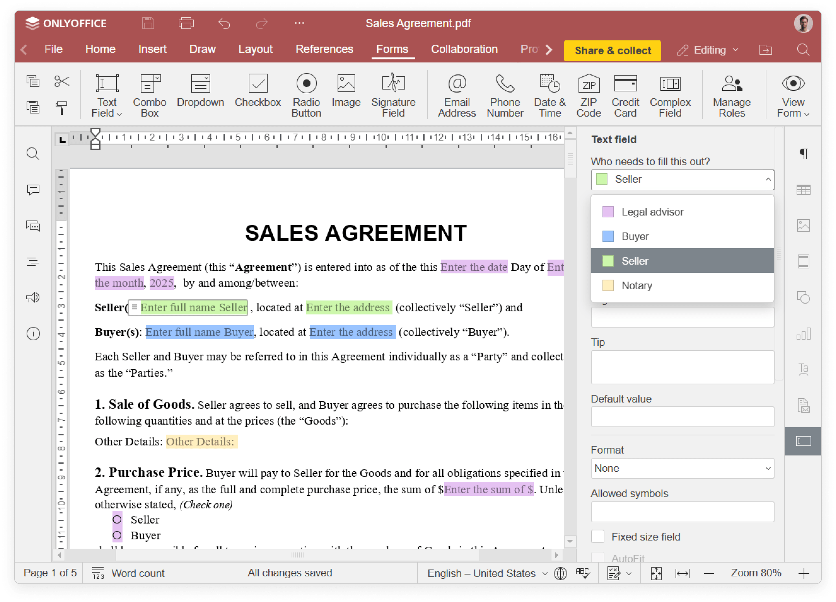
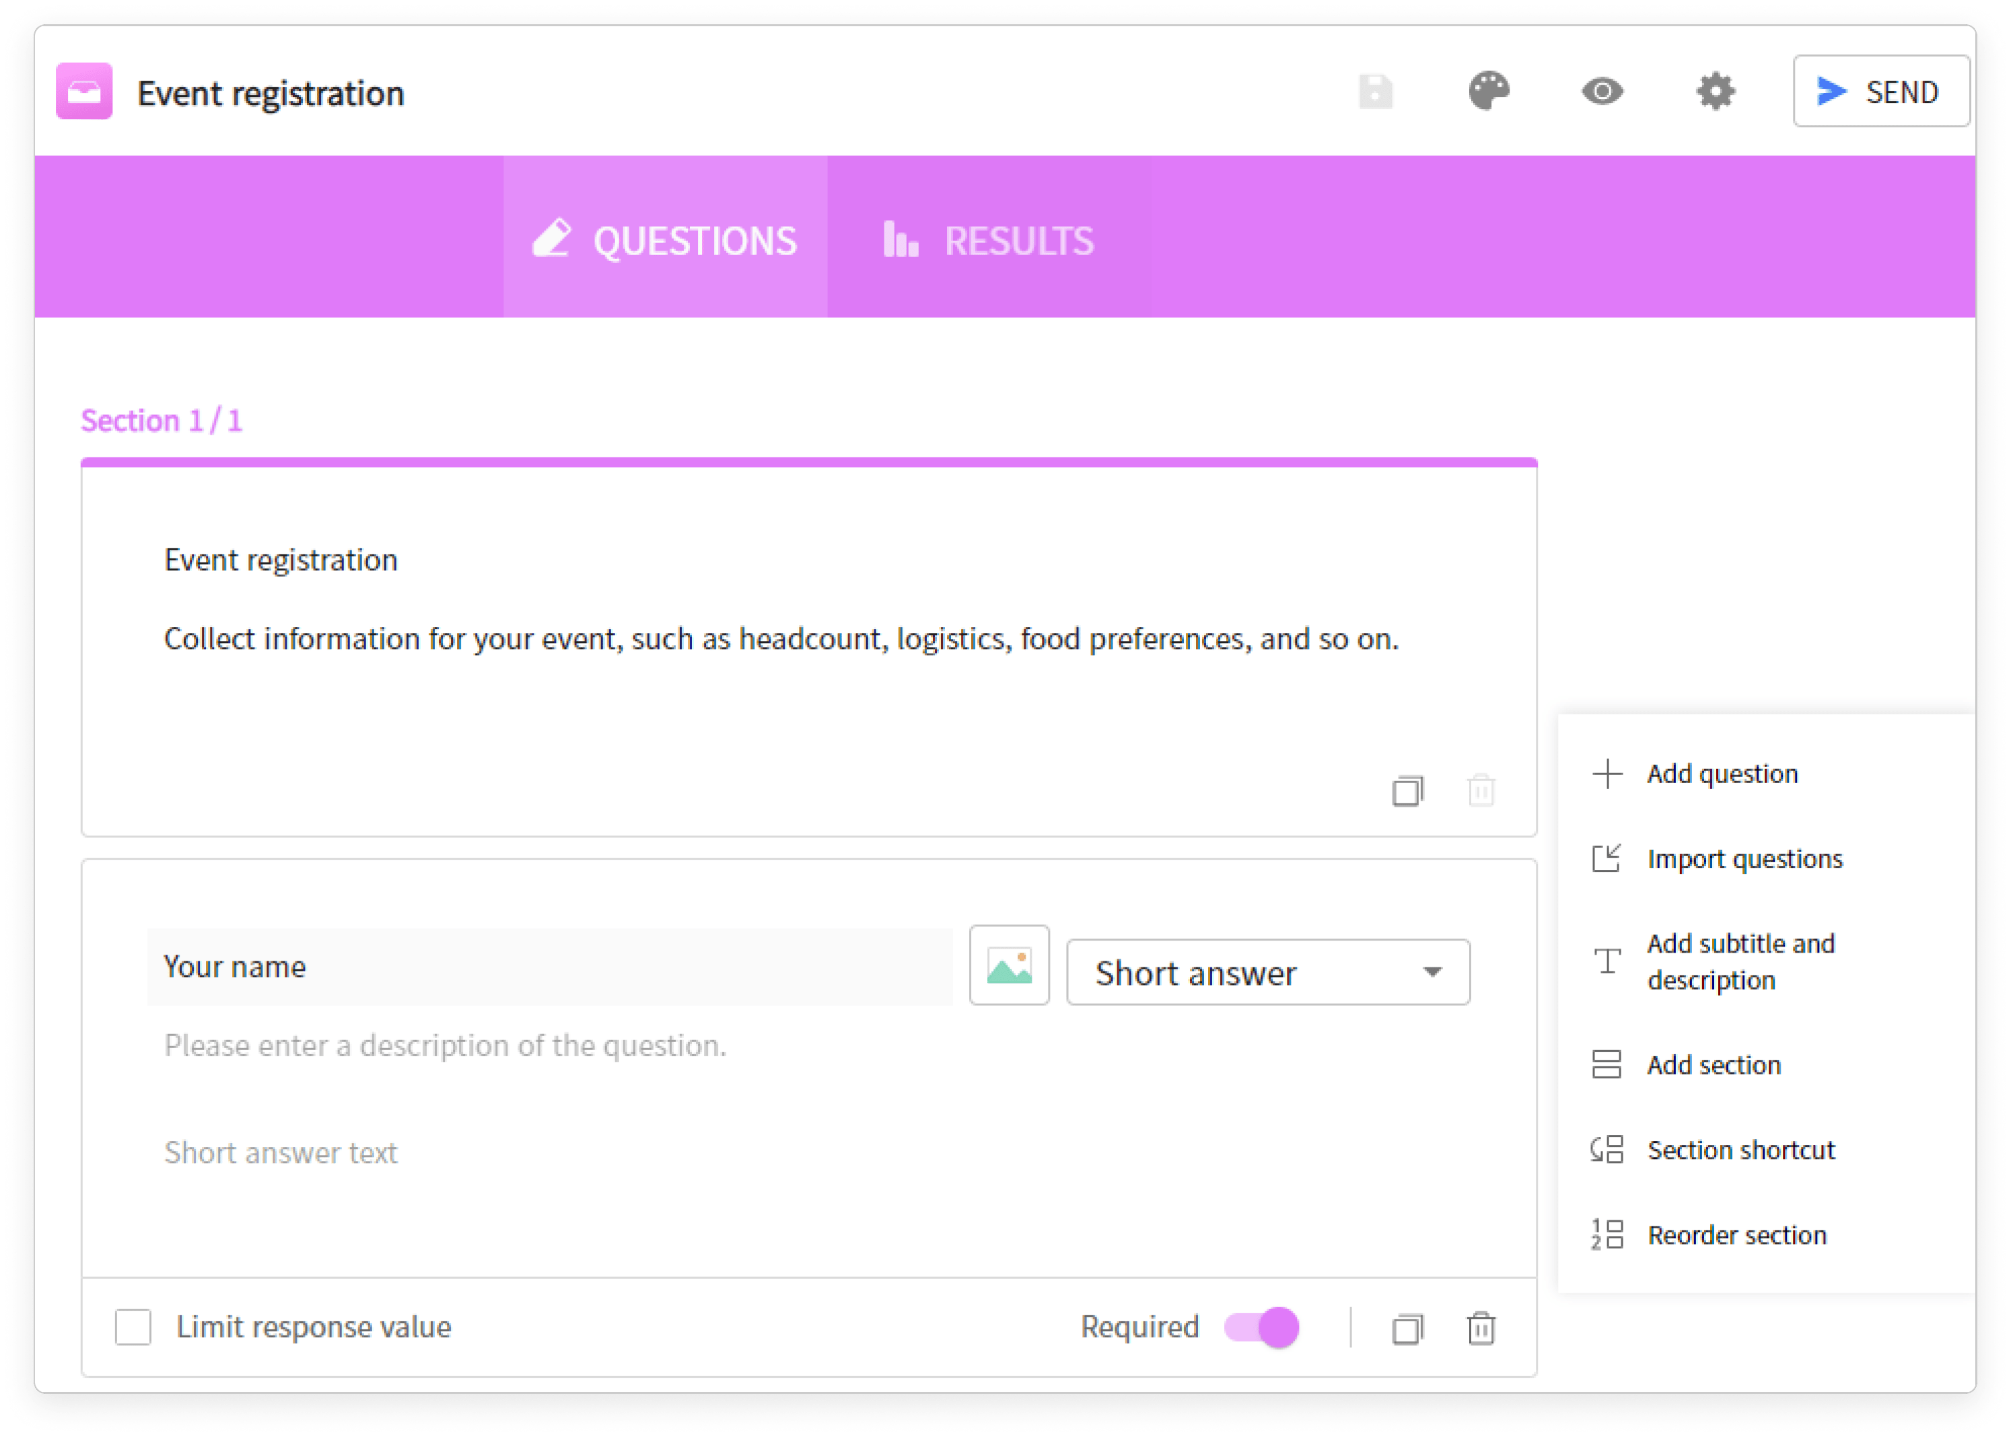
Form creator comparison
ONLYOFFICE PDF form editor
Forms
Extended field settings for creating complex forms both online
and offline
Surveys and quizzes with automatic marking

Slide 13





Slide 14

Web, desktop, mobile
DESKTOP APPS COMPARISON |  | Office
Text processor | ● | ●
Spreadsheet editor | ● | ●
Presentation editor | ● | ●
Form creator | ● | ▬
PDF reader | ● | ●
Diagram viewer | ● | ▬
Collaboration | ● | ▬
Ready integrations | ONLYOFFICE, Nextcloud, ownCloud, Seafile, kDrive, Liferay, Moodle | HancomDocs storage, Dropbox, GoogleDrive, Yandex.Disk
Windows, Linux, macOS | ● | ● / ▬ / ●
Free version / Enterprise version | ● / ▬ | ▬ / ●

Slide 15

Web, desktop, mobile
MOBILE APPS COMPARISON |  | Office Mobile
Text processor | ● | ●
Spreadsheet editor | ● | ●
Presentation editor | ● | ●
Form filler | ● | ▬
PDF viewer | ● | ●
Media player | ● | ▬
Online & offline work | ● | ●
Collaboration | ● | ▬
Connection to cloud | ONLYOFFICE and other storages via WebDAV | HancomDocs storage
iOS/Android | ● | ●
Free | ● | ●

Slide 16
Web, desktop, mobile
MOBILE DOCUMENT EDITOR COMPARISON |  | Office Mobile
Select a font, change its size | ● | ●
Highlight text in bold / italic / underlined / strikethrough | ● | ●
Bulleted/Numbered/Multilevel lists | ● | ●
Inserting autoshapes, images, tables, hyperlinks, charts | ● | ●
Table of contents | ● | ●
Search and replace | ● | ●
Add comments | ● | ●
Set page parameters | ● | ●
Free draw | ● | ●
Insert footnotes, endnotes | ● | ●
Spell checking | ● | ●
Manage macros | ● | ▬
PDF text recognition | ● | ▬

Slide 17
Web, desktop, mobile
MOBILE SPREADSHEET EDITOR COMPARISON |  | Office Mobile
Manage cells: merge cells, fill color, text color, wrap text, borders | ● | ●
Manage sheets: hide, duplicate | ● | ●
Manage sheets: rename, tab color | ● | ▬
Inserting hyperlinks, images, charts, formulas, autoshapes | ● | ●
Freeze panes | ● | ●
Set Number format | ● | ●
Add comments | ● | ●
Selective cell clear | ● | ▬
Sort and filter data | ● | ●
Autosum | ▬ | ●
Manage macros | ● | ●

Slide 18
Web, desktop, mobile
MOBILE PRESENTATION EDITOR COMPARISON |  | Office Mobile
Select a font, change its size | ● | ●
Highlight text in bold/italic/underlined/strikethrough | ● | ●
Bulleted/Numbered/Multilevel lists | ● | ●
Inserting tables, autoshapes, charts, images, hyperlinks | ● | ●
Reshape autoshapes | ● | ●
Manage slides: hide, duplicate | ● | ●
Apply transition | ● | ●
Set slide background | ● | ●
Set slide parameters | ● | ●
Drawing in Preview mode | ▬ | ●
Add notes | ▬ | ●
Search and replace | ● | ●
Manage macros | ● | ▬

Slide 19







ONLYOFFICE:
COLLABORATION WITHOUT DISRUPTION
Elizabeth Rayen
Henry Milton
Samantha Jones

Slide 20
Collaboration
COLLABORATIVE FEATURES COMPARISON | Docs | DocSpace | Desktop | Office Online
Client-side performance | ● | ● | ● | ▬
2 co-editing modes (character- and paragraph-level) | ● | ● | ● | ▬
Undo/Redo | ● | ● | ● | ●
Track changes, accept/reject changes | ● | ● | ● | ●
Changes display modes (Markup and balloons, Only markup, Final, Original) | ● | ● | ● | ●
Commenting, mentions | ● | ● | ● | ○
Built-in chat | ● | ● | ● | ●
External chats, audio and video calls | ● plugins |  |  | ▬
Version history | ● | ● | ● | ▬
Protecting parts of documents from being edited | ● | ● | ● | ●
Embedding into a web page | ● | ● | ● | ▬
Guest names | ● | ● | ● | ▬
Document comparison | ● | ● | ● | ▬

Slide 21
Collaboration
SHARING PERMISSIONS COMPARISON | Docs | DocSpace | Desktop | Office Online
Sharing files | ● | ● | ● | ●
Access by external link | ● | ● | ● | ●
Editing by external link without authorization | ● | ● | ● | ▬
Access rights: Read Only | ● | ● | ● | ●
Access rights: Full Access | ● | ● | ● | ●
Access rights: Review | ● | ● | ● | ▬
Access rights: Comment | ● | ● | ● | ▬
Access rights: Form Filling | ● | ● | ● | ▬
Access rights: Custom Filter (in spreadsheets) | ● | ● | ● | ▬
Access rights: Can't print, download and copy file | ● | ● | ● | ▬
Access rights: Can't change sharing settings | ● | ● | ● | ▬

Slide 22

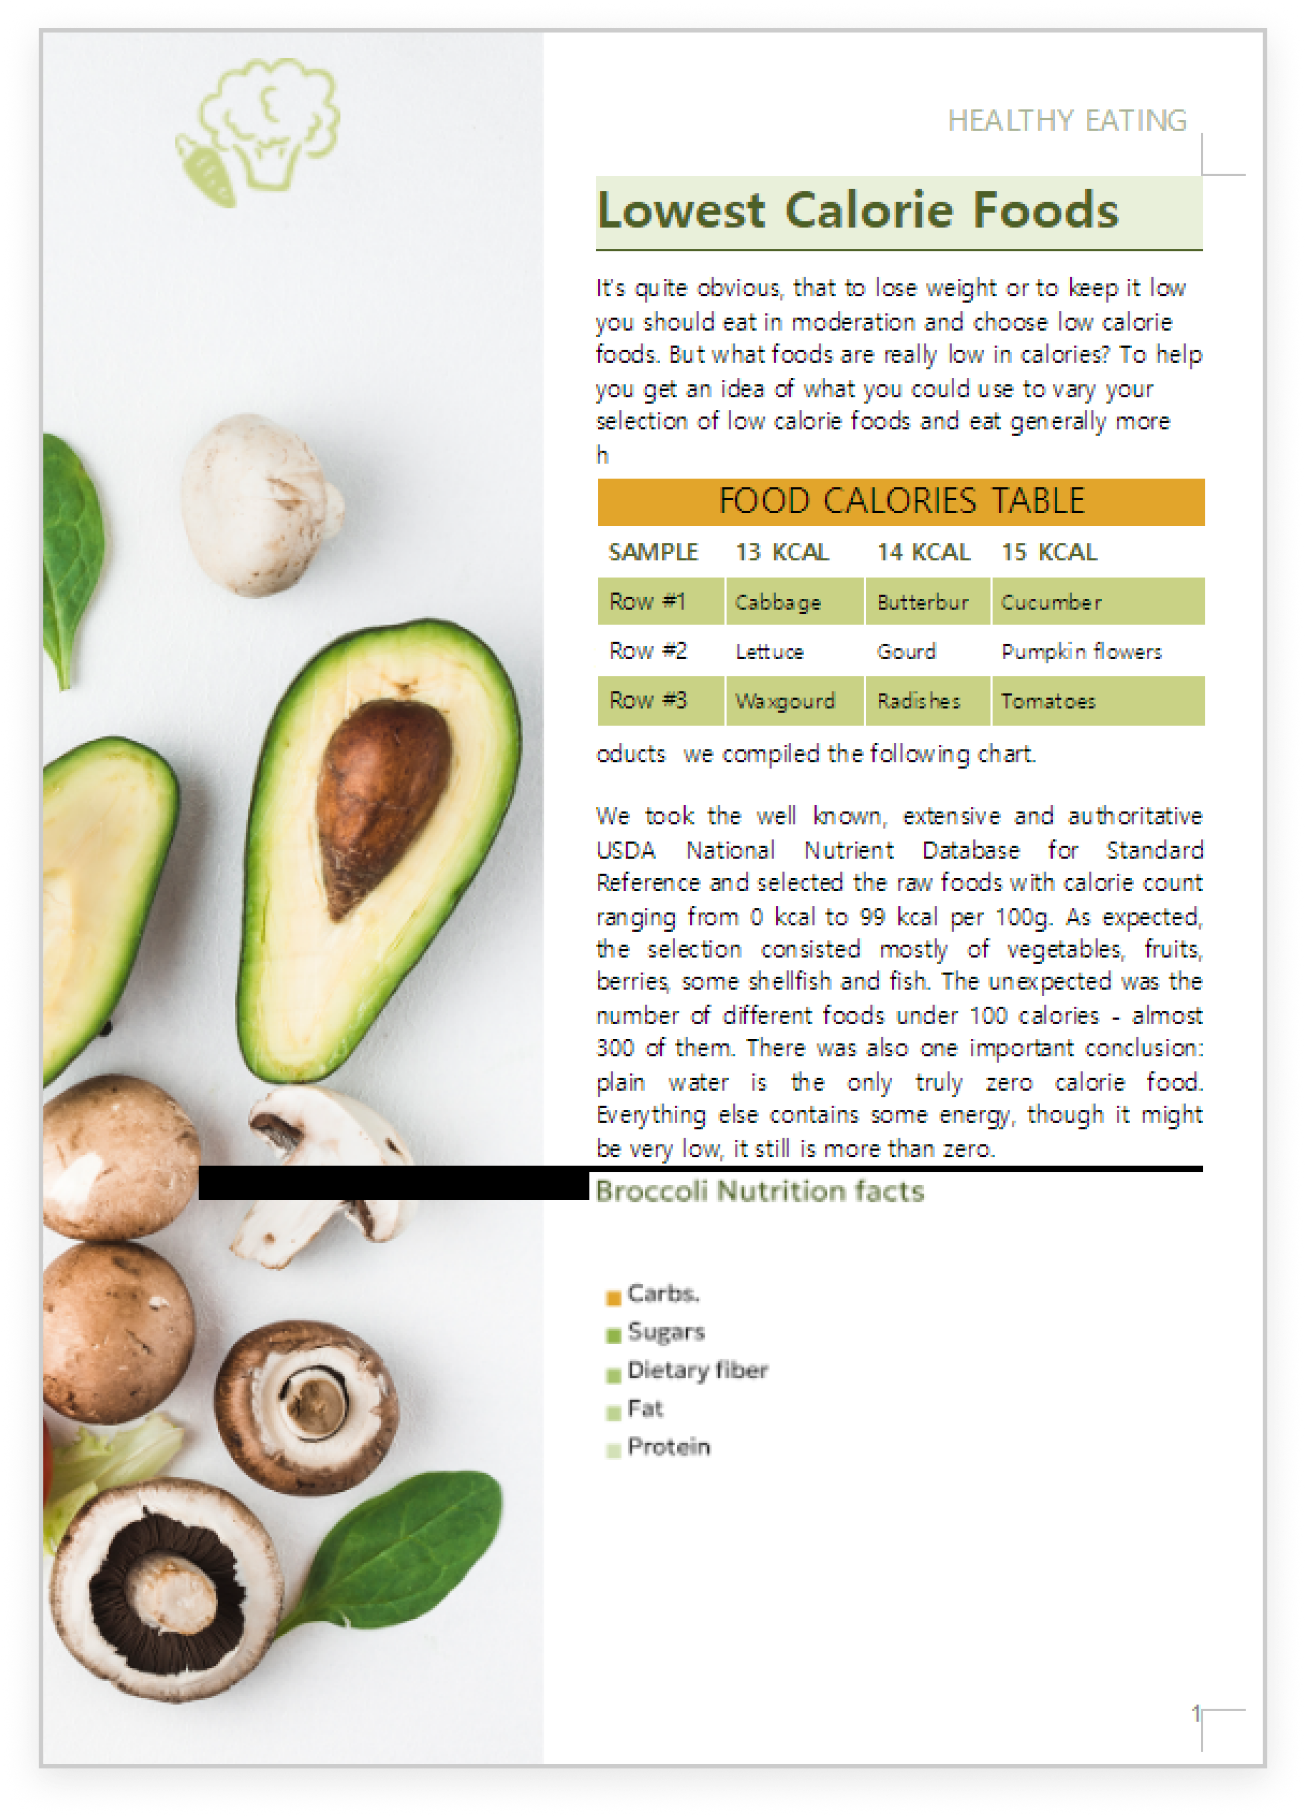

ONLYOFFICE:
MAXIMUM COMPATIBILITY WITH MS OFFICE FILES
MS Office desktop
Hancom Office
ONLYOFFICE Docs

Slide 23
Comparison of file
formats support
 | Docs | DocSpace | Desktop | Office
Native formats | DOCX • XLSX • PPTX |  |  | HWP • HWPX • DOCX • XLSX • PPTX
Editing DOC, DOCX, DOTX, HTML, ODT, TXT, RTF | ● | ● | ● | ●
Editing DOCM, OTT, XML, FB2, EPUB, MD, ODG | ● | ● | ● | ▬
Creating and filling out PDF forms | ● | ● | ● | ▬
Viewing PDF, PDF/A | ● | ● | ● | ●
Viewing DjVu, XPS, VSDX | ● | ● | ● | ▬
Editing XLX, XLSX, XLTX, ODS, OTS, CSV, SXC, TXT, XLSB | ● | ● | ● | ●
Editing XLS, XLSM, XLSB, XLTM, XLT, CELL, PRN, HTM, HTML, DBF | ▬ | ▬ | ▬ | ●
Editing PPT, PPTX, ODP, PPSX, POTX | ● | ● | ● | ●
Editing PPS, OTP, THMX, SHOW | ▬ | ▬ | ▬ | ●
Export to PDF | ● | ● | ● | ●
Converting PDF and XPS to DOCX for further editing | ● | ● | ● | ○

Slide 24

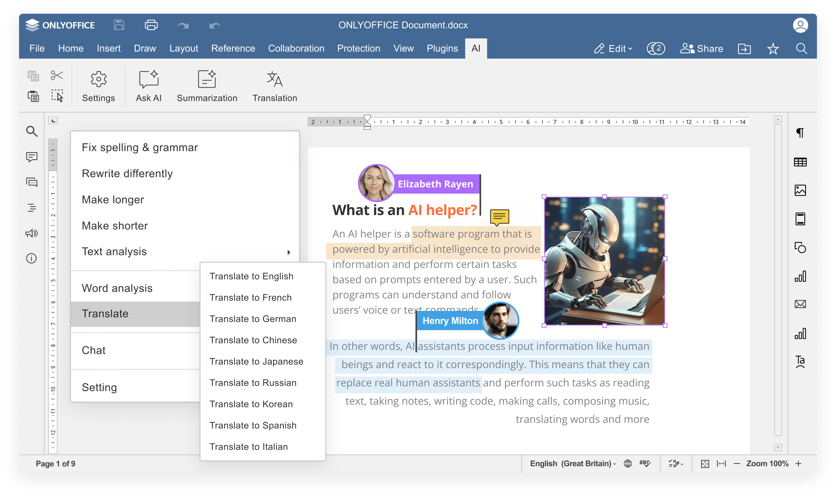


Slide 25
Comparison of AI features
 | Docs | DocSpace | Desktop | Office
Answering questions in chatbot | ● | ● | ● | ●
Writing (generate, rewrite, summarize, expand text, etc.) | ● | ● | ● | ●
Translation | ● | ● | ● | ●
Proofreading (spell checking, sentence analysis, etc.) | ● | ● | ● | ●
Summarization | ● | ● | ● | ●
Images generation | ● | ● | ● | ●
Code review | ● via chatbot |  |  | ● via chatbot
Formula suggestions & explanations | ● | ● | ● | ● via chatbot
AI for macros | ● | ● | ● | ●
OCR for scanned PDFs | ● | ● | ● | ▬

Slide 26
Comparison of AI
customization and flexibility
 | Docs | DocSpace | Desktop | Office
Selecting among AI providers (ChatGPT, Gemini, Deepseek, Ollama, Together AI, Groq AI, Mistal AI, etc.) | ● | ● | ● | Hancom Assistant, Hancom Pedia
Selecting among AI models | ● | ● | ● | ●
Self-hosted AI support | ● | ● | ● | ▬
Custom AI configuration (assigning different AI models for different tasks) | ● | ● | ● | ▬
API keys & access control | ● | ● | ● | ●
Integration into enterprise environments | ● | ● | ● | ●
Availability | free AI plugin available in all editors |  |  | requires separate subscription

Slide 27

ONLYOFFICE:
REINFORCED SECURITY

Slide 28
Data security
COMPARISON OF MAIN SECURITY ASPECTS | Docs | DocSpace | Desktop | Office
Open-source code | ● | ● | ● | ▬
Self-hosting | ● | ● | ● | ▬
SSL | ● | ● | ● | ●
JWT | ● | ● | ● | ▬
Cache lifetime configuration | ● | ● | ● | ▬
Watermarking | ● | ● | ● | ●
Data encryption | Data is transferred via secure channel with ability to edit/co-edit in the encrypted form |  |  | In Hancom xDB solution
End-to-end encryption | ● | ● | ● | ▬
Restrictions support | ● | ● | ● | ▬

Slide 29
Data security
COMPARISON OF SECURITY FEATURES FOR FILES | Docs | DocSpace | Desktop | Office
Support for advanced access permissions | Commenting • reviewing • filling forms • custom filtering in spreadsheets |  |  | View • Edit • Unshared for all
Password protection for docs, sheets, slides | ● | ● | ● | ●
Password protection for workbook structure | ● | ● | ● | ●
Password protection for separate sheets | ● | ● | ● | ●
Locked cells | ● | ● | ● | ●
Hidden formulas | ● | ● | ● | ▬
Digital signatures | ● in desktop app |  |  | ▬

Slide 30




























Flexibility
ONLYOFFICE is integrated
in more than 40 well-known platforms (ready-to-use connectors)

Slide 31

Flexibility
ONLYOFFICE is embedded
in more than 300 web services
(API & WOPI)

Slide 32

Accessibility
UI tweaks
Various color modes
Hotkeys
Screen readers
Useful plugins in the editors
  AI helpers
  Translator (Google, DeepL)
  Text-to-speech
  Speech input
  Typograf
  OCR

Slide 33
Data security
COMPARISON | Docs | Office
Free version | ● | ○ Limited functionality
Enterprise version | ● | ●
License | AGPL V3 | Proprietary
Pricing model | Per connection* | Personal plan, Business plan - Per user
*How many browser tabs with documents can be opened for editing at the same time.

Slide 34




Want to try ONLYOFFICE?
Download Docs
Get Desktops
Join DocSpace

Slide 35

SALES REQUESTS
sales@onlyoffice.com
OFFICIAL WEBSITE
www.onlyoffice.com

