Slide 1



ONLYOFFICE Docs | DocSpace | Desktop VS Zoho Docs

Slide 2










Best-in-breed online document editors
Docs, sheets, slides, forms,
Open-source and security
Flexibility
AI support
Web, desktop, mobile
Seamless collaboration
Support for all popular file formats
Unified core technology
across all solutions

Slide 3
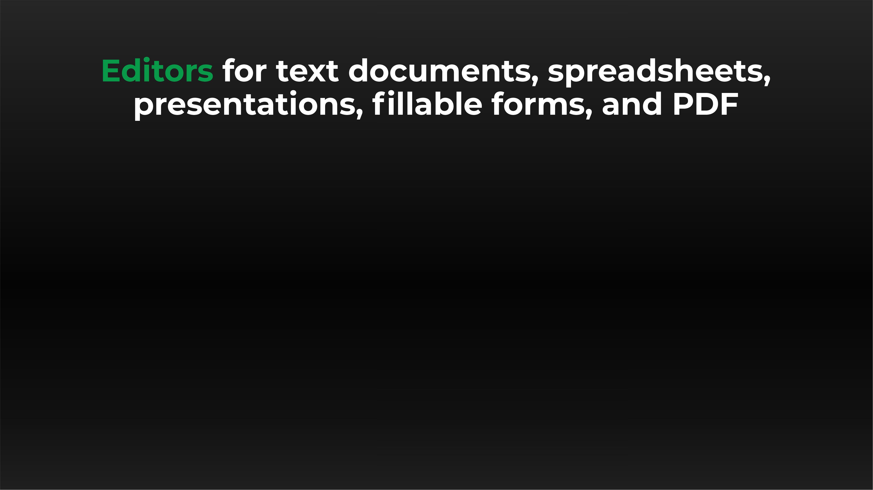






Slide 4



Docs, sheets, slides, forms, PDF
DOCUMENT EDITOR COMPARISON | Docs | DocSpace | Desktop | Zoho Docs
Advanced font formatting | ● | ● | ● | ●
Advanced paragraph formatting | ● | ● | ● | ●
Bulleted/Numbered/Multilevel lists | ● | ● | ● | ●
Columns | ● | ● | ● | ●
Section breaks | ● | ● | ● | ▬
Creating & editing styles | ● | ● | ● | ●
Color schemes | ● | ● | ● | ▬
Non-printing characters | ● | ● | ● | ●
Format Painter | ● | ● | ● | ●
Paste Special | ● | ● | ● | ●
Page margins, size, orientation | ● | ● | ● | ●
Search & Replace tool | ● | ● | ● | ●
Spell checking | ● | ● | ● | ●
Dark theme | ● | ● | ● | ●

Slide 5
Docs, sheets, slides, forms, PDF
DOCUMENT EDITOR COMPARISON | Docs | DocSpace | Desktop | Zoho Docs
Headers & footers, page numbers | ● | ● | ● | ●
Table of contents, footnotes | ● | ● | ● | ●
External and internal hyperlinks | ● | ● | ● | ●
Bookmarks | ● | ● | ● | ●
Tables | ● | ● | ● | ○ limited number of options
Content controls | ● | ● | ● | ●
Images | ● | ● | ● | ●
Charts | ● | ● | ● | ○ editing in Zoho Sheet
Text boxes, Text Art objects | ● | ● | ● | ○ limited number of options
QR, Barcode | ● | ● | ● | ●
Equations | ● | ● | ● | ○ cannot be edited
Align/Arrange/Group objects | ● | ● | ● | ○ limited number of options
Text wrap | ● | ● | ● | ○ limited number of options
Exact object positioning | ● | ● | ● | ▬

Slide 6
Docs, sheets, slides, forms, PDF
SPREADSHEET EDITOR COMPARISON | Docs | DocSpace | Desktop | Zoho Docs
Data filtering and sorting | ● | ● | ● | ●
Freeze panes | ● | ● | ● | ●
Merge cells | ● | ● | ● | ●
Manage sheets | ● | ● | ● | ●
Pivot tables | ● | ● | ● | ●
Named range | ● | ● | ● | ●
Data validation | ● | ● | ● | ●
Conditional formatting | ● | ● | ● | ●
Hyperlinks | ● | ● | ● | ●
Formulas | ● | ● | ● | ●
Selecting external data | ● | ● | ● | ▬

Slide 7
Docs, sheets, slides, forms, PDF
SPREADSHEET EDITOR COMPARISON | Docs | DocSpace | Desktop | Zoho Docs
Inserting images, charts, sparklines | ● | ● | ● | ●
Inserting autoshapes, text boxes, text art, equations, headers & footers | ● | ● | ● | ▬
Inserting picklists, checkboxes | ▬ | ▬ | ▬ | ●
Adding slicers | ● | ● | ● | ▬
Sheet View | ● | ● | ● | ○ limited number of options
Removing duplicates | ● | ● | ● | ●
Mail Merge | ● | ● | ● | ●
Macros | ● | ● | ● | ●
Custom functions | ● | ● | ● | ●
Data protection | ● | ● | ● | ●
Dark theme | ● | ● | ● | ●

Slide 8
Docs, sheets, slides, forms, PDF
PRESENTATION EDITOR COMPARISON | Docs | DocSpace | Desktop | Zoho Docs
Choosing presentation layout | ● | ● | ● | ●
Copy / insert a slide | ● | ● | ● | ●
Hide / show a slide | ● | ● | ● | ●
Slide templates | ● | ● | ● | ●
Inserting images, autoshapes, text boxes tables, footers, charts, date & time | ● | ● | ● | ●
Lists | ● | ● | ● | ●
Transitions | ● | ● | ● | ●
Animation | ● | ● | ● | ●
Hyperlinks | ● | ● | ● | ●
Setting parameters of demonstration | ● | ● | ● | ●
Presenter mode | ● | ● | ● | ●

Slide 9
Docs, sheets, slides, forms, PDF
PRESENTATION EDITOR COMPARISON | Docs | DocSpace | Desktop | Zoho Docs
Align and arrange objects | ● | ● | ● | ●
Add notes | ● | ● | ● | ●
Search and replace | ● | ● | ● | ●
Spell checking | ● | ● | ● | ●
Insert audio and video | ● | ● | ● | ●
AutoCorrect features | ● | ● | ● | ○ limited number of options
Slide Master | ● | ● | ● | ●
Navigation tools | ● | ● | ● | ●
Dark theme | ● | ● | ● | ▬
Macros | ● | ● | ● | ▬
Preview text effects | ● | ● | ● | ▬

Slide 10
Docs, sheets, slides, forms, PDF
PDF FORM CREATOR COMPARISON | Docs | DocSpace | Desktop | Zoho Docs
Filling out PDF forms | ● | ● | ● | ●
Creating and editing | ● | ● | ● | ●
Saving PDF forms | ● | ● | ● | ●
Simple fields (text, combo box, drop-down list, check box, radio button) | ● | ● | ● | ○ excepting combo box
Special fields (image, email, phone, ZIP code, date&time, credit card, complex field, signature field) | ● | ● | ● | ○ limited number of options
Barcode, QR code, Watermark | ● | ● | ● | ●
Extended field properties (tips and placeholders, mark as required, lock, group fields, multiline entry, characters limit, comb of characters) | ● | ● | ● | ○ limited number of options
Recipient roles for field filling | ● | ● | ● | ▬
Collecting data | ● | ● | ● | ▬
Availability | ● | ● | ● | ○ online only

Slide 11
Docs, sheets, slides, forms, PDF
PDF EDITOR COMPARISON | Docs | DocSpace | Desktop | Zoho Docs
Viewing | ● | ● | ● | ●
Editing | ● | ● | ● | ○ limited number of options
Annotations - text highlight, underline, strikethrough | ● | ● | ● | ○ limited number of options
Freehand drawings | ● | ● | ● | ▬
Inserting and editing objects | ● | ● | ● | ▬
Adding stamps | ● | ● | ● | ▬
Printing PDFs | ● | ● | ● | ●
Adding or deleting pages | ● | ● | ● | ●
Copying pages between PDFs | ● | ● | ● | ▬
Rotating pages | ● | ● | ● | ●
Converting PDF to DOCX | ● | ● | ● | ●
Converting PDF to picture | ● | ● | ● | ●
Converting PDF to e-book | ● | ● | ● | ▬

Slide 12





Slide 13

Web, desktop, mobile
DESKTOP APPS COMPARISON | Desktop Editors | Zoho Docs
Text processor | ● | ●
Spreadsheet editor | ● | ●
Presentation editor | ● | ●
Form creator | ● | ▬
PDF reader | ● | ▬
Diagram viewer | ● | ▬
Collaboration | ● | ●
Ready integrations | ONLYOFFICE, Nextcloud, ownCloud, Seafile, kDrive, Liferay | Zoho WorkDrive
Windows, Linux, macOS | ● | ●
Free version / Enterprise version | ○ | ○

Slide 14

Web, desktop, mobile
MOBILE APPS COMPARISON | Documents | Zoho Docs
Number of applications | One comprehensive app | Numerous apps for each type of editing
Text processor | ● | ●
Spreadsheet editor | ● | ●
Presentation editor | ● | ●
Form filler | ● | ▬ Zoho forms only
PDF viewer | ● | ○ via Zoho WorkDrive
Media player | ● | ○ via Zoho WorkDrive
Online/offline work | ● | ●
Collaboration | ● | ●
Connection to cloud | ONLYOFFICE and other storages via WebDAV | Zoho WorkDrive
iOS/Android | ● | ●
Free | ● | ●

Slide 15
Web, desktop, mobile
MOBILE APPS COMPARISON | Document Editor | Zoho Writer
Select a font, change its size | ● | ▬
Highlight text in bold/italic/underlined/strikethrough | ● | ●
Bulleted/Numbered/Multilevel lists | ● | ●
Inserting images, tables, hyperlinks | ● | ●
Inserting charts, autoshapes, table of contents | ● | ▬
Search and replace | ● | ▬
Add comments | ● | ●
Set page parameters | ● | ▬
Insert column, section breaks | ● | ▬
Insert footnotes, endnotes | ● | ▬
Spell checking | ● | ▬
Manage macros | ● | ▬

Slide 16
Web, desktop, mobile
MOBILE APPS COMPARISON | Spreadsheet Editor | Zoho Sheet
Manage cells: merge cells, fill color, text color, wrap text, borders | ● | ●
Manage sheets: hide, rename, duplicate, tab color | ● | ●
Inserting data from picture, checkbox, picklist | ▬ | ●
Inserting hyperlinks, images, charts, formulas | ● | ●
Inserting autoshapes | ● | ▬
Set Number format | ● | ●
Add comments | ● | ●
Selective cell clear | ● | ●
Sort and filter data | ● | ●
Hide/Show grid and headings | ● | ●
Manage macros | ● | ▬

Slide 17
Web, desktop, mobile
MOBILE APPS COMPARISON | Presentation Editor | Zoho Show
Select a font, change its size | ● | ●
Highlight text in bold/italic/underlined/strikethrough | ● | ●
Bulleted/Numbered/Multilevel lists | ● | ●
Inserting tables, autoshapes, charts, images, hyperlinks | ● | ●
Manage sheets: hide, rename, duplicate, tab color | ● | ●
Apply transition | ● | ●
Add animation | ▬ | ●
Set slide parameters | ● | ●
Drawing in Preview mode | ▬ | ●
Slide Gallery | ▬ | ●
Search and replace | ● | ●
Manage macros | ● | ▬

Slide 18




ONLYOFFICE:
COLLABORATION WITHOUT DISRUPTION
Elizabeth Rayen
Elizabeth Rayen
Henry Milton
Henry Milton
Samantha Jones
Samantha Jones

Slide 19
Collaboration
COLLABORATIVE FEATURES COMPARISON | Docs | DocSpace | Desktop | Zoho Docs
Client-side performance | ● | ● | ● | ▬
2 co-editing modes (character- and paragraph-level) | ● | ● | ● | ▬
Undo/Redo | ● | ● | ● | ●
Track changes, accept/reject changes | ● | ● | ● | ●
Changes display modes (Markup and balloons, Only markup, Final, Original) | ● | ● | ● | ●
Commenting, mentions | ● | ● | ● | ●
Built-in chat | ● | ● | ● | ●
External chats, audio and video calls | ● plugins |  |  | ▬
Version history | ● | ● | ● | ●
Protecting parts of documents from being edited | ● | ● | ● | ●
Embedding into a web page | ● | ● | ● | ●
Guest names | ● | ● | ● | ▬
Document comparison | ● | ● | ● | ▬

Slide 20
Collaboration
SHARING PERMISSIONS COMPARISON | Docs | DocSpace | Desktop | Zoho Docs
Sharing files | ● | ● | ● | ●
Access by external link | ● | ● | ● | ●
Editing by external link without authorization | ● | ● | ● | ▬
Access rights: Read Only | ● | ● | ● | ●
Access rights: Full Access | ● | ● | ● | ●
Access rights: Review | ● | ● | ● | ●
Access rights: Comment | ● | ● | ● | ●
Access rights: Form Filling | ● | ● | ● | ●
Access rights: Custom Filter (in spreadsheets) | ● | ● | ● | ▬
Access rights: Can't print, download and copy file | ● | ● | ● | ▬
Access rights: Can't change sharing settings | ● | ● | ● | ▬

Slide 21



ONLYOFFICE:
MAXIMUM COMPATIBILITY WITH MS OFFICE FILES
MS Office desktop
Zoho Docs
ONLYOFFICE Docs

Slide 22
Comparison of file
formats support
 | Docs | DocSpace | Desktop | Zoho Docs
Native formats | DOCX • XLSX • PPTX |  |  | ZDOC • XLSX • PPTX
Editing DOC, DOCX, DOCM, DOTX, HTML, ODT,TXT | ● | ● | ● | ●
Editing OTT, RTF, XML, FB2, EPUB | ● | ● | ● | ▬
Creating and filling out PDF forms | ● | ● | ● | ●
Viewing PDF, PDF/A | ● | ● | ● | ●
Viewing DjVu, XPS, VSDX | ● | ● | ● | ▬
Editing XLX, XLSX, XLTX, ODS, OTS, CSV, SXC | ● | ● | ● | ●
Editing TSV | ▬ | ▬ | ▬ | ●
Editing PPT, PPTX, ODP, PPSX | ● | ● | ● | ●
Editing POTX, OTP | ● | ● | ● | ▬
Editing PPS, SXI | ▬ | ▬ | ▬ | ●
Export to PDF | ● | ● | ● | ●
Converting PDF and XPS to DOCX for further editing | ● | ● | ● | ▬
Editing MD, XLSB, ODG | ● | ● | ● | ▬

Slide 23
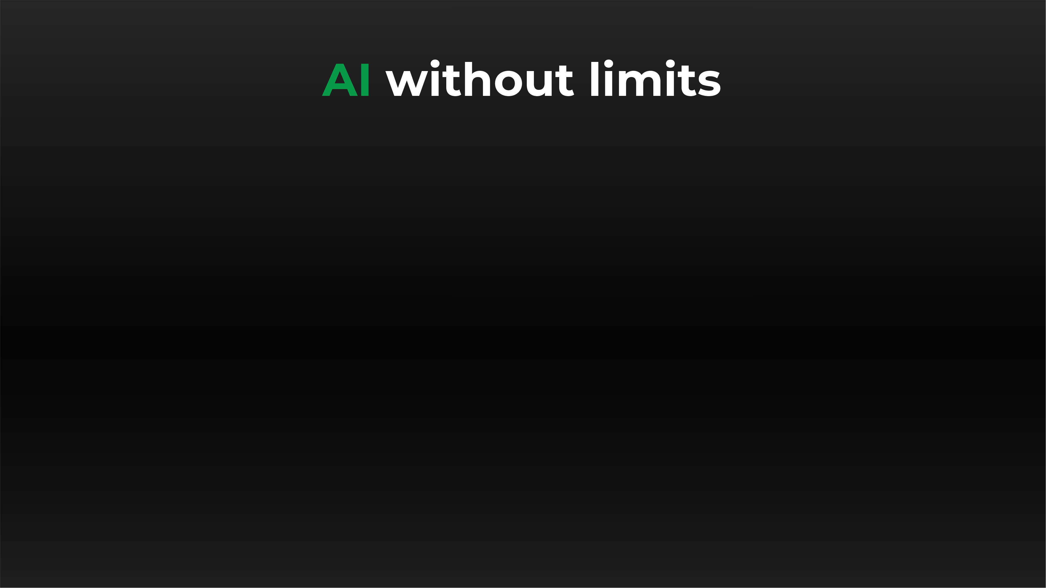
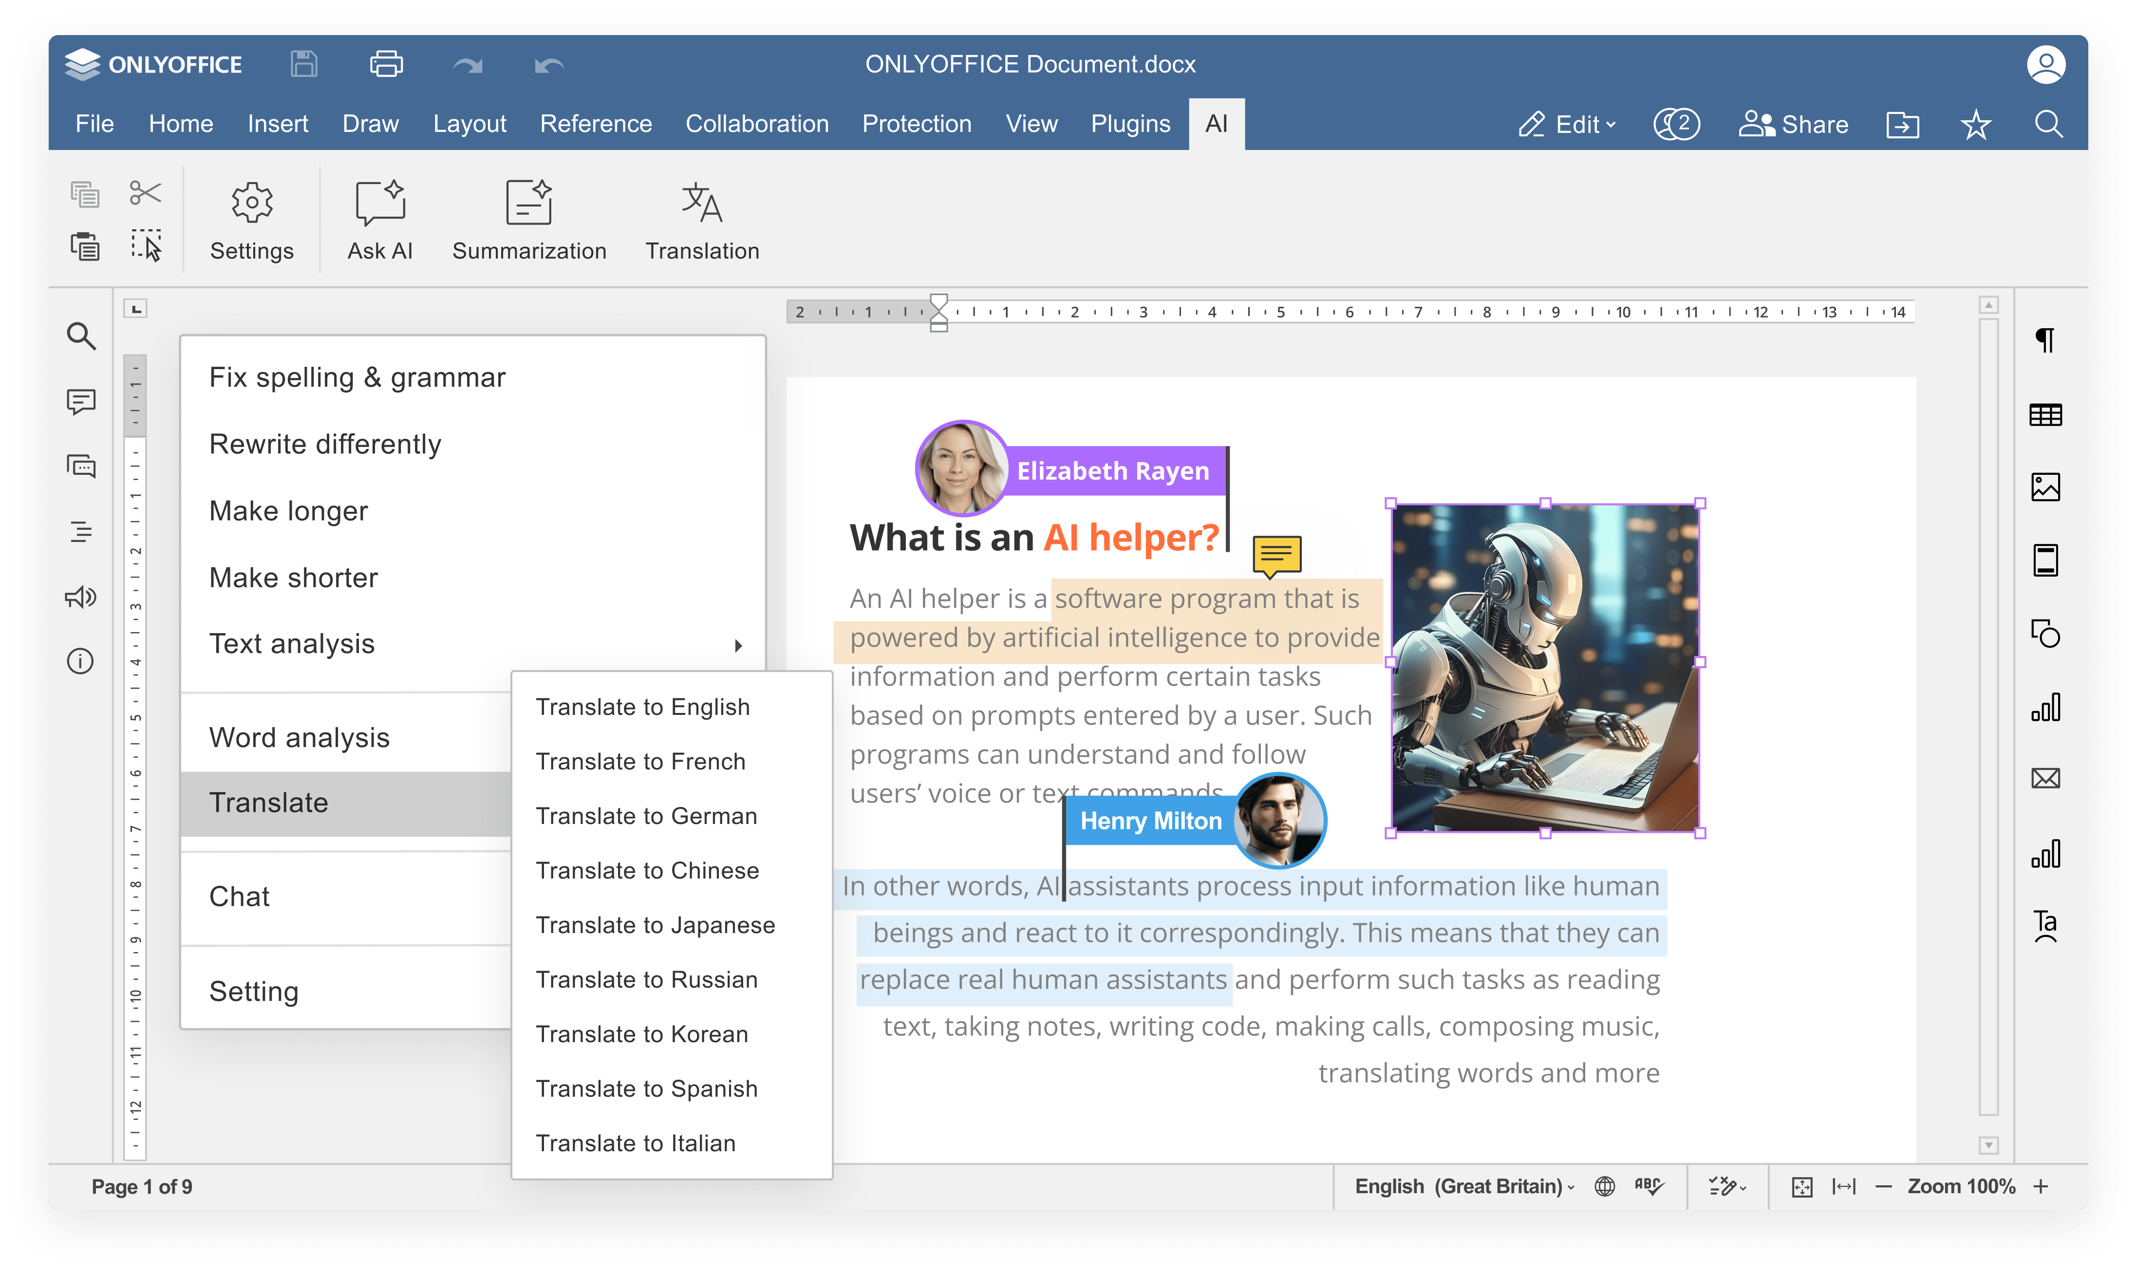


Slide 24
AI integration
COMPARISON OF AI FEATURES | Docs | DocSpace | Desktop | Zoho Docs
Answering questions in chatbot | ● | ● | ● | ●
Writing (generate, rewrite, summarize, expand text, etc.) | ● | ● | ● | ●
Translation | ● | ● | ● | ▬
Proofreading (spell checking, sentence analysis, etc.) | ● | ● | ● | ●
Summarization | ● | ● | ● | ●
Images generation | ● | ● | ● | ▬
Code review | ● via chatbot |  |  | ● via chatbot
Formula suggestions & explanations | ● | ● | ● | ● via chatbot
Spreadsheet data refinement, format suggestions | ▬ | ▬ | ▬ | ●
AI for macros | ● | ● | ● | ▬
OCR for scanned PDFs | ● | ● | ● | ▬

Slide 25
AI integration
COMPARISON OF AI CUSTOMIZATION AND FLEXIBILITY | Docs | DocSpace | Desktop | Zoho Docs
Selecting among AI providers (ChatGPT, Gemini, Deepseek, Ollama, Together AI, Groq AI, Mistal AI, etc.) | ● | ● | ● | Zoho AI or OpenAI Integration
Selecting among AI models | ● | ● | ● | ▬
Self-hosted AI support | ● | ● | ● | ▬
Custom AI configuration (assigning different AI models for different tasks) | ● | ● | ● | ▬
API keys & access control | ● | ● | ● | ●
Integration into enterprise environments | ● | ● | ● | ▬
Availability | free AI plugin available in all editors |  |  | free AI assistants: Zia, Ask Zia

Slide 26

ONLYOFFICE:
REINFORCED SECURITY

Slide 27
Data security
COMPARISON OF MAIN SECURITY ASPECTS | Docs | DocSpace | Desktop | Zoho Docs
Open-source code | ● | ● | ● | ▬
Self-hosting | ● | ● | ● | ▬
SSL | ● | ● | ● | ●
JWT | ● | ● | ● | ○ ASAP add-ons
Cache lifetime configuration | ● | ● | ● | ▬
Watermarking | ● | ● | ● | ●
Data encryption | Data is transferred via secure channel with ability to edit/co-edit in the encrypted form |  |  | The data stored on Zoho servers is not encrypted. In some cases, Zoho may access content stored in your account.
End-to-end encryption | ● | ● | ● | ●
Restrictions support | ● | ● | ● | ●

Slide 28
Data security
COMPARISON OF SECURITY FEATURES FOR FILES | Docs | DocSpace | Desktop | Zoho Docs
Support for advanced access permissions | Commenting, reviewing, filling forms, custom filtering in spreadsheets |  |  | Commenting, reviewing, filling forms
Password protection for docs, sheets, slides | ● | ● | ● | ●
Password protection for workbook structure | ● | ● | ● | ▬
Password protection for separate sheets | ● | ● | ● | ▬
Locked cells | ● | ● | ● | ●
Hidden formulas | ● | ● | ● | ●
Digital signatures | ▬ | ▬ | ● in desktop app | ●

Slide 29




























Flexibility
ONLYOFFICE is integrated
in more than 40 well-known platforms (ready-to-use connectors)

Slide 30
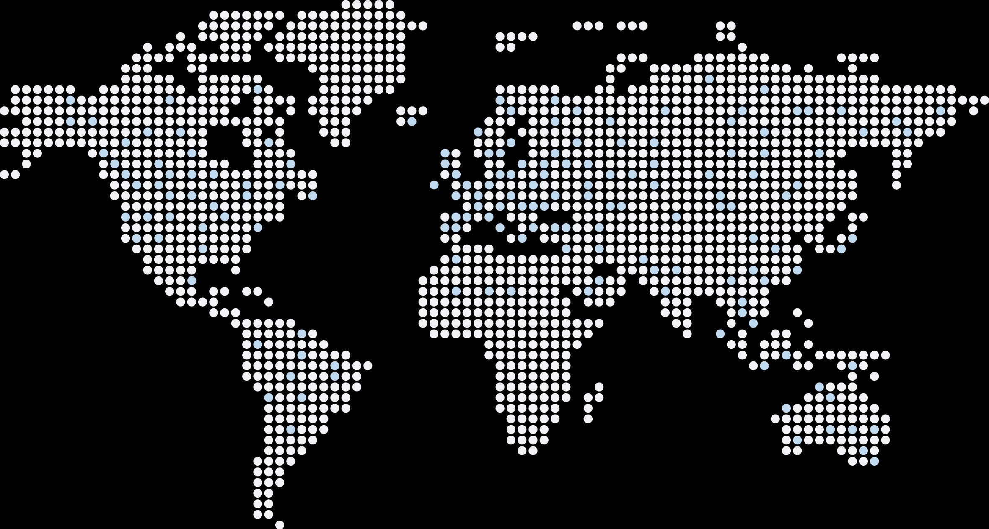
Flexibility
ONLYOFFICE is embedded
in more than 300 web services
(API & WOPI)

Slide 31

Accessibility
UI tweaks
Various color modes
Hotkeys
Screen readers
Useful plugins in the editors
  AI helpers
  Translator (Google, DeepL)
  Text-to-speech
  Speech input
  Typograf
  OCR

Slide 32
Pricing and licensing
COMPARISON | Docs | Zoho Docs
Free version | ● | ●
Enterprise version | ● | ●
License | AGPL V3 | Proprietary
Pricing model | Per connection* | Per user
*How many browser tabs with documents can be opened for editing at the same time.

Slide 33






Want to try ONLYOFFICE?
Download Docs
Get Desktops
Join DocSpace

Slide 34

SALES REQUESTS
sales@onlyoffice.com
OFFICIAL WEBSITE
www.onlyoffice.com

