Slide 1
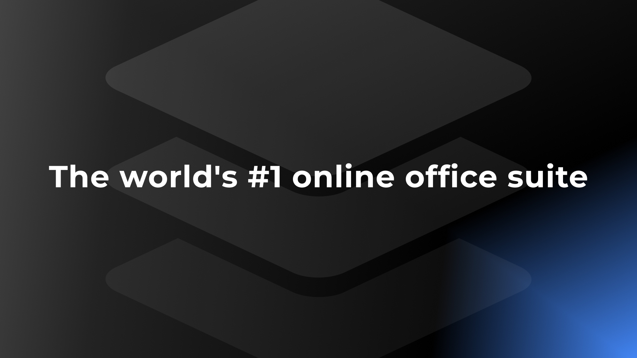


ONLYOFFICE Docs | DocSpace | Desktop VS Google Docs

Slide 2


Best-in-breed online document editors
Docs, sheets, slides, forms, PDF
Open-source and security
Flexibility
AI support
Web, desktop, mobile
Seamless collaboration
Support for all popular file formats
Unified core technology
across all solutions

Slide 3
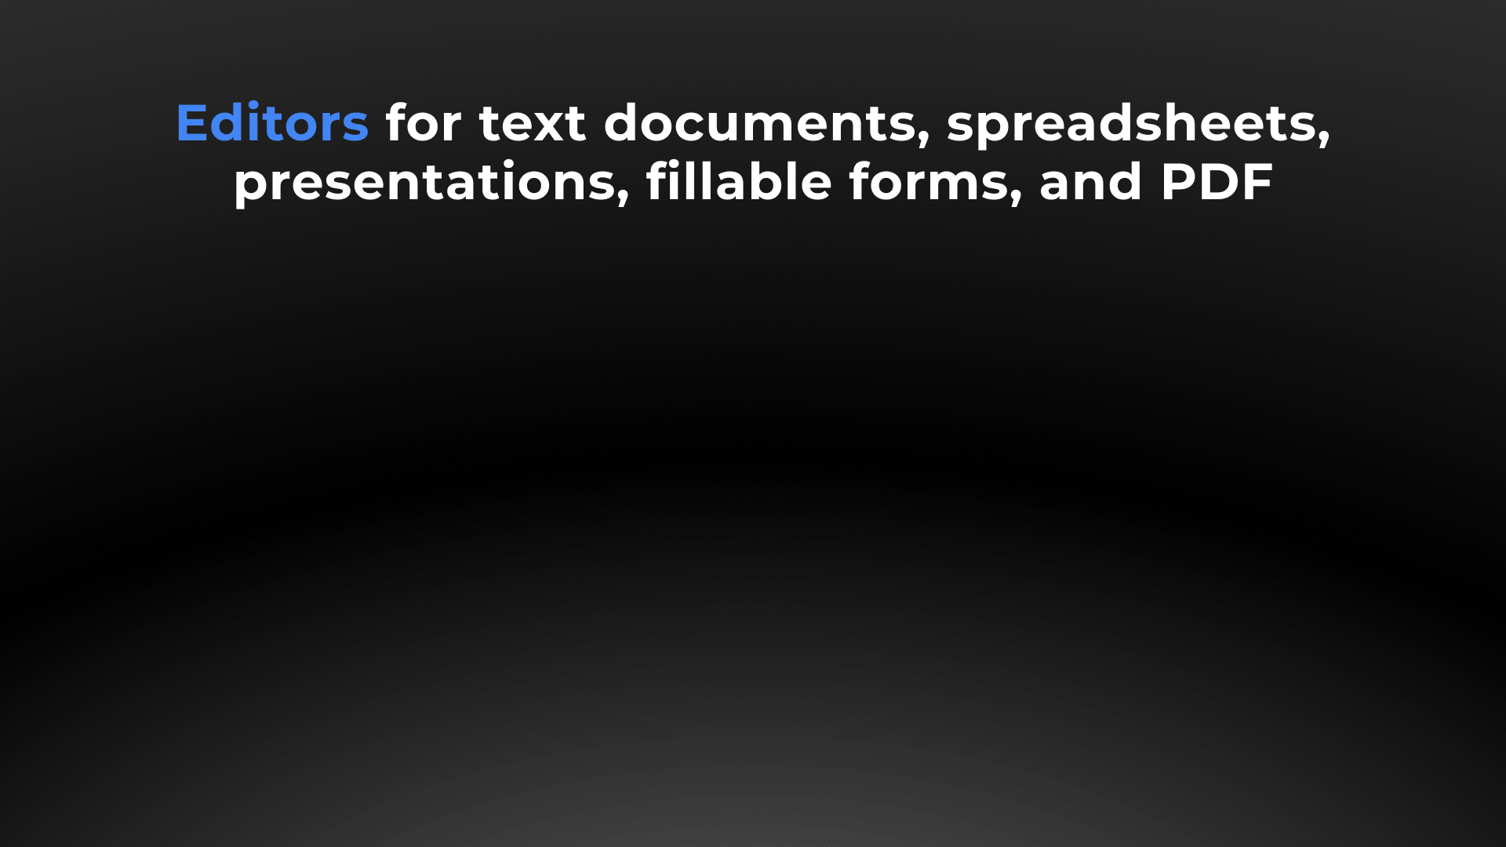






Slide 4



Docs, sheets, slides, forms, PDF
DOCUMENT EDITOR COMPARISON | Docs | DocSpace | Desktop | Google Docs
Advanced font formatting | ● | ● | ● | ●
Advanced paragraph formatting | ● | ● | ● | ●
Bulleted/Numbered/Multilevel lists | ● | ● | ● | ●
Columns | ● | ● | ● | ●
Section breaks | ● | ● | ● | ●
Creating & editing styles | ● | ● | ● | ●
Color schemes | ● | ● | ● | ▬
Non-printing characters | ● | ● | ● | ●
Format Painter | ● | ● | ● | ●
Paste Special | ● | ● | ● | ●
Page margins, size, orientation | ● | ● | ● | ●
Search & Replace tool | ● | ● | ● | ●
Spell checking | ● | ● | ● | ●
Dark theme | ● | ● | ● | Only using third-party software

Slide 5
Docs, sheets, slides, forms, PDF
DOCUMENT EDITOR COMPARISON | Docs | DocSpace | Desktop | Google Docs
Headers & footers, page numbers | ● | ● | ● | ●
Table of contents, footnotes | ● | ● | ● | ●
Table of figures, endnotes | ● | ● | ● | ▬
External and internal hyperlinks | ● | ● | ● | ●
Bookmarks, cross references | ● | ● | ● | ●
Tables | ● | ● | ● | ○ limited number of options
Inserting formulas in tables | ● | ● | ● | ▬
Images | ● | ● | ● | ●
Charts | ● | ● | ● | ○ limited number of options
Shapes, Text boxes, Text Art, SmartArt objects | ● | ● | ● | ○ limited number of options
Drop cap | ● | ● | ● | ▬
Equations | ● | ● | ● | ●
Group objects | ● | ● | ● | ▬
Text wrap | ● | ● | ● | ○ limited number of options
Exact object positioning | ● | ● | ● | ●

Slide 6
Docs, sheets, slides, forms, PDF
SPREADSHEET EDITOR COMPARISON | Docs | DocSpace | Desktop | Google Docs
Data filtering and sorting | ● | ● | ● | ●
Freeze panes | ● | ● | ● | ●
Merge cells | ● | ● | ● | ●
Manage sheets | ● | ● | ● | ●
Pivot tables | ● | ● | ● | ●
Named range | ● | ● | ● | ●
Data validation | ● | ● | ● | ●
Conditional formatting | ● | ● | ● | ●
Hyperlinks | ● | ● | ● | ●
Formulas | ● | ● | ● | ●
Selecting external data | ● | ● | ▬ | ▬

Slide 7
Docs, sheets, slides, forms, PDF
SPREADSHEET EDITOR COMPARISON | Docs | DocSpace | Desktop | Google Docs
Formulas | ● | ● | ● | ●
Adding slicers | ● | ● | ● | ●
Inserting images, charts, autoshapes, text boxes | ● | ● | ● | ●
Sheet View | ● | ● | ● | ●
Removing duplicates | ● | ● | ● | ●
Mail Merge | ● | ● | ● | ●
Macros | ● | ● | ● | ●
Custom functions | ● | ● | ● | ●
Data protection | ● | ● | ● | ●
Colors schemes | ● | ● | ● | ●
Dark theme | ● | ● | ● | Only using third-party software

Slide 8
Docs, sheets, slides, forms, PDF
PRESENTATION EDITOR COMPARISON | Docs | DocSpace | Desktop | Google Docs
Choosing presentation layout | ● | ● | ● | ●
Copy / insert a slide | ● | ● | ● | ●
Hide / show a slide | ● | ● | ● | ●
Lists | ● | ● | ● | ●
Inserting images, autoshapes, tables, text boxes, symbols, footers, date & time | ● | ● | ● | ●
Inserting equations | ● | ● | ● | Via add-ons
Transitions | ● | ● | ● | ●
Animation | ● | ● | ● | ●
Hyperlinks | ● | ● | ● | ●
Setting parameters of demonstration | ● | ● | ● | ●
Presenter mode | ● | ● | ● | ●
Dark theme | ● | ● | ● | Only using third-party software
Preview text effects | ● | ● | ● | ▬

Slide 9
Docs, sheets, slides, forms, PDF
PDF FORM EDITOR COMPARISON | Docs | DocSpace | Desktop | Google Docs
Filling out PDF forms | ● | ● | ● | ▬ Google forms only
Creating and editing | Complex agreements, contracts, etc. |  |  | Simple surveys & questionnaires
Saving PDF forms | ● | ● | ● | ▬
Simple fields (text, combo box, drop-down list, check box, radio button) | ● | ● | ● | ●
Special fields (image, email, phone, ZIP code, date&time, credit card, complex field, signature field) | ● | ● | ● | ○ limited number of options
Extended field properties (tips and placeholders, mark as required, lock, group fields, multiline entry, characters limit, comb of characters) | ● | ● | ● | ○ limited number of options
Recipient roles for field filling | ● | ● | ● | ▬
Collecting data | ● | ● | ● | ●

Slide 10
Docs, sheets, slides, forms, PDF
PDF EDITOR COMPARISON | Docs | DocSpace | Desktop | Google Docs
Viewing | ● | ● | ● | ●
Editing | ● | ● | ● | ○ via third-party apps only
Annotations - text highlight, underline, strikethrough | ● | ● | ● | ○ text comments only
Freehand drawings | ● | ● | ● | ▬
Inserting and editing objects | ● | ● | ● | ▬
Adding stamps | ● | ● | ● | ▬
Printing PDFs | ● | ● | ● | ●
Adding or deleting pages | ● | ● | ● | ▬
Copying pages between PDFs | ● | ● | ● | ▬
Rotating pages | ● | ● | ● | ▬
Converting PDF to DOCX | ● | ● | ● | ●
Converting PDF to picture | ● | ● | ● | ▬
Converting PDF to e-book | ● | ● | ● | ▬

Slide 11
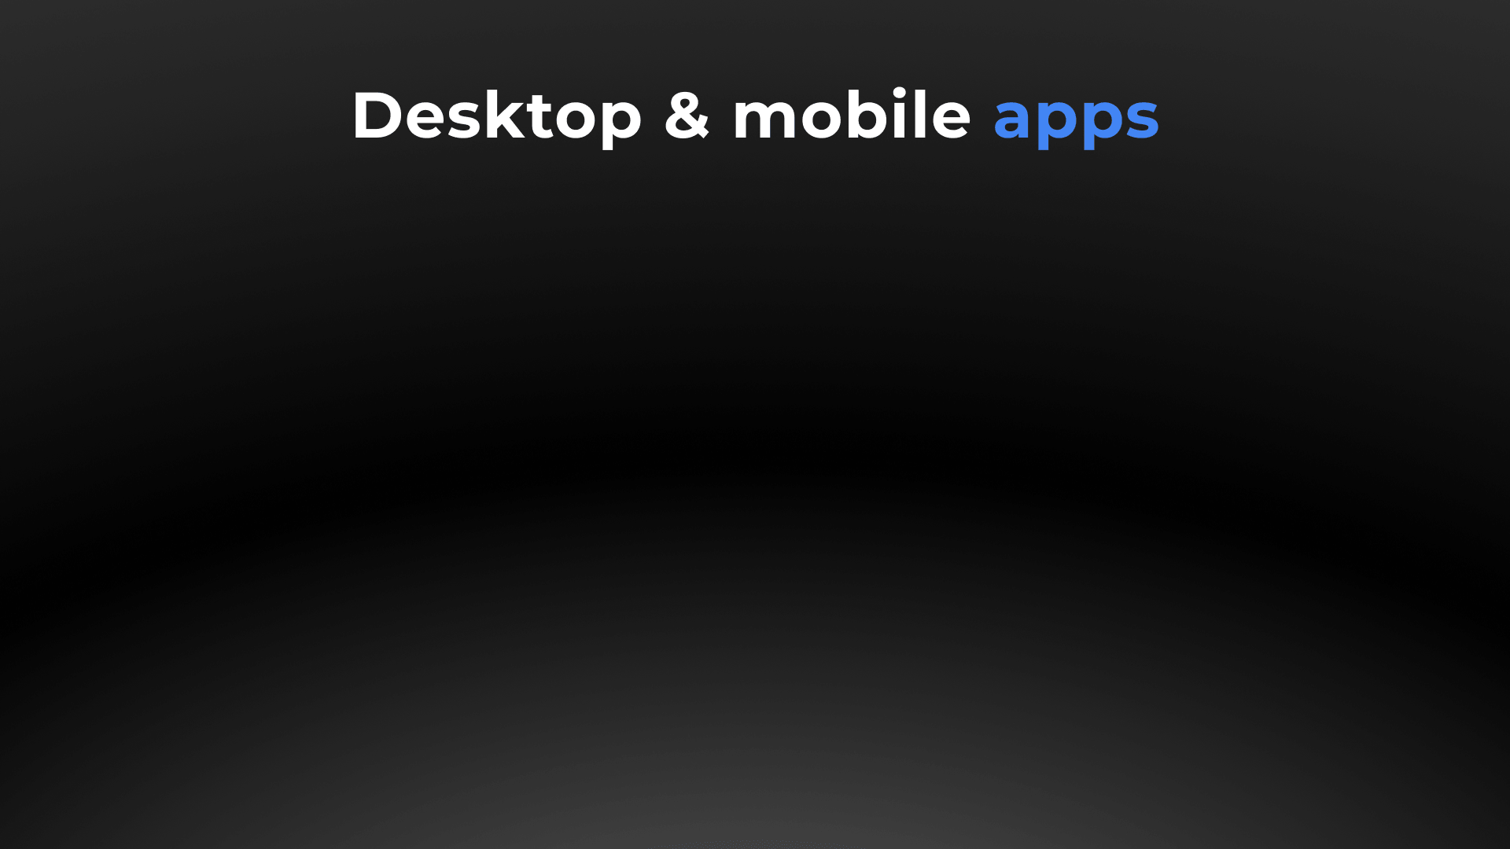




Slide 12

Web, desktop, mobile
DESKTOP APPS COMPARISON |  | no desktop client
Text processor | ● | ▬
Spreadsheet editor | ● | ▬
Presentation editor | ● | ▬
PDF form creator | ● | ▬
PDF editor | ● | ▬
Diagram viewer | ● | ▬
Collaboration | ● | ▬
Ready integrations | ONLYOFFICE, Nextcloud, ownCloud, Seafile, kDrive, Liferay, Moodle | ▬
Windows, Linux, macOS | ● | ▬
Free version / Enterprise version | ● / ▬ | ▬

Slide 13

Web, desktop, mobile
MOBILE APPS COMPARISON
Text processor | ● | ●
Spreadsheet editor | ● | ●
Presentation editor | ● | ●
PDF form creator | ● | Only in web
PDF editor | ● | ●
Media player | ● | ▬
Online & offline work | ● | ●
Collaboration | ● | ●
Connection to cloud | ONLYOFFICE, Nextcloud, ownCloud, kDrive, OneDrive, Dropbox, and other storages via WebDAV | Google Drive
iOS/Android | ● | ●
Free | ● | ●

Slide 14







ONLYOFFICE:
COLLABORATION WITHOUT DISRUPTION
Elizabeth Rayen
Henry Milton
Samantha Jones

Slide 15
Collaboration
COLLABORATIVE FEATURES COMPARISON | Docs | DocSpace | Desktop | Google Docs
Client-side performance | ● | ● | ● | ▬ no self-hosted version
2 co-editing modes (character- and paragraph-level) | ● | ● | ● | ○
Undo/Redo | ● | ● | ● | ●
Track changes, accept/reject changes | ● | ● | ● | ●
Changes display modes (Markup, Final, Original) | ● | ● | ● | ●
Commenting, mentions | ● | ● | ● | ●
Built-in chat | ● | ● | ● | ●
External chats, audio and video calls | ● plugins |  |  | ● add-ons
Version history | ● | ● | ● | ●
Protecting parts of documents from being edited | ● | ● | ● | ▬
Embedding into a web page | ● | ● | ● | ●
Guest names | ● | ● | ● | ▬
Document comparison | ● | ● | ● | ●

Slide 16
Collaboration
SHARING PERMISSIONS COMPARISON | Docs | DocSpace | Desktop | Google Docs
Sharing files | ● | ● | ● | ●
Access by external link | ● | ● | ● | ●
Editing by external link without authorization | ● | ● | ● | ●
Access rights: Read Only | ● | ● | ● | ●
Access rights: Full Access | ● | ● | ● | ●
Access rights: Review | ● | ● | ● | ●
Access rights: Comment | ● | ● | ● | ●
Access rights: Form Filling | ● | ● | ● | ▬
Access rights: Custom Filter (in spreadsheets) | ● | ● | ● | ▬
Access rights: Can't print, download and copy file | ● | ● | ● | ▬
Access rights: Can't change sharing settings | ● | ● | ● | ▬

Slide 17

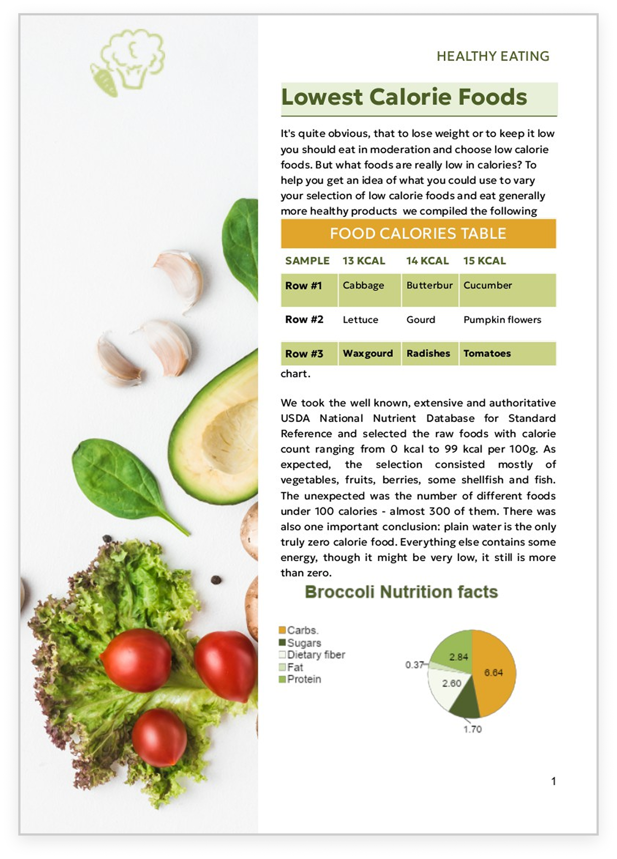

ONLYOFFICE:
MAXIMUM COMPATIBILITY WITH MS OFFICE FILES
MS Office desktop
Google Docs
ONLYOFFICE Docs

Slide 18
Comparison of file
formats support
 | Docs | DocSpace | Desktop | Google Docs
Native formats | DOCX • XLSX • PPTX |  |  | Proprietary formats
Editing DOC, DOTX, TXT, HTML, ODT, TXT, OTT, RTF | ● | ● | ● | ●
Editing EPUB, FB2, DjVu | ● | ● | ● | ▬
Creating and filling out PDF forms | ● | ● | ● | ▬
Viewing and annotating XPS, PDF, PDF/A | ● | ● | ● | ○ text comments only
Editing PDF, PDF/A | ● | ● | ● | ▬
Editing XLS, XLTX, ODS, OTS, CSV | ● | ● | ● | ●
Editing PPT, POTX, ODP, OTP | ● | ● | ● | ●
Export to PDF | ● | ● | ● | ●
Converting PDF and XPS to DOCX for further editing | ● | ● | ● | ●
Viewing VSDX | ● | ● | ● | ▬
Editing MD, XLSB, ODG | ● | ● | ● | ▬

Slide 19
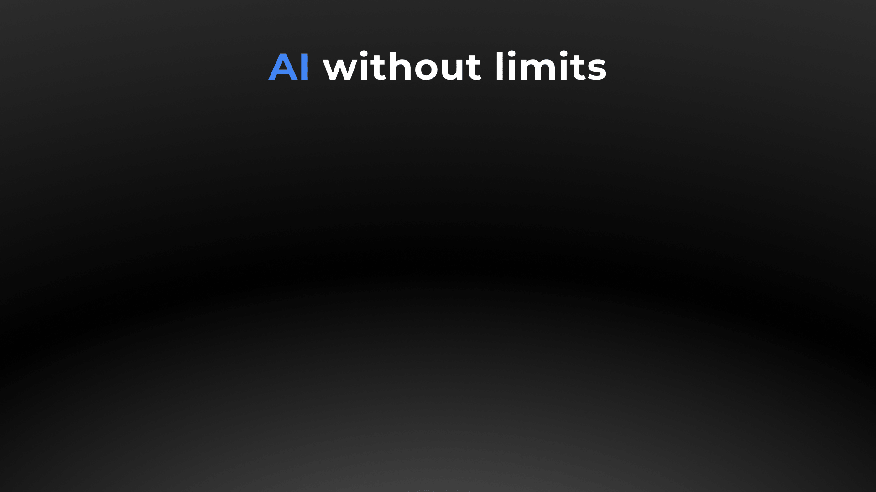
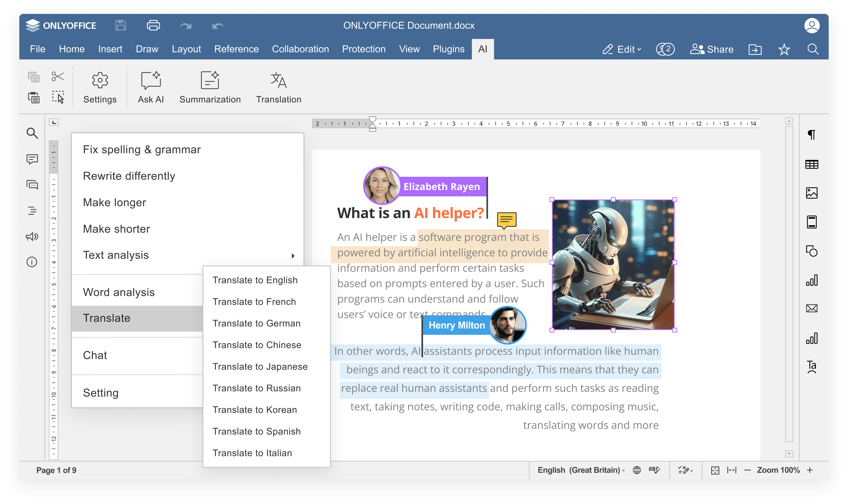


Slide 20
AI integration
COMPARISON OF AI FEATURES | Docs | DocSpace | Desktop | Google Docs
Answering questions in chatbot | ● | ● | ● | ●
Writing (generate, rewrite, summarize, expand text, etc.) | ● | ● | ● | ●
Translation | ● | ● | ● | ●
Proofreading (spell checking, sentence analysis, etc.) | ● | ● | ● | ●
Summarization | ● | ● | ● | ●
Images generation | ● | ● | ● | ●
Code review | ● via chatbot |  |  | ● via chatbot
Formula suggestions & explanations | ● | ● | ● | ●
AI for macros | ● | ● | ● | ●
OCR for scanned PDFs | ● | ● | ● | ●

Slide 21
AI integration
COMPARISON OF AI CUSTOMIZATION AND FLEXIBILITY | Docs | DocSpace | Desktop | Google Docs
Selecting among AI providers (ChatGPT, Gemini, Deepseek, Ollama, Together AI, Groq AI, Mistal AI, etc.) | ● | ● | ● | Gemini
Selecting among AI models | ● | ● | ● | ●
Self-hosted AI support | ● | ● | ● | ▬
Custom AI configuration (assigning different AI models for different tasks) | ● | ● | ● | ▬
API keys & access control | ● | ● | ● | ●
Integration into enterprise environments | ● | ● | ● | ●
Availability | free AI plugin available in all editors |  |  | requires an eligible Google Workspace or Google One AI Premium subscription or Google Workspace Labs

Slide 22

ONLYOFFICE:
REINFORCED SECURITY

Slide 23
Data security
COMPARISON OF MAIN SECURITY ASPECTS | Docs | DocSpace | Desktop | Google Docs
Open-source code | ● | ● | ● | ▬
Self-hosting | ● | ● | ● | ▬*
SSL | ● | ● | ● | ●
JWT | ● | ● | ● | ▬
Cache lifetime configuration | ● | ● | ● | ▬
Watermarking | ● | ● | ● | ●
Data encryption | Data is transferred via secure channel with ability to edit/co-edit in the encrypted form. |  |  | Server-side file encryption is not sufficient: all encryption keys are accessible for Google.
End-to-end encryption | ● | ● | ● | ▬
Restrictions support | ● | ● | ● | ●
*Google reserves the right to access any content associated with your account.

Slide 24
Data security
COMPARISON OF SECURITY FEATURES FOR FILES | Docs | DocSpace | Desktop | Google Docs
Support for advanced access permissions | Commenting • reviewing • filling forms • custom filtering in spreadsheets |  |  | Commenting
Password protection for docs, sheets, slides | ● | ● | ● | No add password feature
Password protection for workbook structure | ● | ● | ● | ▬
Password protection for separate sheets | ● | ● | ● | ●
Locked cells | ● | ● | ● | ●
Hidden formulas | ● | ● | ● | ●
Digital signatures | ▬ | ▬ | ● | ▬

Slide 25




























Flexibility
ONLYOFFICE is integrated
in more than 40 well-known platforms (ready-to-use connectors)

Slide 26
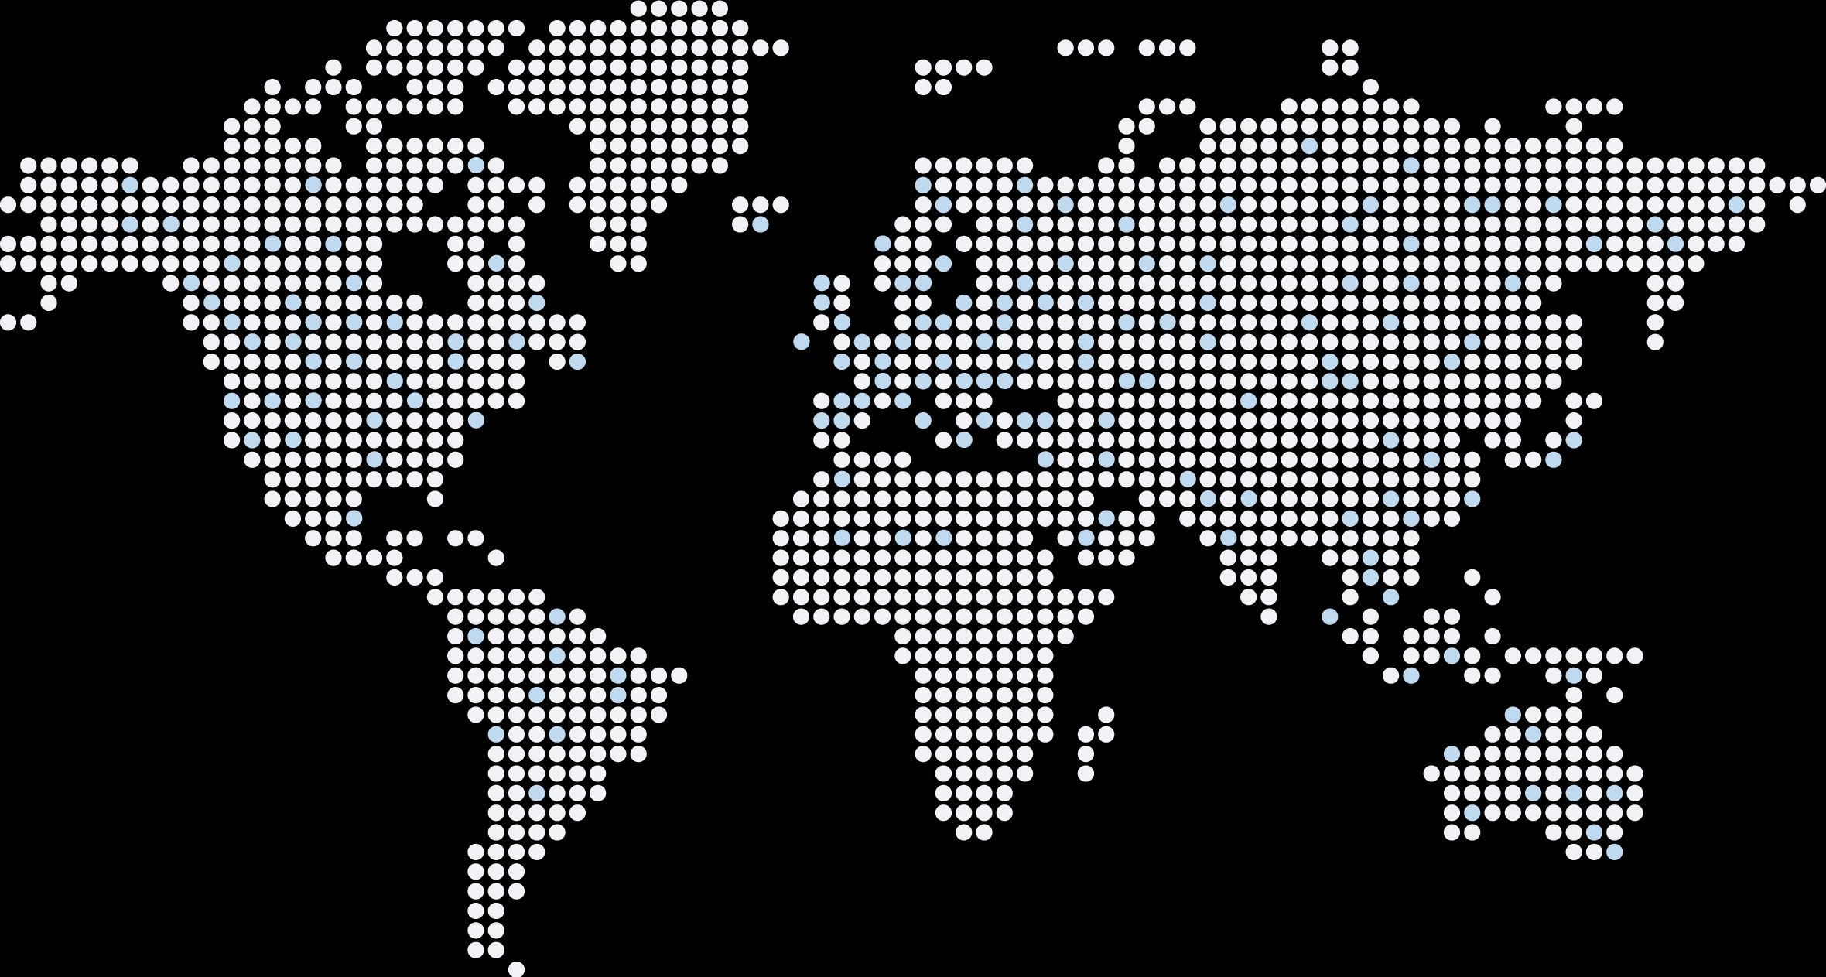
Flexibility
ONLYOFFICE is embedded
in more than 300 web services
(API & WOPI)

Slide 27
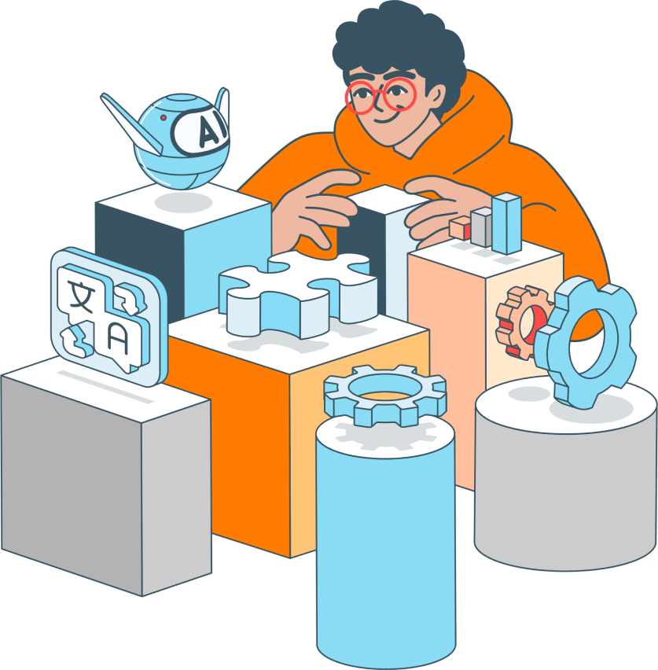
Accessibility
UI tweaks
Various color modes
Hotkeys
Screen readers
Useful plugins in the editors
  AI helpers
  Translator (Google, DeepL)
  Text-to-speech
  Speech input
  Typograf
  OCR

Slide 28
Pricing and licensing
COMPARISON
Free version | ● | ●
Enterprise version | ● | ● Google Workspace
License | AGPL V3 | Proprietary
Pricing model | Per connection* | Per user
*How many browser tabs with documents can be opened for editing at the same time.

Slide 29




Want to try ONLYOFFICE?
Download Docs
Get Desktops
Join DocSpace

Slide 30

SALES REQUESTS
sales@onlyoffice.com
OFFICIAL WEBSITE
www.onlyoffice.com

