Slide 1




ONLYOFFICE Docs | DocSpace | Desktop VS LibreOffice | Collabora

Slide 2


Best-in-breed online document editors
Docs, sheets, slides, forms, PDF
Open-source and security
Flexibility
AI support
Web, desktop, mobile
Seamless collaboration
Support for all popular file formats
Unified core technology
across all solutions

Slide 3
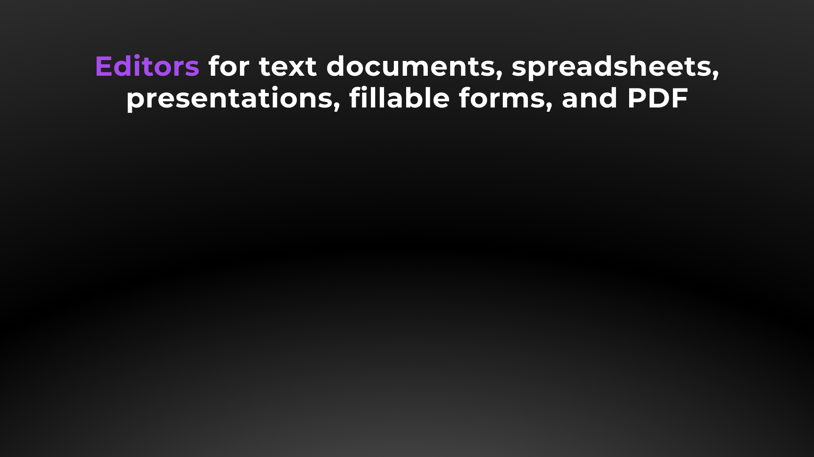






Slide 4




Docs, sheets, slides, forms, PDF
DOCUMENT EDITOR COMPARISON | Docs | DocSpace | Desktop | LibreOffice | Collabora
Advanced font formatting | ● | ● | ● | ● | ●
Advanced paragraph formatting | ● | ● | ● | ● | ●
Bulleted/Numbered/Multilevel lists | ● | ● | ● | ● | ●
Columns | ● | ● | ● | ● | ●
Section breaks | ● | ● | ● | ● | ●
Creating & editing styles | ● | ● | ● | ● | ●
Color schemes | ● | ● | ● | ▬ | ●
Non-printing characters | ● | ● | ● | ● | ●
Format Painter | ● | ● | ● | ● | ●
Paste Special | ● | ● | ● | ● | ●
Page margins, size, orientation | ● | ● | ● | ● | ●
Search & Replace tool | ● | ● | ● | ● | ●
Spell checking | ● | ● | ● | ● | ●
Dark theme | ● | ● | ● | ● | ●

Slide 5
Docs, sheets, slides, forms, PDF
DOCUMENT EDITOR COMPARISON | Docs | DocSpace | Desktop | LibreOffice | Collabora
Headers & footers, page numbers | ● | ● | ● | ● | ●
Table of contents, footnotes | ● | ● | ● | ● | ●
External and internal hyperlinks | ● | ● | ● | ● | ●
Bookmarks | ● | ● | ● | ● | ●
Tables | ● | ● | ● | ● | ●
Content controls | ● | ● | ● | ● | ●
Images | ● | ● | ● | ● | ●
Charts | ● | ● | ● | ● | ●
Text Art objects | ● | ● | ● | ● | ●
QR, Barcode | ▬ | ▬ | ▬ | ● | ●
Equations | ● | ● | ● | ○ via LibreOffice Math | ○ via Collabora Office Math
Align/Arrange/Group objects | ● | ● | ● | ● | ●
Text wrap | ● | ● | ● | ● | ●
Exact object positioning | ● | ● | ● | ● | ●

Slide 6
Docs, sheets, slides, forms, PDF
SPREADSHEET EDITOR COMPARISON | Docs | DocSpace | Desktop | LibreOffice | Collabora
Inserting images, charts | ● | ● | ● | ● | ●
Inserting autoshapes, text boxes | ● | ● | ● | ● | ●
Adding slicers | ● | ● | ● | ▬ | ▬
Sheet View | ● | ● | ● | ● | ●
Removing duplicates | ● | ● | ● | ● | ●
Mail Merge | ● | ● | ● | ● | ●
Macros | ● | ● | ● | ● | ●
Custom functions | ● | ● | ● | ● | ▬
Data protection | ● | ● | ● | ● | ●
Color schemes | ● | ● | ● | ● | ●
Dark theme | ● | ● | ● | ● | ●
Selecting external data | ● | ● | ▬ | ● | ▬

Slide 7
Docs, sheets, slides, forms, PDF
PRESENTATION EDITOR COMPARISON | Docs | DocSpace | Desktop | LibreOffice | Collabora
Copy / insert a slide | ● | ● | ● | ● | ●
Hide / show a slide | ● | ● | ● | ● | ●
Lists | ● | ● | ● | ● | ●
Inserting images, autoshapes, tables, symbols | ● | ● | ● | ● | ●
Transitions | ● | ● | ● | ● | ●
Animation | ● | ● | ● | ● | ●
Inserting SmartArt, charts | ● | ● | ● | ● | ●
Inserting headers & footers, date & time, TextArt | ● | ● | ● | ● | ●
Slide Master | ● | ● | ● | ● | ●
Color schemes | ● | ● | ● | ● | ●
Presenter mode | ● | ● | ● | ● | ●
Dark theme | ● | ● | ● | ● | ●
Preview text effects | ● | ● | ● | ● | ▬

Slide 8
Docs, sheets, slides, forms, PDF
PDF FORM EDITOR COMPARISON | Docs | DocSpace | Desktop | LibreOffice | Collabora
Filling out | ● | ● | ● | ● | ●
Creating and editing | ● | ● | ● | ● | ●
Simple fields (text, combo box, drop-down list, check box, radio button) | ● | ● | ● | ● | ○ text, dropdown, checkbox
Special fields (image, email, phone, ZIP code, date&time, credit card, complex field, signature field) | ● | ● | ● | ○ image, date&time | ○ image, date
Extended field properties (tips and placeholders, mark as required, lock, group fields, multiline entry, characters limit, comb of characters) | ● | ● | ● | ▬ | ▬
Recipient roles for field filling | ● | ● | ● | ▬ | ▬
Collecting data | ● | ● | ● | ▬ | ▬

Slide 9
Docs, sheets, slides, forms, PDF
PDF EDITOR COMPARISON | Docs | DocSpace | Desktop | LibreOffice | Collabora
Viewing | ● | ● | ● | ● | ●
Editing | ● | ● | ● | ● | ▬
Annotations - text highlight, underline, strikethrough | ● | ● | ● | ● | ●
Freehand drawings | ● | ● | ● | ● | ●
Inserting and editing objects | ● | ● | ● | ● | ▬
Adding stamps | ● | ● | ● | ▬ | ▬
Printing PDFs | ● | ● | ● | ● | ●
Adding or deleting pages | ● | ● | ● | ● | ▬
Copying pages between PDFs | ● | ● | ● | ● | ▬
Rotating pages | ● | ● | ● | ▬ | ●
Converting PDF to DOCX | ● | ● | ● | ▬ | ▬
Converting PDF to picture | ● | ● | ● | ▬ | ▬
Converting PDF to e-book | ● | ● | ● | ▬ | ▬

Slide 10
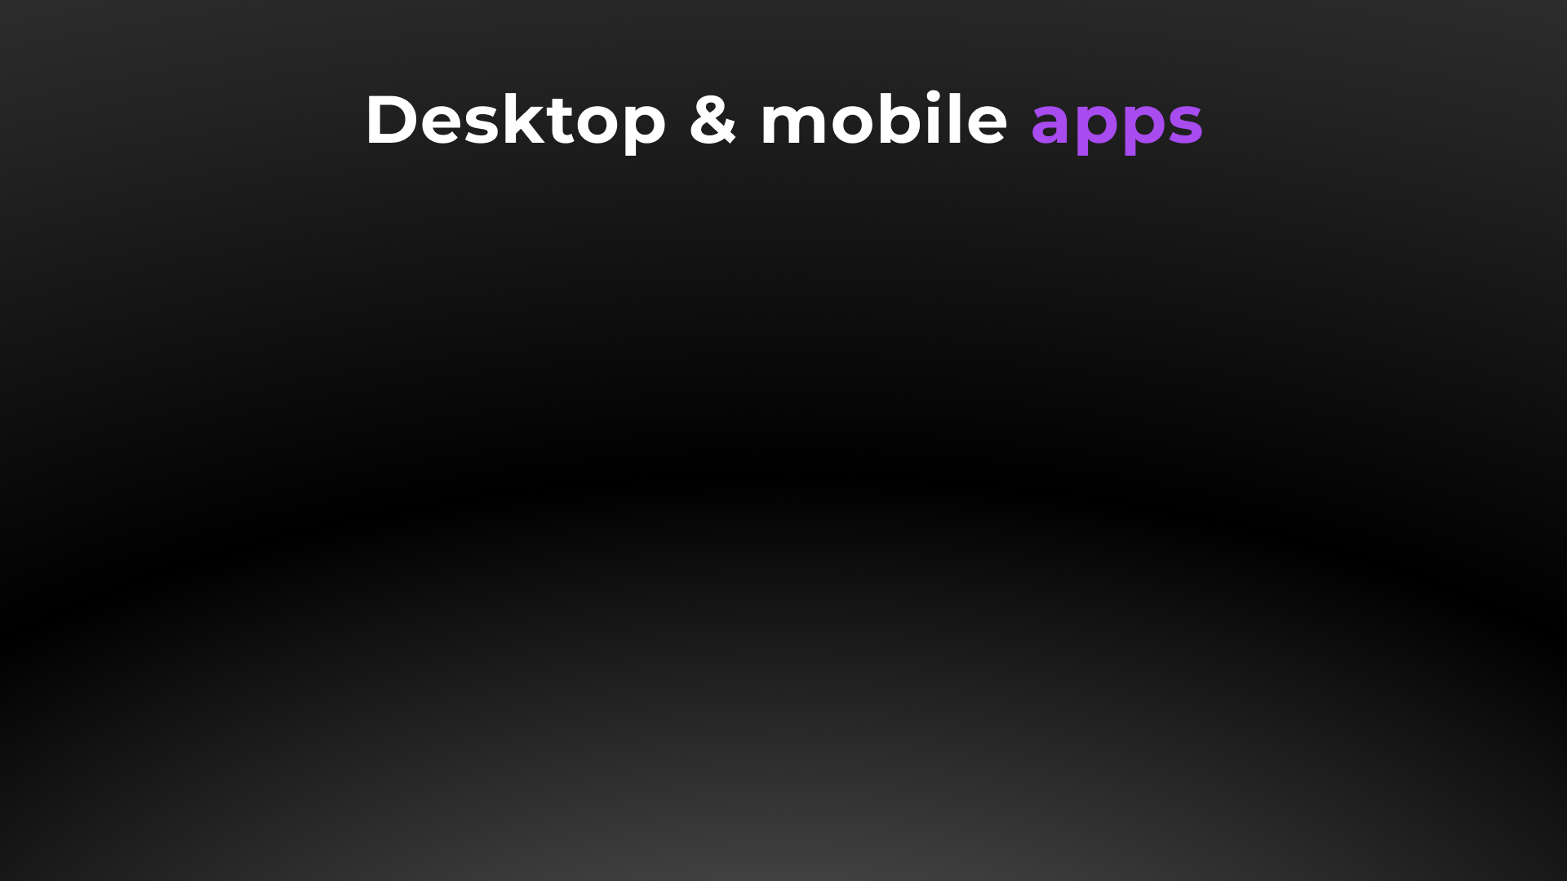




Slide 11

Web, desktop, mobile
DESKTOP APPS COMPARISON
Text processor | ● | ● | ●
Spreadsheet editor | ● | ● | ●
Presentation editor | ● | ● | ●
PDF Form creator | ● | ● | ●
PDF editor | ● | ● | ●
Diagram viewer | ● | ● | ●
Collaboration | ● | ▬ | ▬
Ready integrations | ONLYOFFICE, Nextcloud, ownCloud, Seafile, kDrive, Liferay, Moodle | ▬ | ▬
Windows, Linux, macOS | ● | ● | ●
Free version | ● | ● | ●

Slide 12

Web, desktop, mobile
MOBILE APPS COMPARISON |  |  |  | Collabora
Text processor | ● | ●
Spreadsheet editor | ● | ●
Presentation editor | ● | ●
Form filler | ● | ▬
PDF viewer | ● | ▬
Media player | ● | ▬
Online & offline work | ● | ○
Collaboration | ● | ▬
Connection to cloud | ONLYOFFICE, Dropbox, OneDrive, kDrive, Nextcloud, ownCloud and other storages via WebDAV | ▬
iOS & Android | ● | ●
Free | ● | ●

Slide 13







ONLYOFFICE:
COLLABORATION WITHOUT DISRUPTION
Elizabeth Rayen
Henry Milton
Samantha Jones

Slide 14
Collaboration
COLLABORATIVE FEATURES COMPARISON | Docs | DocSpace | Desktop | Collabora
Client-side performance | ● | ● | ● | ▬
2 co-editing modes (character- and paragraph-level) | ● | ● | ● | ▬
Undo/Redo | ● | ● | ● | ●
Track changes, accept/reject changes | ● | ● | ● | ●
Changes display modes (Markup and baloons, Only markup, Final, Original) | ● | ● | ● | ○ partially
Commenting, mentions | ● | ● | ● | ○ partially
Built-in chat | ● | ● | ● | ▬
External chats, audio and video calls | ● | ● | ● | ▬
Version history | ● | ● | ● | ●
Protecting parts of documents from being edited | ● | ● | ● | ●
Embedding into a web page | ● | ● | ● | ▬
Guest names | ● | ● | ● | ▬
Document comparison | ● | ● | ● | ▬
Combine documents | ● | ● | ● | ▬

Slide 15
Collaboration
SHARING PERMISSIONS COMPARISON | Docs | DocSpace | Desktop | Collabora
Sharing files | ● | ● | ● | ●
Access by external link | ● | ● | ● | ●
Editing by external link without authorization | ● | ● | ● | ●
Access rights: Read Only | ● | ● | ● | ●
Access rights: Full Access | ● | ● | ● | ●
Access rights: Review | ● | ● | ● | ▬
Access rights: Comment | ● | ● | ● | ▬
Access rights: Form Filling | ● | ● | ● | ▬
Access rights: Custom Filter (in spreadsheets) | ● | ● | ● | ▬
Access rights: Can't download | ● | ● | ● | ▬
Access rights: Can't print and copy file | ● | ● | ● | ▬
Access rights: Can't change sharing settings | ● | ● | ● | ▬

Slide 16

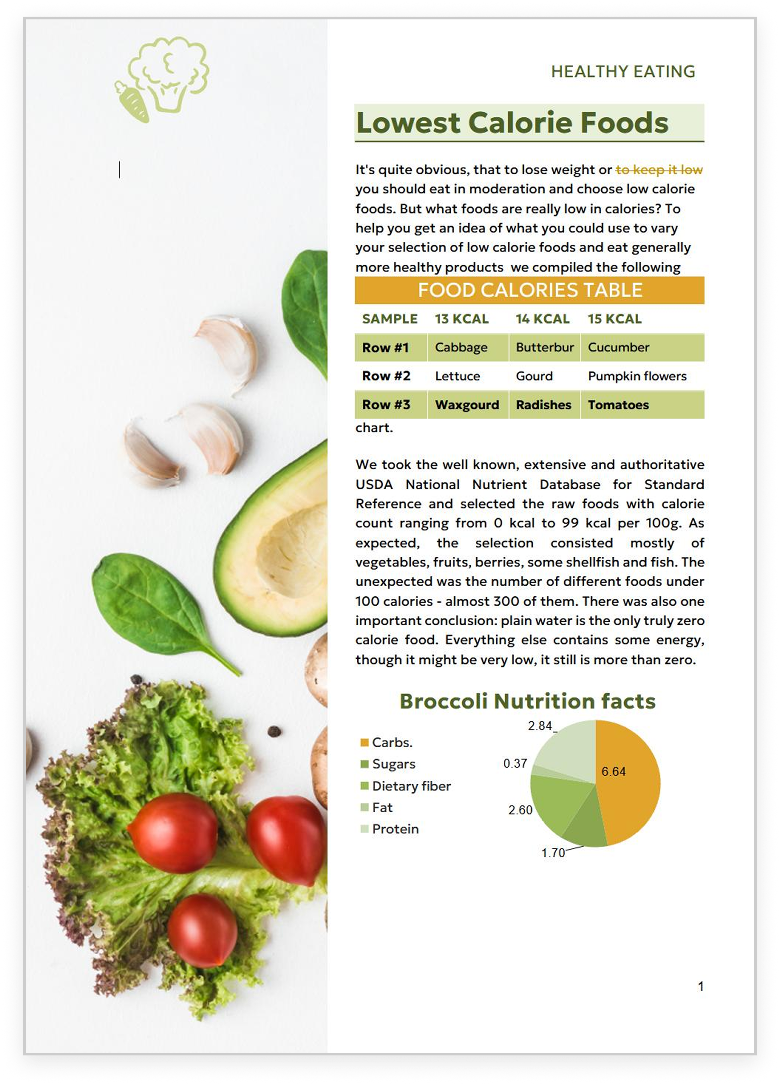

ONLYOFFICE:
MAXIMUM COMPATIBILITY WITH MS OFFICE FILES
MS Office desktop
LibreOffice
ONLYOFFICE Docs

Slide 17
Comparison of file
formats support
 | Docs | DocSpace | Desktop | LibreOffice | Collabora
Native formats | DOCX • XLSX • PPTX |  |  | ODT • ODS • ODP
Editing DOC, TXT, HTML, ODT, DOTX, RTF | ● | ● | ● | ● | ●
Editing EPUB, FB2 | ● | ● | ● | ▬ | ▬
Creating and filling out PDF forms | ● | ● | ● | ▬ | ▬
Viewing and annotating PDF | ● | ● | ● | ● | ●
Editing PDF, PDF/A | ● | ● | ● | ● | ▬
Viewing DjVu, XPS | ● | ● | ● | ▬ | ▬
Editing XLS, ODS, CSV, XLTX, OTS, XLSB | ● | ● | ● | ● | ●
Editing PPT, ODP, POTX, OTP, ODG | ● | ● | ● | ● | ●
Export to PDF | ● | ● | ● | ● | ●
Viewing Apple formats (.pages, .key, .numbers) | ● | ● | ● | ● | ●
Viewing Hancom formats (.hwp, .hwpx) | ● | ● | ● | ▬ | ▬
Viewing VSDX | ● | ● | ● | ● | ●
Editing MD | ● | ● | ● | ● | ▬

Slide 18
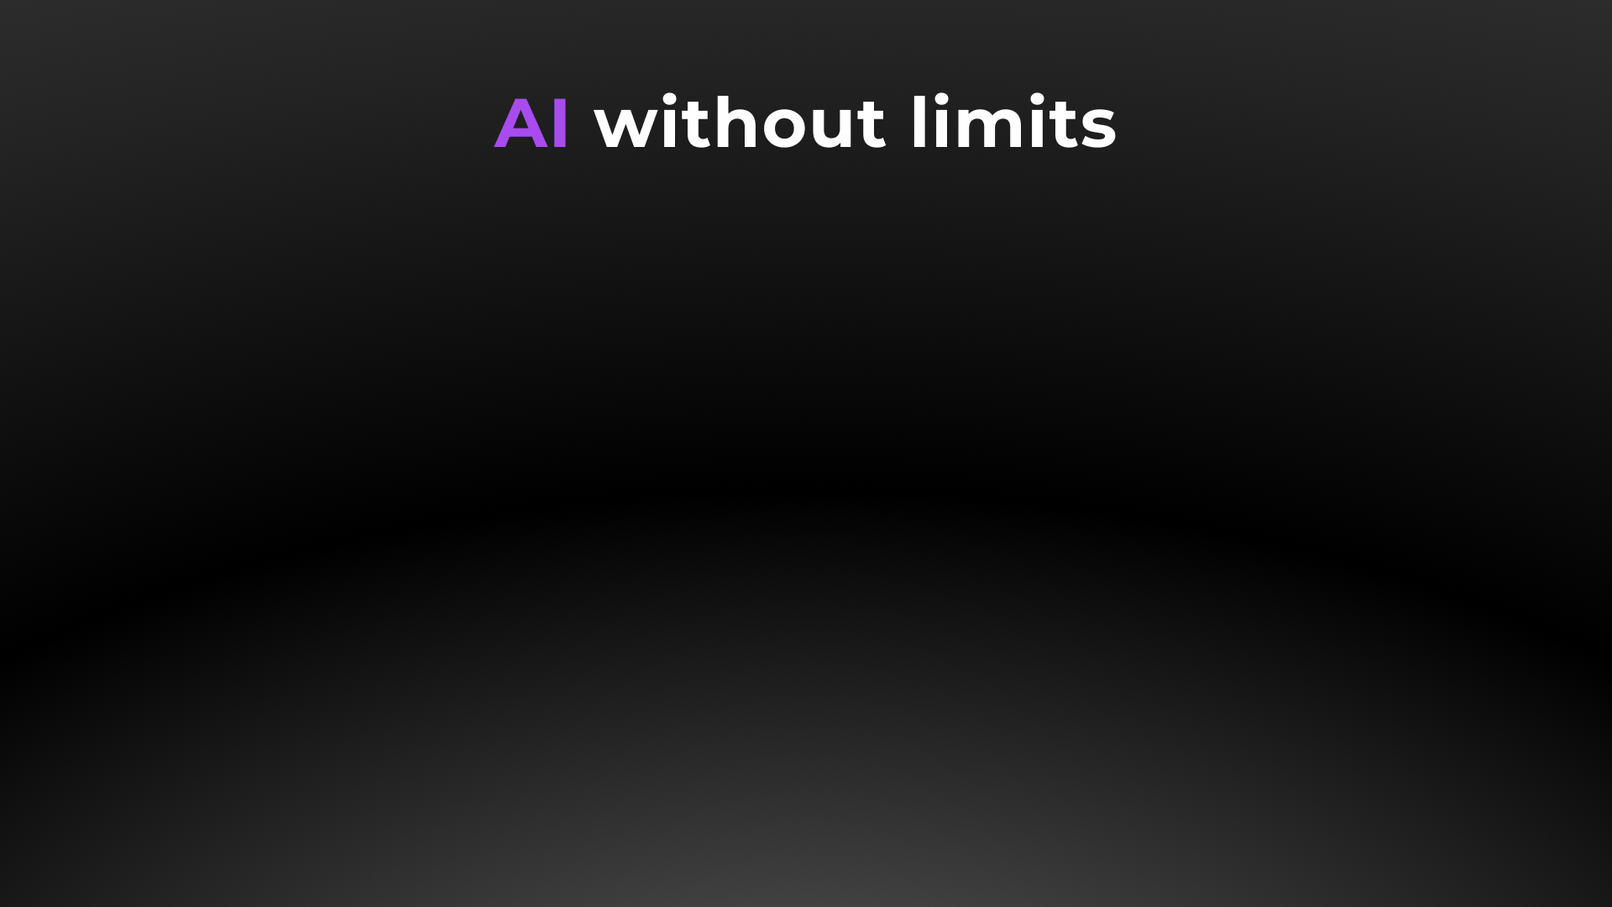
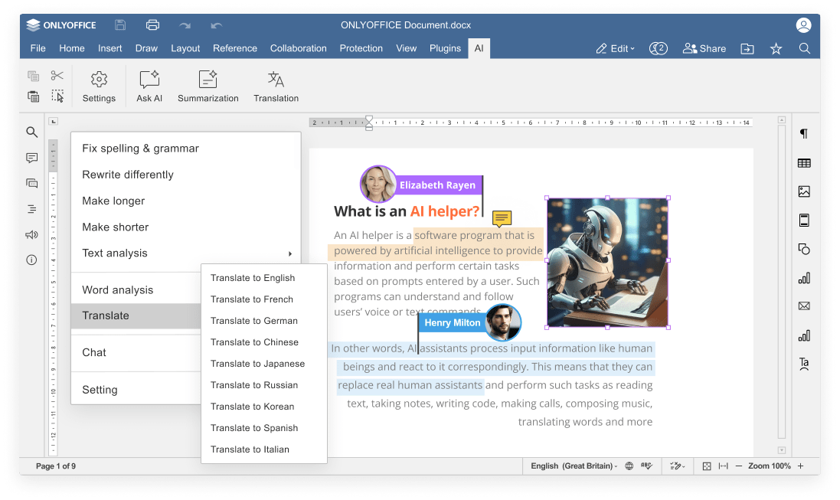


Slide 19
AI integration
COMPARISON OF AI FEATURES | Docs | DocSpace | Desktop | LibreOffice | Collabora
Answering questions in chatbot | ● | ● | ● | ▬ | ▬
Writing (generate, rewrite, summarize, expand text, etc.) | ● | ● | ● | ▬ | ▬
Translation | ● | ● | ● | ● via extension | ●
Proofreading (spell checking, sentence analysis, etc.) | ● | ● | ● | ▬ | ▬
Summarization | ● | ● | ● | ▬ | ▬
Images generation | ● | ● | ● | ▬ | ▬
Code review | ● via chatbot |  |  | ▬ | ▬
Formula suggestions & explanations | ● | ● | ● | ▬ | ▬
AI for macros | ● | ● | ● | ▬ | ▬
OCR for scanned PDFs | ● | ● | ● | ▬ | ▬

Slide 20
AI integration
COMPARISON OF AI CUSTOMIZATION AND FLEXIBILITY | Docs | DocSpace | Desktop | LibreOffice | Collabora
Selecting among AI providers (ChatGPT, Deepseek, Ollama, Together AI, Groq AI, Mistal AI, etc.) | ● | ● | ● | ▬ | ▬
Selecting among AI models | ● | ● | ● | ▬ | ▬
Self-hosted AI support | ● | ● | ● | ▬ | ▬
Custom AI configuration (assigning different AI models for different tasks) | ● | ● | ● | ▬ | ▬
API keys & access control | ● | ● | ● | ▬ | ▬
Integration into enterprise environments | ● | ● | ● | ▬ | ▬
Availability | free AI plugin available in all editors |  |  | DeepL Translations available in Collabora Online

Slide 21

ONLYOFFICE:
REINFORCED SECURITY

Slide 22
Data security
COMPARISON OF MAIN SECURITY ASPECTS | Docs | DocSpace | Desktop | LibreOffice |  | Collabora
Open-source code | ● | ● | ● | ● |  | ●
Self-hosting | ● | ● | ▬ | ▬ |  | ●
SSL | ● | ● | ▬ | ▬ |  | ●
JWT | ● | ● | ▬ | ▬ |  | ▬
Cache lifetime configuration | ● | ● | ▬ | ▬ |  | ●
Watermarking | ● | ● | ● | ● |  | ●
Data encryption | data is transferred via secure channel with ability to edit/ co-edit in the encrypted form |  |  |  | GPG key encryption |  | Heavy layered data protection mechanism with onion approach
End-to-end encryption | ● | ● | ● | ▬ |  | ▬
Restrictions support | ● | ● | ● | ▬ |  | ●

Slide 23
Data security
COMPARISON OF SECURITY FEATURES FOR FILES | Docs | DocSpace | Desktop | LibreOffice | Collabora
Support for advanced access permissions | Commenting • reviewing • filling forms • custom filtering in spreadsheets |  |  | ▬ | ▬
Password protection for docs, sheets, slides | ● | ● | ● | ● | ●
Password protection for workbook structure | ● | ● | ● | ● | ●
Password protection for separate sheets | ● | ● | ● | ● | ●
Locked cells | ● | ● | ● | ● | ▬
Hidden formulas | ● | ● | ● | ● | ▬
Digital signatures | ▬ | ▬ | ● | ● | ● in desktop app

Slide 24




























Flexibility
ONLYOFFICE is integrated
in more than 40 well-known platforms (ready-to-use connectors)

Slide 25

Flexibility
ONLYOFFICE is embedded
in more than 300 web services
(API & WOPI)

Slide 26

Accessibility
UI tweaks
Various color modes
Hotkeys
Screen readers
Useful plugins in the editors
  AI helpers
  Translator (Google, DeepL)
  Text-to-speech
  Speech input
  Typograf
  OCR

Slide 27
Licensing and customization
COMPARISON |  |  | Collabora
Free personal version | ● fully featured and ad‑free | ● free demo versions
Free version for businesses | ● | ▬
Enterprise version | ● | ●
Developer version & white label | ● | ▬
Integration with other platforms | ● | ●
Deployment options | ● cloud / on‑premises | ● on‑premises
License | AGPL V3 / Proprietary | MPL v2
One-time purchase option | ● | ▬ subscription-based only

Slide 28
Pricing
BUSINESS & TEAMS |  |  |  | Collabora
Cloud Editors for integration | Docs Enterprise from $ 8 user / month |  | ▬
On-Premises Editors for integration | Docs Enterprise from $ 1500 / server |  | Collabora Online for Business / for Enterprise from $ 2.03 user / month
Cloud Collaboration Platform | DocSpace Business |  | ▬
 | free for small teams | from $ 20 admin / month
On-Premises Collaboration Platform | DocSpace Enterprise |  | ▬
 | free for small teams | $ 6550 server
Desktop Editors | free |  | free demo version
For reference only. Prices as of March 13, 2025, and may be subject to change.

Slide 29
Pricing
INDIVIDUALS |  |  |  | Collabora
On-Premises Editors for integration | Docs Community free |  | Collabora CODE free
Cloud Collaboration Platform | DocSpace Startup free |  | ▬
On-Premises Collaboration Platform | DocSpace Community free |  | ▬
Desktop Editors | free fully featured and ad‑free |  | free demo version
For reference only. Prices as of March 13, 2025, and may be subject to change.

Slide 30
Pricing
DEVELOPERS |  |  |  | Collabora
Cloud Editors for integration | Docs Developer from $ 12 user / month |  | no developer options
On-Premises Editors for integration | Docs Developer from $ 1950 / per year
On-Premises Collaboration Platform | DocSpace Developer Get a quote
For reference only. Prices as of March 13, 2025, and may be subject to change.

Slide 31




Want to try ONLYOFFICE?
Download Docs
Get Desktops
Join DocSpace

Slide 32

SALES REQUESTS
sales@onlyoffice.com
OFFICIAL WEBSITE
www.onlyoffice.com

