Slide 1



ONLYOFFICE Docs | DocSpace | Desktop VS MS Office Online

Slide 2


Best-in-breed online document editors
Docs, sheets, slides, forms,
Open-source and security
Flexibility
AI support
Web, desktop, mobile
Seamless collaboration
Support for all popular file formats
Unified core technology
across all solutions

Slide 3
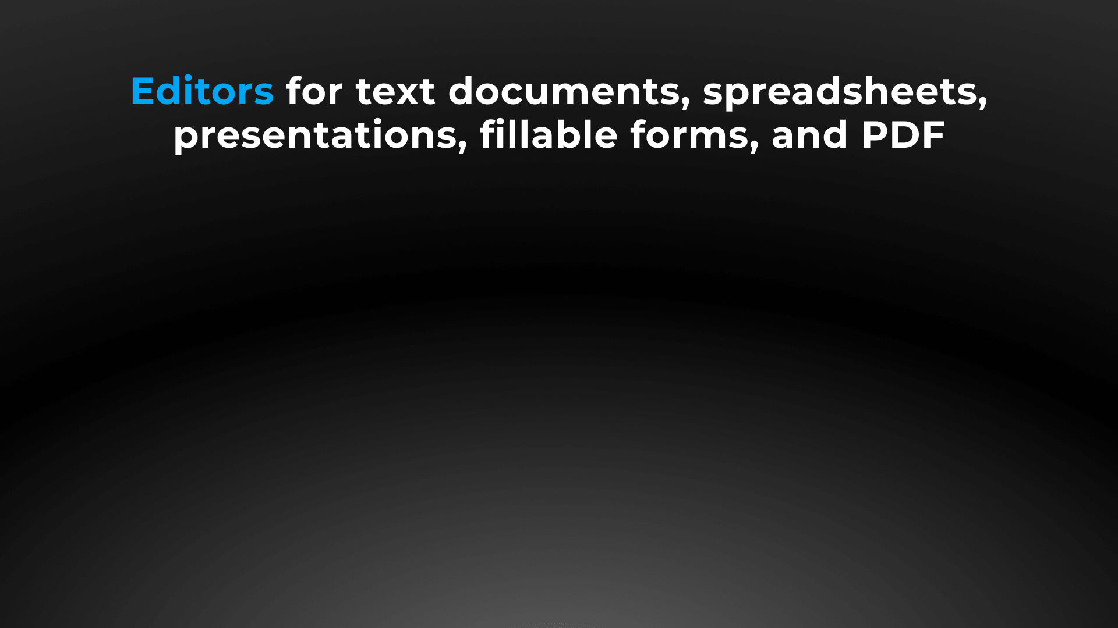






Slide 4



Docs, sheets, slides, forms, PDF
DOCUMENT EDITOR COMPARISON | Docs | DocSpace | Desktop | MS Office Online
Advanced font formatting | ● | ● | ● | ●
Advanced paragraph formatting | ● | ● | ● | ●
Bulleted/Numbered/Multilevel lists | ● | ● | ● | ●
Columns | ● | ● | ● | ●
Section breaks | ● | ● | ● | ●
Creating & editing styles | ● | ● | ● | ●
Color schemes | ● | ● | ● | ▬
Non-printing characters | ● | ● | ● | ●
Format Painter | ● | ● | ● | ●
Paste Special | ● | ● | ● | ●
Page margins, size, orientation | ● | ● | ● | ●
Search & Replace tool | ● | ● | ● | ●
Spell checking | ● | ● | ● | ●
Dark theme | ● | ● | ● | ●

Slide 5
Docs, sheets, slides, forms, PDF
DOCUMENT EDITOR COMPARISON | Docs | DocSpace | Desktop | MS Office Online
Headers & footers, page numbers | ● | ● | ● | ●
Table of contents, footnotes, endnotes | ● | ● | ● | ●
Table of figures, cross references | ● | ● | ● | ▬
External and internal hyperlinks | ● | ● | ● | ●
Bookmarks | ● | ● | ● | ●
Tables | ● | ● | ● | ●
Content controls | ● | ● | ● | ▬
Images, Shapes, Text boxes | ● | ● | ● | ●
Charts | ● | ● | ● | ▬
Text Art objects, SmartArt objects | ● | ● | ● | ▬
Drop cap | ● | ● | ● | ▬
Equations | ● | ● | ● | ●
Align/Arrange/Group objects | ● | ● | ● | ▬
Text wrap | ● | ● | ● | ○ limited number of options
Exact object positioning | ● | ● | ● | ▬

Slide 6
Docs, sheets, slides, forms, PDF
SPREADSHEET EDITOR COMPARISON | Docs | DocSpace | Desktop | MS Office Online
Data filtering and sorting | ● | ● | ● | ●
Freeze panes | ● | ● | ● | ●
Merge cells | ● | ● | ● | ●
Manage sheets | ● | ● | ● | ●
Pivot tables | ● | ● | ● | ●
Named range | ● | ● | ● | ●
Data validation | ● | ● | ● | ●
Conditional formatting | ● | ● | ● | ●
Hyperlinks | ● | ● | ● | ●
Formulas | ● | ● | ● | ●

Slide 7
Docs, sheets, slides, forms, PDF
SPREADSHEET EDITOR COMPARISON | Docs | DocSpace | Desktop | MS Office Online
Inserting images, charts, autoshapes, text boxes | ● | ● | ● | ●
Inserting autoshapes, text boxes | ● | ● | ● | ●
Adding slicers | ● | ● | ● | ●
Sheet View | ● | ● | ● | ●
Removing duplicates | ● | ● | ● | ●
Mail Merge | ● | ● | ● | ▬
Macros | ● | ● | ● | ▬
Data protection | ● | ● | ● | ●
Colors schemes | ● | ● | ● | ▬
Dark theme | ● | ● | ● | ▬

Slide 8
Docs, sheets, slides, forms, PDF
PRESENTATION EDITOR COMPARISON | Docs | DocSpace | Desktop | MS Office Online
Choosing presentation layout | ● | ● | ● | ●
Copy / insert a slide | ● | ● | ● | ●
Hide / show a slide | ● | ● | ● | ●
Lists | ● | ● | ● | ●
Inserting images, autoshapes, tables, symbols, footers, text boxes | ● | ● | ● | ●
Inserting equations, date & time | ● | ● | ● | ▬
Transitions | ● | ● | ● | ●
Animation | ● | ● | ● | ●
Hyperlinks | ● | ● | ● | ●
Setting parameters of demonstration | ● | ● | ● | ●
Presenter mode | ● | ● | ● | ●
Dark theme | ● | ● | ● | ▬

Slide 9
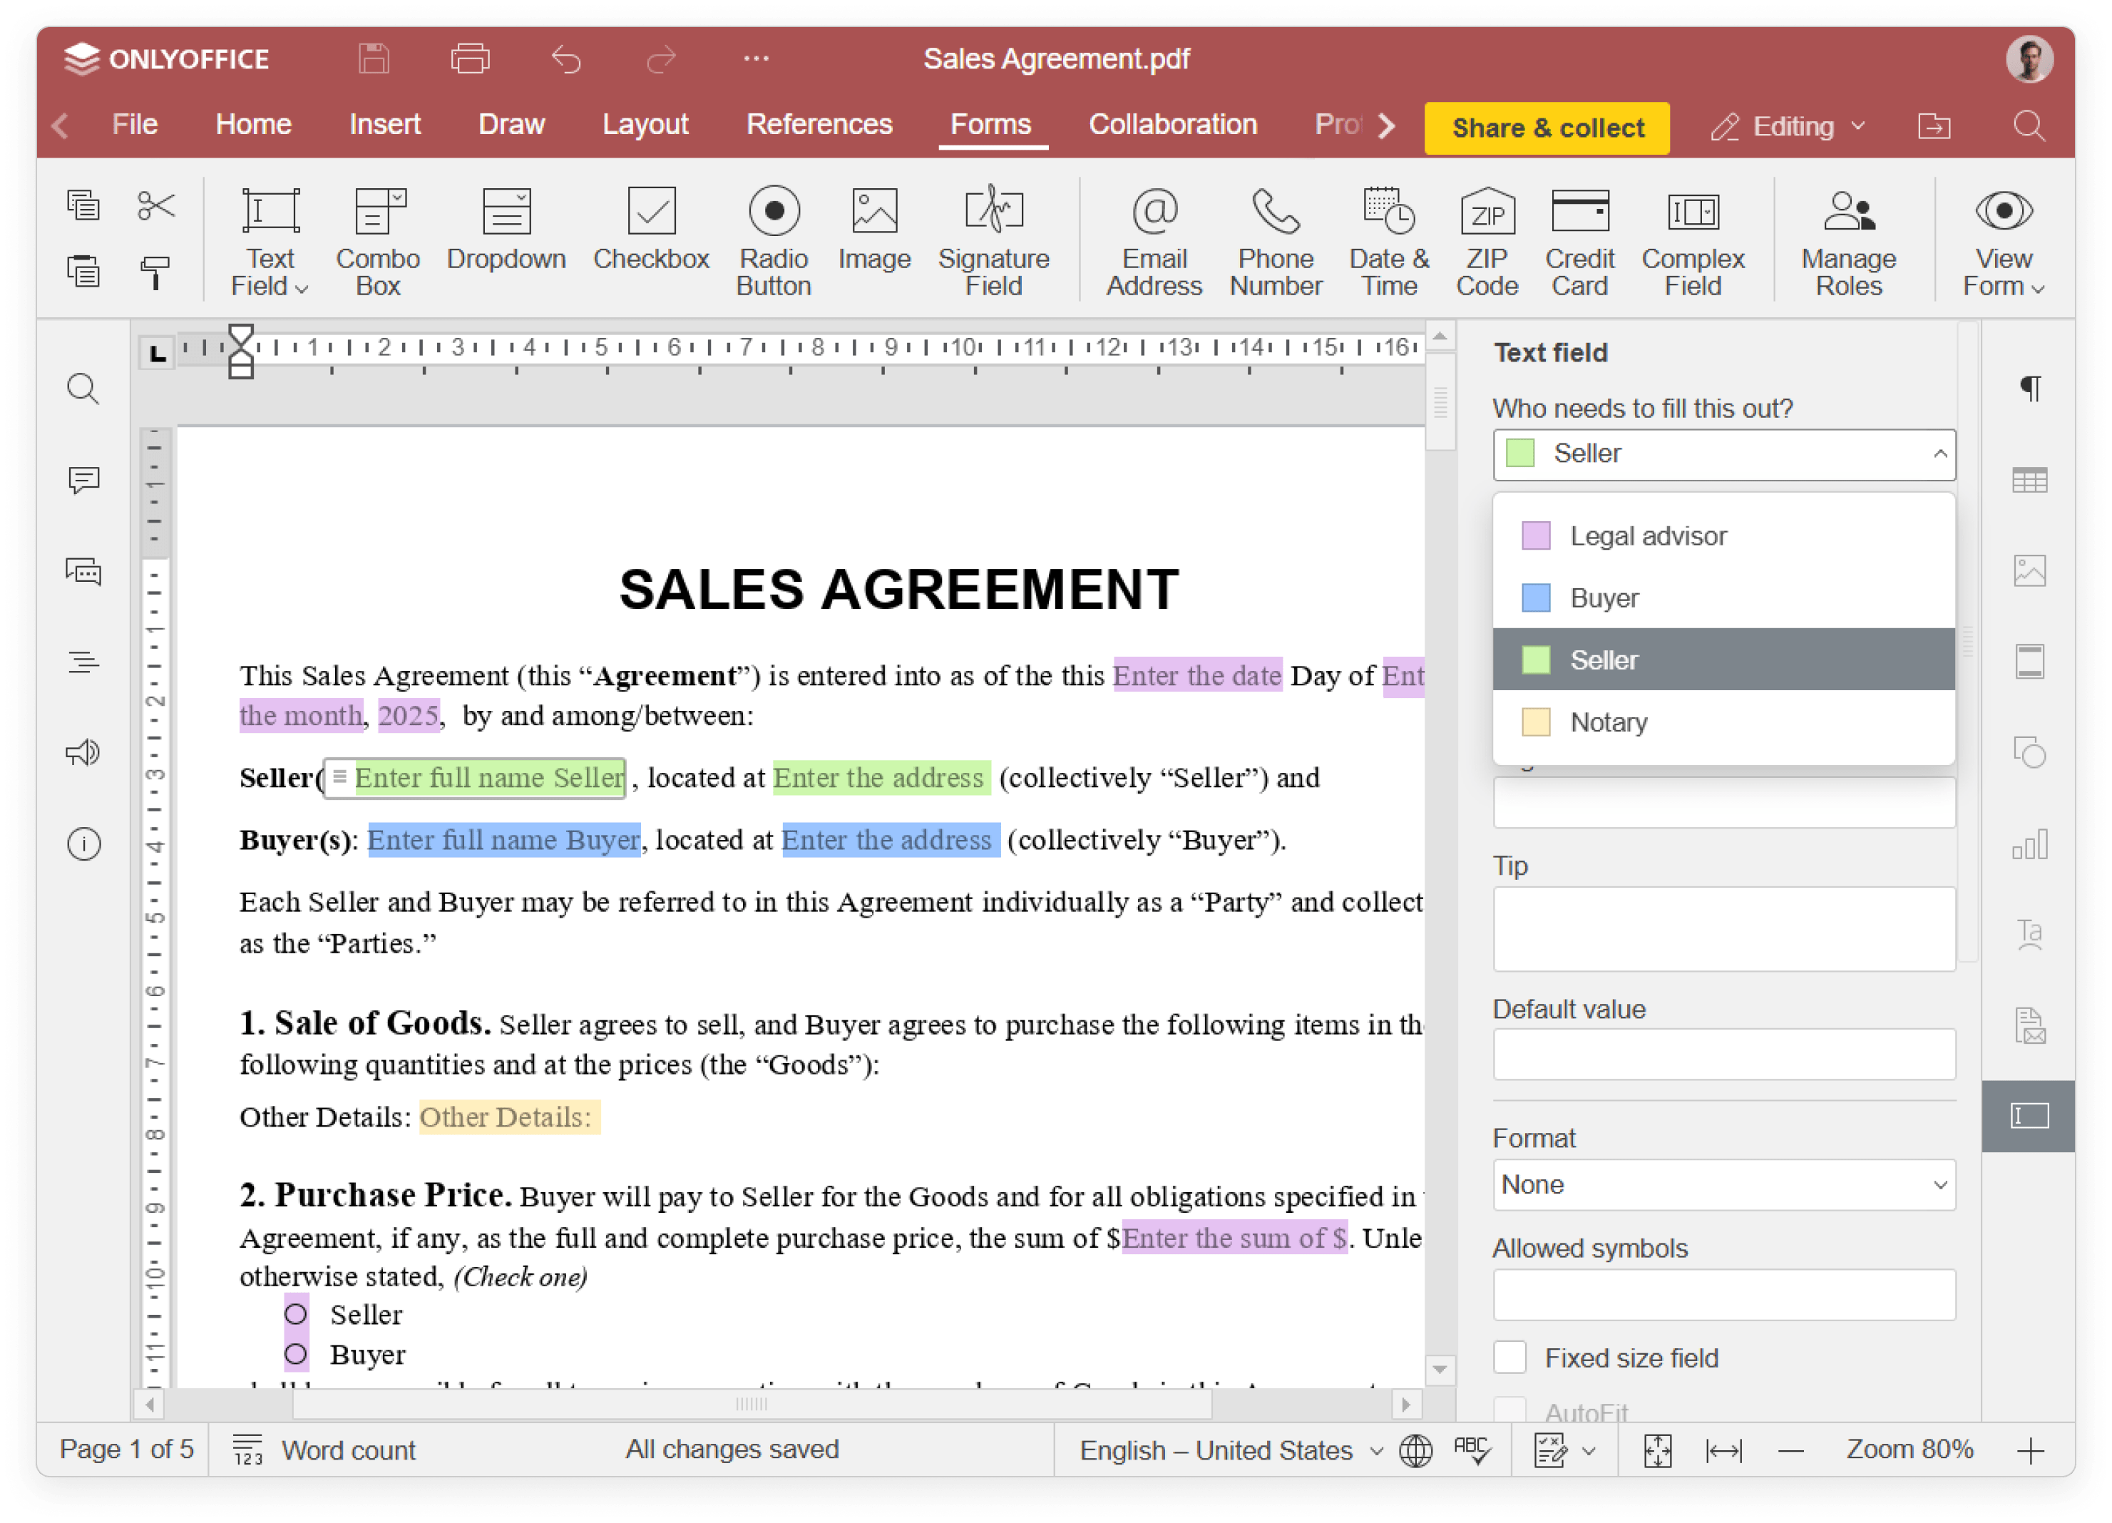
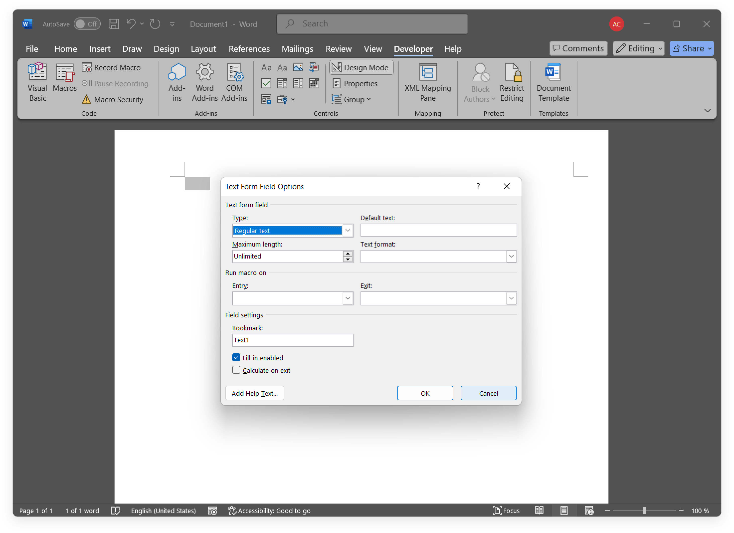
Docs, sheets, slides, forms, PDF
FORM CREATOR COMPARISON
ONLYOFFICE Forms
Extended field settings for creating complex PDF forms
both online and offline
MS Office Content Controls
Available only in the desktop version

Slide 10
Docs, sheets, slides, forms, PDF
FORM CREATOR COMPARISON | Docs | DocSpace | Desktop | Desktop version
Filling out PDF forms | ● | ● | ● | ▬
Creating and editing | Complex PDF forms |  |  | ○ MS Office Content Controls only
Saving PDF forms | ● | ● | ● | ●
Simple fields (text, combo box, drop-down list, check box, radio button) | ● | ● | ● | ●
Special fields (image, email, phone, ZIP code, date&time, credit card, complex field, signature field) | ● | ● | ● | ○ limited number of options
Extended field properties (tips and placeholders, mark as required, lock, group fields, multiline entry, characters limit, comb of characters) | ● | ● | ● | ○ limited number of options
Recipient roles for field filling | ● | ● | ● | ▬
Collecting data | ● | ● | ● | ▬
Availability | online & desktop |  |  | desktop only

Slide 11
Docs, sheets, slides, forms, PDF
PDF EDITOR COMPARISON | Docs | DocSpace | Desktop | MS Office Online
Viewing PDFs | ● | ● | ● | ●
Editing PDFs | ● | ● | ● | ▬
Annotations - Text highlight | ● | ● | ● | ▬
Annotations - Text underline | ● | ● | ● | ▬
Annotations - Text strikethrough | ● | ● | ● | ▬
Annotations - Freehand drawings | ● | ● | ● | ▬
Comments | ● | ● | ● | ●
Form filling | ● | ● | ● | ▬
Printing PDFs | ● | ● | ● | ●
Plugins (including AI-powered) | ● | ● | ● | ▬
View-Tools | ● | ● | ● | ●
Embedding | ● | ● | ● | ●
Adding, deleting, rotating pages | ● | ● | ● | ▬
Converting PDF to DOCX, picture, e-book | ● | ● | ● | ▬

Slide 12





Slide 13

Web, desktop, mobile
DESKTOP APPS COMPARISON |  | MS Office
Text processor | ● | ●
Spreadsheet editor | ● | ●
Presentation editor | ● | ●
Form creator | ● | ●
PDF reader & annotator | ● | ▬
Collaboration | ● | ▬
Ready integrations | ONLYOFFICE, Nextcloud, ownCloud, Seafile, kDrive, Liferay, Moodle | ▬
Windows, Linux, macOS | ● | ● / ▬ / ●
Free version / Enterprise version | ● / ▬ | ▬ / ●

Slide 14

Web, desktop, mobile
MOBILE APPS COMPARISON |  | MS Office
Text processor | ● | ●
Spreadsheet editor | ● | ●
Presentation editor | ● | ●
Form filler | ● | ●
PDF viewer | ● | ●
Media player | ● | ●
Online & offline work | ● | ●
Collaboration | ● | ●
Connection to cloud | ONLYOFFICE and other storages via WebDAV | OneDrive, SharePoint and other storages
iOS & Android | ● | ●
Free | ● | ●

Slide 15







ONLYOFFICE:
COLLABORATION WITHOUT DISRUPTION
Elizabeth Rayen
Henry Milton
Samantha Jones

Slide 16
Collaboration
COLLABORATIVE FEATURES COMPARISON | Docs | DocSpace | Desktop | MS Office Online
Client-side performance | ● | ● | ● | ▬
2 co-editing modes (character- and paragraph-level) | ● | ● | ● | ▬
Undo/Redo | ● | ● | ● | ●
Track changes, accept/reject changes | ● | ● | ● | ●
Changes display modes (Markup and balloons, Only markup, Final, Original) | ● | ● | ● | ○ only All markup and Simple markup
Commenting, mentions | ● | ● | ● | ●
Built-in chat | ● | ● | ● | ▬
External chats, audio and video calls | ● plugins |  |  | ● plugins
Version history | ● | ● | ● | ●
Protecting parts of documents from being edited | ● | ● | ● | ▬
Embedding into a web page | ● | ● | ● | ●
Guest names | ● | ● | ● | ▬
Document comparison, combining | ● | ● | ● | ▬

Slide 17
Collaboration
SHARING PERMISSIONS COMPARISON | Docs | DocSpace | Desktop | MS Office Online
Sharing files | ● | ● | ● | ●
Access by external link | ● | ● | ● | ●
Editing by external link without authorization | ● | ● | ● | ●
Access rights: Read Only | ● | ● | ● | ●
Access rights: Full Access | ● | ● | ● | ●
Access rights: Review | ● | ● | ● | ▬
Access rights: Comment | ● | ● | ● | ▬
Access rights: Form Filling | ● | ● | ● | ▬
Access rights: Custom Filter (in spreadsheets) | ● | ● | ● | ▬
Access rights: Can't print, download and copy file | ● | ● | ● | ▬
Access rights: Can't change sharing settings | ● | ● | ● | ▬

Slide 18

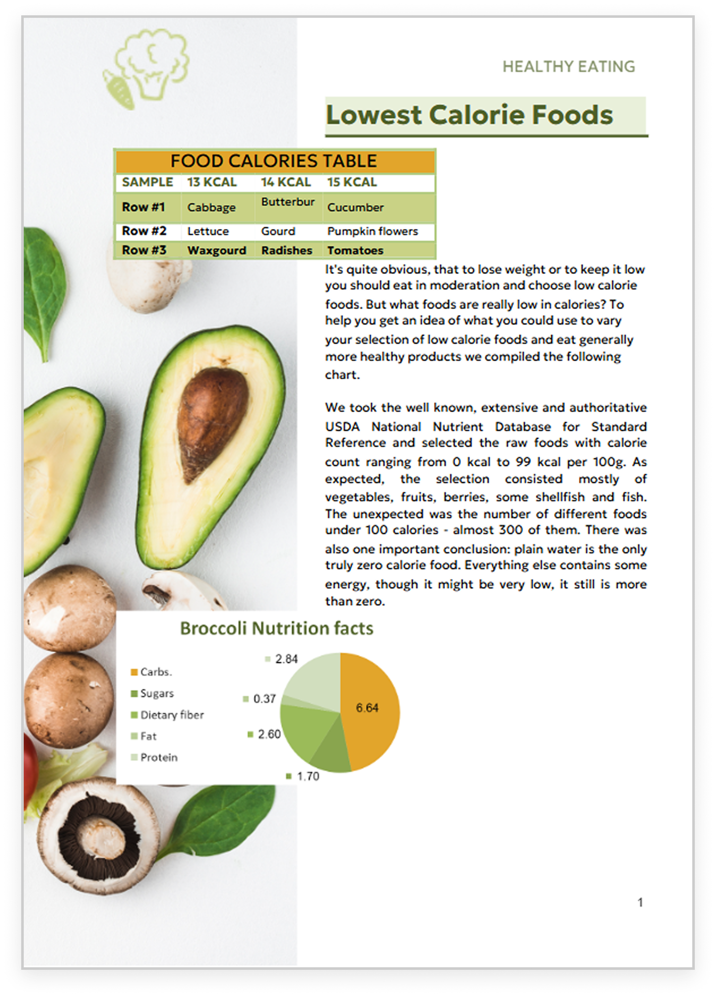

ONLYOFFICE:
MAXIMUM COMPATIBILITY WITH MS OFFICE FILES
MS Office desktop
MS Office Online
ONLYOFFICE Docs

Slide 19
Comparison of file
formats support
 | Docs | DocSpace | Desktop | MS Office Online
Native formats | DOCX • XLSX • PPTX |  |  | DOCX • XLSX • PPTX
Editing DOC, TXT, HTML, ODT | ● | ● | ● | ●*
Editing DOTX, OTT, RTF, EPUB, FB2 | ● | ● | ● | ▬
Creating and filling out PDF forms | ● | ● | ● | ▬
Viewing PDF, PDF/A | ● | ● | ● | ●
Annotating PDF | ● | ● | ● | ○ only commenting
Viewing DjVu, XPS | ● | ● | ● | ▬
Editing XLS, ODS, CSV | ● | ● | ● | ●*
Editing XLTX, OTS | ● | ● | ● | ▬
Editing PPT, ODP | ● | ● | ● | ●*
Editing POTX, OTP | ● | ● | ● | ▬
Export to PDF | ● | ● | ● | ●
Converting PDF and XPS to DOCX for further editing | ● | ● | ● | ▬
*When working with OpenDocument formats, some compatibility issues may occur.

Slide 20

ONLYOFFICE:
REINFORCED SECURITY

Slide 21
Data security
COMPARISON OF MAIN SECURITY ASPECTS | Docs | DocSpace | Desktop | MS Office Online
Open-source code | ● | ● | ● | ▬
Self-hosting | ● | ● | ● | ●*
SSL | ● | ● | ● | ●
JWT | ● | ● | ● | ●
Cache lifetime configuration | ● | ● | ● | ●
Watermarking | ● | ● | ● | ●
Data encryption | Data is transferred via secure channel with ability to edit/co-edit in the encrypted form. |  |  | There are some data disclosure and memory corruption vulnerabilities. Microsoft reserves the right to access files in private folders on OneDrive.
End-to-end encryption | ● | ● | ● | ▬
Restrictions support | ● | ● | ● | ●
*Data encryption and on-premises version are available for business users only.

Slide 22
Data security
COMPARISON OF SECURITY FEATURES FOR FILES | Docs | DocSpace | Desktop | MS Office Online
Support for advanced access permissions | Commenting • reviewing • filling forms • custom filtering in spreadsheets |  |  | Ranges editing (only with the Allow edit level in spreadsheets)
Password protection for docs, sheets, slides | ● | ● | ● | ●
Password protection for workbook structure | ● | ● | ● | ●
Password protection for separate sheets | ● | ● | ● | ●
Locked cells | ● | ● | ● | ▬
Hidden formulas | ● | ● | ● | ▬
Digital signatures | ● in desktop app |  |  | ● in desktop app

Slide 23




























Flexibility
ONLYOFFICE is integrated
in more than 40 well-known platforms (ready-to-use connectors)

Slide 24

Flexibility
ONLYOFFICE is embedded
in more than 300 web services
(API & WOPI)

Slide 25
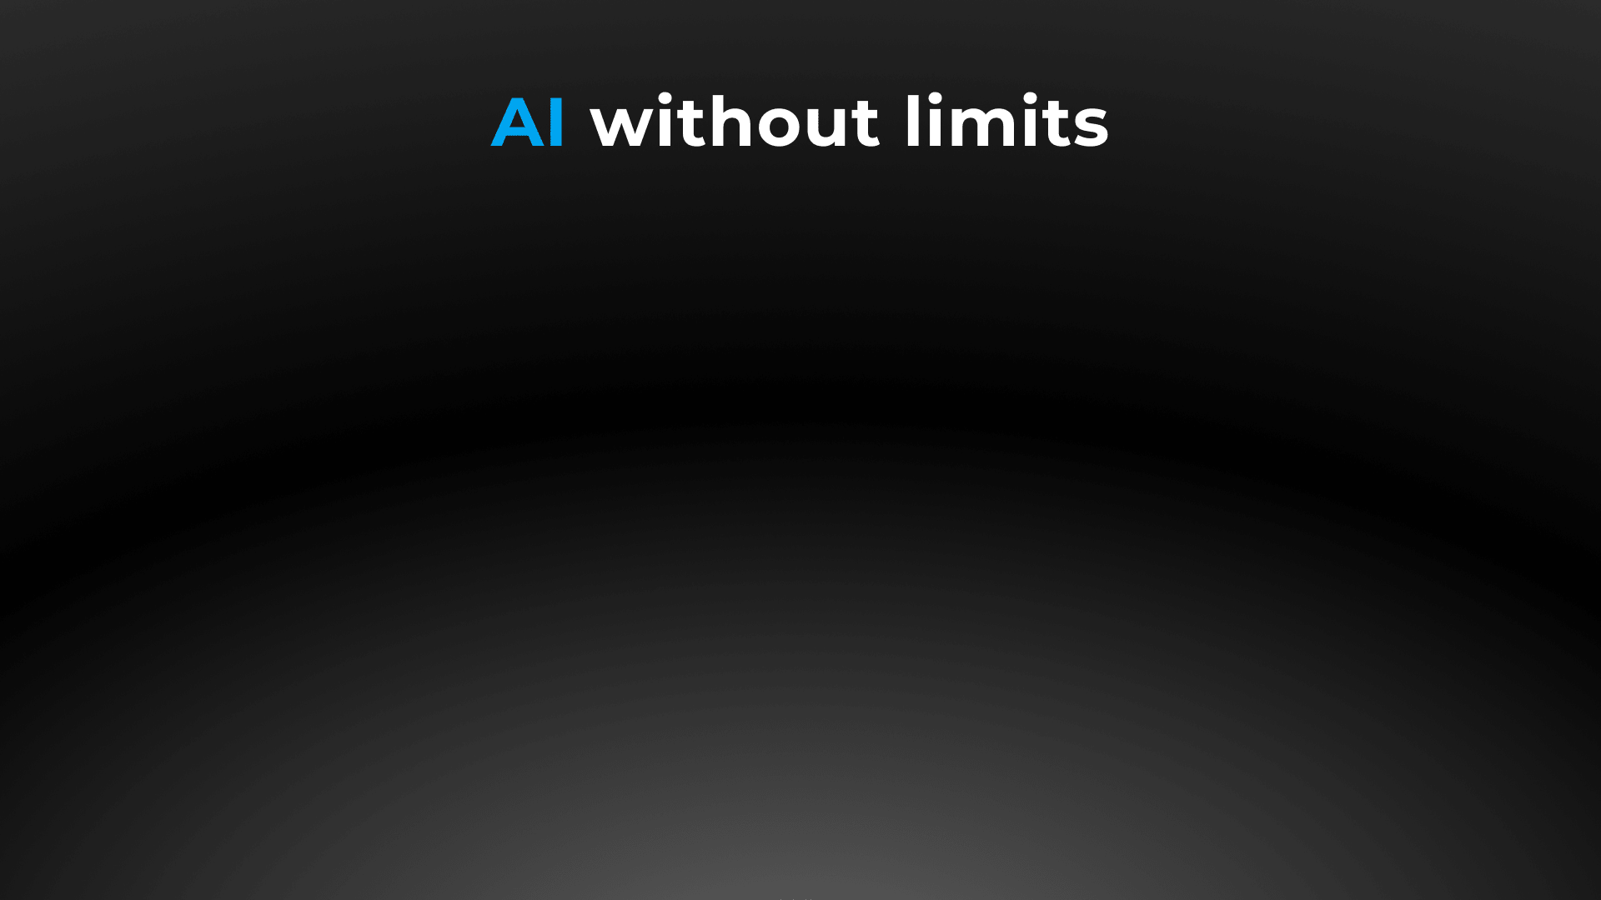
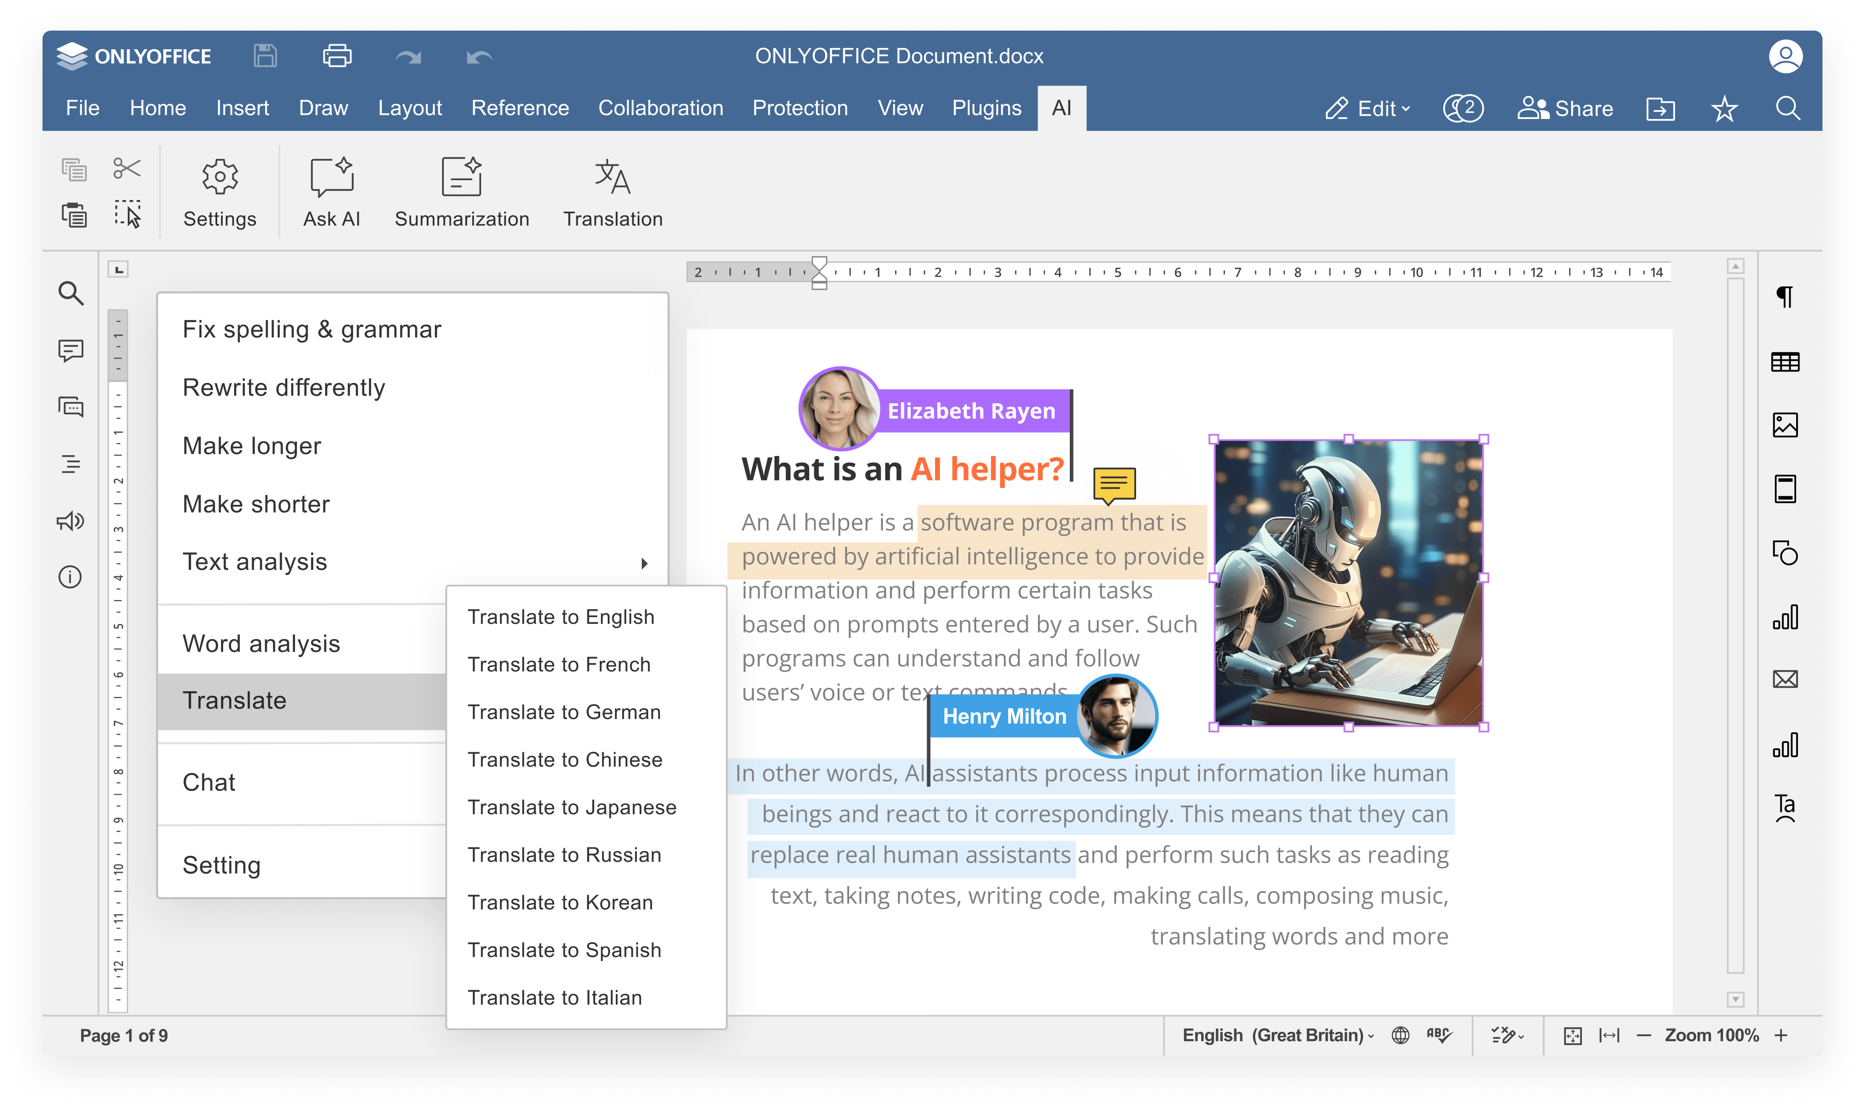


Slide 26
Comparison of AI features
 | Docs | DocSpace | Desktop | MS Office Online
Answering questions in chatbot | ● | ● | ● | ●
Writing (generate, rewrite, summarize, expand text, etc.) | ● | ● | ● | ●
Translation | ● | ● | ● | ●
Proofreading (spell checking, sentence analysis, etc.) | ● | ● | ● | ●
Summarization | ● | ● | ● | ●
Images generation | ● | ● | ● | ●
Code review | ● via chatbot |  |  | ●
Formula suggestions & explanations | ● via chatbot |  |  | ●

Slide 27
Comparison of AI
customization and flexibility
 | Docs | DocSpace | Desktop | MS Office Online
Selecting among AI providers (ChatGPT, Gemini, Deepseek, Ollama, Together AI, Groq AI, Mistal AI, etc.) | ● | ● | ● | Microsoft Copilot
Selecting among AI models | ● | ● | ● | ▬
Self-hosted AI support | ● | ● | ● | ▬
Custom AI configuration (assigning different AI models for different tasks) | ● | ● | ● | ▬
API keys & access control | ● | ● | ● | ▬
Integration into enterprise environments | ● | ● | ● | ●
Availability | free AI plugin available in all editors |  |  | Microsoft 365 Copilot requires a separate license for a qualifying Microsoft 365 plan

Slide 28

Accessibility
UI tweaks
Various color modes
Hotkeys
Screen readers
Useful plugins in the editors
  AI helpers
  Translator (Google, DeepL)
  Text-to-speech
  Speech input
  Typograf
  OCR

Slide 29
Pricing and licensing
COMPARISON |  | MS Office
Free version | ● | ●
Enterprise version | ● | ●
License | AGPL V3 | Proprietary
Pricing model | Per connection* | Per user
*How many browser tabs with documents can be opened for editing at the same time.

Slide 30




Want to try ONLYOFFICE?
Download Docs
Get Desktops
Join DocSpace

Slide 31

SALES REQUESTS
sales@onlyoffice.com
OFFICIAL WEBSITE
www.onlyoffice.com

