Slide 1

How They
Throw Out a Challenge

Slide 2
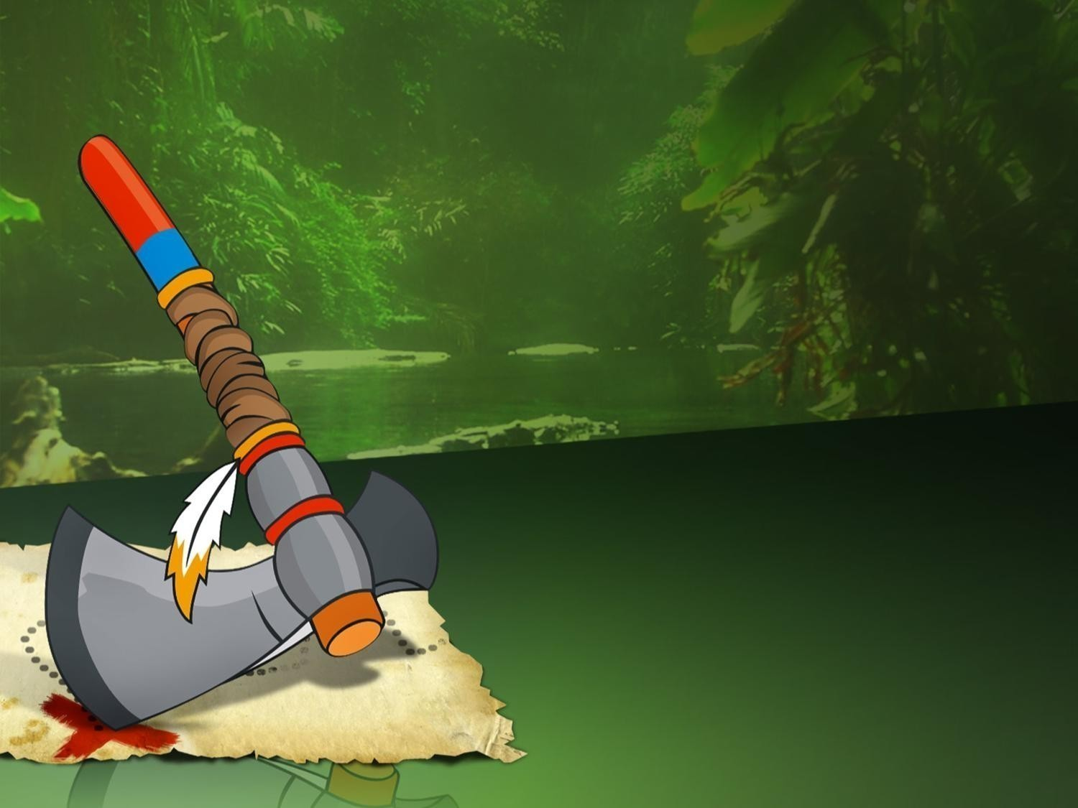
Native Americans (XVII century)

Slide 3
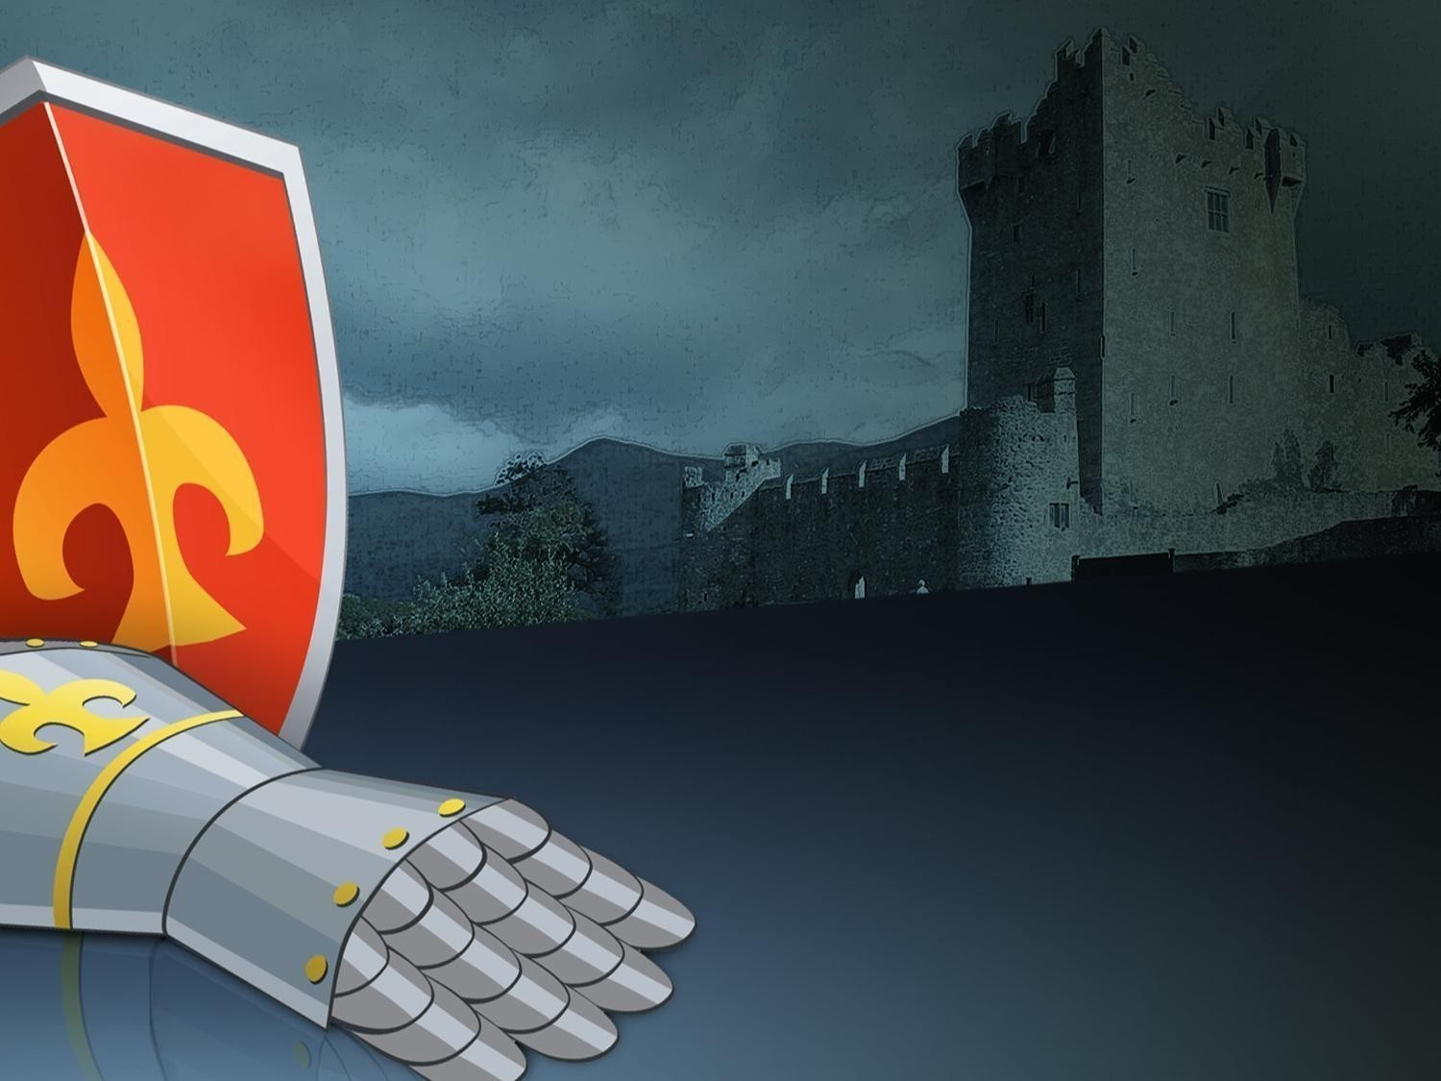
European Knights
(XII-XVI centuries)

Slide 4
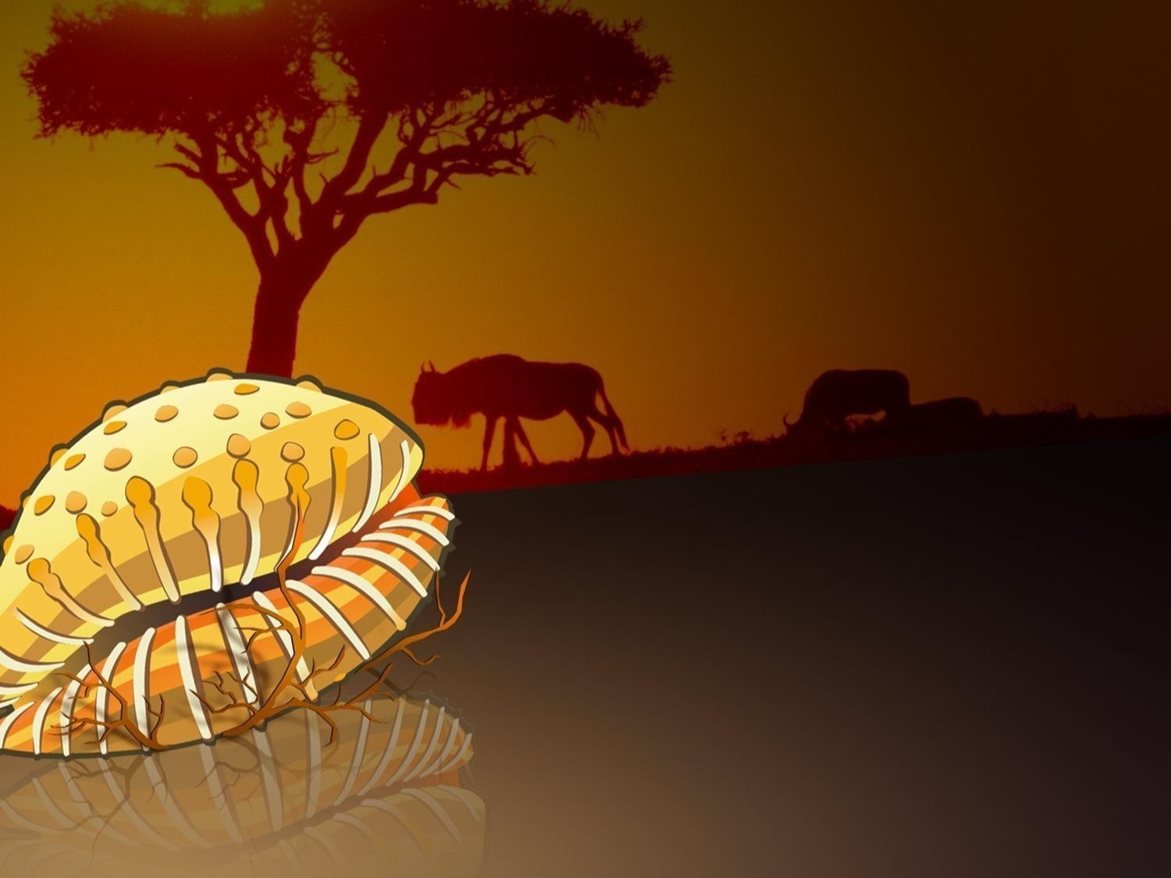
African Yoruba tribes

Slide 5
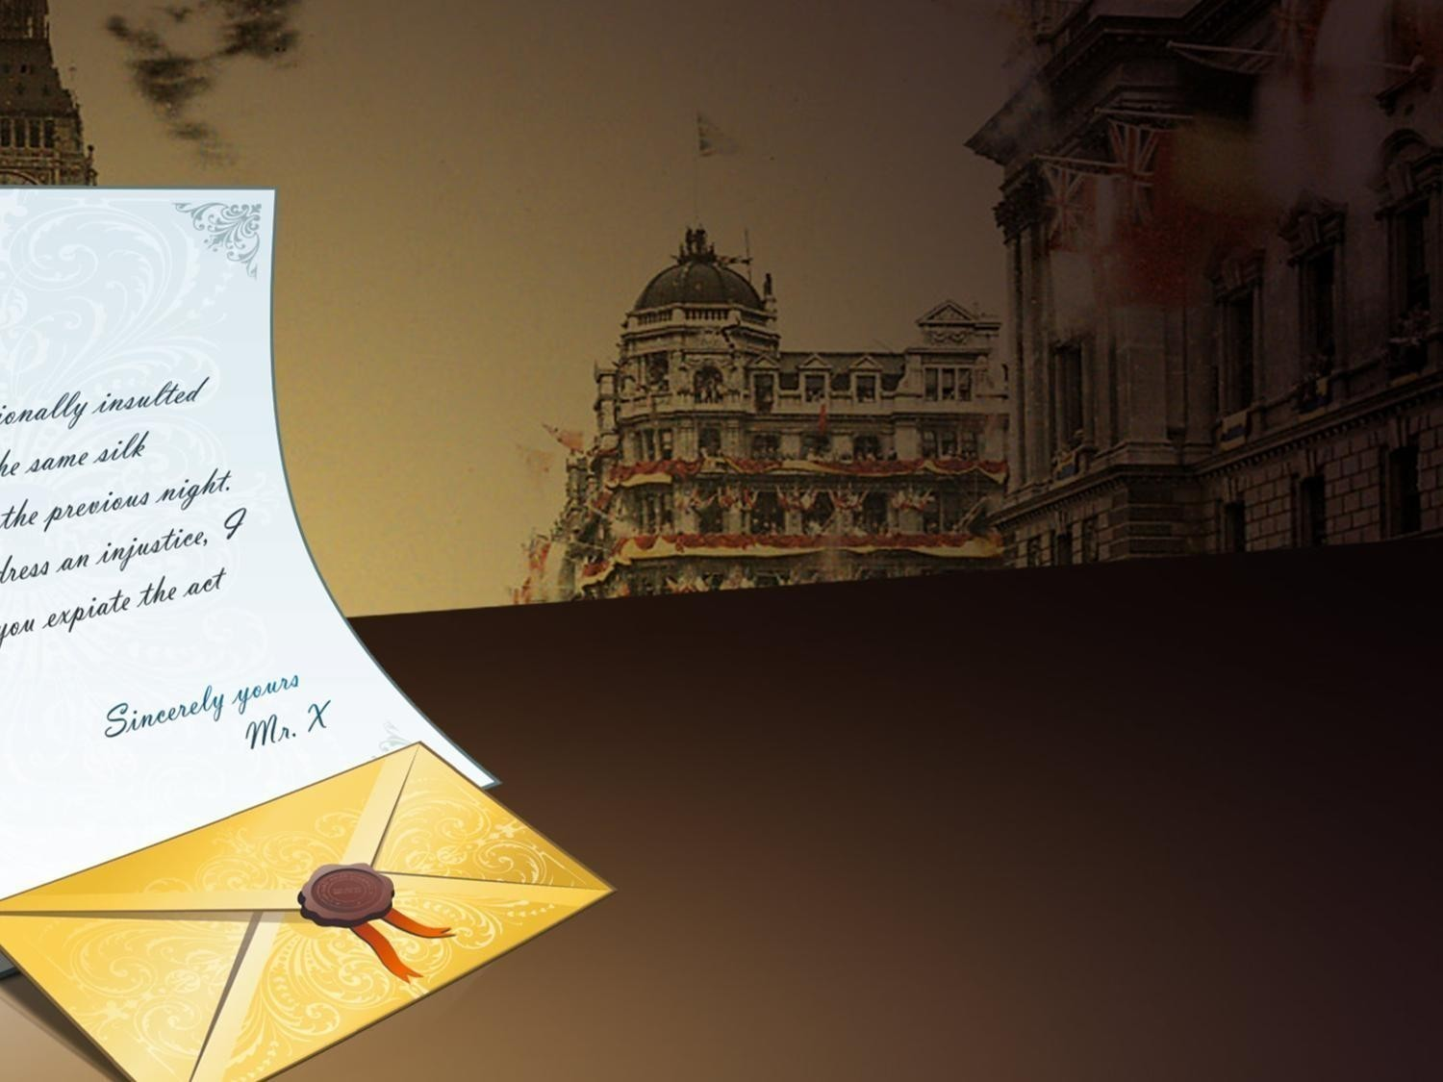
English gentlemen
(XVII century)

Slide 6
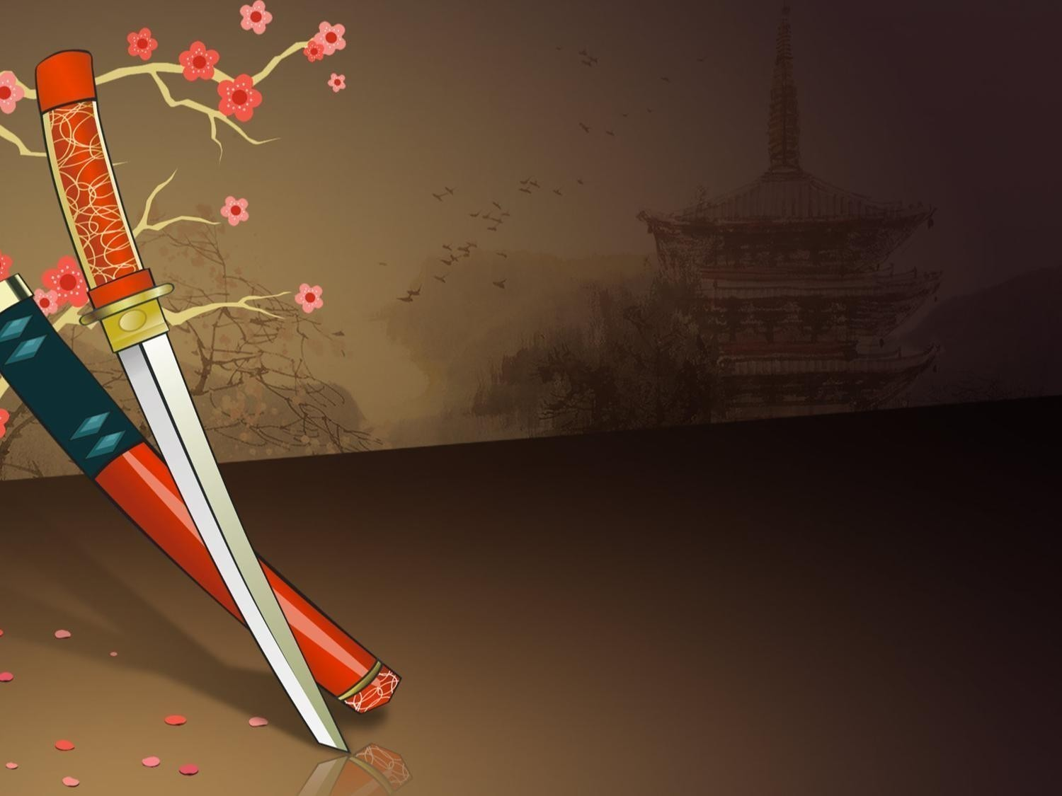
Japan samurais
(XII-XVII centuries)

Slide 7
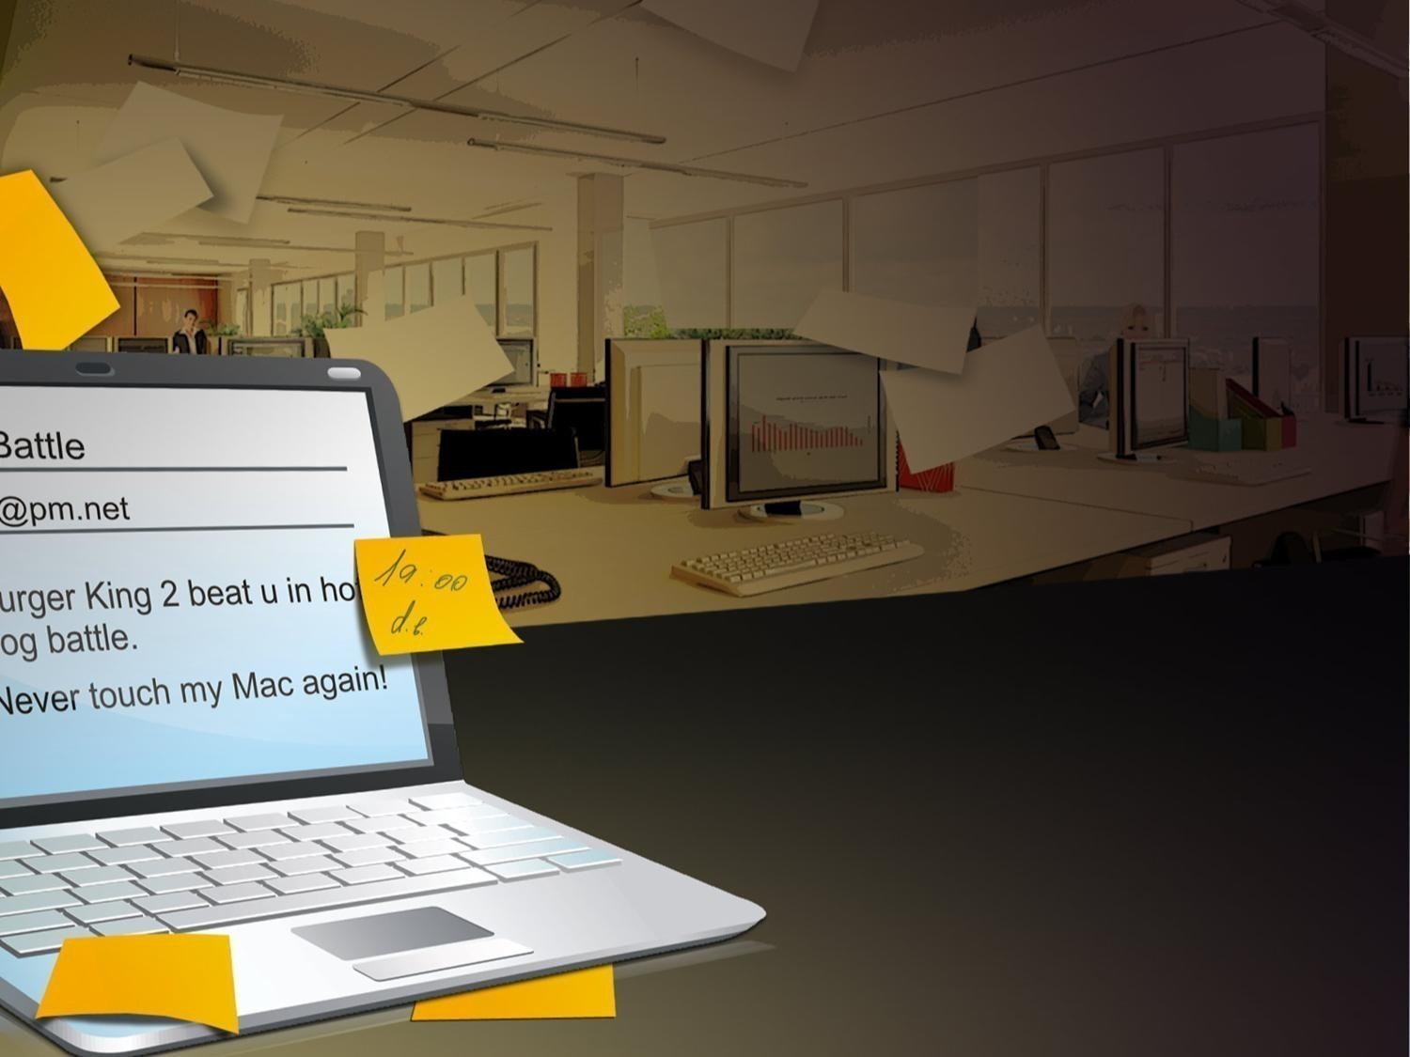
Office plankton
(XXI century)

Slide 8
ONLYOFFICE stands for Peace
www.onlyoffice.com

