Slide 1
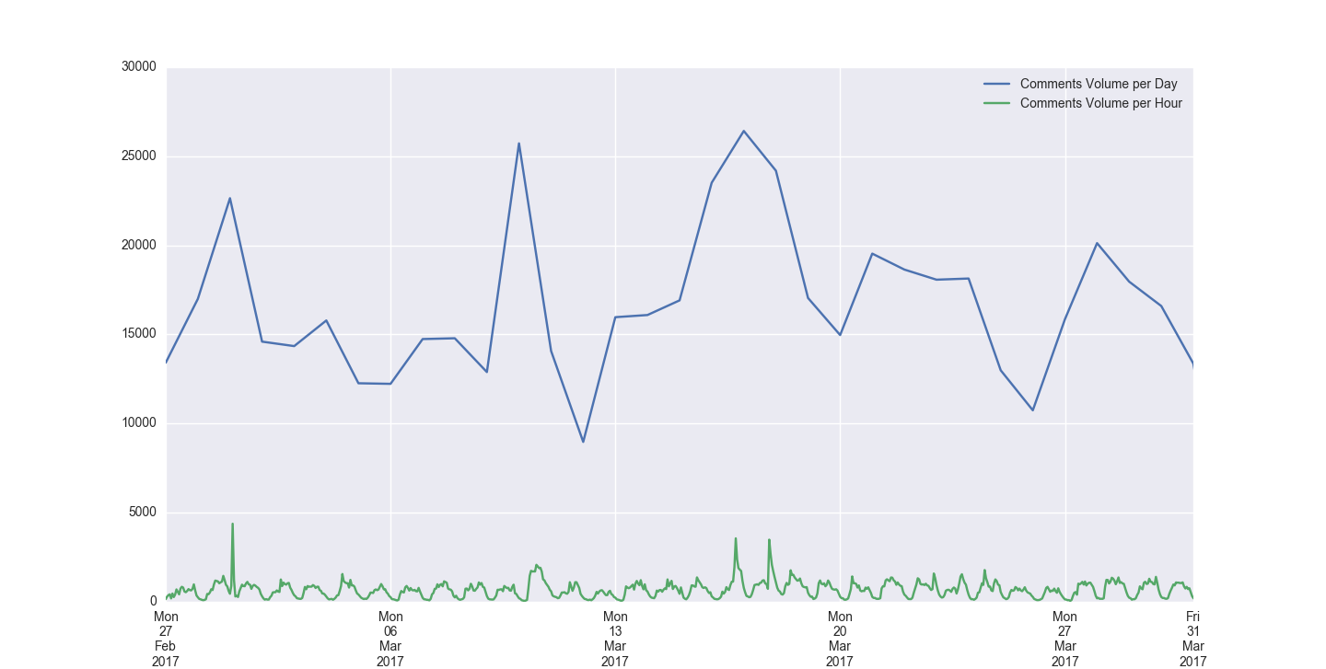
Donald Trump Jr called 'a disgrace' for tweet goading London mayor Sadiq Khan. (840)
Here's the full video of Donald J. Trump's first presidential address.
(3203)
Noel Fielding and Sandi Toksvig to host new Great British Bake Off. (1995)
This is what it looks like when Donald J. Trump doesn't want to shake hands with a foreign leader. (2096)
Woman photographed in hijab on Westminster Bridge responds to online abuse. (777)

