Slide 1
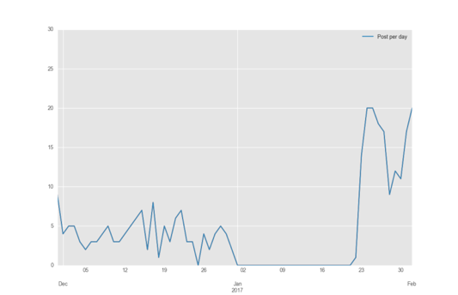
0 posts for a period of approx. 20 days

Slide 2
