Slide 1
Server Monitoring Data Engineering Pipeline
Use Case: Virtual Server Monitoring and Performance Optimization
Tools Used:
Azure Data Lake, Azure Data Factory, Azure Databricks, PySpark, Power BI

Slide 2
Problem Statement
Organizations running distributed cloud servers need a way to monitor system performance.
Challenges:
- Identifying performance bottlenecks
- Monitoring server health
- Preventing downtime
Solution: Build an end-to-end data pipeline to process and visualize server performance data.

Slide 3
Project Architecture
Pipeline Flow:
CSV Server Logs
→ Azure Data Lake Storage
→ Azure Data Factory
→ Azure Databricks
→ Data Transformation
→ Azure Data Lake (Transformed Data)
→ Power BI Dashboard

Slide 4
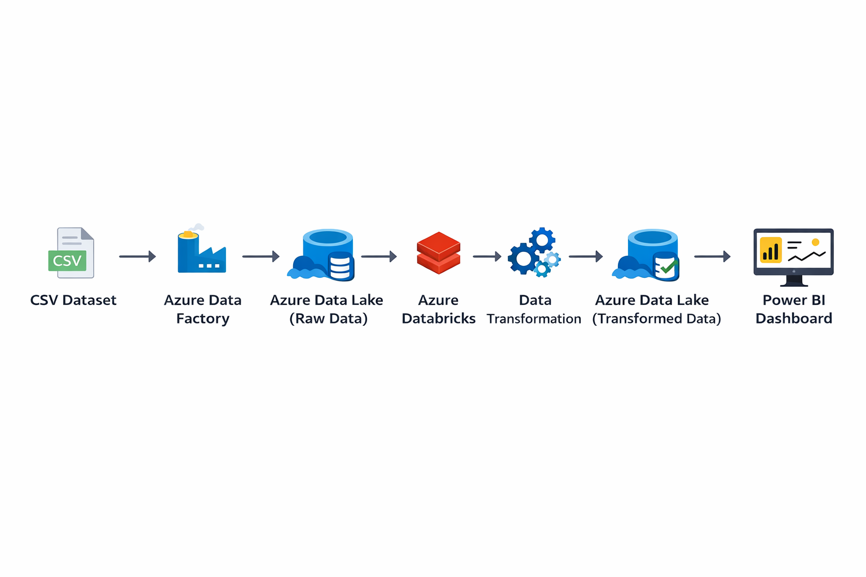
Architecture

Slide 5
Data Ingestion
Raw server log data is uploaded into Azure Data Lake.
Azure Data Factory is used to orchestrate the pipeline and manage the ingestion process.
This ensures structured storage and easy access for processing.

Slide 6
Data Transformation
Azure Databricks processes the raw server logs using PySpark.
Transformation tasks include:
- Cleaning the dataset
- Removing duplicates
- Validating metrics
- Generating performance insights

Slide 7
Power BI Dashboard
The transformed dataset is connected to Power BI.
Dashboard visualizations include:
- Server health distribution
- CPU utilization by server
- Network traffic analysis
- Downtime tracking
- System availability KPI

Slide 8
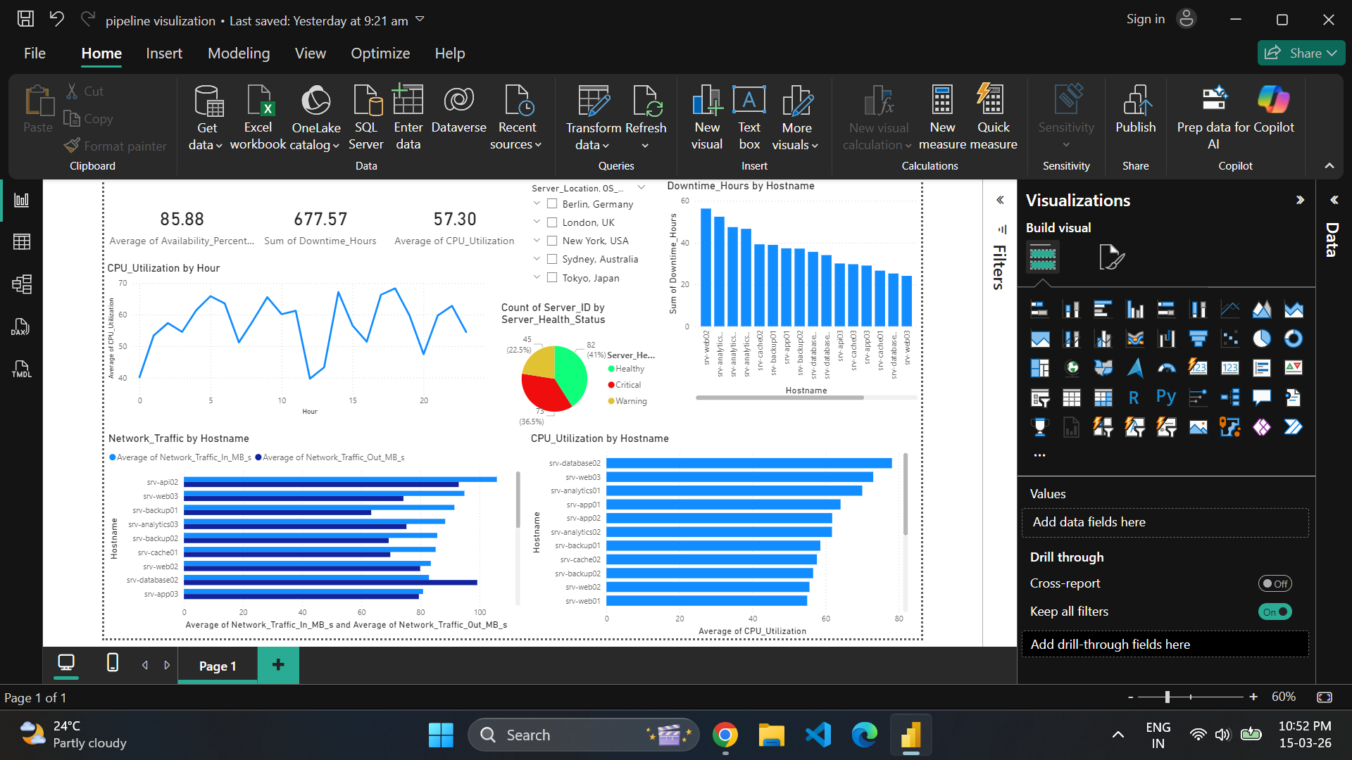
Dashboard

Slide 9
Project Outcome
The pipeline enables real-time monitoring of server performance.
Benefits:
- Identify system issues early
- Improve infrastructure reliability
- Optimize resource utilization

Slide 10
Conclusion
This project demonstrates how Azure cloud services can be used to build a scalable data engineering pipeline for monitoring server performance and generating insights.

