Slide 1
Information for Local Authorities This slide deck has been provided to local authorities for internal promotion

Slide 2
The census
The census is a survey that happens every 10 years and everyone takes part.
The ONS is responsible for the census in England and Wales.
The census is important because it gives the most detailed information we have about our society.
Scotland and Northern Ireland hold their own around the same time.

Slide 3
Keeping personal information safe
Before we publish our statistics, we make sure that they don’t include any personal information.
The information we collect in the census remains anonymous for 100 years.
Everyone must complete the census. Legislation made the modern census a legal obligation in 1920.

Slide 4



Why we have a census
The census provides information that government needs to:
Shape policy
Allocate resources
Plan services
Monitor equality

Slide 5
Census information informs decisions that improve lives
Planning and development
Census information is used to develop local plans to better reflect future needs and to identify inequalities at a very local level.
Public health and social care
Census information is used to inform service demand, to identify pockets of health deprivation and to support future care planning.
Housing
Census information is used to assess local housing needs and to measure housing affordability.

Slide 6
Census information informs decisions that improve lives
Education
Census information is used for pupil forecasting models, to inform capital bids and to monitor the supply of qualified persons.
Transport
Census information is used for funding bids for road improvements, and informs planning and profiles around areas of transport change.
Other
Census information is used to inform emergency services, libraries and waste collection and disposal.

Slide 7
Census 2021 facts
The next census will take place on Sunday 21 March 2021.
For the first time this will be a digital-first census, but paper will be available for those who need it.
We’ll focus on engaging with everyone, including under-represented and hard to reach groups.
Help will be available for people who need support to take part online.

Slide 8
Census 2021 timeline
Sunday 21 March 2021
Census Day
Collection Rehearsal
Sept to Dec 2019
Processing Rehearsal
Jan to Mar 2020
Census Coverage Survey
Address index cut
Address index refresh
Enhanced Census
Outputs
Recruitment
2019
2020
2021
2022
Summer 2020
Autumn 2020
Spring 2021
(before Census Day)
Spring 2021
(after Census Day)
Census liaison managers (CLMs) and Assistant census liaison managers (ACLMs) nominated for all LAs
Regional LA census workshops for ACLM/CLMs
Detailed guidance for CLM / ACLM available
Census engagement managers and Community advisers in place
Communications toolkit available
Area operations managers in place
Online support available and Census Contact Centre open
Online questionnaire available
Post out of initial contact letters
Census follow up
Census Coverage Survey (six weeks after Census Day)
Feb 2019
8

Slide 9
Where we need your help…
The nine strands of partnership activity
Preparation
1. Develop an address index to ensure the fullest coverage.
2. Provide local information to identify and target local challenges.
3. Identify and share local community contacts.
4. Help us to recruit field staff.
Response
5. Provide practical support to the field operation (for example, meeting rooms).
6. Support online completions and our Census Support Centres.
7. Support local publicity and media relations activity.
Outputs
8. Provide local information to support quality assurance.
9. Maximise use of census information in local authorities and support use of census data by local communities.

Slide 10
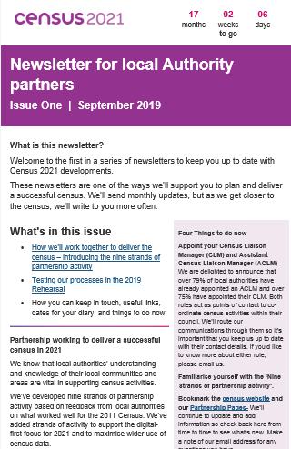
We’ll keep you up to date
Through regular newsletters containing:
topical issues
timely information
help and support

Slide 11
What happens next?
Your local ONS census engagement manager will support you.
We’ll be recruiting local people to work on the census – this could include local authority employees.
All households will receive an invitation to fill out the census questionnaire with a household access code, as well as information to help them to take part online.
We’ll have a media campaign to encourage participation.
We’ll work within the community to support those who need help, including help to get online.

Slide 12
We cannot do it without you
The census happens once every 10 years. It gives us a picture of all the people and households in England and Wales.
The information we collect is vital to ensuring your work has the best impact.
Your local knowledge and expertise is essential to support a successful census in your area. It helps to ensure census information continues to improve, protect and save lives.
Thank you for supporting Census 2021! And making a lasting impact on your community!

Slide 13
Keep in touch
If you have any questions about our partnership activities with local authorities please email us at 2021Census.LA.liaison@ons.gov.uk
Bookmark the Census 2021 website: www.census.gov.uk
Follow us on social Media
#Census2021
Yn Gymraeg: @Cyfrifiad2021

