Slide 1
COVID-19 Forecast Hub – UMass, ReichLab
The COVID-19 Forecast Hub serves as a central repository of forecasts and predictions from over 30 international research groups. Over 45M rows of forecast data are stored in a standard format in the data repository.
Model forecast targets are
N week ahead cumulative/incidental death counts
N week ahead incidental case counts
N day ahead incidental hospitalization
Gold standard reference data from JHU CSSE group
As of August 30, there were
44 models from 37 teams competing for cumulative death forecasts
24 models from 18 teams competing for incidental case count forecasts
cdc.gov/coronavirus/2019-ncov
github.com/reichlab/covid19-forecast-hub
Notes:
CDC is actually using the COVID-19 hub data.
On 2020-06-06, the targets N day ahead inc death and N day ahead cum death were removed, resulting in a massive forecast file size decreases.

Slide 2
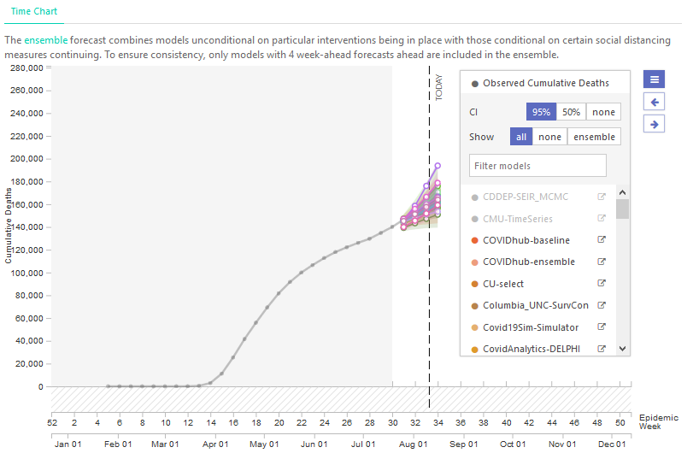


Slide 3
Evaluation of epidemiological models to estimate and predict COVID impact
Epidemiological models of COVID-19 have proliferated quickly, but it is unclear how well they estimate the true values of key underlying variables: how many are truly infected, how many have recovered, and how many have died. Nor is it always clear what exactly these models predict, or whether or not those predictions come true, measured retrospectively.
Yet getting a firm grip on the quality of inference and predictive power is essential if we are to make the best public health decisions including those that manage the delicate tradeoffs between economic and public health. Model evaluation is therefore of critical importance.

Slide 4
Scoring Approach
Score each model using a Leave-Forward-Out-Cross-Validation scheme.
Score computes the log of the likelihood for the model forecasts.
Score is updated continuously as new data becomes available for each week into the future separately for each quantity.
Thus, the score keeps track of how models improve (or degrade) over time and how well they perform into the future.
We augment the Reich Lab approach, which is to take the modeler provided probability distributions, and compute the score each week or whenever the modeler updates their forecasts for the US Grand National Data.

Slide 5
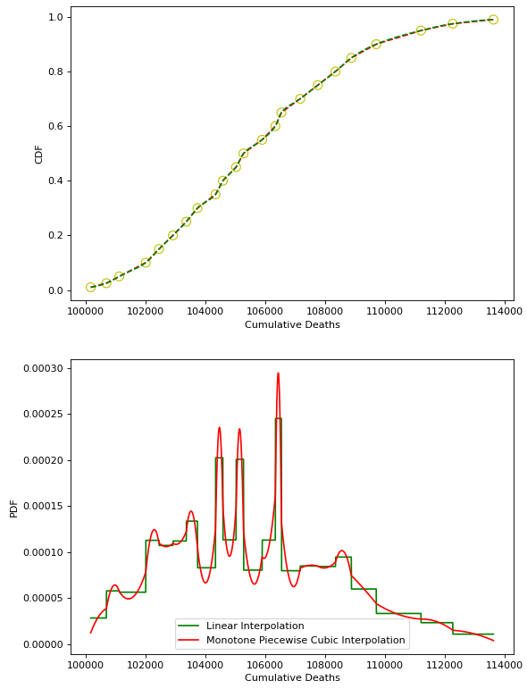

Scoring Algorithm
Read model quantiles $q$ and corresponding values $v$ from COVID-Hub for a forecast date $d$, target end date $t$ and model $m$ along with $G$ the corresponding ground truth.
Calculate Q corresponding to V based PCHIP interpolation of q.
Find the numerical derivative $f = dQ/dV$ (e.g. Python np.gradient(Q,V)).
This is the pdf.
The score S is then $S_{m,d,t}=2\log{p(G)}$, such that larger score means higher fitness.
G

Slide 6
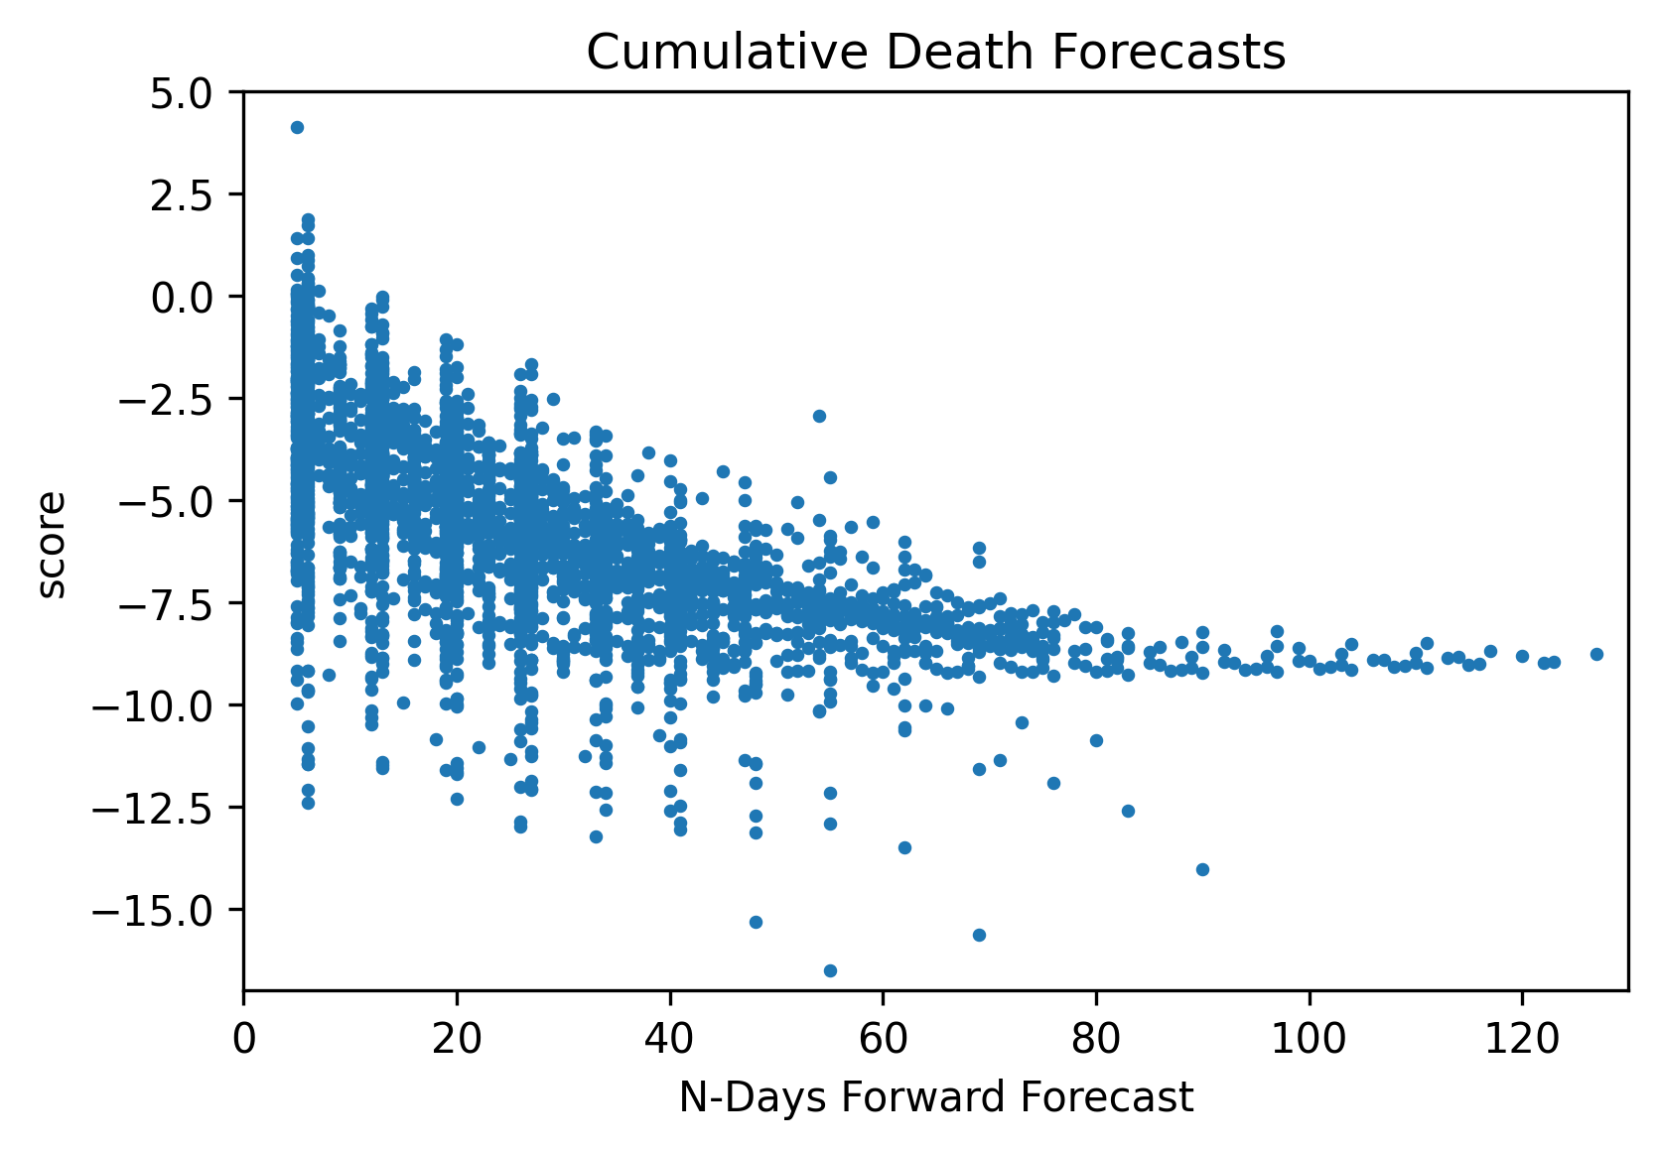
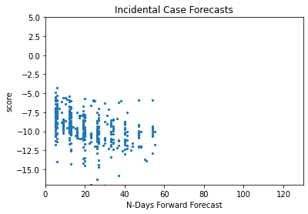
Most models do well for short time predictions but not for long ones
Overall, cumulative death forecasts are more accurate than the incidental case count forecasts.

Slide 7
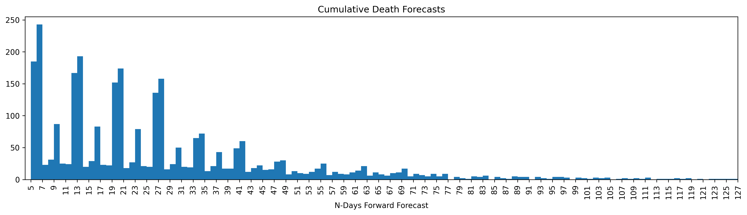
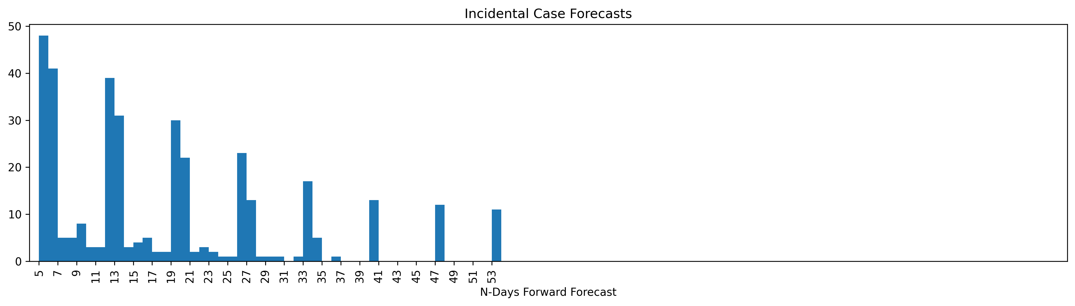
There is no standardization about when a model forecast should be uploaded for a particular week’s competition

Slide 8
Model Types
We group models in COVID-19 Hub into four groups:
Compartmental Epidemiological Models (e.g. SIR, SEIR etc.)
Compartmental Epidemiological Models with Metapopulation Infection Transportation Between Counties
Statistics and Machine Learning-based Models
Ensemble Models

Slide 9
Compartmental Epidemiological Models
Auquan:SEIR
Covid19Sim:Simulator
CovidActNow:SEIR_CAN
Karlen:pypm
MITCovAlliance:SIR
CovidAnalytics:DELPHI
OliverWyman:Navigator
PSI:DRAFT
RPI:UW
SWC:TerminusCM
UA:EpiCovDA
UCLA:SuEIR
UCM_MESALab:FoGSEIR
UMass:MechBayes
USACE:ERDC_SEIR

Slide 10
Compartmental Epidemiological Models with Metapopulation Flavour
CU:nochange
CU:scenario_high
CU:scenario_low
CU:scenario_mid
CU:select
JHU_IDD:CovidSP
MOBS:GLEAM_COVID

Slide 11
Statistics and Machine Learning Models
Columbia_UNC:SurvCon
COVIDhub:baseline
DDS:NBDS
GT:DeepCOVID
IHME:CurveFit
IowaStateLW:STEM
LANL:GrowthRate
QJHong:Encounter
RobertWalraven:ESG
UMich:RidgeTfReg
UT:Mobility
YYG:ParamSearch
WalmartLabsML:LogForecasting

Slide 12
Ensemble Models
COVIDhub:ensemble
epiforecasts:ensemble1
Imperial:ensemble1
Imperial:ensemble2
LNQ:ens1
NotreDame:mobility
UMass:ExpertCrowd

Slide 13
Cumulative Death Forecast Scores
US National Data

Slide 14
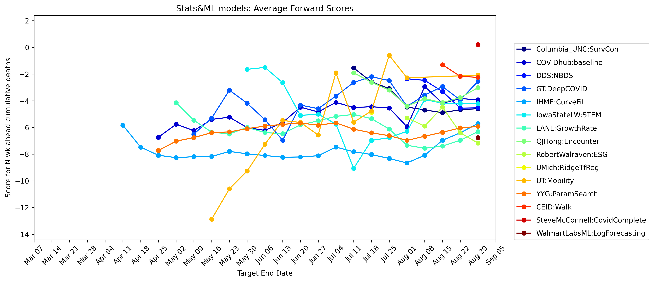
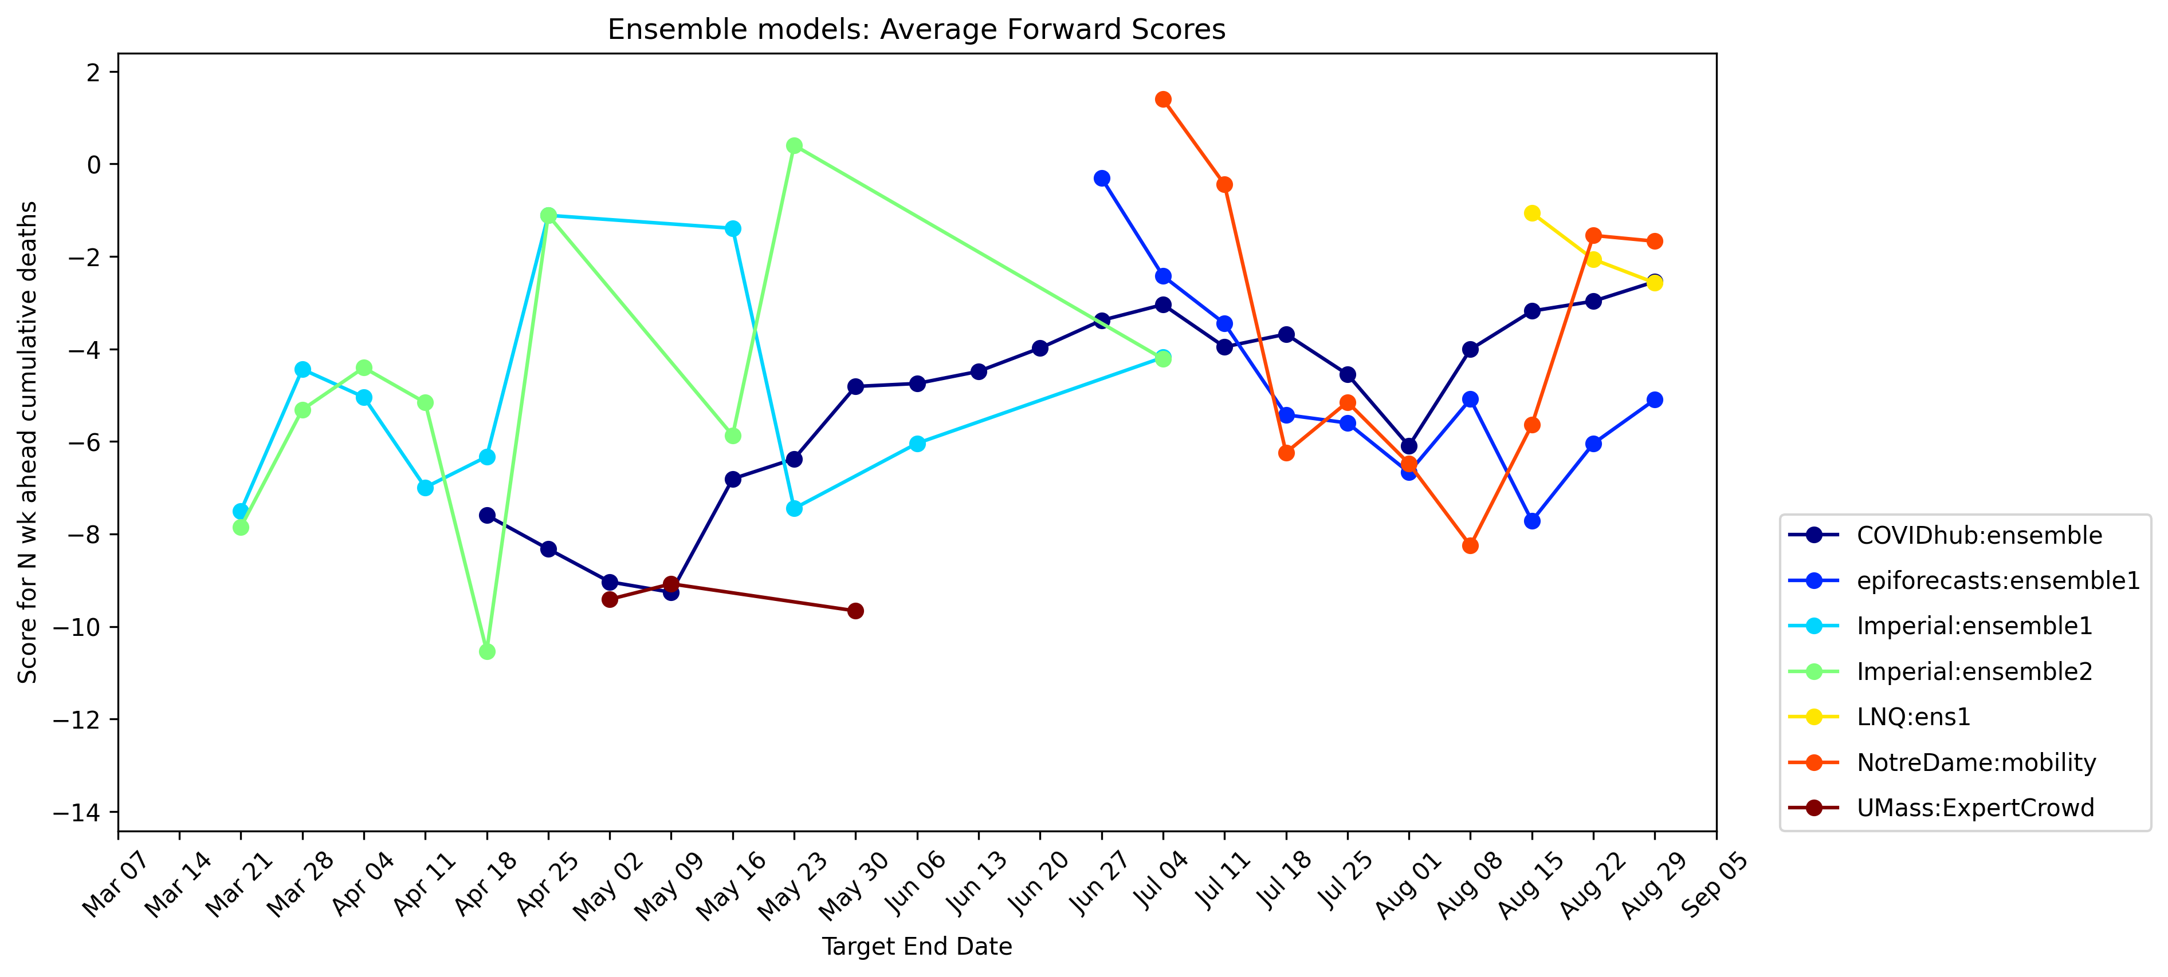
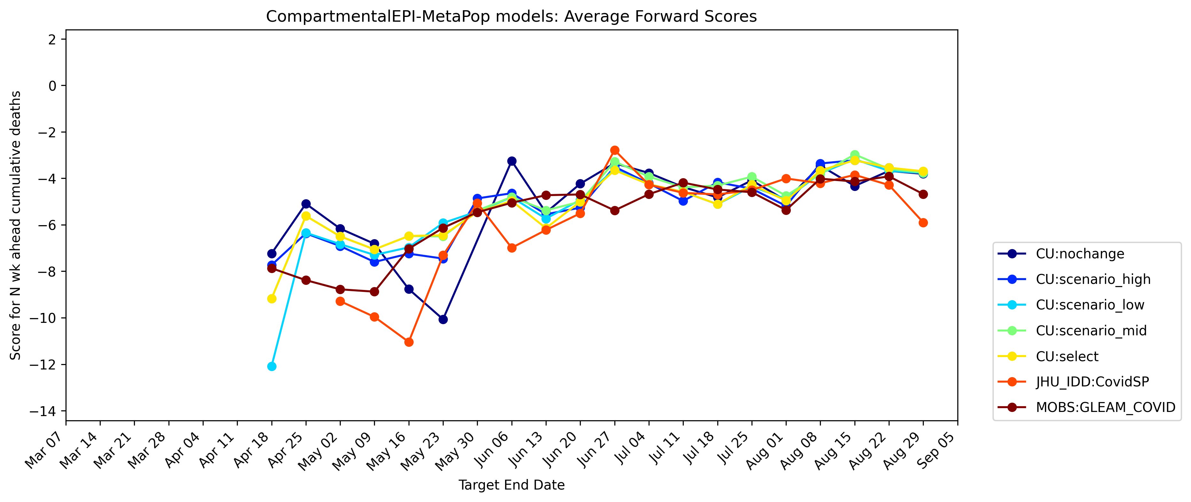
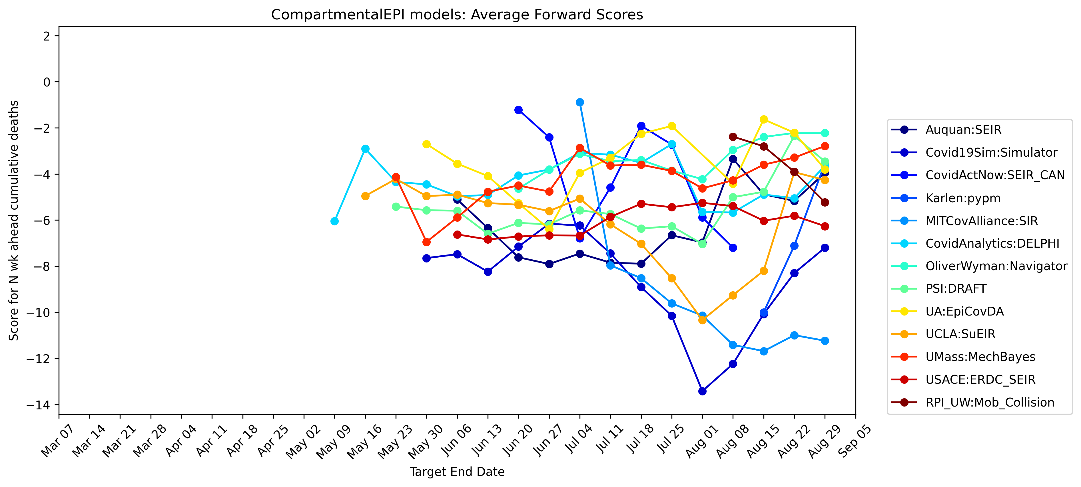

Slide 15
Weekly Incidental Case Forecast Scores
US National Data

Slide 16
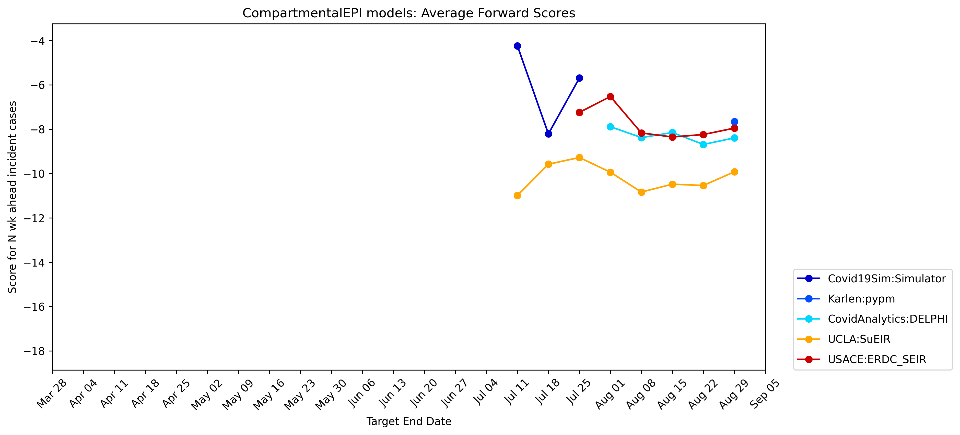
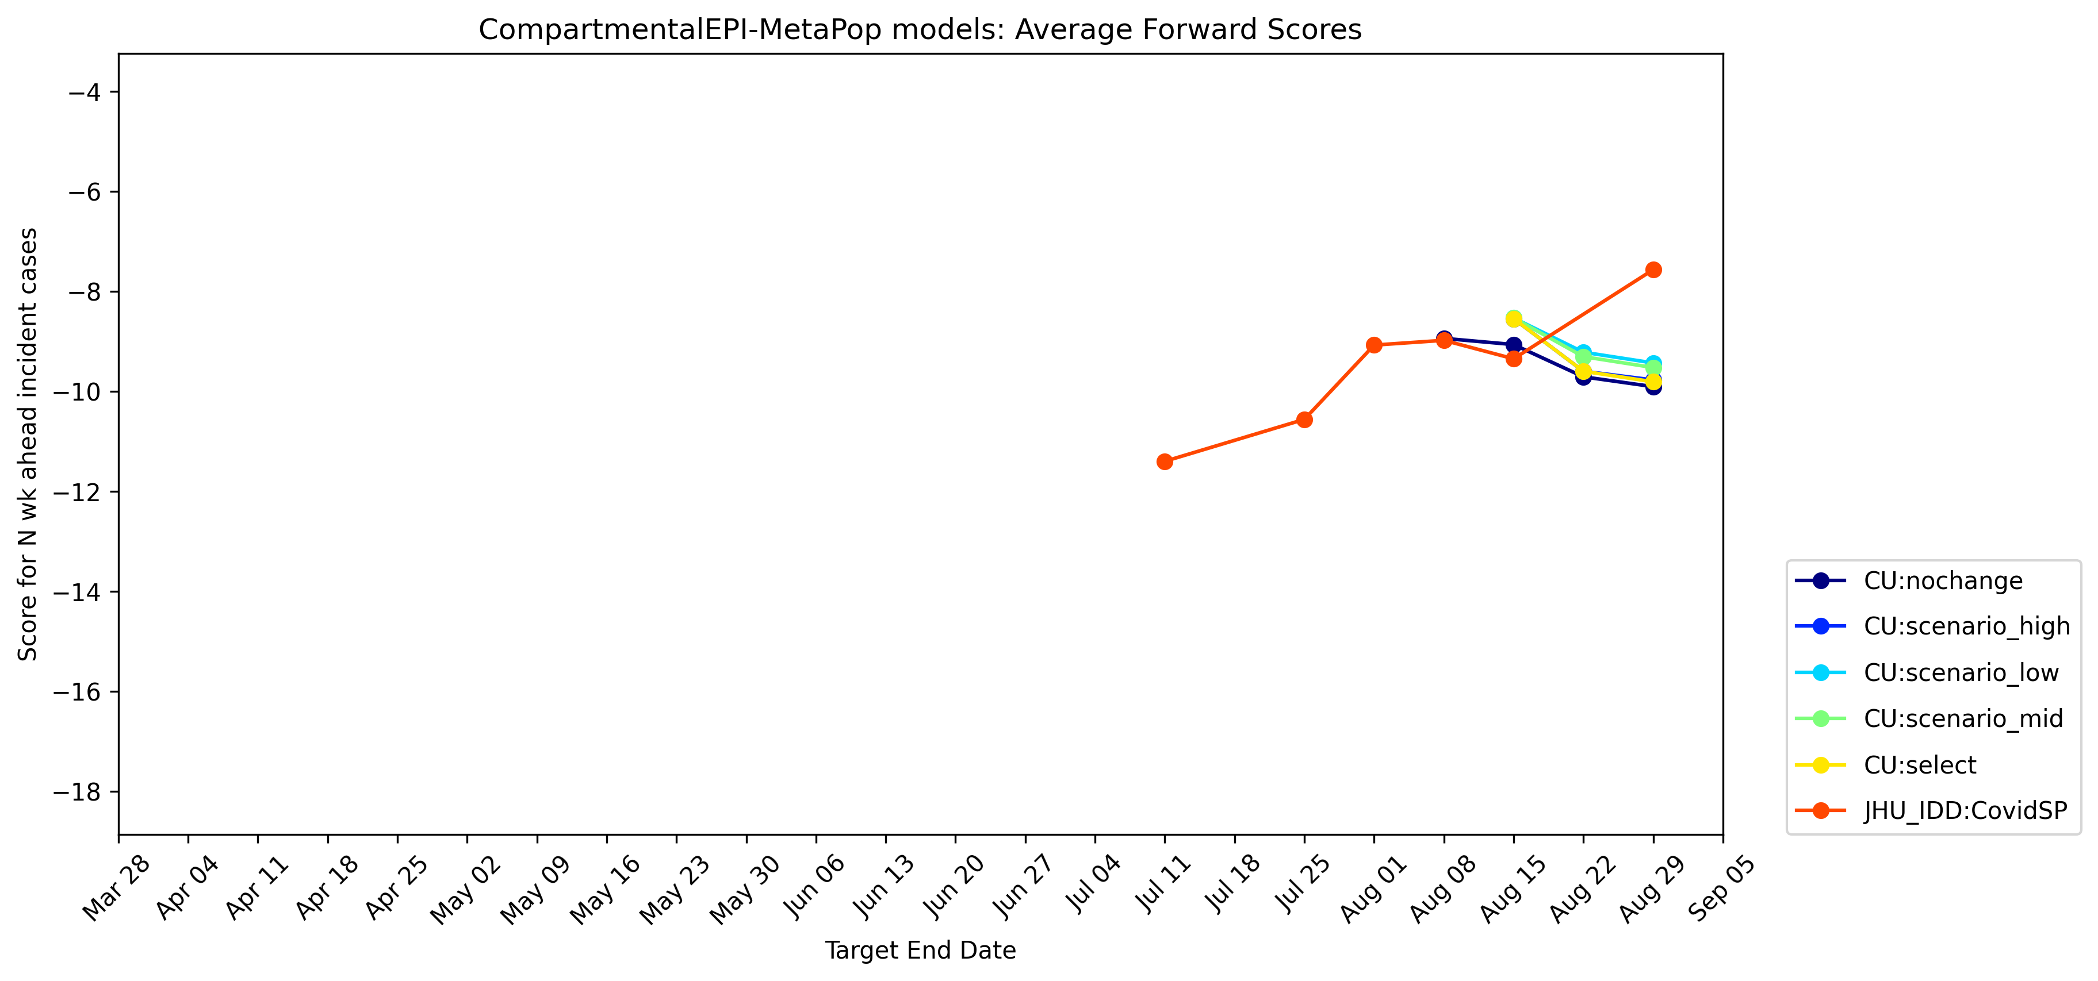
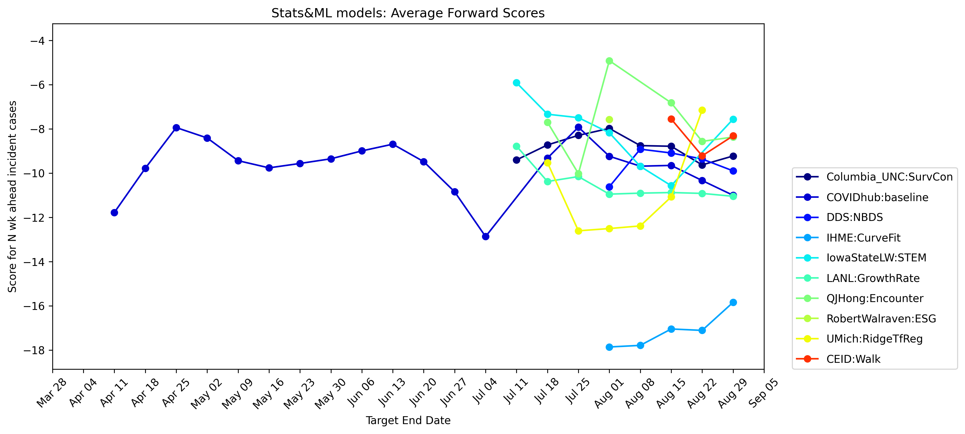
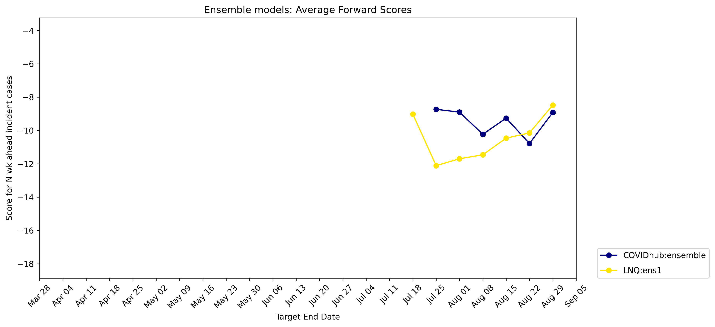

Slide 17
Conclusions
Overall, there is not a large progress in model forecast successes over time.
EPI+Metapopulation models seem to have been the most consistent models so far.

Slide 18
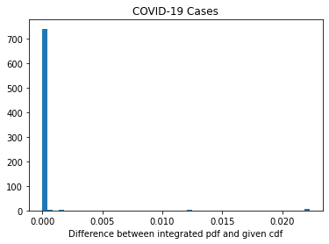
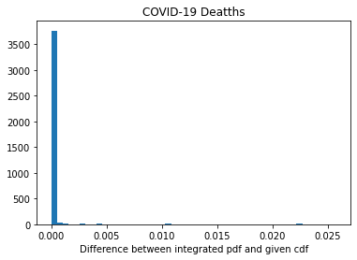
Our Algorithm’s Conversion from CDF to PDF is successful
When we integrate the obtained pdf p and compare with the provided model forecast cdf, we see the difference between the two is small.

Slide 19
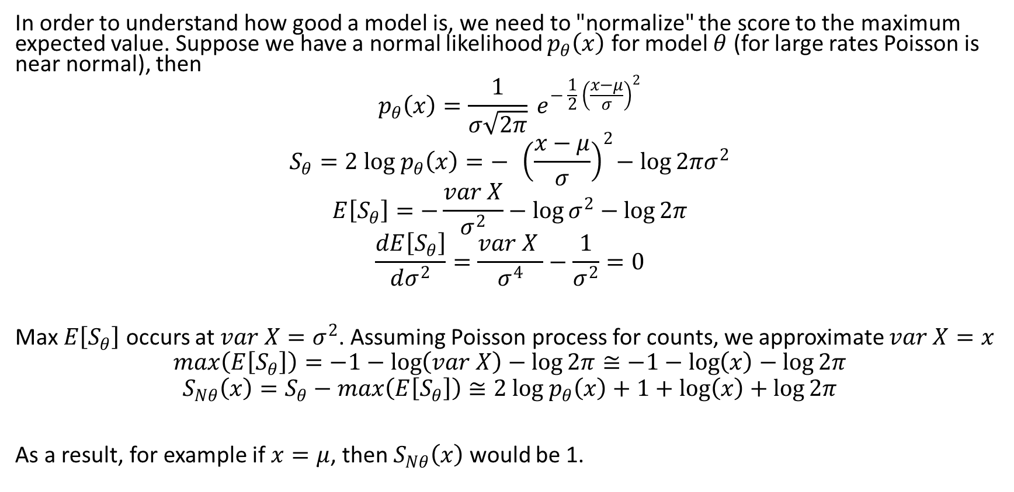
Normalized Scoring
In order to understand how good a model is, we need to "normalize" the score to the maximum expected value. Suppose we have a normal likelihood $p_{θ}\left(x\right)$ for model $θ$ (for large rates Poisson is near normal), then
$$p_{θ}\left(x\right)=\frac{1}{σ\sqrt{2π}} e^{− \frac{1}{2}{ \left(\frac{x−μ}{σ}\right)}^{2}}$$
$$S_{θ}=2 log p_{θ}\left(x\right)=− { \left(\frac{x−μ}{σ}\right)}^{2}−\log{2πσ^{2}}$$
$$E\left[S_{θ}\right]=−\frac{var X}{σ^{2}}−\log{σ^{2}}−\log{2π}$$
$$\frac{dE\left[S_{θ}\right]}{dσ^{2}}=\frac{var X }{σ^{4}}−\frac{1}{σ^{2}}=0$$
Max $E\left[S_{θ}\right]$ occurs at $var X=σ^{2}$. Assuming Poisson process for counts, we approximate $var X=x$
$$max\left(E\left[S_{θ}\right]\right)=−1−\log\left(var X\right)−\log{2π}≅−1−\log\left(x\right)−\log{2π}$$
$$S_{Nθ}\left(x\right)=S_{θ}−max\left(E\left[S_{θ}\right]\right)≅2 log p_{θ}\left(x\right)+1+\log\left(x\right)+\log{2π}$$
As a result, for example if $x=μ$, then $S_{Nθ}\left(x\right)$ would be 1.

