Slide 1
Chain Of Responsibility
OOD Pattern Presentation, Fall 2018
Prepared By
Alex Arcuti
Chaitanya Chakka
Chris Andrews
Chris Unger
James Kelly
William Hou

Slide 2
The Basics
The Chain of Responsibility
Behavioral design pattern
Allows a request to be passed along a chain of handlers
Handler decides to process or pass request to next
Decouples request and concrete handlers

Slide 3
Email Filter
Email Filtering using Chain of Responsibility
A single email request is sent to the first filter object in the chain.
The filter object decides if it should satisfy the email request or not.
If not satisfied, the filter object forwards the email request to the next filter object.
This process will continue to repeat until the email request reaches the end of the chain.

Slide 4
EMAIL FILTERING
SPAM FILTER
PROMO FILTER
SOCIAL FILTER
INBOX (DEFAULT)
From: Mom
“You better be at the library studying for finals!”

Slide 5
successor
Client
Handler
+handleRequest()
SpamFilter
PromoFilter
SocialFilter
Inbox(Default)
+handleRequest()
+handleRequest()
+handleRequest()
+handleRequest()

Slide 6
Email Filter
public abstract class Handler {
public void handleRequest(RequestObj robj) {
if (successor != null) {
successor.handleRequest(robj);
}
}
}
public class SpamFilter extends Handler {
public void handleRequest(emailRequest) {
if (isSpam(emailRequest) {
// take spam related actions
}
else {
super.handleRequest(emailRequest);
// pass email request to next filter in chain
}
}

Slide 7
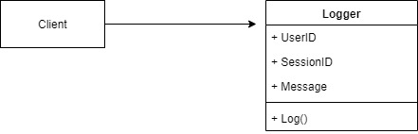
Logging Module at XYZ, Inc
User executes an action
The request is logged
The request is processed and a response is returned
James uses a simple Logger Class to accept the user information and message, then logs the message into the console.

Slide 8

Change request #1
Impressed by the ability to track requests into a text file the company now wants to add the ability to allow the user to email a log.

Slide 9
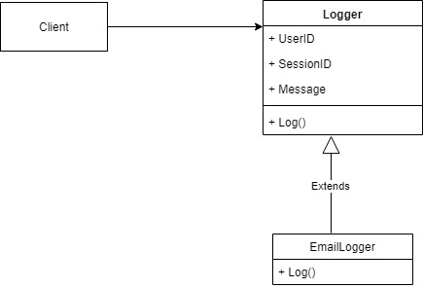
Decorator to the rescue
Since the initial class structure was simple it was easy to use the decorator pattern and create an Email Logger extension that would add the additional feature

Slide 10
Change request #2
Impressed by the ability to track requests into the console the company now wants to add the ability to create different types of logging messages (information, warning, error, etc.).
There is one additional requirement, they want to continue logging everything to the console but now they want to customize the behavior of some logging types.
Warning message should be logged to a file.
Error message should be emailed to the administrator.

Slide 11
Chain of Responsibilities
Intent
Avoid coupling the sender of a request to its receiver by giving more than one object a chance to handle the request. Chain the receiving objects and pass the request along the chain until an object handles it.
How do you decide when to use COR?
More than one object can handle a command
The handler is not known in advance
The handler should be determined automatically
It’s wished that the request is addressed to a group of objects without explicitly specifying its receiver
The group of objects that may handle the command must be specified in a dynamic way

Slide 12
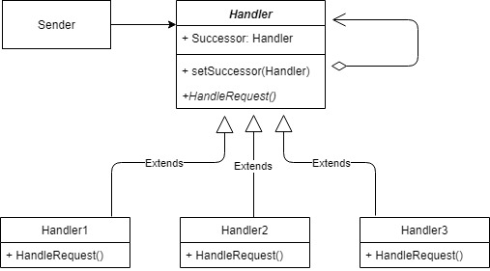
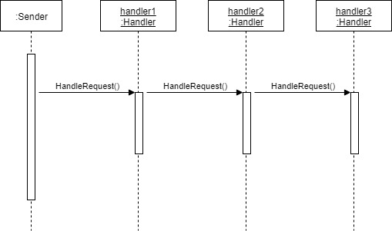
UML Diagram
UML class diagram
The Sender class doesn't refer to a particular handler class directly. Instead, Sender refers to the Handler interface for handling a request (handler.HandleRequest()), which makes the Sender independent of which handler handles the request. The Handler1, Handler2, and Handler3 classes implement the Handler interface by either handling or forwarding a request (depending on run-time conditions).
UML sequence diagram
In this example, the Sender object calls HandleRequest() on the handler1 object (of type Handler). The handler1 forwards the request to handler2, which in turn forwards the request to handler3, which handles (performs) the request.

Slide 13
Comparison with other Patterns
Decorator
Observer
The decorator is not loosely coupled
The COR is structurally similar to the Decorator as they both rely on recursive composition of a series of objects
In the case of Decorator all classes handle the request while in the COR there would be one or selected classes in the chain that handle the request
The Observer passes a request to all subscribed receivers at the same time
COR passes a request sequentially to each item in the chain until one of them handles the request
Observer allows receivers to subscribe and unsubscribe dynamically whereas in case of COR the chain of handlers is dynamically created during initialization and cannot be modified during execution

Slide 14
Logger Class
public abstract class Logger
{
protected LogLevel level;
// The next Handler in the chain
protected Logger next;
public Logger(LogLevel mask)
{
this.level = mask;
}
/// <summary>
/// Sets the Next logger to make a list/chain of Handlers.
/// </summary>
public Logger SetNext(Logger nextlogger)
{
next = nextlogger;
return nextlogger;
}

Slide 15
Logger Class continued…
public void Message(string msg, LogLevel severity)
{
if ((severity & level) != 0)//True only if all logMask bits are set in severity
{
WriteMessage(msg);
}
if (next != null)
{
next.Message(msg, severity);
}
}
abstract protected void WriteMessage(string msg);
}

Slide 16
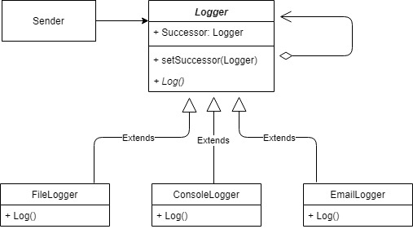
Final Class Structure for Logger Module

Slide 17
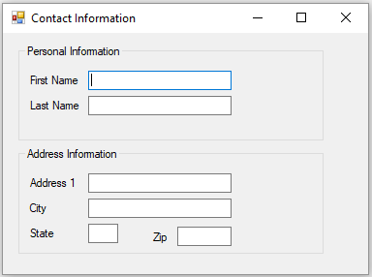
Event Bubbling
In designing software that uses a set of GUI elements. There is often a need to propagate GUI events from one object to another.
Event bubbling is the propagation of an event where the event first triggers on the innermost target element, and then successively triggers on the ancestors (parents) of the target element in the same nesting hierarchy till it reaches the outermost element.
Name should accept alphabets as input
Zip should accept numeric input
This form should display alphabets in Upper Case

Slide 18
Event Bubbling continued….
public partial class Form1 : Form
{
public Form1()
{
InitializeComponent();
}
private void Form1_Keypress(object sender, KeyPressEventArgs e)
{
e.KeyChar = (e.KeyChar.ToString()).ToUpper().ToCharArray()[0];
}
private void TextBox1_Keypress(object sender, KeyPressEventArgs e)
{
e.Handled = !char.IsLetter(e.KeyChar);
}
private void TextBox6_KeyPress(object sender, KeyPressEventArgs e)
{
if (!char.IsControl(e.KeyChar) && !char.IsDigit(e.KeyChar))
{
e.Handled = true;
}
}
}

