Slide 1
Tutorial 6: Data Repositories and Querying

Slide 2
Outline
SQL query
NoSQL query

Slide 3
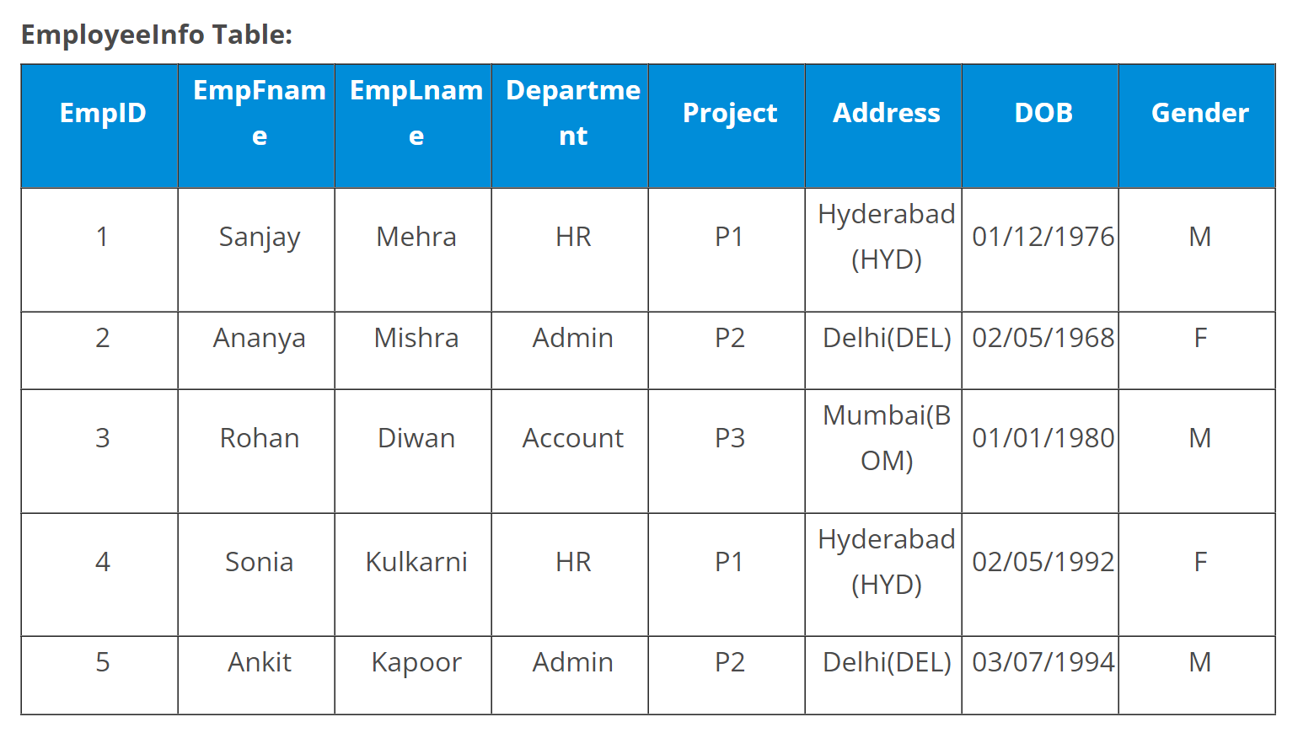
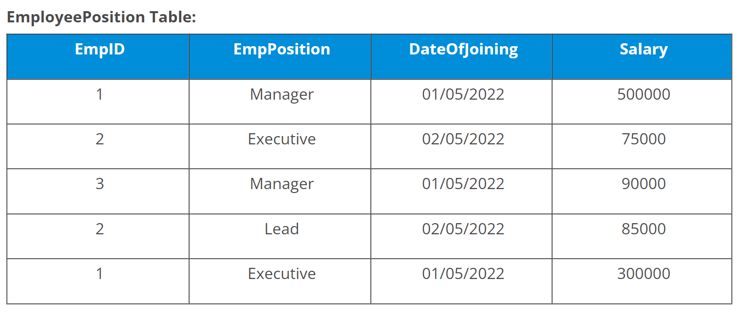
SQL Query

Slide 4
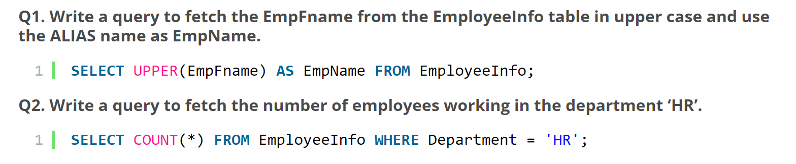
SQL

Slide 5
SQL
Q3. Write a query to get the current date.
You can write a query as follows in SQL Server:
SELECT GETDATE();
You can write a query as follows in MySQL:
SELECT SYSTDATE();

Slide 6
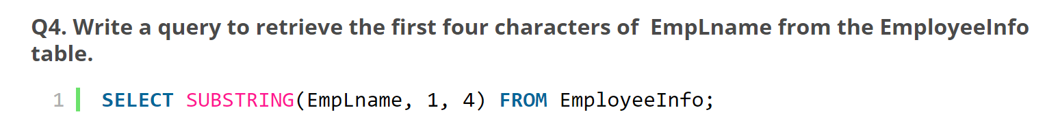
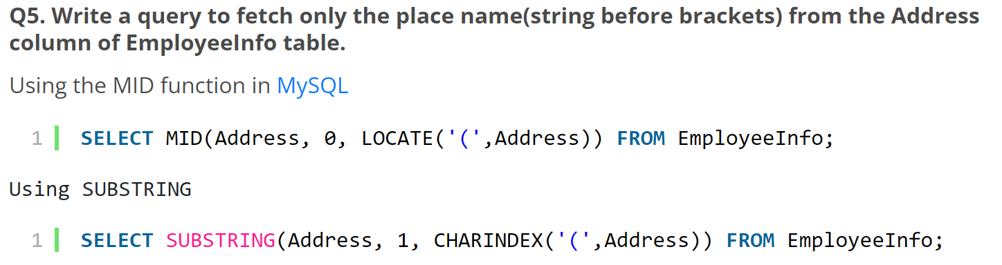
SQL

Slide 7
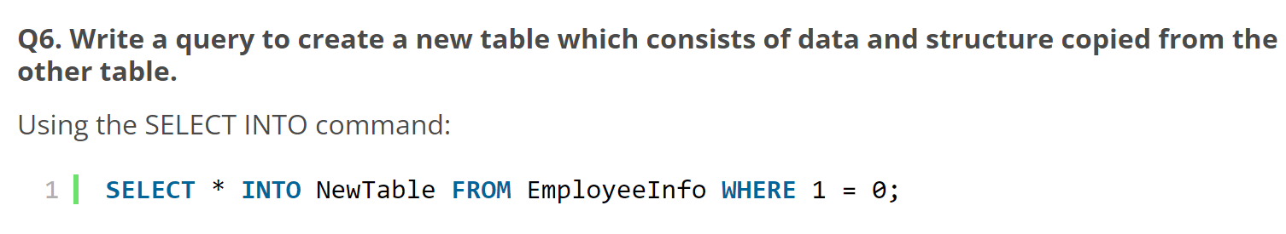
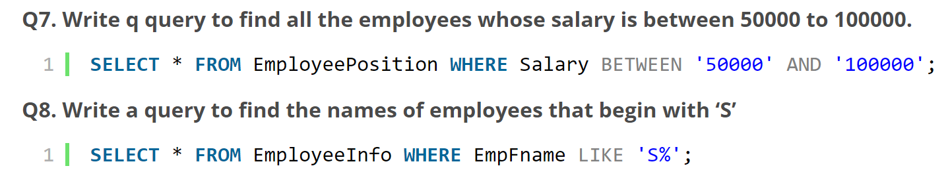
SQL

Slide 8
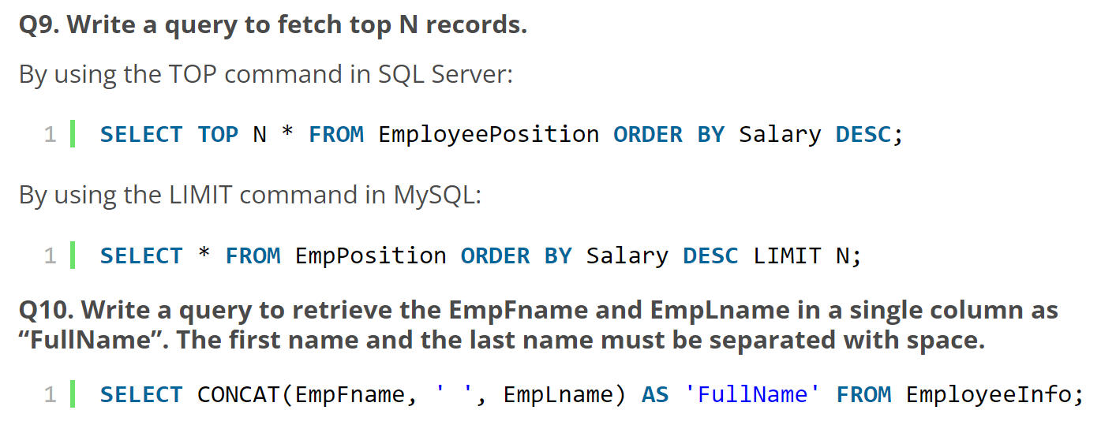
SQL

Slide 9
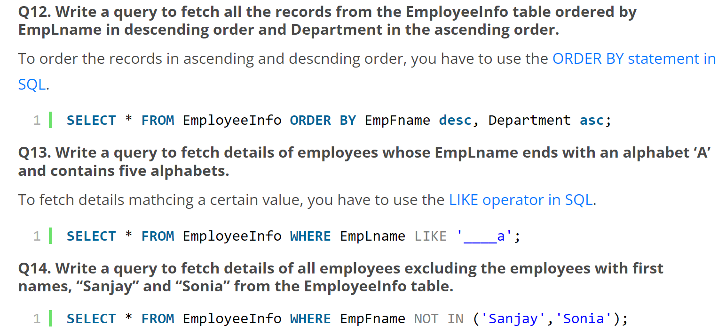
SQL

Slide 10
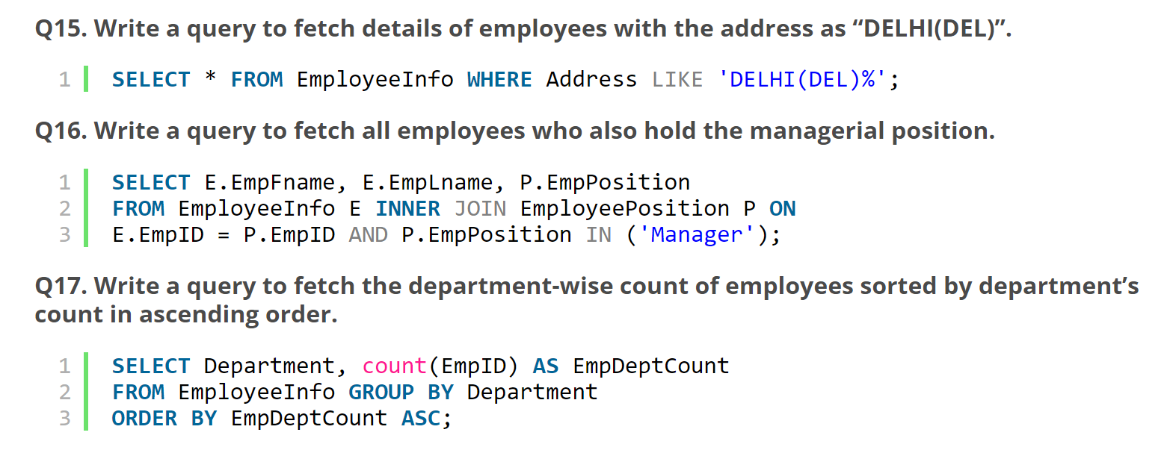
SQL

Slide 11
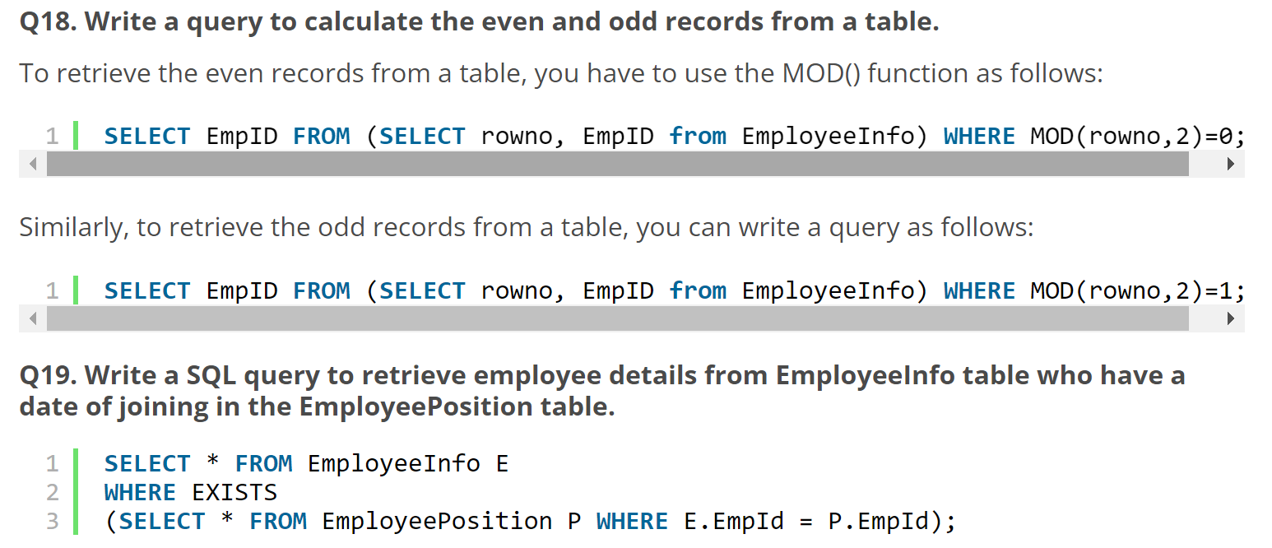
SQL

Slide 12
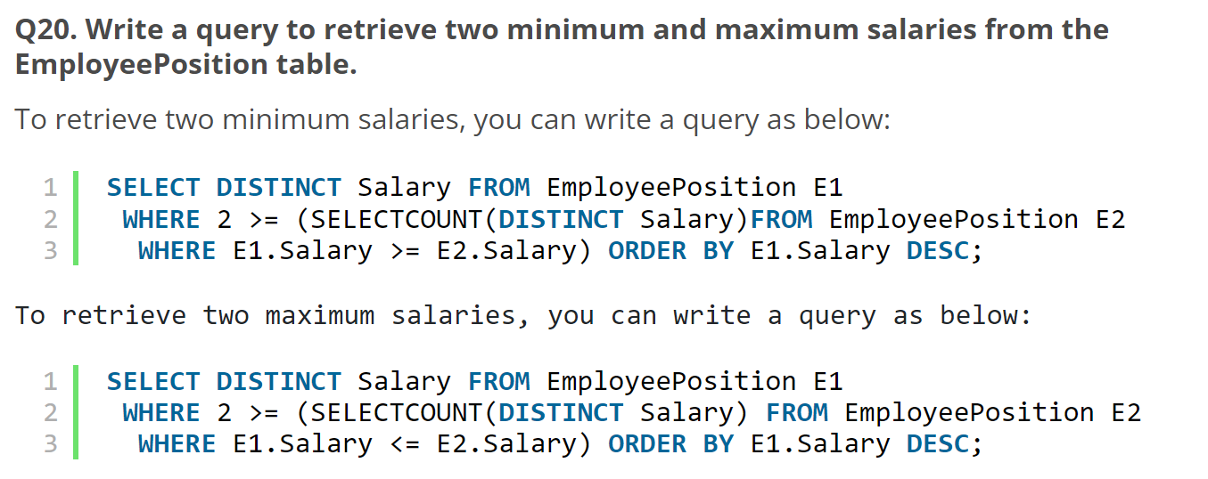
SQL

Slide 13
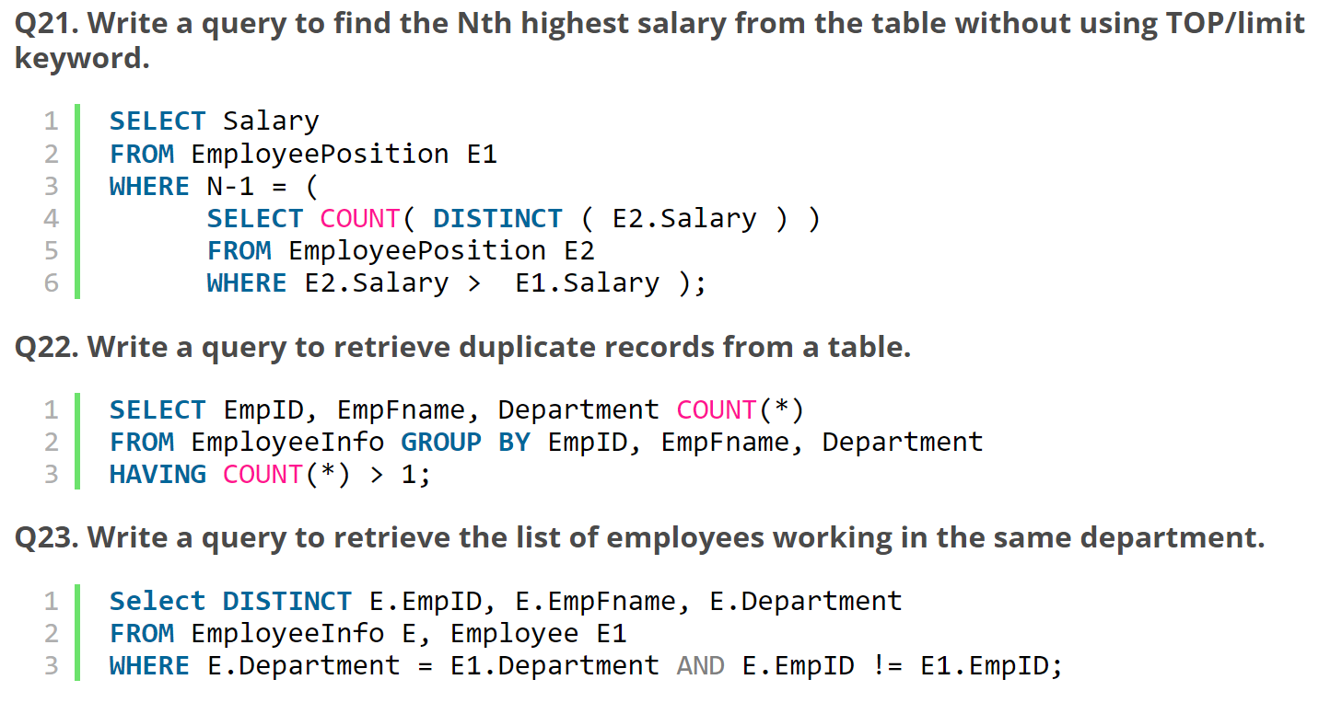
SQL Practice

Slide 14
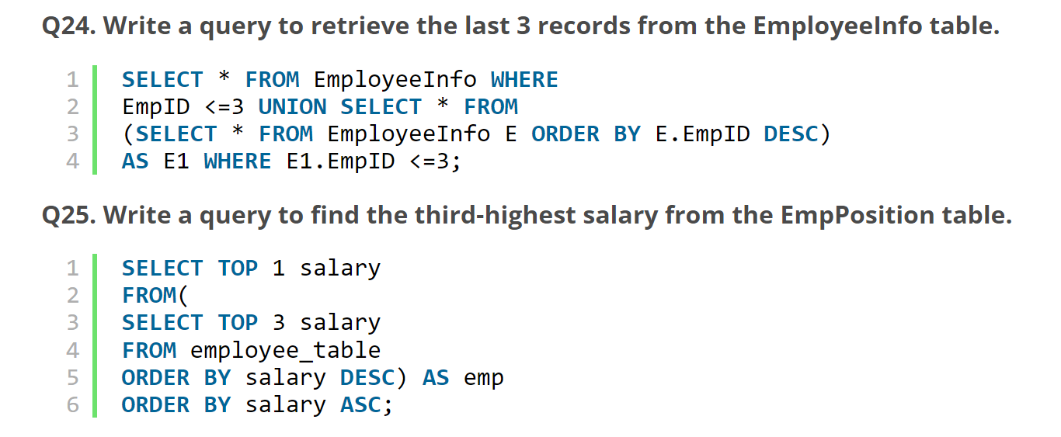
SQL Practice

Slide 15
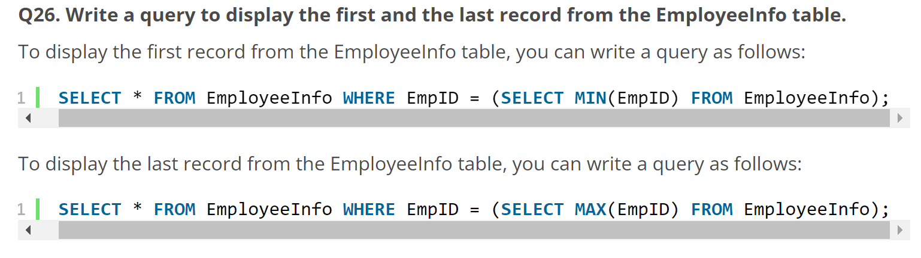
SQL Practice

Slide 16
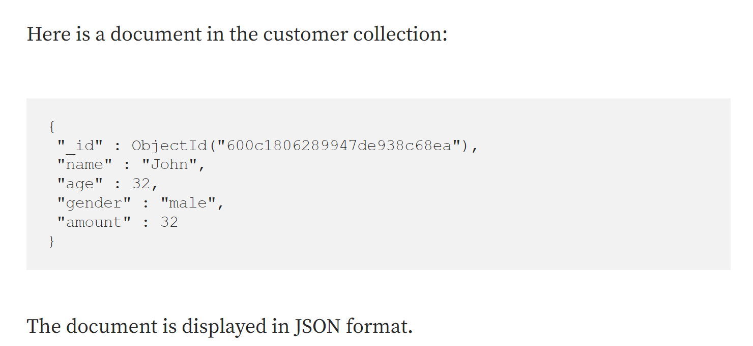
NoSQL Query
Take MongoDB as example

Slide 17
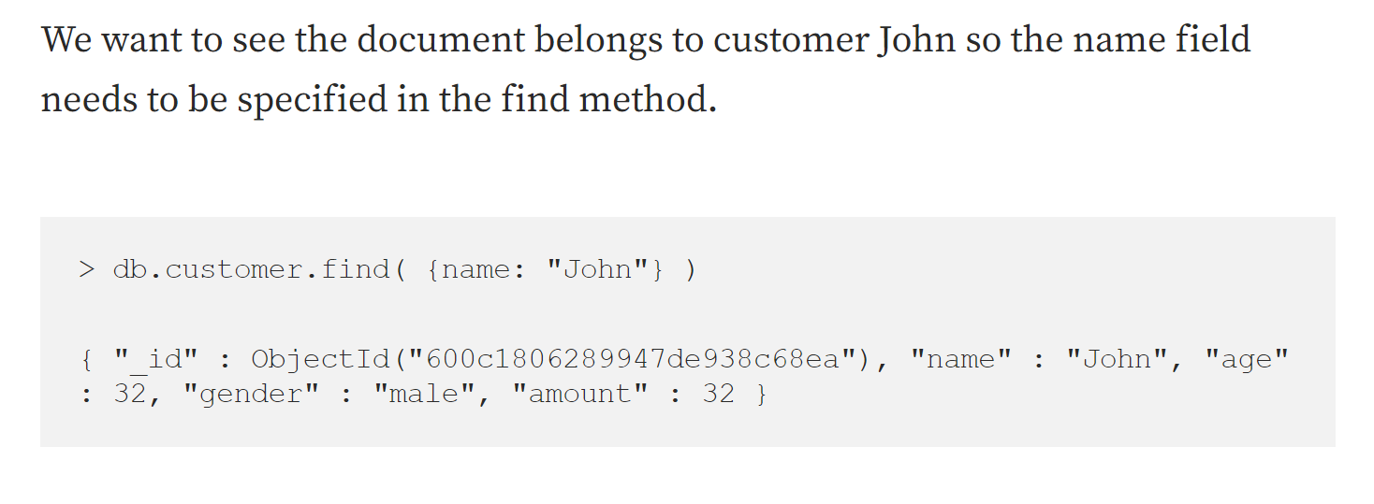
NoSQL

Slide 18
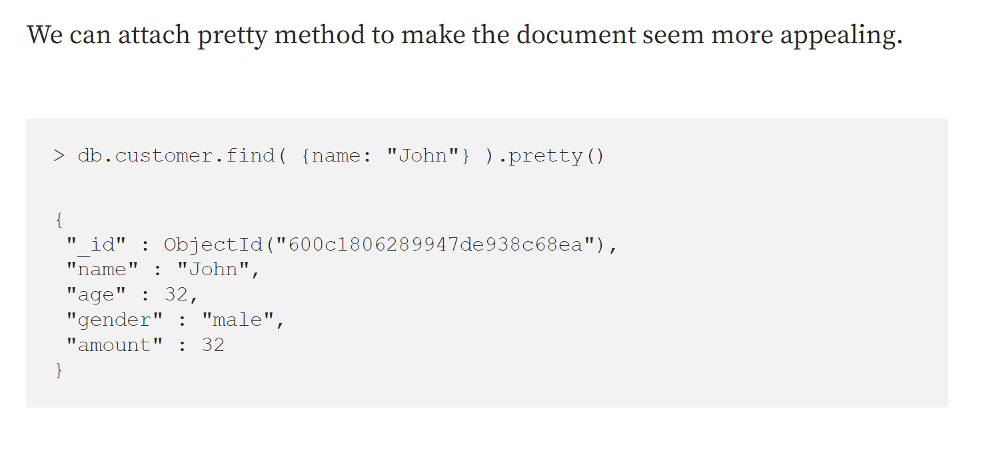
NoSQL

Slide 19
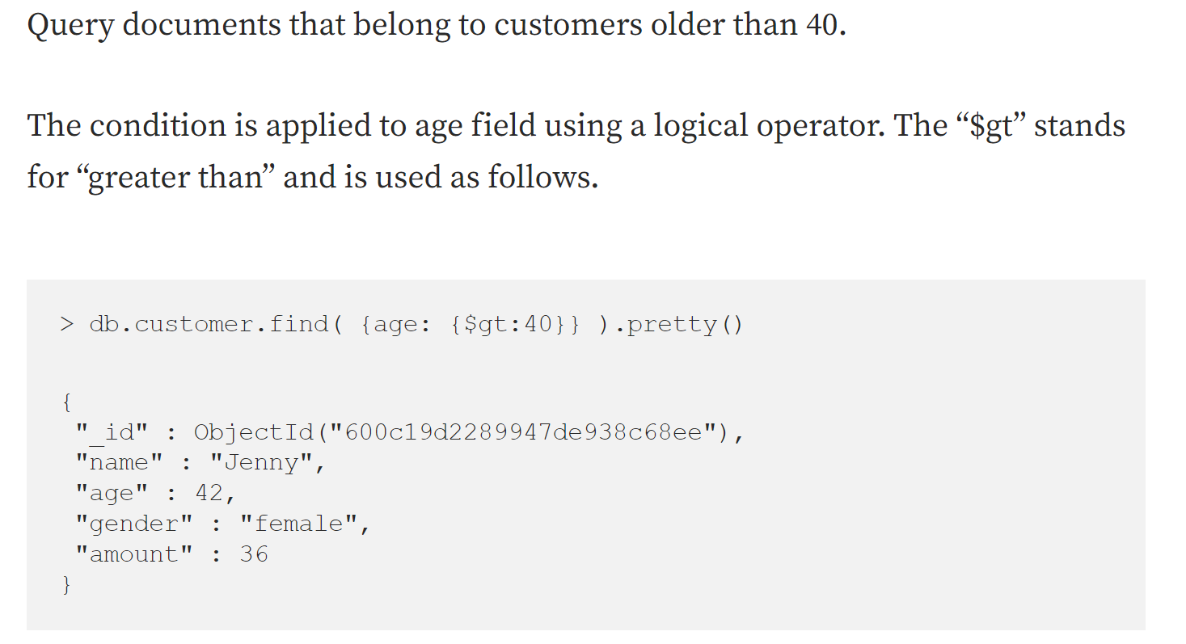
NoSQL

Slide 20
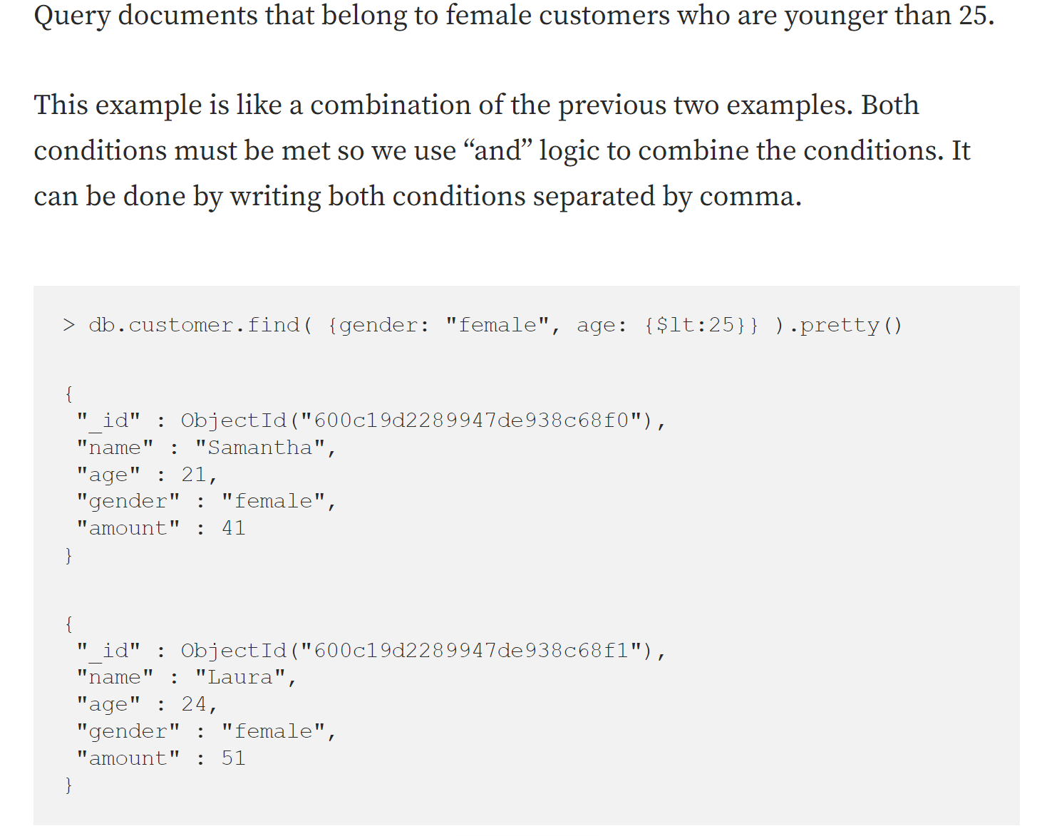
NoSQL

Slide 21
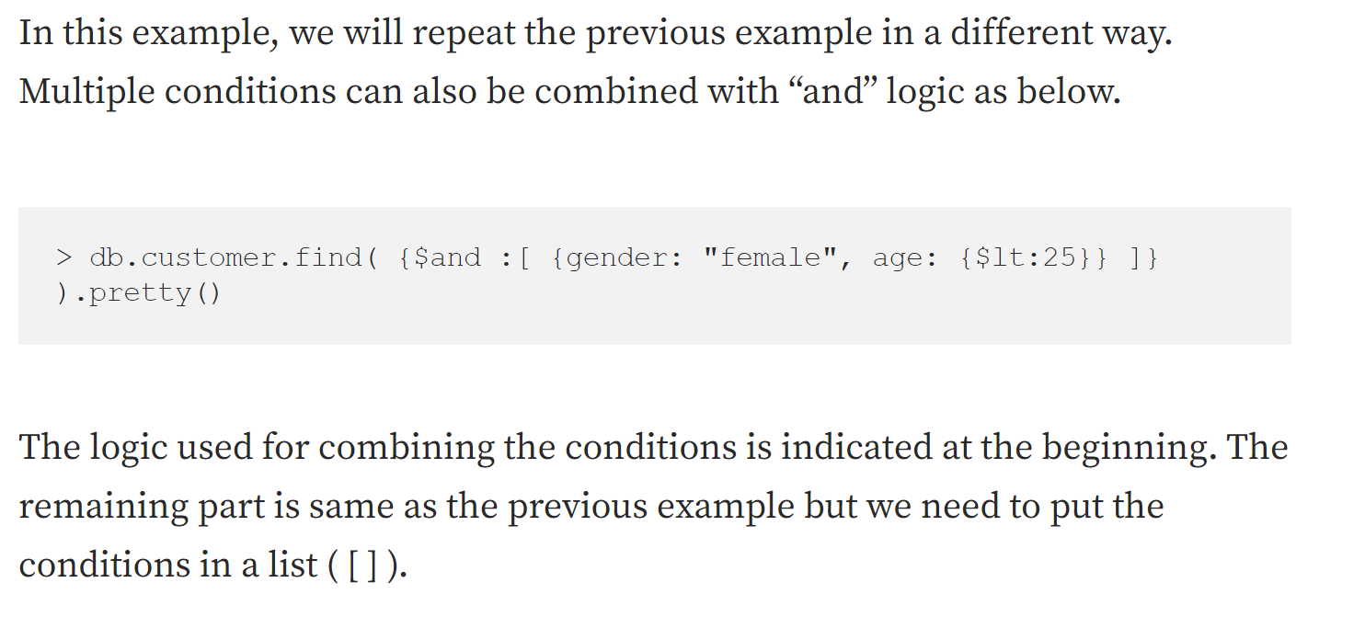
NoSQL

Slide 22
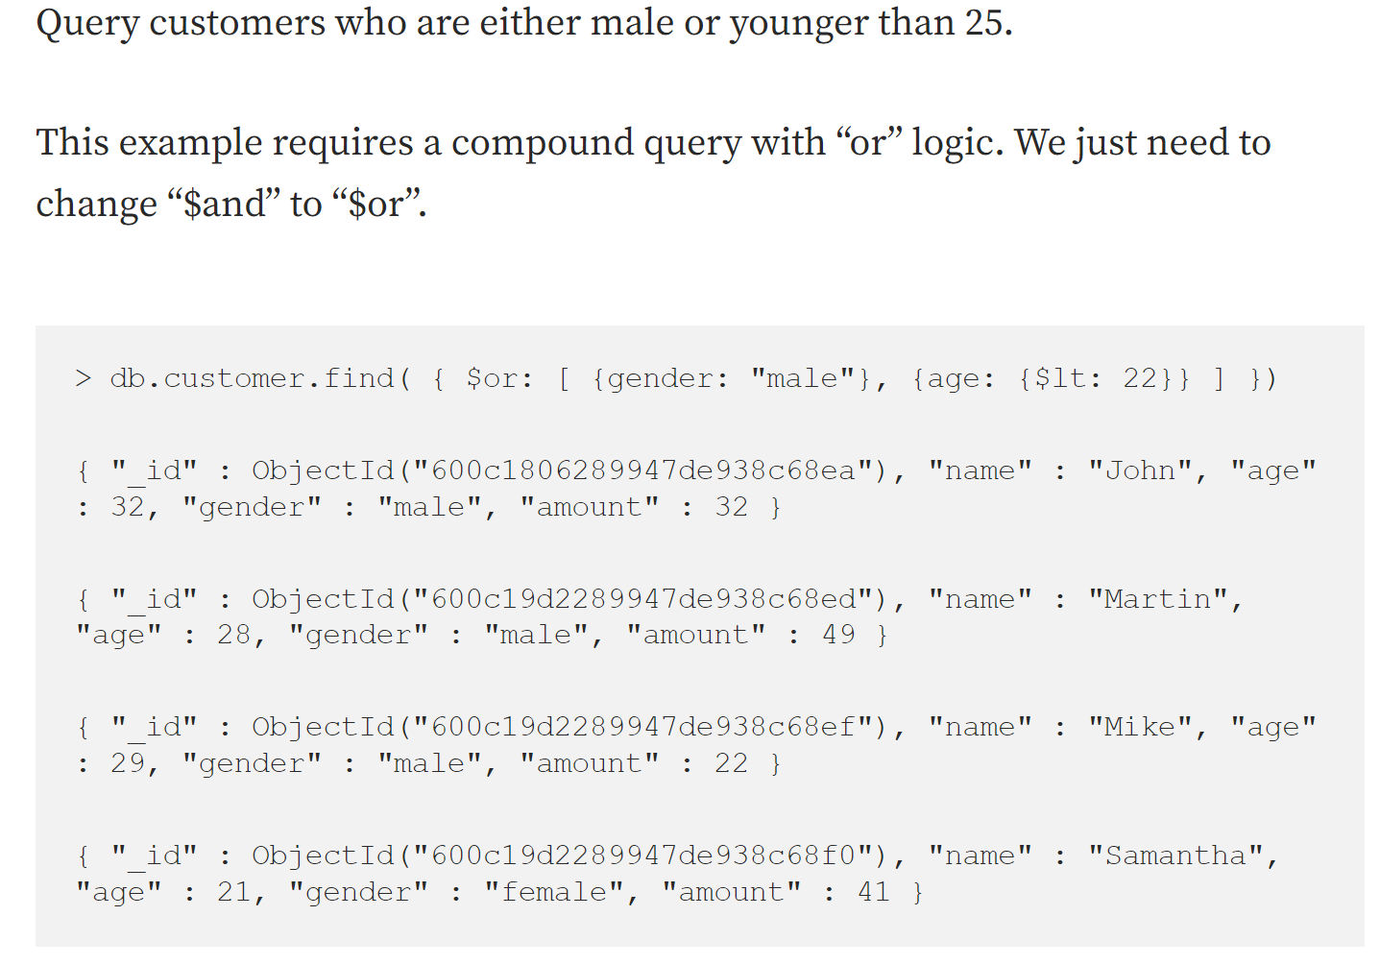
NoSQL

Slide 23
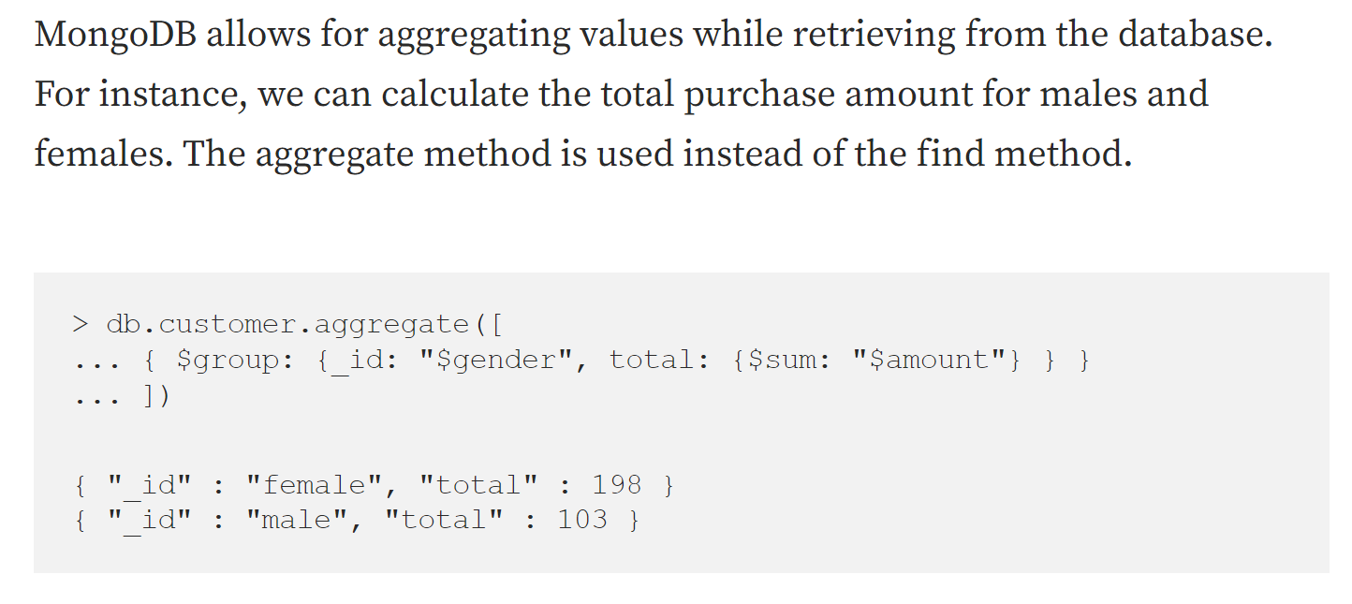
NoSQL

Slide 24
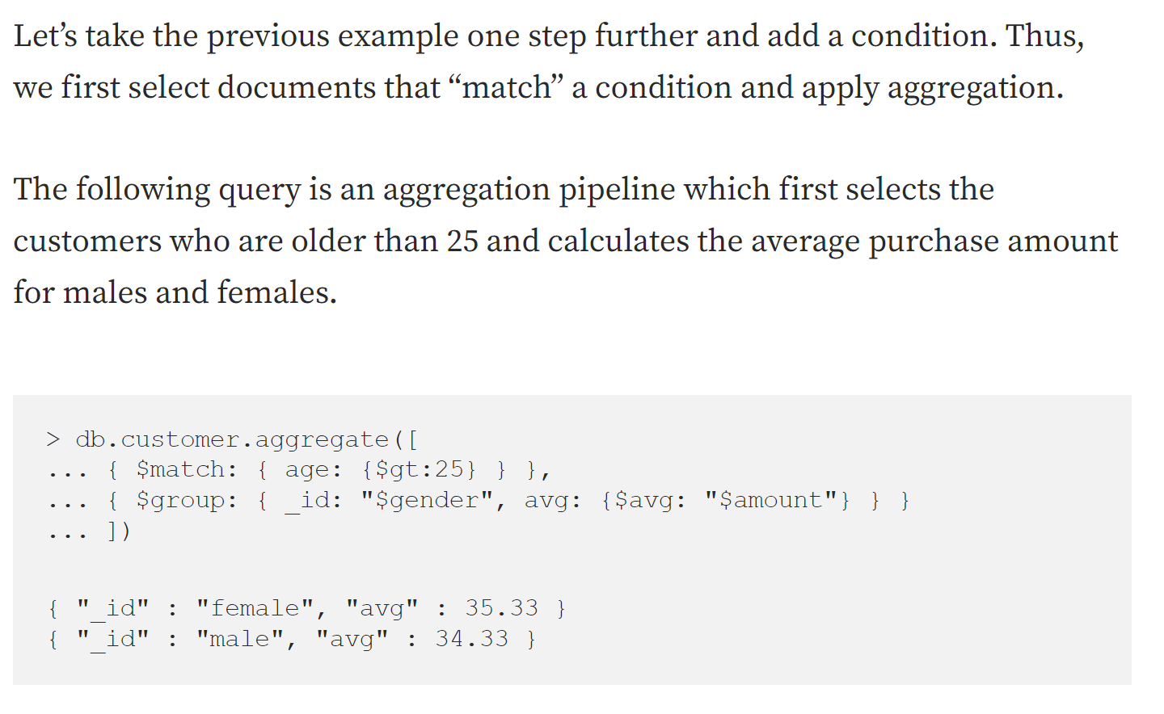
NoSQL Practice

Slide 25
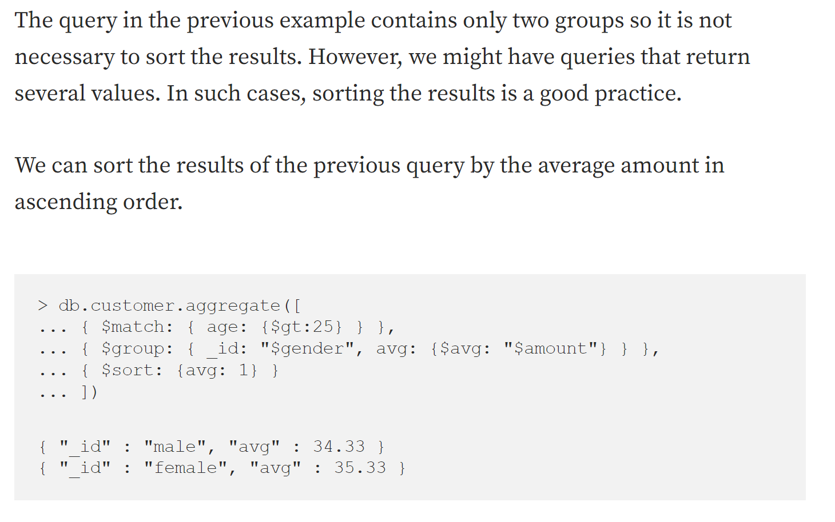
NoSQL Practice

