Slide 1
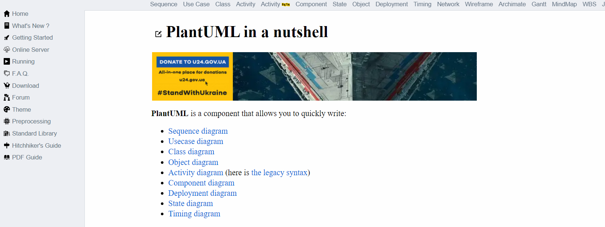
2
1
3

Slide 2
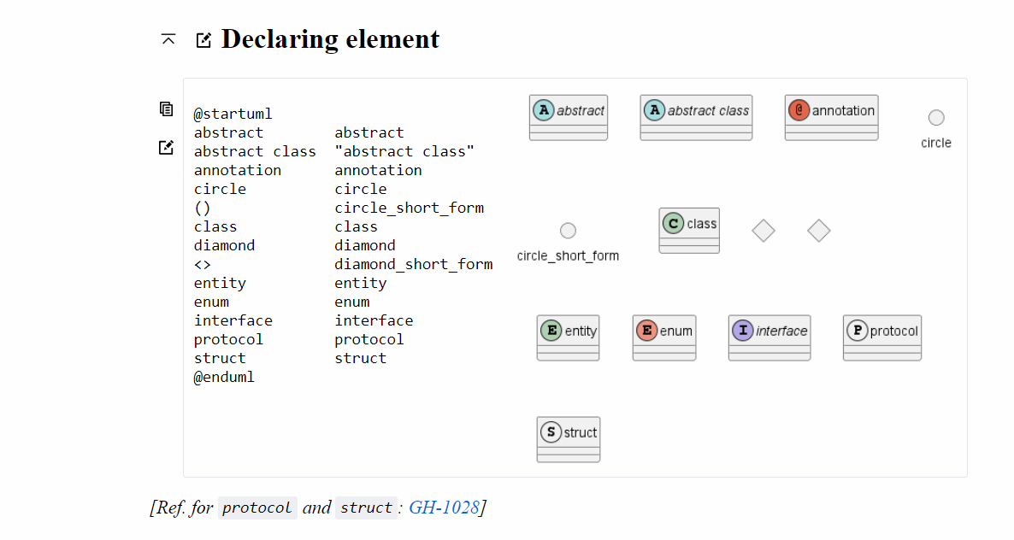
1
Copy to Clipboard
Edit online
2
3

Slide 3
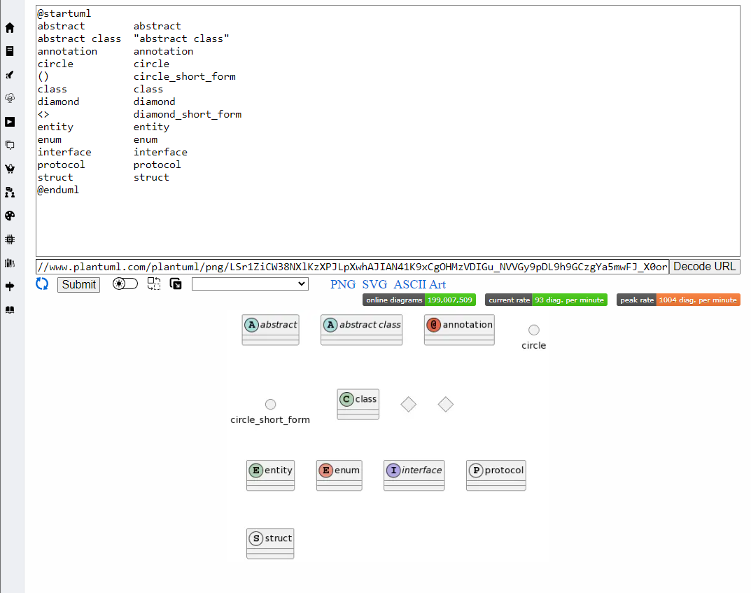
1
3
2

Slide 4
Class name
Book
Book
Attributes
Title
Author
Year
Publisher
Price
...
- Title : string
- Author : string
- Year : int
- Publisher : string
- Price : decimal
...
Methods()
SetTitle(...)
GetTitle()
SetAuthor(...)
GetYear
SetYear(...)
...
+ SetTitle(string)
+ GetTitle() : string
+ SetAuthor(string)
+ GetYear() : int
+ SetYear(int)
...

Slide 5
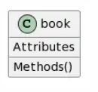
Class name
@startuml
class book
{
Attributes
Methods()
}
@enduml
Attributes
Methods()
Render output
PlantUML code
Class diagram

Slide 6
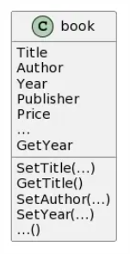
Book
@startuml
class book
{
'attributes
Title
Author
Year
Publisher
Price
...
'Methods()
SetTitle(...)
GetTitle()
SetAuthor(...)
GetYear
SetYear(...)
...()
}
@enduml
Title
Author
Year
Publisher
Price
...
SetTitle(...)
GetTitle()
SetAuthor(...)
GetYear
SetYear(...)
...
Render output
Class diagram
PlantUML code

Slide 7
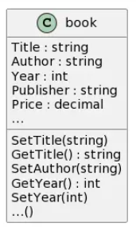
Book
@startuml
class book
{
'attributes
Title : string
Author : string
Year : int
Publisher : string
Price : decimal
...
'Methods()
SetTitle(string)
GetTitle() : string
SetAuthor(string)
GetYear() : int
SetYear(int)
...()
}
@enduml
Title : string
Author : string
Year : int
Publisher : string
Price : decimal
...
SetTitle(string)
GetTitle() : string
SetAuthor(string)
GetYear() : int
SetYear(int)
...
Render output
Class diagram
PlantUML code

Slide 8
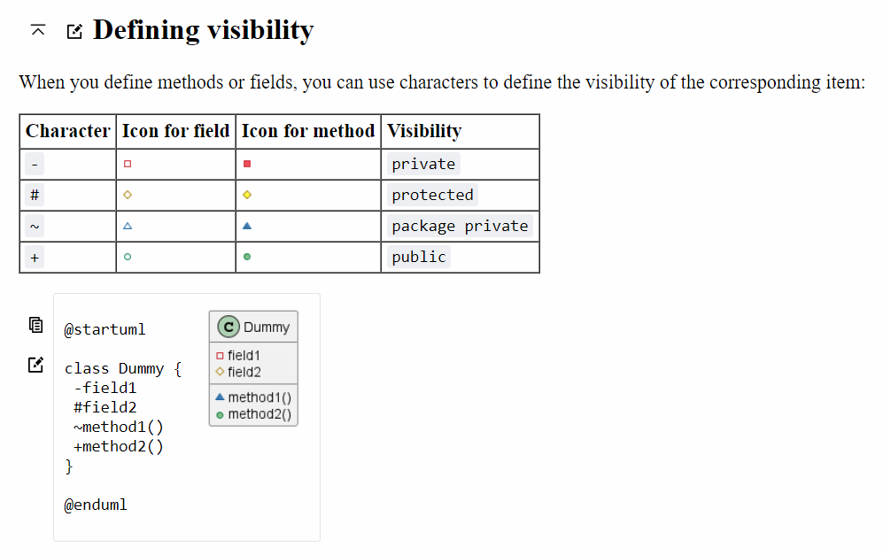

Slide 9
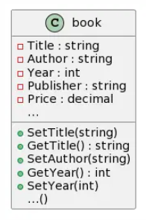
Book
@startuml
class book
{
'attributes
-Title : string
-Author : string
-Year : int
-Publisher : string
-Price : decimal
...
'Methods()
+SetTitle(string)
+GetTitle() : string
+SetAuthor(string)
+GetYear() : int
+SetYear(int)
...()
}
@enduml
- Title : string
- Author : string
- Year : int
- Publisher : string
- Price : decimal
...
+ SetTitle(string)
+ GetTitle() : string
+ SetAuthor(string)
+ GetYear() : int
+ SetYear(int)
...
Render output
Class diagram
PlantUML code

Slide 10
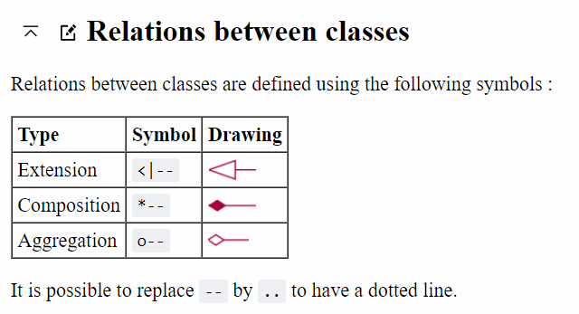

Slide 11
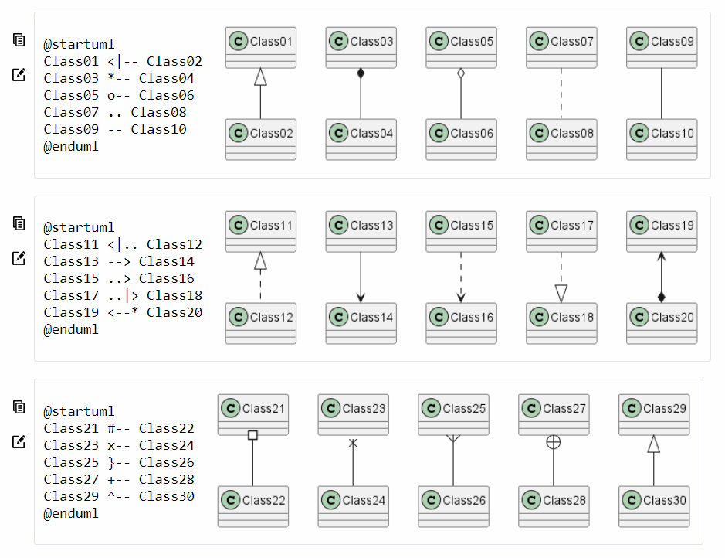

Slide 12
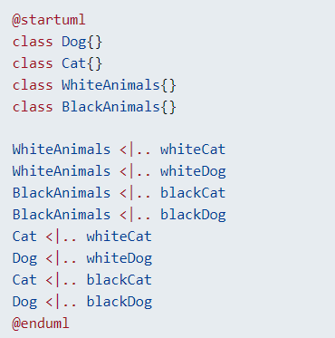
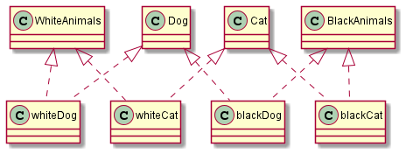

Slide 13
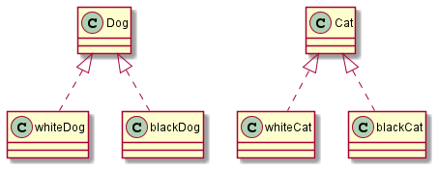

Slide 14
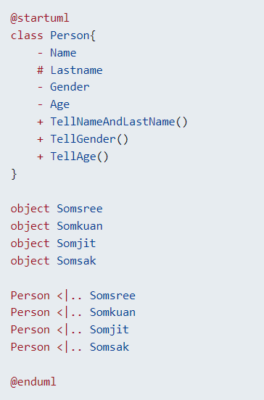

Slide 15
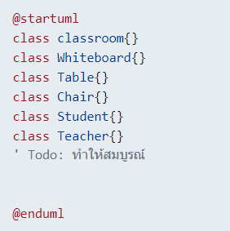
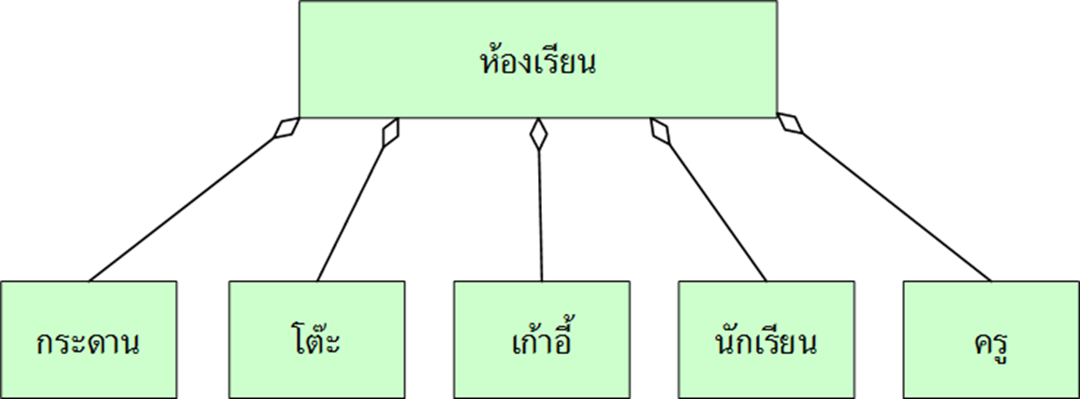

Slide 16
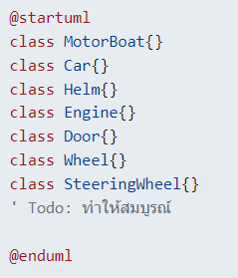
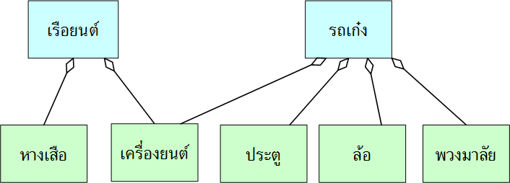

Slide 17
