Slide 1
IS442 Project Presentation
In collaboration with Goldman Sachs
G1T7: AHMAD MUSYAFFAQ, CHONG LEANN, MANIKANDAN ISHA, LOO JIE YI SHEENA, SEAH YOK SIM, TEOH JIN SHENG, YAN YIN KIT EUGENE

Slide 2




Agenda
Demostration
System Architecture
Open Source Libraries
Design Principles

Slide 3

Demostration

Slide 4
System Architecture
Monolithic
All the components of our application are in a single codebase and run as a single unit
Rationale:
Simplicity
Less complexity in coordination between different parts of the application
Faster development cycles
Performance
Minimal overhead from network communication and inter-process communication.

Slide 5
Navigation Diagram
Sign up
Log in
Forget Password
Account
Portfolio Home
Log out
Audit Logs
*for admin user only
Edit Password
Create Portfolio
View Portfolio
Edit Portfolio
Delete Portfolio

Slide 6



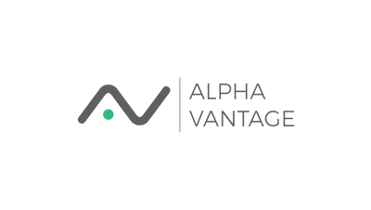
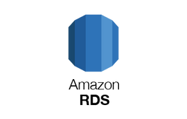


Architecture Diagram
Application
User
Portfolio
StockWrapper
Cache-aside cache
Frontend UI
Controller
Controller
Controller
Service
Service
Service
Repository
Repository
Database
User
Portfolio

Slide 7


Spring boot
Redis
Open Source Libraries & External Services
Utilized for backend development
Utilized for caching stock prices retrieved from Alpha Vantage API calls
Significantly reduces processing time and minimizes the number of API calls required
Java Persistence API (JPA)
Used for mapping Java objects to database tables
Backend
Java mail API
Amazon RDS
Used to send user authentication links when users forget their passwords
Utilized to store user and portfolio data

Slide 8

JSON Web Token (JWT Decoded)
Open Source Libraries & External Services
React.js
Utilized for frontend development
Used in extracting the information contained within a JWT
Frontend
ApexCharts
Material-UI
(MUI)
Utilized to generate interactive visualizations of stocks prices over time
Used in building the user interfaces

Slide 9
Design Principles
Based on the SOLID Principles
Single Responsibility
Open-Closed
Liskov Substitution
Each module has a single and well-defined responsibility.
User module for managing user profiles and related user-specific functionality
Portfolio module handles the creation and management of portfolios
Stockwrapper module focuses on retrieve stock data through calling Alpha Vantage API
UserService interface (and other service interfaces in our code) can be used by other implementation to handle business logic without altering the existing UserServiceImplementation
Subclasses can be created and used interchangeably with the existing parent classes without causing issues

Slide 10
Design Principles
Based on the SOLID Principles
Interface Segregation
Dependency Inversion
Instead of having large interfaces, we created multiple interfaces that are individually catered to a certain functionality
For instance, PortfolioService focused on managing portfolios within the application and PortfolioServiceImplementation implements only PortfolioService methods
Use abstractions in the form of service interface to define the contracts that our high-level components depend on
For instance, our UserController relies on the UserService abstraction to perform user-related operations
Notes:
"In our Spring Boot application, we've applied the Dependency Inversion Principle to create a flexible and maintainable architecture. We use abstractions in the form of service interfaces, such as UserService, to define the contracts that our high-level components depend on.
For instance, our UserController relies on the UserService abstraction to perform user-related operations. We have a concrete implementation, UserServiceImplementation, that adheres to this interface. We specify which implementation of the UserService should be injected into our UserController.
This design decouples the UserController from the specific implementation, such as UserServiceImplementation, and allows us to change or extend the behavior of our application without modifying the UserController. By following the Dependency Inversion Principle and leveraging Spring Boot's dependency injection capabilities, we've achieved a highly flexible and loosely coupled architecture, making our application easier to maintain and extend."

Slide 11
Thank you!

