Slide 1
Command Line Vector Graphics Software
Project Group 1
ZHANG Wengyu 21098431d
XU Le 21096101d
CHEN Derun 21098424d
YE Haowen 21098829d
COMP2021 Object-Oriented Programming (2021)

Slide 2
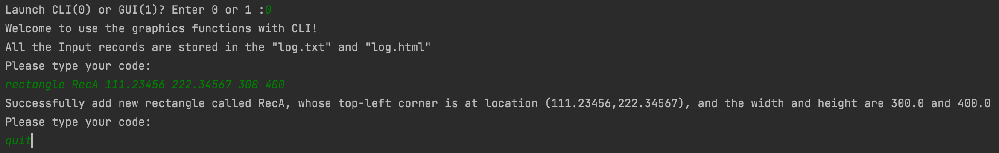
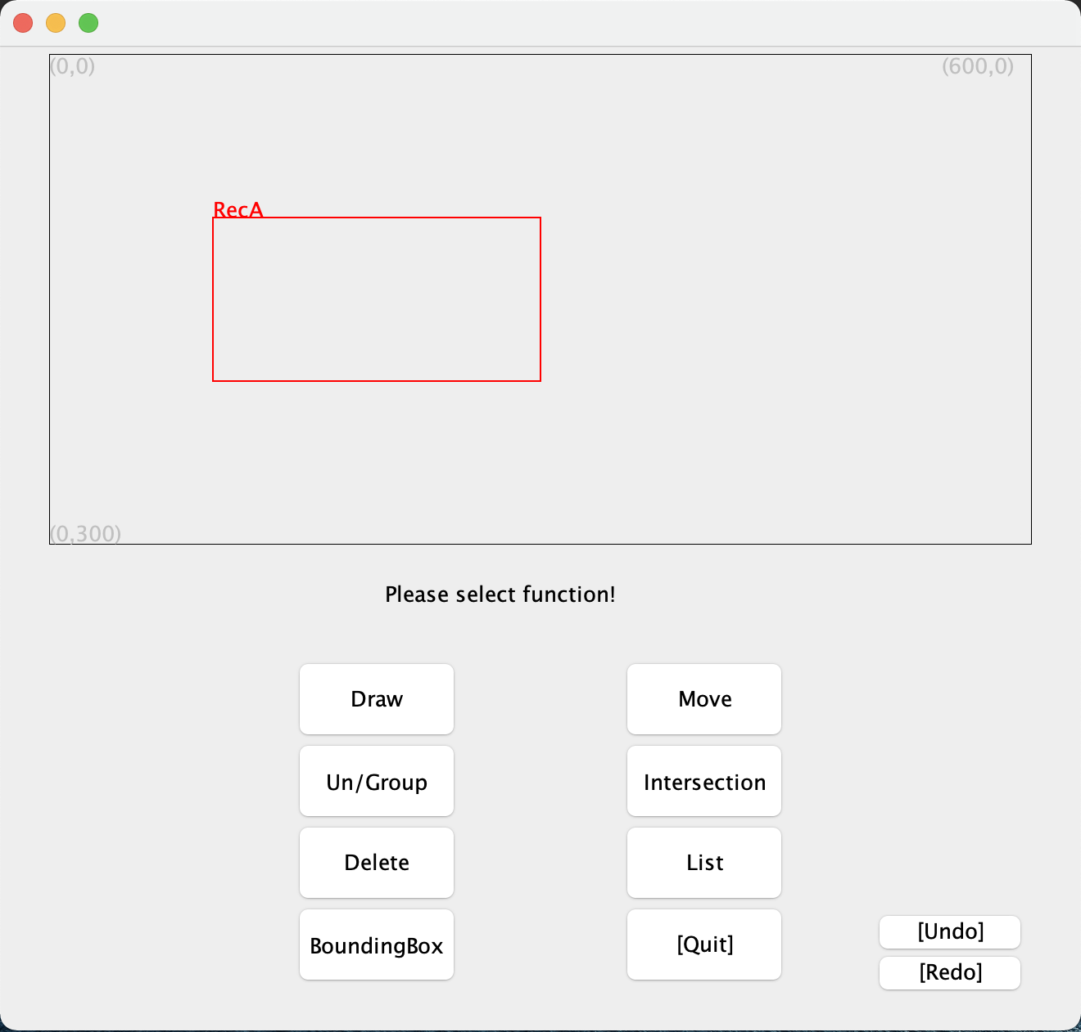
REQs & BONs
All implemented successfully
Clevis
ClevisGUI
Command Line Vector Graphics Software – Group1

Slide 3
Contents
1. Architecture
2. Design
Inheritance usage
Polymorphism usage
3. Object-orientation Benefits
Code reusability
Code scalability
4. Container structure
Command Line Vector Graphics Software – Group1

Slide 4
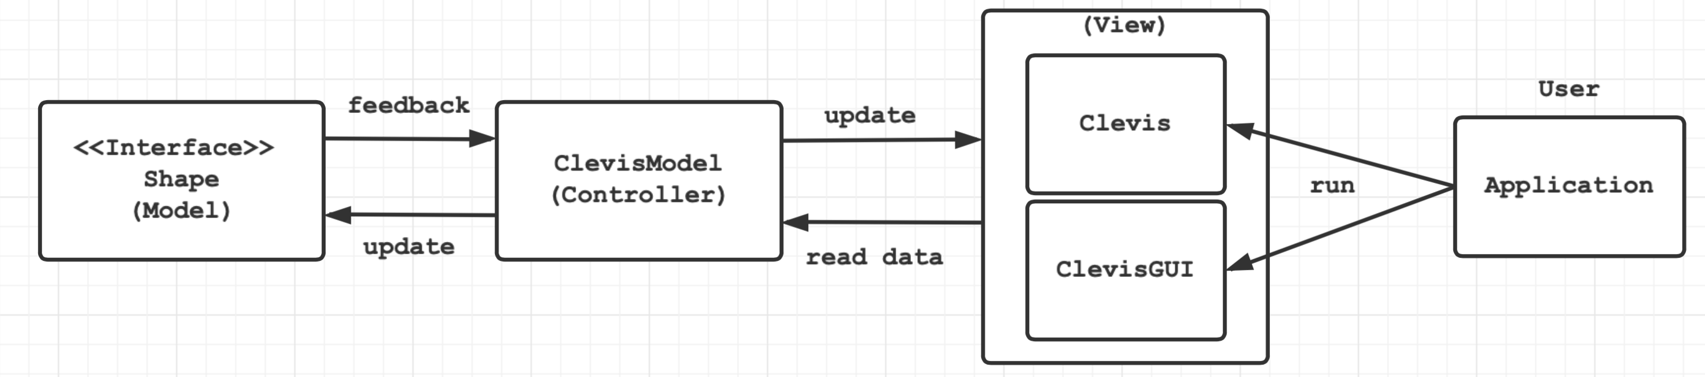
Architecture
MVC
Command Line Vector Graphics Software – Group1

Slide 5
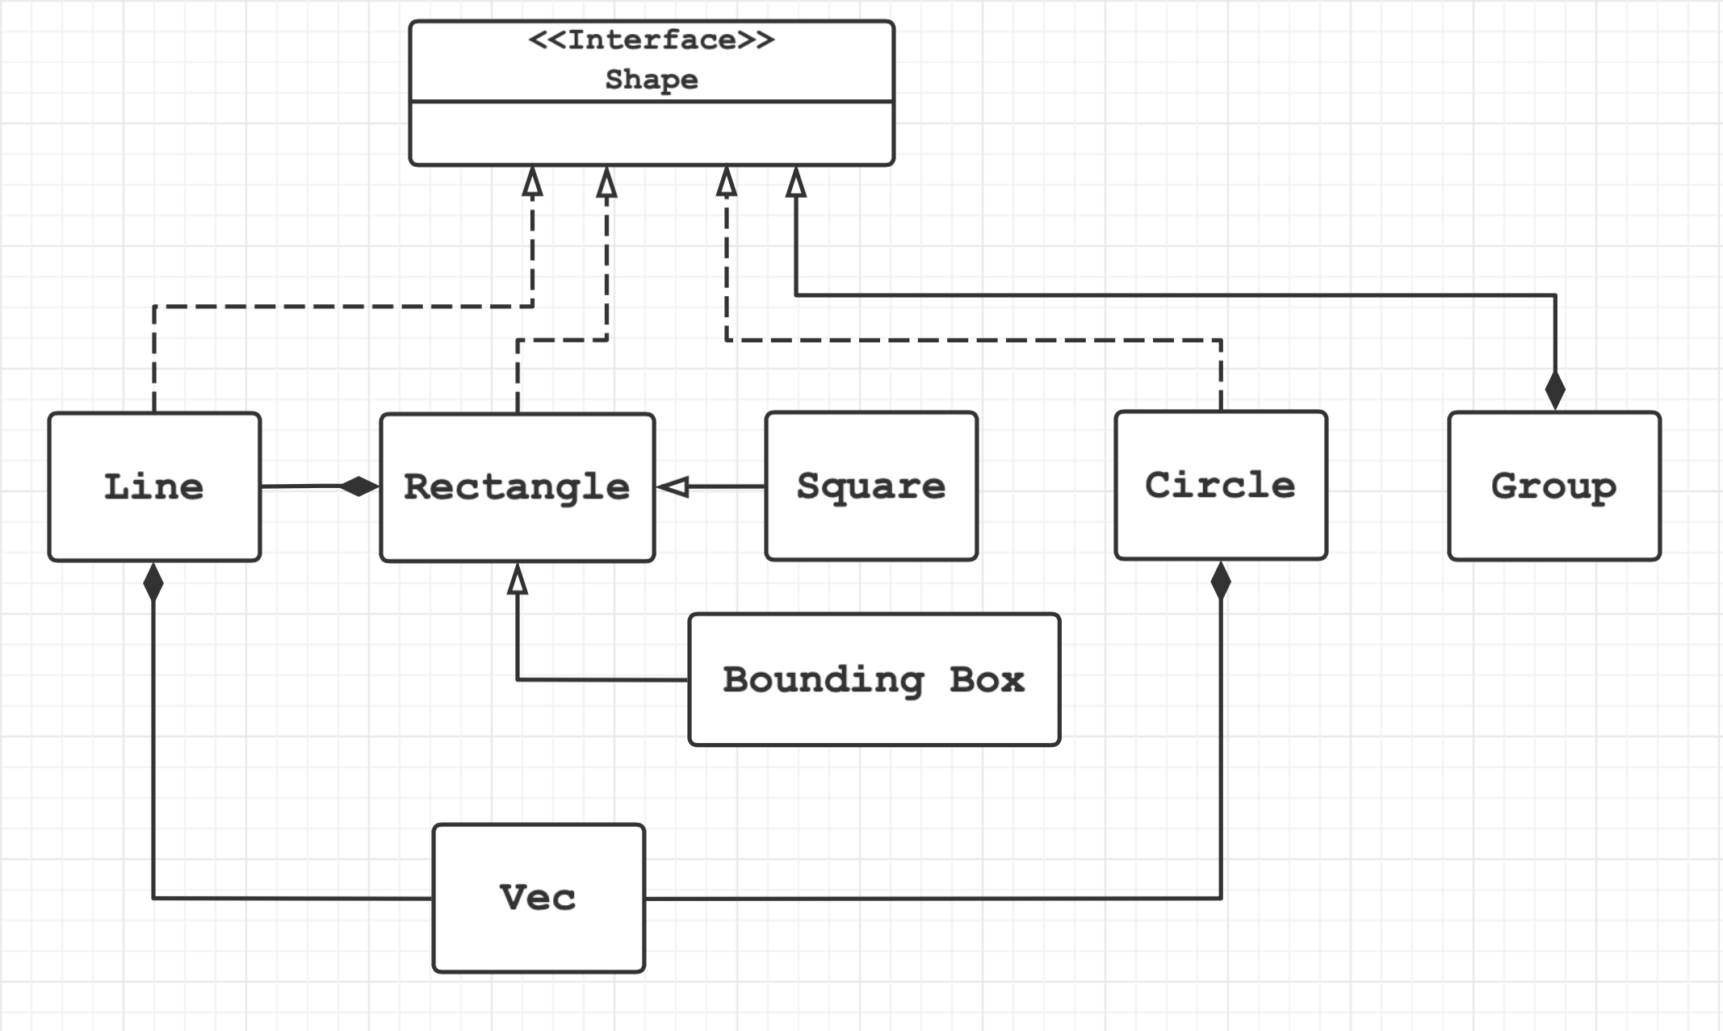
Design
Inheritance usage
Command Line Vector Graphics Software – Group1

Slide 6
Design
Polymorphism usage
Command Line Vector Graphics Software – Group1

Slide 7
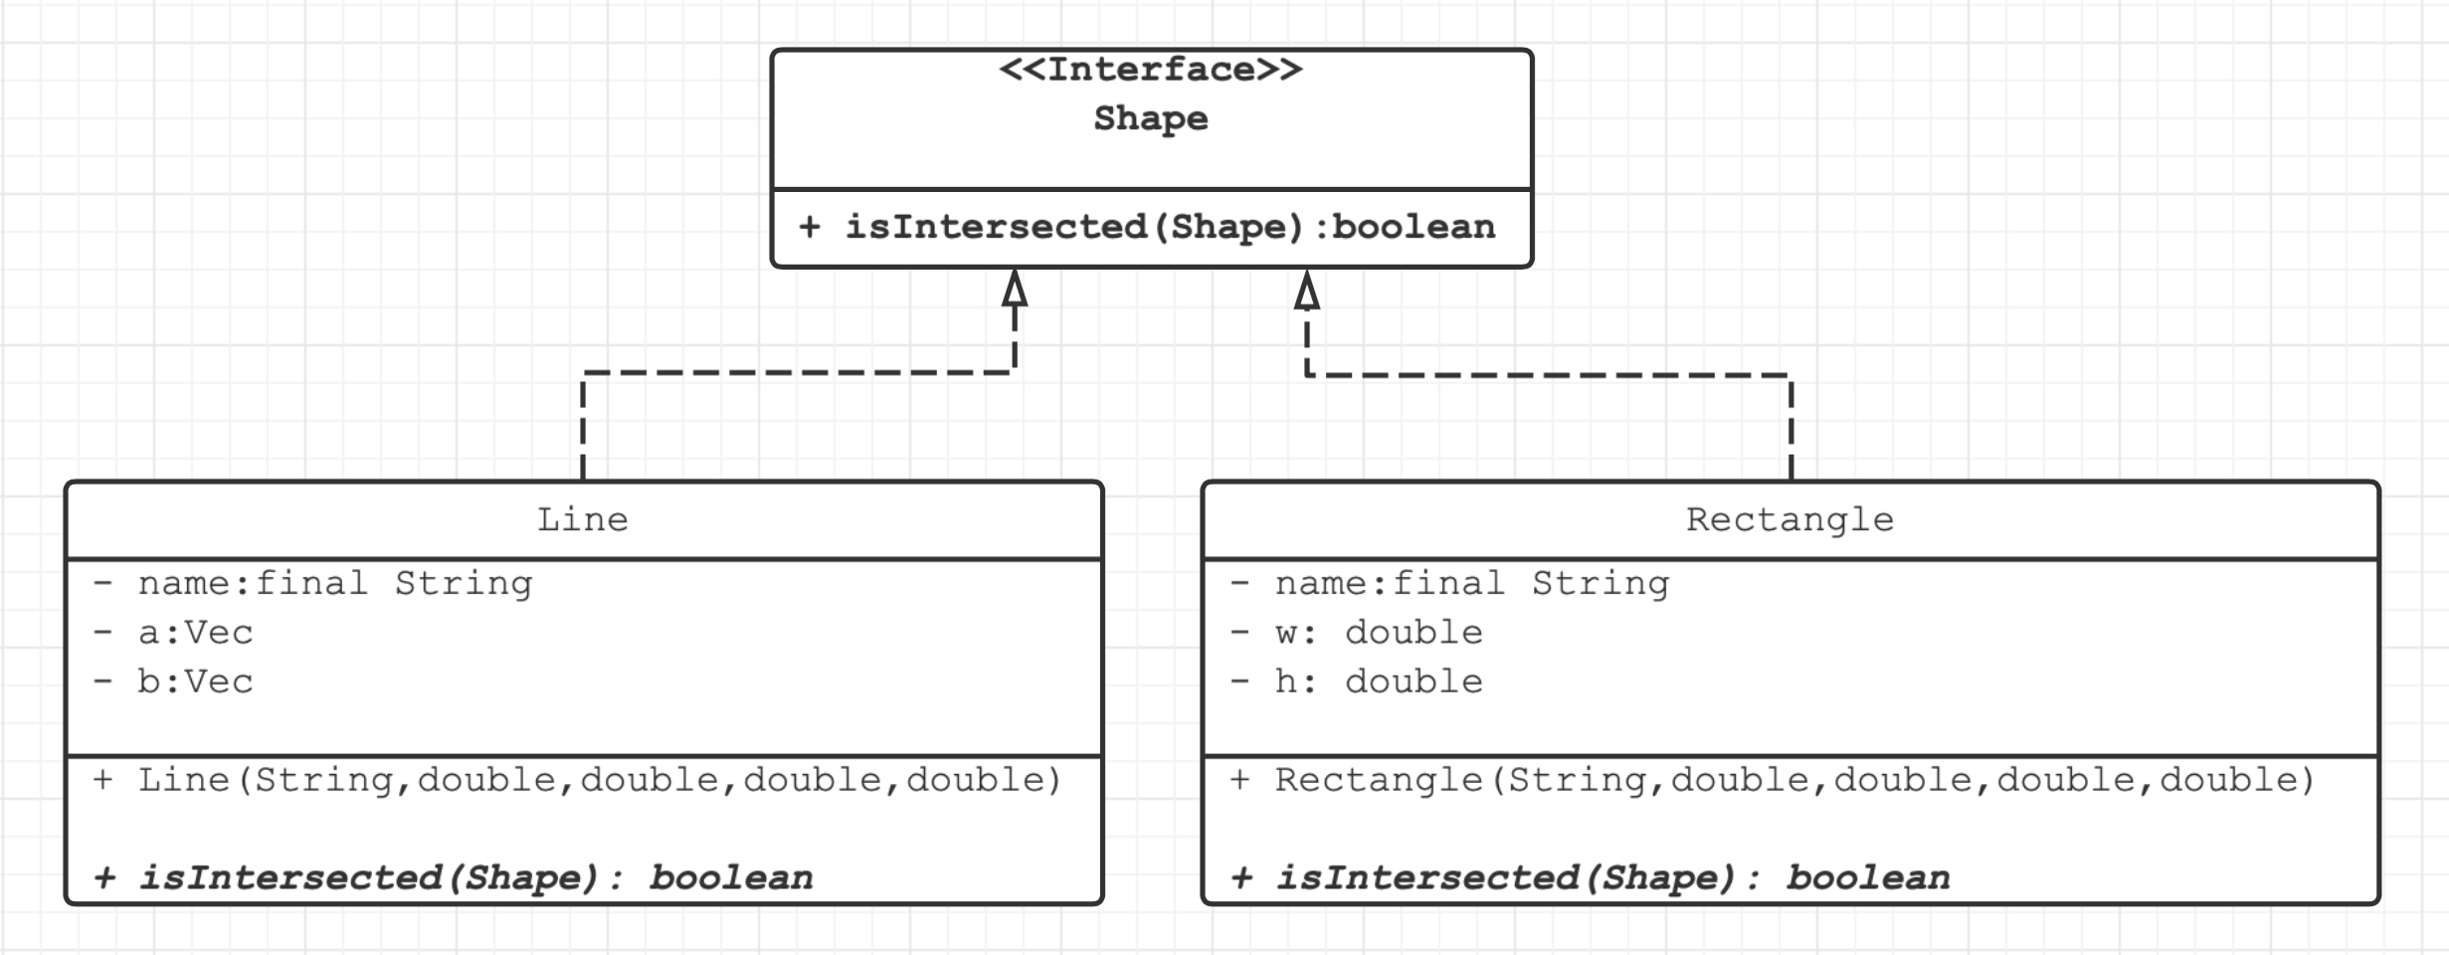
Design
Polymorphism usage
[Example]
Shape lineA = new Line(“LineA”,1d,2d,3d,4d);
Shape recB = new Rectangle(“RecB”,5d,6d,10d,20d);
lineA.isIntersected(recB);
Command Line Vector Graphics Software – Group1

Slide 8
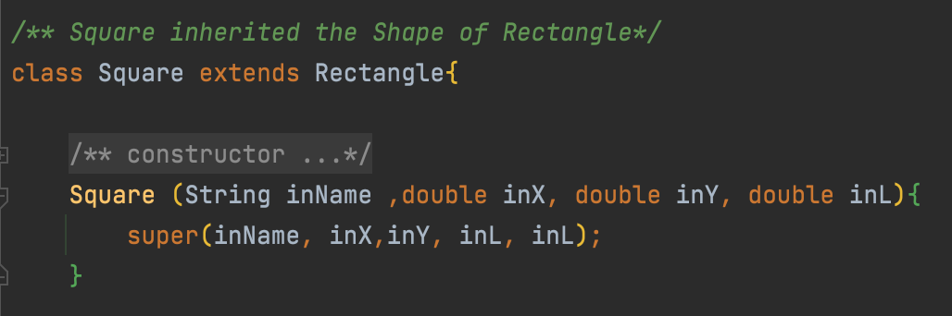
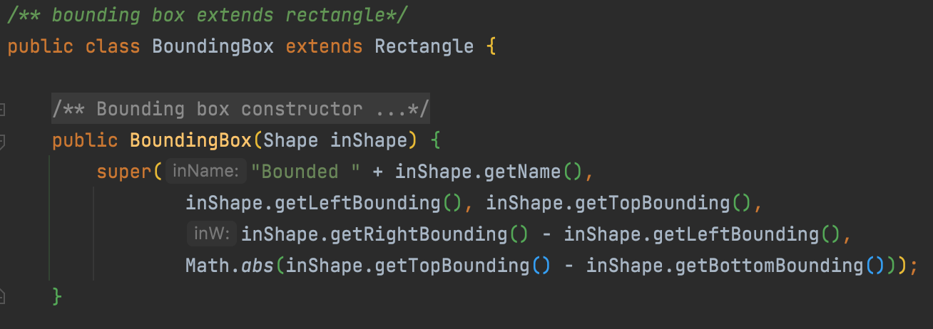
Object-orientation Benefits
Code reusability
Implementation inheritance:
Square : Rectangle with same length of width and height.
BoundingBox : Rectangle with bounded width and height.
Square class constructor
BoundingBox class constructor
Command Line Vector Graphics Software – Group1

Slide 9
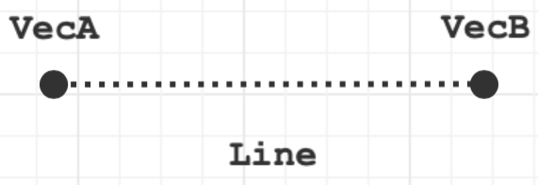
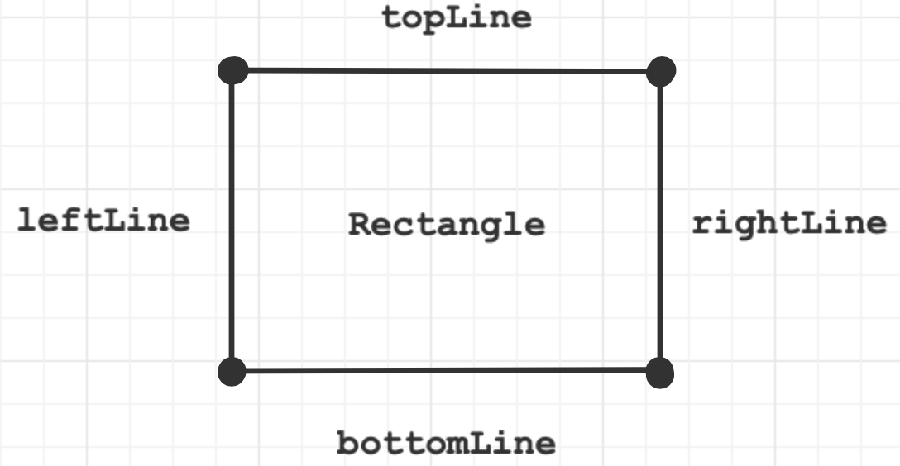
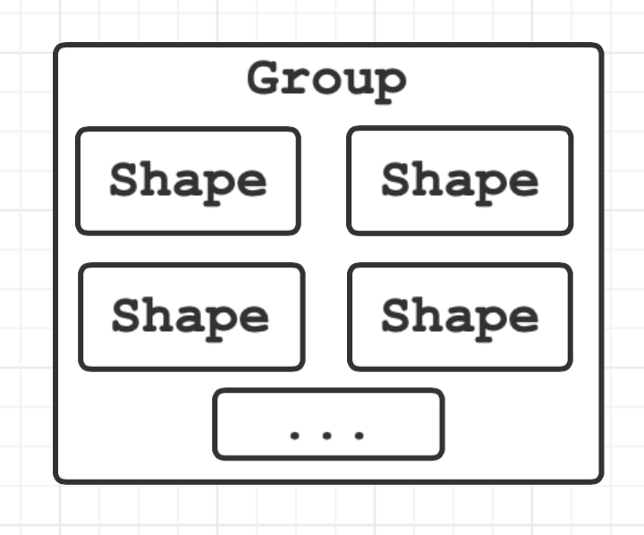
Object-orientation Benefits
Code reusability
Composition:
A Line is formed by two Vecs
A Rectangle is formed by four Lines,
An array of four Lines as a field of Rectangle
A Group is formed by s list of Shapes
An array of Shapes as a field of Group class.
Command Line Vector Graphics Software – Group1

Slide 10
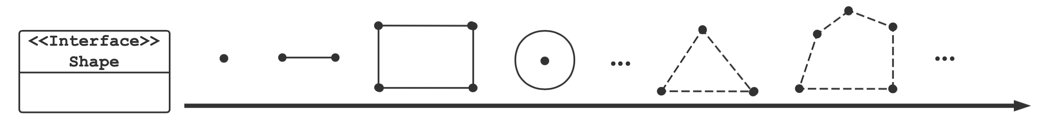
Object-orientation Benefits
Code scalability
t
Improve code extensibility
Shorten developing period
Easy for further development
Command Line Vector Graphics Software – Group1

Slide 11
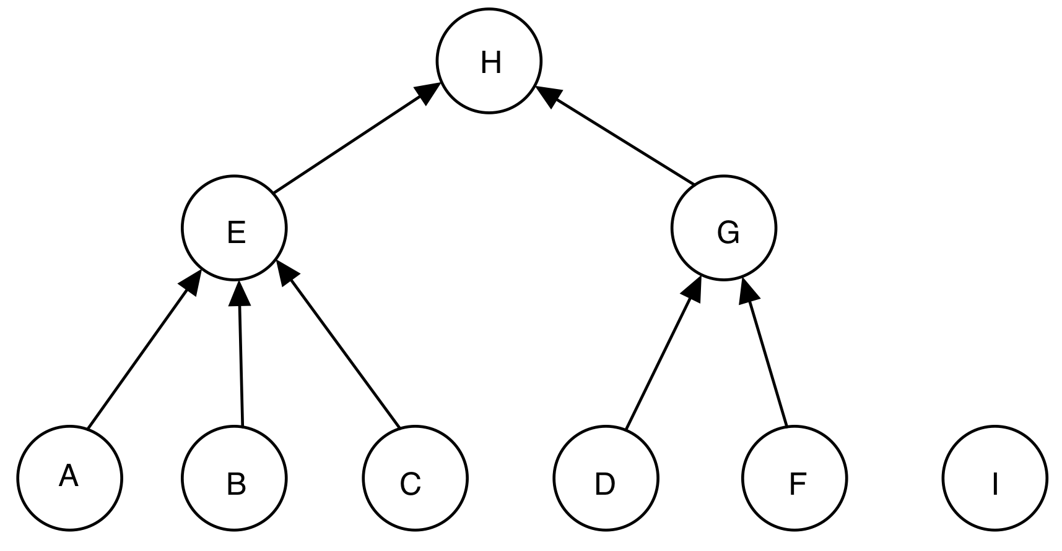
Container
Quick Union
Ancestor
Parent
Independent node
Child
Command Line Vector Graphics Software – Group1

Slide 12
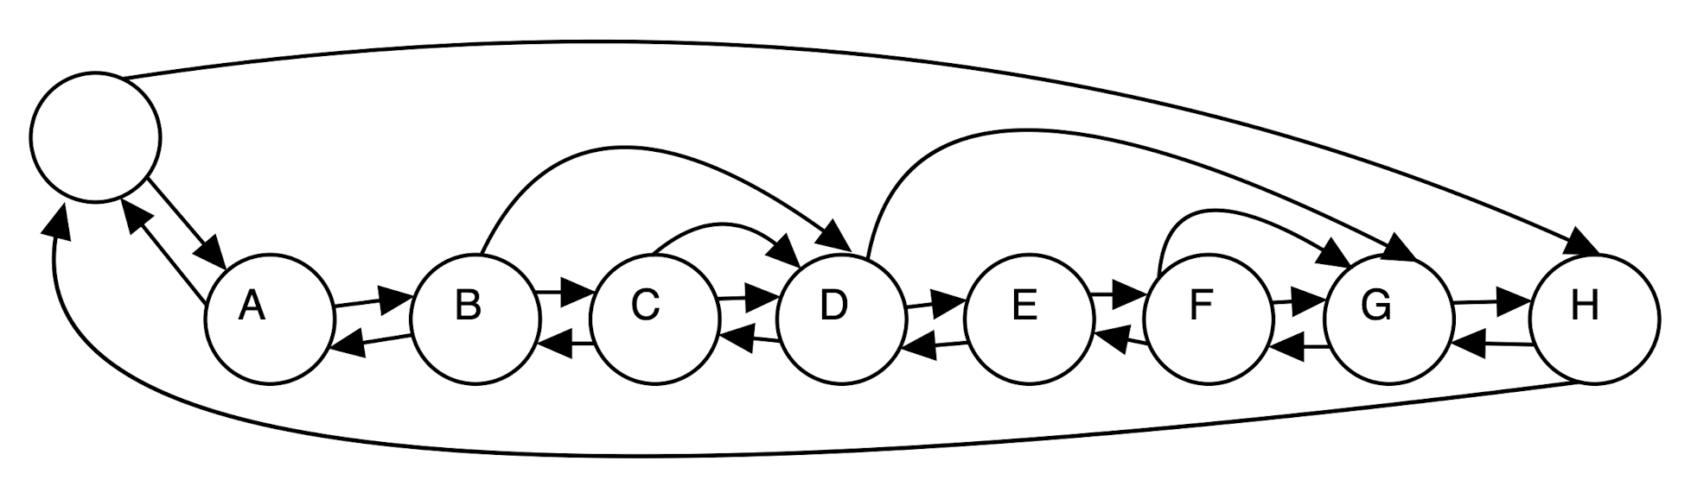
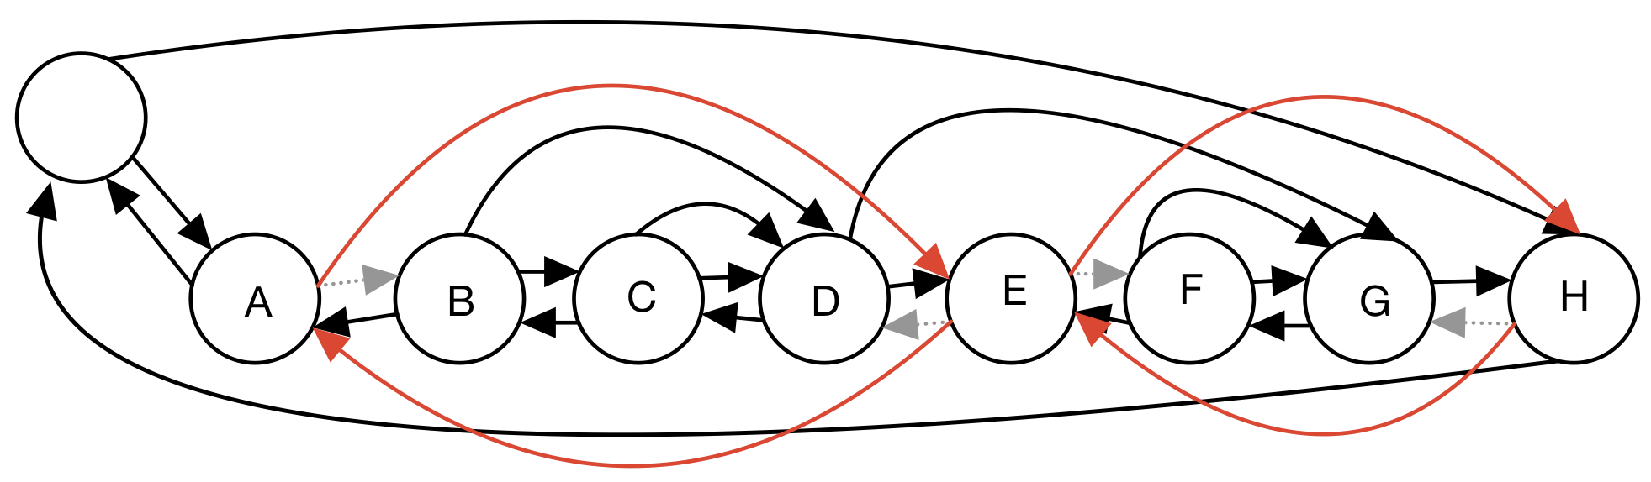
Container
LinkedListDeque
Easy to delete Group G
Easy to undo delete
Command Line Vector Graphics Software – Group1

Slide 13
Q&A
Command Line Vector Graphics Software – Group1

