Slide 1
LIBRARY MANAGEMENT SYSTEM
Submitted to: submitted by:
Mr. arpit deo ramsagar mujawdiya
ritika mandliya
riya parsai

Slide 2

INTRODUCTION
Library is the collection of different types of books. Library Management System provides the systematic handling the records of books and readers. The project “Library Management System” is developed in Python, which mainly focuses on basic operations in a library like adding a book, lend a book or return a book.

Slide 3
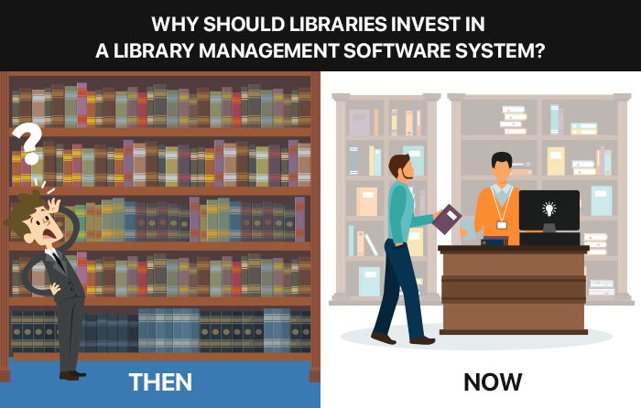
PROBLEM STATEMENT
Manual systems are slow to operate. Instead of using a computer to issue and take back books, locating and updating a card index is slow and laborious. Manual systems are unable to store large amounts of data efficiently.

Slide 4
PURPOSE
It provides “better and efficient” service to members.
Reduce the workload of librarian.
Faster retrieval of information about the desired book.
Provide facility for purpose monitoring reduce paper work and provide data security.
All details will be available on a click for both user and librarian.

Slide 5

SCOPE
Any education institute and government office’s can make use of it for providing information about author, content of the available books etc.
This project can further be extended by adding the facility of e-book’s, to overcome the problem of book stock in library.

Slide 6
FEATURES
Display Books: It will display the book list.
Lend a Book: This will record the details on the book issued to whom.
Add a Book: With this feature we can add books in system with book details.
Return a Book: It will update the book transactions on returned by the member.

Slide 7
Thank you!!

