Slide 1

“OOP team Project”
TEAM "NELTHARION"

Slide 2
Team Members
Valeri Hristov
Username: Valleri
Game object
Collision
Controller
Gabriela Burlakova
Username: G.Burlakova
Creature
Monsters
AI
Boni Mislyashki
Username: BoniMislyashki
Character
Heroes
Presentation
Traqn Zlatanov
Username: felix_de_suza
Item hierarchy
Item generator
Interfaces

Slide 3
Team Members
Valentin Panchev
Username: Gondars
Combat system
Interfaces
Georgi Angelov
Username: georgi.angelov.9237
Items
Creatures
Mario Milev
Username: mondegreen
Game design
Menu
Obstacles

Slide 4
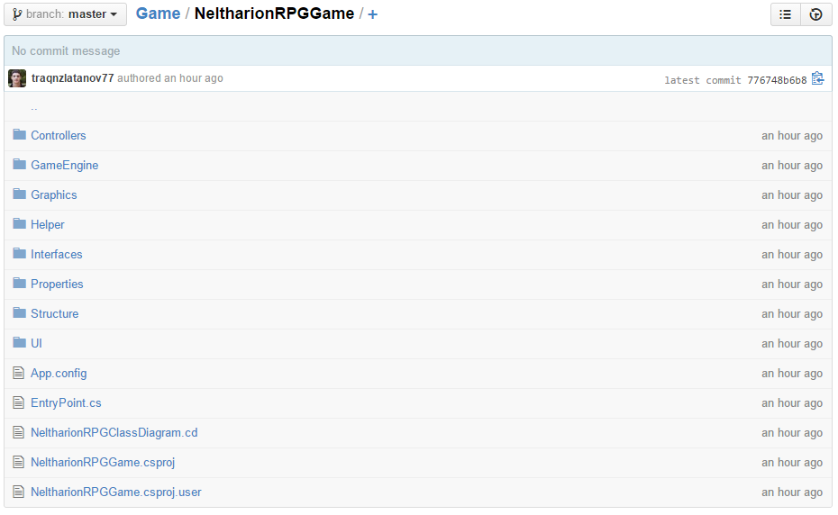
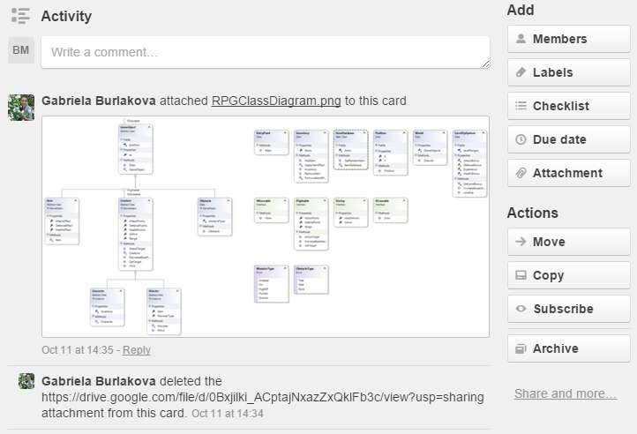
Brief code description

Slide 5
