Slide 1
4-Software Construction
명지대학교/OMG Korea
최성운
choisw@mju.ac.kr

Slide 2
Software Construction KA₁
The term software construction refers to
  the detailed creation of working, meaningful software through a combination of coding, verification, unit testing, integration testing, and debugging.
The Software Construction Knowledge Area is linked to all the other KAs, most strongly to Software Design and Software Testing.
  This is because the software construction process itself involves significant software design and test activity.
  It also uses the output of design and provides one of the inputs to testing, both design and testing being the activities, not the KAs in this case.
  Detailed boundaries between design, construction, and testing (if any) will vary depending upon the software life cycle processes that are used in a project.

Slide 3
Software Construction KA₂
  Although some detailed design may be performed prior to construction, much design work is performed within the construction activity itself. Thus the Software Construction KA is closely linked to the Software Design KA.
  Throughout construction, software engineers both unit-test and integration-test their work. Thus, the Software Construction KA is closely linked to the Software Testing KA as well.
  Software construction typically produces the highest volume of configuration items that need to be managed in a software project (source files, content, test cases, and so on). Thus, the Software Construction KA is also closely linked to the Software Configuration Management KA.

Slide 4
Software Construction KA₃
Since software construction relies heavily on tools and methods and is probably the most tool-intensive of the KAs, it is linked to the Software Engineering Tools and Methods KA.
While software quality is important in all the KAs, code is the ultimate deliverable of a software project, and thus Software Quality is also closely linked to Software Construction.
Among the Related Disciplines of Software Engineering, the Software Construction KA is most akin to
  computer science in its use of knowledge of algorithms and of detailed coding practices, both of which are often considered to belong to the computer science domain.
  It is also related to project management, insofar as the management of construction can present considerable challenges.

Slide 5
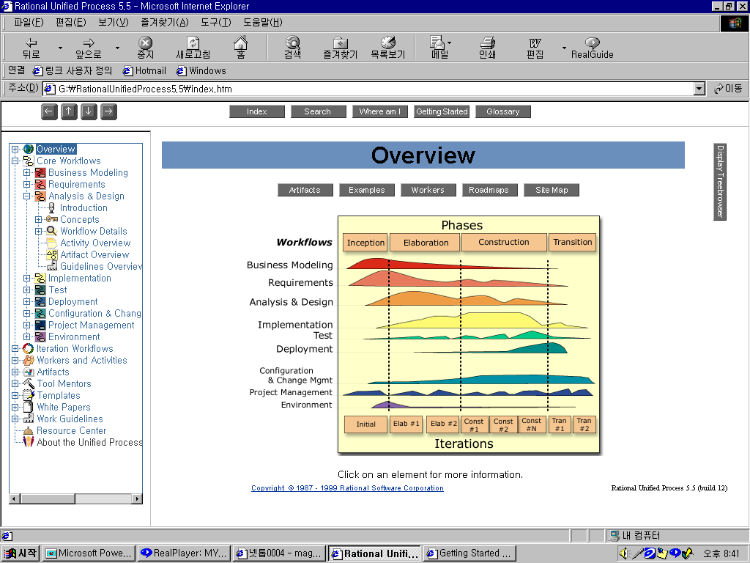
Separation of
Method Components & Process
Method
Components/
Workflows
Process
Business Modeling
Requirements
Analysis & Design
?
Implementation
Test
Deployment
Configuration &
Change Mgmt
Project Management
Environment
Milestones
Conceptual Prototype
Architectural
Baseline
Release
Delivery 1

Slide 6
Software Design KA Subareas
Software Construction Fundamentals
Managing Construction
Practical Considerations
Construction Design
Minimizing Complexity
Construction Models
Anticipating Change
Constructing for Verification
Standards in Construction
Construction Planning
Construction Measurement
Construction Language
Coding
Construction Testing
Reuse
Construction quality
Integration

Slide 7
Software Construction Fundamentals

Slide 8
Minimizing Complexity₁
[Bec99; Ben00; Hun00; Ker99; Mag93; McC04]
A major factor in how people convey intent to computers is the severely limited ability of people to hold complex structures and information in their working memories, especially over long periods of time.
Perception
Cognition
Abstraction
  Modularization
  Generalization
  Classification
  …
Long-term Memory
Working Memory
Visual
Image
Store
Auditory
Image
Store
Cognitive
Processor
Perceptual
Processor
Motor
Processor
The Human Processor Model, Card et al., 1983

Slide 9
Minimizing Complexity₂
This leads to one of the strongest drivers in software construction: minimizing complexity.
  The need to reduce complexity applies to essentially every aspect of software construction, and is particularly critical to the process of verification and testing of software constructions.
  In software construction, reduced complexity is achieved through emphasizing the creation of code that is simple and readable rather than clever.
  Minimizing complexity is accomplished through making use of standards and through numerous coding techniques.
  It is also supported by the construction-focused quality techniques summarized in topic “Construction Quality”.

Slide 10
Anticipating Change
[Ben00; Ker99; McC04]
Most software will change over time, and the anticipation of change drives many aspects of software construction.
Software is unavoidably part of changing external environments, and changes in those outside environments affect software in diverse ways.
Anticipating change is supported by many specific techniques summarized in topic “Coding”.

Slide 11
Constructing for Verification
[Ben00; Hun00; Ker99; Mag93; McC04]
Constructing for verification means building software in such a way that faults can be ferreted out readily by the software engineers writing the software, as well as during independent testing and operational activities.
Specific techniques that support constructing for verification include following coding standards to support
  code reviews,
  unit testing,
  organizing code to support automated testing, and
  restricted use of complex or hard-to-understand language structures, among others.

Slide 12
Standards in Construction₁
[IEEE12207-95; McC04]
Standards that directly affect construction issues include
  Communication methods
    for example, standards for document formats and contents
  Programming languages
    for example, language standards for languages like Java and C++
  Platforms
    for example, programmer interface standards for operating system calls
  Tools
    for example, diagrammatic standards for notations like UML (Unified Modeling Language)

Slide 13
Standards in Construction₂
Use of external standards.
  Construction depends on the use of external standards for
    construction languages, construction tools, technical interfaces, and interactions between Software Construction and other KAs.
  Standards come from numerous sources, including hardware and software interface specifications such as the Object Management Group (OMG) and international organizations such as the IEEE or ISO.
Use of internal standards.
  Standards may also be created on an organizational basis at the corporate level or for use on specific projects.
  These standards support coordination of group activities, minimizing complexity, anticipating change, and constructing for verification.

Slide 14
Managing Construction

Slide 15
Construction Models₁
[Bec99; McC04]
Numerous models have been created to develop software, some of which emphasize construction more than others.
  Some models are more linear from the construction point of view, such as the waterfall and staged-delivery life cycle models.
    These models treat construction as an activity which occurs only after significant prerequisite work has been completed—including detailed requirements work, extensive design work, and detailed planning.
    The more linear approaches tend to emphasize the activities that precede construction (requirements and design), and tend to create more distinct separations between the activities.
    In these models, the main emphasis of construction may be coding.

Slide 16
Construction Models₂
  Other models are more iterative, such as evolutionary prototyping, Extreme Programming, and Scrum.
    These approaches tend to treat construction as an activity that occurs concurrently with other software development activities, including requirements, design, and planning, or overlaps them.
    These approaches tend to mix design, coding, and testing activities, and they often treat the combination of activities as construction.
Consequently, what is considered to be “construction” depends to some degree on the life cycle model used.
?

Slide 17
Construction Planning₁
[Bec99; McC04]
The choice of construction method is a key aspect of the construction planning activity. The choice of construction method affects
  the extent to which construction prerequisites are performed,
  the order in which they are performed, and
  the degree to which they are expected to be completed before construction work begins.
The approach to construction affects the project’s ability to reduce complexity, anticipate change, and construct for verification.
  Each of these objectives may also be addressed at the process, requirements, and design levels—but they will also be influenced by the choice of construction method.
Construction Paradigm
f(x,y) = x+y
k x y = 34
......

Slide 18
Construction Planning₂
Construction planning also defines
  the order in which components are created and integrated,
  the software quality management processes,
  the allocation of task assignments to specific software engineers,
  and the other tasks, according to the chosen method.

Slide 19
Construction Measurement
[McC04]
Numerous construction activities and artifacts can be measured, including code developed, code modified, code reused, code destroyed, code complexity, code inspection statistics, fault-fix and fault-find rates, effort, and scheduling.
These measurements can be useful for purposes of
  managing construction,
  ensuring quality during construction,
  improving the construction process, as well as for other reasons.
See the Software Engineering Process KA for more on measurements

Slide 20
Practical Considerations

Slide 21
Construction Design
[Bec99; Ben00; Hun00; IEEE12207-95; Mag93; McC04]
Some projects allocate more design activity to construction; others to a phase explicitly focused on design. Regardless of the exact allocation, some detailed design work will occur at the construction level, and that design work tends to be dictated by immovable constraints imposed by the real-world problem that is being addressed by the software.
Just as construction workers building a physical structure must make small-scale modifications to account for unanticipated gaps in the builder’s plans, software construction workers must make modifications on a smaller or larger scale to flesh out details of the software design during construction.
The details of the design activity at the construction level are essentially the same as described in the Software Design KA, but they are applied on a smaller scale.
Requirement Design/Design Design ???

Slide 22
Construction Languages₁
[Hun00; McC04]
Construction languages include all forms of communication by which a human can specify an executable problem solution to a computer.
  The simplest type of construction language is a configuration language, in which software engineers choose from a limited set of predefined options to create new or custom software installations.
    The text-based configuration files used in both the Windows and Unix operating systems are examples of this, and the menu style selection lists of some program generators constitute another.
  Toolkit languages are used to build applications out of toolkits (integrated sets of application-specific reusable parts), and are more complex than configuration languages.
    Toolkit languages may be explicitly defined as application programming languages (for example, scripts), or may simply be implied by the set of interfaces of a toolkit.

Slide 23
Construction Languages₂
  Programming languages are the most flexible type of construction languages. They also contain the least amount of information about specific application areas and development processes, and so require the most training and skill to use effectively.
    There are three general kinds of notation used for programming languages, namely:
      Linguistic
      Formal
      Visual

Slide 24
Linguistic notations
Linguistic notations are distinguished in particular by the use of word-like strings of text to represent complex software constructions, and the combination of such wordlike strings into patterns that have a sentence-like syntax.
Properly used, each such string should have a strong semantic connotation providing an immediate intuitive understanding of what will happen when the underlying software construction is executed.

Slide 25
Formal Notations
Formal notations rely less on intuitive, everyday meanings of words and text strings and more on definitions backed up by precise, unambiguous, and formal (or mathematical) definitions.
Formal construction notations and formal methods are at the heart of most forms of system programming, where accuracy, time behavior, and testability are more important than ease of mapping into natural language.
Formal constructions also use precisely defined ways of combining symbols that avoid the ambiguity of many natural language constructions.

Slide 26
Visual Notations
Visual notations rely much less on the text-oriented notations of both linguistic and formal construction, and instead rely on direct visual interpretation and placement of visual entities that represent the underlying software.
Visual construction tends to be somewhat limited by the difficulty of making “complex“ statements using only movement of visual entities on a display.
However, it can also be a powerful tool in cases where the primary programming task is simply to build and “adjust“ a visual interface to a program, the detailed behavior of which has been defined earlier.

Slide 27
Coding
[Ben00; IEEE12207-95; McC04]
The following considerations apply to the software construction coding activity:
  Techniques for creating understandable source code, including naming and source code layout
  Use of classes, enumerated types, variables, named constants, and other similar entities
  Use of control structures
  Handling of error conditions—both planned errors and exceptions (input of bad data, for example)
  Prevention of code-level security breaches (buffer overruns or array index overflows, for example)
  Resource usage via use of exclusion mechanisms and discipline in accessing serially reusable resources (including threads or database locks)
  Source code organization (into statements, routines, classes, packages, or other structures)
  Code documentation
  Code tuning

Slide 28
Construction Testing
[Bec99; Hun00; Mag93; McC04]
Construction involves two forms of testing, which are often performed by the software engineer who wrote the code:
  Unit testing
  Integration testing
The purpose of construction testing is to reduce the gap between the time at which faults are inserted into the code and the time those faults are detected.
In some cases, construction testing is performed after code has been written. In other cases, test cases may be created before code is written.
Construction testing typically involves a subset of types of testing, which are described in the Software Testing KA.
  For instance, construction testing does not typically include system testing, alpha testing, beta testing, stress testing, configuration testing, usability testing, or other, more specialized kinds of testing.
Two standards have been published on the topic:
  IEEE Std 829-1998, IEEE Standard for Software Test Documentation and IEEE Std 1008-1987, IEEE Standard for Software Unit Testing.
See also the corresponding sub-topics in the Software Testing KA: 2.1.1 Unit Testing and 2.1.2 Integration Testing for more specialized reference material.

Slide 29
Reuse
[IEEE1517-99; Som05]
As stated in the introduction of (IEEE1517-99): “Implementing software reuse entails more than creating and using libraries of assets.
It requires formalizing the practice of reuse by integrating reuse processes and activities into the software life cycle. “ However, reuse is important enough in software construction that it is included here as a topic.
The tasks related to reuse in software construction during coding and testing are:
  The selection of the reusable units, databases, test procedures, or test data
  The evaluation of code or test reusability
  The reporting of reuse information on new code, test procedures, or test data
Model-Driven Approach!!

Slide 30
Construction Quality₁
[Bec99; Hun00; IEEE12207-95; Mag93; McC04]
Numerous techniques exist to ensure the quality of code as it is constructed. The primary techniques used for construction include
  Unit testing and integration testing
  Test-first development
  Code stepping
  Use of assertions
  Debugging
  Technical reviews
  Static analysis (IEEE1028)
The specific technique or techniques selected depend on the nature of the software being constructed, as well as on the skills set of the software engineers performing the construction.

Slide 31
Construction Quality₂
Construction quality activities are differentiated from other quality activities by their focus. Construction quality activities focus on code and on artifacts that are closely related to code:
  small-scale designs—as opposed to other artifacts that are less directly connected to the code, such as requirements, high-level designs, and plans.

Slide 32
Integration
[Bec99; IEEE12207-95; McC04]
A key activity during construction is the integration of separately constructed routines, classes, components, and subsystems.
In addition, a particular software system may need to be integrated with other software or hardware systems.
Concerns related to construction integration include
  planning the sequence in which components will be integrated,
  creating scaffolding to support interim versions of the software,
  determining the degree of testing and quality work performed on components before they are integrated, and
  determining points in the project at which interim versions of the software are tested.

Slide 33
Separation of Method & Process
“Unified Process”
Implementation & Construction Phase

Slide 34
Method Components & Process
Method
Components/
Workflows
Process
Business Modeling
Requirements
Analysis & Design
Implementation
Test
Deployment
Configuration &
Change Mgmt
Project Management
Environment
Milestones
Conceptual Prototype
Architectural
Baseline
Release
Delivery 1

Slide 35
Implementation
– Method Component
Purpose
  Plan the system integrations required in each iteration. UP is incremental, which results in a system that is implemented as a succession of small and manageable steps
  Distribute the system by mapping executable components onto nodes in the deployment model. This is primarily based on active classes found during design
  Implement the design classes and subsystems found during design. In particular, design classes are implemented as file components that contain source code.
  Unit test the components, and then integrate them by compiling them and linking them together into one or more executables, before they are sent to integration and system test.

Slide 36
Implementation
Artifact View
Worker View
Activity View

Slide 37
Artifact View

Slide 38
Artifact: Implementation Model
Implementation Model
  How elements in the design mode, such as design classes, are implemented in terms of components such as source code files, executables, and so on.
  How the components are organized according to the structuring and modularizing mechanisms available in the implementation environment and the programming languages in use, and how the components depend on each other

Slide 39
Artifact: Component₁
A component is the physical packaging of model elements, such as design classes in the design model. Some standard stereotypes of components including following:
  <<executable>> is a program that may be run on a node
  <<file>> is a file containing source code or data
  <<library>> is a static or dynamic library
  <<table>> is a database table
  <<document>> is a document

Slide 40
Artifact: Component₂
Characteristics
  Components have trace relationships to the model elements they implement.
  It is common for a component to implement several elements, such as design classes; however, exactly how this trace is created depends on how source code files are to be structured and modularized, given programming language in use.
A Component Tracing to a Design Class

Slide 41
Artifact: Component₃
  Components provide the same interfaces as the model they implement.
Components provide the same interfaces as the classes they implement

Slide 42
Artifact: Component₄
  They can be compilation dependencies between components, denoting which components are required to compile a specific components
Compilation dependencies between two components

Slide 43
Artifact: Component₅
Stubs
  A stub is a component with a skeletal or special-purpose implementation that can be used to develop or test another component depending on the stub.
  Stubs can be used to minimize the number of new components required in each new (intermediate) version of the system, thereby simplifying integration problems and integration tests

Slide 44
Artifact: Implementation Subsystem₁
Implementation subsystem provide a means of organizing the artifacts of the implementation model into more manageable pieces.
A subsystem can consist of components, interfaces, and other subsystems(recursively). Moreover, a subsystem can realize-and thus provide-interfaces that represent the functionality they export in terms of operations.
Subsystem contents and key associations

Slide 45
Artifact: Implementation Subsystem₂
Subsystem is manifested by an actual “packaging mechanism” in the implementation environment, such as
  A package in Java
  A Project in Visual Basic
  A directory of files in a C++ project
  A subsystem in an integrated development environment such as Rational Apex
  A component view package in a visual tool such as Rational Rose

Slide 46
Artifact: Implementation Subsystem₃
Implementation subsystems are very strongly related to design subsystems in the design model. In fact, an corresponding design subsystem.

Slide 47
Artifact: Implementation Subsystem₄
Design subsystem:
  Dependencies on other subsystems and/or interfaces of other subsystems
  What interfaces are to be provided by the subsystem
  Which design classes or, recursively, other design subsystems within the subsystem should provide the interfaces provided by the subsystem itself
Corresponding implementation subsystem:
  The implementation subsystem should define analog dependencies toward other (corresponding) implementation subsystems and/or interfaces
  The implementation subsystem should provide the same interfaces
  The implementation subsystem should define which components or, recursively, other implementation subsystems within the subsystem should provide the interfaces that are provided by the subsystem itself. Moreover, these contained components (or implementation subsystems) should trace to the corresponding classes (or design subsystems) that they implement from the design subsystem

Slide 48
Artifact: Interface₁
Interfaces are used to specify the operations provided by components and subsystems
A component that provides an interface must also provide methods that realize the operations of the interface. A subsystem that provides an interface must also contain design classes or other subsystems (recursively) that provide the interface

Slide 49
Artifact: Interface₂
Interface provide a means of separating the specification of functionality in terms of operations from their implementation in terms of methods
Most interfaces between subsystems are considered architecturally significant since they define how the subsystems are allowed to interact

Slide 50
Artifact: Architecture Description
(View of the implementation Model)
An architectural description contains an architectural view of the implementation model
  The decomposition of the implementation model into subsystems, their interfaces, and the dependencies between them.
    It is very important for the architecture. However, implementation subsystems trace to design subsystems one-to-tone and design subsystems are likely to be depicted in the architectural view of the design model, it is usually unnecessary to depict the implementation subsystems in the architectural view of the implementation model.
  Key components, such as components that trace to architecturally significant design classes, executable components, and components that are general, central, implement generic design mechanisms that many other components depend upon.

Slide 51
Artifact: Integration Build Plan₁
It is important that the software is built incrementally in manageable steps so that each step yields small integration or test problems. The result of each step is called a “build”, which is an executable version of the system, usually a specific part of the system
Each build is then subject to integration tests, before any subsequent build is created. To prepare for a failing build, each build is put under version control so that is possible to roll back to an earlier build

Slide 52
Artifact: Integration Build Plan₂
The benefits of this incremental approach are that
  An executable version of the system can be created early on, instead of having to wait for a more complete version. The integration tests start early, and the executable version can be used to demonstrate system features to internal project members as well as external stakeholders.
  Defects are easier to locate during integration tests because only a small and manageable part of the system is added to or refined in an existing build. Even better, defects are probably (but not always) related to the new or refined part.
  Integration tests tend to be more thorough than system-wide test because they can focus on smaller, more manageable parts

Slide 53
Artifact: Integration Build Plan₃
An integration build plan describes the sequence over several builds required in an iteration. More specifically, such a plan describes the following for each build:
  The functionality that is expected to be implemented in the build. This is a listing of use cases and/or scenarios or parts of them. This listing can also refer to other supplemental requirements.
  Which parts of the implementation model are affected by the build. This is a listing of the subsystems and components required to implement the functionality expected by the build.

Slide 54
Method Components & Process
Method
Components/
Workflows
Process
Business Modeling
Requirements
Analysis & Design
Implementation
Test
Deployment
Configuration &
Change Mgmt
Project Management
Environment
Milestones
Conceptual Prototype
Architectural
Baseline
Release
Delivery 1

Slide 55
Construction-Phase
Objective/Major Milestone
  Initial Operational Capability
  A product ready for beta testing
Characteristics
  Usually the longer period of time than any other phases
  Everything should be straightened out before entering this phase
  A greater number of iterations are carried out than other phases
Activities
  Extending use-case identification, description, and realization to the entire body of use-cases
  Finishing analysis (Perhaps more than half of the use-cases still remain to be analyzed when the construction phase begins), design, implementation, and test (perhaps 90% remains)
  Maintaining the integrity of the architecture; modifying it when necessary
  Monitoring critical and significant risks carried over from the first two phases and, if they materialize, mitigating them

Slide 56
Programming Languages
-Implementation Method

Slide 57
Programming Paradigm
Imperative Programming
  Sequence of Actions
Functional Programming
  Composition of Functions
Object-Oriented Programming
  A set of Objects with Messages
Logic Programming
  Mathematical Logic

