Slide 1
Process Modeling

Slide 2
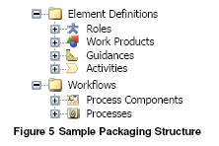
S/W Development Process Components
Process Content/Elements
Workflow
Extensibility Mechanism
Changes, Additions, or the Suppression of Content
Associations in the extended definition

Slide 3
IRIS: Packaging Structure

Slide 4
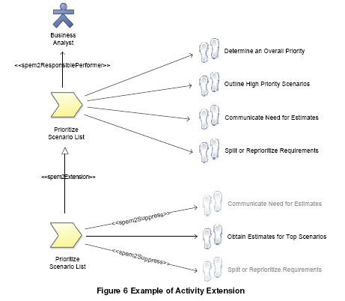
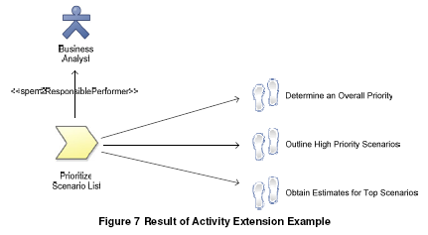
IRIS: Activity Extension

Slide 5
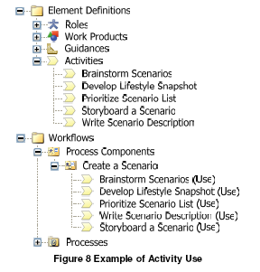
IRIS: Activity Use

Slide 6
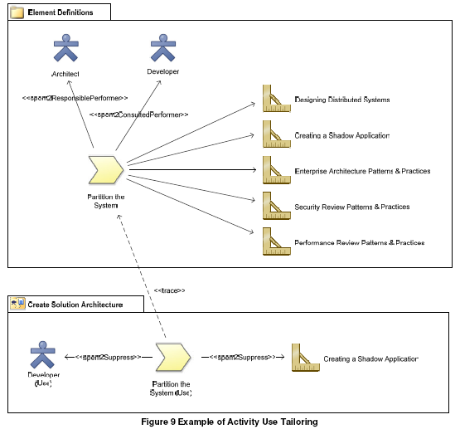
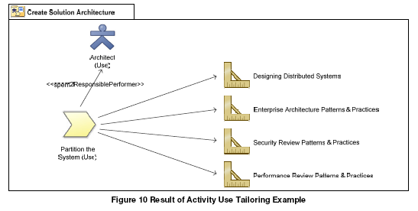
IRIS: Activity Use Tailoring

Slide 7
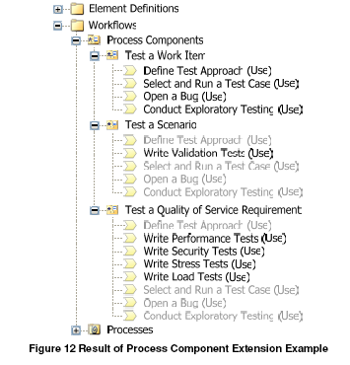
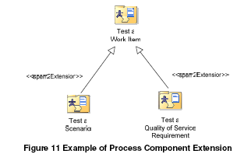
IRIS: Process Component Extension

Slide 8
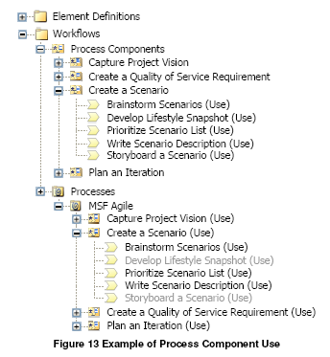
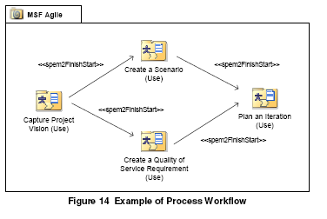
IRIS: Process Workflow

