Slide 1
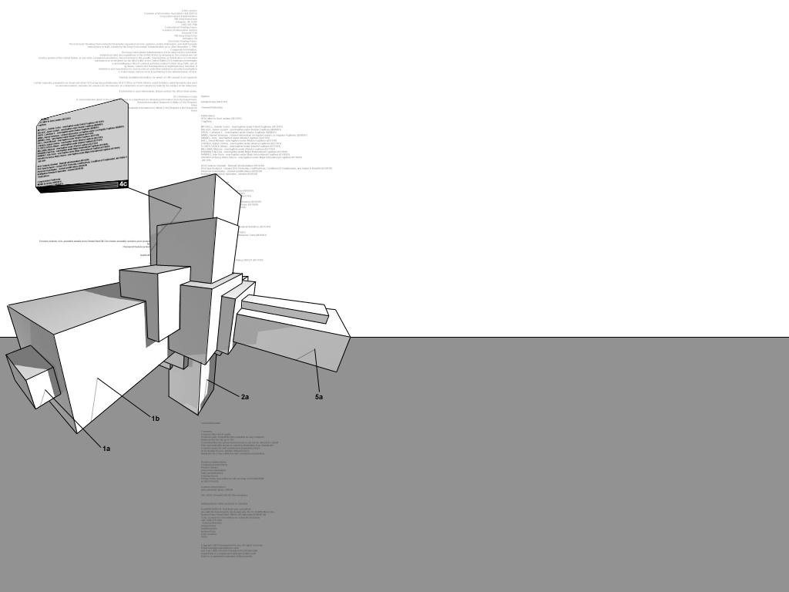


S/W Development Method
명지대학교/한국OMG
최성운

Slide 2
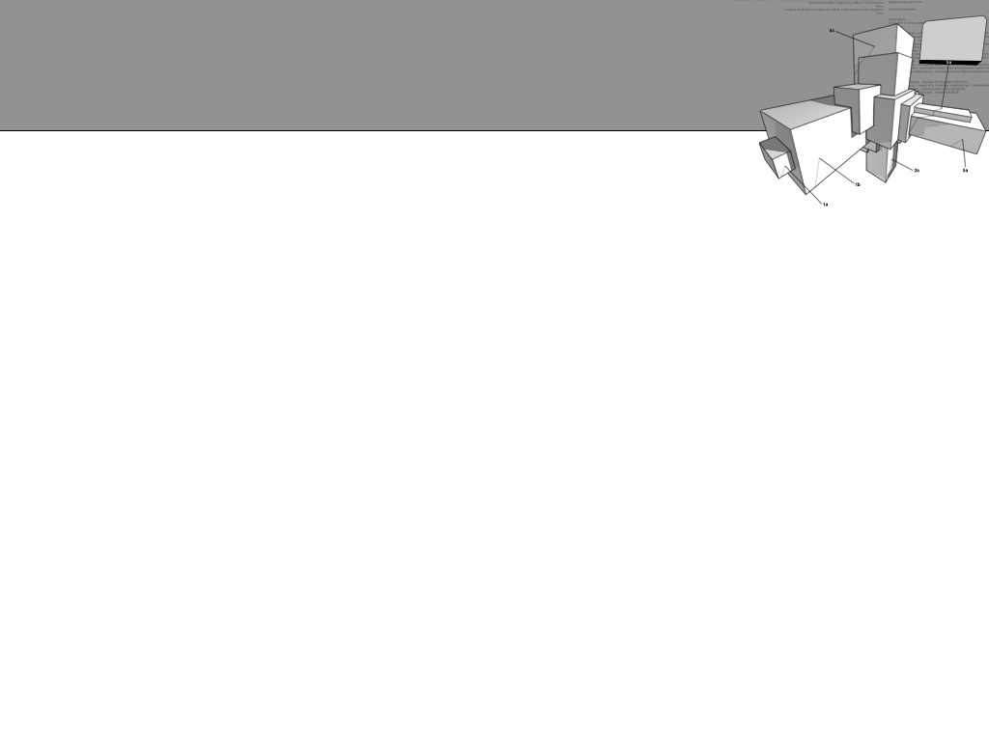

S/W Development Method Design
Key Features
  Process Architecture
  Lifecycle Design
  Process Component Design
  Principles & Mapping Guidelines
Issues
  Usability
  Adaptability
  Efficiency
  Consistency
  Traceability
Risk
Constraint
Domain
Models
Support

Slide 3
S/W Development:
Overview
Needs
Requirement Models
System Models
………………..
………………..
………………..
………………..
………………..
………………..
………………..
………………..
………………..
………………..
………………..
………………..
………………..
………………..
………………..
………………..
………………..
………………..
Stakeholders
Analysts
Developers
Client/Acquirer/ Planner / Owner/ User/ Operator …
Domain Expert/
Analyst/Architect/…
Architect/System Engineer/ Developer/ Designer/ Builder/ Maintainer/ Vendor/ Subcontractor …

Slide 4
S/W Development:
Usecase View
Stakeholder
Analyst
Architect
Designer
Developer
Identify a
Framework
Define
Needs
<<include>>
Develop an
Architecture
<<include>>
Design the
System
Implement
a System
<<include>>
<<include>>
Document
Requirements
<<include>>
<<include>>

Slide 5
Requirement Models
Functional Requirements
Analysis Models
Needs
………………..
………………..
………………..
………………..
………………..
………………..
………………..
………………..
………………..
Use-Case/
Quality Scenario/
Data-Flow/ ……..
Analysis Package/
Logical Models/
Architectural Patterns ……..
………………..
………………..
………………..
Non-Functional Requirements

Slide 6
System Models:
Abstraction Hierarchy
System Models
Implementation View/
Process View/
Deployment View/ …
Architecture:
View Models
Design Models
Class Diagram/
Sequence Diagram/
Flow Chart/ …
Implementation Models
main()
Int I;
Float b;
If (i<b) {
……………..
main()
Int I;
Float b;
If (i<b) {
……………..
main()
Int I;
Float b;
If (i<b) {
……………..
Java/ C#/ COBOL/ …

Slide 7
S/W Development:
From Requirement to System Models
Requirement Models
System Models
 | Concerns
Stake-holders | Needs
Analyst | Functional Requirements | Non-functional Requirements
 | Analysis Models
 | Concerns
Architect | Architecture
Designer | Design Models
Developer | Implementation Models

Slide 8
S/W Development:
Logical View
Needs
Stakeholder
Architecture
Non-Functional
Requirements
Architect
Functional
Requirements
Design Models
Analyst
Designer
Implementation Models
Analysis
Model
Developer

Slide 9
System Models with Multiple Views
 | Development View | Process View
Architecture | Architecture: Implementation Model | Architecture: Process Model
Design Models | Design: Components | Design: Process
Implementation Model | Implementation: Components | Runtime: Process
Source Code/ Configuration/
Development Framework …
Performance/Scalability/
Throughput …
System Topology/ Distribution/ Installation …

Slide 10
S/W Development Process:
Waterfall based
Concerns
Needs
Needs
Requirement Model
Functional
Requirements
Non-functional
Requirements
Analysis Model
Analysis Model
Architecture
Architecture:
Implementation Model
Architecture:
Process Model
Design Model
Design: Components
Design: Process
Implementation Model
Implementation: Components
Runtime: Process

Slide 11
S/W Development Process:
UP based
Transition
Construction
Elaboration
Concerns
Concerns
Inception
Concerns
Stakeholders
Needs
Stakeholders
Needs
Concerns
Stakeholders
Needs
Analyst
Functional
Requirements
Non-functional
Requirements
Needs
Needs
Analyst
Functional
Requirements
Non-functional
Requirements
Analyst
Functional
Requirements
Non-functional
Requirements
Requirement Model
Functional
Requirements
Non-functional
Requirements
Analysis Model
Analysis Model
Analysis Model
Analysis Model
Architect
Architecture:
Implementation Model
Architecture:
Process Model
Analysis Model
Architect
Architecture:
Implementation Model
Architecture:
Process Model
Architect
Architecture:
Implementation Model
Architecture:
Process Model
Architecture
Architecture:
Implementation Model
Designer
Design: Components
Design:
Process
Architecture:
Process Model
Designer
Design: Components
Design:
Process
Designer
Design: Components
Design:
Process
Design Model
Design: Components
Developer
Implementation: Components
Runtime: Process
Design: Process
Developer
Implementation: Components
Runtime: Process
Developer
Implementation: Components
Runtime: Process
Implementation Model
Implementation: Components
Runtime: Process

Slide 12
S/W Development Process:
Model-View-Controller
Concerns
Needs
Needs
Requirement Model
Functional
Requirements
Non-functional
Requirements
Analysis Model
Analysis Model
Application
Data
Architecture
Architecture:
Implementation Model
Architecture:
Process Model
View
Design Model
Design: Components
Design: Process
Implementation Model
Implementation: Components
Runtime: Process

Slide 13
Things to be considered
방법론 Instance 제공, Not model
  프로젝트 유형별 미리 정의된 Engagement Models
  Engagement Model 내에 Project Artifacts, Process Guidance, Technique Papers 제공
프로젝트 수행 산출물 지식 자산화
  정의된 Activity와 수행 산출물간 연계: Meta-Model
  단편적 지식자산
전사 Method 관리조직에서 등록된 Asset을 활용하여 Method의 지속적 Update
  Framework or Meta-Model 기반
Existing Engagement Models/Components
Tailor
Engagement Model Tailored for a Project
Publish

Slide 14
Appendix

Slide 15
Architecture _{[IEEE 1471 ]}
Mission
fulfils 1..*
Environment
influences
System
has an
Architecture
inhabits
described by 1
has 1..*
Stakeholder
identifies
1..*
Architectural
Description
provides
Rationale
is important to
1..*
is addressed to
1..*
participates in
has
1..*
selects
1..*
organized by
1..*
identifies
1..*
Concern
Viewpoint
View
used to
over 1..*
conforms to
participates in 1..*
aggregates
1..*
has source
0..1
consists of 1..*
Library
Viewpoint
Model
establishes
methods for
1..*

Slide 16
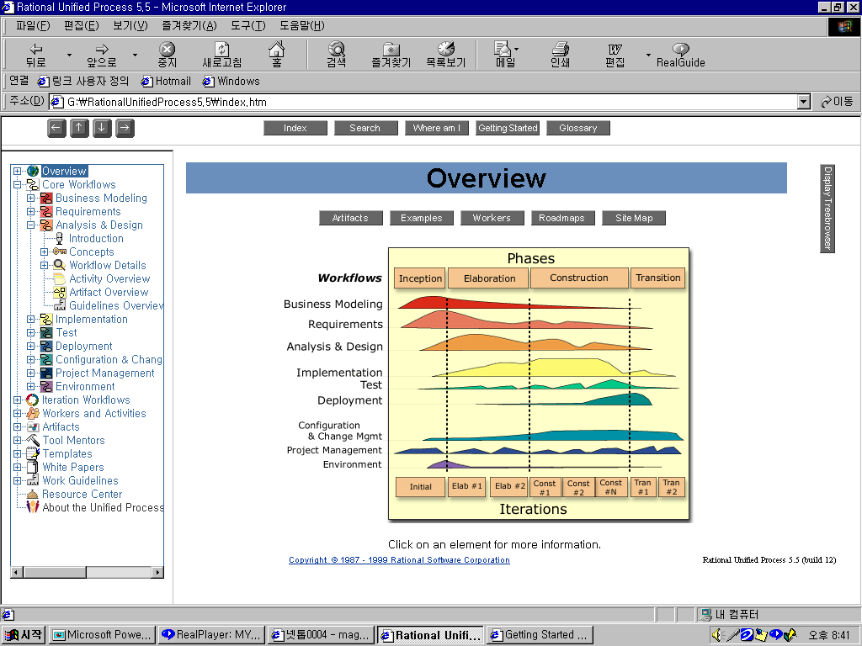
Process & Lifecycle Components
- Unified Process
Workflows
Business Modeling
Requirements
Analysis & Design
Implementation
Test
Deployment
Configuration &
Change Mgmt
Project Management
Environment
Milestones
Conceptual Prototype
Architectural
Baseline
Release
Delivery 1

Slide 17
Asset-Based Development
- Framework & Applications
An approach for planning and developing several similar systems concurrently in order to systematically exploit their commonalities.
  Framework Engineering
    Commonality
  Application Engineering
    Variability
Variability
Commonality
Variability
Framework
Engineering
Generic
Framework
Application
Engineering
Application
System

Slide 18

Service, Component, Object & Function
Coarse Grained
Service
Business Components
Component
Component
Object
Object
Object
Technical Components
Function
Function
Function
Function
Function
Function
Function
Fine Grained

Slide 19
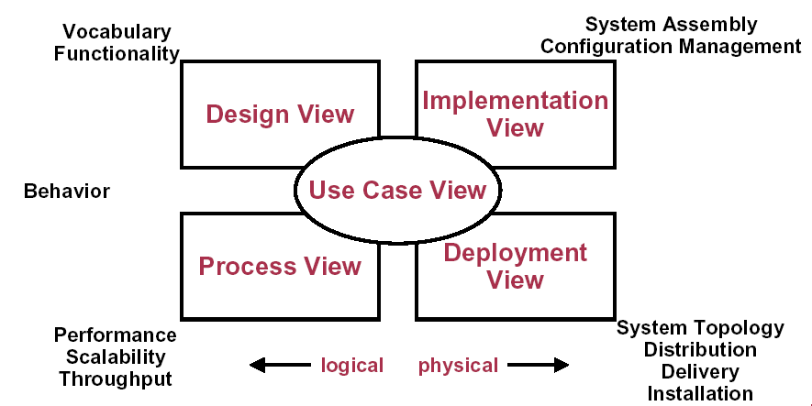
4+1 Views in Unified Process _{[Kruchten]}

Slide 20
Zachman Framework for Enterprise Architecture
abstractions
DATA
What
FUNCTION
How
NETWORK
Where
PEOPLE
Who
TIME
When
MOTIVATION
Why
perspectives
List of Things -
Important to the Business
List of Processes -
the Business Performs
List of Locations -
in which the Business Operates
List of Organizations -
Important to the Business
List of Events -
Significant to the Business
List of Business Goals and Strategies
SCOPE
Planner
contextual
Entity = Class of
Business Thing
Function = Class of
Business Process
Node = Major Business
Location
People = Class of People and
Major Organizations
Time = Major Business Event
Ends/Means=Major Business
Goal/Critical Success Factor
ENTERPRISE
MODEL
Owner
e.g., Semantic Model
e.g., Business Process Model
e.g., Logistics Network
e.g., Work Flow Model
e.g., Master Schedule
e.g., Business Plan
conceptual
Entity = Business Entity
Rel. = Business Relationship
Process = Business Process
I/O = Business Resources
Node = Business Location
Link = Business Linkage
People = Organization Unit
Work = Work Product
Time = Business Event
Cycle = Business Cycle
End = Business Objective
Means = Business Strategy
SYSTEM
MODEL
Designer
e.g., Logical Data Model
e.g., Application Architecture
e.g., Distributed System
Architecture
e.g., Human Interface
Architecture
e.g., Processing Structure
e.g., Business Rule Model
logical
Entity = Data Entity
Rel. = Data Relationship
Process.= Application Function
I/O = User Views
Node = IS Function
Link = Line Characteristics
People = Role
Work = Deliverable
Time = System Event
Cycle = Processing Cycle
End = Structural Assertion
Means =Action Assertion
e.g., Physical Data Model
e.g., System Design
e.g., Technical Architecture
e.g., Presentation Architecture
e.g., Control Structure
e.g., Rule Design
TECHNOLOGY
CONSTRAINED
MODEL
Builder
physical
Entity = Tables/Segments/etc.
Rel. = Key/Pointer/etc.
Process= Computer Function
I/O =Data Elements/Sets
Node = Hardware/System
Software
Link = Line Specifications
People = User
Work = Screen/Device Format
Time = Execute
Cycle = Component Cycle
End = Condition
Means = Action
e.g. Data Definition
e.g. Program
e.g. Network Architecture
e.g. Security Architecture
e.g. Timing Definition
e.g. Rule Specification
DETAILED
REPRESEN-
TATIONS
Subcontractor
out-of-context
Entity = Field
Rel. = Address
Process= Language Statement
I/O = Control Block
Node = Addresses
Link = Protocols
People = Identity
Work = Job
Time = Interrupt
Cycle = Machine Cycle
End = Sub-condition
Means = Step
FUNCTIONING
ENTERPRISE
DATA
Implementation
FUNCTION
Implementation
NETWORK
Implementation
ORGANIZATION
Implementation
SCHEDULE
Implementation
STRATEGY
Implementation
John A. Zachman, Zachman International

Slide 21
Systems and Projects Classification
Higher Technical Complexity
- Embedded, real time, distributed, fault tolerant
- Custom, unprecedented, architecture reengineering
- High performance
Weapon System
Commercial
Compiler
Telecom
Switch
National ATC System
Embedded
Automotive
Software
CASE Tool
Lower
Management
Complexity
- Small scale
- Informal
- Single stakeholder
Higher
Management
Complexity
- Large scale
- Contractual
- Many stakeholder
An average software project:
- 5-10 people
- 10-15 month duration
- 3-5 external interfaces
- Some unknowns, risks
Large scale
Organization/entity
Simulation
Small Scientific
Simulation
IS Application
Distributed Objects
(Order Entry)
Enterprise IS
(Family of IS
Applications)
Defense
MIS system
IS Application
GUI/RDB
(Order Entry)
Business
Spreadsheet
Lower Technical Complexity
- Mostly 4GL, or component based
- Application reengineering
- Interactive Performance

Slide 22
Differentiators₁
Business Context
  Affects the “level of ceremony”, the level of formalism, and the rigidity of the process.
  Contract work, Commercial development, Internal Project
Software Development Effort Size
  Affects the “level of ceremony”, the level of formalism, and the rigidity of the process.
  Source lines of code(SLOC), Delivered source instructions, or Function points, number of person-months, or merely the cost

Slide 23
Differentiators₂
Degree of Novelty
  How “precedented” the software effort is, relative the development organization.
    The maturity level of the organization, its process, its assets, its current skill set, and issues such as assembling and training a team, acquiring tools, and other resources.
Type of Application
  Real-time systems, Distributed information systems, Telecom systems, Case tools, and so on.
  Process issues
    Techniques and tools
    Certification procedures
    Compliance to standards

