Slide 1
Guide to the
Software Engineering
Body of Knowledge
2004 Version

Slide 2
Contents
 | 주제 | 시간 | 강사명
1 | Introduction | 1 | 최성운
2 | Software Requirements | 4 | 송태국
3 | Software Design | 6 | 송태국
4 | Software Construction | 4 | 최성운
5 | Software Testing | 4 | 권원일
6 | Software Maintenance | 2 | 최성운
7 | Software Configuration Management | 2 | 최성운
8 | Software Engineering Management | 4 | 김인현
9 | Software Engineering Process | 4 | 최성운
10 | Software Engineering Tools and Methods | 4 | 최성운
11 | Software Quality | 4 | 최성운
12 | Related Disciplines of Software Engineering | 1 | 최성운

Slide 3
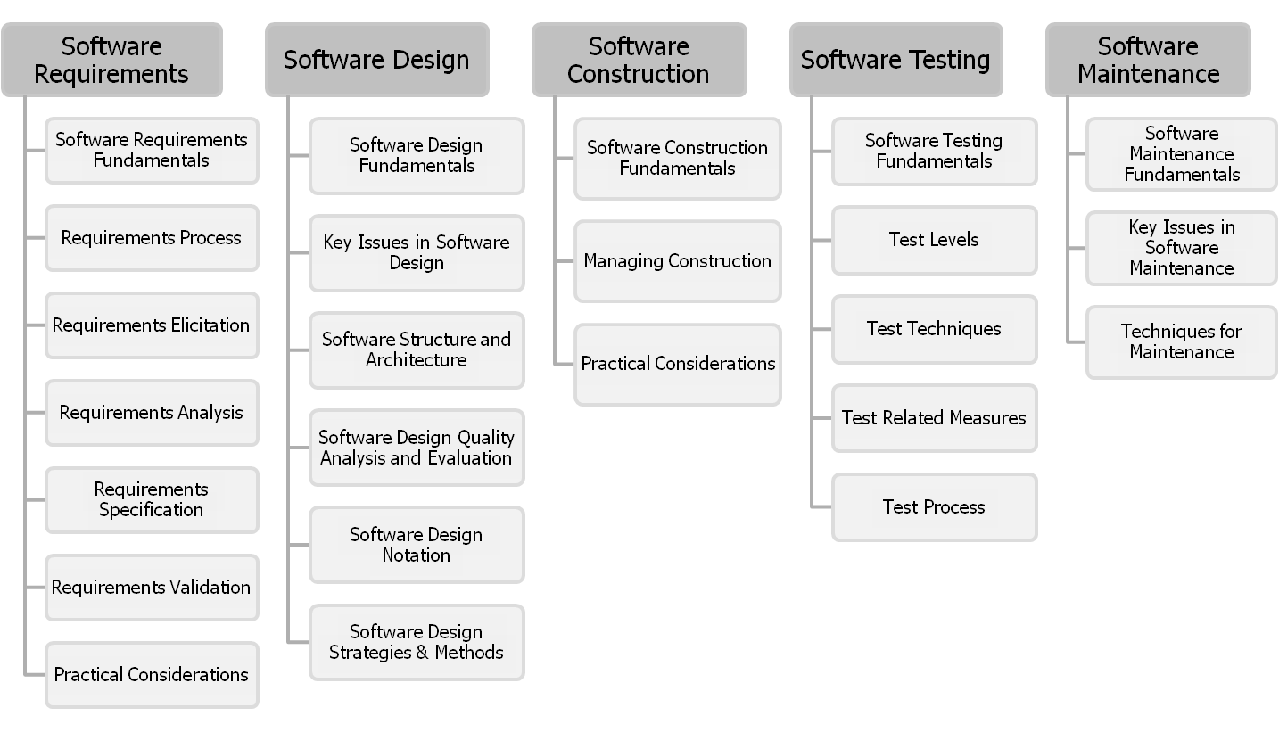
Guide to the SWEBOK₁
2004 Version
Sungwoon Choi
1-<number>

Slide 4
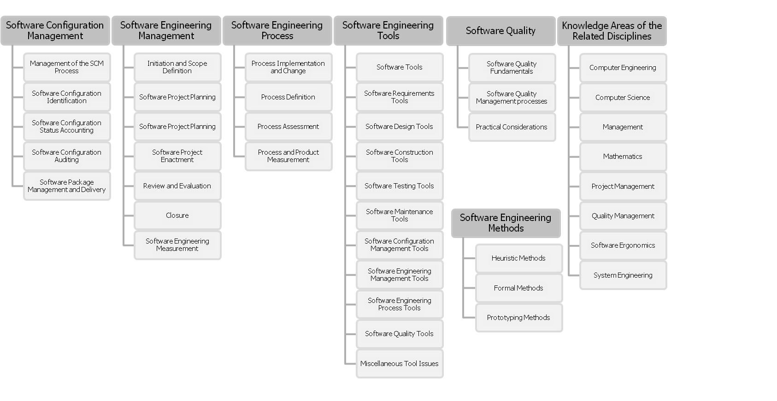
Guide to the SWEBOK₂
2004 Version
Sungwoon Choi
1-<number>

Slide 5
Software Testing KA
Software Testing consists of the dynamic verification of the behavior of a program on a finite set of test cases, suitably selected from the usually infinite executions domain, against the expected behavior.
It includes five subareas.
Sungwoon Choi
1-<number>

Slide 6
Software Testing Subareas₁
Software Testing Fundamentals
  First, the testing-related terminology is presented, then key issues of testing are described, and finally the relationship of testing to other activities is covered.
Test Levels
  These are divided between the targets of the tests and the objectives of the tests.
Test Techniques.
  The first category includes the tests based on the tester’s intuition and experience. A second group comprises specification-based techniques, followed by code-based techniques, fault-based techniques, usage-based techniques, and techniques relative to the nature of the application. A discussion of how to select and combine the appropriate techniques is also presented.
Sungwoon Choi
1-<number>

Slide 7
Software Testing Subareas₂
Test-Related Measures
  The measures are grouped into those related to the evaluation of the program under test and the evaluation of the tests performed.
Test Process
  It includes practical considerations and the test activities.
Sungwoon Choi
1-<number>

