Slide 1
7-Configuration Management

Slide 2
Introduction
A system can be defined as
  A collection of components organized to accomplish a specific function or set of functions (IEEE 610.12-90).
The configuration of a system is the
  The functional and/or physical characteristics of hardware, firmware, or software, or a combination of these, as set forth in technical documentation and achieved in a product. (Buc96)
  It can also be thought of as a collection of specific versions of hardware, firmware, or software items combined according to specific build procedures to serve a particular purpose.
Sungwoon Choi
7-<number>

Slide 3
Configuration management (CM), then, is
  the discipline of identifying the configuration of a system at distinct points in time for the purpose of systematically controlling changes to the configuration, and maintaining the integrity and traceability of the configuration throughout the system life cycle. (Ber97)
It is formally defined (IEEE610.12-90) as
  “A discipline applying technical and administrative direction and surveillance to: identify and document the functional and physical characteristics of a configuration item, control changes to those characteristics, record and report change processing and implementation status, and verify compliance with specified requirements.”
Sungwoon Choi
7-<number>

Slide 4
Software configuration management (SCM) is
  a supporting software life cycle process (IEEE12207.0-96) which benefits project management, development and maintenance activities, assurance activities, and the customers and users of the end product.
Sungwoon Choi
7-<number>

Slide 5
SCM is closely related to the software quality assurance (SQA) activity. As defined in the Software Quality KA, SQA processes provide assurance that the software products and processes in the project life cycle conform to their specified requirements by planning, enacting, and performing a set of activities to provide adequate confidence that quality is being built into the software.
SCM activities help in accomplishing these SQA goals. In some project contexts (see, for example, IEEE730-02), specific SQA requirements prescribe certain SCM activities.
Sungwoon Choi
7-<number>

Slide 6
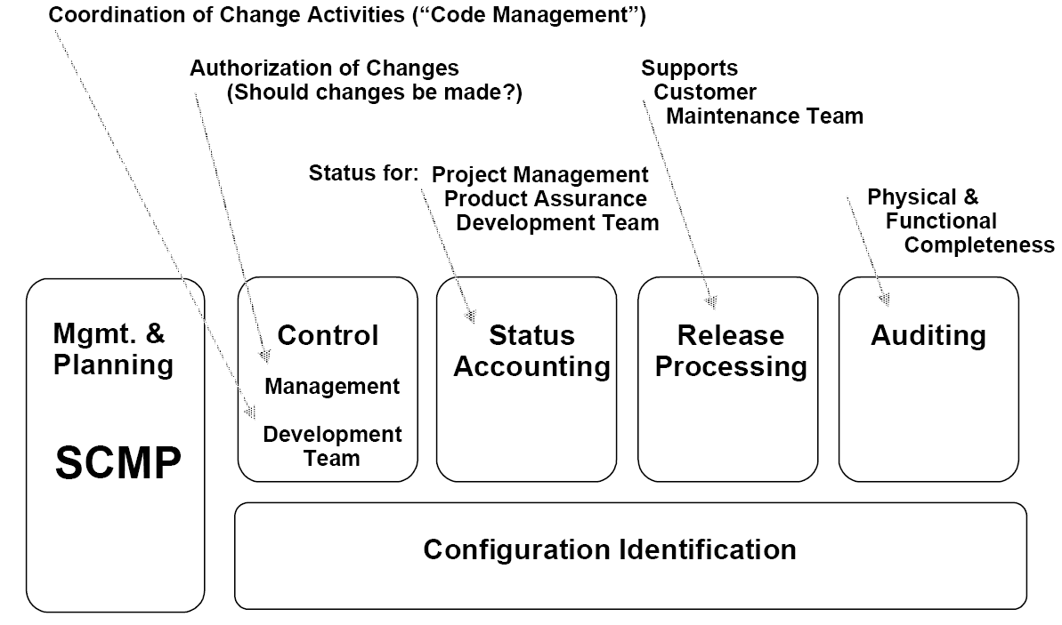
SCM activities
management and planning of the SCM process,
software configuration identification,
software configuration control,
software configuration status accounting,
software configuration auditing, and
software release management and delivery.
Sungwoon Choi
7-<number>

Slide 7
Management of the SCM Process
SCM controls the evolution and integrity of a product by identifying its elements, managing and controlling change, and verifying, recording, and reporting on configuration information. From the software engineer’s perspective, SCM facilitates development and change implementation activities. A successful SCM implementation requires careful planning and management. This, in turn, requires an understanding of the organizational context for, and the constraints placed on, the design and implementation of the SCM process.
Sungwoon Choi
7-<number>

Slide 8
Organizational Context for SCM [Ber92 :c4; Dar90:c2; IEEE828-98:c4s2.1]
Sungwoon Choi
7-<number>

Slide 9

Sungwoon Choi
7-<number>

