Slide 1
Software Configuration Management
SW Engineering Adoption Team
Won-Seok Jang

Slide 2
Index
1. Introduction
2. SCM activities (SWEBOK Contents)
3. SCM Application & Tools
4. Reference

Slide 3
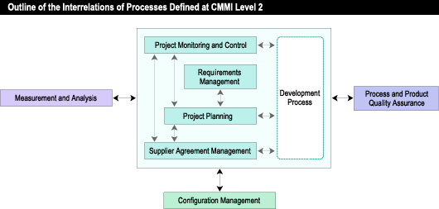
Introduction
Definition
SCM is Software Configuration Management
Manage collections of component functions for their purposes.
Identify of changes of configuration of system.
Maintain the integrity and traceability of configuration.
SCM is Version Management
Verifiy Compliance with Requirements.
Notes:
통일성과 추적성의 유지보수
요구사항에 응낙한다.

Slide 4
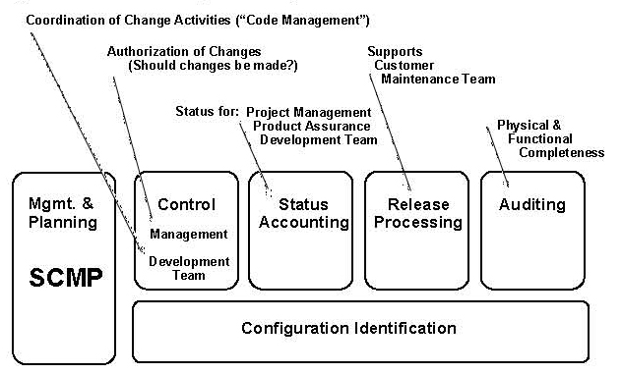
SWEBOK Contents - 1
SCM activities
- SCM Process Mgmt & Planning
- SW Configuration Identification
- SW Configuration Control
- SW Configuration Status Accounting
- SW Configuration Auditing
- SW Release

Slide 5
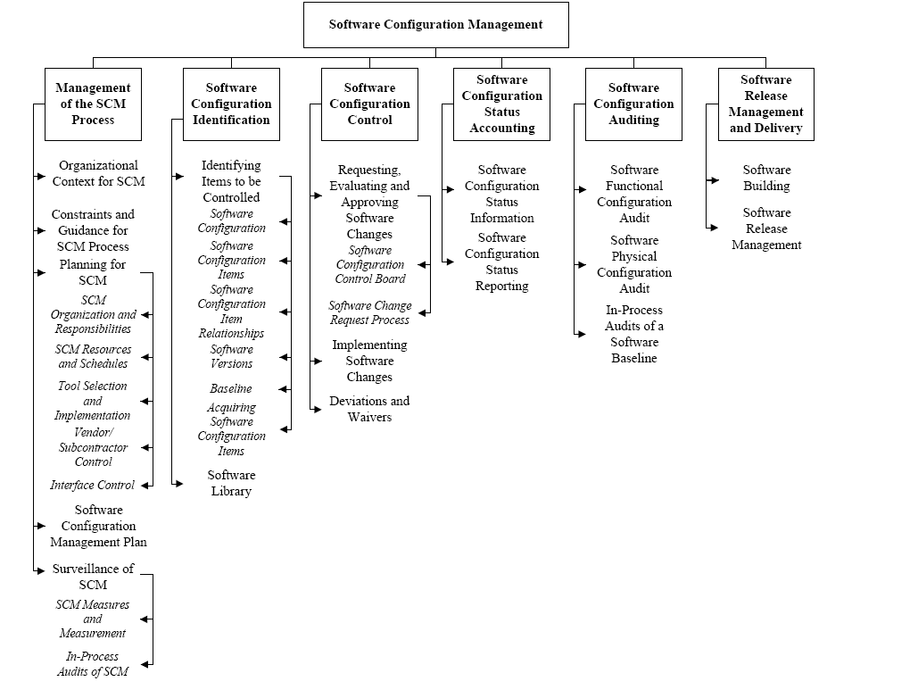
SWEBOK Contents - 2

Slide 6
SWEBOK Contents - 3
Management of the SCM Process
Organizational Context for SCM
Constraints and Guidance for SCM Process
Planning for SCM
Software Configuration Management Plan
Surveillance of SCM
Design
Plan
Surveillance

Slide 7
SWEBOK Contents - 4
Software Configuration Identification
Identifying Items to be Controlled
Software Configuration
Software Configuration Items
Software Configuration Item Relationships
Software Versions
Baseline
Acquiring Software Configuration Items
Software Library
Developer’s choice

Slide 8
SWEBOK Contents - 5
Software Configuration Control
Requesting, Evaluating and Approving Software Changes
Implementing Software Changes
Deviations and Waivers

Slide 9
SWEBOK Contents - 6
Software Configuration Status Accounting
Software Configuration Status Information
Software Configuration Status Reporting

Slide 10
SWEBOK Contents - 7
Software Configuration Auditing
Software Functional Configuration Audit
Software Physical Configuration Audit
In-Process Audits of a Software Baseline

Slide 11
SWEBOK Contents - 8
Software Release Management and Delivery
Software Building
Software Release Management

Slide 12
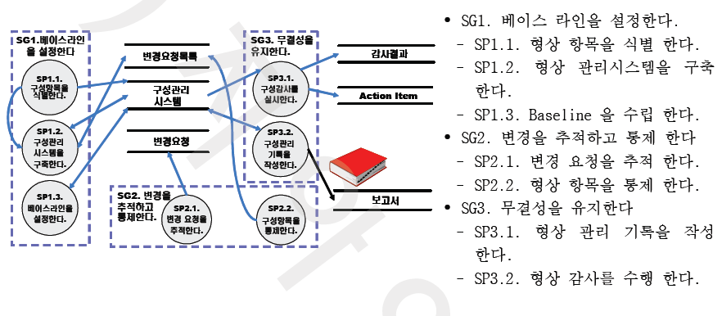
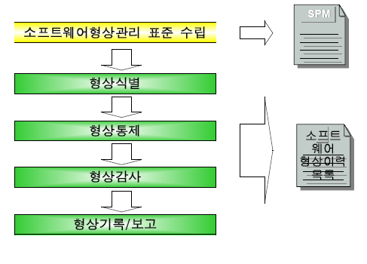
SCM Application - 1
기업 S
기업 G
단체 C

Slide 13
SCM Application - 2
SVN repository
trac
IMS
(Issue Management System)
소스
SW 제품
릴리즈
소스
소스 리뷰
버전/ 릴리즈 관리
Source Control
Web Interface
Testing / Bug report
개발자
QA
개발자
QA
기업 T

Slide 14
SCM Tools
Name | Features
Aegis | Transaction-based software configuration management system.
Bazaar | Written in Python and designed for correctness, performance, simplicity, and familiarity for developers who are familiar with CVS or Subversion. (using distributed system)
BitKeeper | BitKeeper is a very powerful, capable and reliable version control system, that supports copies, moves and renames, atomic commits, changesets, distributed repositories and propagation of changesets, 3-way merging, etc.
ClearCase | ClearCase is developed by the Rational Software division of IBM. ClearCase forms the base of version control for many large and medium sized businesses and can handle projects with hundreds or thousands of developers.
CVS | The Concurrent Versions System (CVS), also known as the Concurrent Versioning System, is a free software revision control system in the field of software development.
GIT | Git is a free & open source, distributed version control system designed to handle everything from small to very large projects with speed and efficiency.
Perforce | Founded in 1995, Perforce Software develops, markets, and supports Perforce, the Fast Software Configuration Management (SCM) System.
Subversion | Subversion (SVN) is a version-control system initiated in 2000 by CollabNet Inc. it became a top-level Apache project on February 17 2010
TFS | Microsoft Visual Studio Team System 2008 Team Foundation Server (TFS) is a team collaboration platform that combines team portal, version control, work-item tracking, build management, process guidance, and business intelligence into a unified server.
Visual SourceSafe | Microsoft Visual SourceSafe (VSS) is a source control software package oriented towards small software development projects. Like most source control systems, SourceSafe creates a virtual library of computer files. Prior versions have been shown to be unstable when confronted with large amounts of non-textual data (images, binary executables, etc).

Slide 15
SCM Tools Comparison
 | Atomic Commit | Move Rename | Intelligent move /rename | Copy | Repository Replication | Changes Parent Repository | Repository Permissions | Changeset’s Support | Tracking Line-wise File Histor y
Aegis | Yes | Yes | - | No | Yes | Yes | Yes | Yes | Yes
Bazaar | Yes | Yes | Yes | No | Yes | Yes | Yes | Yes | Yes
BitKeeper | Yes | Yes | - | Yes | Yes | Yes | Yes | Yes | Yes
ClearCase | Yes | Yes | Yes | Yes | - | Yes | Yes | - | Yes
CVS | No | No | No | No | Partial | No | Partial | No | No
GIT | Yes | Yes | No | No | Yes | Yes | Yes | Yes | Yes
Perforce | Yes | Yes | Partial | Yes | Yes | - | Yes | Yes | Yes
Subversion | Yes | Yes | No | Yes | Partial | Yes | Yes | Partial | Yes
TFS | Yes | Yes | - | Yes | No | No | Yes | Yes | Yes
Visual SourceSafe | No | Partial | No | Yes | Partial | Partial | Partial | No | Partial

Slide 16
SCM Tools Comparison
 | Work only One Directory | Tracking Uncommited | Per-file commit Message | Documentation | Ease of Deployment | Command Set | Network Support | Portability | Web Interface | GUI
Aegis | No | Yes | - | Medium | Good | Complex | Poor | Medium | Yes | Yes
Bazaar | Yes | Yes | No | Execellent | Very Easy | Good | Excellent | Good | Yes | Yes
BitKeeper | No | Yes | Yes | Very Good | Good | Good | Good | Good | Yes | Yes
ClearCase | Yes | Yes | Yes | Good | Poor | Excellent | Poor | Medium | Yes | Yes
CVS | Yes | Yes | No | Execellent | Good | Simple | Good | Good | Yes | Yes
GIT | No | Yes | No | Medium | Good | Good | Excellent | - | Yes | Yes
Perforce | Yes | Yes | No | Very Good | Good | Good | Good | Excellent | Yes | Yes
Subversion | Yes | Yes | No | Very Good | Good | Good | Very Good | Excellent | Yes | Yes
TFS | Yes | Yes | No | Good | Complex | - | Good | - | Yes | Yes
Visual SourceSafe | Yes | Yes | No | Medium | Very Good | - | Good | - | No | Yes

Slide 17
Reference
http://www.bitkeeper.com/Comparisons.html - BitKeeper Hompage
http://better-scm.berlios.de/comparison/ - Better SCM Homepage (last updated 2009.05)
SWEBOK
Software Engineering, 7th Edition - Ian Sommerville 2004

Slide 18
Thank you!

