Slide 1
8-Software Engineering Management
명지대학교/OMG Korea
최성운
choisw@mju.ac.kr

Slide 2
Introduction
Software Engineering Management can be defined as
  the application of management activities
    planning,
    coordinating,
    measuring,
    monitoring,
    controlling, and
    reporting
  to ensure that the development and maintenance of software is systematic, disciplined, and quantified (IEEE610.12-90).
The Software Engineering Management KA addresses
  the management and measurement of software engineering.
  While measurement is an important aspect of all KAs, it is here that the topic of measurement programs is presented.

Slide 3
Aspects specific to software products and the software life cycle processes
Perception of clients
  is such that there is often a lack of appreciation for the complexity inherent in software engineering, particularly in relation to the impact of changing requirements.
Iterative
  It is almost inevitable that the software engineering processes themselves will generate the need for new or changed client requirements. As a result, software is often built in an iterative process rather than a sequence of closed tasks.
Creative
  Software engineering necessarily incorporates aspects of creativity and discipline—maintaining an appropriate balance between the two is often difficult.
Rapid rate of change in the underlying technology

Slide 4
Engineering
Engineering
  The creative application of scientific principles to design or develop structures, machines, apparatus, or manufacturing processes, or works utilizing them singly or in combination;
    or to construct or operate the same with full cognizance of their design;
    or to forecast their behavior under specific operating conditions;
    all as respects an intended function, economics of operation and safety to life and property.
  [American Engineers' Council for Professional Development (ECPD)]
  The discipline, art and profession of acquiring and applying technical, scientific, and mathematical knowledge to design and implement materials, structures, machines, devices, systems, and processes that safely realize a desired objective or invention.
  [Wikipedia]

Slide 5

Manufacturing vs. Engineering
Production
  Research, Engineering, Manufacturing
Engineering
  Requirement, Design, Implementation
Engineering
Move Ax,Bx;
if(Ax>Bx){
Cx=Ax*Bx;
Dx=Cx/Ax;
}.....

Slide 6
Management
The directing of a group of people or entities toward a goal
  Planning: Deciding what needs to happen in the future (today, next week, next month, next year, over the next 5 years, etc.) and generating plans for action.
  Organizing: (Implementation) making optimum use of the resources required to enable the successful carrying out of plans.
  Staffing: Job Analyzing, recruitment, and hiring individuals for appropriate jobs.
  Leading/Directing: Determining what needs to be done in a situation and getting people to do it.
  Controlling/Monitoring: Checking progress against plans, which may need modification based on feedback.
Organizing
Planning/Monitoring/Controlling
Resource
Process
Product
Staffing/Leading/Directing

Slide 7
S/W Engineering Characteristics
Easily Reversible
  Source-code lines vs. Materials
Invisible/Intangible
  Intellectual Process
Lack of Appreciation of the Complexity of Change
Iterative Process
Needs quantifiable milestone
with visible work-product
for the effective management !!
Hard to Manage
Document

Slide 8
SE Management Activities
Organizational and infrastructure management
Project management
Measurement program planning and control
Organizing
Planning/Monitoring/Controlling
Resource
Process
Product
Staffing/Leading/Directing

Slide 9
Software Engineering Management Subareas
Software Project Management Process
  The activities that are undertaken in order to ensure that the software engineering processes are performed in a manner consistent with the organization’s policies, goals, and standards.
Software Engineering Measurement
  The assignment of values and labels to aspects of software engineering (products, processes, and resources as defined by [Fen98]) and the models that are derived from them, whether these models are developed using statistical, expert knowledge or other techniques.

Slide 10
SE management KA Subareas
Initiation & Scope Definition
Determination & Negotiation of Requirements
Software Project Planning
Process Planning
Software Project Enactment
Review & Evaluation
Closure
Feasibility Analysis
Process for the Review and Revision of Requirements
Determine Deliverables
Determining Satisfaction of Requirements
Reviewing & Evaluating Performance
Effort Schedule and Cost Estimation
Resource Allocation
Risk Management
Quality Management
Plan Management
Implementation of Plans
Supplier Contract Management
Implementation of Measurement Process
Monitor Process
Control Process
Reporting
Determining Closure
Closure Activities
SW Engineering Measurement
Establish & Sustain Measurement Commitment
Plan the Measurement Process
Perform the Measurement Process
Evaluate Measurement
IEEE/EIA 12207 Management Process

Slide 11
Software Lifecycle Processes
- Roles & Relationships
Organizational Context
Goal/Policy/Strategy
Supporting Context
Standard
Tools
Configuration Management
Quality Assurance
Business Context
Business
Manager
Supply
Process
contract
Acquisition
Process
Business
Manager
employ
Project Context
Supplier Perspective
employ
employ
Acquirer Perspective
Project
Manager
Project
Management
Process
Audit
Process
Project
Management
Process
Manager
employ
employ
System Context
Developer
Maintainer
Development
Process
employ
Maintenance
Process
employ
Operation
Process
Operator
User

Slide 12
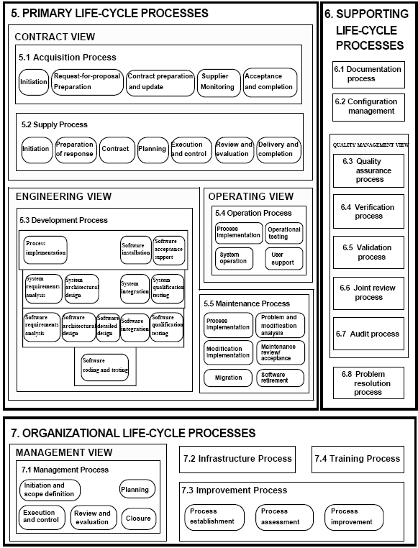
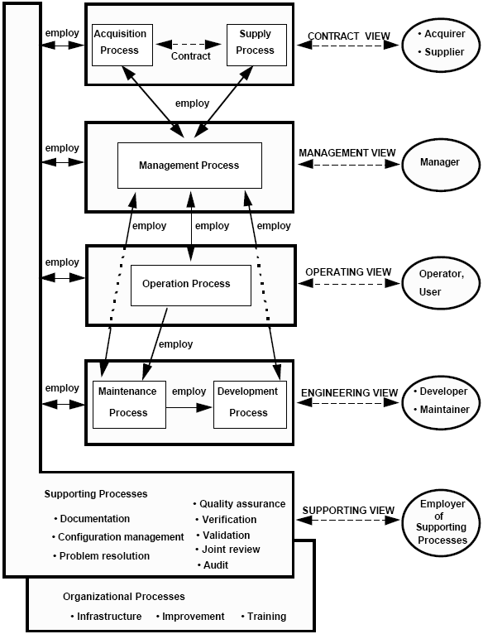
IEEE 12207
Software Lifecycle Processes

Slide 13
Engineering vs. Management
Engineering
Project
Management
Process
Plan
Initiation & Scope Definition
Software Project Planning
Monitor
Activity
Software Project Enactment
Review & Evaluation
SW Engineering Measurement
Control
Closure
Closure
Task

Slide 14
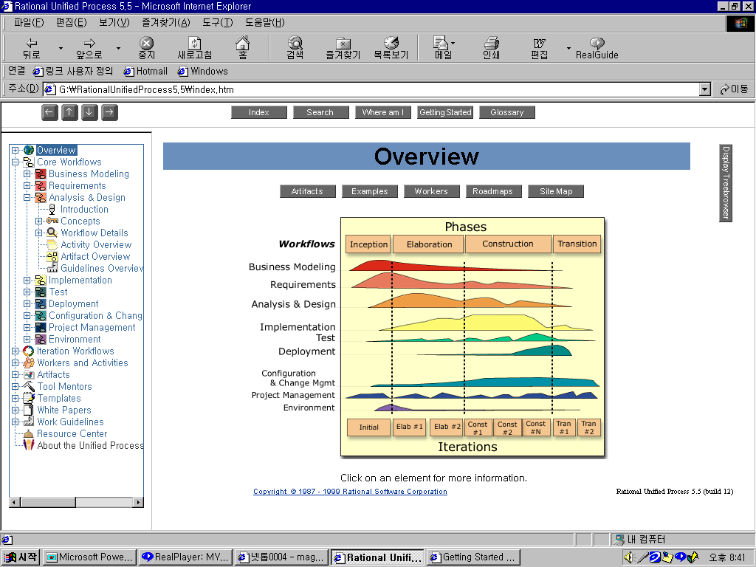
Unified Process
Workflows
Business Modeling
Requirements
Analysis & Design
Implementation
Test
Deployment
Configuration &
Change Mgmt
Project Management
Environment
Milestones
Conceptual Prototype
Architectural
Baseline
Release
Delivery 1

Slide 15
PMBOK
(Project Management Body of Knowledge)
Project Management
4. Project Integration
Management
5. Project Scope
Management
6. Project Time
Management
4.1
Project Plan Development
4.2
Project Plan Execution
4.3
Overall Change Control
5.1 Initiation
5.2 Scope Planning
5.3 Scope Definition
5.4 Scope Verification
5.5 Scope Change Control
6.1 Activity Definition
6.2 Activity Sequencing
6.3 Activity Duration Estimating
6.4 Schedule Development
6.5 Schedule Control
7. Project Cost
Management
8. Project Quality
Management
9. Project Human Resource
Management
7.1 Resource Planning
7.2 Cost Estimating
7.3 Cost Budgeting
7.4 Cost Control
8.1 Quality Planning
8.2 Quality Assurance
8.3 Quality Control
9.1 Organizational Planning
9.2 Staff Acquisition
9.3 Team Development
10. Project
Communication Management
11. Project Risk
Management
12. Project Procurement
Management
10.1 Communications Planning
10.2 Information Distribution
10.3 Performance Reporting
10.4 Administrative Closure
11.1 Risk Identification
11.2 Risk Quantification
11.3 Risk Response Development
11.4 Risk Response Control
12.1 Procurement Planning
12.2 Solicitation Planning
12.3 Solicitation
12.4 Source Selection
12.5 Contract Administration
12.6 Contract Close-out

Slide 16
Project Management Process & Workload
착수
프로세스
계획
프로세스
작업수준
실행
계획
정보흐름
통제
프로세스
실행
프로세스
착수
종료
통제
종료
프로세스
시작
시간
완료

Slide 17
Project Management
Process Activities
착수
계획
실행
통제
종료
범위 관리
-개시
범위 계획 수립
범위 확정
범위 검증
범위 변경통제
일정 관리
Activity 정의
Activity 배열
작업 기간 산정
일정 개발
일정 컨트롤
재무 관리
자원 계획 수립
원가 산정
원가 예산 편성
원가 컨트롤
품질 관리
품질 계획 수립
품질 보증
품질 컨트롤
자원 관리
조직 계획 수립
인원 획득
팀 개발
의사소통 관리
의사소통 계획 수립
정보 배포
성과 보고
의사소통
종료
위험 계획 수립
위험 식별
정성적 / 정량적 위험 분석
위험 통제
및 컨트롤
위험관리
위험 대처계획 수립
조달관리
조달계획
계약 협상 -계약체결
주문
행정
계약 이행
통제
계약 종료
고객 관계
관리
고객 정보 수집
Commitment 획득
Partnership 구축
고객 관계 유지

Slide 18
1. Initiation & Scope Definition

Slide 19
Initiation & Scope Definition
The focus of this set of activities is on
  the effective determination of software requirements via various elicitation methods
    Interviews, Scenarios, Prototypes, Facilitated meetings, Observation, …
  the assessment of the project’s feasibility from a variety of standpoints.
    Budget, Staffing, Technology, Schedule, …
Once feasibility has been established, the remaining task within this process is the specification of
  requirements validation and
  change procedures (see also the Software Requirements KA).
Determination & negotiation of requirements
Assessment of the project’s feasibility
Specification of requirements validation
Specification of change procedures

Slide 20
Determination and Negotiation of Requirements
Software requirement methods for requirements
  elicitation (for example, observation),
  analysis (for example, data modeling, use-case modeling),
  specification, and validation (for example, prototyping)
must be selected and applied,
taking into account the various stakeholder perspectives.
This is always an important activity, as it sets the visible boundaries for the set of tasks being undertaken, and is particularly so where the novelty of the undertaking is high. Additional information can be found in the Software Requirements KA.
  Project Scope
  Objectives
  Constraints
Visible boundaries
of the project

Slide 21
Feasibility Analysis₁
Software engineers must be assured that adequate capability and resources are available in the form of
  people,
  expertise,
  facilities,
  infrastructure, and
  support (either internally or externally)
to ensure that the project can be successfully completed in a timely and cost-effective manner
  using, for example, a requirement-capability matrix
This often requires some “ballpark” estimation of effort and cost based on appropriate methods
  for example, expert-informed analogy techniques

Slide 22
Feasibility Analysis₂
Resource
  Hardware/Software
  Work Space
Staffing
  Engineers/Managers
Technical
  Functionality/Quality
Schedule
Financial
  Budget/Cost
Social/Political
  Communication
  Strategy

Slide 23
Process for the Review and Revision of Requirements
Change Management
  Given the inevitability of change, it is vital that agreement among stakeholders is reached at this early point as to the means by which scope and requirements are to be reviewed and revised
    for example, via agreed change management procedures
  This clearly implies that scope and requirements will not be “set in stone” but can and should be revisited at predetermined points as the process unfolds
    for example, at design reviews, management reviews
If changes are accepted, then some form of
  traceability analysis and
  risk analysis
should be used to ascertain the impact of those changes.

Slide 24
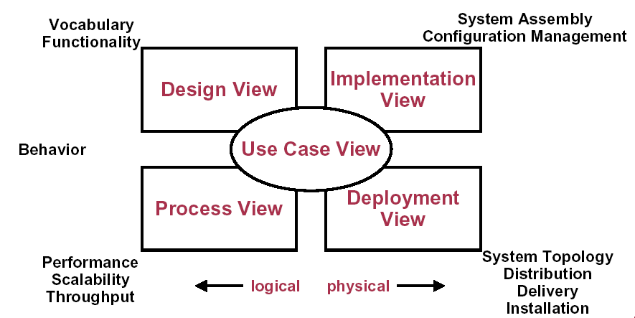
4+1 Views in Unified Process _{[Kruchten]}

Slide 25
Software Project Planning

Slide 26
Planning: Activities
The iterative planning process is informed by the scope and requirements and by the establishment of feasibility.
Software life cycle processes are evaluated and the most appropriate is selected
  given the nature of the project, its degree of novelty, its functional and technical complexity, its quality requirements, and so on.
The project itself is then planned in the form of
  a hierarchical decomposition of tasks,
  the associated deliverables of each task specified and characterized in terms of quality and other attributes in line with stated requirements, and
  detailed effort, schedule, and cost estimation is undertaken.
Resources are then allocated to tasks and adherence to schedule
  so as to optimize personnel productivity (at individual, team, and organizational levels), equipment and materials utilization.
Detailed risk management is undertaken
  and the “risk profile” of the project is discussed among, and accepted by, all relevant stakeholders.
Comprehensive software quality management processes are determined
  as part of the planning process in the form of procedures and responsibilities for software quality assurance, verification and validation, reviews, and audits (see the Software Quality KA).
As an iterative process, it is vital that the processes and responsibilities for ongoing plan management, review, and revision are also clearly stated and agreed

Slide 27
Planning: Activities in Project Management
Planning Processes
Core Processes
Scope
Planning
Activity
Sequencing
Activity
Definition
Schedule
Development
Activity
Duration
Estimating
Scope
Definition
Resource
Planning
Cost
Budgeting
Initial
Process
Cost
Estimating
Project Plan
Development
Risk Mng.
Planning
Plan
Process
Facilitating Processes
Control
Process
Quality
Planning
Organizational
Planning
Staff
Acquisition
Procurement
Planning
Solicitation
Planning
Communications
Planning
Risk
Identification
Qualitative
Risk Analysis
Quantitative
Risk Analysis
Risk Response
Planning

Slide 28
Process Planning
Selection of the appropriate software life cycle model
  for example, spiral, evolutionary prototyping
The adaptation and deployment of appropriate software life cycle processes
Relevant methods and tools are also selected
At the project level, appropriate methods and tools are used to decompose the project into
  tasks, with associated inputs, outputs, and
  completion conditions (for example, work breakdown structure).
This in turn influences decisions on the project’s high-level schedule and organization structure.

Slide 29
Determine Deliverables
The product(s) of each task are specified and characterized
  for example, architectural design, inspection report
Evaluation of opportunities
  to reuse software components from previous developments or
  to utilize off-the-shelf software products
Use of third parties and procured software are planned and suppliers are selected.

Slide 30
Effort, Schedule, and Cost Estimation
The expected effort range required for each task is determined
  using a calibrated estimation model based on historical size-effort data where available and relevant, or other methods like expert judgment
  based on the breakdown of tasks, inputs, and outputs.
Task dependencies are established
Potential bottlenecks are identified using suitable methods
  for example, critical path analysis.
Bottlenecks are resolved where possible.
The expected schedule of tasks with projected start times, durations, and end times is produced
  for example, PERT chart
Resource requirements (people, tools) are translated into cost estimates
This is a highly iterative activity which must be negotiated and revised until consensus is reached among affected stakeholders
  primarily engineering and management

Slide 31
Resource Allocation
Equipment, facilities, and people are associated with the scheduled tasks, including the allocation of responsibilities for completion
  for example using a Gantt chart
This activity is informed and constrained
  by the availability of resources and their optimal use under these circumstances, as well as
  by issues relating to personnel for example,
    productivity of individuals/teams,
    team dynamics,
    organizational and team structures

Slide 32
Typical Resource Estimates in UP
1. 개요
Beta
95% Functions
85% Quality
Initial Domain Model(10-20%)
Delivery
100%
Domain Model(80%)
Build Solution
Understand Solution
Install Solution
Understand Problem
Construction
Inception
Elaboration
Transition
Lifecycle
Objective
Milestone
Lifecycle
Architecture
Milestone
Initial
Operational
Capability
Time
Schedule 10% 30% 50% 10%
Effort 5% 20% 65% 10%
Example project: 2 year schedule, 200 staff-months
Months 2.5 7 12 2.5
People 4 6 11 8
Notes:
기존의 Waterfall Development에서 실질적으로 Iterative Development을 가장 자연스럽게 적용할 수 있는 방법으로 OOT가 인식됨.
위의 프로세스는 먼저 4개의 단계(Inception, Elaboration, Construction, Transition)로 구성되고, 각 단계는 업무의 복잡도에 따라 기존의 폭포수 개발에서 적용하는 단계(분석, 설계, 구현, 테스트 등)들을 필요한 만큼 반복(One Iteration)하여 원하는 어플리케이션을 최단 시일 내에 개발할 수 있게 하여 줌. 특히 Risk가 완전히 검증되지 않은 신기술을 적용하는 프로젝트에서 Risk Avoiding을 위한 훌륭한 방법임.

Slide 33
Risk Management
Risk identification and analysis
  what can go wrong, how and why, and what are the likely consequences
Critical risk assessment
  which are the most significant risks in terms of exposure, which can we do something about in terms of leverage
Risk mitigation and contingency planning
  formulating a strategy to deal with risks and to manage the risk profile
Risk assessment methods should be used in order to highlight and evaluate risks - for example, decision trees and process simulations
Project abandonment policies should also be determined at this point in discussion with all other stakeholders.
Risk Management Framework

Slide 34
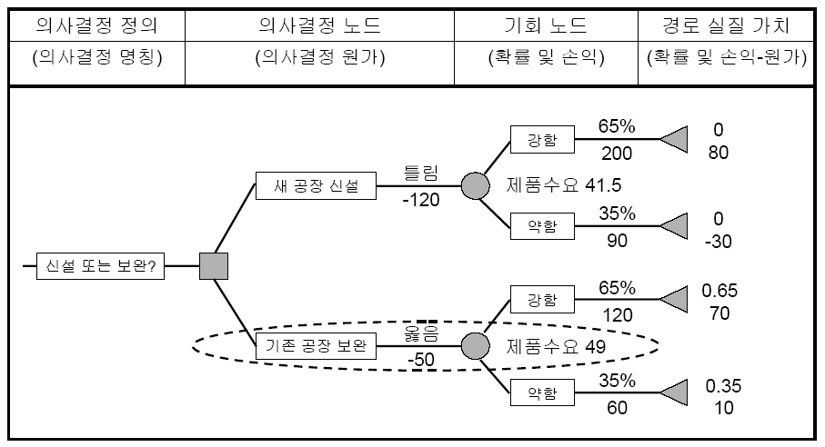
Decision Tree

Slide 35
Quality Management
Quality
  pertinent attributes of
  the specific project and any associated product(s),
  perhaps in both quantitative and qualitative terms.
  Quality characteristics will have been determined in the specification of detailed software requirements.
Thresholds for adherence to quality are set for each indicator as appropriate to stakeholder expectations for the software at hand.
Procedures are specified at this stage
  relating to ongoing SQA throughout the process and
  for product (deliverable) verification and validation
  for example, technical reviews and inspections

Slide 36
Plan Management
How the project will be managed and how the plan will be managed must also be planned.
  Reporting, monitoring, and control (management) of the project
    must fit the selected software engineering process and the realities of the project, and
    must be reflected in the various artifacts that will be used for managing it.
But, in an environment where change is an expectation rather than a shock, it is vital that plans are themselves managed.
  This requires that adherence to plans be systematically directed, monitored, reviewed, reported, and, where appropriate, revised.
  Plans associated with other management-oriented support processes also need to be managed in the same manner
    for example, documentation, software configuration management, and problem resolution

Slide 37
프로젝트 베이스라인 개정
일반적으로 모든 편차가 시정조치를 통해 해결될 수 있는 것이 아니므로, 필요에 따라 프로젝트의 베이스라인 계획을 개정한다.
베이스라인 개정 절차
베이스라인 개정 문서화 가치
제기된 개정 파악
프로젝트 팀원이 베이스라인 개정을 인지하게 함
무단 개정을 방지함
모든 프로젝트 베이스라인의 버전 기록을 제공함
모든 프로젝트 팀원들이 현재의 베이스라인을 기준으로 작업하는 것을 확신하게 함
베이스라인의 무결성을 유지함
품질, 원가, 일정 등 영향 분석
승인을 득한 후 개정 완료
관련 요소를 프로젝트 계획에 반영
계약사항 변경, 비 계약사항 변경
베이스라인 무결성 유지
Notes:
통합 관리
3. 통합 변경 컨트롤

Slide 38
Software Project Enactment

Slide 39
Introduction
The plans are then implemented, and
  the processes embodied in the plans are enacted.
Fundamental to enactment are the ongoing management activities of
  measuring,
  monitoring,
  controlling, and
  reporting.

Slide 40
Implementation of Plans
The project is initiated and the project activities are undertaken according to the schedule.
In the process,
  resources are utilized and
    for example, personnel effort, funding
  deliverables are produced
    for example, architectural design documents, test cases

Slide 41
Supplier Contract Management
Prepare and execute agreements with suppliers,
monitor supplier performance, and
accept supplier products,
incorporating them as appropriate.

Slide 42
Implementation of measurement process
The measurement process is enacted alongside the software project, ensuring that relevant and useful data are collected.

Slide 43
Monitor Process₁
Adherence to the various plans is assessed continually and at predetermined intervals.
  Outputs and completion conditions for each task are analyzed.
  Deliverables are evaluated in terms of their required characteristics
    for example, via reviews and audits
  Effort expenditure, schedule adherence, and costs to date are investigated, and resource usage is examined.
  The project risk profile is revisited, and adherence to quality requirements is evaluated.

Slide 44
Monitor Process₂
Measurement data are modeled and analyzed.
Variance analysis based on the deviation of actual from expected outcomes and values is undertaken. This may be in the form of cost overruns, schedule slippage, and the like.
Outlier identification and analysis of quality and other measurement data are performed
  for example, defect density analysis
Risk exposure and leverage are recalculated, and decisions trees, simulations, and so on are rerun in the light of new data.
These activities enable problem detection and exception identification based on exceeded thresholds.
Outcomes are reported as needed and certainly where acceptable thresholds are surpassed.

Slide 45
Controlling Process
Controlling Processes
Performance
Reporting
Integrated
Change Control
계획
프로세스
실행
프로세스
입력
Facilitating Processes
실행
프로세스
Scope
Verification
Scope Change
Control
Schedule
Control
종결
프로세스
Cost
Control
Quality
Control
Risk Monitoring
And Control

Slide 46
Control Process
The outcomes of the process monitoring activities provide the basis on which action decisions are taken.
Where modeled and managed, changes can be made to the project.
  This may take the form of corrective action
    for example, retesting certain components
  it may involve the incorporation of contingencies so that similar occurrences are avoided
    for example, the decision to use prototyping to assist in software requirements validation
  it may entail the revision of the various plans and other project documents to accommodate the unexpected outcomes and their implications
    for example, requirements specification
In all cases,
  change control and software configuration management procedures are adhered to,
  decisions are documented and communicated to all relevant parties,
  plans are revisited and revised where necessary, and
  relevant data is recorded in the central database

Slide 47
Reporting
At specified and agreed periods, adherence to the plans is reported, both
  within the organization and
    for example to the project portfolio steering committee
  to external stakeholders
    for example, clients, users
Reports of this nature should focus on overall adherence as opposed to the detailed reporting required frequently within the project team.

Slide 48
Review & Evaluation

Slide 49
Introduction
At critical points in the project, overall progress towards achievement of the stated objectives and satisfaction of stakeholder requirements are evaluated.
Similarly, assessments of the effectiveness of the overall process to date, the personnel involved, and the tools and methods employed are also undertaken at particular milestones.

Slide 50
Determining Satisfaction of Requirements
Assessment of stakeholder (user and customer) satisfaction occurs on achievement of major project milestones
  for example, confirmation of software design architecture, software integration technical review
Variances from expectations are identified and appropriate action is taken.
In all cases
  change control and software configuration management procedures are adhered to,
  decisions are documented and communicated to all relevant parties,
  plans are revisited and revised where necessary, and
  relevant data are recorded in the central database.

Slide 51
Reviewing and Evaluating Performance
Periodic performance reviews for project personnel provide insights as to the likelihood of adherence to plans as well as possible areas of difficulty
  for example, team member conflicts
The various methods, tools, and techniques employed are evaluated for their effectiveness and appropriateness, and the process itself is systematically and periodically assessed for its relevance, utility, and efficacy in the project context.
Where appropriate, changes are made and managed.

Slide 52
Closure

Slide 53
Closure
The project reaches closure when all the plans and embodied processes have been enacted and completed.
At this stage, the criteria for project success are revisited.
Once closure is established, archival, post mortem, and process improvement activities are performed.

Slide 54
Determining Closure
The tasks as specified in the plans are complete, and satisfactory achievement of completion criteria is confirmed.
All planned products have been delivered with acceptable characteristics.
Requirements are checked off and confirmed as satisfied, and the objectives of the project have been achieved.
These processes generally involve all stakeholders and result in the documentation of client acceptance and any remaining known problem reports.

Slide 55
Closure Activities
After closure has been confirmed, archival of project materials takes place in line with stakeholder-agreed methods, location, and duration.
The organization’s measurement database is updated with final project data and post-project analyses are undertaken.
A project post mortem is undertaken so that
  issues, problems, and opportunities encountered during the process (particularly via review and evaluation, see subarea 4 Review and evaluation) are analyzed, and lessons are drawn from the process and fed into organizational learning and improvement endeavors (see also the Software Engineering Process KA).

Slide 56
Project Closure
프로젝트 종료 전파(내외부 홍보)
고객 만족도 극대화
자원 철수 계획 수립 / 실행
기존 산출물 마무리
모든 계약상 산출물에 대한
만족 확인
계약 이슈 확인 및 문서화
협력사/공급사와 계약 종결
고객과 자사간 상호 호혜적
관계 마련
기대효과
종
료
절
차
추가 사업 파악 및 추가 계약
프로젝트 마무리에 따른
인원 재배치에 대한 불안감 해소
프로젝트 종료 승인 획득
재무 절차 종료
프로젝트와 그 결과에 대한
정확한 정보 제공
사후 검토 및 평가/보상
고객 만족도 조사 및 감사 인사
프로젝트 모든 참여 인원에게
감사 인사를 통한 유대 강화
프로젝트 관련 문서 등록 / 보관

Slide 57
Project Post Mortem
프로젝트 사후 검토를 통해 향후 프로젝트를 위한 프로젝트 관리 프로세스 개선 방안과 Lessons learned를 작성한다.
자료 수집
검토 실시
검토 결과 요약
결과 보고
프로젝트 사후 검토
설문서
사후검토회의
Workshop
검토 결과 요약 지침
- 검토에 참석하지 않은
인원 고려
- 심각한 영향을 미치는
중요 영역에 초점
- 80/20 법칙 적용
- 그래픽을 이용한 데이터 요약
- Lessons learned 및 경험 포함
프로젝트 사후
검토보고서
Notes:
1
통합 관리
4. 프로젝트 종료

Slide 58
Software Engineering Measurement
ISO 15939-02

Slide 59
Software Engineering Measurement
Effective measurement has become one of the cornerstones of organizational maturity.
Key terms on software measures and measurement methods have been defined in [ISO15939-02] on the basis of the ISO international vocabulary of metrology [ISO93].
This topic follows the international standard ISO/IEC 15939, which describes a process which defines the activities and tasks necessary to implement a software measurement process and includes, as well, a measurement information model.

Slide 60
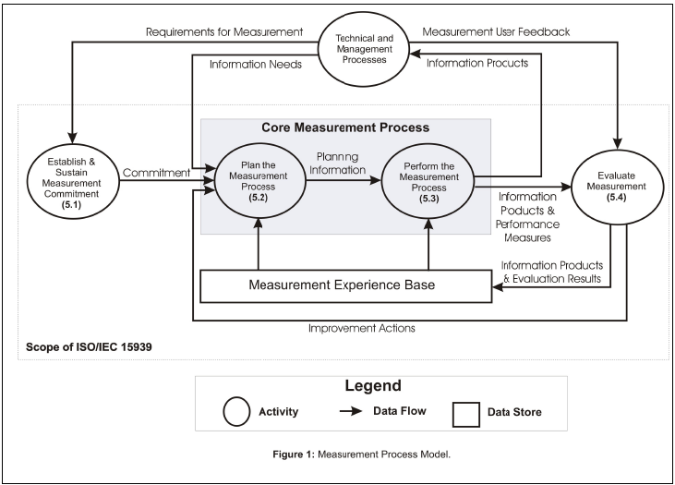
Measurement Process

Slide 61
Establish & Sustain Measurement Commitment

Slide 62
Establish & Sustain Measurement Commitment
Accept requirements for measurement.
  Each measurement endeavor should be
    guided by organizational objectives and
    driven by a set of measurement
  For example,
    an organizational objective might be “first-to-market with new products.” This in turn might engender a requirement that factors contributing to this objective be measured so that projects might be managed to meet this objective.
Assign resources for measurement.
  Assigning resources includes
    allocation of responsibility for the various tasks of the measurement process (such as user, analyst, and librarian) and
    providing adequate funding, training, tools, and support to conduct the process in an enduring fashion.

Slide 63
Accept requirements for measurement
Define scope of measurement.
  The organizational unit to which each measurement requirement is to be applied must be established.
    This may consist of
      a functional area, a single project, a single site, or even the whole enterprise.
    All subsequent measurement tasks related to this requirement should be within the defined scope.
  The stakeholders should be identified.
Commitment of management and staff to measurement.
  The commitment must be formally established, communicated, and supported by resources.
Commitment shall be communicated to the organizational unit.
  This can be achieved, for example, through organizational unit-wide announcements or newsletters.

Slide 64
Assign Resources
Individuals shall be assigned responsibility for the measurement process within the organizational unit.
  Competent individuals may be acquired through transfer, coaching, training, sub-contracting and/or hiring.
  Competence includes knowledge of the principles of measurement, how to collect data, perform data analysis, and communicate the information products. At a minimum, individuals should be assigned the responsibility for the following typical roles:
    measurement user;
    measurement analyst;
    measurement librarian.
The assigned individuals shall be provided with resources to plan the measurement process.
  The sponsor of measurement should be responsible for ensuring that resources are provided. Resources include funding and staff. Resource allocations may be updated in the course of planning.

Slide 65
Plan the Measurement Process

Slide 66
Characterize the Organizational Unit
Characterization can be in terms of organizational processes, application domains, technology, and organizational interfaces.
  This task is similar in nature to task “Define scope of measurement”. However, this task produces more detailed information than the scoping performed in “Define scope of measurement”.

Slide 67
Identify Information Needs₁
Information needs for measurement shall be identified.
  Information needs originate from the technical and management processes. Information needs are based on: goals, constraints, risks, and problems of the organizational unit. The information needs may be derived from the business, organizational, regulatory (such as legal or governmental), product and/or project objectives.
The identified information needs shall be prioritized.
  This prioritization is normally accomplished by, or in conjunction with, the stakeholders.
  An example of a simple and concrete prioritization approach is to ask a group of stakeholders to rank the information needs.
    For each information need calculate the average rank.
    Then order the average ranks. This ordering provides a prioritization of the information needs.

Slide 68
Identify Information Needs₂
Information needs to be addressed shall be selected.
  From the prioritized information needs, a subset is selected to be addressed during the measurement process. This selection is likely driven by a trade-off among resource constraints, and criticality/urgency of information needs.
Selected information needs shall be documented and communicated.
  The selected information needs should be communicated to all stakeholders. This is to ensure that they understand why certain data are to be collected and how they are to be used.

Slide 69
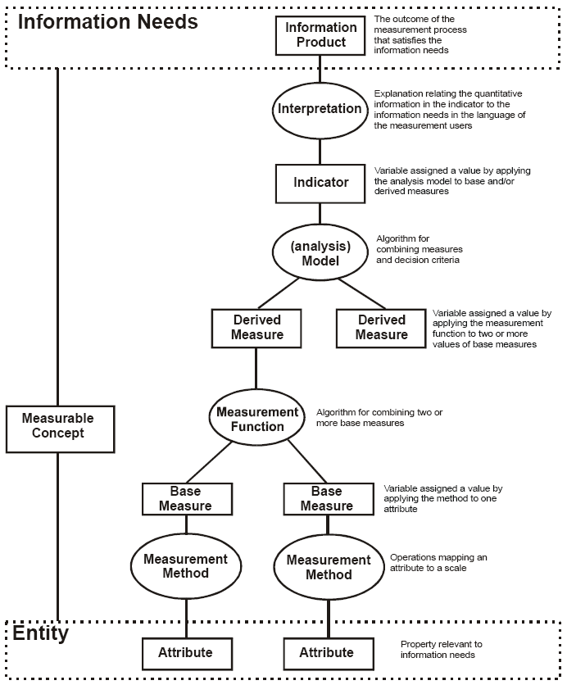
Select Measures
Candidate measures that satisfy the selected information needs shall be identified.
Measures shall be selected from the candidate measures.
Selected measures shall be documented by their name, the unit of measurement, their formal definition, the method of data collection, and their link to the information needs.

Slide 70
Define data collection, analysis, and reporting procedures
This encompasses collection procedures and schedules, storage, verification, analysis, reporting, and configuration management of data
  Procedures for data collection, including storage and verification shall be defined.
  Procedures for data analysis and reporting of information products shall be defined.
  Configuration management procedures shall be defined.

Slide 71
Define Criteria for evaluating the information products and the measurement process
Criteria for evaluation are influenced by the technical and business objectives of the organizational unit.
Information products include those associated with the product being produced, as well as those associated with the processes being used to manage and measure the project.
  Criteria for evaluating information products shall be defined.
  Criteria for evaluating the measurement process shall be defined.
    Timeliness
    Efficiency
    Defect Containment
    Customer Satisfaction
    Process Compliance
      The execution of measurement activities should comply with any plans and procedures developed to describe the intended measurement process

Slide 72
Review, approve, and provide resources for measurement tasks.
The measurement plan must be reviewed and approved by the appropriate stakeholders. This includes all data collection procedures, storage, analysis, and reporting procedures; evaluation criteria; schedules; and responsibilities.
Resources should be made available for implementing the planned and approved measurement tasks.

Slide 73
Acquire and deploy supporting technologies
This includes evaluation of available supporting technologies, selection of the most appropriate technologies, acquisition of those technologies, and deployment of those technologies.

Slide 74
Example Elements of Measurement Planning
characterization of the organizational unit;
business and project objectives;
prioritized information needs, and how they link to the business, organizational, regulatory, product and/or project objectives;
definition of the measures and how they relate to the information needs;
responsibility for data collection and sources of data;
schedule for data collection (e.g., at the end of each inspection, monthly);
tools and procedures for data collection (e.g., instructions for executing a static analyzer);
data storage;
requirements for data verification;
data entry and verification procedures;
data analysis plan including frequency of analysis and reporting;
necessary organizational and/or process changes to implement the measurement plan;
criteria for the evaluation of the information products;
criteria for the evaluation of the measurement process;
confidentiality constraints on the data and information products, and actions/precautions necessary to ensure confidentiality;
schedule and responsibilities for the implementation of measurement plan including pilots and organizational unit wide implementation;
procedures for configuration management of data, measurement experience base, and data definitions.

Slide 75
Perform the Measurement Process

Slide 76
Integrate measurement procedures with relevant processes
The measurement procedures, such as data collection, must be integrated into the processes they are measuring.
  This may involve changing current processes to accommodate data collection or generation activities.
  It may also involve analysis of current processes to minimize additional effort and evaluation of the effect on employees to ensure that the measurement procedures will be accepted.
  Morale issues and other human factors need to be considered.
In addition, the measurement procedures must be communicated to those providing the data, training may need to be provided, and support must typically be provided.
Data analysis and reporting procedures must typically be integrated into organizational and/or project processes in a similar manner [ISO 15939-02: 5.3.1].

Slide 77
Collect data
The data must be collected, verified, and stored
The collected data shall be stored, including any context information necessary to verify, understand, or evaluate the data.
The collected data shall be verified.

Slide 78
Analyze data and develop information products
The collected data shall be analyzed.
The data analysis results shall be interpreted.
The information products shall be reviewed.

Slide 79
Communicate results
Information products must be documented.
The information products shall be communicated to the measurement users.

Slide 80
Guidelines for reporting information products
limitations of the results and any other qualifications (e.g., limitations to the validity of the conclusions drawn);
date or period when the data were collected;
names and versions of tools used for performing statistical analysis;
number of observations from which conclusions are drawn;
sampling procedures that are used;
assumptions underlying the analysis techniques that are used, and the results of any sensitivity analysis performed to check for robustness to violation of assumptions;
precisely how aggregates are performed (e.g., average or weighted average);
unit of observation about which conclusions are drawn (e.g., inspection package, configuration item);
how missing data and anomalies were dealt with, where applicable;
how outliers were dealt with during data analysis, where applicable;
how combining data across different data sets was performed, where applicable;
for any statistical tests, whether they are one or two sided;
for any statistical tests, the alpha levels used (amount of acceptable error);
for any statistical tests, how p values are calculated (the probability of getting the observed result or a more extreme one by chance);
how confidence intervals are calculated, where applicable;
statistical methods used (including limits).

Slide 81
Evaluate Measurement

Slide 82
Evaluate information products and the measurement process
The information products shall be evaluated against the specified evaluation criteria and conclusions on strengths and weaknesses of the information products drawn.
Lessons learned from the evaluation shall be stored in the “Measurement Experience Base”.

Slide 83
Identify potential improvements
Potential improvements to the information products shall be identified.
Potential improvements to the measurement process shall be identified.
Potential improvements shall be communicated.

