Slide 1
9-Software Engineering Process
명지대학교/OMG Korea
최성운
choisw@mju.ac.kr

Slide 2
Introduction
The Software Engineering Process KA is concerned with the
  definition,
  implementation,
  assessment,
  measurement,
  management,
  change, and
  improvement of the software life cycle processes themselves.

Slide 3
Software Engineering Process KA Subareas
Process Implementation and Change
Process Infrastructure
Process Definition
Software Lifecycle Models
Process Assessment
Process and Product Measurement
Process Assessment Models
Process Measurement
Software Process Management Cycle
Models for Process Implementation and Change
Practical Consideration
Software Lifecycle Processes
Notation for Process Definition
Process Adaptation
Automation
Process Assessment Methods
Software Products Measurement
Quality of Measurement Results
Software Information Models
Process Measurement Techniques

Slide 4
Process Implementation and Change

Slide 5
Process Implementation and Change
This subarea focuses on organizational change. It describes the infrastructure, activities, models, and practical considerations for process implementation and change.
Described here is the situation
  in which processes are deployed for the first time and
    for example, introducing an inspection process within a project or a method covering the complete life cycle
  where current processes are changed
    for example, introducing a tool, or optimizing a procedure
This can also be termed process evolution.
In both instances, existing practices have to be modified. If the modifications are extensive, then changes in the organizational culture may also be necessary.

Slide 6
Process Infrastructure₁
To establish software life cycle processes, it is necessary to have an appropriate infrastructure in place, meaning that
  the resources must be available (competent staff, tools, and funding)
  and the responsibilities assigned.
When these tasks have been completed, it is an indication of management’s commitment to, and ownership of, the software engineering process effort.
Various committees may have to be established, such as a steering committee to oversee the software engineering process effort.

Slide 7
Process Infrastructure Types
Software Engineering Process Group (SEPG)
  The SEPG is intended to be the central focus of software engineering process improvement, and it has a number of responsibilities in terms of initiating and sustaining it. These are described in [Fow90].
Experience Factory (EF)
  The concept of the EF separates
    the project organization (the software development organization, for example)
    from the improvement organization.
  The EF is intended to institutionalize the collective learning of an organization by developing, updating, and delivering to the project organization experience packages (for example, guides, models, and training courses), also referred to as process assets.

Slide 8
Software Process Management Cycle
An iterative cycle allowing for continuous feedback and improvement of the software process:
  Establish Process Infrastructure
    establish commitment to process implementation and change
    Have an appropriate infrastructure (resources and responsibilities)
  Planning
    understand the current business objectives and process needs of the individual, project, or organization, to identify its strengths and weaknesses,
    make a plan for process implementation and change
  Process Implementation and Change
    execute the plan,
    deploy new processes (involve the deployment of tools and training of staff)
    change existing processes
  Process Evaluation
    finding out how well the implementation and change went, whether or not the expected benefits materialized. The results are then used as input for subsequent cycles.

Slide 9
Models For
Process Implementation and Change
Two general models that have emerged for driving process implementation and change are
  the Quality Improvement Paradigm (QIP) [SEL96] and
  the IDEAL model [McF96].
The two paradigms are compared in [SEL96].
Evaluation of process implementation and change outcomes can be qualitative or quantitative.

Slide 10
Practical Considerations
Most successful organizational change efforts treat the change as a project in its own right, with appropriate plans, monitoring, and review.
  Guidelines about process implementation and change within software engineering organizations, including action planning, training, management sponsorship, commitment, and the selection of pilot projects, and which cover both processes and tools, are given in [Moi98; San98; Sti99].
  Empirical studies on success factors for process change are reported in (ElE99a).
  The role of change agents in this activity is discussed in (Hut94).
  One can also view organizational change from the perspective of technology transfer (Rog83). Software engineering articles which discuss technology transfer and the characteristics of recipients of new technology (which could include process-related technologies) are (Pfl99; Rag89).
  There are two ways of approaching the evaluation of process implementation and change, either in terms of changes to the process itself or in terms of changes to the process outcomes (for example, measuring the return on investment from making the change). A pragmatic look at what can be achieved from such evaluation studies is given in (Her98).
  Overviews of how to evaluate process implementation and change, and examples of studies that do so, can be found in [Gol99], (Kit98; Kra99; McG94).

Slide 11
Process Definition

Slide 12
Process Definition
Software life cycle processes are defined for a number of reasons, including
  increasing the quality of the product,
  facilitating human understanding and communication,
  supporting process improvement,
  supporting process management,
  providing automated process guidance, and
  providing automated execution support.
The context of the project and organization will determine the type of process definition that is most useful.
  Important variables to consider include
    the nature of the work (for example, maintenance or development),
    the application domain,
    the life cycle model, and
    the maturity of the organization.

Slide 13
Systems and Projects Classification
Higher Technical Complexity
- Embedded, real time, distributed, fault tolerant
- Custom, unprecedented, architecture reengineering
- High performance
Weapon System
Commercial
Compiler
Telecom
Switch
National ATC System
Embedded
Automotive
Software
CASE Tool
Lower
Management
Complexity
- Small scale
- Informal
- Single stakeholder
Higher
Management
Complexity
- Large scale
- Contractual
- Many stakeholder
An average software project:
- 5-10 people
- 10-15 month duration
- 3-5 external interfaces
- Some unknowns, risks
Large scale
Organization/entity
Simulation
Small Scientific
Simulation
IS Application
Distributed Objects
(Order Entry)
Enterprise IS
(Family of IS
Applications)
Defense
MIS system
IS Application
GUI/RDB
(Order Entry)
Business
Spreadsheet
Lower Technical Complexity
- Mostly 4GL, or component based
- Application reengineering
- Interactive Performance

Slide 14
Software Life Cycle Models
- Process Patterns
Software life cycle models serve as a high-level definition of the phases that occur during development. They are not aimed at providing detailed definitions but at highlighting the key activities and their interdependencies.
Examples of software life cycle models are
  the waterfall model,
  the throwaway prototyping model,
  evolutionary development,
  incremental/iterative delivery,
  the spiral model, the reusable software model, and
  automated software synthesis.

Slide 15
개발 프로세스 구조
시간 축과 태스크 축
소규모 waterfall
작업의 양
작업 단계
Inception
Elaboration
Construction
Transition
비즈니스 모델링
요구사항 분석
분석/설계
waterfall
waterfall
waterfall
waterfall
waterfall
작업영역
구현
테스트
프로젝트 관리
형상관리/변경요구관리
환경
Iteration #1
Iteration #2
Iteration #3
Iteration #4
Iteration #5

Slide 16
반복주기 패턴 (1/4)
개발 프로세스
증가형 라이프사이클
  특징
    짧은 도입 반복주기
    단일 발단 반복주기
    여러 구축 반복주기
    여러 전이 반복주기
  적용
    익숙한 도메인
    정확한 위험요소 파악
    경험이 풍부한 수행팀
도입
발단
구축
전이
Iter #
Iter #
Iter #
Iter #
Iter #
Iter #
Iter #
발전(evolution)영역
POC
아키텍처 프로토타입
릴리즈
인도

Slide 17
반복주기 패턴 (2/4)
발전형 라이프사이클
  특징
    짧은 도입반복주기
    단일 발단 반복주기
    단일 구축 반복주기
    여러 전이 반복주기
  적용
    새로운 도메인
    경험이 부족한 수행팀
도입
발단
구축
전이
Iter #
Iter #
Iter #
Iter #
Iter #
Iter #
Iter #
발전(evolution)영역
POC
아키텍처 프로토타입
릴리즈
인도

Slide 18
반복주기 패턴 (3/4)
증가식 인도 라이프사이클
  특징
    짧은 도입반복주기
    단일 발단 반복주기
    단일 구축 반복주기
    여러 전이 반복주기
  적용
    익숙한 도메인 - 아키텍처와 요구사항이 개발 사이클의 초기에 안정화될 수 있음
    경험이 풍부한 수행팀
    고객이 점증적인 기능 릴리스를 원할 경우
도입
발단
구축
전이
Iter #
Iter #
Iter #
Iter #
Iter #
Iter #
Iter #
발전(evolution)영역
POC
아키텍처 프로토타입
릴리즈
인도

Slide 19
반복주기 패턴 (4/4)
개발 프로세스
“주요 설계” 라이프사이클
  특징
    짧은 도입반복주기
    매우 긴 단일 구축 반복주기
    여러 전이 반복주기
  적용
    잘 정의된 작은 기능이 안정된 제품에 추가되는 경우
    새로운 기능이 잘 정의되고, 이해된 경우
    도메인과 기존 제품에 대한 수행팀의 경험이 풍부한 경우
도입
발단
구축
전이
Iter #
Iter #
Iter #
발전(evolution)영역
POC
아키텍처 프로토타입
릴리즈
인도

Slide 20
Software Life Cycle Processes
- Process Components
Definitions of software life cycle processes tend to be more detailed than software life cycle models. However, software life cycle processes do not attempt to order their processes in time.
The software life cycle processes can be arranged to fit any of the software life cycle models. The main reference in this area is IEEE/EIA 12207.0: Information Technology — Software Life Cycle Processes [IEEE 12207.0-96].
Lifecycle Processes
  The IEEE 1074:1997 standard on developing life cycle processes
  IEEE Std 1540: Software Risk Management (IEEE1540-01)
  IEEE Std 1517: Software Reuse Processes (IEEE 1517-99)
  ISO/IEC 15939: Software Measurement Process [ISO15939-02].
  See also the Software Engineering Management KA for a detailed description of this process.

Slide 21
Notations for Process Definitions
Data flow diagrams,
in terms of process purpose and outcomes [ISO15504-98],
as a list of processes decomposed into constituent activities and tasks defined in natural language [IEEE12207.0-96],
Statecharts (Har98),
ETVX (Rad85),
Actor-Dependency modeling (Yu94),
SADT notation (Mcg93),
Petri nets (Ban95);
IDEF0 (IEEE 1320.1-98), and
rule-based (Bar95).
OMG SPEM (Software & Systems Process Engineering Meta-Model) specification.

Slide 22
Process Adaptation
- Process Tailoring
It is important to note that predefined processes—even standardized ones—must be adapted to local needs, for example,
  organizational context,
  project size,
  regulatory requirements,
  industry practices, and
  corporate cultures.
Some standards, such as IEEE/EIA 12207, contain mechanisms and recommendations for accomplishing the adaptation.

Slide 23
Automation
Automated tools either support the execution of the process definitions or they provide guidance to humans performing the defined processes.
  Some tools allow different types of simulations (for example, discrete event simulation)
  Some tools support each of the above process definition notations. Moreover, these tools can execute the process definitions to provide automated support to the actual processes, or to fully automate them in some instances.
An overview of process-modeling tools can be found in [Fin94] and of process-centered environments in (Gar96). Work on applying the Internet to the provision of real-time process guidance is described in (Kel98).

Slide 24
Process Assessment

Slide 25
Process Assessment
Process assessment is carried out using both
  an assessment model and
  an assessment method.
In some instances, the term “appraisal” is used instead of assessment, and the term “capability evaluation” is used when the appraisal is for the purpose of awarding a contract.

Slide 26
Process Assessment Models
An assessment model captures what is recognized as good practices. These practices may pertain to technical software engineering activities only, or may also refer to, for example, management, systems engineering, and human resources management activities as well.
ISO/IEC 15504 [ISO15504-98] (SPICE, Software Process Improvement and Capability Determination) defines an exemplar assessment model and conformance requirements on other assessment models.
Specific assessment models available and in use are SW-CMM (SEI95), CMMI [SEI01], and Bootstrap [Sti99].
ISO 9001 is another common assessment model which has been applied by software organizations (ISO9001-00).

Slide 27
Process Assessment Methods
In order to perform an assessment, a specific assessment method needs to be followed to produce a quantitative score which characterizes the capability of the process (or maturity of the organization).
The CBA-IPI assessment method, for example, focuses on process improvement (Dun96), and the SCE method focuses on evaluating the capability of suppliers (Bar95). Both of these were developed for the SW-CMM.
Requirements on both types of methods which reflect what are believed to be good assessment practices are provided in [ISO15504-98], (Mas95).
The SCAMPI methods are geared toward CMMI assessments [SEI01].

Slide 28
Process and Product Measurement

Slide 29
Process and Product Measurement
Measurement can be performed
  to support the initiation of process implementation and change or
  to evaluate the consequences of process implementation and change, or
  it can be performed on the product itself.
Key terms on software measures and measurement methods have been defined in ISO/IEC 15939 on the basis of the ISO international vocabulary of metrology. ISO/IEC 15359 also provides a standard process for measuring both process and product characteristics. [VIM93]

Slide 30
Process Measurement
Measurement is used
  to identify the strengths and weaknesses of processes and
  to evaluate processes after they have been implemented and/or changed.

Slide 31
Software Product Measurement₁
Software product measurement includes, notably, the measurement of product size, product structure, and product quality.
Size measurement
  Software product size is most often assessed by measures of length (for example, lines of source code in a module, pages in a software requirements specification document), or functionality (for example, function points in a specification).
Structure measurement
  A diverse range of measures of software product structure may be applied to both high- and low-level design and code artifacts to reflect control flow (for example the cyclomatic number, code knots), data flow (for example, measures of slicing), nesting (for example, the nesting polynomial measure, the BAND measure), control structures (for example, the vector measure, the NPATH measure), and modular structure and interaction (for example, information flow, tree-based measures, coupling and cohesion). [Fen98: c8; Pre04: c15]

Slide 32
Software Product Measurement₂
Quality measurement
  As a multi-dimensional attribute, quality measurement is less straightforward to define than those above. Furthermore, some of the dimensions of quality are likely to require measurement in qualitative rather than quantitative form. A more detailed discussion of software quality measurement is provided in the Software Quality KA, topic 3.4. ISO models of software product quality and of related measurements are described in ISO 9126, parts 1 to 4 [ISO9126-01]. [Fen98: c9,c10; Pre04: c15; Som05: c24]

Slide 33
Quality Of Measurement Results
The quality of the measurement results (accuracy, reproducibility, repeatability, convertibility, random measurement errors) is essential for the measurement programs to provide effective and bounded results.
Key characteristics of measurement results and related quality of measuring instruments have been defined in the ISO International vocabulary on metrology. [VIM93]
The theory of measurement establishes the foundation on which meaningful measurements can be made. The theory of measurement and scale types is discussed in [Kan02].
Measurement is defined in the theory as “the assignment of numbers to objects in a systematic way to represent properties of the object.”

Slide 34
Software Information Models
As the data are collected and the measurement repository is populated, we become able to build models using both data and knowledge.
These models exist for the purposes of analysis, classification, and prediction. Such models need to be evaluated to ensure that their levels of accuracy are sufficient and that their limitations are known and understood. The refinement of models, which takes place both during and after projects are completed, is another important activity.

Slide 35
Model building
  Model building includes both calibration and evaluation of the model. The goal-driven approach to measurement informs the model building process to the extent that models are constructed to answer relevant questions and achieve software improvement goals. This process is also influenced by the implied limitations of particular measurement scales in relation to the choice of analysis method. The models are calibrated (by using particularly relevant observations, for example, recent projects, projects using similar technology) and their effectiveness is evaluated (for example, by testing their performance on holdout samples). [Fen98: c4,c6,c13;Pfl01: c3,c11,c12; Som05: c25]
Model implementation
  Model implementation includes both interpretation and refinement of models–the calibrated models are applied to the process, their outcomes are interpreted and evaluated in the context of the process/project, and the models are then refined where appropriate. [Fen98: c6; Pfl01: c3,c11,c12; Pre04: c22; Som05: c25]

Slide 36
Process Measurement Techniques
Process measurement techniques have been classified into two general types: analytic and benchmarking. The two types of techniques can be used together since they are based on different types of information. (Car91)
The analytical techniques are characterized as relying on
  “quantitative evidence to determine where improvements are needed and whether an improvement initiative has been successful.”
Benchmarking techniques
  “depends on identifying an ‘excellent’ organization in a field and documenting its practices and tools.” Benchmarking assumes that if a less-proficient organization adopts the practices of the excellent organization, it will also become excellent. Benchmarking involves assessing the maturity of an organization or the capability of its processes. It is exemplified by the software process assessment work. A general introductory overview of process assessments and their application is provided in (Zah98).

Slide 37
Software Lifecycle Processes
- ISO/IEC 12207

Slide 38
Software Lifecycle Processes
- Roles & Relationships
Organizational Context
Goal/Policy/Strategy
Supporting Context
Standard
Tools
Configuration Management
Quality Assurance
Business Context
Business
Manager
Supply
Process
contract
Acquisition
Process
Business
Manager
employ
Project Context
Supplier Perspective
employ
employ
Acquirer Perspective
Project
Manager
Project
Management
Process
Audit
Process
Project
Management
Process
Manager
employ
employ
System Context
Developer
Maintainer
Development
Process
employ
Maintenance
Process
employ
Operation
Process
Operator
User

Slide 39
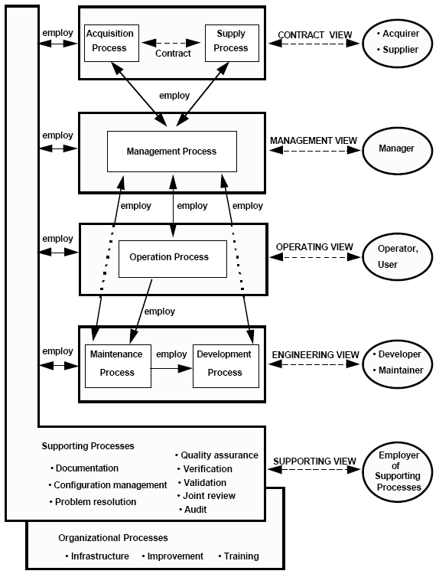
Software Life-Cycle Processes
- Roles and Relationships

Slide 40
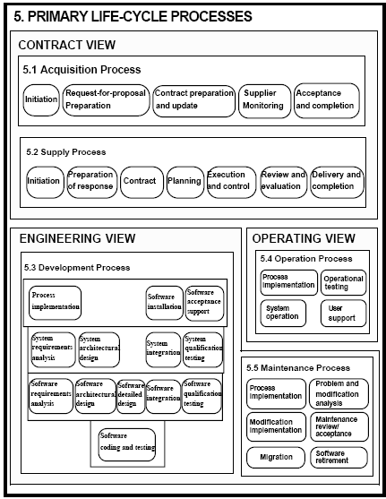
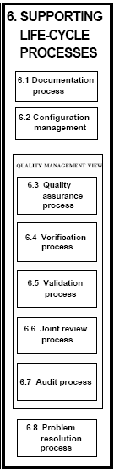
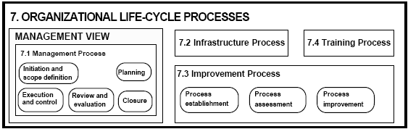
Software Life-Cycle Processes
- Views and Activities

Slide 41
Primary Life Cycle Processes
Acquisition process
Supply process
Development process
Operation process
Maintenance process

Slide 42
Acquisition Process
The Acquisition Process contains the activities and tasks of the acquirer.
  The process begins with the definition of the need to acquire a system, software product or software service.
List of activities: This process consists of the following activities:
  Initiation;
  Request-for-Proposal [-tender] preparation;
  Contract preparation and update;
  Supplier monitoring;
  Acceptance and completion.

Slide 43
Supply Process
The Supply Process contains the activities and tasks of the supplier.
List of activities: This process consists of the following activities:
  Initiation;
  Preparation of response;
  Contract;
  Planning;
  Execution and control;
  Review and evaluation;
  Delivery and completion.

Slide 44
Development process
The Development Process contains the activities and tasks of the developer.
List of activities: This process consists of the following activities:
  Process implementation;
  System requirements analysis;
  System architectural design;
  Software requirements analysis;
  Software architectural design;
  Software detailed design;
  Software coding and testing;
  Software integration;
  Software qualification testing;
  System integration;
  System qualification testing;
  Software installation;
  Software acceptance support.

Slide 45
Operation process
The Operation Process contains the activities and tasks of the operator.
The process covers the operation of the software product and operational support to users. Because operation of software product is integrated into the operation of the system, the activities and tasks of this process refer to the system.

Slide 46
Maintenance process
The Maintenance Process contains the activities and tasks of the maintainer.
List of activities. This process consists of the following activities:
1) Process implementation;
2) Problem and modification analysis;
3) Modification implementation;
4) Maintenance review/acceptance;
5) Migration;
6) Software retirement

Slide 47
Supporting life cycle processes
This clause defines the following supporting life cycle processes:
1) Documentation process;
2) Configuration management process;
3) Quality assurance process;
4) Verification process;
5) Validation process;
6) Joint review process;
7) Audit process;
8) Problem resolution process.

Slide 48
Documentation process
The Documentation Process is a process for recording information produced by a life cycle process or activity.
The process contains the set of activities, which plan, design, develop, produce, edit, distribute, and maintain those documents needed by all concerned such as managers, engineers, and users of the system or software product.
List of activities. This process consists of the following activities:
  1) Process implementation;
  2) Design and development;
  3) Production;
  4) Maintenance.

Slide 49
Configuration management process
The Configuration Management Process is a process of applying administrative and technical procedures throughout the software life cycle to:
  identify, define, and baseline software items in a system;
  control modifications and releases of the items;
  record and report the status of the items and modification requests;
  ensure the completeness, consistency, and correctness of the items;
  and control storage, handling, and delivery of the items.
List of activities. This process consists of the following activities:
  1) Process implementation;
  2) Configuration identification;
  3) Configuration control;
  4) Configuration status accounting;
  5) Configuration evaluation;
  6) Release management and delivery.

Slide 50
Quality assurance process
The Quality Assurance Process is a process for providing adequate assurance that the software products and processes in the project life cycle conform to their specified requirements and adhere to their established plans.
To be unbiased, quality assurance needs to have organizational freedom and authority from persons directly responsible for developing the software product or executing the process in the project.
List of activities. This process consists of the following activities:
  1) Process implementation;
  2) Product assurance;
  3) Process assurance;
  4) Assurance of quality systems.

Slide 51
Verification process
The Verification Process is a process for determining whether the software products of an activity fulfill the requirements or conditions imposed on them in the previous activities.
For cost and performance effectiveness, verification should be integrated, as early as possible, with the process (such as supply, development, operation, or maintenance) that employs it. This process may include analysis, review and test.
List of activities. This process consists of the following activities:
  1) Process implementation;
  2) Verification

Slide 52
Validation process
The Validation Process is a process for determining whether the requirements and the final, as-built system or software product fulfills its specific intended use.
Validation may be conducted in earlier stages. This process may be conducted as a part of Software Acceptance Support (5.3.13).
List of activities. This process consists of the following activities:
  1) Process implementation;
  2) Validation.

Slide 53
Joint review process
The Joint Review Process is a process for evaluating the status and products of an activity of a project as appropriate.
Joint reviews are at both project management and technical levels and are held throughout the life of the contract. This process may be employed by any two parties, where one party (reviewing party) reviews another party (reviewed party).
List of activities: This process consists of the following activities:
  1) Process implementation;
  2) Project management reviews;
  3) Technical reviews.

Slide 54
Audit process
The Audit Process is a process for determining compliance with the requirements, plans, and contract as appropriate.
This process may be employed by any two parties, where one party (auditing party) audits the software products or activities of another party (audited party).
List of activities. This process consists of the following activities:
  1) Process implementation;
  2) Audit.

Slide 55
Problem resolution process
The Problem Resolution Process is a process for analyzing and resolving the problems (including non-conformances), whatever their nature or source, that are discovered during the execution of development, operation, maintenance, or other processes.
The objective is to provide a timely, responsible, and documented means to ensure that all discovered problems are analyzed and resolved and trends are recognized.
List of activities. This process consists of the following activities:
  1) Process implementation;
  2) Problem resolution.

Slide 56
Organizational life cycle processes
This clause defines the following organizational life cycle processes:
1) Management process;
2) Infrastructure process;
3) Improvement process;
4) Training process.

Slide 57
Management process
The Management Process contains the generic activities and tasks, which may be employed by any party that has to manage its respective process(es).
The manager is responsible for product management, project management, and task management of the applicable process(es), such as the acquisition, supply, development, operation, maintenance, or supporting process.
List of activities: This process consists of the following activities:
  1) Initiation and scope definition;
  2) Planning;
  3) Execution and control;
  4) Review and evaluation;
  5) Closure.

Slide 58
Infrastructure process
The Infrastructure Process is a process to establish and maintain the infrastructure needed for any other process. The infrastructure may include hardware, software, tools, techniques, standards, and facilities for development, operation, or maintenance.
List of activities.
  1) Process implementation;
  2) Establishment of the infrastructure;
  3) Maintenance of the infrastructure.

Slide 59
Improvement process
The Improvement Process is a process for establishing, assessing, measuring, controlling, and improving a software life cycle process.
List of activities. This process consists of the following activities:
  1) Process establishment;
  2) Process assessment;
  3) Process improvement.

Slide 60
Training process
The Training Process is a process for providing and maintaining trained personnel.
The acquisition, supply, development, operation, or maintenance of software products is largely dependent upon knowledgeable and skilled personnel. For example: developer personnel should have essential training in software management and software engineering. It is, therefore, imperative that personnel training be planned and implemented early so that trained personnel are available as the software product is acquired, supplied, developed, operated, or maintained.
List of activities. This process consists of the following activities:
  1) Process implementation;
  2) Training material development;
  3) Training plan implementation.

Slide 61
SPEM 2.0
Software & Systems Process Engineering MetaModel

Slide 62
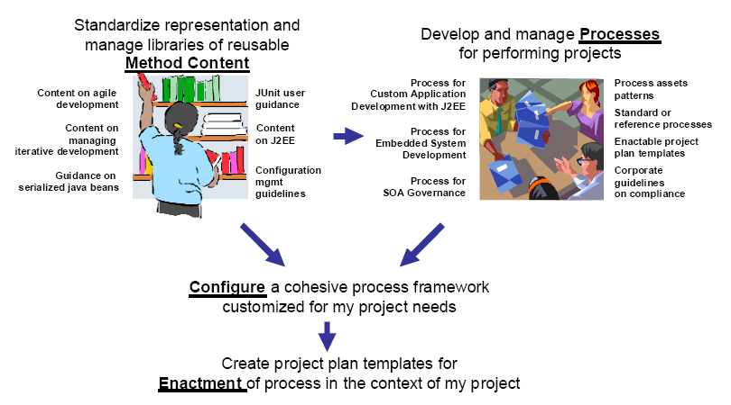
Backgrounds

Slide 63
Introduction-Process

Slide 64
Process-Definition
Engineering Process
  A set of transformations of input elements into products: respecting constraints, requiring resources, meeting a defined mission, corresponding to a specific purpose adapted to a given environment.
Business process or business method
  A collection of related, structured activities or tasks that produce a specific service or product (serve a particular goal) for a particular customer or customers.
Meets
Mission
1..*
1..*
Role
Performs
Activity
1..*
Requires
Resource
1
0..*
1..*
1
1
1
Respects
Constraint
Defines
Uses
Produces
1..*
0..*
0..*
+input
+output
IsResponsibleFor
Work-Product
1..*
Delivered
1..*
Customer
0..*
1..*

Slide 65
Process-Core Elements
Activity
  A tangible unit of work performed by a role in a workflow that yields a well-defined result based on a well-defined input.
Work-Product
  A tangible piece of information that is created, changed, and used by roles when performing activities and represents an area of responsibility. A work-product can be a model, model-element, or a document.
Role
  A position that can be assigned to a person or a team, requiring responsibilities and abilities such as performing certain activities and developing certain work-product.
Role
Performs
Activity
1
0..*
1
1
1
Uses
Produces
0..*
0..*
+input
+output
IsResponsibleFor
Work-Product
0..*

Slide 66
Enterprise Process
Business Processes
  Business Management Process
    processes that govern the operation of a business system. Typical management processes include "Corporate Governance" and "Strategic Management".
  Business Operation Process
    processes that constitute the core business and create the primary value stream. Typical operational processes are Purchasing, Manufacturing, Marketing, and Sales.
  Business Supporting Process
    processes, which support the core processes. Examples include Accounting, Recruitment, Technical support
Project Process
  Project Management Process
  Project Engineering Process
  Project Supporting Process

Slide 67
Enterprise Architecture-Zachman Framework
abstractions
DATA
What
FUNCTION
How
NETWORK
Where
PEOPLE
Who
TIME
When
MOTIVATION
Why
perspectives
List of Things -
Important to the Business
List of Processes -
the Business Performs
List of Locations -
in which the Business Operates
List of Organizations -
Important to the Business
List of Events -
Significant to the Business
List of Business Goals and Strategies
SCOPE
Planner
contextual
Entity = Class of
Business Thing
Function = Class of
Business Process
Node = Major Business
Location
People = Class of People and
Major Organizations
Time = Major Business Event
Ends/Means=Major Business
Goal/Critical Success Factor
ENTERPRISE
MODEL
Owner
e.g., Semantic Model
e.g., Business Process Model
e.g., Logistics Network
e.g., Work Flow Model
e.g., Master Schedule
e.g., Business Plan
conceptual
Entity = Business Entity
Rel. = Business Relationship
Process = Business Process
I/O = Business Resources
Node = Business Location
Link = Business Linkage
People = Organization Unit
Work = Work Product
Time = Business Event
Cycle = Business Cycle
End = Business Objective
Means = Business Strategy
SYSTEM
MODEL
Designer
e.g., Logical Data Model
e.g., Application Architecture
e.g., Distributed System
Architecture
e.g., Human Interface
Architecture
e.g., Processing Structure
e.g., Business Rule Model
logical
Entity = Data Entity
Rel. = Data Relationship
Process.= Application Function
I/O = User Views
Node = IS Function
Link = Line Characteristics
People = Role
Work = Deliverable
Time = System Event
Cycle = Processing Cycle
End = Structural Assertion
Means =Action Assertion
TECHNOLOGY
CONSTRAINED
MODEL
Builder
e.g., Physical Data Model
e.g., System Design
e.g., Technical Architecture
e.g., Presentation Architecture
e.g., Control Structure
e.g., Rule Design
physical
Entity = Tables/Segments/etc.
Rel. = Key/Pointer/etc.
Process= Computer Function
I/O =Data Elements/Sets
Node = Hardware/System
Software
Link = Line Specifications
People = User
Work = Screen/Device Format
Time = Execute
Cycle = Component Cycle
End = Condition
Means = Action
DETAILED
REPRESEN-
TATIONS
Subcontractor
e.g. Data Definition
e.g. Program
e.g. Network Architecture
e.g. Security Architecture
e.g. Timing Definition
e.g. Rule Specification
out-of-context
Entity = Field
Rel. = Address
Process= Language Statement
I/O = Control Block
Node = Addresses
Link = Protocols
People = Identity
Work = Job
Time = Interrupt
Cycle = Machine Cycle
End = Sub-condition
Means = Step
FUNCTIONING
ENTERPRISE
DATA
Implementation
FUNCTION
Implementation
NETWORK
Implementation
ORGANIZATION
Implementation
SCHEDULE
Implementation
STRATEGY
Implementation
John A. Zachman, Zachman International

Slide 68
Federal Enterprise Architecture Framework based on Object-Oriented/UML View
Data
Architecture
Application
Architecture
Technology
Architecture
Planner
Perspective
List of Business Objects /Domain Model | List of Business Processes /Use-case Model | List of Business Locations /Deployment Model
Semantic Model /Domain Model with Relationships | Business Process Model /Activity Diagram | Business Logistics System /Locality Diagram
Logical Data Model /Class Diagram | Application Architecture /Interaction Diagram | System Geographic Deployment Architecture /Deployment Diagram
Physical Data Model /Physical Data Model | Systems Design /Interaction Diagram | Technology Architecture /Software System allocated to Hardware
Data Dictionary | Programs | Network Architecture
Owner
Perspective
Designer
Perspective
Builder
Perspective
Subcontractor
Perspective
FEAF (Federal Enterprise Architecture Framework)
IBM 2003

Slide 69
Enterprise Process vs. Enterprise Architecture
Stakeholders
  Planner
  Owner
  Designer
  Builder
  Subcontractor
Abstractions
  Role
  Activity
  Work-product
Organization
Performs
Enterprise Process
1
0..*
1
1
1
Uses
Produces
0..*
0..*
+input
+output
IsResponsibleFor
Enterprise Architecture/Model
0..*

Slide 70
Model-Driven & Meta-Model

Slide 71
Model-Driven
A way to specify and build systems
  language, vendor and middleware neutral
  supports full lifecycle : analysis, design, implementation, deployment, maintenance, evolution & integration with later systems
  builds in Interoperability and Portability
Model
  A formal/Informal specification of the function, structure and/or behavior of a system.
  A specification is said to be formal when it is based on some well defined language that has well defined meaning associated with each of its constructs.
    Informal: A diagram with boxes and lines and arrows that does not have behind it a definition of the meaning of a box and the meaning of a line and of an arrow
    Formal: Source code that it can be executed by a machine.
  A UML-based specification expressed visually or via an XML document.
Notes:
2-2 MDA Guide V1.0 1st May 2003
2.2 The Basic Concepts
Let’s look at the concepts that are at the core of MDA. Later chapters present each
concept in greater detail.
2.2.1 System
We present the MDA concepts in terms of some existing or planned system. That
system may include anything: a program, a single computer system, some combination
of parts of different systems, a federation of systems, each under separate control,
people, an enterprise, a federation of enterprises…
Much of the discussion focuses on software within the system.
2.2.2 Model
A model of a system is a description or specification of that system and its
environment for some certain purpose. A model is often presented as a combination
of drawings and text. The text may be in a modeling language or in a natural language.
2.2.3 Model-Driven
MDA is an approach to system development, which increases the power of models in
that work. It is model-driven because it provides a means for using models to direct the
course of understanding, design, construction, deployment, operation, maintenance and
modification.
2
2.2.4 Architecture
The architecture of a system is a specification of the parts and connectors of the
system and the rules for the interactions of the parts using the connectors. [5]
The Model-Driven Architecture prescribes certain kinds of models to be used, how
those models may be prepared and the relationships of the different kinds of models.
2.2.5 Viewpoint
A viewpoint on a system is a technique for abstraction using a selected set of
architectural concepts and structuring rules, in order to focus on particular concerns
within that system. Here ‘abstraction’ is used to mean the process of suppressing
selected detail to establish a simplified model.
The concepts and rules may be considered to form a viewpoint language.
Examples:
The Reference Model of Open Distributed Processing (ODP) provides five
viewpoints for specifying a distributed system. [1].
Another classification specifies three (very similar to the SPARC database model
viewpoints [2]): a conceptual viewpoint, describing the place of a system in the
situation in which that system will be (or is already) placed, a specification
(logical) viewpoint, specifying what that system must know and do, and an
implementation (physical) viewpoint, specifying in detail the construction of that
system. [3]
The Model-Driven Architecture specifies three viewpoints on a system, a computation
independent viewpoint, a platform independent viewpoint and a platform specific
viewpoint.
2.2.6 View
A viewpoint model or view of a system is a representation of that system from the
perspective of a chosen viewpoint. [4].
2.2.7 Platform
A platform in general is a set of subsystems/technologies that provide a coherent set of
functionality through interfaces and specified usage patterns that any subsystem that
depends on the platform can use without concern for the details of how the
functionality provided by the platform is implemented.

Slide 72
Meta-model
A model of models
A language(Generator) to describe(generate) models
  Java meta-model is the language(grammar) used to define the Java programming language,
  Java model is a program source code that defines aspects of a computer system.
Metamodel
Model
Model
Model
Model
Model
Model
Notes:
ab/2001-02-04 Model Driven Architecture - A Technical Perspective 3
21st February 2001 Draft
3.1 What is a Model
Some people define a model as a visual representation of a system. However, many
people refer to a set of IDL interfaces as a “CORBA object model.” Furthermore, a
specification expressed in terms of UML can be rendered into an XML document using
the OMG’s XMI DTD for UML, which certainly is not a visual artifact. Thus, we
conclude that this definition is too limiting.
We offer the following definition: A model is a formal specification of the function,
structure and/or behavior of a system.
A specification is said to be formal when it is based on some well defined language
that has well defined meaning associated with each of its constructs. A specification
that is not formal in this sense, is not a model. Thus a diagram with boxes and lines
and arrows that does not have behind it a definition of the meaning of a box and the
meaning of a line and of an arrow is not a model—it is just an informal diagram.
Note that under this definition, source code is a model that has the salient characteristic
that it can be executed by a machine. A set of IDL interfaces is a model that can be
used with any CORBA implementation and that specifies the signature of operations
and attributes of which the interfaces are composed. A UML-based specification is a
model whose properties can be expressed visually or via an XML document.
We could have taken the stance that a model is not necessarily formal, so that we could
talk about formal and informal models, which in a way seems to be quite natural
discourse. However we then would end up with a very weak definition of model such
as “a representation of a system.” We feel that the definition that encompasses
formality is more useful.
For a nice discussion about modeling the enterprise in particular see Section 3 of
“Model-Driven Architecture - Opportunities and Callenges” by Desmond DSouza,
OMG document number ab/2001-02-03. In general this document presents a very nice
perspective on MDA.
3.2 Abstractions and Viewpoints
ISO’s Open Distributed Processing (ODP) Part II defines abstraction as the
suppression of irrelevant detail2. We view this as an appropriate definition. Thus, all
models are abstractions and term like “abstract model” can be very confusing. We must
be careful about the terminology we use to categorize different kinds of models.
It is useful to identify models in terms of the abstraction criteria that were used to
determine what is included in the model. A model that is based on a specific
abstraction criterion is often referred to as a model from that viewpoint, or in short as a
view of the system.
Another common use of the word abstraction is in the phrase higher level of
abstraction, which is used to characterize a model in which more of the details of the
system is elided as compared to a lower level of abstraction.
Furthermore in common usage, the notion of viewpoints and levels of abstraction are
used together such that a larger amount of detail from a viewpoint may be elided to
obtain a model from that viewpoint or a view, at a higher level of abstraction, while
little or no detail may be elided to obtain a model or view, at a low level of abstraction.
ISO’s ODP defines five standard viewpoints that are convenient to use to describe
systems. Many projects have used other sets of viewpoints to specify systems.

Slide 73
Framework for Metamodeling
Four meta-layers
  Information layer
    Data that is to be described
  Model Layer
    Metadata that describes data in the information layer
    Metadata is informally aggregated as models
  Metamodel Layer
    Descriptions that define the structure and semantics of metadata
    Meta-metadata is informally aggregated as metamodels
    A metamodel is an “abstract language” for describing different kinds of data; i.e., a language without a concrete syntax or notation
  Meta-metamodel Layer
    Descriptions of the structure and semantics of meta-metadata.
    A meta-metamodel is an “abstract language” for describing different kinds of metadata

Slide 74
Four-Layer Metamodel Architecture
Metamodeling
  The use of models to define other models
  The metamodel defines possible structures and the meaning to elements in a model; the meta-model is by itself another model
Hard-wired Meta-meta-model
M3 layer
meta-metamodel
MetaClass(“Record”,
[MetaAttr(“name”,String),
MetaAttr(“fileds”,List<“Field”>)] )
MetaClass(“Field”,…)
M2 layer
metamodels
Record(“StockQuote”,
[Field(“company”,String),
Field(“price”,FixedPoint)])
M1 layer
models
StockQuote(“Sunbeam Harvesters”,98.77)
StockQuote(“Ace Taxi Cab Ltd”,12.32)
…
M0 layer
information

Slide 75
User Objects/M0
cM1:
CourseModule
meta-
metamodel
Olsen:
Student
DAT2160:
Course
cM2:
CourseModule
metamodel
model
compBaseDev:
CourseModule
user objects
(user data)
SCP:
StudentCourseProfile
:reached
A UML model instantiated, illustrated with an
object diagram( objects/ data)

Slide 76
Model/M1
meta-
metamodel
Course
CourseModule
name : String
description : String
*
name : String
description : String
1..*
metamodel
1
1
*
StudentCourseProfile
model
*
reached
finished : boolean
user objects
(user data)
*
1
Student
A metamodel instantiated, a language to describe an
information domain, Illustrated with a class diagram

Slide 77
Metamodel/M2
meta-
metamodel
Classifier
metamodel
Interface
Node
model
Class
isActive:Boolean
user objects
(user data)
Component
A meta-metamodel instantiated. The definition of
UML, a language to describe a model.

Slide 78
Meta-Metamodel/M3
meta-
metamodel
MetaClass
metamodel
model
user objects
(user data)
MetaOperation
MetaAttribute
A language to describe metamodels. The level of
abstraction is higher than for a metamodel and it is
also typically more compact.

Slide 79
Four-Layer Metamodel Architecture Revisited
M3 | Meta-metamodel with meta-metamodel elements | A language for describing metamodels. The level of abstraction is higher than for a metamodel and it is also typically more compact
M2 | Metamodel with metamodel elements | A meta-metamodel instantiated. The definition of UML; a language for describing models
M1 | Model with model elements | A metamodel instantiated; a language for describing an infromation domain.
M0 | User data with instances | The things to model; user data. A UML model instantiated, illustrated with an object model
Classifier
Class
Association
ModelElement
Relationship
NameSpace
Association
Classifier
Class
Person
+owner
Car
1
0..*
regNo: Integer
tom: Person
+owner
myCar: Car
1
0..*
regNo= 234

Slide 80
Advantages of Four Layer Metadata Architecture
It can support any kind of model and modeling paradigm that is imaginable
It can allow different kinds of metadata to be related
It can allow metamodels and new kinds of metadata to be added incrementally,
It can support interchange of arbitrary metadata(models) and meta-metadata(metamodels) between parties that use the same meta-metamodel
Meta-metamodel
instanceOf
Metamodel #1
Metamodel #2
instanceOf
Model #1
Model #2
instanceOf
User Data #1
User Data #2

Slide 81
SEP-Framework
Architecture & Meta-Model

Slide 82
Architecture
Architect
Roles
Designer
Analyst
Lifecycle Process
Inception
Elaboration
Delivery
Process
Method
Class
Method
Component
Iteration #1
Iteration #2
Iteration #3
Iteration #4
Process
Pattern
Usecase Model
OO BusinessModel
1
5
Component Model
OO Domain Model
2
4
6
8
9
13
Method Contents
Class Model
DB Design Model
3
7
10
14
E-R
Model
Java Implementation Model
11
15
Business Model
CBD Test Model
12
16

Slide 83
Meta-Model: Top-Level
Process View
Delivery
Process
Waterfall
Unified Process
…
How to find an actor
How to describe a usecase
…
Inception
Elaboration
…
Process
Component
Guidance
Method
Component
Requirement Model
Analysis Model
…
Method View
Usecase Specifier
Architect
Designer
…
Role
Definition
Method
Class
Use-Case Diagram
Class Diagram
…
Find actors
Find Usecases
…
Activity
Work Product
Actor List
Use Cases
…
Input, Output

Slide 84
Meta-Model: Method Class
A Primitive Work-Product with Activities
<<Abstract>>
Base(공통)
Use-Case Diagram
Class Diagram
…
<<Abstract>>
Generic Diagram
(기술공통)
<<Abstract>>
Generic Work-Product
(업무공통)
Requirement Specification
Data Table Definition
…
<<Concrete>>
Work-Product
(업무종속)
As-Is Biz Process Diagram
Analysis Class Diagram
…

Slide 85
Meta-Model: Method Component
A Method Component is defined by a Model with a specific View
Generally Views are associated with Roles
Business
Developer
…
Stakeholder
View
Logical
Business
…
Have
Consists-Of
<<Model>>
Method Component
Analysis Model
Business Model
…
Method Class
As-Is Biz Process Diagram
Analysis Class Diagram
…

Slide 86
Meta-Model: Process Component
The span of time between two milestone of a Process
It consists of a set of Method Component
Inception
Elaboration
…
Process Component
Identified by
Milestone
Project Scope
Baseline Architecture
…
Consists-Of
Method Component
Analysis Model
Business Model
…
Major
Milestone
Minor
Milestone
Method Class
As-Is Biz Process Diagram
Analysis Class Diagram
…

Slide 87
Meta-Model: Delivery Process
Generic Process
  일반 프로세스
Domain Process
  업무영역별 공통 프로세스
Specific Process
  구체적 적용 프로세스
Generic Process
표준 Eng. 프로세스
Domain Process
OOCBD 금융 대규모
<<Concrete>>
Specific Process
삼성화재

Slide 88
Meta-Model

Slide 89
Method Design Guide
Process Engineering Framework

Slide 90
Overview
Method Class
  독립적 산출물
  Work-Product 구성요소간 매핑관계 정의
Method Component
  관점별/역할별 독립적 모델
  Work-Product간 매핑관계 정의
Process Component
  마일스톤을 가진 작업 단위
  Method Component간 매핑관계 정의
Delivery Process
  Process Component간 매핑관계 정의

Slide 91
Method Class
Work-Product 구성요소간 매핑관계 정의
Sample: 분석 시퀀스 다이어 그램
  입력물
    유스케이스 정의서 ::= 시나리오
    시나리오 ::= 문장
    문장 ::= 명사 + 동사 + 부사
  출력물
    분석시퀀스다이어그램 ::= 객체 + 메시지
    메시지 ::= 객체 + 오퍼레이션 + 파라메터
  매핑 가이드
    유스케이스 정의서 시나리오의 명사를 중심으로 객체를 추출한다.
    해당 객체와 연관된 동사를 중심으로 메시지를 추출한다.
      메시지 포맷은 대상객체, 오퍼레이션, 파라메터로 구성된다.
      메시지 파라메터는 동사의 수식어로부터 추출한다.
분석시퀀스
다이어그램
객체
메시지
유즈케이스정의서
객체 추출
메시지 추출

Slide 92
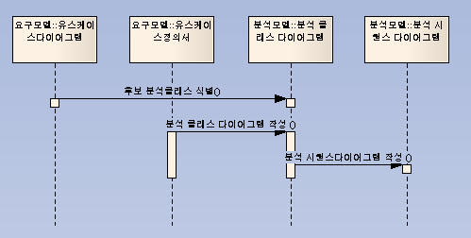
Method Component
Work-Product간 매핑관계 정의
Sample: 분석 업무 모델

Slide 93
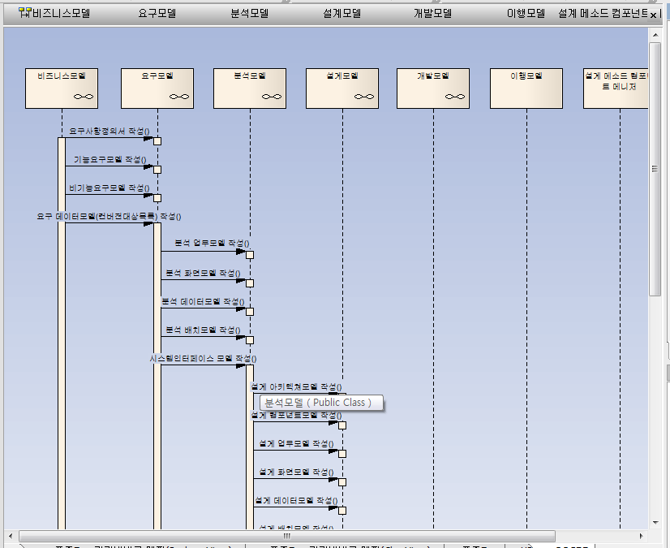
Process Component/Deliver Process
Method Component/Model간 매핑 정의
Sample: Iteration

Slide 94
Architectural Pattern
표준 엔지니어링 방법론

Slide 95
Architectural Pattern₁: Use-Case Driven
Requirement
Analysis
Design
Implementation
Static Model
Class
Diagram
Analysis
Class
Diagram
Design
Class
Diagram
Implementation
Classes:
Source Code
<<trace>>
Use-Case
<<trace>>
Dynamic Model
Interaction
Diagram
Use-Case
Realization:
Analysis
Use-Case
Realization:
Design
Use-Case
Realization:
Source Code
<<trace>>
Collaboration
Diagram
Sequence
Diagram

Slide 96
Architectural Pattern₂: Model-Transformation
Package
Diagram
Package
Diagram
Package
Diagram
Package
Diagram
Interface
Interface
Interface
Interface
Class
Diagram
Interaction
Diagram
Class
Diagram
Interaction
Diagram
Class
Diagram
Interaction
Diagram
Class
Diagram
Interaction
Diagram
Requirement Model
Analysis Model
Design Model
Implementation Model
Model Mapping/Transformation
Logical Dependency

Slide 97
Architectural Pattern₃: Architecture-Centric
Why Architecture first?
  Detect and prevent the risk early
  Understand the system
  Organize Development
  Foster Reuse
  Evolve the system
Architecture
Package
Diagram
Interface
Criticality
Construction
Class
Diagram
Interaction
Diagram
System Model

Slide 98
Architectural Pattern₄: Iterative
Architecture
Physical Control Sequence
Package
Diagram
Package
Diagram
Package
Diagram
Package
Diagram
Interface
Interface
Interface
Interface
Construction
Class
Diagram
Interaction
Diagram
Class
Diagram
Interaction
Diagram
Class
Diagram
Interaction
Diagram
Class
Diagram
Interaction
Diagram
Requirement Model
Analysis Model
Design Model
Implementation Model
Model Mapping/Transformation
Logical Dependency

Slide 99
Method Class/Method Component
Process Component/Delivery Process
표준 엔지니어링 방법론

Slide 100
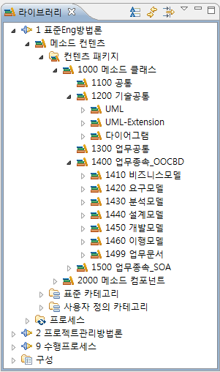
Method Class
공통(Base)
기술공통(Generic Diagrams)
  UML
  UML-Extensions
  Other Diagrams
업무공통(Generic Work-Product))
업무종속(Work-Product)
  요구모델
  분석모델
  설계모델
  개발모델
  이행모델
<<Abstract>>
Base
<<Abstract>>
Generic Diagram
<<Abstract>>
Generic Work-Product
<<Concrete>>
Work-Product

Slide 101
Method Component Taxonomy based on Views
Method
Component
Business View
System View
In-Use View
S/W View
H/W View
User-View
Developer-View
Platform-
Independent
Model
Platform-
Specific
Model
Implementation-
Independent
Model
Implementation-
Specific
Model
Business
Model
Requirement
Model
Analysis
Model
Design
Model
Implementation
Model
Deployment
Model
Transition
Model

Slide 102
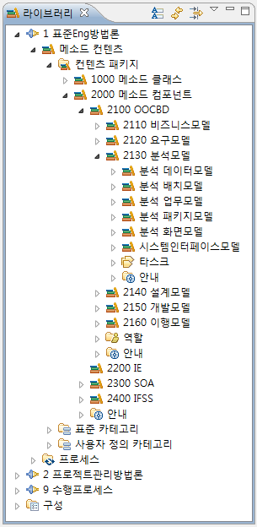
Method Component
View Models
  비즈니스모델
  요구모델
  분석모델
  설계모델
  개발모델
  이행모델
Roles with Views
  개발자
  분석자
  테스터
  …

Slide 103
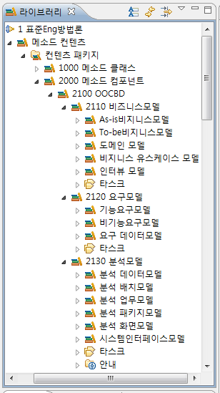
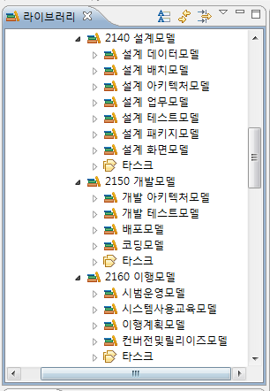
Method Component: Sub-Components

Slide 104
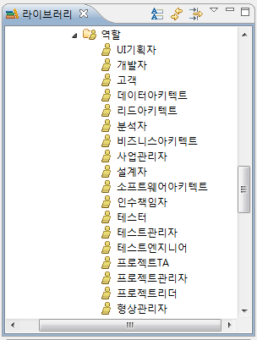
Method Component: Roles
A Method Component is defined by a Model with a specific View
Generally Views are associated with Roles

Slide 105
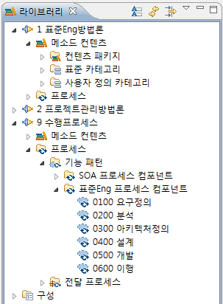
Process Component with Milestones
요구정의
  Project Scope
분석
  System Scope & Logical Model
아키텍처정의
  Architectural Baseline
설계
  Detail System Design
개발
  System
이행
  Release

Slide 106
Delivery Process: Process/Method Component View
Standard
Engineering
Delivery Process
Process Component View
Requirement
Analysis
Architecting
Design
Construction
Transition
Requirement
Model
Analysis
Model
Arhitecture
Model
Design
Model
Implementation
Model
Transition
Model
Method Component View

Slide 107
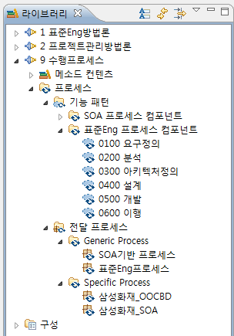
Delivery Process: Generic vs. Specific Process
Generic Process(공통 프로세스)
  표준 Eng. 프로세스
  Unified Process
Domain Process(업무공통 프로세스)
  소규모 금융
  대규모 금융
Specific Process(적용프로세스)
  삼성화재
  삼성생명

Slide 108
Delivery Process: Method Class View
Architecture
Static Structure
Dynamic
Behavior
Business
View
Biz Req.
View
Business UC
Package
Diagram
Business
Use-Case
Diagram
Method Class View
Biz Dev.
View
Business
Package
Diagram
Business
Class
Diagram
Use-Case
Realization:
Business
System
View
Req.
View
System UC
Package
Diagram
System
Use-Case
Diagram
Development
View
Platform
Independent
View
Analysis
Package
Diagram
Analysis
Class
Diagram
Use-Case
Realization:
Analysis
Platform
Dependent
View
Design
Package
Diagram
Design
Class
Diagram
Use-Case
Realization:
Design
Deployment
Diagram
Implementation
Package
Diagram
Implementation
Class
Diagram
Use-Case
Realization:
Source Code

Slide 109
Method Integration
표준 Eng. 방법론 & 프로젝트 관리 방법론

Slide 110
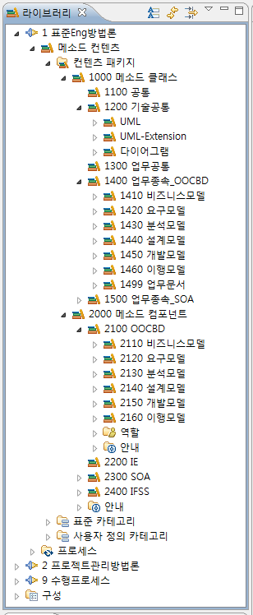
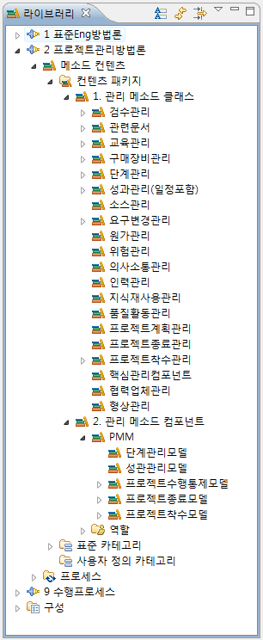
Method Class & Method Component
표준 Eng. 방법론
프로젝트 관리 방법론
Process
Component

Slide 111
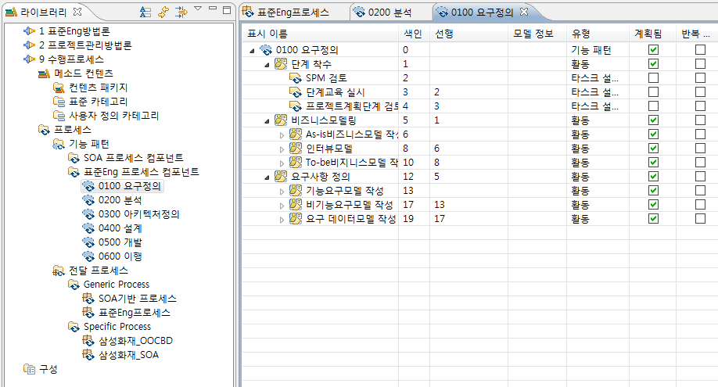
Process Component: Composition

Slide 112
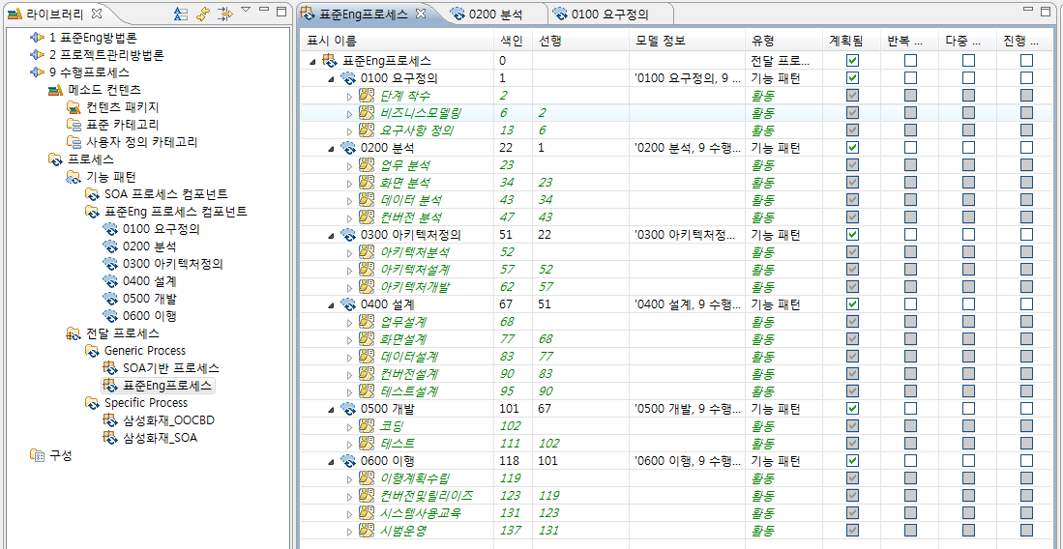
Delivery Process

Slide 113
Conclusion

Slide 114
Product-Line for Process Engineering Framework
Delivery Process Engineering
Process Framework
Selection
Process Architecture
Design
Process Component
Selection/Development
Component
Composition
Delivery Process
Requirements
Asset
Repository
Classification/Distribution
Configuration Management
Retrieval/Explanation
Frameworks
Components
Requirements
Process Framework Engineering
Method Component Engineering
Domain
Analysis
Framework
Qualification
Component
Qualification
Domain
Analysis
Framework
Design
Framework
Implementation
Component
Implementation
Component
Design

Slide 115
Key Features of Process Engineering Framework₁
Separation of Concerns
  Work-Product
    Use Case Diagram, E-R Diagram, …
  View Models
    OO System Analysis Model, E-R Conceptual DB Design Model, …
  Process Pattern
    Inception, Iteration, …
  Project Domain
    Bank, Manufacturing, …
Class Based Modeling/Architecture-Centric
  Modularity/Encapsulation
  Interface-Driven Modeling/Traceability, Consistency

Slide 116
Key Features of Process Engineering Framework₂
Meta-Model Based
  Any Process can be modeled
  Any Process can be integrated
    Engineering
    Management
    Business
  Any Architecture & Model can be described

Slide 117
Future Direction

Slide 118
Backgrounds
Process Silos
  Processes typically address only a segment of the full scope of IT operations. For example, IBM's Rational Unified Process (RUP) is focused on software lifecycles and the IT Infrastructure Library (ITIL) orients on the infrastructure.
Redundancy/Inconsistency/No Traceability
  Processes lack coordination, traceability to policy, and often contradict each other. For example, RUP and ITIL both define configuration and change management but with different roles, work products, and tasks.
Failure of organizational collaboration
  The synchronization of the software development lifecycles and infrastructure operation practices
No Governance
  A majority of governance and governance-based processes are intuitive, ad-hoc, or non-existent. One of the primary reasons is that IT industry processes, such as RUP and ITIL, are not enabled to facilitate the integration of governance in a mature manner. For example, RUP has no mechanisms for the integration of compliance management. Similarly, ITIL exists in the same state but without any actionable process elements to facilitate integration of governance.5

Slide 119
Goals
Strategic process alignment.
  Captures both internal and external alignment to synchronize processes with enterprise strategies.
Seamless process Integration.
  Maps process dependencies between enterprise organizational processes and manages them in terms of responsibility, consistency, and collaboration.
Process traceability chain.
  Maps the implementation of strategy, governance, and standards from policy to the process actionable elements realized in day-to-day tasks. Traceability enables the identification of process elements for strategy, alignment, and policy while also facilitating the management of process change.
Flexible process description based on meta-process models
  Captures the complete set of IT enterprise processes specific to the enterprise's constituent organizations. The discrete processes are owned and utilized by the individual organizations but are harmonized and managed across the enterprise via meta-process models.
Governance infrastructure.
  Standardizes regulatory compliance mechanisms and control points across all organizations within the IT Enterprise; streamlines the integration and implementation of transparent governance to constituent organizational processes.

Slide 120
Expected Values
Higher ROI from effective governance processes
  A survey revealed that "81% of CEO's and CIO's identified a higher ROI" due to the IT organization having implemented an effective governance-based process.
  [“Findings of the IT Governance Global Status Report – 2006”, IT Governance Institute]
Superior IT governance equates to greater profits
  Firms with superior IT Governance have more than 25% greater profits than firms with poor governance. The firms with the return had custom-designed governance processes aligning IT decisions with monitors for performance and accountability.
  [IT Governance: How top performers manage IT decision rights for superior results, Peter Weill and Jenny W Ross. Harvard Business School Press]
Increased market value with improved governance
  "On average, when moving from poorest to best on corporate governance, firms could expect an increase of 10 to 12 percent in market value.”,
  [The Mckinsey Quarterly, 2002]

Slide 121
Architecture/Model vs. Activity/Process
Structural View
Interaction View

Slide 122
Process Engineering Framework as a Generator for Architecture & Models
M3 layer
meta-meta-model
Meta-Object Facility
Process Engineering Framework
Software Process Engineering Meta-Model
M2 layer
meta-models
Delivery Process
Zachman Framework/FEAF
M1 layer
models
System Architecture/Models
Business Architecture/Models
M0 layer
information

Slide 123
Process Engineering Framework as an Enterprise Process Framework(EPF)
Process View
  Engineering Process
    OOCBD
    ITO
  Project Management Process
    PMM
  Business Process
    BPR
    ISP
Model View
  Enterprise Architecture & Model
  System Architecture & Model

Slide 124
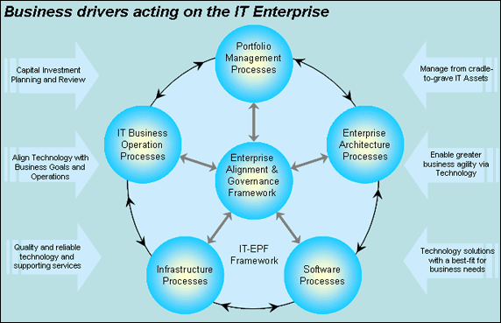
IT Enterprise Process Framework-IBM Case
IBM 2007

