Slide 1
2-Software Requirements
명지대학교/OMG Korea
최성운
choisw@mju.ac.kr

Slide 2
Software Requirements
Knowledge Area (KA)
It is concerned with the
  elicitation,
  analysis,
  specification, and
  validation of software requirements.
Software requirements express
  the needs and constraints placed on a software product that contribute to the solution of some real-world problem. [Kot00]
The KA breakdown is broadly compatible with the sections of IEEE 12207 that refer to requirements activities. (IEEE12207.1-96)
Sungwoon Choi
2-<number>

Slide 3
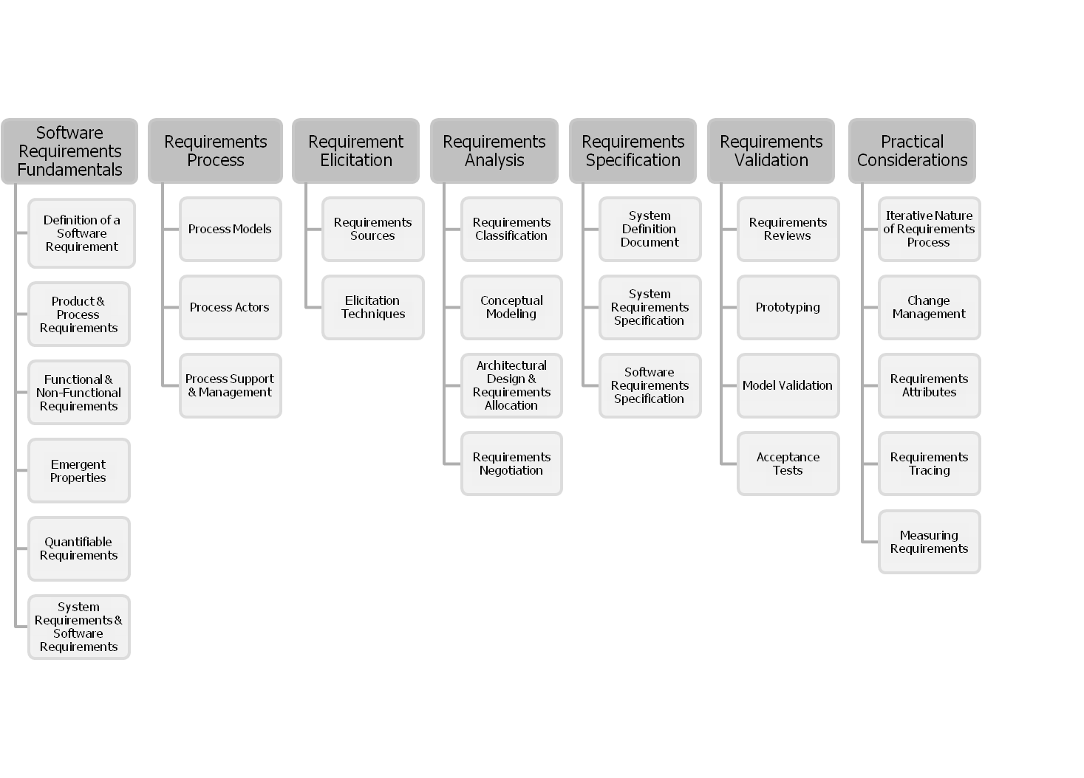
Software Requirements KA Subareas
Sungwoon Choi
2-<number>

Slide 4
Software Requirement Fundamentals
Sungwoon Choi
2-<number>

Slide 5
Definition of a Software Requirement
Requirement
  a property which must be exhibited in order to solve some problem in the real world.
Software requirement
  a property which must be exhibited by software developed or adapted to solve a particular problem.
  The problem may be
    to automate part of a task of someone who will use the software,
    to support the business processes of the organization that has commissioned the software,
    to correct shortcomings of existing software,
    to control a device, and many more.
Sungwoon Choi
2-<number>

Slide 6
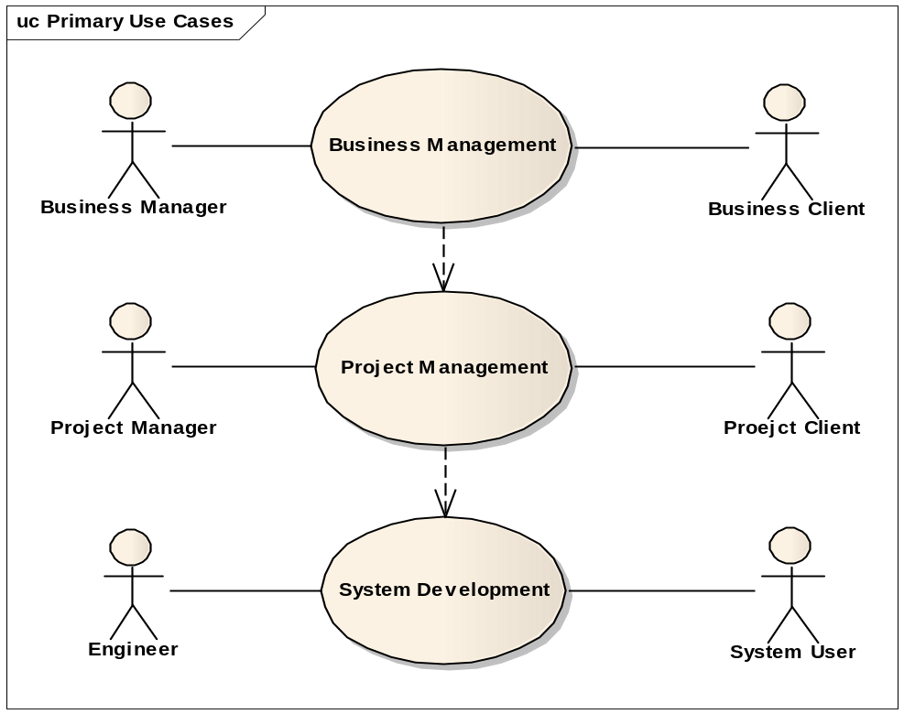
Contexts & Stakeholders
Software requirements are a complex combination of requirements
  from different people at different levels of an organization and
  from the environment in which the software will operate.
Contractor
Customer
Sungwoon Choi
2-<number>

Slide 7
Properties & Attributes
An essential property of all software requirements
  Verifiable , but it may be difficult or costly to verify certain software requirements
    For example, verification of the throughput requirement on the call center may necessitate the development of simulation software. Both the software requirements and software quality personnel must ensure that the requirements can be verified within the available resource constraints.
Other requirement attributes examples
  priority rating
    to enable trade-offs in the face of finite resources and
  a status value
    to enable project progress to be monitored.
Typically, software requirements are uniquely identified so that they can be subjected to software configuration control and managed over the entire software life cycle. [Kot00; Pfl01; Som05;Tha97]
Sungwoon Choi
2-<number>

Slide 8
Products & Process Requirements
Product parameters are requirements on software to be developed
  for example, “The software shall verify that a student meets all prerequisites before he or she registers for a course.”
A process parameter is essentially a constraint on the development of the software
  for example, “The software shall be written in Ada.”
  some software requirements generate implicit process requirements.
    the choice of verification technique
    the use of particularly rigorous analysis techniques (such as formal specification methods) to reduce faults which can lead to inadequate reliability.
  Process requirements may also be imposed directly by the development organization, their customer, or a third party such as a safety regulator [Kot00; Som97].
Sungwoon Choi
2-<number>

Slide 9
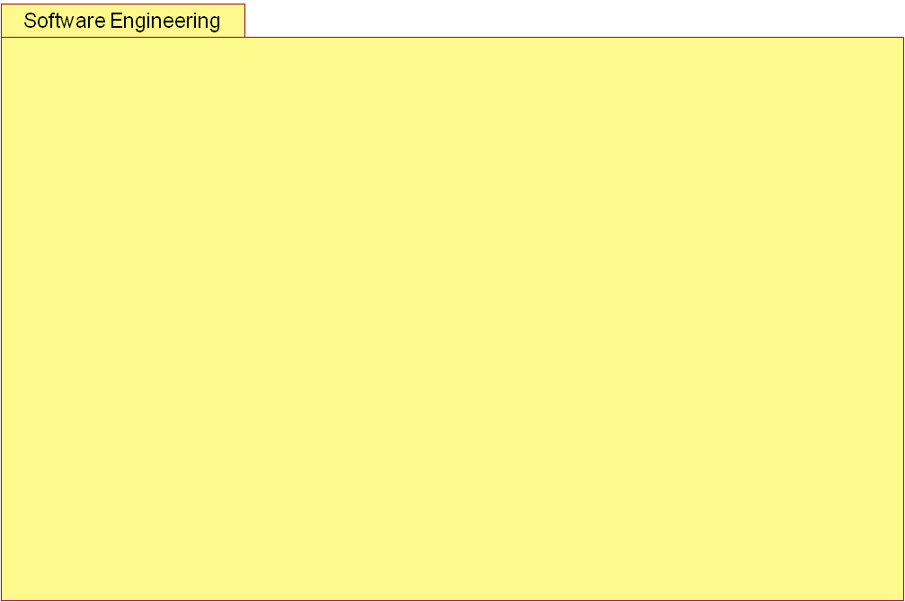
Other Perspectives
Core
Role
Performs
Activity
Process
1
0..*
1
1
1
Uses
Produces
0..*
0..*
IsResponsibleFor
+input
+output
Work-Product
Model/System
0..*
Uses
Support
Tool
Quality/Metric
Framework/
Asset
Standard
Sungwoon Choi
2-<number>

Slide 10
Functional &
Non-Functional Requirements
Functional requirements
  describe the functions that the software is to execute
    for example, formatting some text or modulating a signal. They are sometimes known as capabilities.
Nonfunctional requirements
  are the ones that act to constrain the solution. Nonfunctional requirements are sometimes known as constraints or quality requirements.
  They can be further classified according to whether they are performance requirements, maintainability requirements, safety requirements, reliability requirements, or one of many other types of software requirements.
  These topics are also discussed in the Software Quality KA. [Kot00; Som97]
Sungwoon Choi
2-<number>

Slide 11
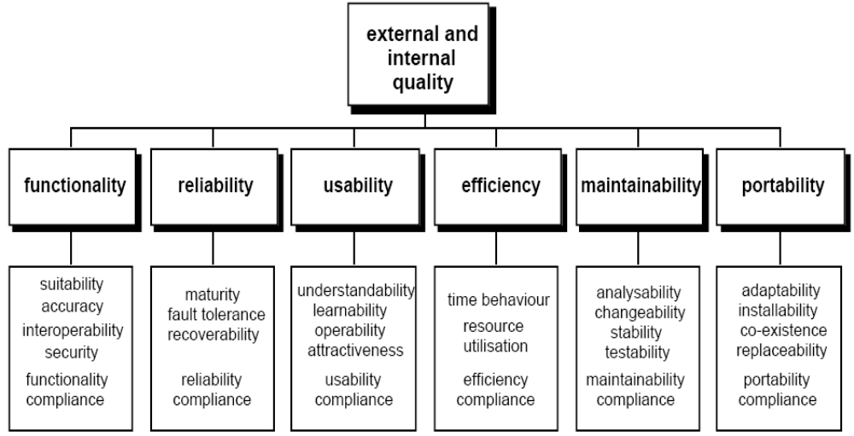
Quality Model for Product Quality
ISO 9126
Sungwoon Choi
2-<number>

Slide 12
Emergent Properties
Some requirements represent emergent properties of software—
  requirements which cannot be addressed by a single component, but which depend for their satisfaction on how all the software components interoperate.
    The throughput requirement for a call center would, for example, depend on how the telephone system, information system, and the operators all interacted under actual operating conditions.
Emergent properties are crucially dependent on the system architecture. [Som05]
  Usually related to non-functional requirements
Sungwoon Choi
2-<number>

Slide 13
Quantifiable Requirements
  Software requirements should be stated as clearly and as unambiguously as possible, and, where appropriate, quantitatively. This is particularly important for nonfunctional requirements.
  Examples of vague and unverifiable requirements which depend for their interpretation on subjective judgment
    “the software shall be reliable”
    “the software shall be user-friendly”.
  Examples of quantified requirements
    a call center’s software must increase the center’s throughput by 20%.
      It is also at a very high level and will need to be used to derive a number of detailed requirements.
    a system shall have a probability of generating a fatal error during any hour of operation of less than 1 * 10⁻⁸.
      It will tightly constrain the system architecture. [Dav93; Som05]
Sungwoon Choi
2-<number>

Slide 14
Software & System Requirements
In this topic, system means
  “an interacting combination of elements to accomplish a defined objective. These include hardware, software, firmware, people, information, techniques, facilities, services, and other support elements,” as defined by the International Council on Systems Engineering (INCOSE00).
  In a confined context
System Engineering
  The activity of specifying, designing, implementing, validating, installing, and maintaining systems as a whole
Sungwoon Choi
2-<number>

Slide 15
Requirement Process
This section introduces the software requirements process, orienting the remaining five subareas and showing how the requirements process dovetails with the overall software engineering process. [Dav93; Som05]

Slide 16
Process Models
Requirements process
  Is not a discrete front-end activity of the software life cycle, but rather a process initiated at the beginning of a project and continuing to be refined throughout the life cycle
  Identifies software requirements as configuration items, and manages them using the same software configuration management practices as other products of the software life cycle processes
  Needs to be adapted to the organization and project context
It is concerned with how the activities of elicitation, analysis, specification, and validation are configured for different types of projects and constraints.
The topic also includes activities which provide input into the requirements process, such as marketing and feasibility studies. [Kot00; Rob99; Som97; Som05]
Sungwoon Choi
2-<number>

Slide 17

Sungwoon Choi
2-<number>

Slide 18
Process Actors
This topic introduces the roles of the people who participate in the requirements process. This process is fundamentally interdisciplinary, and the requirements specialist needs to mediate between the domain of the stakeholder and that of software engineering.
There are often many people involved besides the requirements specialist, each of whom has a stake in the software. The stakeholders will vary across projects, but always include users/operators and customers (who need not be the same). [Gog93]
Typical examples of software stakeholders include (but are not restricted to)
  Users: This group comprises those who will operate the software. It is often a heterogeneous group comprising people with different roles and requirements.
  Customers: This group comprises those who have commissioned the software or who represent the software’s target market.
  Market analysts: A mass-market product will not have a commissioning customer, so marketing people are often needed to establish what the market needs and to act as proxy customers.
  Regulators: Many application domains such as banking and public transport are regulated. Software in these domains must comply with the requirements of the regulatory authorities.
  Software engineers: These individuals have a legitimate interest in profiting from developing the software by, for example, reusing components in other products. If, in this scenario, a customer of a particular product has specific requirements which compromise the potential for component reuse, the software engineers must carefully weigh their own stake against those of the customer.
Sungwoon Choi
2-<number>

Slide 19
Process Actors
It will not be possible to perfectly satisfy the requirements of every stakeholder, and it is the software engineer’s job to negotiate trade-offs which are both acceptable to the principal stakeholders and within budgetary, technical, regulatory, and other constraints. A prerequisite for this is that all the stakeholders be identified, the nature of their “stake” analyzed, and their requirements elicited. [Dav93; Kot00; Rob99; Som97; You01]
Sungwoon Choi
2-<number>

Slide 20
Process Support & Management
This topic introduces the project management resources required and consumed by the requirements process. It establishes the context for the first subarea (Initiation and scope definition) of the Software Engineering Management KA. Its principal purpose is to make the link between the process activities identified in 2.1 and the issues of cost, human resources, training, and tools. [Rob99; Som97; You01]
Sungwoon Choi
2-<number>

Slide 21
Process Quality & Improvement
This topic is concerned with the assessment of the quality and improvement of the requirements process. Its purpose is to emphasize the key role the requirements process plays in terms of the cost and timeliness of a software product, and of the customer’s satisfaction with it [Som97].
It will help to orient the requirements process with quality standards and process improvement models for software and systems. Process quality and improvement is closely related to both the Software Quality KA and the Software Engineering Process KA. Of particular interest are issues of software quality attributes and measurement, and software process definition.
This topic covers
  Requirements process coverage by process improvement standards and models
  Requirements process measures and benchmarking
  Improvement planning and implementation [Kot00; Som97; You01]
Sungwoon Choi
2-<number>

Slide 22
Requirements Elicitation
Sungwoon Choi
2-<number>

Slide 23
Requirements Elicitation
Requirements elicitation is concerned with where software requirements come from and how the software engineer can collect them. It is the first stage in building an understanding of the problem the software is required to solve.
It is fundamentally a human activity, and is where the stakeholders are identified and relationships established between the development team and the customer.
It is variously termed “requirements capture,” “requirements discovery,” and “requirements acquisition.”
One of the fundamental tenets of good software engineering is that there be good communication between software users and software engineers. Before development begins, requirements specialists may form the conduit for this communication. They must mediate between the domain of the software users (and other stakeholders) and the technical world of the software engineer.
Sungwoon Choi
2-<number>

Slide 24
Requirements Sources
Requirements have many sources in typical software, and it is essential that all potential sources be identified and evaluated for their impact on it. This topic is designed to promote awareness of the various sources of software requirements and of the frameworks for managing them.
The main points covered are
  Goals. The term goal (sometimes called “business concern” or “critical success factor”) refers to the overall, high-level objectives of the software. Goals provide the motivation for the software, but are often vaguely formulated. Software engineers need to pay particular attention to assessing the value (relative to priority) and cost of goals. A feasibility study is a relatively low-cost way of doing this. [Lou95].
  Domain knowledge. The software engineer needs to acquire, or have available, knowledge about the application domain. This enables them to infer tacit knowledge that the stakeholders do not articulate, assess the trade-offs that will be necessary between conflicting requirements, and, sometimes, to act as a “user” champion.
Sungwoon Choi
2-<number>

Slide 25
  Stakeholders (see topic 2.2 Process actors). Much software has proved unsatisfactory because it has stressed the requirements of one group of stakeholders at the expense of those of others. Hence, software is delivered which is difficult to use or which subverts the cultural or political structures of the customer organization. The software engineer needs to identify, represent, and manage the “viewpoints” of many different types of stakeholders. [Kot00]
  The operational environment. Requirements will be derived from the environment in which the software will be executed. These may be, for example, timing constraints in real-time software or interoperability constraints in an office environment. These must be actively sought out, because they can greatly affect software feasibility and cost, and restrict design choices. [Tha97]
  The organizational environment. Software is often required to support a business process, the selection of which may be conditioned by the structure, culture, and internal politics of the organization. The software engineer needs to be sensitive to these, since, in general, new software should not force unplanned change on the business process.
Sungwoon Choi
2-<number>

Slide 26
Elicitation Techniques
Once the requirements sources have been identified, the software engineer can start eliciting requirements from them. This topic concentrates on techniques for getting human stakeholders to articulate their requirements. It is a very difficult area and the software engineer needs to be sensitized to the fact that (for example) users may have difficulty describing their tasks, may leave important information unstated, or may be unwilling or unable to cooperate.
It is particularly important to understand that elicitation is not a passive activity, and that, even if cooperative and articulate stakeholders are available, the software engineer has to work hard to elicit the right information.
A number of techniques exist for doing this, the principal ones being [Gog93]
Sungwoon Choi
2-<number>

Slide 27
Interviews, a “traditional” means of eliciting requirements. It is important to understand the advantages and limitations of interviews and how they should be conducted.
Scenarios, a valuable means for providing context to the elicitation of user requirements. They allow the software engineer to provide a framework for questions about user tasks by permitting “what if” and “how is this done” questions to be asked. The most common type of scenario is the use case. There is a link here to topic 4.2 (Conceptual modeling) because scenario notations such as use cases and diagrams are common in modeling software.
Prototypes, a valuable tool for clarifying unclear requirements. They can act in a similar way to scenarios by providing users with a context within which they can better understand what information they need to provide. There is a wide range of prototyping techniques, from paper mock-ups of screen designs to beta-test versions of software products, and a strong overlap of their use for requirements elicitation and the use of prototypes for requirements validation (see topic 6.2 Prototyping).
Sungwoon Choi
2-<number>

Slide 28
Facilitated meetings. The purpose of these is to try to achieve a summative effect whereby a group of people can bring more insight into their software requirements than by working individually. They can brainstorm and refine ideas which may be difficult to bring to the surface using interviews. Another advantage is that conflicting requirements surface early on in a way that lets the stakeholders recognize where there is conflict. When it works well, this technique may result in a richer and more consistent set of requirements than might otherwise be achievable. However, meetings need to be handled carefully (hence the need for a facilitator) to prevent a situation from occurring where the critical abilities of the team are eroded by group loyalty, or the requirements reflecting the concerns of a few outspoken (and perhaps senior) people are favored to the detriment of others.
Observation. The importance of software context within the organizational environment has led to the adaptation of observational techniques for requirements elicitation. Software engineers learn about user tasks by immersing themselves in the
Sungwoon Choi
2-<number>

Slide 29
Requirements Analysis
Sungwoon Choi
2-<number>

Slide 30
Requirements Analysis
It is concerned with the process of analyzing requirements to
  Detect and resolve conflicts between requirements
  Discover the bounds of the software and how it must interact with its environment
  Elaborate system requirements to derive software requirements
Traditional view
  Conceptual Modeling
  Structured Analysis & Design Technique(SADT)
+
  Classification of requirements to help trade-offs between requirements(requirements classification) and the process of establishing these trade-offs (requirements negotiation)
Requirements should be described precisely enough to enable the requirements to be validated, their implementation to be verified, and their costs to be estimated
Sungwoon Choi
2-<number>

Slide 31
Requirements Classification
Examples
  Functional or Non-functional
  Derived from one or more high-level requirements or an emergent property or imposed directly on the software by a stakeholder or some other source.
  On the product or the process
    Requirements on the process can constrain the choice of contractor, the software engineering process to be adopted, or the standards to be adhered to.
  Priority
    Mandatory, Highly desirable, or optional
  Scope
    Global, a discrete component
  Volatility/Stability
Sungwoon Choi
2-<number>

Slide 32
Conceptual Modeling
Purpose
  To understand the problem rather than to initiate design of the solution.
Conceptual models comprise models of entities from the problem domain configured to reflect their real-world relationships and dependencies.
Models
  Data & control flows, state models, event trace, user interactions, object models, data models, and many others.
Factors that influence the choice of model
  The nature of the problem.
    Ex) control flow and state models: real-time software
  The expertise of the software engineer
  The process requirements of the customer
  The availability of methods and tools
Sungwoon Choi
2-<number>

Slide 33
Start by building a model of the software context
A method
  A notation or set of notations supported by a process which guides the application of the notations.
  Unified Modeling Language
IEEE Std. 1320.1: IDEF0(Integration Definition for Function Modeling) for functional modeling
  A functional modeling language for the analysis, development, reengineering, and integration of information systems; business processes; or software engineering analysis.
IEEE Std. 1320.2: IDEF1X97 (IDEFObject) for information modeling
Sungwoon Choi
2-<number>

Slide 34
Architectural Design and Requirements Allocation
Sungwoon Choi
2-<number>

Slide 35
Requirements Negotiation
Conflict Resolution
Decisions should be traceable
  It is also a requirements validation topic
Sungwoon Choi
2-<number>

Slide 36
Requirements Specification
Sungwoon Choi
2-<number>

Slide 37
Requirements Specification
Specification in general engineering
  The assignment of numerical values or limits to a product’s design goals.
Specification in software engineering
  The production of a document, or its electronic equivalent, which can be systematically reviewed, evaluated, and approved.
For complex systems, particularly those involving substantial non-software components, as many as three different types of documents are produced: system definition, system requirements, and software requirements
Sungwoon Choi
2-<number>

Slide 38
System Definition Document
User Requirements document or concept of operations
The high-level system requirements from the domain perspective
The target reader
  Representatives of the system users/customers (marketing may play these roles for market-driven software)
The contents should be couched in terms of the domain.
Contents
  The system requirements along with background information about the overall objectives for the system, its target environment and a statement of the constraints, assumptions, and non-functional requirements.
  It may include conceptual models designed to illustrate the system context, usage scenarios and the principal domain entities, as well as data, information, and workflows.
IEEE Std. 1362-98, Concept of Operations Document
Sungwoon Choi
2-<number>

Slide 39
System Requirements Specification
Developers of systems with substantial software and non-software components, a modern airliner, for example, often separate the description of system requirements from the description of software requirements.
In this view, system requirements are specified, the software requirements are derived from the system requirements, and then the requirements for the software components are specified.
Strictly speaking, system requirements specification is a systems engineering activity and falls outside the scope of this Guide.
IEEE Std 1233 is a guide for developing system requirements. (IEEE1233-98)
Sungwoon Choi
2-<number>

Slide 40
Software Requirements Specification
Software requirements specification
  Establishes the basis for agreement between customers and contractors or suppliers (in market-driven projects, these roles may be played by the marketing and development divisions) on what the software product is to do, as well as what it is not expected to do.
  Permits a rigorous assessment of requirements before design can begin and reduces later redesign. It should also provide a realistic basis for estimating product costs, risks, and schedules.
  Organizations can also use a software requirements specification document to develop their own validation and verification plans more productively.
  Provides an informed basis for transferring a software product to new users or new machines.
  Finally, can provide a basis for software enhancement.
  For non-technical readers, the software requirements specification document is often accompanied by a software requirements definition document.
Sungwoon Choi
2-<number>

Slide 41
Requirements Specification Descriptions
Software requirements are often written in natural language, but, in software requirements specification, this may be supplemented by formal or semi-formal descriptions. Selection of appropriate notations permits particular requirements and aspects of the software architecture to be described more precisely and concisely than natural language.
The general rule is that notations should be used which allow the requirements to be described as precisely as possible. This is particularly crucial for safety-critical and certain other types of dependable software. However, the choice of notation is often constrained by the training, skills and preferences of the document’s authors and readers.
Sungwoon Choi
2-<number>

Slide 42
A number of quality indicators have been developed which can be used to relate the quality of software requirements specification to other project variables such as cost, acceptance, performance, schedule, reproducibility, etc.
Quality indicators for individual software requirements specification statements include imperatives, directives, weak phrases, options, and continuances.
Indicators for the entire software requirements specification document include size, readability, specification, depth, and text structure. [Dav93; Tha97] (Ros98)
IEEE has a standard, IEEE Std 830 [IEEE830-98], for the production and content of the software requirements specification. Also, IEEE 1465 (similar to ISO/IEC 12119) is a standard treating quality requirements in software packages. (IEEE1465-98)
Sungwoon Choi
2-<number>

Slide 43
Requirements Validation
The requirements documents may be subject to validation and verification procedures. The requirements may be validated to ensure that the software engineer has understood the requirements, and it is also important to verify that a requirements document conforms to company standards, and that it is understandable, consistent, and complete. Formal notations offer the important advantage of permitting the last two properties to be proven (in a restricted sense, at least).
Different stakeholders, including representatives of the customer and developer, should review the document(s).
Requirements documents are subject to the same software configuration management practices as the other deliverables of the software life cycle processes. (Bry94, Ros98)
Sungwoon Choi
2-<number>

Slide 44
It is normal to explicitly schedule one or more points in the requirements process where the requirements are validated. The aim is to pick up any problems before resources are committed to addressing the requirements.
Requirements validation is concerned with the process of examining the requirements document to ensure that it defines the right software (that is, the software that the users expect). [Kot00]
Sungwoon Choi
2-<number>

Slide 45
Requirements Reviews
Perhaps the most common means of validation is by inspection or reviews of the requirements document(s).
A group of reviewers is assigned a brief to look for errors, mistaken assumptions, lack of clarity, and deviation from standard practice. The composition of the group that conducts the review is important (at least one representative of the customer should be included for a customer-driven project, for example), and it may help to provide guidance on what to look for in the form of checklists.
Reviews may be constituted on completion of the system definition document, the system specification document, the software requirements specification document, the baseline specification for a new release, or at any other step in the process.
IEEE Std 1028 provides guidance on conducting such reviews. (IEEE1028-97) Reviews are also covered in the Software Quality KA, topic 2.3 Reviews and Audits.
Sungwoon Choi
2-<number>

Slide 46
Prototyping
Prototyping is commonly a means for validating the software engineer’s interpretation of the software requirements, as well as for eliciting new requirements.
As with elicitation, there is a range of prototyping techniques and a number of points in the process where prototype validation may be appropriate.
The advantage of prototypes is that they can make it easier to interpret the software engineer’s assumptions and, where needed, give useful feedback on why they are wrong.
  For example, the dynamic behavior of a user interface can be better understood through an animated prototype than through textual description or graphical models.
There are also disadvantages, however.
  These include the danger of users’ attention being distracted from the core underlying functionality by cosmetic issues or quality problems with the prototype. For this reason, several people recommend prototypes which avoid software, such as flip-chart-based mockups.
Prototypes may be costly to develop. However, if they avoid the wastage of resources caused by trying to satisfy erroneous requirements, their cost can be more easily justified.
Sungwoon Choi
2-<number>

Slide 47
Model Validation
It is typically necessary to validate the quality of the models developed during analysis.
For example,
  in object models, it is useful to perform a static analysis to verify that communication paths exist between objects which, in the stakeholders’ domain, exchange data.
  If formal specification notations are used, it is possible to use formal reasoning to prove specification properties.
Sungwoon Choi
2-<number>

Slide 48
Acceptance Tests
An essential property of a software requirement is that it should be possible to validate that the finished product satisfies it.
  Requirements which cannot be validated are really just “wishes.”
  An important task is therefore planning how to verify each requirement.
  In most cases, designing acceptance tests does this.
Identifying and designing acceptance tests may be difficult for non-functional requirements (see topic 1.3 Functional and Non-functional Requirements).
  To be validated, they must first be analyzed to the point where they can be expressed quantitatively.
Additional information can be found in the Software Testing KA, sub-topic 2.2.4 Conformance testing.
Sungwoon Choi
2-<number>

Slide 49
Practical Considerations
Sungwoon Choi
2-<number>

Slide 50
Practical Considerations
The first level of decomposition of subareas presented in this KA may seem to describe a linear sequence of activities. This is a simplified view of the process. [Dav93]
The requirements process spans the whole software life cycle. Change management and the maintenance of the requirements in a state which accurately mirrors the software to be built, or that has been built, are key to the success of the software engineering process. [Kot00; Lou95]
Sungwoon Choi
2-<number>

Slide 51
Not every organization has a culture of documenting and managing requirements.
  It is frequent in dynamic start-up companies, driven by a strong “product vision” and limited resources, to view requirements documentation as an unnecessary overhead.
  Most often, however, as these companies expand, as their customer base grows, and as their product starts to evolve, they discover that they need to recover the requirements that motivated product features in order to assess the impact of proposed changes. Hence, requirements documentation and change management are key to the success of any requirements process.
Sungwoon Choi
2-<number>

Slide 52
Iterative Nature of the Requirements Process
There is general pressure in the software industry for ever shorter development cycles, and this is particularly pronounced in highly competitive market-driven sectors.
Moreover, most projects are constrained in some way by their environment, and many are upgrades to, or revisions of, existing software where the architecture is a given.
In practice, therefore, it is almost always impractical to implement the requirements process as a linear, deterministic process in which software requirements are elicited from the stakeholders, base-lined, allocated, and handed over to the software development team.
It is certainly a myth that the requirements for large software projects are ever perfectly understood or perfectly specified. [Som97]
Sungwoon Choi
2-<number>

Slide 53
Instead, requirements typically iterate towards a level of quality and detail which is sufficient to permit design and procurement decisions to be made.
In some projects, this may result in the requirements being base-lined before all their properties are fully understood. This risks expensive rework if problems emerge late in the software engineering process.
However, software engineers are necessarily constrained by project management plans and must therefore take steps to ensure that the “quality” of the requirements is as high as possible given the available resources. They should, for example, make explicit any assumptions which underpin the requirements, as well as any known problems.
In almost all cases, requirements understanding continues to evolve as design and development proceeds. This often leads to the revision of requirements late in the life cycle.
Sungwoon Choi
2-<number>

Slide 54
Perhaps the most crucial point in understanding requirements engineering is that a significant proportion of the requirements will change. This is sometimes due to errors in the analysis, but it is frequently an inevitable consequence of change in the “environment”:
  for example, the customer’s operating or business environment, or the market into which software must sell.
Whatever the cause, it is important to recognize the inevitability of change and take steps to mitigate its effects. Change has to be managed by ensuring that proposed changes go through a defined review and approval process, and, by applying careful requirements tracing, impact analysis, and software configuration management (see the Software Configuration Management KA).
Hence, the requirements process is not merely a front-end task in software development, but spans the whole software life cycle. In a typical project, the software requirements activities evolve over time from elicitation to change management.
Sungwoon Choi
2-<number>

Slide 55
Change Management
Change management is central to the management of requirements. This topic describes the role of change management, the procedures that need to be in place, and the analysis that should be applied to proposed changes. It has strong links to the Software Configuration Management KA
Sungwoon Choi
2-<number>

Slide 56
Requirements Attributes
Requirements should consist not only of a specification of what is required, but also of ancillary information which helps manage and interpret the requirements.
  This should include the various classification dimensions of the requirement (see topic 4.1 Requirements Classification) and the verification method or acceptance test plan.
  It may also include additional information such as a summary rationale for each requirement, the source of each requirement, and a change history.
  The most important requirements attribute, however, is an identifier which allows the requirements to be uniquely and unambiguously identified.
Sungwoon Choi
2-<number>

Slide 57
Requirements Tracing
Requirements tracing is concerned with recovering the source of requirements and predicting the effects of requirements.
  Tracing is fundamental to performing impact analysis when requirements change. A requirement should be traceable backwards to the requirements and stakeholders which motivated it (from a software requirement back to the system requirement(s) that it helps satisfy, for example).
  Conversely, a requirement should be traceable forwards into the requirements and design entities that satisfy it (for example, from a system requirement into the software requirements that have been elaborated from it, and on into the code modules that implement it).
The requirements tracing for a typical project will form a complex directed acyclic graph (DAG) of requirements.
Sungwoon Choi
2-<number>

Slide 58
Measuring Requirements
As a practical matter, it is typically useful to have some concept of the “volume” of the requirements for a particular software product.
This number is useful
  in evaluating the “size” of a change in requirements,
  in estimating the cost of a development or maintenance task, or
  simply for use as the denominator in other measurements.
Functional Size Measurement (FSM) is a technique for evaluating the size of a body of functional requirements.
  IEEE Std 14143.1 defines the concept of FSM.
  [IEEE14143.1-00] Standards from ISO/IEC and other sources describe particular FSM methods.
Additional information on size measurement and standards will be found in the Software Engineering Process KA.
Sungwoon Choi
2-<number>

