Slide 1
Guide to the
Software Engineering
Body of Knowledge
2004 Version

Slide 2
Contents
 | 주제 | 시간 | 강사명
1 | Introduction | 1 | 최성운
2 | Software Requirements | 4 | 송태국
3 | Software Design | 6 | 송태국
4 | Software Construction | 4 | 최성운
5 | Software Testing | 4 | 권원일
6 | Software Maintenance | 2 | 최성운
7 | Software Configuration Management | 2 | 최성운
8 | Software Engineering Management | 4 | 김인현
9 | Software Engineering Process | 4 | 최성운
10 | Software Engineering Tools and Methods | 4 | 최성운
11 | Software Quality | 4 | 최성운
12 | Related Disciplines of Software Engineering | 1 | 최성운

Slide 3
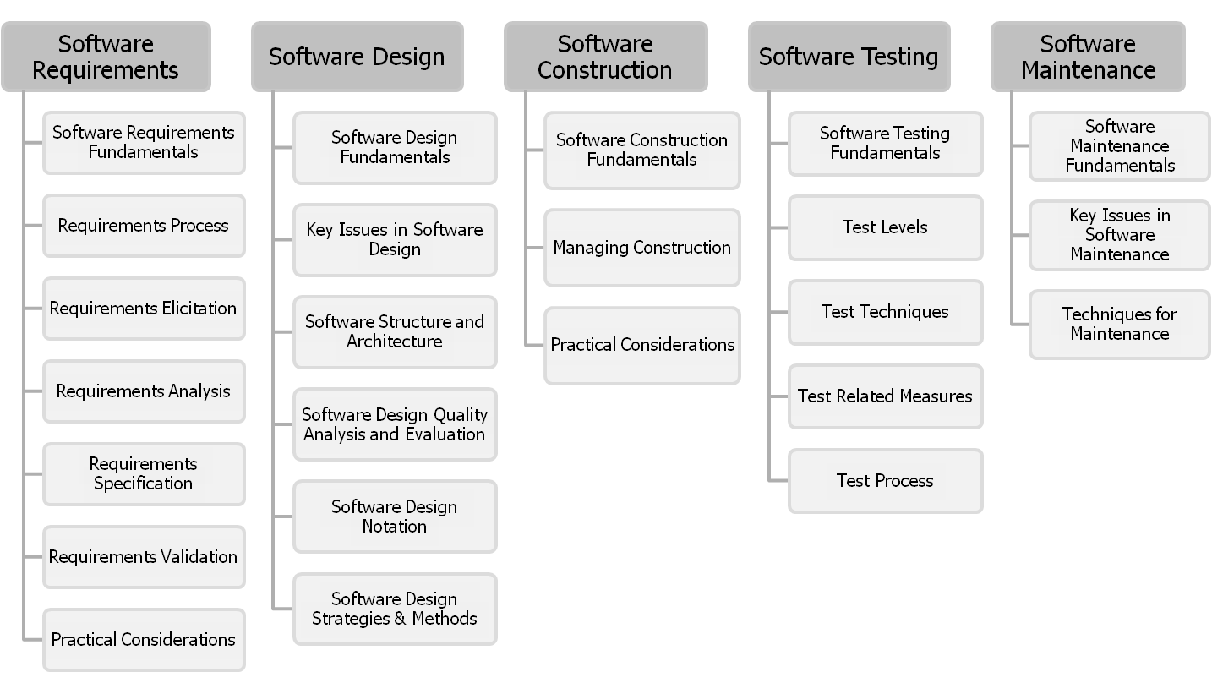
Guide to the SWEBOK₁
2004 Version
Sungwoon Choi
1-<number>

Slide 4
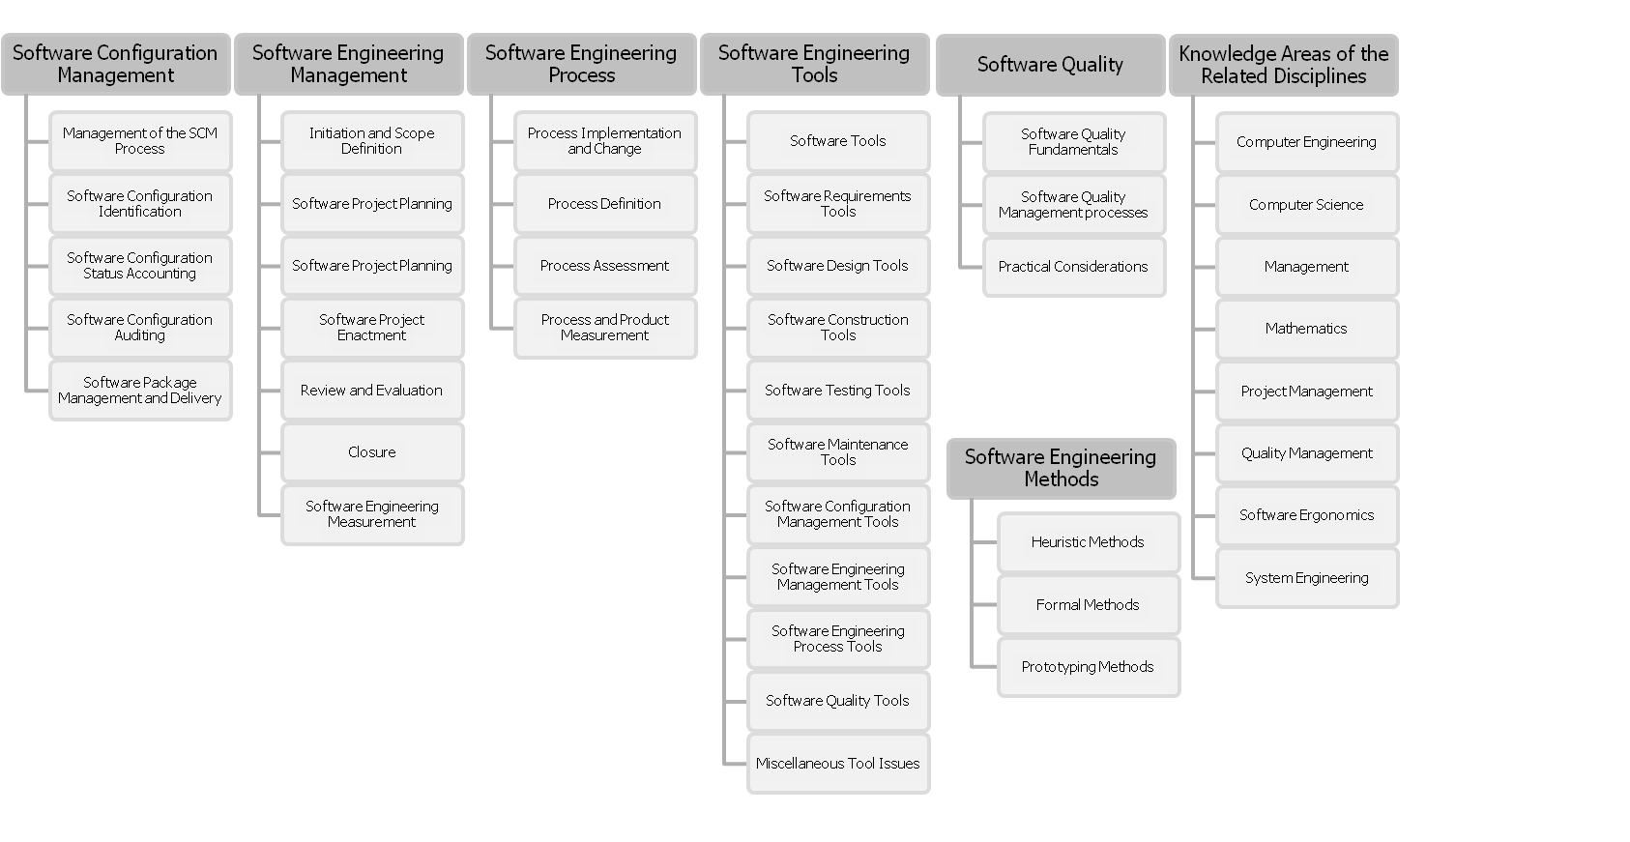
Guide to the SWEBOK₂
2004 Version
Sungwoon Choi
1-<number>

Slide 5
Software Engineering Management KA
The Software Engineering Management KA addresses
  the management and measurement of software engineering. While measurement is an important aspect of all KAs, it is here that the topic of measurement programs is presented.
There are six subareas for software engineering management.
  The first five cover software project management and the sixth describes software measurement programs.
Sungwoon Choi
1-<number>

Slide 6
Software Engineering Management Subareas1
Initiation and Scope Definition
  It comprises determination and negotiation of requirements, feasibility analysis, and process for the review and revision of requirements.
Software Project Planning
  It includes process planning, determining deliverables, effort, schedule and cost estimation, resource allocation, risk management, quality management, and plan management.
Software Project Enactment
  The topics here are implementation of plans, supplier contract management, implementation of measurement process, monitor process, control process, and reporting.
Sungwoon Choi
1-<number>

Slide 7
Software Engineering Management Subareas2
Review and Evaluation,
  It includes the topics of determining satisfaction of requirements and reviewing and evaluating performance.
Closure
  It determines closure and closure activities.
Software Engineering Measurement, more specifically, measurement programs.
  Product and process measures are described in the Software Engineering Process KA. Many of the other KAs also describe measures specific to their KA.
  The topics of this subarea include establishing and sustaining measurement commitment, planning the measurement process, performing the measurement process, and evaluating measurement.
Sungwoon Choi
1-<number>

