Slide 1
1-Introduction
명지대학교/OMG Korea
최성운
choisw@mju.ac.kr

Slide 2
Course Overview
The Guide should not be confused with the Body of Knowledge itself, which already exists in the published literature. The purpose of the Guide is to describe what portion of the Body of Knowledge is generally accepted, to organize that portion, and to provide a topical access to it.
The Guide to the Software Engineering Body of Knowledge (SWEBOK) was established with the following five objectives:
  To promote a consistent view of software engineering worldwide
  To clarify the place—and set the boundary—of software engineering with respect to other disciplines such as computer science, project management, computer engineering, and mathematics
  To characterize the contents of the software engineering discipline
  To provide a topical access to the Software Engineering Body of Knowledge
  To provide a foundation for curriculum development and for individual certification and licensing material
Sungwoon Choi
1-<number>

Slide 3
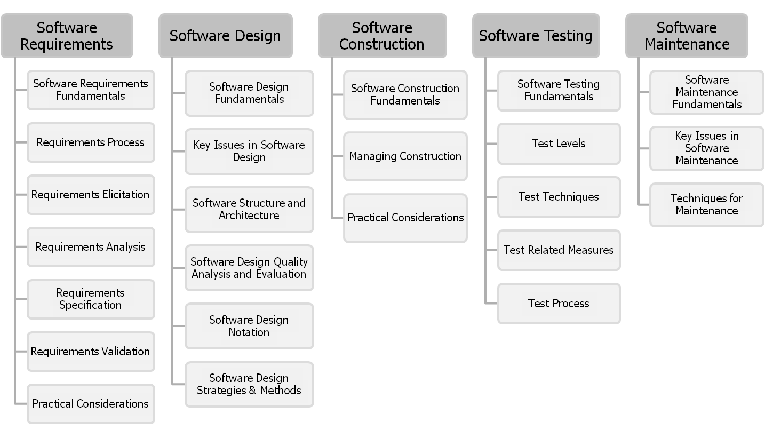
Contents₁
2004 Version
Sungwoon Choi
1-<number>

Slide 4
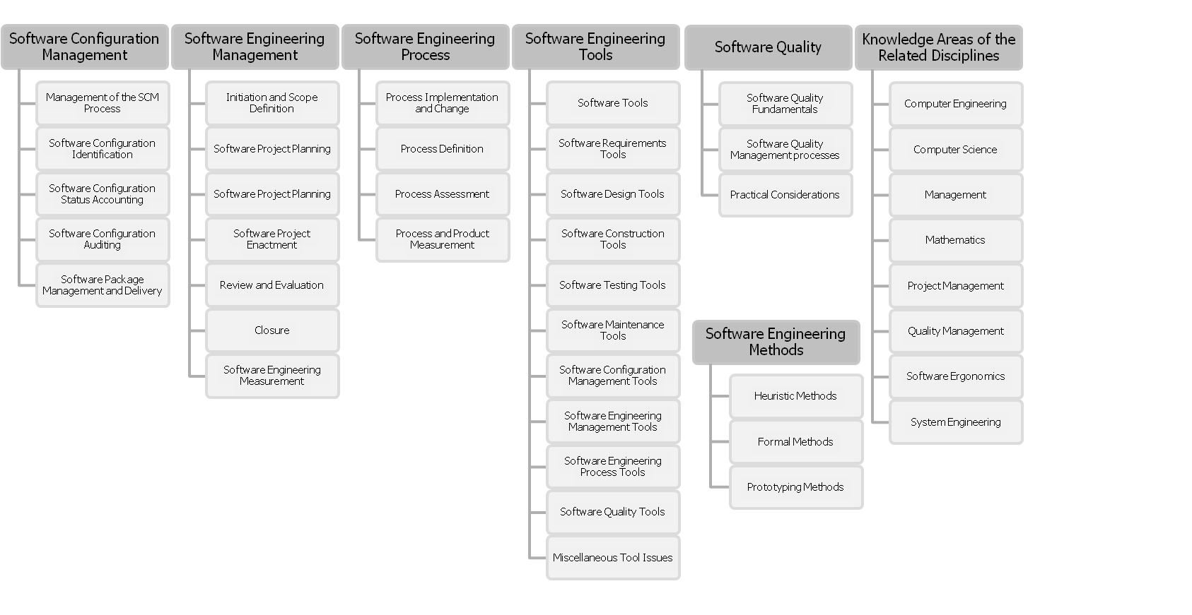
Contents₂
2004 Version
Sungwoon Choi
1-<number>

Slide 5

Software
Sungwoon Choi
1-<number>

Slide 6
Computer
Sungwoon Choi
1-<number>

Slide 7
Software Engineering
The application of a systematic, disciplined, quantifiable approach to the development, operation, and maintenance of software; that is, the application of engineering to software.[SEBOK2004]
Software Engineering is concerned with the theories, methods and tools which are needed to develop the software for the computers.[SOM2005]
  Software Engineering is different from other engineering disciplines in the sense that it deals with software, not hardware/materials governed by physical laws or by manufacturing processes.
Sungwoon Choi
1-<number>

Slide 8
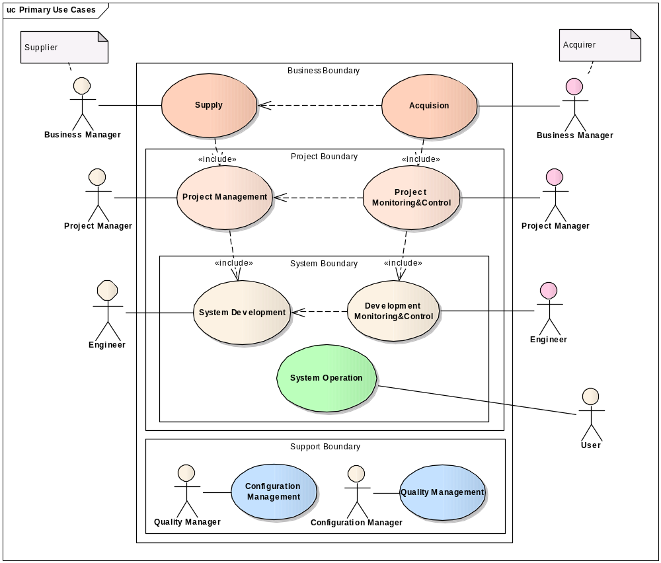
Stakeholders & System Context
Sungwoon Choi
1-<number>

Slide 9














Software Engineering in Process View
개발
영역
분석
아키텍처 설계
시스템
설계
시스템
구현
시험
유지
보수
요구사항
목표 시스템
?
관리
일정
예산
품질
형상
조직
지원
도구
프로세스
플랫폼 & 프레임워크
표준
Sungwoon Choi
1-<number>

Slide 10
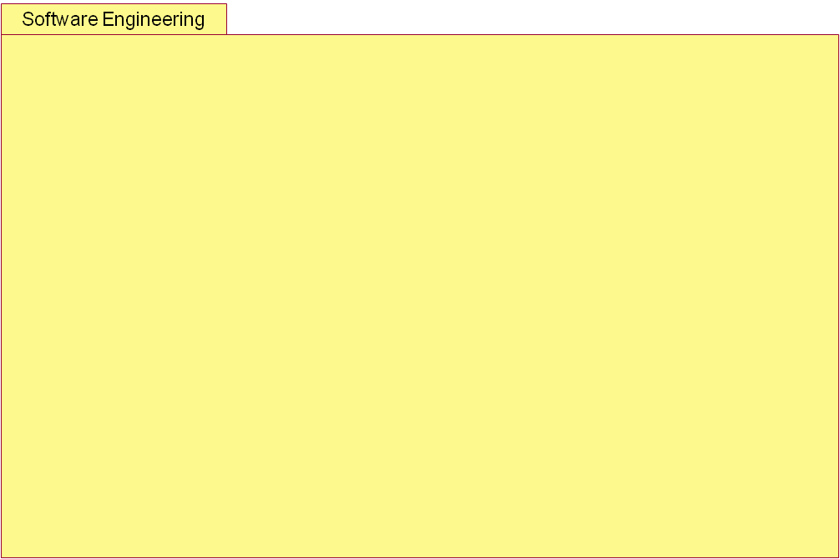
Software Engineering
Conceptual Model
Core
Role
Performs
Activity
Process
1
0..*
1
1
1
Uses
Produces
0..*
0..*
IsResponsibleFor
+input
+output
Work-Product
Model/System
0..*
Uses
Support
Tool
Quality/Metric
Framework/
Asset
Standard
Sungwoon Choi
1-<number>

Slide 11
Software Requirements KA
A requirement is defined as a property that must be exhibited in order to solve some real-world problem.
The KA is divided into seven subareas.
  Software Requirements Fundamentals
  Requirements Process
  Requirements Elicitation
  Requirements Analysis
  Requirements Specification
  Requirements Validation
  Practical Considerations
Sungwoon Choi
1-<number>

Slide 12
Software Requirements Fundamentals
It includes definitions of software requirements themselves, but also of the major types of requirements:
  product vs. process, functional vs. nonfunctional, emergent properties.
The subarea also describes the importance of quantifiable requirements and distinguishes between systems and software requirements.
Sungwoon Choi
1-<number>

Slide 13
Requirements Process
It introduces the process itself, orienting the remaining five subareas and showing how requirements engineering dovetails with the other software engineering processes.
It describes process models, process actors, process support and management, and process quality and improvement.
Sungwoon Choi
1-<number>

Slide 14
Requirements Elicitation
It is concerned with where software requirements come from and how the software engineer can collect them.
It includes requirement sources and elicitation techniques.
Sungwoon Choi
1-<number>

Slide 15
Requirements Analysis
It is concerned with the process of analyzing requirements to
  Detect and resolve conflicts between requirements
  Discover the bounds of the software and how it must interact with its environment
  Elaborate system requirements to software requirements
Requirements analysis includes requirements classification, conceptual modeling, architectural design and requirements allocation, and requirements negotiation
Sungwoon Choi
1-<number>

Slide 16
Requirements Specification
It typically refers to the production of a document, or its electronic equivalent, that can be systematically reviewed, evaluated, and approved.
For complex systems, particularly those involving substantial non-software components, as many as three different types of documents are produced:
  system definition,
  system requirements specification, and
  software requirements specification.
The subarea describes all three documents and the underlying activities.
Sungwoon Choi
1-<number>

Slide 17
Requirements Validation
The aim of this subarea is to pick up any problems before resources are committed to addressing the requirements.
Requirements validation is concerned with the process of examining the requirements documents to ensure that they are defining the right system (that is, the system that the user expects).
It is subdivided into descriptions of the conduct of
  requirements reviews,
  prototyping, and
  model validation and acceptance tests.
Sungwoon Choi
1-<number>

Slide 18
Practical Considerations
It describes topics which need to be understood in practice.
  The first topic is the iterative nature of the requirements process.
  The next three topics are fundamentally about change management and the maintenance of requirements in a state which accurately mirrors the software to be built, or that has already been built. It includes
    change management,
    requirements attributes, and
    requirements tracing.
  The final topic is requirements measurement.
Sungwoon Choi
1-<number>

Slide 19
Software Design KA
According to the IEEE definition [IEEE 610.12-90], design is both
  “the process of defining the architecture, components, interfaces, and other characteristics of a system or component” and “the result of [that] process.”
The KA is divided into six subareas.
  Software Design Fundamentals
  Key Issues in Software Design
  Software Structure and Architecture
  Software Design Quality Analysis and Evaluation
  Software Design Notation
  Software Design Strategies & Methods
Sungwoon Choi
1-<number>

Slide 20
Software Design Fundamentals
It forms an underlying basis to the understanding of the role and scope of software design.
These are
  general software concepts,
  the context of software design,
  the software design process, and
  the enabling techniques for software design.
Sungwoon Choi
1-<number>

Slide 21
Key Issues in Software Design
They include
  concurrency,
  control and handling of events,
  distribution of components,
  error and exception handling and fault tolerance,
  interaction and presentation, and
  data persistence.
Sungwoon Choi
1-<number>

Slide 22
Software Structure and Architecture
The topics of the subarea are
  architectural structures and viewpoints,
  architectural styles,
  design patterns, and, finally,
  families of programs and frameworks.
Sungwoon Choi
1-<number>

Slide 23
Software Design Quality Analysis and Evaluation
While there is a entire KA devoted to software quality, this subarea presents the topics specifically related to software design.
These aspects are
  quality attributes,
  quality analysis, and
  evaluation techniques and measures.
Sungwoon Choi
1-<number>

Slide 24
Software Design Notations
The Software Design Notations are divided into structural and behavioral descriptions.
Sungwoon Choi
1-<number>

Slide 25
Software Design Strategies and
Methods
The last subarea describes Software Design Strategies and Methods.
  First, general strategies are described, followed by
  function-oriented design methods,
  object-oriented design methods,
  data-structure-centered design,
  component- based design, and others.
Sungwoon Choi
1-<number>

Slide 26
Software Construction KA
It refers to the detailed creation of working, meaningful software through a combination of coding, verification, unit testing, integration testing, and debugging.
The KA includes three subareas.
  Software Construction Fundamentals
  Managing Construction
  Practical Considerations
Sungwoon Choi
1-<number>

Slide 27
Software Construction Subareas
Software Construction Fundamentals.
  The first three topics are basic principles of construction:
    minimizing complexity,
    anticipating change, and
    constructing for verification.
  The last topic discusses standards for construction.
Managing Construction.
  The topics are construction models, construction planning, and construction measurement.
Practical Considerations.
  The topics are construction design, construction languages, coding, construction testing, reuse, construction quality, and integration.
Sungwoon Choi
1-<number>

Slide 28
Software Testing KA
Software Testing consists of the dynamic verification of the behavior of a program on a finite set of test cases, suitably selected from the usually infinite executions domain, against the expected behavior.
It includes five subareas.
Sungwoon Choi
1-<number>

Slide 29
Software Testing Subareas₁
Software Testing Fundamentals
  First, the testing-related terminology is presented, then key issues of testing are described, and finally the relationship of testing to other activities is covered.
Test Levels
  These are divided between the targets of the tests and the objectives of the tests.
Test Techniques.
  The first category includes the tests based on the tester’s intuition and experience. A second group comprises specification-based techniques, followed by code-based techniques, fault-based techniques, usage-based techniques, and techniques relative to the nature of the application. A discussion of how to select and combine the appropriate techniques is also presented.
Sungwoon Choi
1-<number>

Slide 30
Software Testing Subareas₂
Test-Related Measures
  The measures are grouped into those related to the evaluation of the program under test and the evaluation of the tests performed.
Test Process
  It includes practical considerations and the test activities.
Sungwoon Choi
1-<number>

Slide 31
Software Maintenance KA
Once in operation, anomalies are uncovered, operating environments change, and new user requirements surface.
The maintenance phase of the life cycle commences upon delivery, but maintenance activities occur much earlier.
The Software Maintenance KA is divided into four subareas.
Sungwoon Choi
1-<number>

Slide 32
Software Maintenance Subareas
Software Maintenance Fundamentals
  definitions and terminology, the nature of maintenance, the need for maintenance, the majority of maintenance costs, the evolution of software, and the categories of maintenance.
Key Issues in Software Maintenance.
  These are the technical issues, the management issues, maintenance cost estimation, and software maintenance measurement.
Maintenance Process
  The topics here are the maintenance processes and maintenance activities.
Techniques for Maintenance
  These include program comprehension, re-engineering, and reverse engineering.
Sungwoon Choi
1-<number>

Slide 33
Software Configuration KA
Software Configuration Management (SCM) is the discipline of identifying the configuration of software at distinct points in time for the purpose
  of systematically controlling changes to the configuration and
  of maintaining the integrity and traceability of the configuration throughout the system life cycle.
This KA includes six subareas.
Sungwoon Choi
1-<number>

Slide 34
Software Configuration Subareas1
Management of the SCM Process
  It covers the topics of the organizational context for SCM, constraints and guidance for SCM, planning for SCM, the SCM plan itself, and surveillance of SCM.
Software Configuration Identification
  It identifies items to be controlled, establishes identification schemes for the items and their versions, and establishes the tools and techniques to be used in acquiring and managing controlled items.
  The first topics in this subarea are identification of the items to be controlled and the software library.
Sungwoon Choi
1-<number>

Slide 35
Software Configuration Subareas2
Software Configuration Control
  It is the management of changes during the software life cycle. The topics are:
    requesting, evaluating, and approving software changes;
    implementing software changes;
    deviations and waivers.
Software Configuration Status Accounting
  Its topics are software configuration status information and software configuration status reporting.
Sungwoon Choi
1-<number>

Slide 36
Software Configuration Subareas3
Software Configuration Auditing
  It consists of software functional configuration auditing, software physical configuration auditing, and in-process audits of a software baseline.
Software Release Management and Delivery
  It covers software building and software release management.
Sungwoon Choi
1-<number>

Slide 37
Software Engineering Management KA
The Software Engineering Management KA addresses
  the management and measurement of software engineering. While measurement is an important aspect of all KAs, it is here that the topic of measurement programs is presented.
There are six subareas for software engineering management.
  The first five cover software project management and the sixth describes software measurement programs.
Sungwoon Choi
1-<number>

Slide 38
Software Engineering Management Subareas1
Initiation and Scope Definition
  It comprises determination and negotiation of requirements, feasibility analysis, and process for the review and revision of requirements.
Software Project Planning
  It includes process planning, determining deliverables, effort, schedule and cost estimation, resource allocation, risk management, quality management, and plan management.
Software Project Enactment
  The topics here are implementation of plans, supplier contract management, implementation of measurement process, monitor process, control process, and reporting.
Sungwoon Choi
1-<number>

Slide 39
Software Engineering Management Subareas2
Review and Evaluation,
  It includes the topics of determining satisfaction of requirements and reviewing and evaluating performance.
Closure
  It determines closure and closure activities.
Software Engineering Measurement, more specifically, measurement programs.
  Product and process measures are described in the Software Engineering Process KA. Many of the other KAs also describe measures specific to their KA.
  The topics of this subarea include establishing and sustaining measurement commitment, planning the measurement process, performing the measurement process, and evaluating measurement.
Sungwoon Choi
1-<number>

Slide 40
Software Engineering Process KA
The Software Engineering Process KA is concerned with
  the definition,
  implementation,
  assessment,
  measurement,
  management,
  change, and
  improvement of the software engineering process itself.
It is divided into four subareas.
Sungwoon Choi
1-<number>

Slide 41
Software Engineering Process Subareas1
Process Implementation and Change
  The topics here are process infrastructure, the software process management cycle, models for process implementation and change, and practical considerations.
Process Definition
  It includes the topics of software life cycle models, software life cycle processes, notations for process definitions, process adaptation, and automation.
Sungwoon Choi
1-<number>

Slide 42
Software Engineering Process Subareas2
Process Assessment
  The topics here include process assessment models and process assessment methods.
Process and Product Measurements
  The software engineering process covers general product measurement, as well as process measurement in general. Measurements specific to KAs are described in the relevant KA.
  The topics are process measurement, software product measurement, quality of measurement results, software information models, and process measurement techniques.
Sungwoon Choi
1-<number>

Slide 43
Software Engineering Tools & Methods KA
Software Engineering Tools subarea
  uses the same structure as the Guide itself, with one topic for each of the other nine software engineering KAs.
  An additional topic is provided: miscellaneous tools issues, such as tool integration techniques, which are potentially applicable to all classes of tools.
The Software Engineering Methods subarea is divided into four subsections:
  heuristic methods dealing with informal approaches,
  formal methods dealing with mathematically based approaches,
  and prototyping methods dealing with software development approaches based on various forms of prototyping.
Sungwoon Choi
1-<number>

Slide 44
Software Quality KA
The Software Quality KA deals with software quality considerations which transcend the software life cycle processes.
Since software quality is a ubiquitous concern in software engineering, it is also considered in many of the other KAs, and the reader will notice pointers to those KAs throughout this KA.
The description of this KA covers three subareas
Sungwoon Choi
1-<number>

Slide 45
Software Quality Subareas
Software Quality Fundamentals
  It describes software quality fundamentals such as software engineering culture and ethics, the value and costs of quality, models and quality characteristics, and quality improvement.
Software Quality Management Processes
  The topics here are software quality assurance, verification and validation, and reviews and audits.
Practical Considerations Related to Software Quality
  The topics are software quality requirements, defect characterization, software quality management techniques, and software quality measurement.
Sungwoon Choi
1-<number>

Slide 46
Related Disciplines of Software Engineering KA
In order to circumscribe software engineering, it is necessary to identify the disciplines with which software engineering shares a common boundary.
This topic identifies, in alphabetical order, these related disciplines. For each related discipline, and using a consensus-based recognized source as found, are identified:
  an informative definition (when feasible);
  a list of KAs.
Sungwoon Choi
1-<number>

Slide 47
The List of Related Disciplines
Computer engineering
Project management
Computer science
Quality management
Management
Software ergonomics
Mathematics
Systems engineering
Sungwoon Choi
1-<number>

