Slide 1







SDS Enterprise Process(SEP) Framework
2009.1.29
명지대학교 /OMG Korea
최성운

Slide 2

프로젝트 주요 경과
프로젝트 추진 현황
1차 리뷰 (10.10) : 도구 선정 및 개념 검증 완료 (상무님 보고)
2차 리뷰 (11.14) : 기존 방법론 분석 및 방법론 프레임워크 중간 보고 (전무님 보고)
3차 리뷰 (12.02) : 방법론 메타모델 및 방법론 프레임워크 아키텍쳐 리뷰 (팀 내 리뷰)
현재 : 방법론 프레임워크에 맞게 EPF 상에 표준 ENG 방법론 및 관리방법론 일부 구현 완료
1 단계
2 단계
도구선정 및 개념검증
(1차 검토-10/10)
기존 방법론 분석
(2차 검토-10/31)
방법론 프레임워크 정의
(3차 검토-11/30)
적용 및 검증
(4차 검토-12/31)
프로세스 엔지니어링 도구 분석
미니 프로젝트 수행을 통한 개념 검증 (Proof of Concept)
표준 Engineering 개발 방법론 및 관리 방법론 일부 객체 모델링
IFSS 핵심 활동 객체 모델링
방법론 메타모델 정의
메타모델을 기반으로 한 방법론 컴포넌트 개발
메타모델을 기반으로 하는 프로세스 패턴 및 프로세스 모델 개발
정의 된 메타모델 기반으로 표준 ENG 방법론 구현
IFSS 핵심 활동 적용
및 검증

Slide 3
Introduction-Process

Slide 4
Process-Definition
Engineering Process
  A set of transformations of input elements into products: respecting constraints, requiring resources, meeting a defined mission, corresponding to a specific purpose adapted to a given environment.
Business process or business method
  A collection of related, structured activities or tasks that produce a specific service or product (serve a particular goal) for a particular customer or customers.
Meets
Mission
1..*
1..*
Role
Performs
Activity
1..*
Requires
Resource
1
0..*
1..*
1
1
1
Respects
Constraint
Defines
Uses
Produces
1..*
0..*
0..*
+input
+output
IsResponsibleFor
Work-Product
1..*
Delivered
1..*
Customer
0..*
1..*
SEP-Framework
- <number> -

Slide 5
Process-Core Elements
Activity
  A tangible unit of work performed by a role in a workflow that yields a well-defined result based on a well-defined input.
Work-Product
  A tangible piece of information that is created, changed, and used by roles when performing activities and represents an area of responsibility. A work-product can be a model, model-element, or a document.
Role
  A position that can be assigned to a person or a team, requiring responsibilities and abilities such as performing certain activities and developing certain work-product.
Role
Performs
Activity
1
0..*
1
1
1
Uses
Produces
0..*
0..*
+input
+output
IsResponsibleFor
Work-Product
0..*
SEP-Framework
- <number> -

Slide 6
Enterprise Process
Business Processes
  Business Management Process
    processes that govern the operation of a business system. Typical management processes include "Corporate Governance" and "Strategic Management".
  Business Operation Process
    processes that constitute the core business and create the primary value stream. Typical operational processes are Purchasing, Manufacturing, Marketing, and Sales.
  Business Supporting Process
    processes, which support the core processes. Examples include Accounting, Recruitment, Technical support
Project Process
  Project Management Process
  Project Engineering Process
  Project Supporting Process
SEP-Framework
- <number> -

Slide 7
Enterprise Architecture-Zachman Framework
abstractions
DATA
What
FUNCTION
How
NETWORK
Where
PEOPLE
Who
TIME
When
MOTIVATION
Why
perspectives
List of Things -
Important to the Business
List of Processes -
the Business Performs
List of Locations -
in which the Business Operates
List of Organizations -
Important to the Business
List of Events -
Significant to the Business
List of Business Goals and Strategies
SCOPE
Planner
contextual
Entity = Class of
Business Thing
Function = Class of
Business Process
Node = Major Business
Location
People = Class of People and
Major Organizations
Time = Major Business Event
Ends/Means=Major Business
Goal/Critical Success Factor
ENTERPRISE
MODEL
Owner
e.g., Semantic Model
e.g., Business Process Model
e.g., Logistics Network
e.g., Work Flow Model
e.g., Master Schedule
e.g., Business Plan
conceptual
Entity = Business Entity
Rel. = Business Relationship
Process = Business Process
I/O = Business Resources
Node = Business Location
Link = Business Linkage
People = Organization Unit
Work = Work Product
Time = Business Event
Cycle = Business Cycle
End = Business Objective
Means = Business Strategy
SYSTEM
MODEL
Designer
e.g., Logical Data Model
e.g., Application Architecture
e.g., Distributed System
Architecture
e.g., Human Interface
Architecture
e.g., Processing Structure
e.g., Business Rule Model
logical
Entity = Data Entity
Rel. = Data Relationship
Process.= Application Function
I/O = User Views
Node = IS Function
Link = Line Characteristics
People = Role
Work = Deliverable
Time = System Event
Cycle = Processing Cycle
End = Structural Assertion
Means =Action Assertion
TECHNOLOGY
CONSTRAINED
MODEL
Builder
e.g., Physical Data Model
e.g., System Design
e.g., Technical Architecture
e.g., Presentation Architecture
e.g., Control Structure
e.g., Rule Design
physical
Entity = Tables/Segments/etc.
Rel. = Key/Pointer/etc.
Process= Computer Function
I/O =Data Elements/Sets
Node = Hardware/System
Software
Link = Line Specifications
People = User
Work = Screen/Device Format
Time = Execute
Cycle = Component Cycle
End = Condition
Means = Action
DETAILED
REPRESEN-
TATIONS
Subcontractor
e.g. Data Definition
e.g. Program
e.g. Network Architecture
e.g. Security Architecture
e.g. Timing Definition
e.g. Rule Specification
out-of-context
Entity = Field
Rel. = Address
Process= Language Statement
I/O = Control Block
Node = Addresses
Link = Protocols
People = Identity
Work = Job
Time = Interrupt
Cycle = Machine Cycle
End = Sub-condition
Means = Step
FUNCTIONING
ENTERPRISE
DATA
Implementation
FUNCTION
Implementation
NETWORK
Implementation
ORGANIZATION
Implementation
SCHEDULE
Implementation
STRATEGY
Implementation
SEP-Framework
John A. Zachman, Zachman International
- <number> -

Slide 8
Federal Enterprise Architecture Framework based on Object-Oriented/UML View
Data
Architecture
Application
Architecture
Technology
Architecture
Planner
Perspective
List of Business Objects /Domain Model | List of Business Processes /Use-case Model | List of Business Locations /Deployment Model
Semantic Model /Domain Model with Relationships | Business Process Model /Activity Diagram | Business Logistics System /Locality Diagram
Logical Data Model /Class Diagram | Application Architecture /Interaction Diagram | System Geographic Deployment Architecture /Deployment Diagram
Physical Data Model /Physical Data Model | Systems Design /Interaction Diagram | Technology Architecture /Software System allocated to Hardware
Data Dictionary | Programs | Network Architecture
Owner
Perspective
Designer
Perspective
Builder
Perspective
Subcontractor
Perspective
FEAF (Federal Enterprise Architecture Framework)
IBM 2003
- <number> -

Slide 9
Enterprise Process vs. Enterprise Architecture
Stakeholders
  Planner
  Owner
  Designer
  Builder
  Subcontractor
Abstractions
  Role
  Activity
  Work-product
Organization
Performs
Enterprise Process
1
0..*
1
1
1
Uses
Produces
0..*
0..*
+input
+output
IsResponsibleFor
Enterprise Architecture/Model
0..*
SEP-Framework
- <number> -

Slide 10
Model-Driven & Meta-Model

Slide 11
Model-Driven
A way to specify and build systems
  language, vendor and middleware neutral
  supports full lifecycle : analysis, design, implementation, deployment, maintenance, evolution & integration with later systems
  builds in Interoperability and Portability
Model
  A formal/Informal specification of the function, structure and/or behavior of a system.
  A specification is said to be formal when it is based on some well defined language that has well defined meaning associated with each of its constructs.
    Informal: A diagram with boxes and lines and arrows that does not have behind it a definition of the meaning of a box and the meaning of a line and of an arrow
    Formal: Source code that it can be executed by a machine.
  A UML-based specification expressed visually or via an XML document.
Notes:
2-2 MDA Guide V1.0 1st May 2003
2.2 The Basic Concepts
Let’s look at the concepts that are at the core of MDA. Later chapters present each
concept in greater detail.
2.2.1 System
We present the MDA concepts in terms of some existing or planned system. That
system may include anything: a program, a single computer system, some combination
of parts of different systems, a federation of systems, each under separate control,
people, an enterprise, a federation of enterprises…
Much of the discussion focuses on software within the system.
2.2.2 Model
A model of a system is a description or specification of that system and its
environment for some certain purpose. A model is often presented as a combination
of drawings and text. The text may be in a modeling language or in a natural language.
2.2.3 Model-Driven
MDA is an approach to system development, which increases the power of models in
that work. It is model-driven because it provides a means for using models to direct the
course of understanding, design, construction, deployment, operation, maintenance and
modification.
2
2.2.4 Architecture
The architecture of a system is a specification of the parts and connectors of the
system and the rules for the interactions of the parts using the connectors. [5]
The Model-Driven Architecture prescribes certain kinds of models to be used, how
those models may be prepared and the relationships of the different kinds of models.
2.2.5 Viewpoint
A viewpoint on a system is a technique for abstraction using a selected set of
architectural concepts and structuring rules, in order to focus on particular concerns
within that system. Here ‘abstraction’ is used to mean the process of suppressing
selected detail to establish a simplified model.
The concepts and rules may be considered to form a viewpoint language.
Examples:
The Reference Model of Open Distributed Processing (ODP) provides five
viewpoints for specifying a distributed system. [1].
Another classification specifies three (very similar to the SPARC database model
viewpoints [2]): a conceptual viewpoint, describing the place of a system in the
situation in which that system will be (or is already) placed, a specification
(logical) viewpoint, specifying what that system must know and do, and an
implementation (physical) viewpoint, specifying in detail the construction of that
system. [3]
The Model-Driven Architecture specifies three viewpoints on a system, a computation
independent viewpoint, a platform independent viewpoint and a platform specific
viewpoint.
2.2.6 View
A viewpoint model or view of a system is a representation of that system from the
perspective of a chosen viewpoint. [4].
2.2.7 Platform
A platform in general is a set of subsystems/technologies that provide a coherent set of
functionality through interfaces and specified usage patterns that any subsystem that
depends on the platform can use without concern for the details of how the
functionality provided by the platform is implemented.

Slide 12
Meta-model
A model of models
A language(Generator) to describe(generate) models
  Java meta-model is the language(grammar) used to define the Java programming language,
  Java model is a program source code that defines aspects of a computer system.
Metamodel
Model
Model
Model
Model
Model
Model
Notes:
ab/2001-02-04 Model Driven Architecture - A Technical Perspective 3
21st February 2001 Draft
3.1 What is a Model
Some people define a model as a visual representation of a system. However, many
people refer to a set of IDL interfaces as a “CORBA object model.” Furthermore, a
specification expressed in terms of UML can be rendered into an XML document using
the OMG’s XMI DTD for UML, which certainly is not a visual artifact. Thus, we
conclude that this definition is too limiting.
We offer the following definition: A model is a formal specification of the function,
structure and/or behavior of a system.
A specification is said to be formal when it is based on some well defined language
that has well defined meaning associated with each of its constructs. A specification
that is not formal in this sense, is not a model. Thus a diagram with boxes and lines
and arrows that does not have behind it a definition of the meaning of a box and the
meaning of a line and of an arrow is not a model—it is just an informal diagram.
Note that under this definition, source code is a model that has the salient characteristic
that it can be executed by a machine. A set of IDL interfaces is a model that can be
used with any CORBA implementation and that specifies the signature of operations
and attributes of which the interfaces are composed. A UML-based specification is a
model whose properties can be expressed visually or via an XML document.
We could have taken the stance that a model is not necessarily formal, so that we could
talk about formal and informal models, which in a way seems to be quite natural
discourse. However we then would end up with a very weak definition of model such
as “a representation of a system.” We feel that the definition that encompasses
formality is more useful.
For a nice discussion about modeling the enterprise in particular see Section 3 of
“Model-Driven Architecture - Opportunities and Callenges” by Desmond DSouza,
OMG document number ab/2001-02-03. In general this document presents a very nice
perspective on MDA.
3.2 Abstractions and Viewpoints
ISO’s Open Distributed Processing (ODP) Part II defines abstraction as the
suppression of irrelevant detail2. We view this as an appropriate definition. Thus, all
models are abstractions and term like “abstract model” can be very confusing. We must
be careful about the terminology we use to categorize different kinds of models.
It is useful to identify models in terms of the abstraction criteria that were used to
determine what is included in the model. A model that is based on a specific
abstraction criterion is often referred to as a model from that viewpoint, or in short as a
view of the system.
Another common use of the word abstraction is in the phrase higher level of
abstraction, which is used to characterize a model in which more of the details of the
system is elided as compared to a lower level of abstraction.
Furthermore in common usage, the notion of viewpoints and levels of abstraction are
used together such that a larger amount of detail from a viewpoint may be elided to
obtain a model from that viewpoint or a view, at a higher level of abstraction, while
little or no detail may be elided to obtain a model or view, at a low level of abstraction.
ISO’s ODP defines five standard viewpoints that are convenient to use to describe
systems. Many projects have used other sets of viewpoints to specify systems.

Slide 13
Framework for Metamodeling
Four meta-layers
  Information layer
    Data that is to be described
  Model Layer
    Metadata that describes data in the information layer
    Metadata is informally aggregated as models
  Metamodel Layer
    Descriptions that define the structure and semantics of metadata
    Meta-metadata is informally aggregated as metamodels
    A metamodel is an “abstract language” for describing different kinds of data; i.e., a language without a concrete syntax or notation
  Meta-metamodel Layer
    Descriptions of the structure and semantics of meta-metadata.
    A meta-metamodel is an “abstract language” for describing different kinds of metadata

Slide 14
Four-Layer Metamodel Architecture
Metamodeling
  The use of models to define other models
  The metamodel defines possible structures and the meaning to elements in a model; the meta-model is by itself another model
Hard-wired Meta-meta-model
M3 layer
meta-metamodel
MetaClass(“Record”,
[MetaAttr(“name”,String),
MetaAttr(“fileds”,List<“Field”>)] )
MetaClass(“Field”,…)
M2 layer
metamodels
Record(“StockQuote”,
[Field(“company”,String),
Field(“price”,FixedPoint)])
M1 layer
models
StockQuote(“Sunbeam Harvesters”,98.77)
StockQuote(“Ace Taxi Cab Ltd”,12.32)
…
M0 layer
information

Slide 15
User Objects/M0
cM1:
CourseModule
meta-
metamodel
Olsen:
Student
DAT2160:
Course
cM2:
CourseModule
metamodel
model
compBaseDev:
CourseModule
user objects
(user data)
SCP:
StudentCourseProfile
:reached
A UML model instantiated, illustrated with an
object diagram( objects/ data)

Slide 16
Model/M1
meta-
metamodel
Course
CourseModule
name : String
description : String
*
name : String
description : String
1..*
metamodel
1
1
*
StudentCourseProfile
model
*
reached
finished : boolean
user objects
(user data)
*
1
Student
A metamodel instantiated, a language to describe an
information domain, Illustrated with a class diagram

Slide 17
Metamodel/M2
meta-
metamodel
Classifier
metamodel
Interface
Node
model
Class
isActive:Boolean
user objects
(user data)
Component
A meta-metamodel instantiated. The definition of
UML, a language to describe a model.

Slide 18
Meta-Metamodel/M3
meta-
metamodel
MetaClass
metamodel
model
user objects
(user data)
MetaOperation
MetaAttribute
A language to describe metamodels. The level of
abstraction is higher than for a metamodel and it is
also typically more compact.

Slide 19
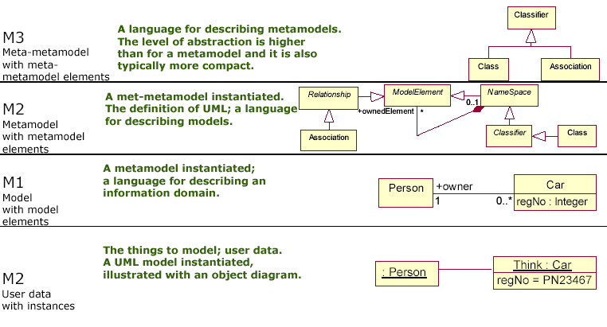
Four-Layer Metamodel Architecture Revisited
SEP-Framework

Slide 20
Advantages of Four Layer Metadata Architecture
It can support any kind of model and modeling paradigm that is imaginable
It can allow different kinds of metadata to be related
It can allow metamodels and new kinds of metadata to be added incrementally,
It can support interchange of arbitrary metadata(models) and meta-metadata(metamodels) between parties that use the same meta-metamodel
SEP-Framework

Slide 21
SEP-Framework
Architecture & Meta-Model

Slide 22
Architecture
Architect
Roles
Designer
Analyst
Lifecycle Process
Inception
Elaboration
Delivery
Process
Method
Class
Method
Component
Iteration #1
Iteration #2
Iteration #3
Iteration #4
Process
Pattern
Usecase Model
OO BusinessModel
1
5
Component Model
OO Domain Model
2
4
6
8
9
13
Method Contents
Class Model
DB Design Model
3
7
10
14
E-R
Model
Java Implementation Model
11
15
Business Model
CBD Test Model
12
16
SEP-Framework
- <number> -

Slide 23
Meta-Model: Top-Level
Process View
Delivery
Process
Waterfall
Unified Process
…
How to find an actor
How to describe a usecase
…
Inception
Elaboration
…
Process
Component
Guidance
Method
Component
Requirement Model
Analysis Model
…
Model View
Usecase Specifier
Architect
Designer
…
Role
Definition
Method
Class
Use-Case Diagram
Class Diagram
…
Find actors
Find Usecases
…
Activity
Work Product
Actor List
Use Cases
…
Input, Output
Process Engineering Framework
- <number> -

Slide 24
Meta-Model: Method Class
A Primitive Work-Product with Activities
<<Abstract>>
Base(공통)
Use-Case Diagram
Class Diagram
…
<<Abstract>>
Generic Diagram
(기술공통)
<<Abstract>>
Generic Work-Product
(업무공통)
Requirement Specification
Data Table Definition
…
<<Concrete>>
Work-Product
(업무종속)
As-Is Biz Process Diagram
Analysis Class Diagram
…
Process Engineering Framework
- <number> -

Slide 25
Meta-Model: Method Component
A Method Component is defined by a Model with a specific View
Generally Views are associated with Roles
Business
Developer
…
Stakeholder
View
Logical
Business
…
Have
Consists-Of
<<Model>>
Method Component
Analysis Model
Business Model
…
Method Class
As-Is Biz Process Diagram
Analysis Class Diagram
…
Process Engineering Framework
- <number> -

Slide 26
Meta-Model: Process Component
The span of time between two milestone of a Process
It consists of a set of Method Component
Inception
Elaboration
…
Process Component
Identified by
Milestone
Project Scope
Baseline Architecture
…
Consists-Of
Method Component
Analysis Model
Business Model
…
Major
Milestone
Minor
Milestone
Method Class
As-Is Biz Process Diagram
Analysis Class Diagram
…
Process Engineering Framework
- <number> -

Slide 27
Meta-Model: Delivery Process
Generic Process
  일반 프로세스
Domain Process
  업무영역별 공통 프로세스
Specific Process
  구체적 적용 프로세스
Generic Process
표준 Eng. 프로세스
Domain Process
OOCBD 금융 대규모
<<Concrete>>
Specific Process
삼성화재
Process Engineering Framework
- <number> -

Slide 28
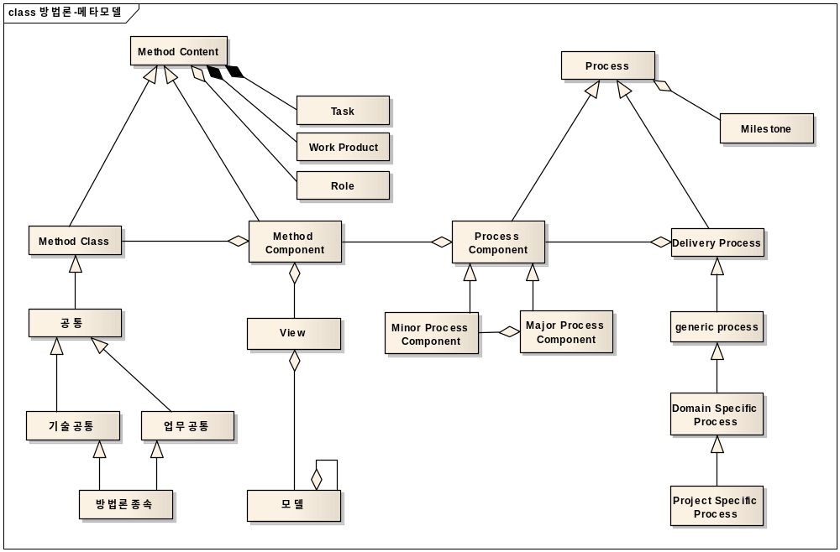
Meta-Model
Process Engineering Framework
- <number> -

Slide 29
Method Design Guide
SDS Process Engineering Framework

Slide 30
Overview
Method Class
  독립적 산출물
  Work-Product 구성요소간 매핑관계 정의
Method Component
  관점별/역할별 독립적 모델
  Work-Product간 매핑관계 정의
Process Component
  마일스톤을 가진 작업 단위
  Method Component간 매핑관계 정의
Delivery Process
  Process Component간 매핑관계 정의
Process Engineering Framework
- <number> -

Slide 31
Method Class
Work-Product 구성요소간 매핑관계 정의
Sample: 분석 시퀀스 다이어 그램
  입력물
    유스케이스 정의서 ::= 시나리오
    시나리오 ::= 문장
    문장 ::= 명사 + 동사 + 부사
  출력물
    분석시퀀스다이어그램 ::= 객체 + 메시지
    메시지 ::= 객체 + 오퍼레이션 + 파라메터
  매핑 가이드
    유스케이스 정의서 시나리오의 명사를 중심으로 객체를 추출한다.
    해당 객체와 연관된 동사를 중심으로 메시지를 추출한다.
      메시지 포맷은 대상객체, 오퍼레이션, 파라메터로 구성된다.
      메시지 파라메터는 동사의 수식어로부터 추출한다.
분석시퀀스
다이어그램
객체
메시지
유즈케이스정의서
객체 추출
메시지 추출
Process Engineering Framework
- <number> -

Slide 32
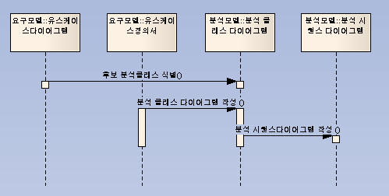
Method Component
Work-Product간 매핑관계 정의
Sample: 분석 업무 모델
Process Engineering Framework
- <number> -

Slide 33
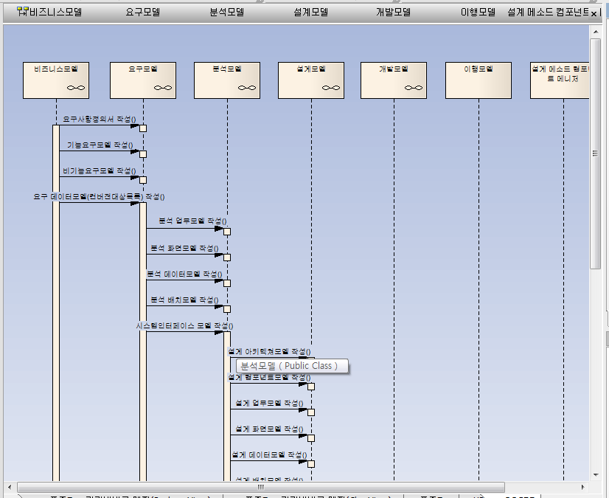
Process Component/Deliver Process
Method Component/Model간 매핑 정의
Sample: Iteration
Process Engineering Framework
- <number> -

Slide 34
Architectural Pattern
표준 엔지니어링 방법론

Slide 35
Architectural Pattern₁: Use-Case Driven
Requirement
Analysis
Design
Implementation
Static Model
Class
Diagram
Analysis
Class
Diagram
Design
Class
Diagram
Implementation
Classes:
Source Code
<<trace>>
Use-Case
<<trace>>
Dynamic Model
Interaction
Diagram
Use-Case
Realization:
Analysis
Use-Case
Realization:
Design
Use-Case
Realization:
Source Code
<<trace>>
Collaboration
Diagram
Sequence
Diagram
Process Engineering Framework
- <number> -

Slide 36
Architectural Pattern₂: Model-Transformation
Package
Diagram
Package
Diagram
Package
Diagram
Package
Diagram
Interface
Interface
Interface
Interface
Class
Diagram
Interaction
Diagram
Class
Diagram
Interaction
Diagram
Class
Diagram
Interaction
Diagram
Class
Diagram
Interaction
Diagram
Requirement Model
Analysis Model
Design Model
Implementation Model
Model Mapping/Transformation
Logical Dependency
Process Engineering Framework
- <number> -

Slide 37
Architectural Pattern₃: Architecture-Centric
Why Architecture first?
  Detect and prevent the risk early
  Understand the system
  Organize Development
  Foster Reuse
  Evolve the system
Architecture
Package
Diagram
Interface
Criticality
Construction
Class
Diagram
Interaction
Diagram
System Model
Process Engineering Framework
- <number> -

Slide 38
Architectural Pattern₄: Iterative
Architecture
Physical Control Sequence
Package
Diagram
Package
Diagram
Package
Diagram
Package
Diagram
Interface
Interface
Interface
Interface
Construction
Class
Diagram
Interaction
Diagram
Class
Diagram
Interaction
Diagram
Class
Diagram
Interaction
Diagram
Class
Diagram
Interaction
Diagram
Requirement Model
Analysis Model
Design Model
Implementation Model
Model Mapping/Transformation
Logical Dependency
Process Engineering Framework
- <number> -

Slide 39
Method Class/Method Component
Process Component/Delivery Process
표준 엔지니어링 방법론

Slide 40
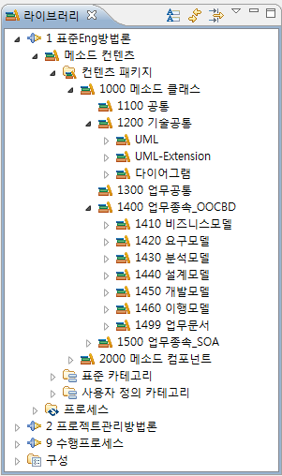
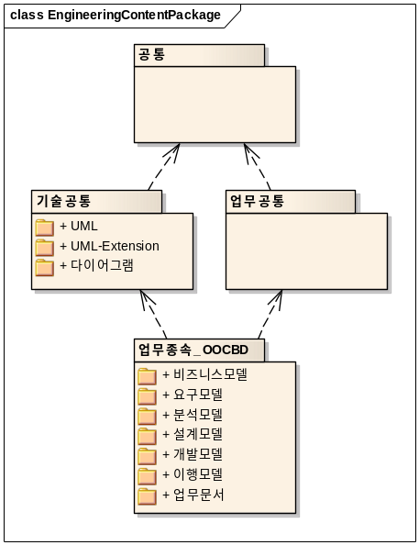
Method Class
공통(Base)
기술공통(Generic Diagrams)
  UML
  UML-Extensions
  Other Diagrams
업무공통(Generic Work-Product))
업무종속(Work-Product)
  요구모델
  분석모델
  설계모델
  개발모델
  이행모델
<<Abstract>>
Base
<<Abstract>>
Generic Diagram
<<Abstract>>
Generic Work-Product
<<Concrete>>
Work-Product
Process Engineering Framework
- <number> -

Slide 41
Method Component Taxonomy based on Views
Method
Component
Business View
System View
In-Use View
S/W View
H/W View
User-View
Developer-View
Platform-
Independent
Model
Platform-
Specific
Model
Implementation-
Independent
Model
Implementation-
Specific
Model
Business
Model
Requirement
Model
Analysis
Model
Design
Model
Implementation
Model
Deployment
Model
Transition
Model
Process Engineering Framework
- <number> -

Slide 42
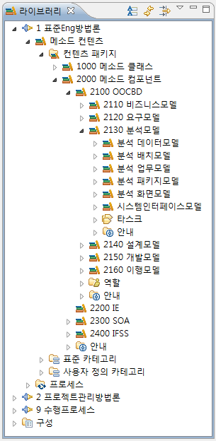
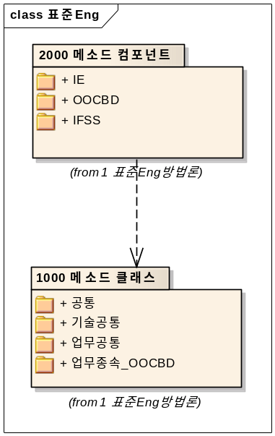
Method Component
View Models
  비즈니스모델
  요구모델
  분석모델
  설계모델
  개발모델
  이행모델
Roles with Views
  개발자
  분석자
  테스터
  …
Process Engineering Framework
- <number> -

Slide 43
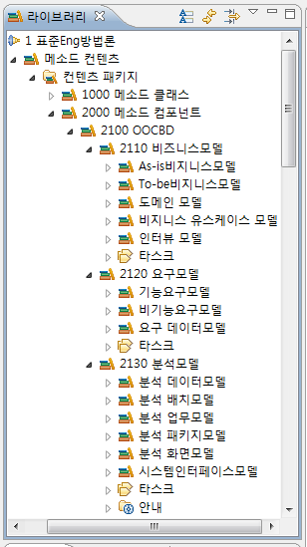
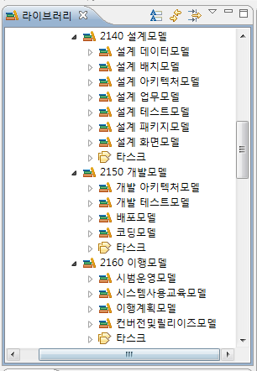
Method Component: Sub-Components
Process Engineering Framework
- <number> -

Slide 44
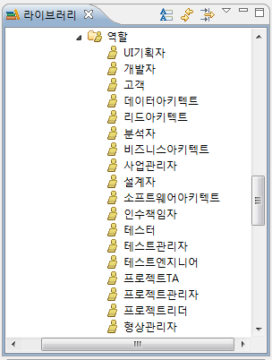
Method Component: Roles
A Method Component is defined by a Model with a specific View
Generally Views are associated with Roles
Process Engineering Framework
- <number> -

Slide 45
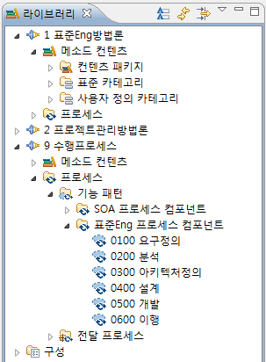
Process Component with Milestones
요구정의
  Project Scope
분석
  System Scope & Logical Model
아키텍처정의
  Architectural Baseline
설계
  Detail System Design
개발
  System
이행
  Release
Process Engineering Framework
- <number> -

Slide 46
Delivery Process: Process/Method Component View
Standard
Engineering
Delivery Process
Process Component View
Requirement
Analysis
Architecting
Design
Construction
Transition
Requirement
Model
Analysis
Model
Arhitecture
Model
Design
Model
Implementation
Model
Transition
Model
Method Component View
Process Engineering Framework
- <number> -

Slide 47
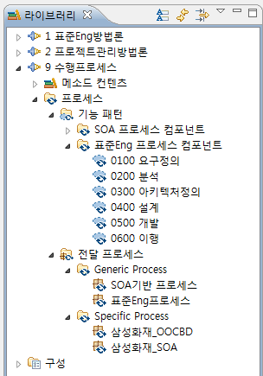
Delivery Process: Generic vs. Specific Process
Generic Process(공통 프로세스)
  표준 Eng. 프로세스
  Unified Process
Domain Process(업무공통 프로세스)
  소규모 금융
  대규모 금융
Specific Process(적용프로세스)
  삼성화재
  삼성생명
Process Engineering Framework
- <number> -

Slide 48
Delivery Process: Method Class View
Architecture
Static Structure
Dynamic
Behavior
Business
View
Biz Req.
View
Business UC
Package
Diagram
Business
Use-Case
Diagram
Method Class View
Biz Dev.
View
Business
Package
Diagram
Business
Class
Diagram
Use-Case
Realization:
Business
System
View
Req.
View
System UC
Package
Diagram
System
Use-Case
Diagram
Development
View
Platform
Independent
View
Analysis
Package
Diagram
Analysis
Class
Diagram
Use-Case
Realization:
Analysis
Platform
Dependent
View
Design
Package
Diagram
Design
Class
Diagram
Use-Case
Realization:
Design
Deployment
Diagram
Implementation
Package
Diagram
Implementation
Class
Diagram
Use-Case
Realization:
Source Code
Process Engineering Framework
- <number> -

Slide 49
Method Integration
표준 Eng. 방법론 & 프로젝트 관리 방법론

Slide 50
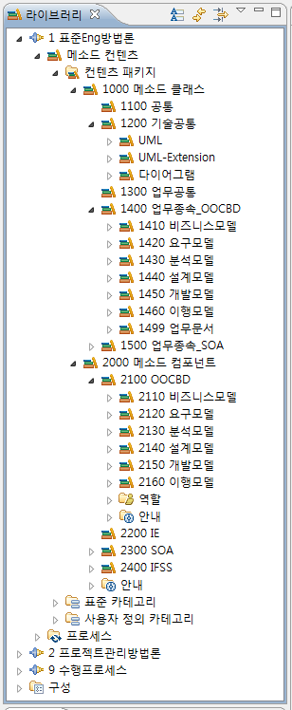
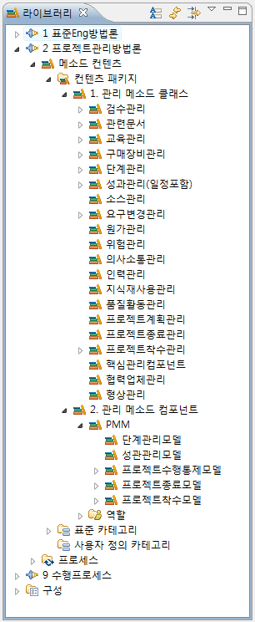
Method Class & Method Component
표준 Eng. 방법론
프로젝트 관리 방법론
Process
Component
Process Engineering Framework
- <number> -

Slide 51
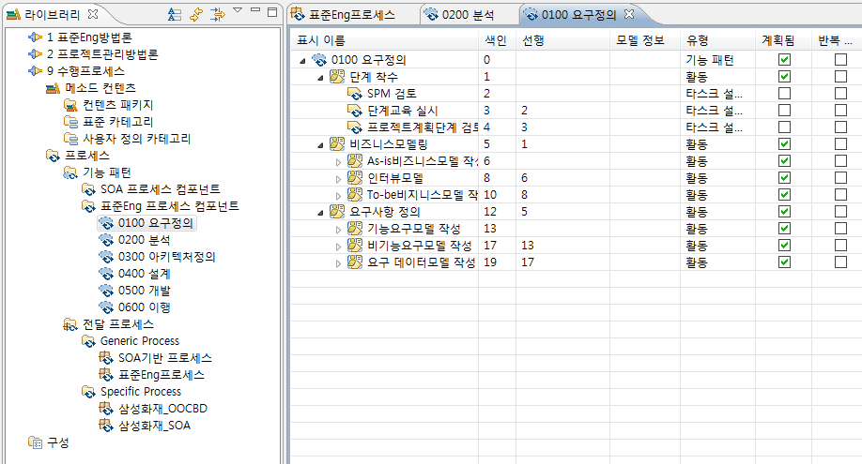
Process Component: Composition
Process Engineering Framework
- <number> -

Slide 52
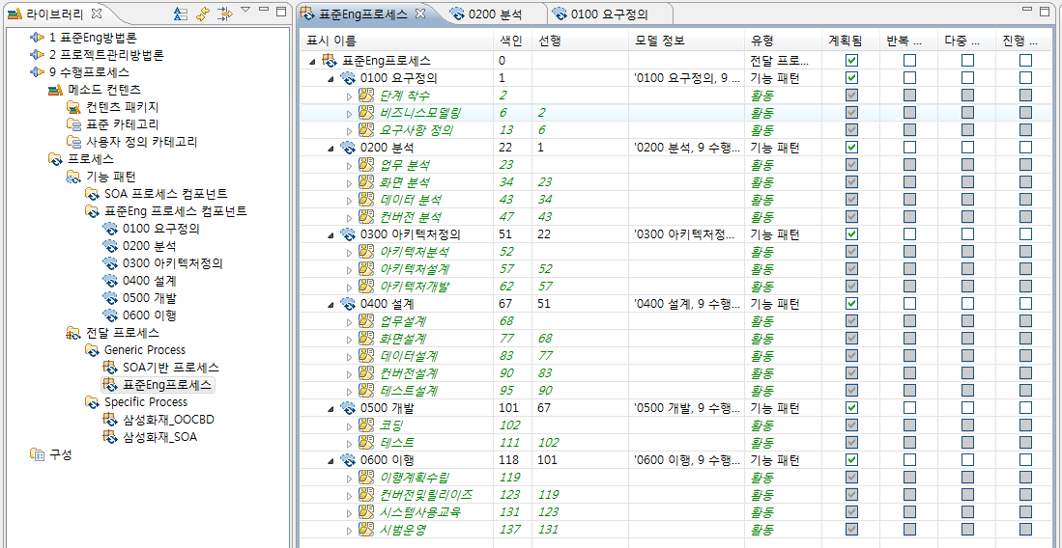
Delivery Process
Process Engineering Framework
- <number> -

Slide 53
Conclusion

Slide 54

Product-Line for SDS Process Engineering Framework
Delivery Process Engineering
Process Framework
Selection
Process Architecture
Design
Process Component
Selection/Development
Component
Composition
Delivery Process
Requirements
Asset
Repository
Classification/Distribution
Configuration Management
Retrieval/Explanation
Frameworks
Components
Requirements
Process Framework Engineering
Method Component Engineering
Domain
Analysis
Framework
Qualification
Component
Qualification
Domain
Analysis
Framework
Design
Framework
Implementation
Component
Implementation
Component
Design
Process Engineering Framework
- <number> -

Slide 55
Key Features of SDS Process Engineering Framework₁
Separation of Concerns
  Work-Product
    Use Case Diagram, E-R Diagram, …
  View Models
    OO System Analysis Model, E-R Conceptual DB Design Model, …
  Process Pattern
    Inception, Iteration, …
  Project Domain
    Bank, Manufacturing, …
Class Based Modeling/Architecture-Centric
  Modularity/Encapsulation
  Interface-Driven Modeling/Traceability, Consistency
Process Engineering Framework
- <number> -

Slide 56
Key Features of SDS Process Engineering Framework₂
Meta-Model Based
  Any Process can be modeled
  Any Process can be integrated
    Engineering
    Management
    Business
  Any Architecture & Model can be described
Process Engineering Framework
- <number> -

Slide 57
Future Direction

Slide 58
Backgrounds
Process Silos
  Processes typically address only a segment of the full scope of IT operations. For example, IBM's Rational Unified Process (RUP) is focused on software lifecycles and the IT Infrastructure Library (ITIL) orients on the infrastructure.
Redundancy/Inconsistency/No Traceability
  Processes lack coordination, traceability to policy, and often contradict each other. For example, RUP and ITIL both define configuration and change management but with different roles, work products, and tasks.
Failure of organizational collaboration
  The synchronization of the software development lifecycles and infrastructure operation practices
No Governance
  A majority of governance and governance-based processes are intuitive, ad-hoc, or non-existent. One of the primary reasons is that IT industry processes, such as RUP and ITIL, are not enabled to facilitate the integration of governance in a mature manner. For example, RUP has no mechanisms for the integration of compliance management. Similarly, ITIL exists in the same state but without any actionable process elements to facilitate integration of governance.5
Process Engineering Framework
- <number> -

Slide 59
Goals
Strategic process alignment.
  Captures both internal and external alignment to synchronize processes with enterprise strategies.
Seamless process Integration.
  Maps process dependencies between enterprise organizational processes and manages them in terms of responsibility, consistency, and collaboration.
Process traceability chain.
  Maps the implementation of strategy, governance, and standards from policy to the process actionable elements realized in day-to-day tasks. Traceability enables the identification of process elements for strategy, alignment, and policy while also facilitating the management of process change.
Flexible process description based on meta-process models
  Captures the complete set of IT enterprise processes specific to the enterprise's constituent organizations. The discrete processes are owned and utilized by the individual organizations but are harmonized and managed across the enterprise via meta-process models.
Governance infrastructure.
  Standardizes regulatory compliance mechanisms and control points across all organizations within the IT Enterprise; streamlines the integration and implementation of transparent governance to constituent organizational processes.
Process Engineering Framework
- <number> -

Slide 60
Expected Values
Higher ROI from effective governance processes
  A survey revealed that "81% of CEO's and CIO's identified a higher ROI" due to the IT organization having implemented an effective governance-based process.
  [“Findings of the IT Governance Global Status Report – 2006”, IT Governance Institute]
Superior IT governance equates to greater profits
  Firms with superior IT Governance have more than 25% greater profits than firms with poor governance. The firms with the return had custom-designed governance processes aligning IT decisions with monitors for performance and accountability.
  [IT Governance: How top performers manage IT decision rights for superior results, Peter Weill and Jenny W Ross. Harvard Business School Press]
Increased market value with improved governance
  "On average, when moving from poorest to best on corporate governance, firms could expect an increase of 10 to 12 percent in market value.”,
  [The Mckinsey Quarterly, 2002]
Process Engineering Framework
- <number> -

Slide 61
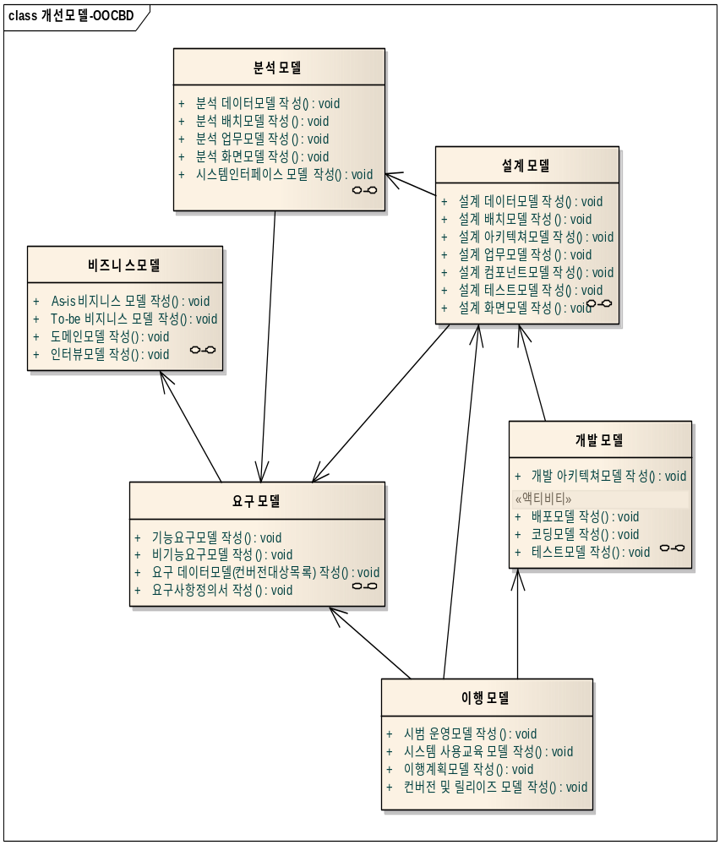
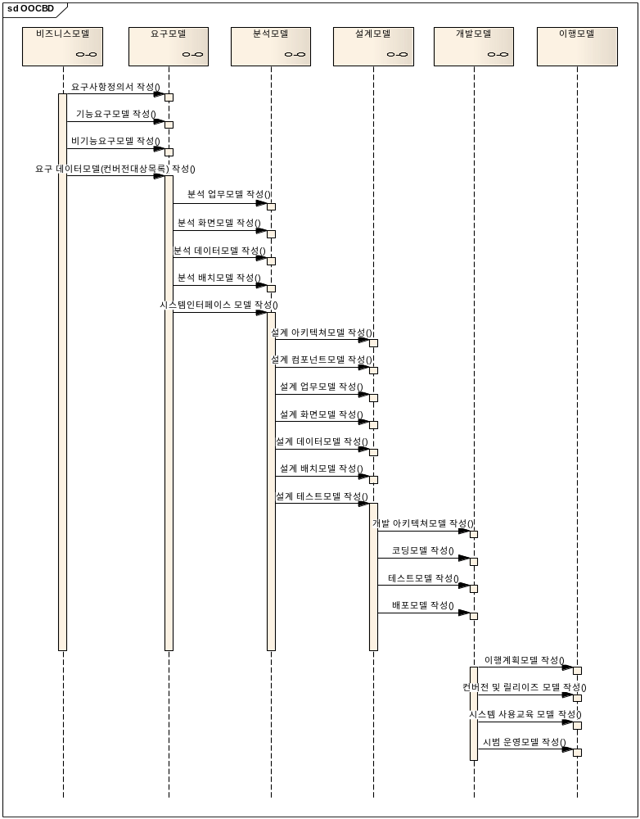
Architecture/Model vs. Activity/Process
Structural View
Interaction View
Process Engineering Framework
- <number> -

Slide 62
Process Engineering Framework as a Generator for Architecture & Models
M3 layer
meta-meta-model
Meta-Object Facility
SDS Process Engineering Framework
Software Process Engineering Meta-Model
M2 layer
meta-models
Delivery Process
Zachman Framework/FEAF
M1 layer
models
System Architecture/Models
Business Architecture/Models
M0 layer
information
Process Engineering Framework
- <number> -

Slide 63
SDS Process Engineering Framework as an Enterprise Process Framework(EPF)
Process View
  Engineering Process
    OOCBD
    ITO
  Project Management Process
    PMM
  Business Process
    BPR
    ISP
Model View
  Enterprise Architecture & Model
  System Architecture & Model
Process Engineering Framework
- <number> -

Slide 64
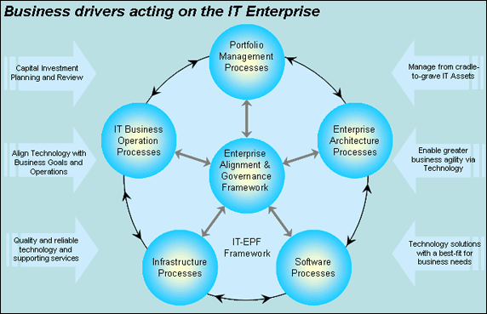
IT Enterprise Process Framework-IBM Case
IBM 2007
Process Engineering Framework
- <number> -

Slide 65


제안-INNOVATOR 방법론 로드맵
향후 기존 방법론들을 새로운 방법론 프레임워크에 구현함으로써 현장의 효율적 업무 수행과 생산성을 높이고, 관리 및 비즈니스 차원의 모델을 정의하고 구축하여 품질 경영 체계 구현을 목표로 함
Enterprise 수준의
프로세스 프레임워크
생산성 향상
고도期
(2011 ~)
방법론 프레임워크 구현
Prototyping을 통한
방법론 프레임워크 정의
성숙期
(2010)
제정 期
(2009)
Prototyping
(2008)
품질,견적 등과 통합
현장 테일러링 지원
Process Governance
프로젝트 툴 연계
표준 ENG 재정비
기타 기존 방법론 재정비
프로젝트 관리 재정비
메타모델 정의
정비된 방법론을 프레임워크에 구현
방법론 프레임워크 현실화
방법론 운영 전략 수립(툴 배포 및 확산)
Notes:
어려운 이야기…

Slide 66
Discussion
Innovator 적용
전사적 프로세스 통합
Enterprise Architecture와의 연계
Corporate Governance와의 연계
Process Engineering Framework
- <number> -

