Slide 1

Evaluating Centralized,
Hierarchical, and Networked
Architectures for Rule Systems
Benjamin Craig
University of New Brunswick
Faculty of Computer Science
Fredericton, NB, Canada
Senior Technical Report Presentation
November 20, 2008

Slide 2
Outline
Defining Terminology
  Rules, Distributed Systems, Topologies, OO jDREW, Rule Responder
Topologies for distributed Architectures
  Star Topology
    Advantages and Disadvantages
  P2P Topology
    Advantages
Knowledge Maintenance for Rule Systems
  Knowledge Organization
  Knowledge Maintenance
Conclusion

Slide 3
What is a rule?
Fact (POSL format):
spending(Peter Miller, min 5000 euro, last year).
Rule (POSL format):
premium(?Customer) :-
spending(?Customer, min 5000 euro, last year).
A deductive rule engine would determine that Peter Miller is a premium customer

Slide 4
Distributed Systems
A distributed system is a set of computer processes that appear to the user as a single system
The distributed system must coordinate all of these processes
Distributed systems are implemented using middleware that creates a topology
Notes:
You use rule templates to define them how to assist you

Slide 5
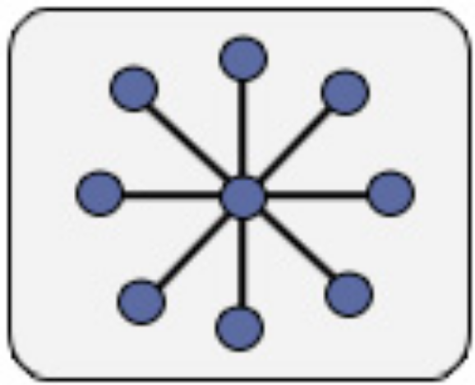
Hierarchical - Star Topology
Single level hierarchy
Connects all spokes with a centralized hub
All information must be sent through the hub to the spokes

Slide 6

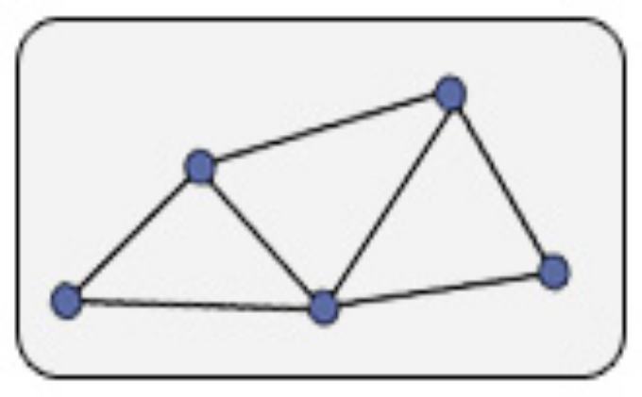
Networked (P2P-Like Architecture)
Fully connected network
  Connects all nodes together with a direct connection
  Full mesh topology
Partially connected network
  Only a subset of nodes are connected together
  Partial mesh topology

Slide 7
OO jDREW
Centralized Rule System
Object Oriented Java Deductive Reasoning Engine for the Web – extensions of jDREW
Supports rules in two formats:
  POSL: Positional Slotted presentation syntax
  RuleML: XML interchange syntax
  (can be generated from POSL)

Slide 8
Rule Responder
Distributed Rule System
Is currently implemented as a hierarchical rule system
Rule Responder is a prototypical
multi-agent system for virtual communities
Supports rule-based collaboration between the distributed members of community
Members are assisted by semi-automated rule-based agents, which use rules to describe the decision and behavioral logic

Slide 9
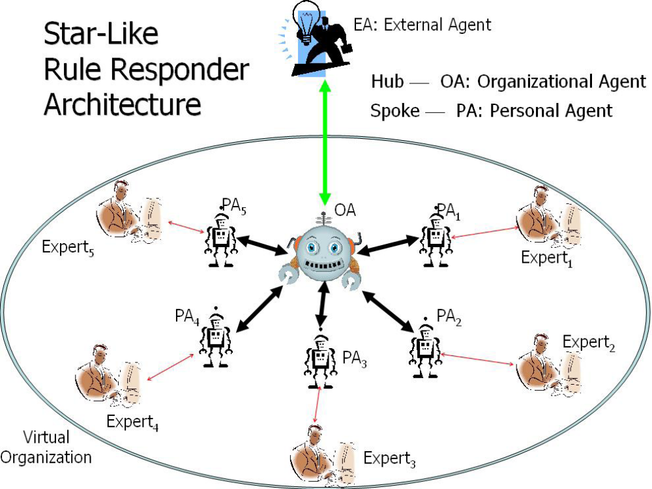

Slide 10
Topology Performance
When building a distributed system a topology is required
Distributed topologies all have communication over head that centralized systems do not have
A key design goal for distributed systems is to minimize this communication overhead

Slide 11
Star Advantages
Isolation of spokes from other spokes
  If one spoke fails then it does not affect others
Adding and remove spokes to the hub is trivial
Inspection of all traffic through the topology
  Improved Security
Trouble shooting is easy
Easy to understand and implement

Slide 12
Star Disadvantages
Scalability, reliability and performance of the star topology rely on the hub
If the hub fails then the entire system fails
The hub can become over loaded and the system will encounter slow downs
To prevent the bottle neck of the star topology a P2P topology can be used

Slide 13
P2P Advantages
Does encounter bottleneck performance issues like the star topology
Whenever a node is added the total bandwidth capacity is increased
When a node fails the system will be able to recover
  A peer can act in place of another peer

Slide 14
Knowledge Maintenance for
Rule Systems
A distributed system has many different knowledge bases distributed across the system
  Many files and databases
  Each knowledge base is known as a module
A centralized system has all of the knowledge stored in a single location
  Either a file or a database

Slide 15
Knowledge Organization - I
When deciding how to group modules one of two ways can be used
  Predicate Centric
    All predicates are stored in one module
  Person Centric
    All knowledge about one person or thing is stored in a module
    Rule Responder uses person centric organization
example on next slide

Slide 16
Knowledge Organization - II
Person Centric:
  phoneOf(ben, 1-506-270-3403)
  emailOf(ben, ben.craig@unb.ca)
  phoneOf(jim, 1-506-275-9712)
  emailOf(jim, jim.lorde@unb.ca)
Predicate Centric:
  phoneOf(ben, 1-506-270-3403)
  phoneOf(jim, 1-506-275-9712)
  emailOf(ben, ben.craig@unb.ca)
  emailOf(jim, jim.lorde@unb.ca)

Slide 17
Module Boundaries
When querying modules sometimes information from multiple modules is required
Example Query
  “What are the phone numbers of everyone in the organization?”
  This query must backtrack across multiple modules when using person centric storage

Slide 18
Centralize Maintenance
All knowledge is stored in a single format
  No translation steps when using a rule engine to execute the rules and facts
All knowledge is stored in a single location
  Updating knowledge is simple
  Do not need to worry about inconsistencies in the knowledge

Slide 19
Distributed Maintenance
Knowledge is stored in many formats
  Translation steps are required when sending a query from one rule engine to another
  An interchange language is required
Knowledge is stored in a many locations
  Each agent can update their own knowledge
  Knowledge bases could be incomplete or inconsistent
  Consistency rules can be used to test if the knowledge is complete and consistent

Slide 20

Benchmarking Use Case
RuleML-20xy Symposia
  An organizational agent acts as the single point of entry to assist with symposium planning:
    Currently, query answering about the symposium
    Ultimately, preparing and running the symposium
  Personal agents have supported symposium chairs since 2007 (deployed as Q&A in 2008)
    General Chair, Program Chair, Panel Chair, Publicity Chair, etc.

Slide 21
OO jDREW (centralized) Benchmarking
Query: Computation Time (ms):
1) 141
2) 31
3) 22
4) 18
5) 16
Results show that a centralized system does not take much computation time

Slide 22
Rule Responder (Hierarchical) Benchmarking
Same 5 queries used as in the OO jDREW bench marking
Query: Computation Time (ms):
1) 3430
2) 4861
3) 4057
4) 9048
5) 2780
The variation in the computation time comes from the number of answers to the queries
Computation time is much higher from the communication overhead of a distributed system

Slide 23
Theoretical Networked Performance
Speed ups can be obtained using a P2P topology
Instead of having all communication going through the hub - direct communication from one spoke to another could be used
  Will reduce the amount of communication steps in the distributed system
The bottleneck issue of a hierarchical system does not show exists in a networked system

Slide 24
Conclusion
A rule system can be either distributed or centralized
When using a distributed system a topology must be used
The advantages and disadvantages of the topology must be evaluated when deciding which topology to use in a distributed rule system
Distributed Knowledge maintenance must be addressed when building a distributed rule system
The Benchmarking done shows the difference in computation time between a Centralized and a distributed Hierarchal system

Slide 25




Expert₅
EA
PA₁
OA
PA₅
PA₂
PA₃
PA₄
Expert₂
Expert₃
Expert₄
Notes:
Reponse

