Slide 1

Rule Responder: An Intelligent
Multi-Agent System for Collaborative Teams and Virtual Communities
Benjamin Craig
Harold Boley
Institute for Information Technology
National Research Council, Canada
Fredericton, NB, Canada
New Brunswick Innovation Forum
St. John New Brunswick
October 28-29, 2008

Slide 2




Star-Like Rule Responder Architecture
EA: External Agent
Hub ⎯ OA: Organizational Agent
Spoke ⎯ PA: Personal Agent
PA₅
OA
PA₁
Expert₅
Expert₁
PA₄
PA₂
Expert₂
PA₃
Expert₄
Virtual
Organization
Expert₃

Slide 3
Existing Auto-Responders
Mail Clients can act as auto-responders when people are unreachable, as illustrated by “Vacation Programs”
Other auto-responders engage users in interaction sequences, e.g. to check user identity when subscribing/unsubscribing
to/from a mailing list
Rule Responder extends such auto-responders to intelligent, distributed rule systems such as for symposium planning

Slide 4
Overview of Rule Responder
Rule Responder is a prototypical
multi-agent system for virtual communities
Supports rule-based collaboration between the distributed members of community
Members are assisted by semi-automated rule-based agents, which use rules to describe the decision and behavioral logic
Notes:
Why rules are important -> to implement the decision logic

Slide 5

Deployed Use Case:
Symposium Planner
RuleML-20xy Symposia
  An organizational agent acts as the single point of entry to assist with symposium planning:
    Currently, query answering about the symposium
    Ultimately, preparing and running the symposium
  Personal agents have supported symposium chairs since 2007 (deployed as Q&A in 2008)
    General Chair, Program Chair, Panel Chair, Publicity Chair, etc.

Slide 6
Personal Agents
Each PA acts as a Personal Assistant to a human in the organization
These agents are softbots
that help you in working
and networking
You define the rules how
your agent shall assist you
In our deployed use case, symposium chairs are assisted
by PAs

Slide 7
Organizational Agent
The Organizational Agent interconnects all the Personal Agents in our
Star-Like Rule Responder Architecture
The OA channels the right information
to the right agent at the right time
The OA acts as a Mediator,
Middleman, or Facilitator
In our deployed use case, the OA contains general policies & regulations of the RuleML-2008 Symposium

Slide 8
External Agents
External agents supports clients outside
your organization who want to interact with the organization
An External Agent links clients
with the OA of your organization
The OA will find for them the right
PA and Expert for each problem at hand
Mediated by the OA,
the Expert, their PA, or both together
will solve your problem

Slide 9
Competing/Complementary Work
Intelligent Agents:
ISI’s Electric Elves (e-Elves)
SRI’s Open Agent ArchitectureTM (OAA)
FIPA’s Agent Communication Language (ACL)
JADE-Board’s Java Agent Development Framework (JADE)
Web Services:
Publish: W3C’s Web Services Description Language (WSDL)
Find: OASIS’ Universal Description Discovery & Integration (UDDI)

Slide 10
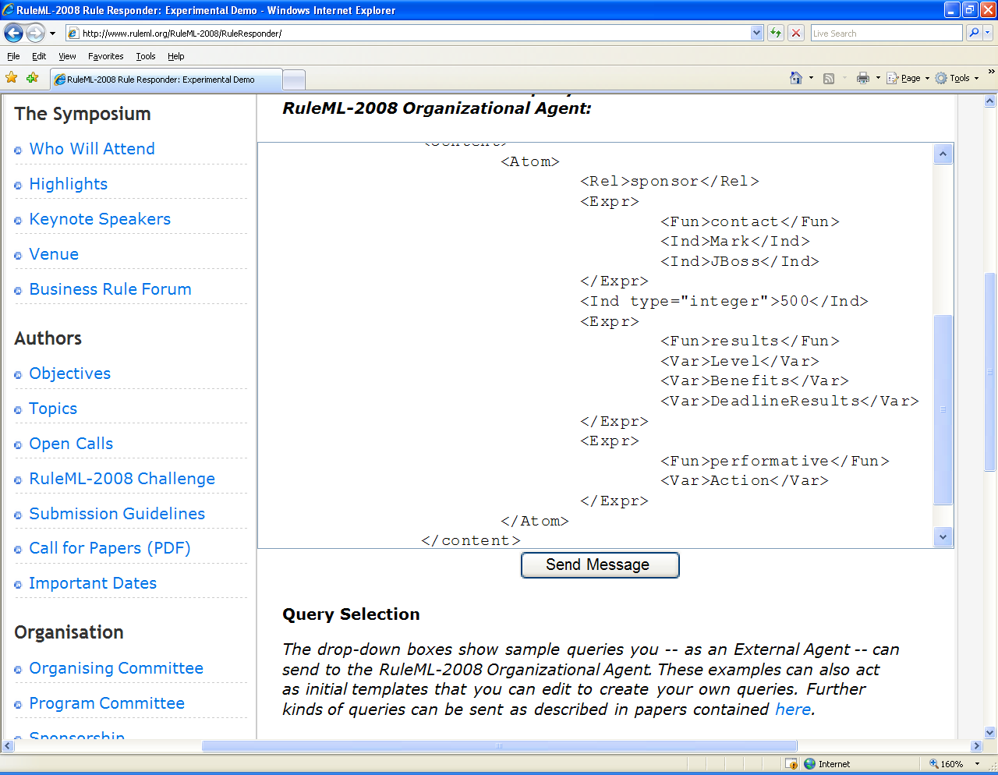

Slide 11
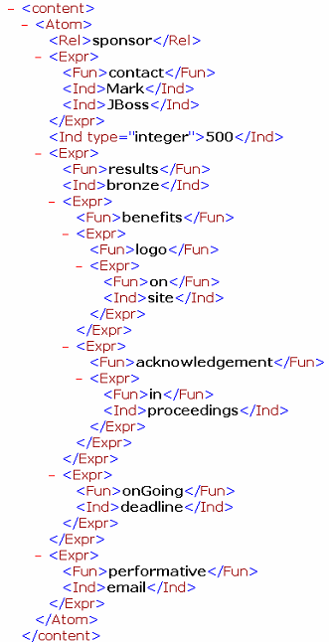
Expert₅
EA
Expert₅
PA₁
OA
PA₅
PA₂
PA₃
PA₄
Expert₂
Expert₃
Expert₄
Notes:
Reponse

Slide 12
Conclusion
Created Star-Like Rule Responder Architecture
Deployed Symposium Planning Use Case
can be adapted to organizing other meetings
and assisting other virtual communities
Further deployed use cases include the
Health Care and Life Science Rule Responder (HCLS)
Thanks to RuleML’s int’l Rule Responder
Technical Group with Adrian Paschke,
Alexander Kozlenkov, and Nick Bassiliades

Slide 13
Rule Responder Opportunities
Status of the Business Idea:
  Open Source Prototype with Deployed Use Cases:
  http://www.ruleml.org/RuleML-2008/RuleResponder/
  http://ibis.in.tum.de/projects/paw/hcls/
Desired Cooperations
  Partnership for Your Intelligent Agents
  Partnership for Your Use Cases
→ COME TO OUR BOOTH!

