Slide 1
The OO jDREW
Reference Implementation of RuleML
RuleML-2005, 10-12 November 2005
Marcel Ball¹, Harold Boley², David Hirtle^{1,2},
Jing Mei^{1,2}, Bruce Spencer²
¹University of New Brunswick, Canada
²National Research Council of Canada

Slide 2
Contents
1 Modular Schemas
1.1 Schema Modularization
1.2 RDF Rules
2 Bidirectional Interpreters in Java
2.1 jDREW Principles
2.2 OO jDREW Slots
2.3 OO jDREW Types
2.4 OO jDREW OIDs
2.5 OO jDREW Extensions
3 Conclusions

Slide 3
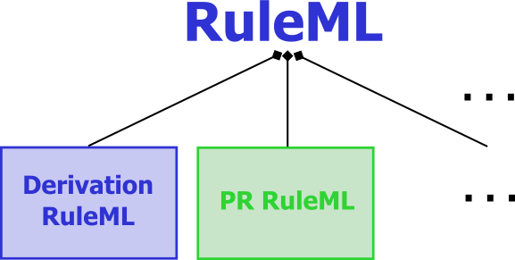
1. Modular Schemas
“RuleML is a family of sublanguages
whose root allows access to
the language as a whole and
whose members allow to identify
customized subsets of the language.”
. . .
RuleML: Rule Markup Language
  RuleML derivation rules (shown here) and production rules defined in XML Schema Definition (XSD)
  Each XSD of the family corresponds to the
  expressive class of a specific RuleML sublanguage
The most recent schema specification of RuleML is always available at http://www.ruleml.org/spec
Current release: RuleML 0.89
Pre-release: RuleML 0.9

Slide 4
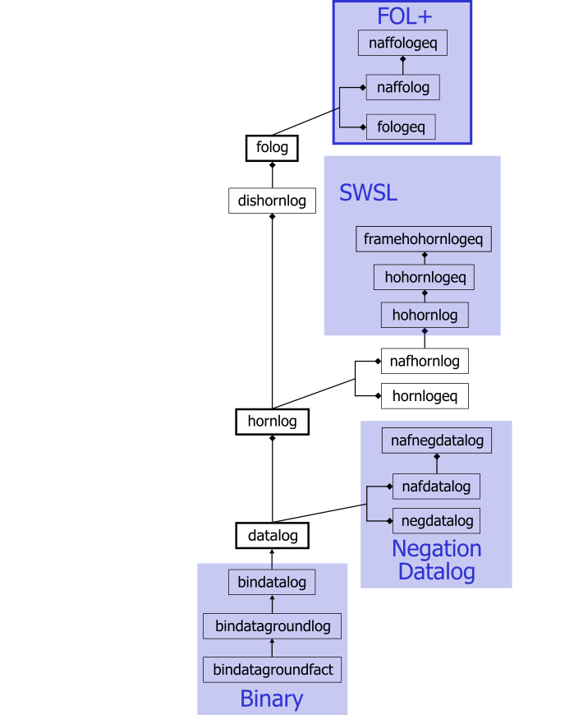
1.1 Schema Modularization
XSD URIs identify expressive classes
  Receivers of a rulebase can validate applicability of tools
  (such as Datalog vs. Hornlog interpreters)
  Associated with semantic classes
  (such as function-free vs. function-containing Herbrand models)
Modularization (Official Model)
  Aggregation:
  e.g., Datalog part of Hornlog
  Generalization:
  e.g., Bindatalog is a Datalog

Slide 5
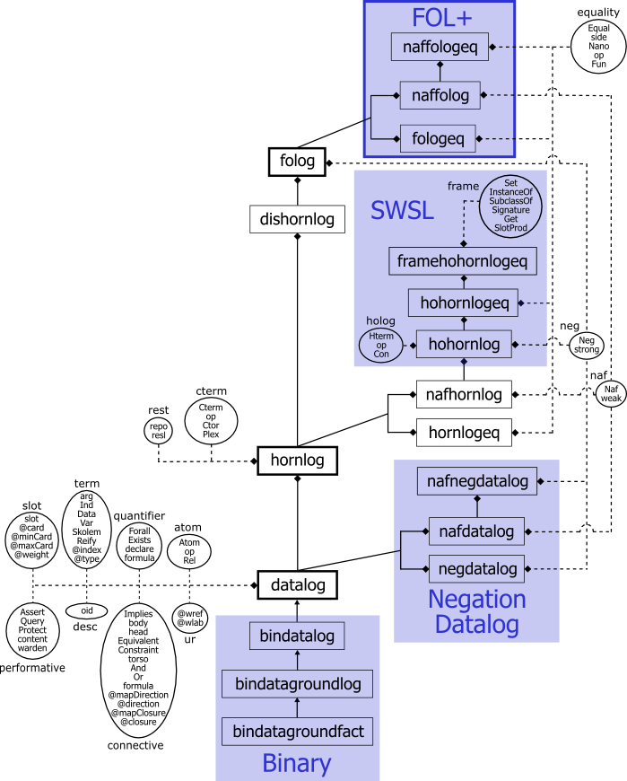
Rectangles are sublanguages
  Inheritance between schemas
Ovals are auxiliary modules
  Elementary, including only
  element and/or attribute definitions
  Become part of sublanguages
E.g., in http://www.ruleml.org/_x000b_0.9/xsd/hornlog.xsd
<xs:redefine
schemaLocation=
"datalog.xsd">
<xs:include
schemaLocation=
"modules/cterm_module.xsd"/>

Slide 6
1.2 RDF Rules
RDF-like Rules: Important RuleML sublanguage
  Datalog: Relational databases augmented by views
  RDF Properties: Slots permit non-positional, keyed arguments
  RDF URIs: Anchors provide object identity via webzing through URIs
    oids: Can be Individuals, Variables, etc.
    uris: Now used for both RDF’s about and resource
  RDF Blank Nodes: F-logic/Flora-2 Skolem-constant approach
    E.g., Skolem generator ‘_’ becomes <Skolem/>

Slide 7
<Implies>
<body>
<And>
<Atom>
<oid><Var>x</Var></oid>
<Rel>product</Rel>
<slot><Ind uri=":price"/><Var>y</Var></slot>
<slot><Ind uri=":weight"/><Var>z</Var></slot>
</Atom>
<Atom>
<Rel uri="swrlb:greaterThan"/><Var>y</Var><Data>200</Data>
</Atom>
<Atom>
<Rel uri="swrlb:lessThan"/><Var>z</Var><Data>50</Data>
</Atom>
</And>
</body>
<head>
<Atom>
<oid><Var>x</Var></oid>
<Rel>product</Rel>
<slot><Ind uri=":shipping"/><Data>0</Data></slot>
</Atom>
</head>
</Implies>
“For a product whose price is greater than 200 and
whose weight is less than 50, no shipping is billed.”

Slide 8
2. Bidirectional Interpreters in Java
Two varieties of reasoning engines
  Top-Down: backward chaining
  Bottom-Up: forward chaining
jDREW: Java Deductive Reasoning Engine
for the Web includes both TD and BU http://www.jdrew.org
OO jDREW: Object-Oriented extension to jDREW http://www.jdrew.org/oojdrew
Demos: November 11th, 2005; on demand today
  Java Web Start online demo available at http://www.jdrew.org/oojdrew/demo.html

Slide 9
2.1 jDREW Principles
Utilities:
  Reading files of RuleML statements into
  the internal clause data structure
  Storing and manipulating clauses
  Unification of clauses according to the positions
  of the selected literals
  Basic resolution engine
    Clause to clause subsumption
    Clause to clause-list subsumption
  Choice point managers
  Priority queues for various reasoning tasks
  Readable top-level procedures

Slide 10
2.1 jDREW Principles (contd.)
Control flow:
  Oriented around iterators
    Iterator: Maintain the state of a partially completed computation
  Pay as you go
    Consistency: Common interface for different reasoning tasks
    Efficiency: Few additional data structures introduced for
    storing intermediate results
  Asking for the next solution
    In Top-down: Choice point iterator to initiate a request for the most recent choice to be undone
    In Bottom-up: Generating solutions one-at-a-time

Slide 11
2.2 OO jDREW Slots
Normalized atoms and complex terms
  oids (object identifier)
  Positional parameters (in their original order)
  Positional rest terms
  Slotted parameters (in the order encountered)
  Slotted rest terms
Efficient unification algorithm
  Linear O(m+n): instead of O(m*n)
    No need for positional order
    Slots internally sorted
  Steps:
    Scan two lists of parameters
      Matching up roles and positions for positional parameters
      Unifying those parameters
    Add unmatched roles to list of rest terms
    Generate dynamically a Plex (RuleML’s closest equivalent to a list)
    for a collection of rest terms

Slide 12
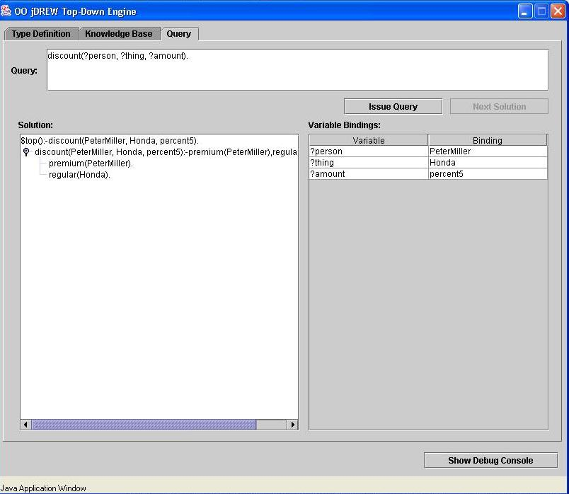
positional
discount(?customer,?product,percent5)
:- premium(?customer), regular(?product).
premium(PeterMiller).
regular(Honda).

Slide 13
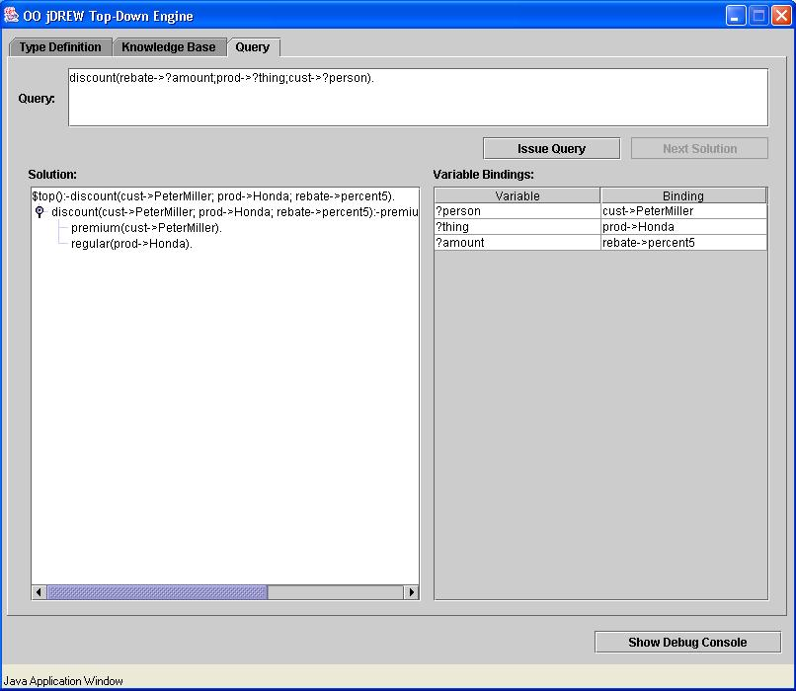
slotted
discount(cust->?customer;prod->?product;rebate->percent5)
:- premium(cust->?customer), regular(prod->?product).
premium(cust->PeterMiller).
regular(prod->Honda).

Slide 14
2.3 OO jDREW Types
Order-sorted type system
  RDF Schema: lightweight taxonomies of the Semantic Web
  To specify a partial order for a set of classes in RDFS
Advantages
  Having the appropriate types specified for the parameters
  To restrict the search space
  Faster and more robust system than when reducing types to unary predicate calls in the body
Limitations
  Only modeling the taxonomic relationships between classes
  Not modeling properties with domain and range restrictions

Slide 15
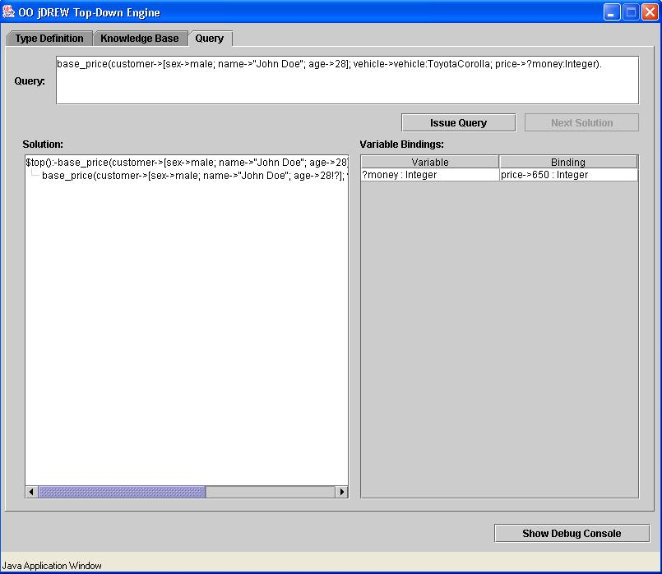
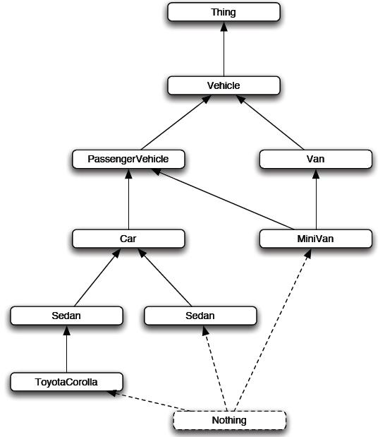
base_price(customer->[sex->male; !];
vehicle->:Car;
price->650:Integer).
base_price(customer->[sex->male; !];
vehicle->:Van;
price->725:Integer).

Slide 16
2.4 OO jDREW OIDs
<Atom>
<oid><Ind>mary-12</Ind></oid>
<Rel>keep</Rel>
<Ind>Mary</Ind>
<Var>object</Var>
</Atom>
oid: Object Identifier
Currently: symbolic names
  In <Atom> & <Implies>
Planned: uri attribute
E.g., give name to fact
keep(Mary, ?object).
<Atom>
<oid><Ind uri=“http://mkb.ca”/></oid>
<Rel>keep</Rel>
<Ind>Mary</Ind>
<Var>object</Var>
</Atom>
<Atom>
<oid><Var>object</Var></oid>
<Rel>keep</Rel>
<Ind>Mary</Ind>
<Var>object</Var>
</Atom>

Slide 17
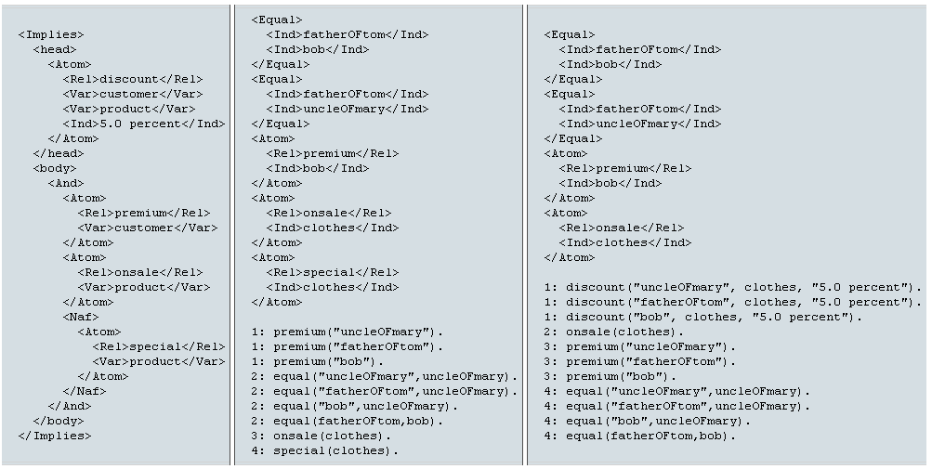
2.5 OO jDREW Extensions
Negation-as-failure
  Implemented both in Top-Down and Bottom-Up
Equality ground facts
  Mapping all equal individuals to a representative of their equivalence class

Slide 18
3. Conclusions
Concrete & abstract syntax of RuleML
  Specified by modular XSD (shown here) & MOF
Operational semantics of RuleML
  Implemented by OO jDREW BU & TD
Interoperability of RuleML
  Realized by translators, primarily via XSLT; see W3C WS version:
  http://www.ruleml.org/w3c-ws-rules/implementing-ruleml-w3c-ws.html

Slide 19
Thank you
Questions?

