Slide 1

Deploying a Distributed Symposium
Planner Through Rule Responder
Benjamin Craig
Harold Boley
Institute for Information Technology
National Research Council, Canada
Fredericton, NB, Canada
RuleML-2008 Challenge
Orlando Florida
October 30-31, 2008

Slide 2
Outline
Rule Responder Overview
Symposium Planner Use Case
  Agents
    Personal / Organizational / External
  Rule Engines (for Realizing Agents)
    Prova
    OO jDREW
  Communication Middleware (for Connecting Agents)
    Mule ESB
    Reaction RuleML Messages
Online Demo
Conclusion

Slide 3
Overview of Rule Responder
Rule Responder is an experimental
multi-agent system for collaborative teams and virtual communities on the Web
Supports rule-based collaboration between the distributed members of such a virtual organization
Members of each virtual organization are assisted by semi-automated rule-based agents, which use rules to describe the decision and behavioral logic
Implemented on top of a Mule-based
Service Oriented Architecture (SOA)
Notes:
Why rules are important -> to implement the decision logic

Slide 4
Use Case: Symposium Planner
RuleML-20xy Symposia
  An organizational agent acts as the single point of entry to assist with the symposium:
    Currently, query answering about the symposium
    Ultimately, preparing and running the symposium
  Personal agents have supported symposium chairs since 2007 (deployed as Q&A in 2008)
    General Chair, Program Chair, Panel Chair, Publicity Chair, etc.

Slide 5
Organizational Agents
The organizational agent represents the goals and strategies shared by each committee chair
It contains rule sets that describe the policies and regulations of the RuleML Symposium
Delegates incoming queries to the chair’s PAs

Slide 6
Personal Agents
A personal agent assists a single chair
of the symposium, (semi-autonomously) acting on his/her behalf
Each personal agent contains a rule-base FOAF-like profile
It contains a FOAF*-like fact profile plus
FOAF-extending rules to encode selected knowledge of its human owner
* The Friend of a Friend (FOAF) project: http://www.foaf-project.org

Slide 7
External Agents
External agents exchange messages with the RuleML-2008 OA.
  They submit queries and receive answers
End users, as external agents, interact with the OA using a Web (HTTP) interface to the Symposium Planner
Support for simultaneous external agents
  Many EAs can communicate with the OA

Slide 8
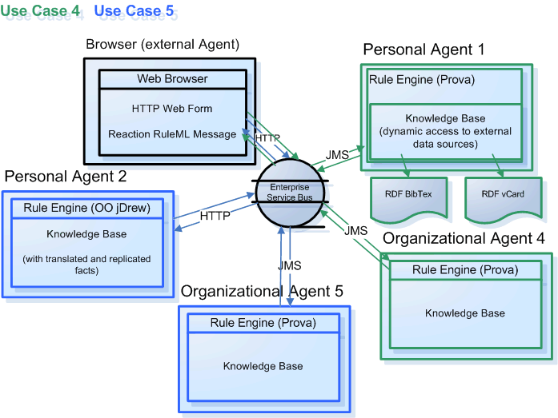
Infrastructure - Overview

Slide 9
Reaction RuleML
Reaction RuleML is a branch of the RuleML family that supports actions and events
When an external agent submits a query to the Symposium planner a Reaction RuleML message must be used
In general, when any two agents communicate, Reaction RuleML messages are sent through the ESB
  Our ESB implementation is MULE

Slide 10
Communication Middleware
Mule Enterprise Service Bus (ESB)
  Mule* is used to create communication end points at each personal and organizational agent of Rule Responder
  Mule supports various transport protocols
  (e.g. HTTP, JMS, SOAP)
  Rule Responder currently uses HTTP and JMS as transport protocols
  * Mule – The open source SOA infrastructure: http://mulesource.com

Slide 11
Current Rule Engines
Prova: Prolog + Java
OO jDREW: Object Oriented
java Deductive Reasoning Engine for the Web

Slide 12
Prova
Prova is mainly used to realize the organizational agents of Rule Responder
It implements Reaction RuleML for agent interaction (event-condition-action rules)

Slide 13
OO jDREW
OO jDREW is used to realize the
personal agents of Rule Responder
  Deployed as Java Servlets
It implements Hornlog RuleML for agent reasoning (Horn logic rules)

Slide 14
Online Use Case Demo
Rule Responder:
http://responder.ruleml.org
RuleML-2007/RuleML-2008 Symposia:
http://ibis.in.tum.de/projects/paw/ruleml-2007
http://www.ruleml.org/RuleML-2008/RuleResponder/
Personal agents:
Supporting all Chairs
Organizational agent:
Supporting Symposium as a whole
Online

Slide 15
Conclusion
Rule Responder was implemented & tested for various use cases (http://responder.ruleml.org) and deployed for RuleML-2008 Q&A
Its organizational agents delegate external queries to topic-assigned personal agents
It couples rule engines OO jDREW & Prova via Mule middleware and RuleML 0.91 XML interchange format

