Slide 1

Evaluating Centralized,
Hierarchical, and Networked
Architectures for Rule Systems
Benjamin Craig
University of New Brunswick
Faculty of Computer Science
Fredericton, NB, Canada
Senior Technical Report Presentation
November 20, 2008

Slide 2
Outline
Defining the Terminology
  Rules, Distributed Systems, Topologies, OO jDREW, Rule Responder
Topologies for distributed Architectures
  Star Topology Advantages and Disadvantages
  P2P Topology Advantages
Knowledge Maintenance for Rule Systems
  Knowledge Organization
  Knowledge Maintenance
Conclusion

Slide 3
What is a rule?
Fact (POSL format):
spending(Peter Miller, min 5000 euro, last year).
Rule (POSL format):
premium(?Customer) :-
spending(?Customer, min 5000 euro, last year).
A deductive rule engine can deduce that Peter Miller is a premium customer from his spending

Slide 4
Distributed Systems
A distributed system is a set of computer processes that appear to the user as a single system
The distributed system must coordinate all of these processes
Distributed systems are implemented using middleware that creates a communication topology
Notes:
You use rule templates to define them how to assist you

Slide 5
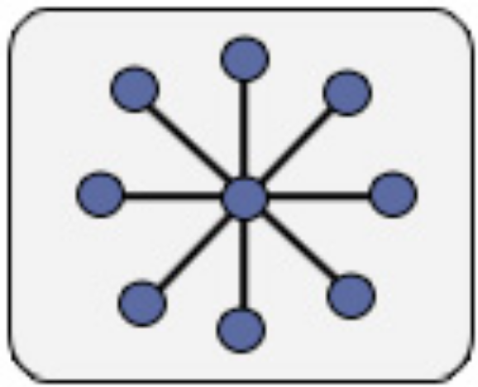
Hierarchical - Star Topology
Single level hierarchy
Connects all spokes with a centralized hub
All information must be sent through the hub to the spokes

Slide 6

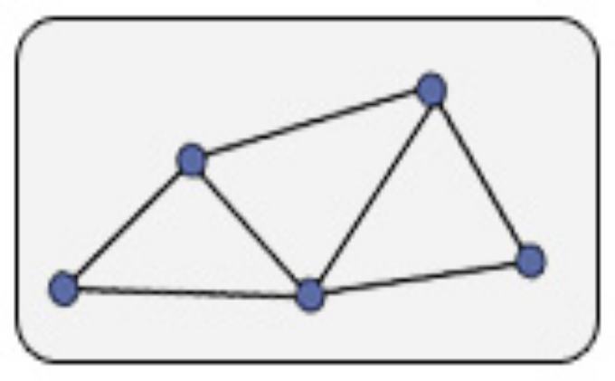
Networked (P2P-Like Architecture)
Fully connected network
  Connects all nodes together with a direct connection
  Full mesh topology
Partially connected network
  Only a subset of nodes are connected together
  Partial mesh topology

Slide 7
OO jDREW
Centralized Rule System
Object Oriented Java Deductive Reasoning Engine for the Web – extensions of jDREW
Supports rules in two formats:
  POSL: Positional Slotted presentation syntax
  RuleML: XML interchange syntax
  (can be generated from POSL)

Slide 8
Rule Responder
Distributed Rule System
Is currently implemented as a hierarchical rule system
Rule Responder is a prototypical
multi-agent system for virtual communities
Supports rule-based collaboration between the distributed members of community
Members are assisted by semi-automated rule-based agents, which use rules to describe the decision and behavioral logic

Slide 9
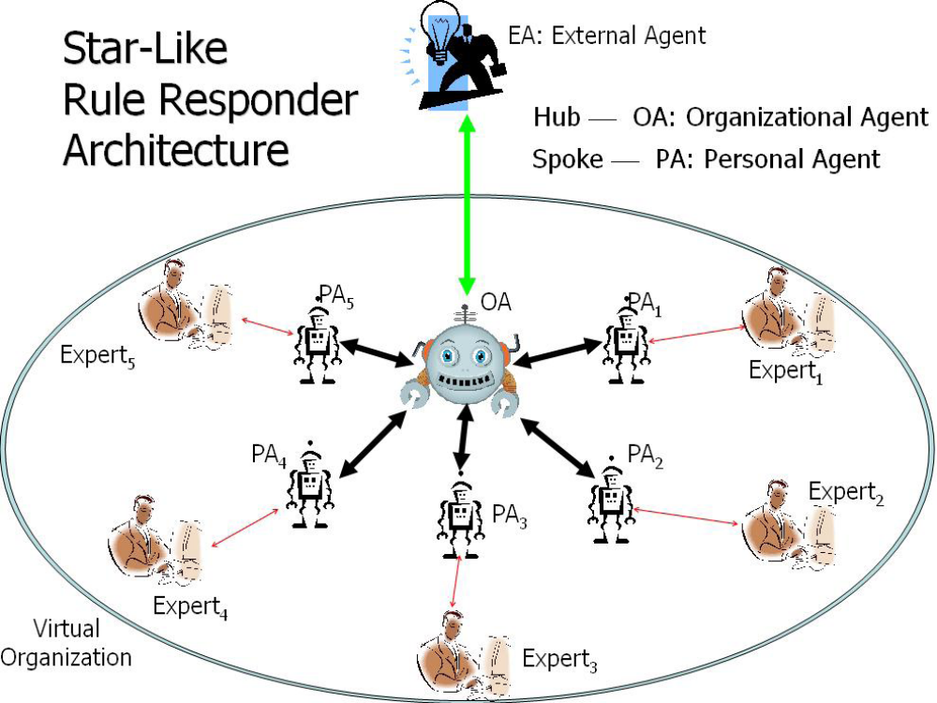

Slide 10
Topology Performance
When building a distributed system a topology is required
Distributed topologies all have communication over head that centralized systems do not have
A key design goal for distributed systems is to minimize this communication over head

Slide 11
Star Advantages
Isolation of spokes from other spokes
  If one spoke fails then it does not affect others
Adding and removing spokes in the hub is trivial
Hub provides single point of inspection of all traffic through the topology
  Improved Security
Trouble shooting is easy
Easy to understand and implement

Slide 12
Star Disadvantages
Scalability, reliability and performance of the star topology rely on the hub
If the hub fails then the entire system fails
The hub can become overloaded and the system will experience slowdown
To prevent the bottleneck of the star topology a P2P topology can be used

Slide 13
P2P Advantages
Removes bottleneck performance issues of the star topology
Whenever a node is added the total bandwidth capacity is increased
When a node fails the system will be able to recover
  A peer can act in place of another peer

Slide 14
Knowledge Maintenance for
Rule Systems
A distributed system can have many different knowledge bases distributed across the system
  Each knowledge base acts as a module
  Many files and databases
A centralized system has all of the knowledge stored in a single location
  Either a file or a database

Slide 15
Knowledge Organization - I
When deciding how to group modules one of two ways can be used
  Predicate Centric
    All clauses of a predicates are stored in one module
  Person Centric
    All clauses about one person or thing is stored in one module
    Rule Responder uses person centric organization
example on next slide

Slide 16
Knowledge Organization - II
Predicate Centric:
  phoneOf(ben, 1-506-270-3403)
  phoneOf(jim, 1-506-275-9712)
  emailOf(ben, ben.craig@unb.ca)
  emailOf(jim, jim.lorde@unb.ca)
Person Centric:
  phoneOf(ben, 1-506-270-3403)
  emailOf(ben, ben.craig@unb.ca)
  phoneOf(jim, 1-506-275-9712)
  emailOf(jim, jim.lorde@unb.ca)

Slide 17
Module Boundaries
When querying modules sometimes information from multiple modules is required
Example Query
  “What are the phone numbers of everyone in the organization?”
  This query must backtrack across multiple modules when using person centric storage

Slide 18
Centralized Maintenance
All knowledge is stored in a single location
  Updating knowledge is simple
  Can better avoid/repair knowledge inconsistencies
All knowledge is stored in a single format
  No translation steps when using a rule engine to execute the rules and facts

Slide 19
Distributed Maintenance
Knowledge is stored in a many locations
  Each agent can separately update their own knowledge
  Knowledge bases could be incomplete or inconsistent
  Integrity rules can be used to test if the knowledge is complete and consistent
Knowledge is stored in many formats
  Translation steps are required when sending a query from one rule engine to another
  An interchange language is required

Slide 20

Benchmarking Use Case
RuleML-20xy Symposia
  An organizational agent acts as the single point of entry to assist with symposium planning:
    Currently, query answering about the symposium
    Ultimately, preparing and running the symposium
  Personal agents have supported symposium chairs since 2007 (deployed as Q&A in 2008)
    General Chair, Program Chair, Panel Chair, Publicity Chair, etc.

Slide 21
Queries Used
1) Sponsoring the symposium
2) Check panel participants
3) View symposium sponsors
4) View organization partners
5) Check panel time

Slide 22
OO jDREW (centralized) Benchmarking
Query: Computation Time (ms):
1) 141
2) 31
3) 22
4) 18
5) 16
Results show that a centralized system does not take much computation time
Queries do not require heavy computation

Slide 23
Rule Responder (Hierarchical) Benchmarking
Same 5 queries used as in the OO jDREW bench marking
Query: Computation Time (ms):
1) 3430
2) 4861
3) 4057
4) 9048
5) 2780
Increase in computation time due to sequential delivery of answers to the queries
Communication overhead of distributed system not compensated by workload distribution

Slide 24
Network Performance Considerations
Speed ups can be obtained using a P2P topology
Instead of all communication going 'vertically' through the hub, direct 'horizontal' communication between spokes could be often used
  Will reduce the amount of communication steps in the distributed system
The bottleneck issue of a hierarchical system does not exist in a networked system

Slide 25
Conclusion
A rule system can be either distributed or centralized
When using a distributed system the communication topology must be decided
The topology should reflect the modularization decision about the distributed rule system
The advantages and disadvantages of distributed knowledge maintenance must be weighted when building a rule system
Our initial benchmarks, not requiring heavy computation, show increase in computation time for a distributed Hierarchal system
Only distributed networked system will *scale* to the Web

Slide 26




Expert₅
EA
PA₁
OA
PA₅
PA₂
PA₃
PA₄
Expert₂
Expert₃
Expert₄
Notes:
Reponse

