Slide 1




Arbeitsgruppe
SymposiumPlanner-2011:
Querying Two Virtual Organization Committees
Zhili Zhao, Adrian Paschke, Chaudhry Usman Ali,
and Harold Boley
Corporate Semantic Web (AG-CSW)
Institute for Computer Science,
Freie Universitaet Berlin
paschke@inf.fu-berlin.de
http://www.inf.fu-berlin.de/groups/ag-csw/

Slide 2
What is SymposiumPlanner?
  Is a series of Rule Responder instantiations for the Q&A sections of the official websites of the RuleML Symposia since 2007
    Organizational Agent (OA) filters and delegates of incoming queries
    External Agent (EA) acts as the interface to the organizational agent, i.e. as the single point of entry to support the symposium organization
    Personal Agents (PAs) assist symposium chairs

Slide 3
Organizational Agents
Represents goals and strategies shared by each member of the Symposium organization
Contains rule sets that describe
the policies, regulations, opportunities, and expertise of its organization
Manages the roles of each personal agent via a Role Assignment Matrix

Slide 4
Personal Agents
Act in a rule-based manner on behalf of symposium chairs
Work on a profile of FOAF-like facts and FOAF-extending rules that encode ‘routine’ knowledge of symposium chairs

Slide 5
Role Assignment Ontology
Topics
Personal Agents
Sponsoring
Metatopics
.
.
.
General Chair
General Chair
Press Release
Challenge
Program Chair
Program Chair
.
.
.
Demos
Challenge Chair
Challenge Chair
.
Media Partners
.
.
.
.
.
.
.
.
.
.
.
.
.
.
.
.
.
Publicity Chair
Sponsors
Publicity Chair
Registration
.
Liaison Chair
.
Liaison Chair
.
Visa Letter
Responsible
Properties:
Accountable
Submissions
.

Slide 6
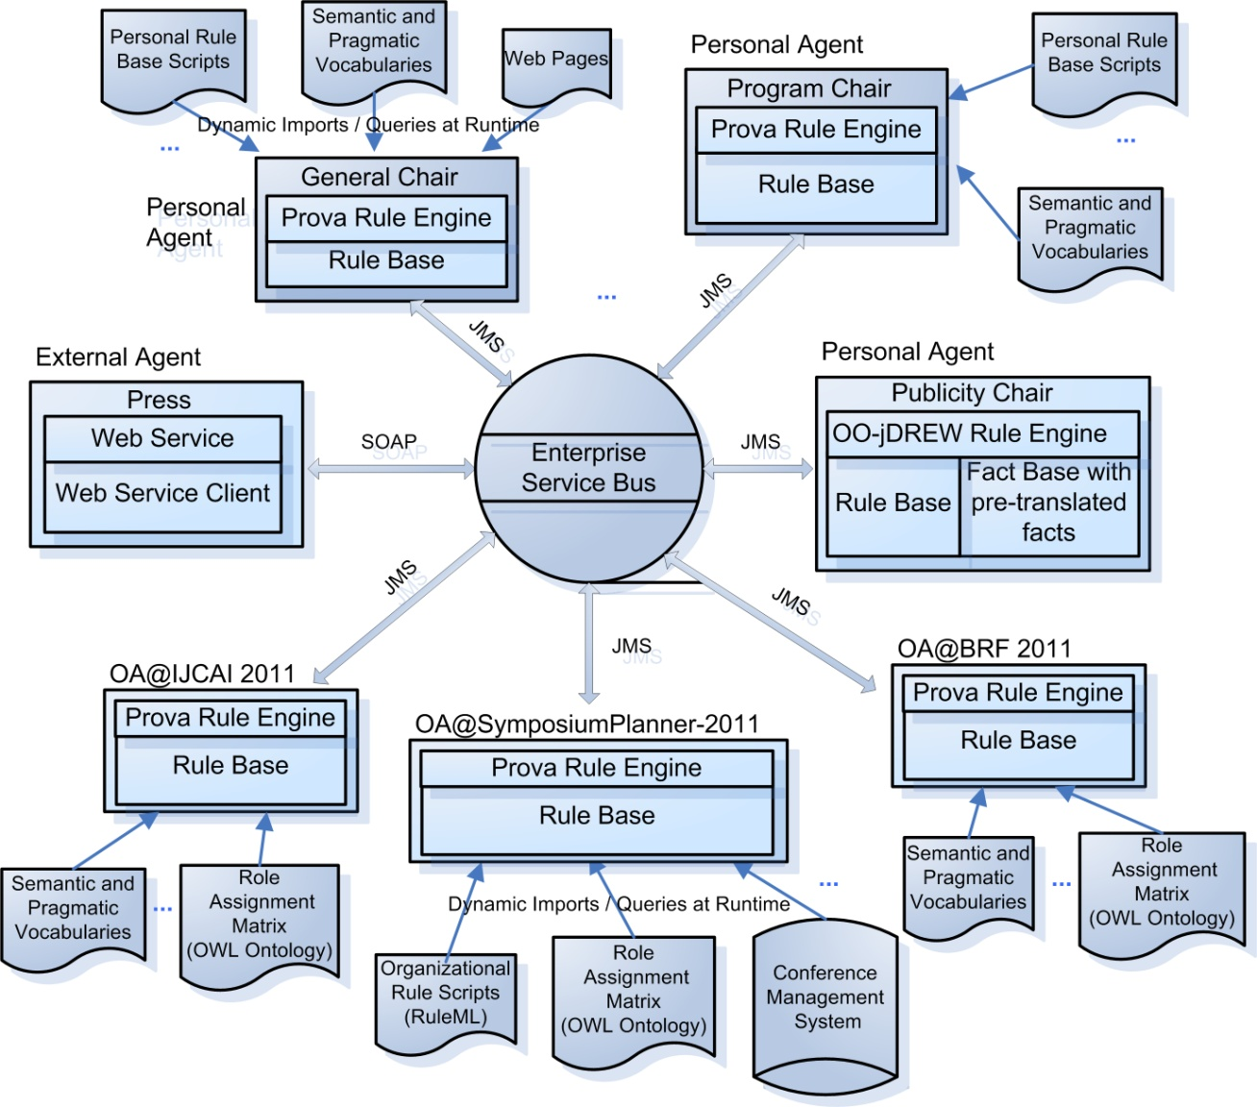
SymposiumPlanner 2011 Architecture
  One super-OA: OA@SymposiumPlanner-2011
  Two sub-OAs: OA@IJCAI 2011 and OA@BRF 2011
  Each agent consists of internal or external knowledge sources.
  Reaction RuleML messages are transported via the ESB to the appropriate agent with different transport protocols

Slide 7
Communication Middleware
Mule Enterprise Service Bus (ESB)
  Is used to create communication
  end points at each Personal and Organizational Agent
  Provides a highly scalable and flexible application messaging framework to communicate synchronously or asynchronously
  Supports a variety of transport protocols
  (including HTTP, JMS, JDBC, SOAP, etc.)
  Is based on a staged event-driven architecture (SEDA)

Slide 8
Rule Engine: Prova
Is both a rule language and a rule engine
Tight integration of Java and Semantic Web technologies
Is used to realize the organizational agents of SymposiumPlanner system

Slide 9
Prova: Messaging Reaction Rules
Send a message
sendMsg(XID,Protocol,Agent,Performative,[Predicate|Args]|Context)
Receive a message
rcvMsg(XID,Protocol,Agent,Performative,[Predicate|Args]|Context)
Receive multiple messages
rcvMult(XID,Protocol,Agent,Performative,[Predicate|Args]|Context)
  XID is the conversation identifier
  Protocol: protocol e.g. self, jms, esb etc.
  Agent: denotes the target or sender of the message
  Performative: pragmatic context, e.g. FIPA Agent Communication
  [Predicate|Args] or Predicate(Arg₁,..,Arg_{n}): Message payload

Slide 10
Example
getTracks(XID,Track):-
% look-up responsible agent (Program Chair) from RAM
assigned(XID,Agent,ruleml2011ATijcai_ProgramChair,ruleml2011ATijcai_responsible),
% send the query to personal agent
sendMsg(XID,esb,Agent, "query", getTrack(Track)),
% receive answers multiple times
rcvMult(XID,esb,Agent, "answer", substitutions(Track)).

Slide 11
Access to External Data Sources (Prova query built-ins)
File Input / Output
..., fopen(File,Reader), ...
XML (DOM)
document(DomTree,DocumentReader) :- XML(DocumenReader),...
SQL
... ,sql_select(DB,cla,[pdb_id,"1alx"],[px,Domain]).
RDF
...,rdf(http://...,"rdfs",Subject,"rdf_type","gene1_Gene"),...
XQuery
..., XQuery = 'for $name in StatisticsURL//Author[0]/@name/text()
return $name', xquery_select(XQuery,name(ExpertName)),...
SPARQL
...,sparql_select(SparqlQuery,...

Slide 12
Reaction RuleML
Is a branch of the RuleML family that supports actions and events
Works as interchange language between agents, where Reaction RuleML messages are sent through the ESB
The ESB carries RuleML queries (requests), answers (results), and rule bases to/from agents

Slide 13
Example Reaction RuleML Message
<RuleML xmlns="http://www.ruleml.org/0.91/xsd"
xmlns:xsi="http://www.w3.org/2001/XMLSchema-instance"
xsi:schemaLocation="http://www.ruleml.org/0.91/xsd
http://ibis.in.tum.de/research/ReactionRuleML/0.2/rr.xsd"
xmlns:ruleml2011="http://ibis.in.tum.de/projects/paw#">
<Message mode="outbound" directive="query-sync" >
<oid> <Ind> RuleML-2011-IJCAI </Ind> </oid>
<protocol> <Ind>esb</Ind> </protocol>
<sender> <Ind>User</Ind> </sender>
<content>
<Atom>
<Rel>getContact</Rel>
<Ind> ruleml2011ATijcai_GeneralChair </Ind>
<Var>Contact</Var>
</Atom>
</content>
</Message>
</RuleML>

Slide 14
User Clients
Ways of issuing queries:
  Follow a menu to create and fill HTML forms
  Or use Attempto Controlled English (a rich subset of standard English designed to serve as knowledge representation language)
*Attempto Project: http://attempto.ifi.uzh.ch/site/

Slide 15
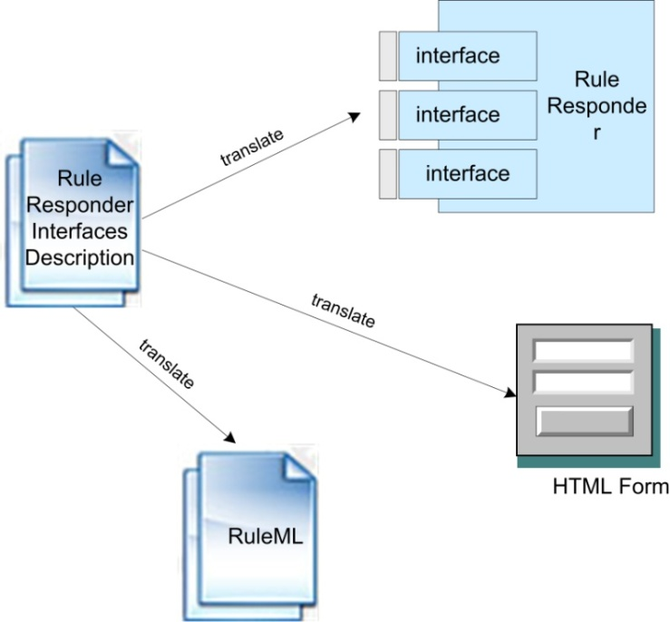
Queries Defined by Organizational Agent Interfaces
Describe public interfaces of rule functions with an XML file
Translate interfaces descriptions to HTML forms
Construct Reaction RuleML queries with interface descriptions and parameter values

Slide 16
Issue Query with Attempto Controlled English
Attempto Parsing
Engine (APE)
Discourse Representation
Structure (DRS)
XML Parser
Reaction RuleML
Message
ACE Text
Example:
<DRS domain="">
<Question>
<DRS domain="A B C">
<query obj="A" question="who" sentid="1" tokid="1"/>
<relation obj1="C" rel="of" obj2="string('Rule-based Distributed and Agent Systems')"
sentid="1" tokid="5"/>
<object ref="C" noun="author" struct="countable" unit="na" numrel="geq" num="2"
sentid="1" tokid="4"/>
<predicate ref="B" verb="be" subj="A" obj="C" sentid="1" tokid="2"/>
</DRS>
</Question>
</DRS>
<Atom>
<Rel>getAuthorsOfPaper</Rel>
<Ind>'Rule-based Distributed and Agent Systems'</Ind>
<Var>author</Var>
</Atom>
"Who are the authors of 'Rule-based Distributed and Agent Systems'"?

Slide 17
Example Rule Function Interface Description
<signature agent="SymposiumPlannerSystem">
<meta>
<Atom>
<Rel iri="dc:description"/>
<Data xsi:type="xs:string">decide whether can submit a paper</Data>
</Atom>
</meta>
<qualification>
<Atom><Rel iri="http://reaction.ruleml.org/ns/signature/Public-Signature"/></Atom>
</qualification>
<oid><Ind>submission</Ind></oid>
<Expr>
<Fun mode="+" meta="User's Contact Informaion">contact</Fun>
<Var mode="+" meta="User's FirstName" default="Mark">FirstName</Var>
<Var mode="+" meta="User's LastName" default="JBoss">LastName</Var>
<Var mode="+" meta="User's Country" default="USA">Country</Var>
<Var mode="+" meta="User's Email" default="markDOTjbossATgmailDOTcom">Email</Var>
</Expr>
<Var mode="+" type="string" meta="Paper Title" default="Rules and Automated Reasoning">Title</Var>
<Var mode="+" type="string" meta="Paper Type" default="Full Paper" candiates="Demo Paper;Full Paper">SubmissionCategory</Var>
<Var mode="+" type="string" meta="Paper Keywords, please serparated by semicolon." default="rules; reasoning">Keywords</Var>
</signature>

Slide 18
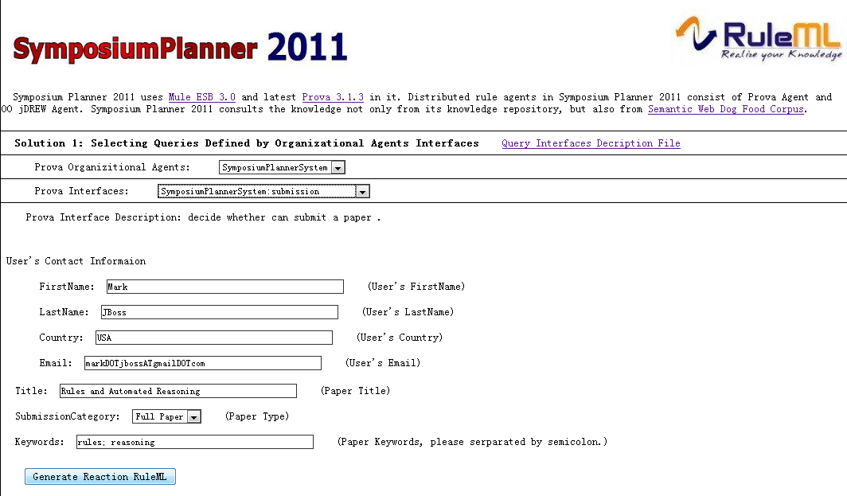
Online Demo

Slide 19
Online Demo
http://de.dbpedia.org/redirects/ruleml/ACE2ReactionRuleML/

Slide 20
Analysis
SEDA decomposes the processes of Q&A in SymposiumPlanner with event-driven stages connected by explicit queues
SEDA maximizes throughput and exhibits higher performance and more robust behavior under load than traditional service designs
SymposiumPlanner can process users' queries reasonably and prevent resources from being overcommitted when demand exceeds agent processing capacity

Slide 21
Conclusion
Adapted to organize the both installments of RuleML 2011 Symposium
  Created three OAs to bring clarity in system operations
Access to external data sources (e.g. Semantic Web DogFood, FOAF profiles) and ontologies (responsibility assignment matrix ontology) from the rule-based agents
Provides a more powerful user Client
  Template-based Configurable Web Forms
  Attempto Controlled English (translation into Reaction RuleML)

Slide 22

Questions?

