Slide 1




Arbeitsgruppe
Principles of the
SymposiumPlanner Instantiations of
Rule Responder
Zhili Zhao, Adrian Paschke, Chaudhry Usman Ali,
and Harold Boley
Corporate Semantic Web (AG-CSW)
Institute for Computer Science,
Freie Universitaet Berlin
paschke@inf.fu-berlin.de
http://www.inf.fu-berlin.de/groups/ag-csw/

Slide 2
Overview of Rule Responder (I)
Rule Responder is a multi-agent system
for collaborative team and community support on the (Semantic) Web
Enables rule-based collaboration between
the distributed human members
Persons of an organization are assisted by semi-automated rule-based agents, which use rules (and various ontologies) to describe the decision and behavioral logic
Notes:
Why rules are important -> to implement the decision logic

Slide 3
Overview of Rule Responder (II)
Uses Reaction RuleML as the standardized interchange language
Implemented on top of a Mule-based
Enterprise Service Bus (ESB)
Notes:
Why rules are important -> to implement the decision logic

Slide 4
What is SymposiumPlanner?
  Is a series of Rule Responder instantiations for the Q&A sections of the official websites of the RuleML Symposia since 2007.
    Organizational Agent (OA) filters and delegates incoming queries
    Personal Agents (PAs) assist symposium chairs
    External Agent (EA) acts as the interface to the organizational agent, i.e. as the single point of entry to support the symposium organization

Slide 5
Why SymposiumPlanner? (I)
Coordinating chair responsibilities (responsibility assignment)
Finding contact information about selected chairs of the symposium
Helping the program and track chairs with mapping planned paper topics to program and track themes
Helping the program chair to monitor and possibly move important dates

Slide 6
Why SymposiumPlanner? (II)
Helping the liaison chair with special events by symposium partners
Helping the panel chair with managing panel participants
Helping the publicity chair with sponsoring correspondence
Answering questions of participants about the conference such as important dates, topics addresses, program schedule etc.

Slide 7





SymposiumPlanner
Architecture
Enquiry User
OA: Organizational Agent
EA: External Agent
PA: Personal Agent
General Chair
PA
Challenge Chair
PA
OA
General Chair
Profile User
Challenge Chair
Profile User
Publicity Chair
PA
Program Chair
PA
Program Chair
Profile User
Liaison
Chair
PA
Publicity Chair
Profile User
Liaison Chair
Profile User
Virtual
Organization

Slide 8
Personal Agents
Act in a rule-based manner on behalf of symposium chairs
Work on a profile of FOAF-like facts and FOAF-extending rules that encode ‘routine’ knowledge of symposium chairs

Slide 9
Organizational Agents
Represents goals and strategies shared by each member of the Symposium organization
Contains rule sets that describe
the policies, regulations, opportunities, and expertise of its organization

Slide 10
External Agents
Exchange messages with
(the public interface of) organizational agents, sending queries (requests), receiving answers (results), or interchanging complete rule sets
Constitute the public interface to the OA of a Symposium's virtual organization through which enquiry users can send queries and receive answers

Slide 11
Query Delegation to Personal Agents
The Organizational Agent delegates queries to appropriate Personal Agents
Tasks for the symposium organization are managed via a Role Assignment Matrix
Defined here by an OWL Lite ontology
(alternatives: RDFS, RuleML, ...)
Assigns (meta) topics to PAs within the virtual organization: ... see next slide ...

Slide 12
Role Assignment Ontology
Topics
Personal Agents
Sponsoring
Metatopics
.
.
.
General Chair
General Chair
Press Release
Challenge
Program Chair
Program Chair
.
.
.
Demos
Challenge Chair
Challenge Chair
.
Media Partners
.
.
.
.
.
.
.
.
.
.
.
.
.
.
.
.
.
Publicity Chair
Sponsors
Publicity Chair
Registration
.
Liaison Chair
.
Liaison Chair
.
Visa Letter
Responsible
Properties:
Accountable
Submissions
.

Slide 13
Query Answering for Personal Agents
Some queries have more than one answer
The PA will send the answers
one at a time to the OA
  Interleaved backtracking and transmission
When the PA finds no more answers,
it sends an end-of-transmission message

Slide 14
Reaction RuleML
Is a branch of the RuleML family that supports actions and events
Works as interchange language between agents, where Reaction RuleML messages are sent through the ESB
The ESB carries RuleML queries (requests), answers (results), and rule bases to/from agents

Slide 15
Example Reaction RuleML Message
<RuleML xmlns="http://www.ruleml.org/0.91/xsd"
xmlns:xsi="http://www.w3.org/2001/XMLSchema-instance"
xsi:schemaLocation="http://www.ruleml.org/0.91/xsd
http://ibis.in.tum.de/research/ReactionRuleML/0.2/rr.xsd"
xmlns:ruleml2011="http://ibis.in.tum.de/projects/paw#">
<Message mode="outbound" directive="query-sync" >
<oid> <Ind> RuleML-2011-IJCAI </Ind> </oid>
<protocol> <Ind>esb</Ind> </protocol>
<sender> <Ind>User</Ind> </sender>
<content>
<Atom>
<Rel>getContact</Rel>
<Ind> ruleml2011ATijcai_GeneralChair </Ind>
<Var>Contact</Var>
</Atom>
</content>
</Message>
</RuleML>

Slide 16
Performatives
The attribute directive="..."
specifies the pragmatic performative
  Message exchange/interaction protocols
are used to understand the pragmatic context of the message
  such as: query-sync, answer and etc.

Slide 17
Agent Communication Protocols
In-Only
  Message is sent from agent₁ to agent₂;
  then agent₂ executes performative
Request-Response
  Performs above In-Only;
  then agent₂ sends response to agent₁
Request-Response-Acknowledge
  Performs Request-Response;
  then agent₁ sends an acknowledgement to agent₂
Workflows
  Generalizes the above protocols to allow other compositions of message interchange between agents

Slide 18
Translation between Interchange Language and Proprietary Languages
Each rule engine can use its own rule language
Agents require the translations between interchange language and proprietary languages

Slide 19
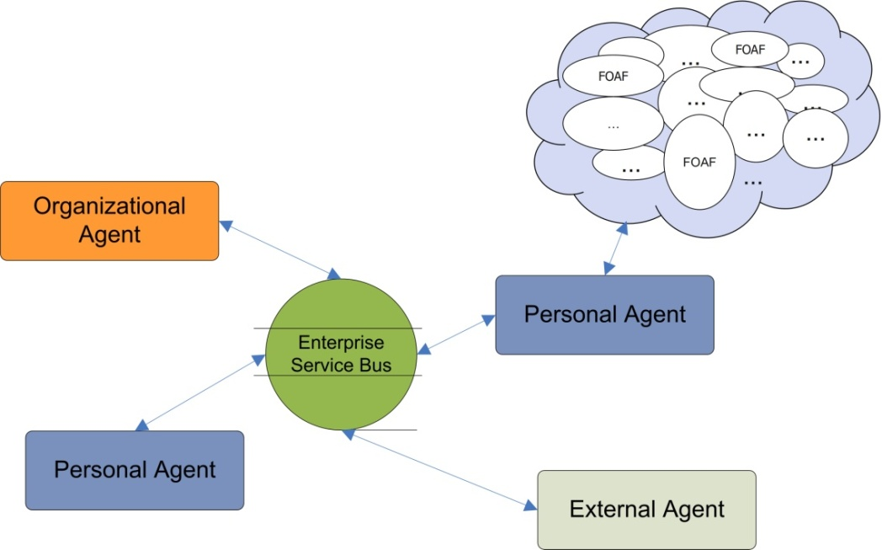
Integration with External Sources
External data sources are dynamically queried at runtime and used as facts in the internal knowledge base of an agent
  Such as: calendars, vocabulary definitions, web pages, personal data
Via query languages such as SQL, SPARQL, etc.

Slide 20
User Client
Ways of issuing queries:
  Follow a menu to create and fill HTML forms
  Or use Attempto Controlled English (a rich subset of standard English designed to serve as knowledge representation language)
*Attempto Project: http://attempto.ifi.uzh.ch/site/

Slide 21
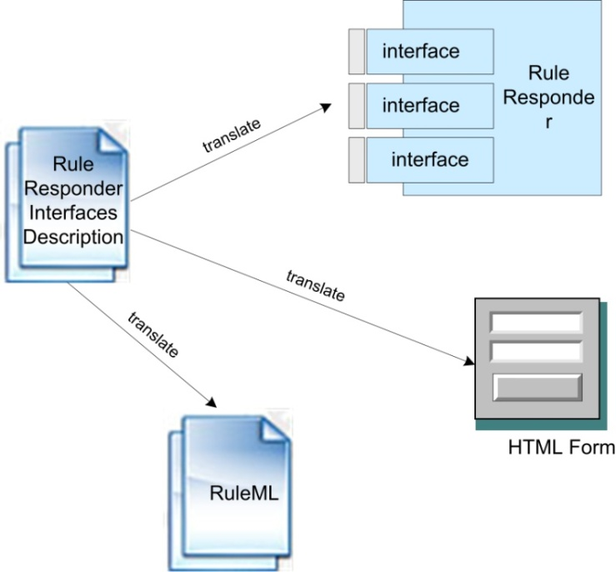
Queries Defined by Organizational Agent Interfaces
Describe public interfaces of rule functions with an XML file
Translate interfaces descriptions to HTML forms
Construct Reaction RuleML queries with interface descriptions and parameter values

Slide 22
Issue Query with Attempto Controlled English
Attempto Parsing
Engine (APE)
Discourse Representation
Structure (DRS)
XML Parser
Reaction RuleML
Message
ACE Text
Example:
<DRS domain="">
<Question>
<DRS domain="A B C">
<query obj="A" question="who" sentid="1" tokid="1"/>
<relation obj1="C" rel="of" obj2="string('Rule-based Distributed and Agent Systems')"
sentid="1" tokid="5"/>
<object ref="C" noun="author" struct="countable" unit="na" numrel="geq" num="2"
sentid="1" tokid="4"/>
<predicate ref="B" verb="be" subj="A" obj="C" sentid="1" tokid="2"/>
</DRS>
</Question>
</DRS>
<Atom>
<Rel>getAuthorsOfPaper</Rel>
<Ind>'Rule-based Distributed and Agent Systems'</Ind>
<Var>author</Var>
</Atom>
"Who are the authors of 'Rule-based Distributed and Agent Systems'"?

Slide 23
Communication Middleware
Mule Enterprise Service Bus (ESB)
  Is used to create communication
  end points at each Personal and Organizational Agent
  Provides a highly scalable and flexible application messaging framework to communicate synchronously or asynchronously
  Supports a variety of transport protocols
  (including HTTP, JMS, JDBC, SOAP, etc.)
  Is based on a staged event-driven architecture (SEDA)

Slide 24
Rule Engines
Prova: Prolog + Java
OO jDREW: Object Oriented
java Deductive Reasoning Engine for the Web
(others: DR-Device, Euler, Drools, …)

Slide 25
Prova
is both a rule language and a rule engine
tight integration of Java and Semantic Web technologies
separates the logic of data access from computation
is used to realize mainly the Organizational Agents of Rule Responder

Slide 26
OO jDREW
OO jDREW is used to realize the
Personal agents of Rule Responder
Implements Hornlog RuleML for agent reasoning (Horn logic rules)
Supports rules in two formats:
  POSL: Positional Slotted presentation syntax
  RuleML: XML interchange syntax
  (can be generated from POSL:
  http://www.ruleml.org/posl/converter.jnlp)

Slide 27
Conclusion
SymposiumPlanner was implemented & tested for various instantiations (http://ruleml.org/SymposiumPlanner/) and deployed for RuleML-2007/.../2011 Q&A
Its Organizational Agents delegate external queries to topic-assigned Personal Agents acting as committee chairs
It couples rule engines such as Prova and
OOjDREW via ESB middleware
and Reaction RuleML interchange format

Slide 28

Questions?

