Slide 1

The OO jDREW Engine of
Rule Responder: Naf Hornlog RuleML Query Answering
Benjamin Craig
Harold Boley
Fredericton NB
NRC-IIT
Wednesday, February 27, 2007

Slide 2
Outline
Rule Responder Overview
Agents
  Personal
  Organizational
  External
Rule Engines
  Prova
  OO jDREW
Communication Middleware
  Mule ESB
  Reaction RuleML messages
Demo
  Use Cases

Slide 3
Overview of Rule Responder
Rule Responder is an intelligent multi-agent system for collaborative teams and virtual communities
Supports rule-based collaboration between the distributed members of such a virtual organization
Members of a virtual organization are represented as semi-automated rule-based agents which use rules to describe the behavioral and decision logic
Uses RuleML subset as its Rule Markup Language, based on logic and XML
  The member of the RuleML family employed here is Naf (Negation as failure) Hornlog
Implemented as a Web-based service architecture
Notes:
Why rules are important -> to implement the decision logic

Slide 4
Personal Agents
A personal agent assists a single person
of an organization, (semi-autonomously) acting on his/her behalf
The personal agent contains a FOAF*-like profile plus FOAF-extending rules
* The Friend of a Friend (FOAF) project: http://www.foaf-project.org

Slide 5
Organizational Agents
Organizational agents are used to represent goals and strategies shared
by each person in the organization
Organizational agents contain rule sets that describe their organizations’ policies, regulations, opportunities, etc.

Slide 6
External Agents
External agents communicate with the public interface of the organizational agents, exchanging messages that transport queries, answers, or complete rule sets
End users employ a Web (HTTP) interface as an external agent of Rule Responder (currently an API-like browser interface)
Support for multiple external agents (end users) at any time

Slide 7
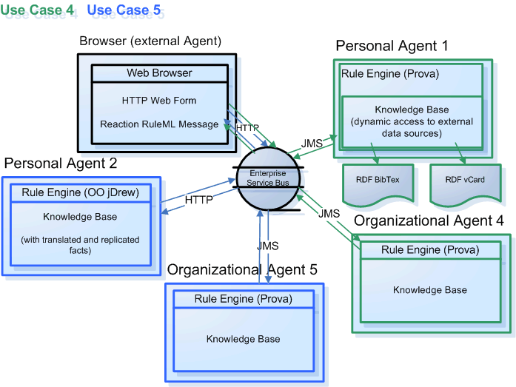
Architecture - Overview

Slide 8
Rule Engines
Prova (Prolog + Java)
OO jDREW (Object Oriented Java Deductive Reasoning Engine for the Web)

Slide 9
Prova
Prova is used to implement the organizational agents of Rule Responder
Prova is also used for some personal agents

Slide 10
OO jDREW
OO jDREW is used for implementing personal agents of Rule Responder
Two modes of Rule Execution:
  Bottom-up (fact-directed forward reasoning)
  Top-down (query-directed backward reasoning)
Rule Responder primarily uses top-down
Supports rules in the following formats:
  POSL (Positional Slotted presentation syntax)
  RuleML (XML syntax, can be generated from POSL)

Slide 11
Communication Middleware
Mule Enterprise Service Bus (ESB)
  Mule* is used to create communication end points at each personal and organizational agent of Rule Responder
  Mule supports various transport protocols
  (i.e. http, jms, soap)
  Rule Responder uses http and jms as transport protocols
  * Mule – The open source SOA infrastructure: http://mulesource.com

Slide 12
Reaction RuleML
Reaction RuleML is a branch of the RuleML family that supports actions and events
When two agents need to communicate, each others’ Reaction RuleML messages are sent through the ESB

Slide 13
Use Case
RuleML-200x Symposium
  One organizational agent acts as the single point of entry to the symposium
    Assists with planning, preparing, and running the symposium
  Personal agents represent Chairs of the Symposium
    Program Chair, Publicity Chair, Panel Chair, General Chair, etc.

Slide 14
Online Demo
http://responder.ruleml.org/
Use Case Demo Link:
http://ibis.in.tum.de/projects/paw/ruleml-2007/

Slide 15
Ex.: Personal Agent’s Knowledge Base
% Sample OO jDREW rule in POSL syntax:
person(?person, ?role, ?title, ?email, ?telephone):-
mailphone(?person, ?email, ?telephone),
role(?person, ?role),
title(?person, ?title).
% Sample OO jDREW facts used by the above rule:
mailphone(John, john@email.com, 1-555-555-5555).
role(John, Panel Chair).
title(John, PHD).
Notes:
Explain how the rules work

Slide 16
Ex.: Organizational Agent’s Knowledge Base (Abridged)
% Sample Prova rule in POSL syntax:
getContact(?conference_part, ?info, ?contact) :-
person(
?contact, ?role, ?title, ?email, ?telephone).
Notes:
Explain how the rules work

Slide 17
Example Message to the Organizational Agent
<RuleML xmlns="http://www.ruleml.org/0.91/xsd"
xmlns:xsi="http://www.w3.org/2001/XMLSchema-instance"
xsi:schemaLocation="http://www.ruleml.org/0.91/xsd
http://ibis.in.tum.de/research/ReactionRuleML/0.2/rr.xsd"
xmlns:ruleml2007="http://ibis.in.tum.de/projects/paw#">
<Message mode="outbound" directive="query-sync">
<oid><Ind>RuleML-2007</Ind></oid>
<protocol><Ind>esb</Ind></protocol>
<sender><Ind>user</Ind></sender>
<content>
<Atom>
<Rel>getContact</Rel>
<Ind>ruleml2007_Challenge</Ind>
<Ind>update</Ind>
<Var>Contact</Var>
</Atom>
</content>
</Message>
</RuleML>
Notes:
Explain what the message means OID, protocol, sender

Slide 18
Architecture - Overview

Slide 19
Architecture - Overview

Slide 20
Architecture - Overview

Slide 21
Architecture - Overview

Slide 22
Architecture - Overview

Slide 23
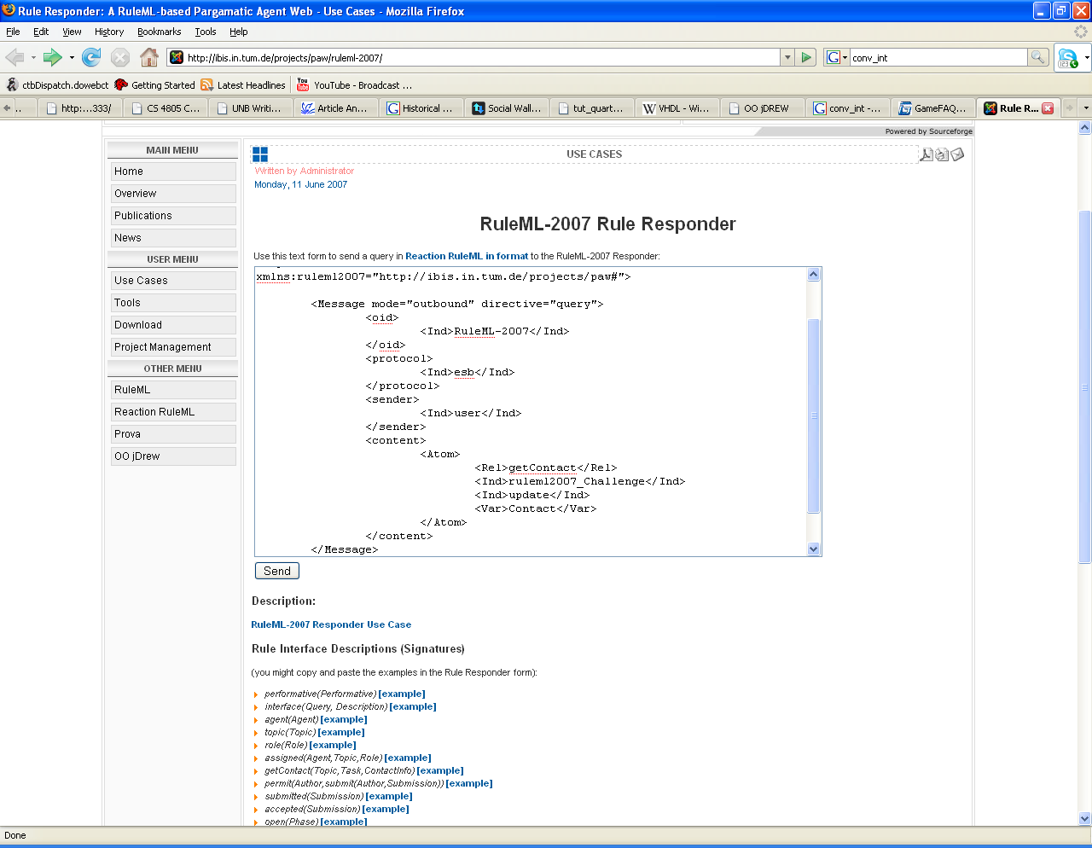
Notes:
Query

Slide 24
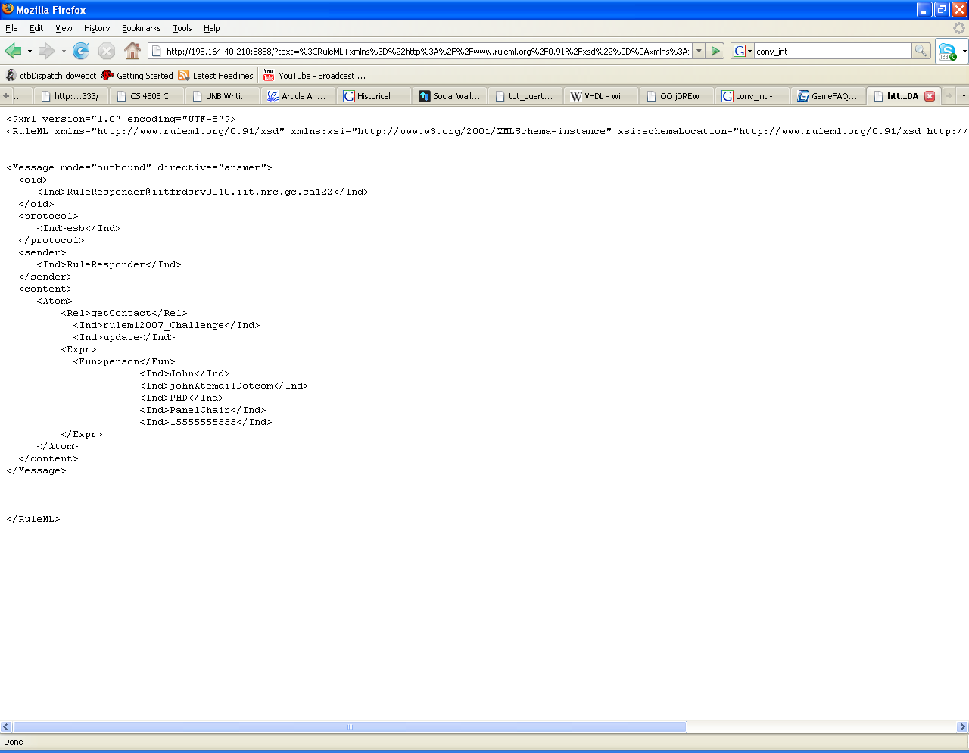
Notes:
Response

Slide 25
Ex.: Query to the Publicity Chair
<content>
<Atom>
<Rel>sponsor</Rel>
<Expr>
<Fun>contact</Fun>
<Ind>ben</Ind>
<Ind>nrc</Ind>
</Expr>
<Ind type="integer">500</Ind>
<Expr>
<Fun>results</Fun>
<Var>Level</Var>
<Var>Benefits</Var>
<Var>DeadlineResults</Var>
</Expr>
<Expr>
<Fun>performative</Fun>
<Var>Action</Var>
</Expr>
</Atom>
</content>
Notes:
Query

Slide 26
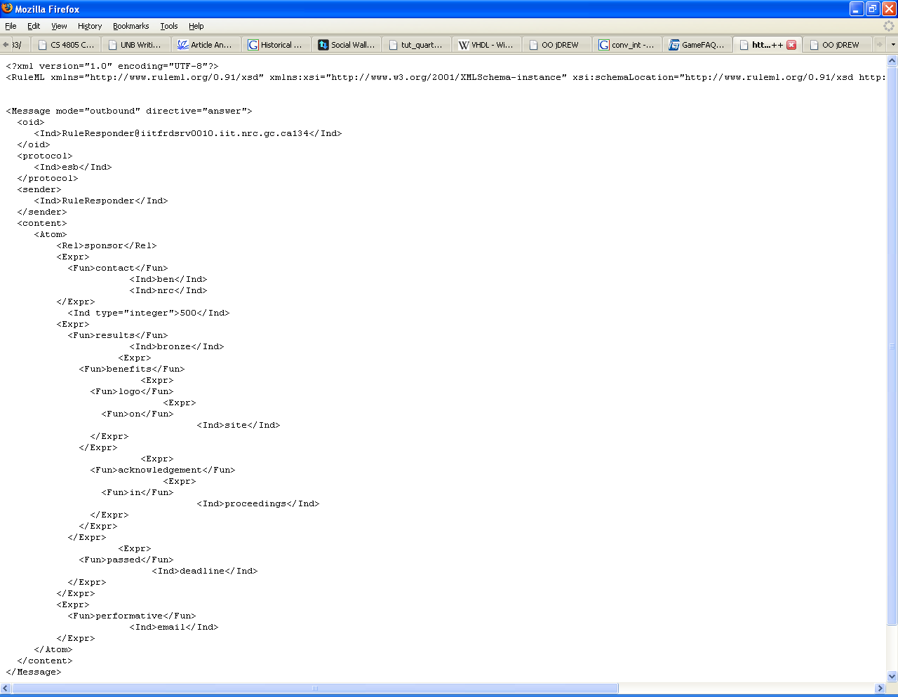
Notes:
Reponse

Slide 27
Ex.: Query to the Publicity Chair (ctnd)
<content>
<Atom>
<Rel>sponsor</Rel>
<Expr>
<Fun>contact</Fun>
<Ind>ben</Ind>
<Ind>nrc</Ind>
</Expr>
<Ind type="integer">5000</Ind>
<Expr>
<Fun>results</Fun>
<Var>Level</Var>
<Var>Benefits</Var>
<Var>DeadlineResults</Var>
</Expr>
<Expr>
<Fun>performative</Fun>
<Var>Action</Var>
</Expr>
</Atom>
</content>
Notes:
Query

Slide 28
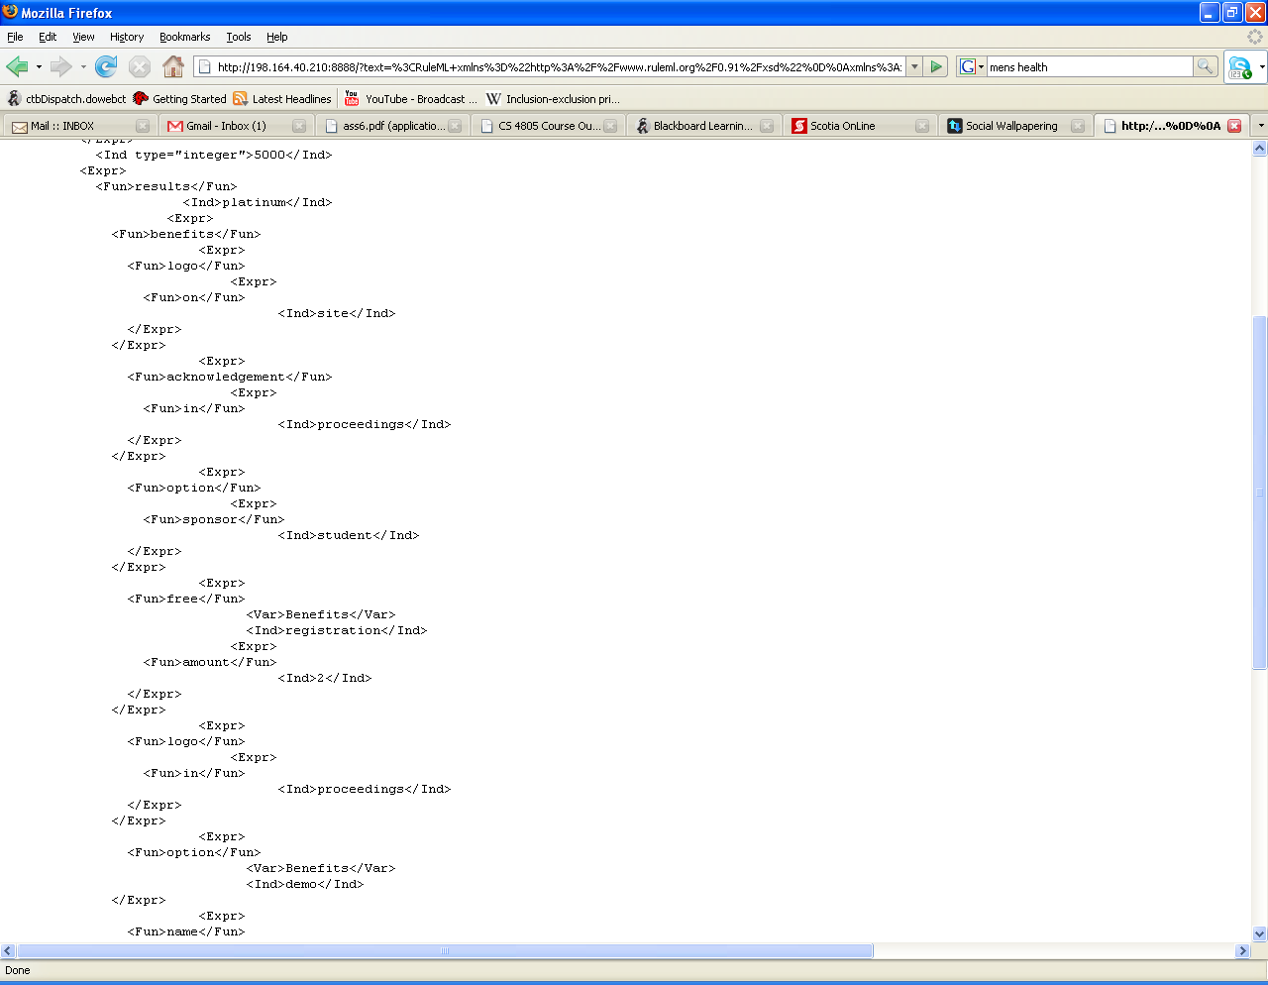

Slide 29
Conclusion
Rule Responder can be used to implement a wide range of use cases that require an intelligent, semi-automated decision layer
The middleware of Rule Responder allows deployment of multiple running use cases concurrently

