Slide 1

Rule Responder:
A Multi-Agent Web Platform for Collaborative Virtual Organizations
Based on RuleML and OO jDREW
Benjamin Craig
University Of New Brunswick
APICS 2007
Saturday, October 13, 2007

Slide 2
Outline
Overview
Agents
  Personal
  Organizational
  External
Rule Engines
  Prova
  OO jDREW
Communication Middleware
  Mule ESB
  Reaction RuleML messages
Demo
  Use Cases

Slide 3
Overview of Rule Responder
Rule Responder is an intelligent multi-agent system for collaborative teams and virtual communities
Supports rule-based collaboration between the different members of the virtual organization
Uses RuleML as its Rule Markup Language, based on logic and XML
  The member of the RuleML family employed here is Naf Hornlog
Implemented as a Web-based service architecture

Slide 4
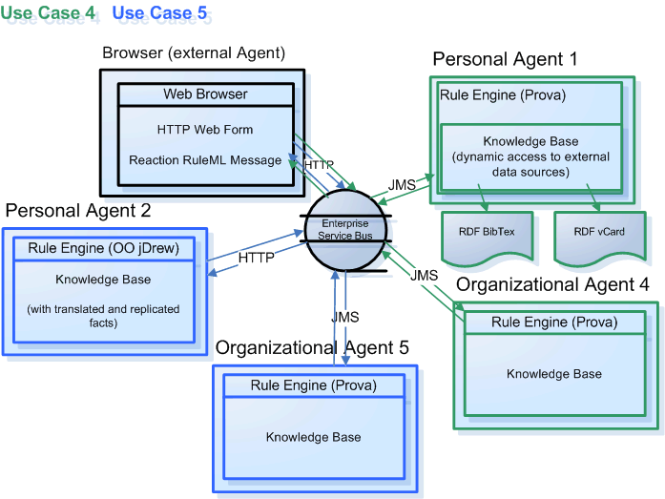
Architecture - Overview

Slide 5
Personal Agents
A personal agent represents a single person of an organization
The personal agent contains a FOAF* profile with FOAF extended rules
*The Friend of a Friend (FOAF) project: http://www.foaf-project.org

Slide 6
Organizational Agents
Organizational agents are used to represent shared goals and strategies of each person in the collaborative team
Organizational agents contain rule sets that describe their organizations’ policies, regulations, opportunities, etc.

Slide 7
External Agents
External agents communicate with the virtual organization by sending messages that transport queries, answers, or complete rule sets to the public interface of the organizational agents
HTTP interface to Rule Responder
Support for multiple unique External Agents (end users) at a single time
Users can use a web browser to communicate with Rule Responder (current test interface)

Slide 8
Rule Engines
Prova (Prolog + Java)
OO jDREW (Object Oriented Java Deductive Reasoning Engine for the Web)

Slide 9
Prova
Prova is used to implement the organizational agents of Rule Responder
Prova is also used as some personal agents

Slide 10
OO jDREW
OO jDREW is used for personal agents in
Rule Responder
Two modes of Rule Execution:
  Bottom-up (forward reasoning)
  Top-down (backward reasoning)
Rule Responder primarily uses top-down
Supports rules in the following formats:
  POSL (Positional Slotted Language)
  RuleML

Slide 11
Communication Middleware
Mule Enterprise Service Bus (ESB)
  Mule is used to create communication end points at each personal and organizational agent of Rule Responder
  Mule supports various transport protocols
  (i.e. http, jms, soap)
  Rule Responder uses http and jms as transport protocols

Slide 12
Reaction RuleML
Reaction RuleML is a branch of the RuleML family that supports actions and events
When two agents need to communicate, each others’ Reaction RuleML messages are sent through the ESB

Slide 13
Use Cases
RuleML-2007 Symposium
  Single Organizational Agent that acts as the single point of entry to the conference
  Assist with planning, preparing, and running the Symposium
  Personal Agents represent Chairs of the Symposium

Slide 14
Online Demo
http://responder.ruleml.org/
http://ibis.in.tum.de/projects/paw/ruleml-2007/

Slide 15
Example Message
<RuleML xmlns="http://www.ruleml.org/0.91/xsd"
xmlns:xsi="http://www.w3.org/2001/XMLSchema-instance"
xsi:schemaLocation="http://www.ruleml.org/0.91/xsd
http://ibis.in.tum.de/research/ReactionRuleML/0.1/rr.xsd"
xmlns:ruleml2007="http://ibis.in.tum.de/projects/paw#">
<Message mode="outbound" directive="query">
<oid>
<Ind>RuleML-2007</Ind>
</oid>
<protocol>
<Ind>esb</Ind>
</protocol>
<sender>
<Ind>User</Ind>
</sender>
<content>
<Atom>
<Rel>sponsor</Rel>
<Expr>
<Fun>contact</Fun>
<Ind>ben</Ind>
<Ind>nrc</Ind>
</Expr>
<Ind type="integer">500</Ind>
<Expr>
<Fun>results</Fun>
<Var>Level</Var>
<Var>Benefits</Var>
<Var>DeadlineResults</Var>
</Expr>
<Expr>
<Fun>performative</Fun>
<Var>Action</Var>
</Expr>
</Atom>
</content>
</Message>
</RuleML>

Slide 16
Example Message
<RuleML xmlns="http://www.ruleml.org/0.91/xsd"
xmlns:xsi="http://www.w3.org/2001/XMLSchema-instance"
xsi:schemaLocation="http://www.ruleml.org/0.91/xsd
http://ibis.in.tum.de/research/ReactionRuleML/0.2/rr.xsd"
xmlns:ruleml2007="http://ibis.in.tum.de/projects/paw#">
<Message mode="outbound" directive="query">
<oid>
<Ind>RuleML-2007</Ind>
</oid>
<protocol>
<Ind>esb</Ind>
</protocol>
<sender>
<Ind>user</Ind>
</sender>
<content>
<Atom>
<Rel>getContact</Rel>
<Ind>ruleml2007_Challenge</Ind>
<Ind>update</Ind>
<Var>Contact</Var>
</Atom>
</content>
</Message>
</RuleML>

Slide 17
Rule Bases
http://www.jdrew.org/oojdrew/programChairAgent2.posl
http://www.jdrew.org/oojdrew/rulesets/publicityChair.posl

