Slide 1

Rule Responder Agents for Distributed Query Answering
Harold Boley
Benjamin Craig
Taylor Osmun
Institute for Information Technology
National Research Council, Canada
Fredericton, NB, Canada
Database Seminar
School of Computer Science at Carleton University
Ottawa, ON, Canada
November 19, 2009
(Updated: December 8, 2009)

Slide 2
Outline
Rule Responder Overview
Agents
  Personal / Organizational / External
Infrastructure
  Reaction RuleML Messages
  Message Performatives
  Agent Communication Protocols
  Mule ESB (Communication Middleware)
Rule Engines (for Realizing Agents)
  Prova
  OO jDREW
Symposium Planner Use Case
  Query Delegation/Answering
  Shared Knowledge between Pas
  Ontology Description
Future Work and Conclusion

Slide 3
Overview of Rule Responder (I)
Rule Responder is an experimental
multi-agent system for collaborative teams and virtual communities on the Web
Supports rule-based collaboration between the distributed members of such
virtual organizations
Members of each virtual organization are assisted by semi-automated rule-based agents, which use rules to describe the decision and behavioral logic
Notes:
Why rules are important -> to implement the decision logic

Slide 4
Overview of Rule Responder (II)
Uses languages and engines of the RuleML family for rule serialization, based on logic and XML:
  Hornlog RuleML: Reasoning (decision)
  Reaction RuleML: Interaction (behavior)
Implemented on top of a Mule-based
Service Oriented Architecture (SOA)
as an Enterprise Service Bus (ESB)
Notes:
Why rules are important -> to implement the decision logic

Slide 5
Personal Agents
A personal agent assists a person
− sometimes several − of an organization, (semi-autonomously) acting on their behalf
It contains a FOAF*-like fact profile plus
FOAF-extending rules to encode ‘routine’ knowledge of its human owner
* The Friend of a Friend (FOAF) project: http://www.foaf-project.org

Slide 6
Organizational Agents
An organizational agent represents goals and strategies shared by each member of the organization
It contains rule* sets that describe
the policies, regulations, opportunities, etc. of its organization
* To be brief, the term ‘rule’ encompasses ‘fact’ (which is a rule without premise)

Slide 7
External Agents
External agents exchange messages with
(the public interface of) organizational agents, sending queries (requests), receiving answers (results), or interchanging complete rule sets
End users, as external agents, employ a
Web (HTTP) interface of Rule Responder (currently an API-like browser interface)
Support for simultaneous external agents:
- Currently, end users (B2C)
- Ultimately, other organizations (B2B)

Slide 8
Rule Responder as a
Multi-Agent Infrastructure
Realizes Virtual Organizations in which a central OA mediates between EAs and PAs
  Built on top of the Mule ESB
Each OA is realized with an instance of a
Rule Engine
Each PA is realized with a Servlet using a
Rule Engine − sometimes several
Combines ideas of multi-agent systems, distributed rule management systems,
as well as service-oriented and
event-driven architectures

Slide 9
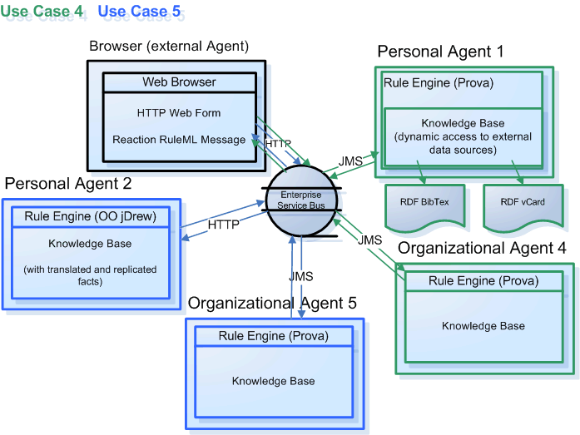
Two Simple Rule Responder Virtual Organizations on ESB Infrastructure

Slide 10
Translation Between PAs' Native Languages and OA's Interchange Language
Each rule engine can use
its own rule language
Agents require an interchange language
so they can communicate with each other
Rule Responder uses RuleML as its interchange language
Translations between the interchange language and the PA languages
are done by the PAs

Slide 11
Reaction RuleML
Reaction RuleML is a branch of the RuleML family that supports actions and events
When two agents want to communicate, each others’ Reaction RuleML messages are sent through the ESB
The ESB carries RuleML queries (requests), answers (results), and rule bases to/from agents

Slide 12
Example Reaction RuleML Message
<RuleML xmlns="http://www.ruleml.org/0.91/xsd"
xmlns:xsi="http://www.w3.org/2001/XMLSchema-instance"
xsi:schemaLocation="http://www.ruleml.org/0.91/xsd
http://ibis.in.tum.de/research/ReactionRuleML/0.2/rr.xsd"
xmlns:ruleml2007="http://ibis.in.tum.de/projects/paw#">
<Message mode="outbound" directive="query-sync">
<oid> <Ind>RuleML-2009</Ind> </oid>
<protocol> <Ind>esb</Ind> </protocol>
<sender> <Ind>User</Ind> </sender>
<content>
<Atom>
<Rel>getContact</Rel>
<Ind>ruleml2009_PanelChair</Ind>
<Ind>update</Ind>
<Var>Contact</Var>
</Atom>
</content>
</Message>
</RuleML>

Slide 13
Message Performatives
The attribute directive="..."
specifies the pragmatic performative
  Message exchange/interaction protocols
Rule Responder Performatives
  In tradition of KQML and FIPA-ACL
  Currently implemented: Query and Answer
  Retract and Update requests planned
  in collaboration with RIF-PRD

Slide 14
Agent Communication Protocols
WSDL-like communication protocols
In-Only
  Message is sent from agent₁ to agent₂;
  then agent₂ executes performative
Request-Response
  Performs above In-Only;
  then agent₂ sends response to agent₁
Request-Response-Acknowledge
  Performs Request-Response;
  then agent₁ sends an acknowledgement to agent₂
Workflows
  Generalizes the above protocols to allow other compositions of message interchange between agents

Slide 15
Communication Middleware
Mule Enterprise Service Bus (ESB)
  Mule* is used to create communication
  end points at each personal and organizational agent of Rule Responder
  Mule supports various transport protocols
  (e.g. HTTP, JMS, SOAP)
  Rule Responder currently uses HTTP and JMS as transport protocols
  * Mule – The open source SOA infrastructure: http://mulesource.com

Slide 16
Rule Engines
Prova: Prolog + Java
OO jDREW: Object Oriented
java Deductive Reasoning Engine for the Web

Slide 17
Prova
Prova is mainly used to realize the organizational agents of Rule Responder
It implements Reaction RuleML for agent interaction (event-condition-action rules)

Slide 18
OO jDREW
OO jDREW is used to realize the
personal agents of Rule Responder
It implements Hornlog RuleML for agent reasoning (Horn logic rules)
Supports rules in two formats:
  POSL: Positional Slotted presentation syntax
  RuleML: XML interchange syntax
  (can be generated from POSL:
  http://www.jdrew.org/oojdrew/demo/translator)

Slide 19
Use Case: Symposium Planner
RuleML-20xy Symposia
  An organizational agent acts as the single point of entry to assist with the symposium:
    Currently, query answering about the symposium
    Ultimately, preparing and running the symposium
  Personal agents have supported symposium chairs since 2007 (deployed as Q&A since 2008)
    General Chair, Program Chair, Panel Chair,
    Publicity Chair, etc.

Slide 20




Star-Like Rule Responder Architecture
EA: External Agent
Hub ⎯ OA: Organizational Agent
Spoke ⎯ PA: Personal Agent
General Chair
PA
Challenge Chair
PA
OA
General Chair
Expert
Challenge Chair
Expert
Publicity Chair
PA
Program Chair
PA
Program Chair
Expert
Liaison
Chair
PA
Publicity Chair
Expert
Liaison Chair
Expert
Virtual
Organization

Slide 21
Online Use Case Demo
Rule Responder:
http://responder.ruleml.org
RuleML-2007/2008/2009 Symposia:
http://ibis.in.tum.de/projects/paw/ruleml-2007
http://ibis.in.tum.de/projects/paw/ruleml-2008
http://ruleml.org/RuleML-2009/RuleResponder
Organizational agent:
Supporting Symposium as a whole
Personal agents:
Supporting all Chairs
Online

Slide 22
Query Delegation
Query delegation to personal agents is done by the organizational agent
Tasks for the symposium organization are managed via a role assignment matrix
Is defined here by an OWL Lite Ontology
(alternatives: RDFS, RuleML, ...)
Assigns (meta)topics to agents within the virtual organization: ... see next slide ...

Slide 23
Role Assignment Ontology
Topics
Agents
Sponsoring
Metatopics
.
.
.
General Chair
General Chair
Press Release
Challenge
Program Chair
Program Chair
.
.
.
Demos
Challenge Chair
Challenge Chair
.
Media Partners
.
.
.
.
.
.
.
.
.
.
.
.
.
.
.
.
.
Publicity Chair
Sponsors
Publicity Chair
Registration
.
Liaison Chair
.
Liaison Chair
.
Visa Letter
Responsible
Submissions
.
.
.
Properties:
Accountable
Presentations

Slide 24
Multiple Query Answers by PAs
Some queries have more than one answer
The PA will send the answers
one at a time to the OA
  interleaving backtracking and transmission
When the PA finds no more answers,
it sends an end-of-transmission message

Slide 25
Knowledge Shared Between Personal Agents
Rules can be shared among
personal agents
Rules that apply to all PAs can be lifted to the OA level
... see next slide ...

Slide 26
Organizational Symposium
Agent Knowledge Base
% Sample Prova rule stored in the OA:
getContact(XID,Topic,Request,Contact) :-
% Retrieve the responsible PA (Agent) for the Topic
assigned(XID,Agent,Topic,ruleml2009_responsible),
% Send the query to the PA
sendMsg(XID,esb,Agent,"query",
person(Role,Name,Title,Email,Telephone) ),
% Receive the answer(s)
rcvMult(XID,esb,Agent,"answer",Contact).
Notes:
Explain how the rules work

Slide 27
Personal General Chair Agent Knowledge Base: Fact
% Sample FOAF-like fact used by the OA rule:
% Example fact stored in the General Chair’s PA
person(
symposiumChair[ ruleML_2009, general ],
foafname[ firstName[ Adrian ], lastName[ Paschke ]],
foaftitle[ title[ Dr ]],
foafmbox[
email[ adrianDOTpaschkeATbiotecDOTtuDASHdresdenDOTde ]],
exphones[ telephoneNumbers[ office[ 4935146340074 ]]]).
% Sample query in RuleML syntax:
... see next slide ...
Notes:
Explain how the rules work

Slide 28
Sample Message to Organizational Agent
<RuleML xmlns="http://www.ruleml.org/0.91/xsd"
xmlns:xsi="http://www.w3.org/2001/XMLSchema-instance"
xsi:schemaLocation="http://www.ruleml.org/0.91/xsd
http://ibis.in.tum.de/research/ReactionRuleML/0.2/rr.xsd"
xmlns:ruleml2007="http://ibis.in.tum.de/projects/paw#">
<Message mode="outbound" directive="query-sync">
<oid>
<Ind>RuleML-2009</Ind>
</oid>
<protocol>
<Ind>esb</Ind>
</protocol>
<sender>
<Ind>User</Ind>
</sender>
<content>
<Atom>
<Rel>getContact</Rel>
<Ind>ruleml2009_GeneralChair</Ind>
<Ind>update</Ind>
<Var>Contact</Var>
</Atom>
</content>
</Message>
</RuleML>
Online
http://ruleml.org/RuleML-2009/RuleResponder/
Query Selection: General Chair Contact
Notes:
Explain what the message means OID, protocol, sender

Slide 29
Architecture - Execution

Slide 30
Architecture - Execution

Slide 31
Architecture - Execution

Slide 32
Architecture - Execution

Slide 33
Architecture - Execution

Slide 34
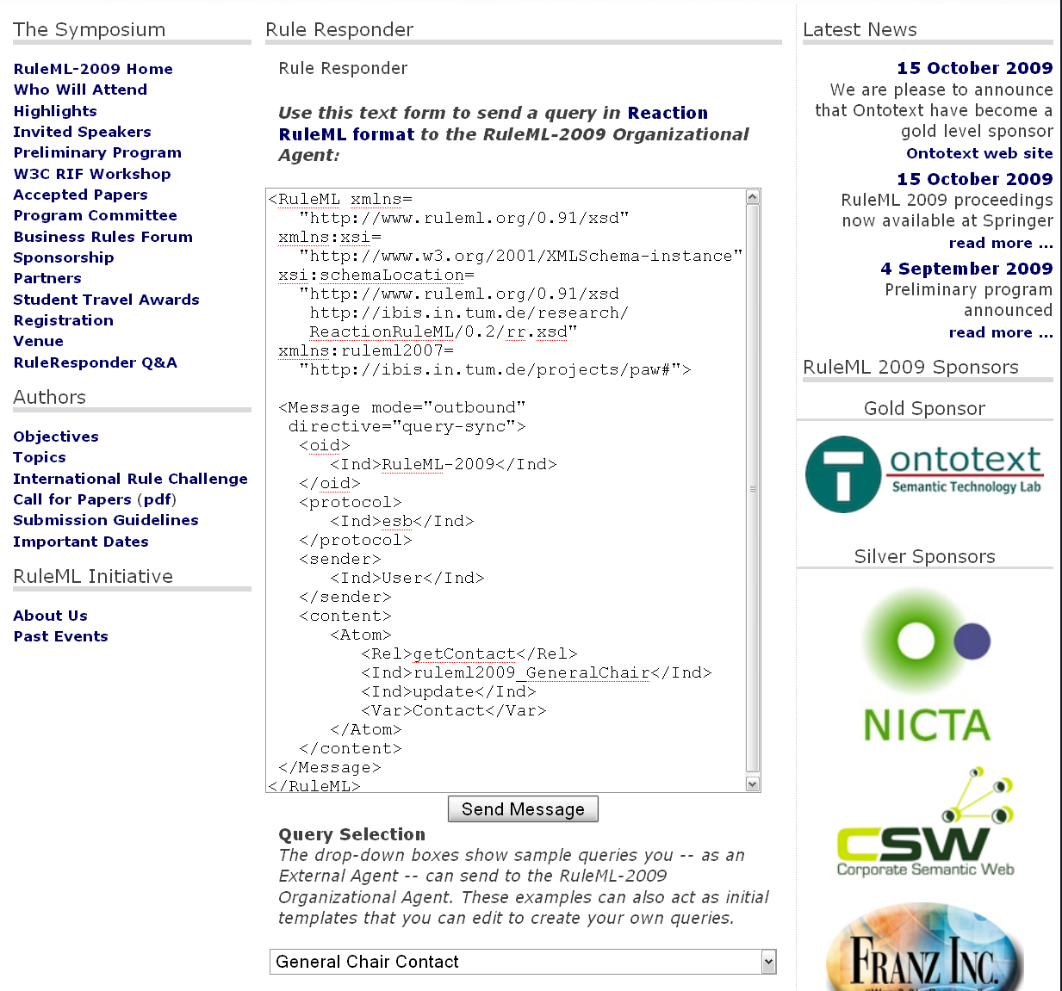

Slide 35
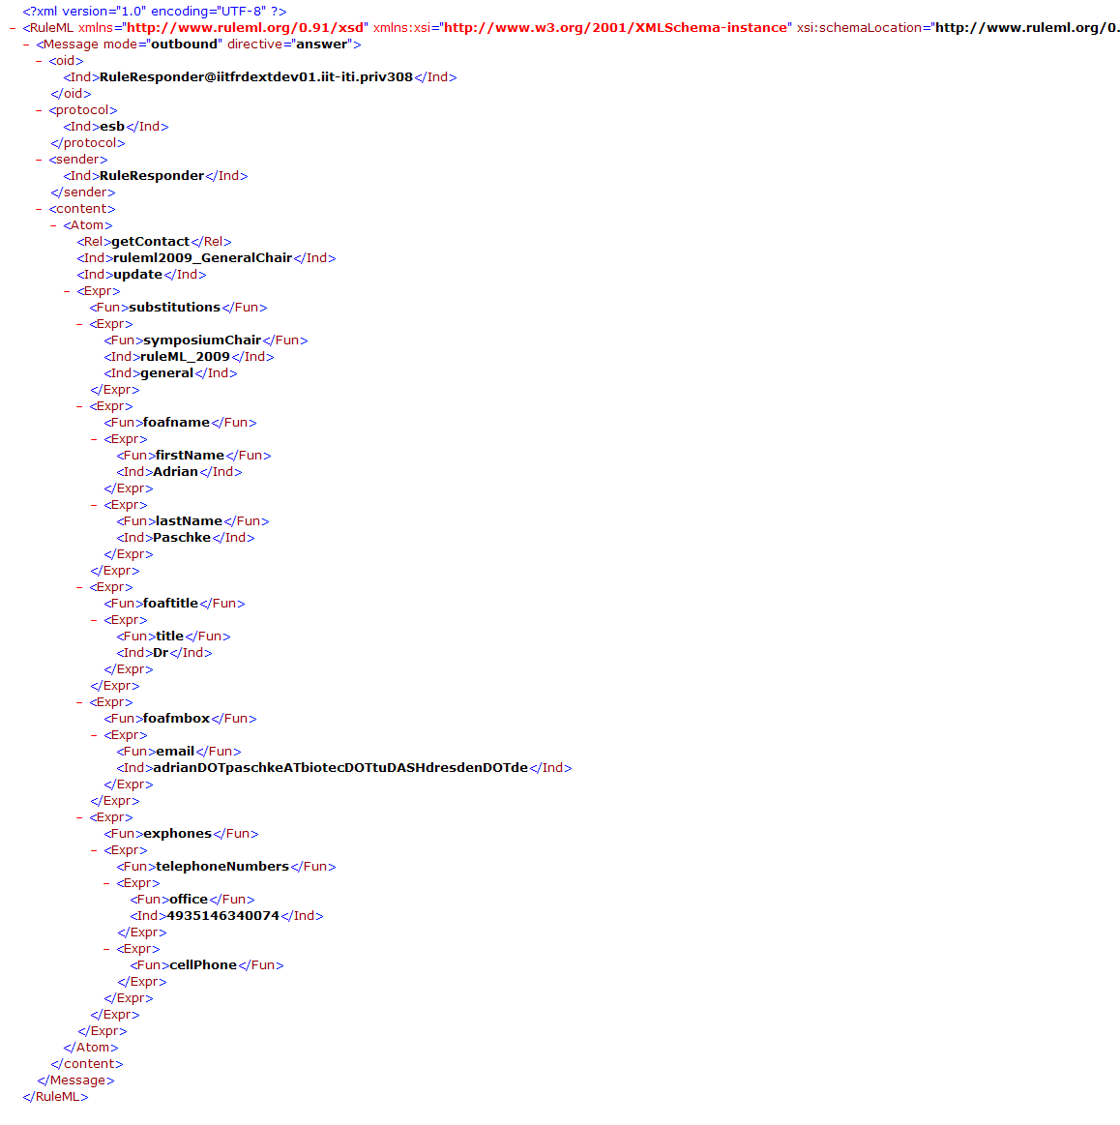
Notes:
Response

Slide 36
Sample Message to Publicity Chair Agent (I)
<content>
<Atom>
<Rel>sponsor</Rel>
<Expr>
<Fun>contact</Fun>
<Ind>Mark</Ind>
<Ind>JBoss</Ind>
</Expr>
<Ind type="integer">500</Ind>
<Expr>
<Fun>results</Fun>
<Var>Level</Var>
<Var>Benefits</Var>
<Var>DeadlineResults</Var>
</Expr>
<Expr>
<Fun>performative</Fun>
<Var>Action</Var>
</Expr>
</Atom>
</content>
Online
http://www.ruleml.org/RuleML-2009/RuleResponder
Query Selection: Publicity Chair Sponsoring
English Description:
Mark from JBoss would like to sponsor RuleML-2009 with $500. What level, benefits, and deadline results will this provide, and what kind of action should be taken?
Notes:
Query

Slide 37
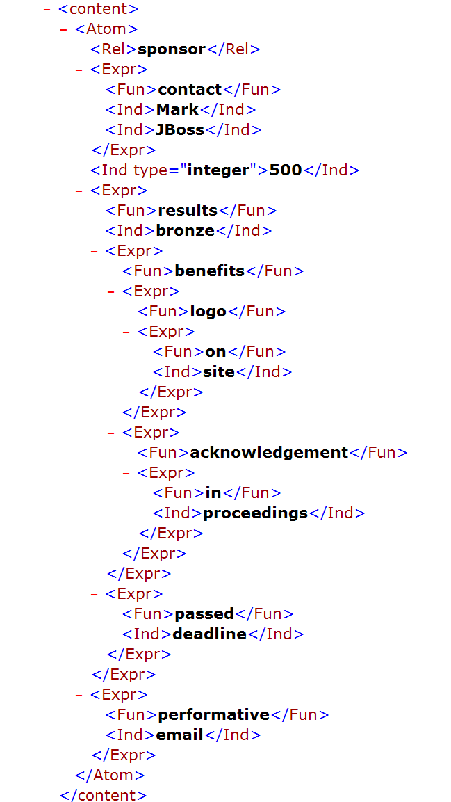
Notes:
Reponse

Slide 38
Personal Publicity Chair Agent Knowledge Base: Rule
% Rule stored in the Publicity Chair’s PA
sponsor(contact[?Name,?Organization],
?Amount:integer,
results[?Level,?Benefits,?DeadlineResults] ,
performative[?Action]) :-
requestSponsoringLevel(?Amount:integer,?Level),
requestBenefits(?Level,?Benefits),
checkDeadline(?DeadlineResults),
checkAction(?Action,?Level,?Amount:integer).
Orange:
Query other rules
Notes:
Explain how the rules work

Slide 39
Personal Publicity Chair Agent Knowledge Base: 1st & 2nd Rule Premise
requestSponsoringLevel(?Amount:integer,?Level),
% Satisfied by rule:
requestSponsoringLevel(?Amount:integer,?Level) :-
sponsoringLevel(rank0,
?Level,
under[us$[?UnderBronzeAmount:integer]]),
lessThan(?Amount:integer,?UnderBronzeAmount:integer).
requestBenefits(?Level,?Benefits),
% Satisfied by rule:
requestBenefits(?Level,?Benefits) :-
benefits(?Level,?Benefits).
Light Red:
Query facts
Notes:
Explain how the rules work

Slide 40
Personal Publicity Chair Agent Knowledge Base: 3rd & 4th Rule Premise
checkDeadline(?DeadlineResults),
% Satisfied by rule:
checkDeadline(passed[deadline]):-
date(?X:integer),
deadline(sponsoring,?D:integer),
greaterThan(?X:integer,?D:integer).
checkAction(?Action,?Level,?Amount:integer).
% Satisfied by rule:
checkAction(?Action,?Level,?Amount:integer) :- actionPerformed(?Action,?Level,?Amount:integer).
What happens if we now provide a $5000 sponsorship?
... see next slide ...
Yellow:
Query further rule
Notes:
Explain how the rules work

Slide 41
Sample Message to Publicity Chair Agent (II)
<content>
<Atom>
<Rel>sponsor</Rel>
<Expr>
<Fun>contact</Fun>
<Ind>Mary</Ind>
<Ind>Super</Ind>
</Expr>
<Ind type="integer">5000</Ind>
<Expr>
<Fun>results</Fun>
<Var>Level</Var>
<Var>Benefits</Var>
<Var>DeadlineResults</Var>
</Expr>
<Expr>
<Fun>performative</Fun>
<Var>Action</Var>
</Expr>
</Atom>
</content>
Online
http://www.ruleml.org/RuleML-2009/RuleResponder
Query Selection: Publicity Chair Sponsoring (edit)
English Description:
Mark from JBoss would like to sponsor RuleML-2009 with $5000. What level, benefits, and deadline results will this provide, and what kind of action should be taken?
Notes:
Query

Slide 42
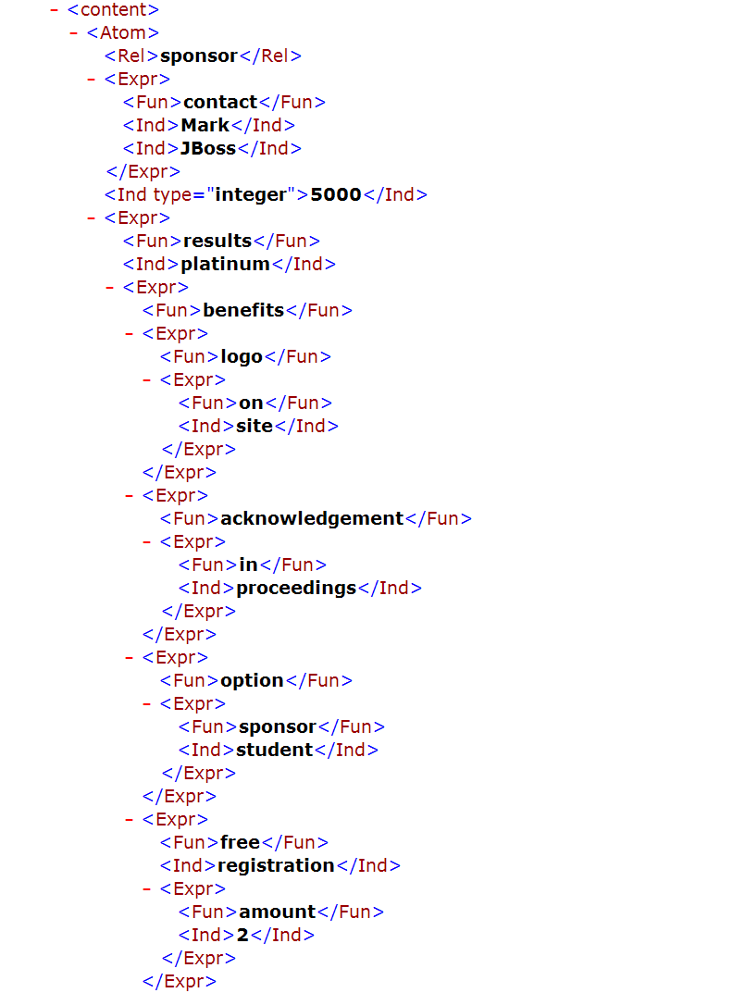
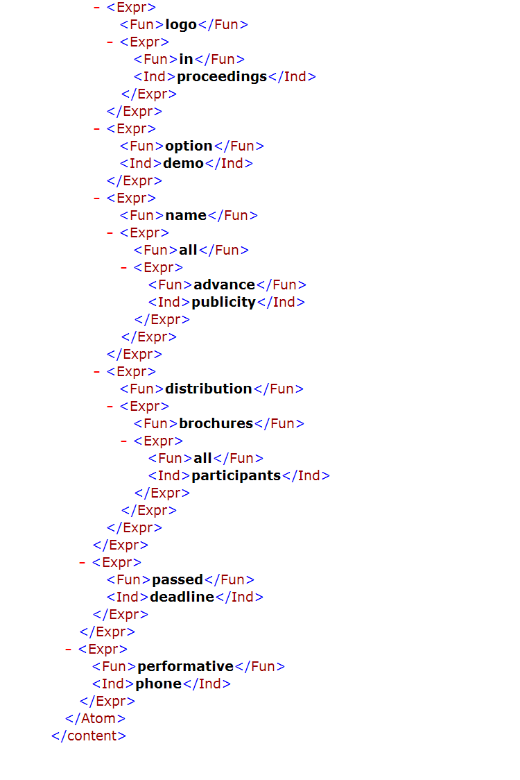

Slide 43
Conclusion (I)
Rule Responder was implemented & tested for various use cases (http://responder.ruleml.org) and deployed for RuleML-2008/2009 Q&A
Its organizational agents delegate external queries to topic-assigned personal agents
It couples rule engines OO jDREW & Prova (& Euler) via Mule middleware and
RuleML 0.91 XML interchange format

Slide 44
Conclusion (II)
Without a Reaction Rule Dialect, RIF could not be used for behavioral Responder logic
Current system is reusable on all levels:
Symposium Planner, Rule Responder, POSL, RuleML, OO jDREW, Prova, Mule
RuleML Techn. Group with Adrian Paschke, Alexander Kozlenkov and Nick Bassiliades
Integrated another ‘partner engine’, Euler, for recent use cases, e.g. in WellnessRules

Slide 45
Future Work (I)
Communication between
Personal Agent and Expert Owner
  The PA may need to interact with its expert owner
  The intended formal interaction between PAs and their owners could use email (SMTP)
  The initial interaction language for these emails could be Reaction RuleML
Query Decomposition
  Each subquery of a rule can be decomposed for
  different PAs, followed by answer integration

Slide 46
Future Work (II)
Centralized, Distributed-Hierarchical (here), and Distributed-Networked (future) Query Answering
Centralized: Avoids Communication Overhead
Distributed: Fault Tolerance
  Alternative agents when an agent becomes defunct
  Hierarchical: OA still a bottleneck
From Centralized to Distributed
Knowledge Maintenance
  Easier to keep Distributed Rules up-to-date
Technical Report: http://ruleml.org/papers/EvalArchiRule.pdf

