Slide 1

RuleML Query Answering with Personal OO jDREW Agents in Rule Responder
Benjamin Craig
Harold Boley
Fredericton, NB
National Research Council - IIT
May 15, 2008

Slide 2
Outline
Rule Responder Overview
Agents
  Personal / Organizational / External
Rule Engines (for Realizing Agents)
  Prova
  OO jDREW
Communication Middleware (for Connecting Agents)
  Mule ESB
  Reaction RuleML Messages
Symposium Planner Use Case
  Online Demo
Conclusion

Slide 3
Overview of Rule Responder (I)
Rule Responder is an experimental
multi-agent system for collaborative teams and virtual communities on the Web
Supports rule-based collaboration between the distributed members of such a virtual organization
Members of the virtual organization are assisted by semi-automated rule-based agents, which use rules to describe the behavioral and decision logic
Notes:
Why rules are important -> to implement the decision logic

Slide 4
Overview of Rule Responder (II)
Uses languages and engines of the RuleML family for rule serialization, based on logic and XML:
  Hornlog RuleML: Reasoning
  Reaction RuleML: Interaction
Implemented on top of a Mule-based
Service Oriented Architecture (SOA)
Notes:
Why rules are important -> to implement the decision logic

Slide 5
Personal Agents
A personal agent assists a single person
of an organization, (semi-autonomously) acting on his/her behalf
It contains a FOAF*-like fact profile plus FOAF-extending rules to encode some of the knowledge of its human owner
* The Friend of a Friend (FOAF) project: http://www.foaf-project.org

Slide 6
Organizational Agents
An organizational agent represents goals and strategies shared by each member of the organization
It contains rule sets that describe the policies, regulations, opportunities, etc. of its organization

Slide 7
External Agents
External agents communicate with the public interface of organizational agents, exchanging messages that transport queries, answers, or complete rule sets
End users, as external agents, employ a Web (HTTP) interface of Rule Responder (currently an API-like browser interface)
Support for multiple external agents (end users) at the same time

Slide 8
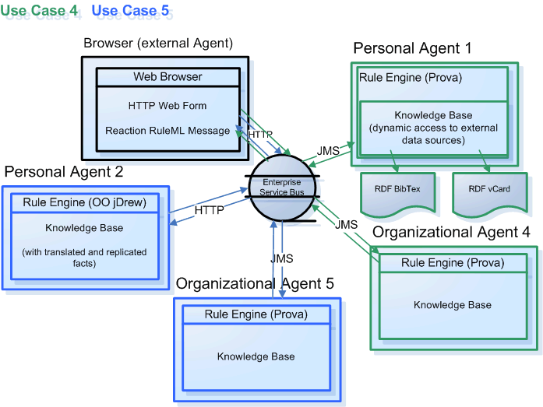
Architecture - Overview

Slide 9
Rule Engines
Prova (Prolog + Java)
OO jDREW (Object Oriented Java Deductive Reasoning Engine for the Web)

Slide 10
Prova
Prova is mainly used to realize the organizational agents of Rule Responder
It implements Reaction RuleML for agent interaction (event-condition-action rules)

Slide 11
OO jDREW
OO jDREW is used to realize the
personal agents of Rule Responder
It implements Hornlog RuleML for agent reasoning (Horn logic rules)
Supports rules in two formats:
  POSL: Positional Slotted presentation syntax
  RuleML: XML interchange syntax
  (can be generated from POSL)

Slide 12
Communication Middleware
Mule Enterprise Service Bus (ESB)
  Mule* is used to create communication end points at each personal and organizational agent of Rule Responder
  Mule supports various transport protocols
  (e.g. HTTP, JMS, SOAP)
  Rule Responder currently uses HTTP and JMS as transport protocols
  * Mule – The open source SOA infrastructure: http://mulesource.com

Slide 13
Reaction RuleML
Reaction RuleML is a branch of the RuleML family that supports actions and events
When two agents need to communicate, each others’ Reaction RuleML messages are sent through the ESB

Slide 14
Use Case: Symposium Planner
RuleML-20xy Symposium
  An organizational agent acts as the single point of entry to the symposium
    Assists with planning, preparing, and running the symposium
  Personal agents support chairs of the symposium
    Program Chair, Panel Chair, Publicity Chair, General Chair, etc.

Slide 15
Online Use Case Demo
Rule Responder:
http://responder.ruleml.org
RuleML-2007/RuleML-2008 Symposia:
http://ibis.in.tum.de/projects/paw/ruleml-2007
http://ibis.in.tum.de/projects/paw/ruleml-2008
Personal agents:
Supporting Panel and Publicity Chairs
Organizational agent:
Supporting Symposium as a whole
Online

Slide 16
Personal Panel Chair Agent Knowledge Base
% Sample FOAF-extending rule in POSL syntax:
person(?person, ?role, ?title, ?email, ?telephone) :-
mailphone(?person, ?email, ?telephone),
role(?person, ?role),
title(?person, ?title).
% Sample FOAF-like facts used by the above rule:
mailphone(John, john@email.com, 1-555-555-5555).
role(John, Panel Chair).
title(John, PHD).
Notes:
Explain how the rules work

Slide 17
Organizational Symposium Agent Knowledge Base (Abridged)
% Sample Prova-like rule in POSL syntax:
getContact(?conference_part, ?info, ?contact) :-
person(
?contact, ?role, ?title, ?email, ?telephone).
Notes:
Explain how the rules work

Slide 18
Sample Message to Organizational Agent
<RuleML xmlns="http://www.ruleml.org/0.91/xsd"
xmlns:xsi="http://www.w3.org/2001/XMLSchema-instance"
xsi:schemaLocation="http://www.ruleml.org/0.91/xsd
http://ibis.in.tum.de/research/ReactionRuleML/0.2/rr.xsd"
xmlns:ruleml2007="http://ibis.in.tum.de/projects/paw#">
<Message mode="outbound" directive="query-sync">
<oid><Ind>RuleML-2007</Ind></oid>
<protocol><Ind>esb</Ind></protocol>
<sender><Ind>user</Ind></sender>
<content>
<Atom>
<Rel>getContact</Rel>
<Ind>ruleml2007_Challenge</Ind>
<Ind>update</Ind>
<Var>Contact</Var>
</Atom>
</content>
</Message>
</RuleML>
Online
Notes:
Explain what the message means OID, protocol, sender

Slide 19
Architecture - Execution

Slide 20
Architecture - Execution

Slide 21
Architecture - Execution

Slide 22
Architecture - Execution

Slide 23
Architecture - Execution

Slide 24
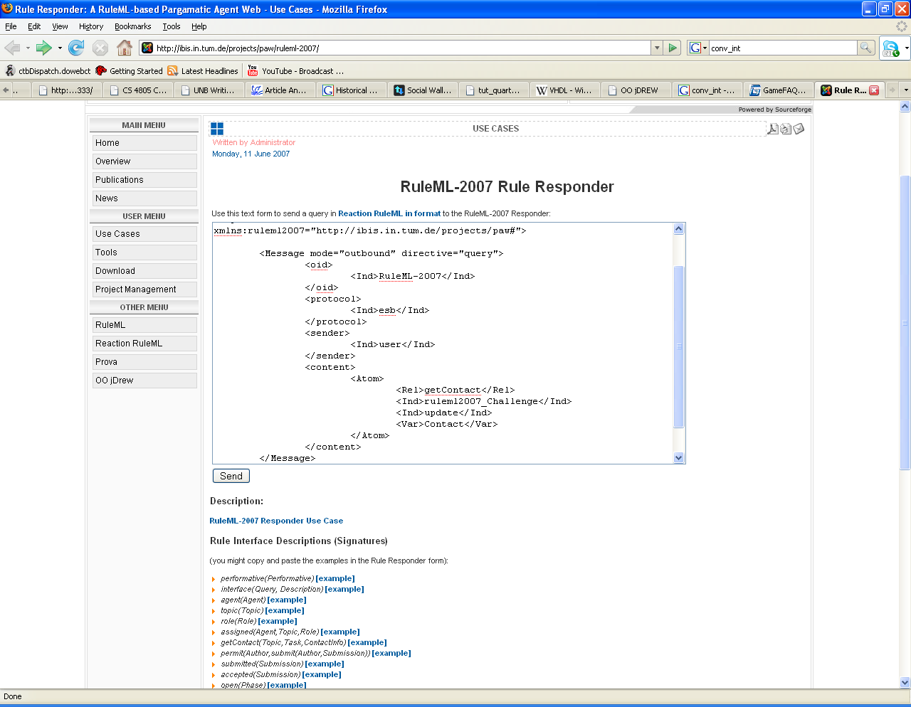
Notes:
Query

Slide 25
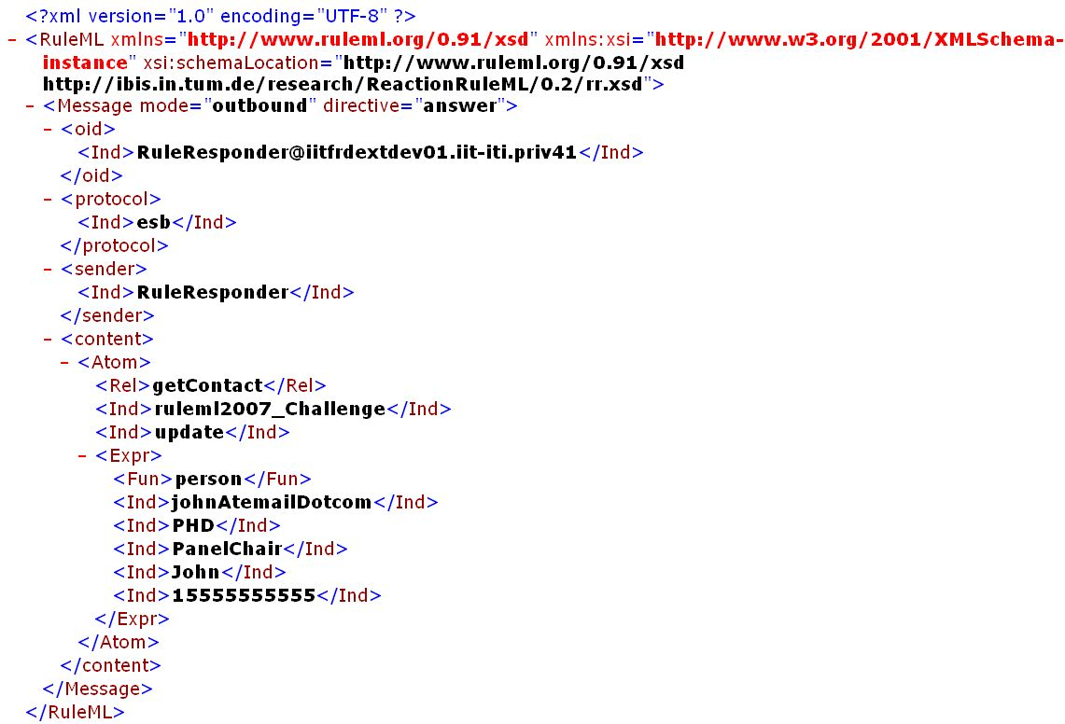
Notes:
Response

Slide 26
Sample Message to Publicity Chair Agent (I)
<content>
<Atom>
<Rel>sponsor</Rel>
<Expr>
<Fun>contact</Fun>
<Ind>Mark</Ind>
<Ind>JBoss</Ind>
</Expr>
<Ind type="integer">500</Ind>
<Expr>
<Fun>results</Fun>
<Var>Level</Var>
<Var>Benefits</Var>
<Var>DeadlineResults</Var>
</Expr>
<Expr>
<Fun>performative</Fun>
<Var>Action</Var>
</Expr>
</Atom>
</content>
Online
Notes:
Query

Slide 27
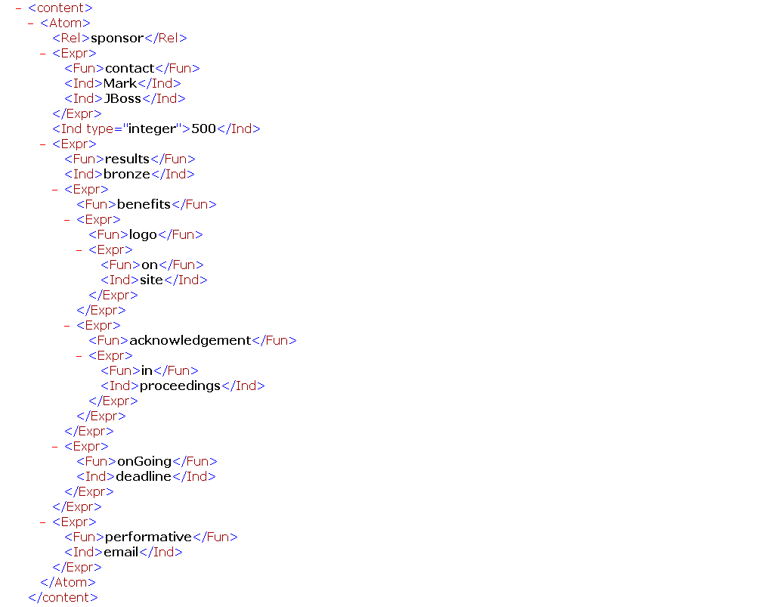
Notes:
Reponse

Slide 28
Sample Message to Publicity Chair Agent (II)
<content>
<Atom>
<Rel>sponsor</Rel>
<Expr>
<Fun>contact</Fun>
<Ind>Mark</Ind>
<Ind>JBoss</Ind>
</Expr>
<Ind type="integer">5000</Ind>
<Expr>
<Fun>results</Fun>
<Var>Level</Var>
<Var>Benefits</Var>
<Var>DeadlineResults</Var>
</Expr>
<Expr>
<Fun>performative</Fun>
<Var>Action</Var>
</Expr>
</Atom>
</content>
Online
Notes:
Query

Slide 29
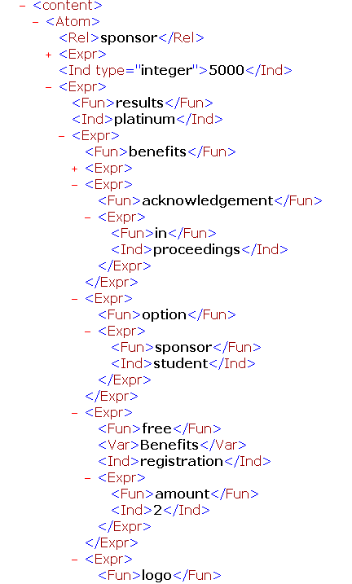
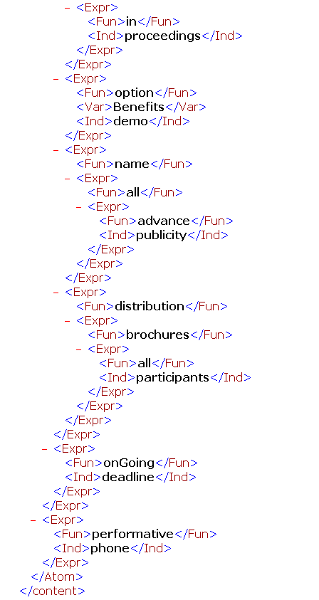

Slide 30
Conclusion
Rule Responder can be used to implement a wide range of use cases that require a semi-automated decision layer
The Mule middleware of Rule Responder allows platform-independent deployment of multiple running use cases simultaneously
The system is reusable on all levels:
Symposium Planner, Rule Responder, POSL, RuleML, OO jDREW, Prova, Mule

