Slide 1

The OO jDREW Engine of Rule Responder: Naf Hornlog RuleML Query Answering Presentation
Benjamin Craig
Orlando Florida
RuleML 2007
Thursday, October 25, 2007

Slide 2
Outline
Overview
Agents
  Personal
  Organizational
  External
Rule Engines
  Prova
  OO jDREW
Communication Middleware
  Mule ESB
  Reaction RuleML messages
Demo
  Use Cases

Slide 3
Overview of Rule Responder
Rule Responder is an intelligent multi-agent system for collaborative teams and virtual communities
Supports rule-based collaboration between the different members of a virtual organization
Members of a virtual registration are represented as semi-automated rule-based agents which use rules to describe the behavioral and decision logic
Uses RuleML subset as its Rule Markup Language, based on logic and XML
  The member of the RuleML family employed here is Naf Hornlog
Implemented as a Web-based service architecture
Notes:
Why rules are important -> to implement the decision logic

Slide 4
Personal Agents
A personal agent acts on behalf of a single person of an organization
The personal agent contains a FOAF* profile with FOAF-extended rules
*The Friend of a Friend (FOAF) project: http://www.foaf-project.org

Slide 5
Organizational Agents
Organizational agents are used to represent goals and strategies shared
by each person in the collaborative team
Organizational agents contain rule sets that describe their organizations’ policies, regulations, opportunities, etc.

Slide 6
External Agents
External agents communicate with the virtual organization, exchanging messages that transport queries, answers, or complete rule sets via the public interface of the organizational agents
HTTP interface to Rule Responder
Support for multiple External Agents (end users) at a single time
Users can use a web browser to communicate with Rule Responder (currently a API interface)

Slide 7
Rule Engines
Prova (Prolog + Java)
OO jDREW (Object Oriented Java Deductive Reasoning Engine for the Web)

Slide 8
Prova
Prova is used to implement the organizational agents of Rule Responder
Prova is also used for some personal agents

Slide 9
OO jDREW
OO jDREW is used for personal agents in
Rule Responder
Two modes of Rule Execution:
  Bottom-up (forward reasoning)
  Top-down (backward reasoning)
Rule Responder primarily uses top-down
Supports rules in the following formats:
  POSL (Positional Slotted presentation syntax)
  RuleML (XML syntax, can be generated from POSL)

Slide 10
Communication Middleware
Mule Enterprise Service Bus (ESB)
  Mule is used to create communication end points at each personal and organizational agent of Rule Responder
  Mule supports various transport protocols
  (i.e. http, jms, soap)
  Rule Responder uses http and jms as transport protocols

Slide 11
Reaction RuleML
Reaction RuleML is a branch of the RuleML family that supports actions and events
When two agents need to communicate, each others’ Reaction RuleML messages are sent through the ESB

Slide 12
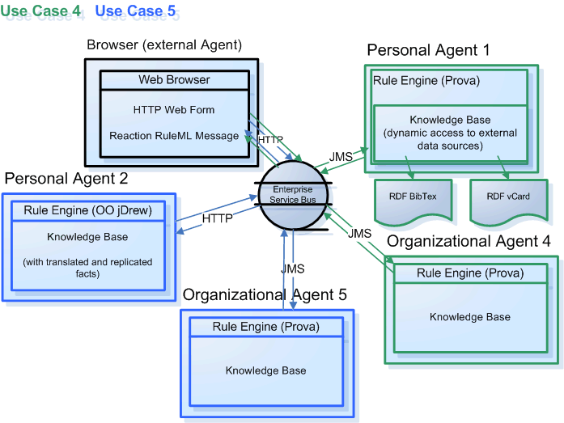
Architecture - Overview

Slide 13
Use Case
RuleML-2007 Symposium
  One Organizational Agent that acts as the single point of entry to the conference
    Assists with planning, preparing, and running the Symposium
  Personal Agents represent Chairs of the Symposium
    Program Chair, Publicity Chair, etc

Slide 14
Online Demo
http://responder.ruleml.org/
Use Case Demo Link:
http://ibis.in.tum.de/projects/paw/ruleml-2007/

Slide 15
Ex. Personal Agent’s knowledge base
% Sample rule POSL syntax
person(?person,?role, ?title, ?email, ?telephone):-
contact(?person,?email,?telephone),
role(?person,?role),
title(?person,?title).
% Sample facts that match the previous rule
contact(John, john@email.com, 1-555-555-5555).
role(John,Panel Chair).
title(John, Doctor).
Notes:
Explain how the rules work

Slide 16
Example Message to the Organizational Agent
<RuleML xmlns="http://www.ruleml.org/0.91/xsd"
xmlns:xsi="http://www.w3.org/2001/XMLSchema-instance"
xsi:schemaLocation="http://www.ruleml.org/0.91/xsd
http://ibis.in.tum.de/research/ReactionRuleML/0.2/rr.xsd"
xmlns:ruleml2007="http://ibis.in.tum.de/projects/paw#">
<Message mode="outbound" directive="query">
<oid>
<Ind>RuleML-2007</Ind>
</oid>
<protocol>
<Ind>esb</Ind>
</protocol>
<sender>
<Ind>user</Ind>
</sender>
<content>
<Atom>
<Rel>getContact</Rel>
<Ind>ruleml2007_Challenge</Ind>
<Ind>update</Ind>
<Var>Contact</Var>
</Atom>
</content>
</Message>
</RuleML>
Notes:
Explain what the message means OID, protocol, sender

Slide 17
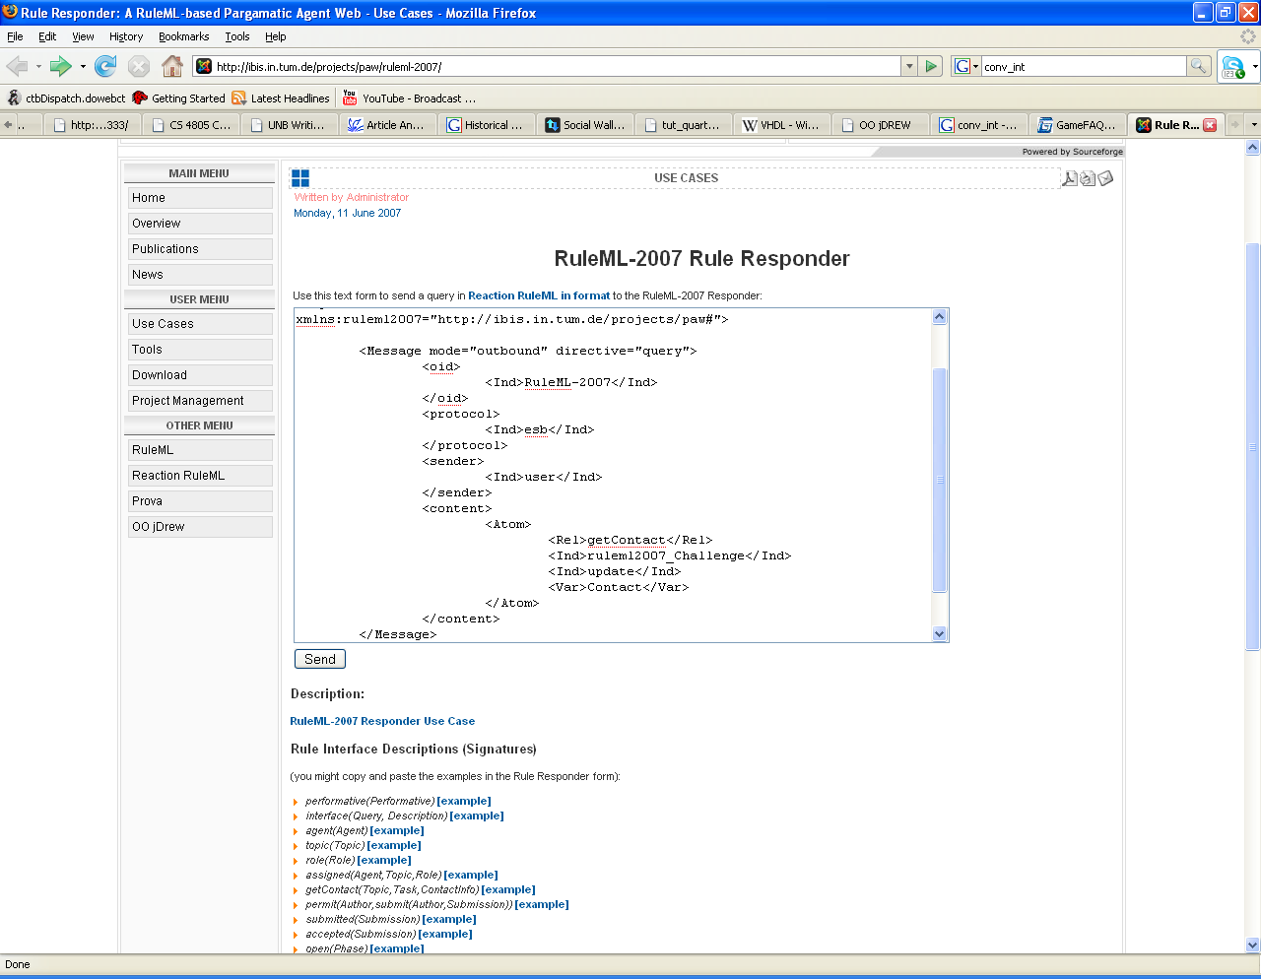
Notes:
Query

Slide 18
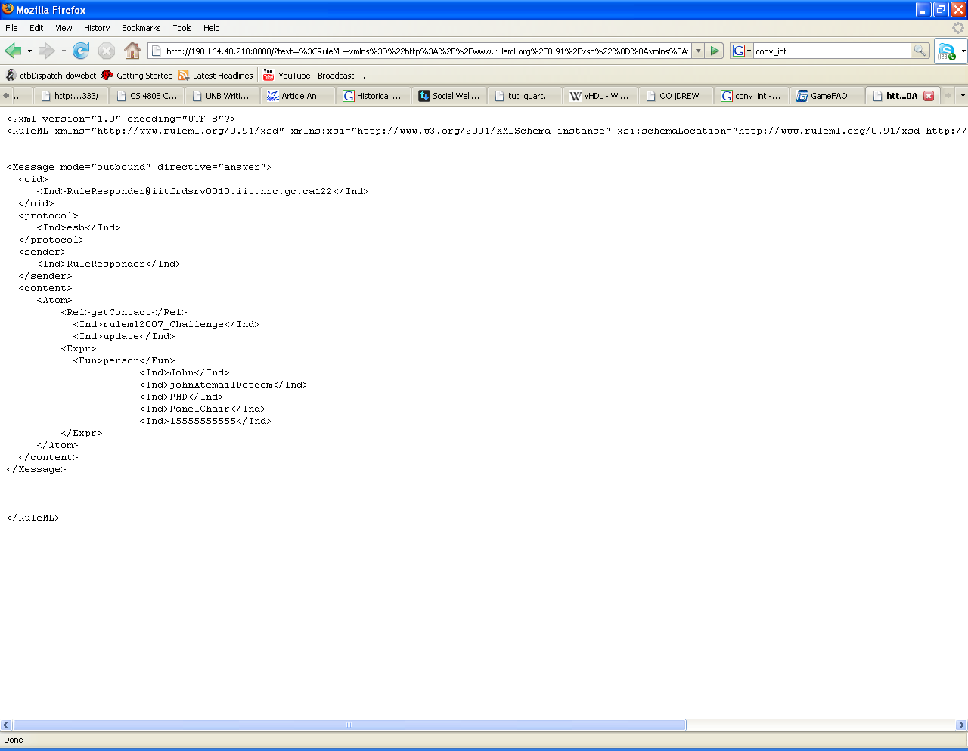
Notes:
Response

Slide 19
Example Message 2
<content>
<Atom>
<Rel>sponsor</Rel>
<Expr>
<Fun>contact</Fun>
<Ind>ben</Ind>
<Ind>nrc</Ind>
</Expr>
<Ind type="integer">500</Ind>
<Expr>
<Fun>results</Fun>
<Var>Level</Var>
<Var>Benefits</Var>
<Var>DeadlineResults</Var>
</Expr>
<Expr>
<Fun>performative</Fun>
<Var>Action</Var>
</Expr>
</Atom>
</content>
Notes:
Query

Slide 20
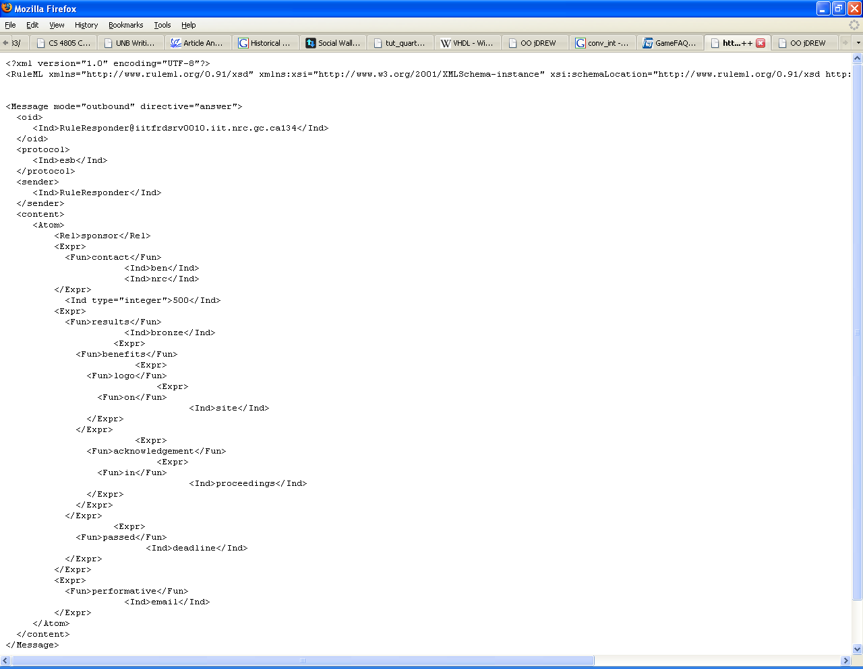
Notes:
Reponse

Slide 21
Example Message 3
<content>
<Atom>
<Rel>sponsor</Rel>
<Expr>
<Fun>contact</Fun>
<Ind>ben</Ind>
<Ind>nrc</Ind>
</Expr>
<Ind type="integer">5000</Ind>
<Expr>
<Fun>results</Fun>
<Var>Level</Var>
<Var>Benefits</Var>
<Var>DeadlineResults</Var>
</Expr>
<Expr>
<Fun>performative</Fun>
<Var>Action</Var>
</Expr>
</Atom>
</content>
Notes:
Query

Slide 22
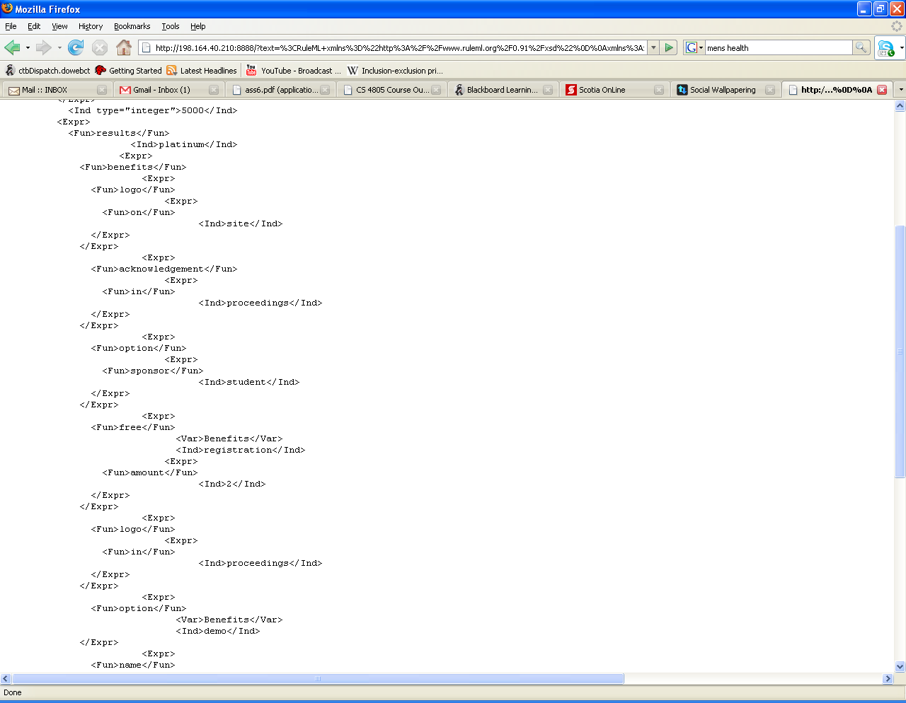

Slide 23
Conclusion
Rule Responder can be used to implement a wide range of use cases that require an intelligent, semi-automated decision layer
The middleware of Rule Responder allows deployment of multiple running use cases concurrently

