Slide 1
The V8 Engine optimization tips - make the most from your JavaScript
Oleksandr Olashyn

Slide 2







Introduction
Oleksandr Olashyn
CRM Architect, 3SHAPE
https://www.dancingwithcrm.com/
https://www.linkedin.com/in/dancingwithcrm/
https://twitter.com/dancingwithcrm
https://github.com/OOlashyn

Slide 3
Agenda
JavaScript Engines
Optimization technics
V8 JS Engine
QnA

Slide 4

JavaScript Engines

Slide 5









How JS Engine works
Your JS code
Parsing
Abstract syntax tree
optimize
Optimizing compiler
profiling data
Interpreter
deoptimize
Optimized code
Bytecode

Slide 6



JavaScript Engines
Spider Monkey (Firefox)
V8 (Chrome, Edge, Node.js)
JavaScriptCore (Safari)

Slide 7

V8 JavaScript Engine
Open source
ECMAScript compliant
Multithreaded
Written in C++

Slide 8



V8 high level overview
Ignition
Interpreter
Orinoco
Garbage collector
TurboFan
Optimizing compiler

Slide 9
Hidden classes

Slide 10
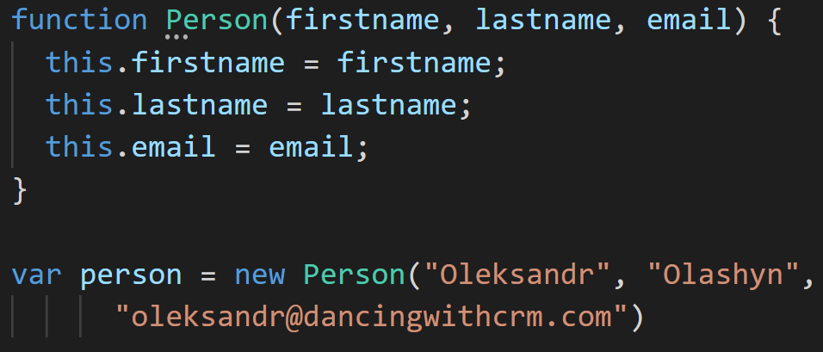
Hidden Classes

Slide 11

Hidden Classes
Class Person
Initial hidden class
C0
Class pointer

Slide 12
Hidden Classes
Hidden class
C1
Class pointer
For “firstname”, see offset 0
Initial hidden class
C0
If property “firstname” added transition to C1

Slide 13
Hidden Classes
Hidden class
C2
For “firstname”, see offset 0
For “lastname”, see offset 1
Class pointer
Initial hidden class
C0
Hidden class
C1
If property “firstname” added transition to C1
For “firstname”, see offset 0
If property “lastname” added transition to C2

Slide 14
Hidden Classes
Hidden class
C3
For “firstname”, see offset 0
For “lastname”, see offset 1,
For “email”,
See offset 2
Class pointer
Initial hidden class
C0
Hidden class
C1
Hidden class
C2
If property “firstname” added transition to C1
For “firstname”, see offset 0
If property “lastname” added transition to C2
For “firstname”, see offset 0
For “lastname”, see offset 1
If property “email” added transition to C3

Slide 15
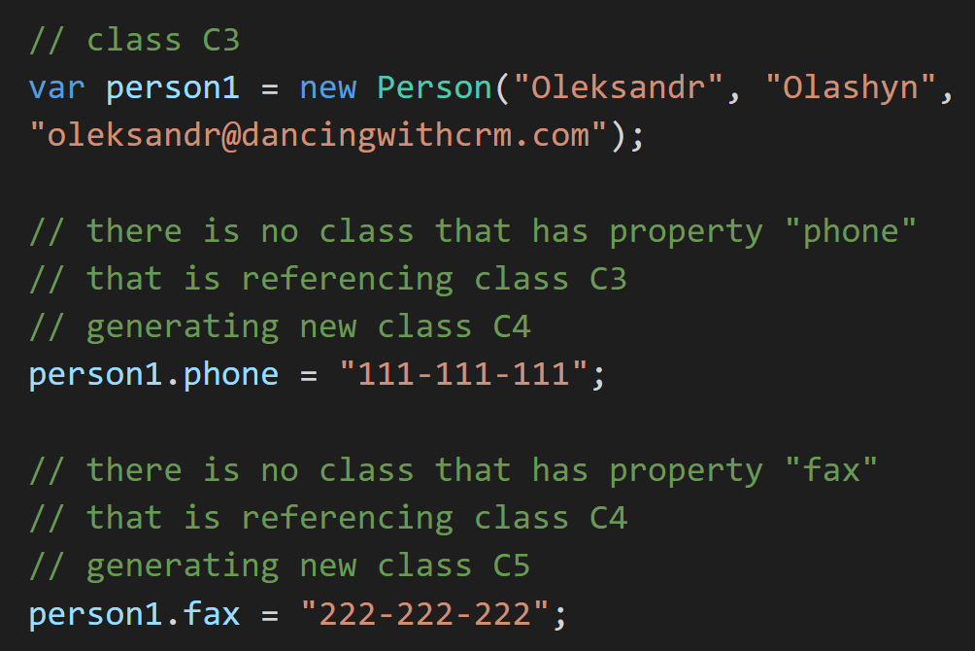
Hidden Classes
Notes:
Let’s see if the order of adding properties matters.

Slide 16
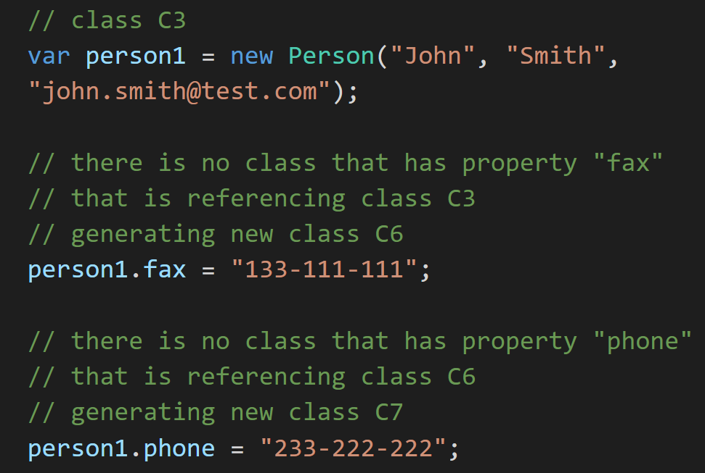
Hidden Classes

Slide 17
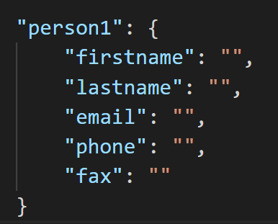
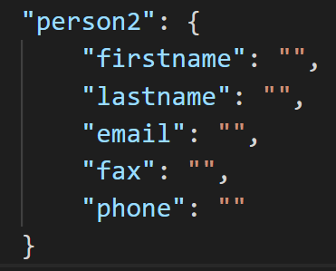
Hidden Classes
Class C5
Class C7
Notes:
As a result 2 objects with the same properties but completely different hidden classes.

Slide 18
Hidden Classes
Iteration num | Execution time (mks)
 | Static | Mixed | Dynamic
1 | 70,234 | 74,678 | 78,174
50 | 6,187 | 10,231 | 41,678
100 | 5,671 | 9,714 | 42,518

Slide 19
Hidden Classes
Iteration num | Execution time (ms)
 | Static | Mixed | Dynamic
100 | 0,73 | 1,31 | 4,78
1000 | 6,21 | 12,01 | 39,14
3000 | 16,23 | 32,78 | 152,41
10000 | 38,04 | 101,67 | 428,18

Slide 20
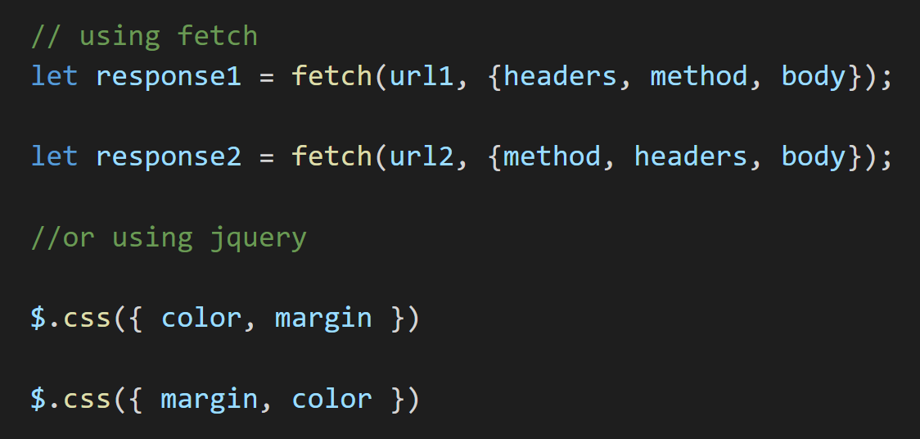
Hidden Classes
Notes:
Examples of where you can unintentionally use different object thus creating different hidden classes.

Slide 21
Inlining

Slide 22
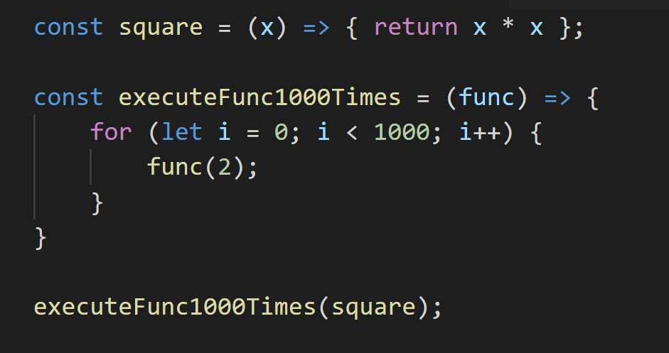
Inlining

Slide 23
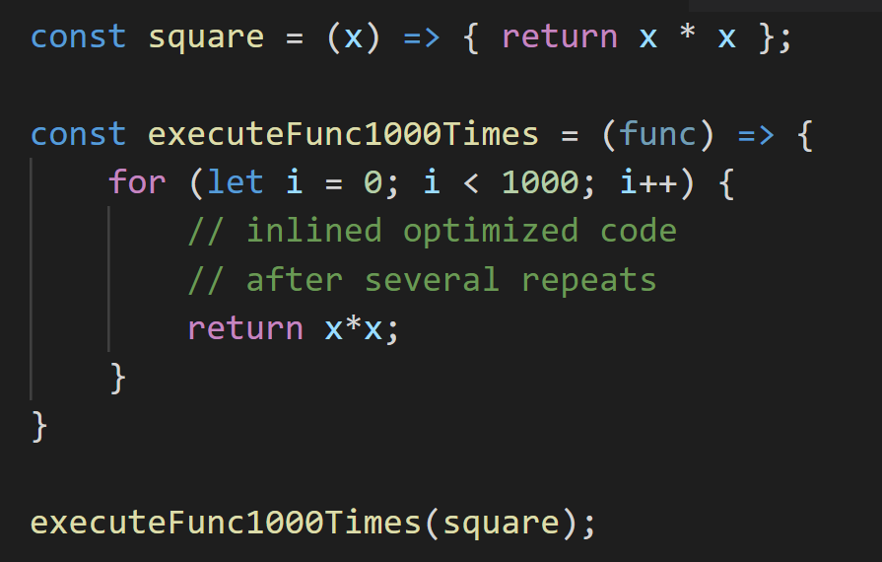
Inlining

Slide 24
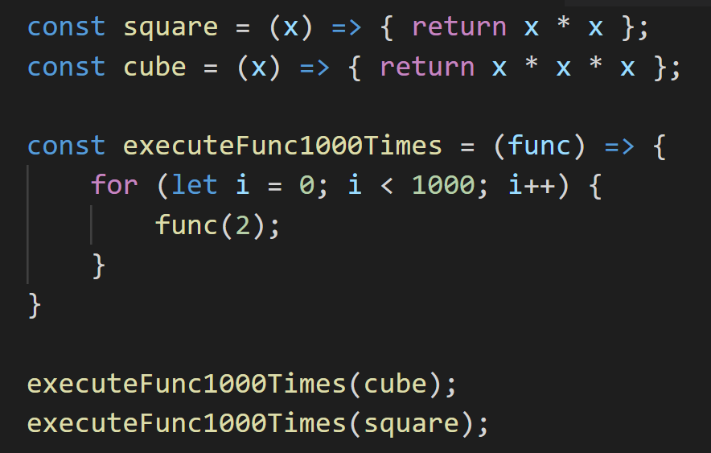
Inlining

Slide 25
Inline caching

Slide 26
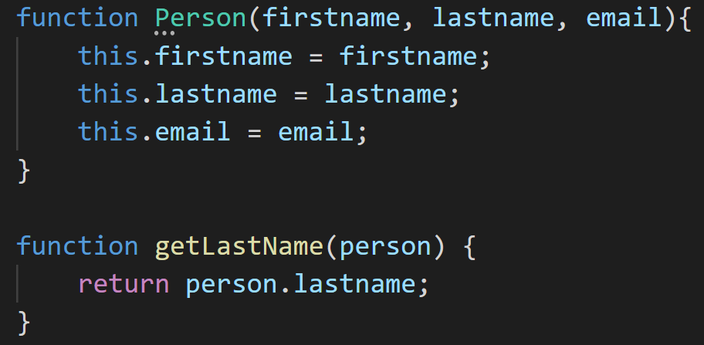
Inline caching

Slide 27

Inline caching
Hidden class
C3
function getLastName(person) {
return person.lastname;
}
For “firstname”, see offset 0
For “lastname”, see offset 1,
For “email”,
See offset 2
For “lastname”, see offset 1,
Notes:
After several executions optimizing compiler will assume that in this function you will always pass the same type of parameter and will cache it so it can obtain needed properties much faster. If complier guess it correctly you will gain a big boost in speed. So try to not create functions that might receive multiple different type of arguments.

Slide 28
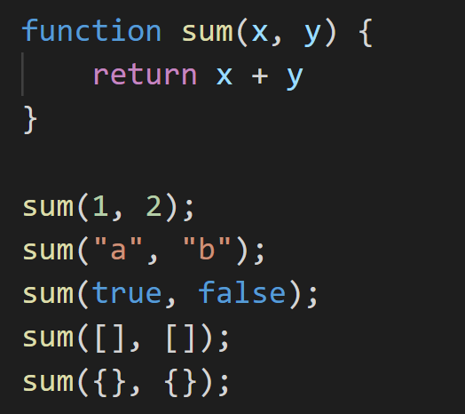
Inline caching
Notes:
Classical example that you might find on the internet is sum or add function. Let’s say we have simple function that has two arguments and return their addition. Function that receives only one type of parameters is called monomorphic. Function that receives couple of different type of parameters is called polymorphic. Function that receives completely different type of parameters is called megamorphic. It is always better to have mono or at least polymorphic function to get benefits of compiler optimization. When we run function for the first type compiler will assume that is monomorphic function. After the second run (because we passed strings instead of number) it will assume that is polymorphic. After the third run with Boolean parameters compiler will not make any assumptions. After the fourth run with arrays as parameter compiler will see that this function is megamorphic and will not optimize it.

Slide 29
For .. in loop

Slide 30
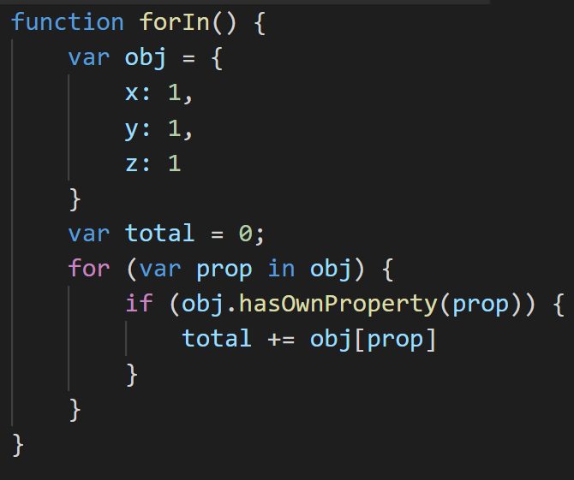
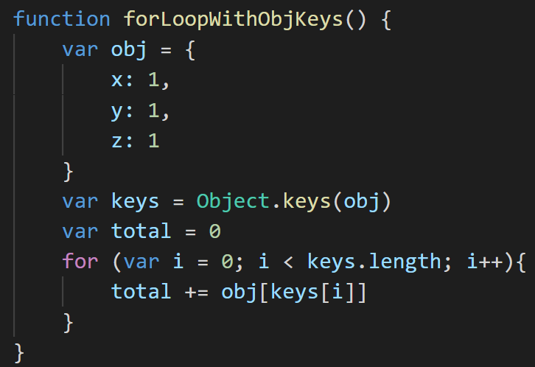
Use for in loop
Notes:
Use for in loop to move through the properties of the objects.

Slide 31
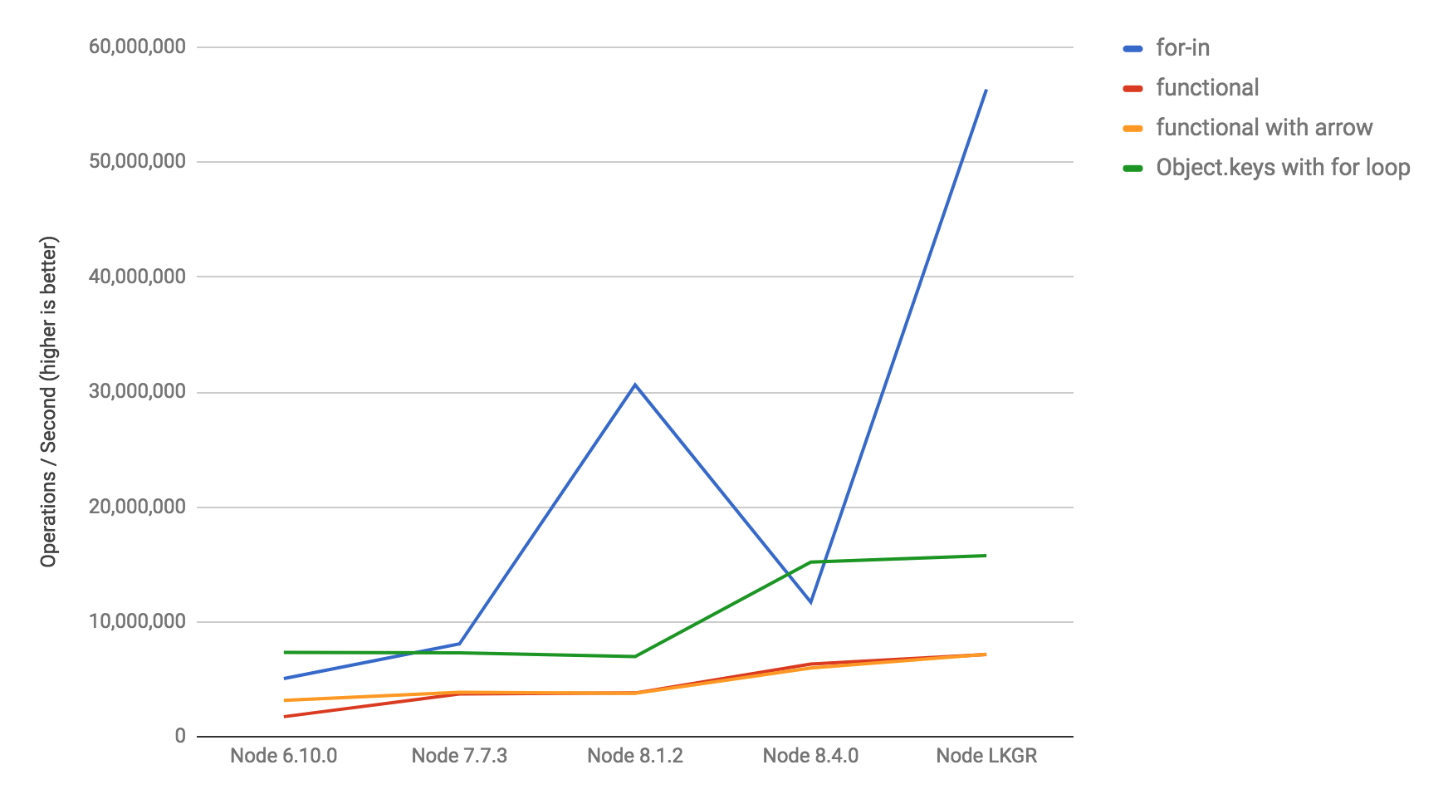
Use for in loop
Credit: Restoring for..in peak performance

Slide 32
Try/catch bad optimization

Slide 33
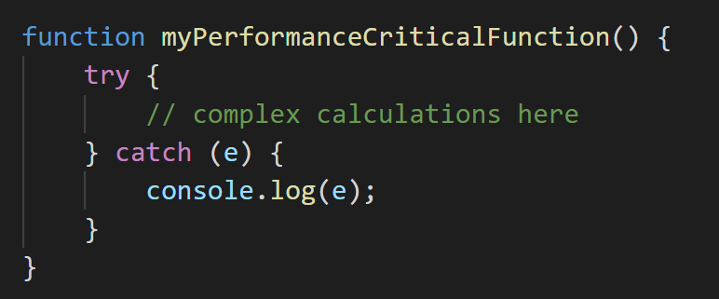
Use try/catch/finally
Notes:
It’s quite common to see that people on the internet saying that you shouldn’t put complex calculations in try/catch block of your code. You can see code like that.

Slide 34
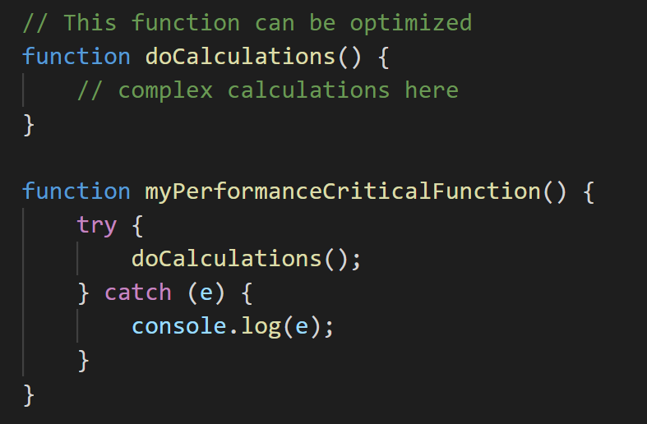
Use try/catch/finally
Notes:
Common approach that you might find on the internet is put your complex code to separate function, so compiler can optimize it. And then that function can be wrapped up with try catch block. Well that was true some time ago, but right now V8 can perform optimization of your code in try catch blocks without any issues. So don’t be afraid to use it for performance critical function and complex calculations.

Slide 35
Links
V8 official website: https://v8.dev/
Restoring for..in peak performance: https://benediktmeurer.de/2017/09/07/restoring-for-in-peak-performance/
How JavaScript works: Optimizing the V8 compiler for efficiency: https://blog.logrocket.com/how-javascript-works-optimizing-the-v8-compiler-for-efficiency/
A deep dive in V8: https://blog.appsignal.com/2020/07/01/a-deep-dive-into-v8.html
How import is object properties order in JS? (RU) (code for performance table example): https://habr.com/ru/post/486162/
V8 performance benchmark for Node (GitHub): https://github.com/davidmarkclements/v8-perf/blob/master/bench/object-iteration.js

Slide 36
QnA

Slide 37
Thanks for attention

