Slide 1

MLB Salary
b02705013 蕭友量 b02705027 陳信豪 b02705028 冷俊瑩

Slide 2
Outline
Introduction
Related Research
Data
Regression
Classification
Ensemble
Summary

Slide 3
Introduction
Players with better performance deserve better salary.
A player’s salary should be decided by his performance last year.

Slide 4
Related Research
Using Regression to Predict Baseball Salaries.
By Nate Reed.
http://natereed.com/using-regression-to-predict-baseball-salaries/

Slide 5
Related Research - Modeling
Clean useless data.
Feature Engineering.
Normalizing input variables.
Rescale salary
Creating Linear Regression Model.
R² = 0.68
5-fold Cross Validation -> Accuracy = 0.65±0.08

Slide 6
Related Research - Regularization
Ridge : Performs L2 Regularization.
Did not eliminate any variable.
LASSO : Performs L1 Regularization.
38 variables eliminated.
ElasticNet : Combines L1 and L2 Regularization.
35 variables eliminated.
Notes:
它類似於嶺回歸，Lasso （Least Absolute Shrinkage and Selection Operator）也會懲罰回歸系數的絕對值大小。此外，它能夠減少變化程度並提高線性回歸模型的精度。看看下面的公式：
Lasso 回歸與Ridge回歸有一點不同，它使用的懲罰函數是絕對值，而不是平方。這導致懲罰（或等於約束可能的絕對值之和）值使一些參數可能結果等於零。使用懲罰值越大，進一步可能會使得縮小值趨近於零。這將導致我們要從給定的n個變量中選擇變量。
要點：
除常數項以外，這種回歸的假設與最小二乘回歸類似；
它收縮系數接近零（等於零），這確實有助於特徵選擇；
這是一個正則化方法，使用的是L1正則化；
· 如果預測的一組變量是高度相關的，Lasso 會選出其中一個變量並且將其它的收縮為零。

Slide 7
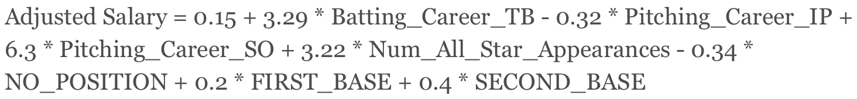
Related Research - Simplified Model
Eliminating statistically insignificant variables.
OLS Regression.
R² = 0.64
Notes:
ordinary least squares (OLS)
R 平方：能解釋的yi變異量的比例
R²愈大，代表此迴歸模式能夠解釋全體y_{i}變異量的比例愈大

Slide 8
Data - Source
MLB Official Website – Player Statistics
Spotrac – Player Salary
2011 ~ 2016
3834 observations, 85 features

Slide 9
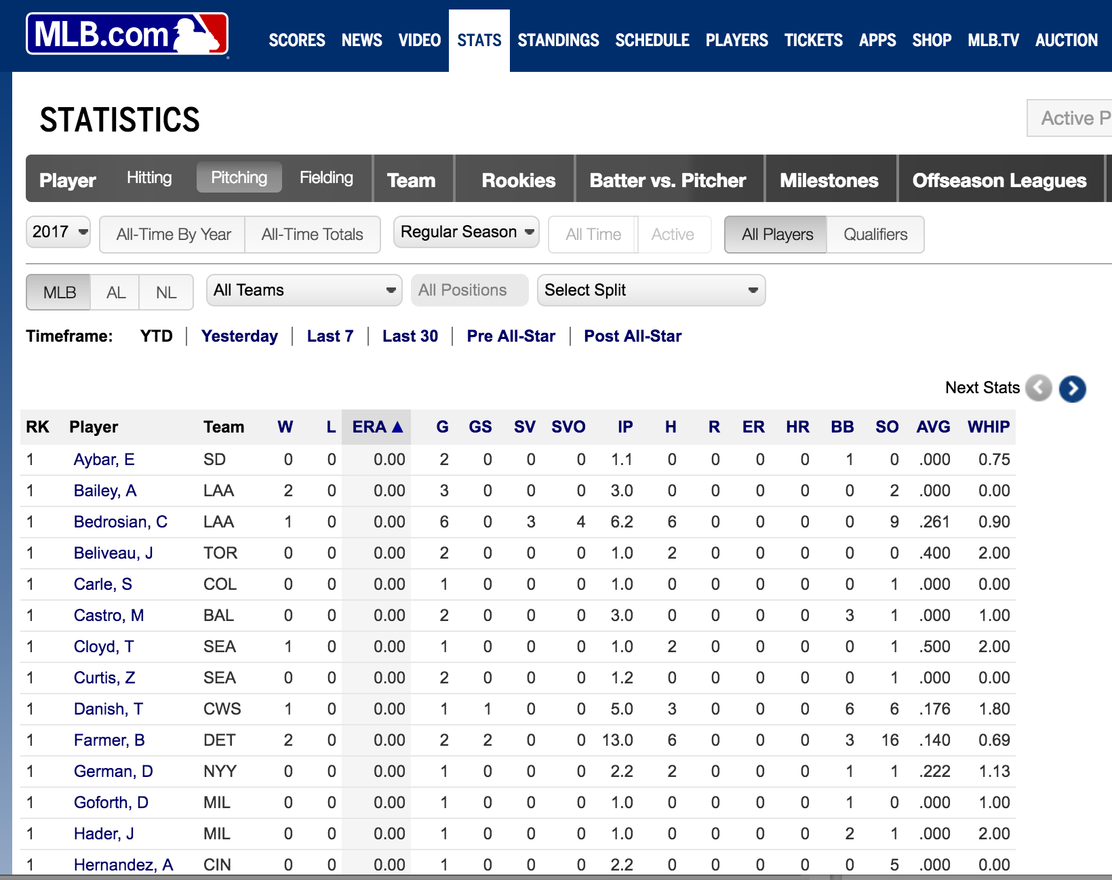

Data - Source

Slide 10
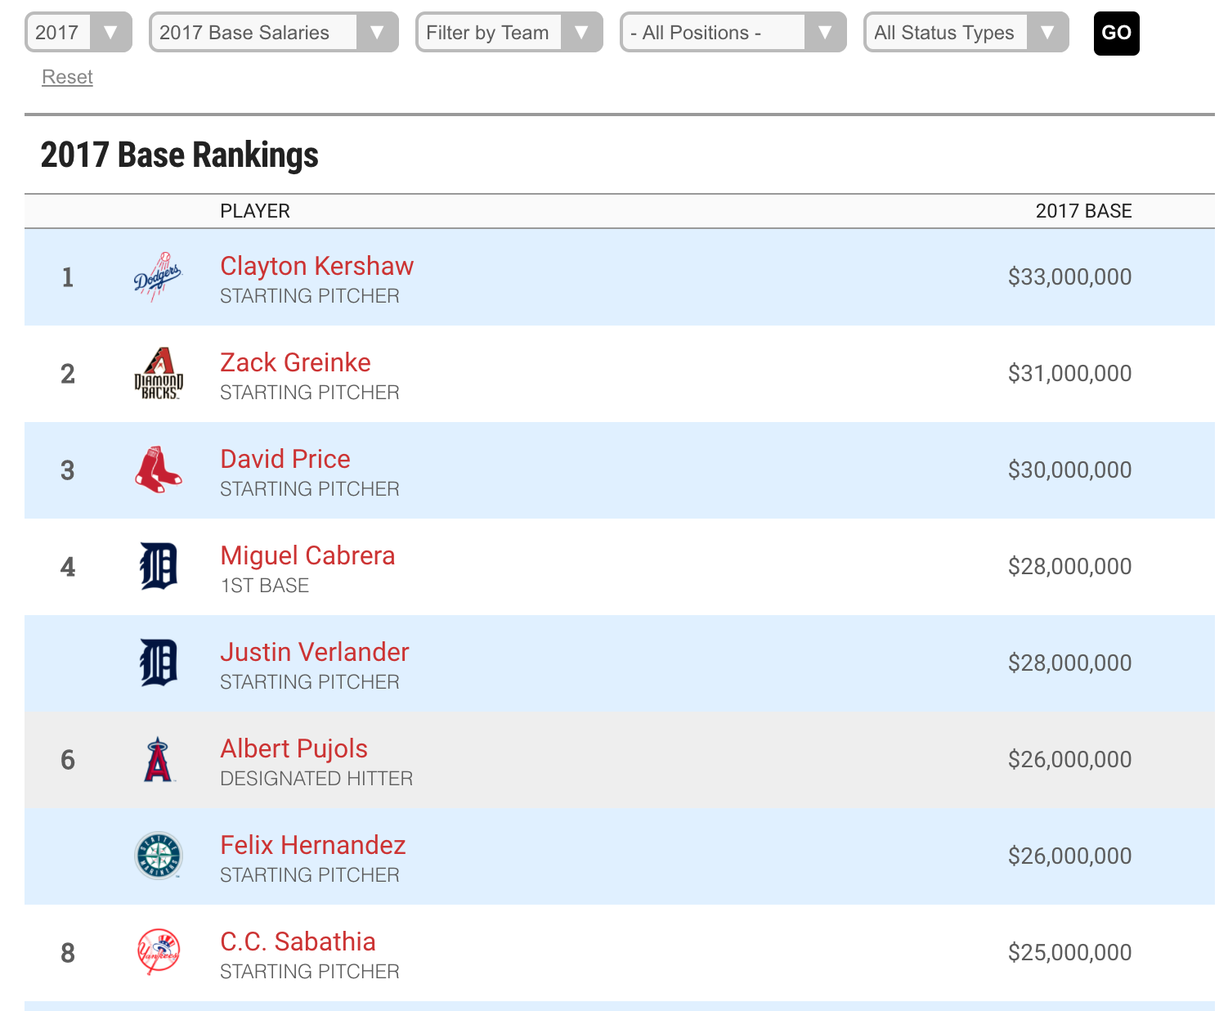

Data - Source

Slide 11
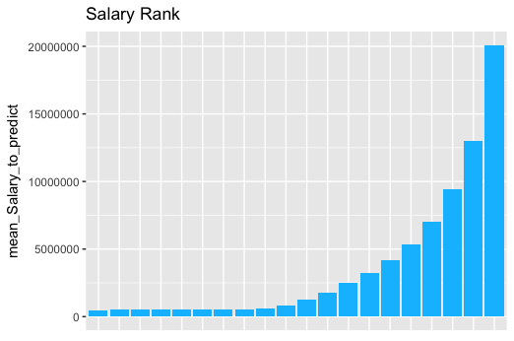
Data – Salary Distribution

Slide 12
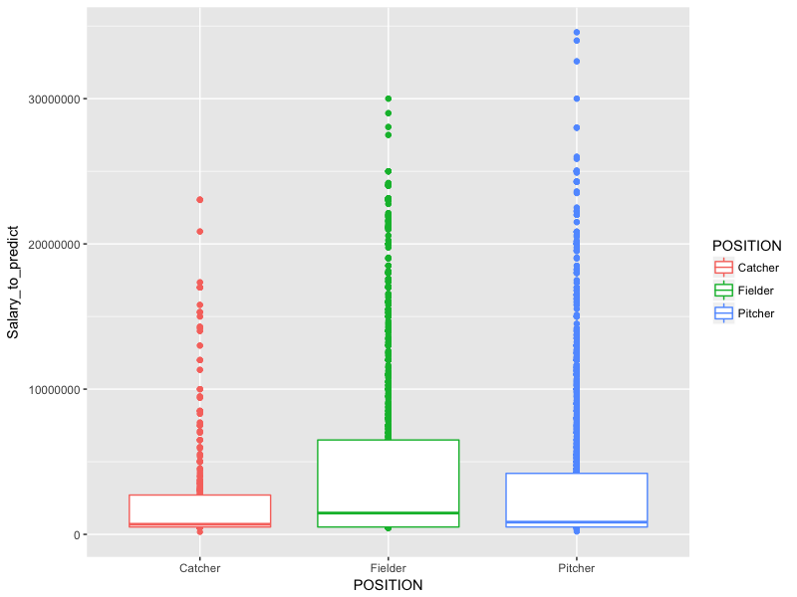
Data – Salary Distribution

Slide 13
Data - Feature
Basic
Player Name, Team, Position, Salary
Hitting
G, AB, H, 2B, 3B, HR, RBI, BB, SO, SB, CS, AVG, OBP, SLG, OPS ….
Fielding
G, GS, INN, TC, PO, A, E, DP, SB, CS, SBPCT, PB, C_WP, FPCT, RF …
Pitching
W, L, ERA, G, GS, SV, SVO, IP, H, R, ER, HR, BB, SO, AVG, WHIP …

Slide 14
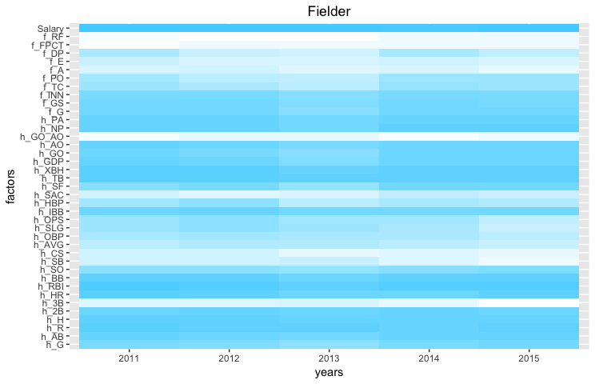
Feature Selection – Correlation Heatmap

Slide 15
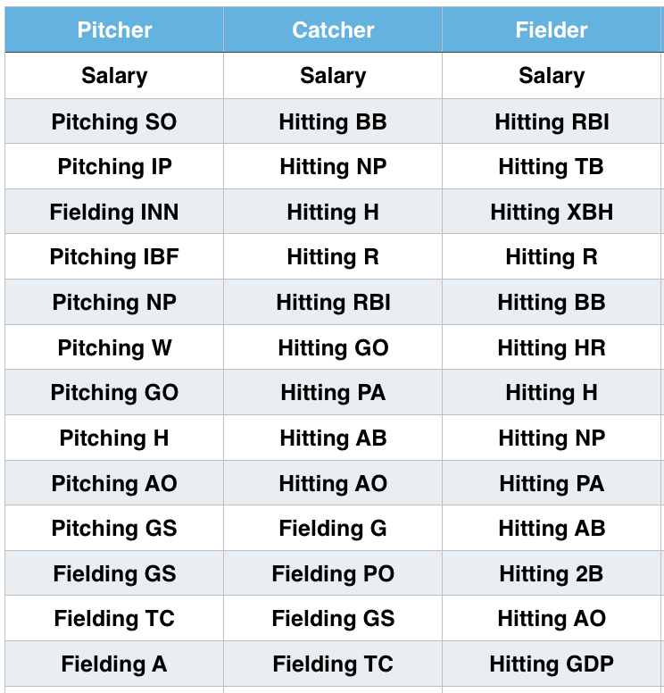
Feature Selection - Correlation

Slide 16
Feature Selection – Chi2

Slide 17
Feature Normalization
Performance is relative in each year
Scale each feature in each year

Slide 18
Regression
RMSE : 2054935
Relative Mean Abs Error ： 70%

Slide 19
Regression – Cause of Failure
Contract Based Salary
Average salary tends to get higher every year
Disabled List

Slide 20
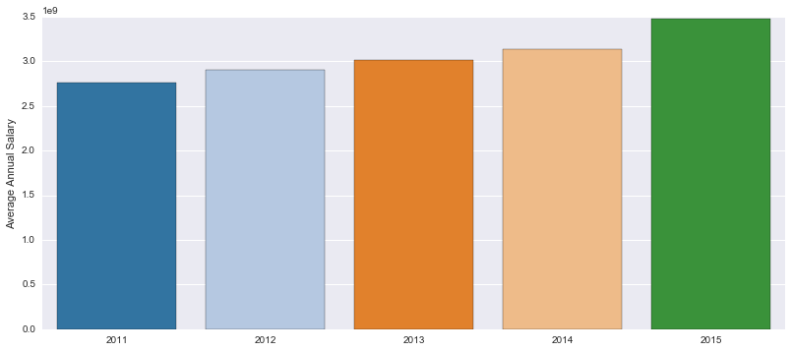
Regression – Cause of Failure

Slide 21
Classification
Determine whether the player‘s performance deserves raise on salary.

Slide 22
Classification

Slide 23
Classifier
Logistic Regression
RandomForest
Libsvm
Xgboost

Slide 24
Classifier –Logistic Regression
“improved” = 1
“umimproved “= 0

Slide 25
Classifier - RandomForest
Parameter
mtry
ntree
Notes:
ntree指定随机森林所包含的决策树数目，默认为500；
mtry指定节点中用于二叉树的变量个数，默认情况下数据集变量个数的二次方根（分类模型）或三分之一（预测模型）。一般是需要进行人为的逐次挑选，确定最佳的m值；
mtry参数是随机森林建模中，构造决策树分支时随机抽样的变量个数；选择合适的mtry值可以降低随机森林模型的预测误差；
mtry是每棵树每个split的时候randomly selected的variable cadidate。

Slide 26
Classifier - Libsvm
library e1071
Parameter
kernel (linear, rbf, poly, sigmoid)
Notes:
Kernel 是隐式地将两个向量转换到其他形式然后求内积, 相比显式的转换可以极大的减少计算复杂度,
甚至可以将有限维的 x 转换到无限维. 与其先求出再计算, 不如直接算, 这就是 kernel相对于手动(显式)转化的优势.

Slide 27
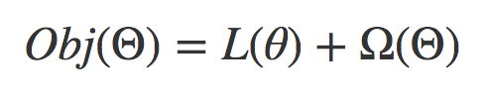
Classifier - Xgboost
Gradient Boosting Machine
Powerful and fast
Parameter
max_depth
Notes:
Objectives function = loss function + regularization item
CPU 多線程
把樹的模型的複雜度作為正則向加到 objective function
樹的深度
xgboost是boosting Tree的一個很牛的實現，它在最近Kaggle比賽中大放異彩。它 有以下幾個優良的特性：
1. 顯示的把樹模型複雜度作為正則項加到優化目標中。
2. 公式推導中用到了二階導數，用了二階泰勒展開。
3. 實現了分裂點尋找近似算法。
4. 利用了特徵的稀疏性。
5. 數據事先排序並且以block形式存儲，有利於並行計算。
6. 基於分布式通信框架rabit，可以運行在MPI和yarn上。
7. 實現做了面向體系結構的優化，針對cache和內存做了性能優化。
在項目實測中使用發現，Xgboost的訓練速度要遠遠快於傳統的GBDT實現，10倍量級。
原文網址：https://read01.com/yPxxaM.html

Slide 28
K fold Cross-Validation
(before train-test-spliting)
K = 10
1/10 tuning
9/10 training
1
2
3
4
5
6
7
8
9
10

Slide 29
Classifier – Pitcher Comparison

Slide 30
Classifier – Catcher Comparison

Slide 31
Classifier – Fielder Comparison

Slide 32
Ensemble
Xgboost
Libsvm
randomforest
Model

Slide 33
Ensemble

Slide 34
Ensemble

Slide 35
Ensemble
Taking various types of models to make it better.
It may not be the best, but it is assumed to be good.

Slide 36
Ensemble

Slide 37
Summary
Take the position into consideration.
Using RandomForest and Xgboost gives us good result in this MLB Salary Case.
Try Model Blending to get the best result.

Slide 38
Summary – To be improved
Our dataset is too small
Lack of some features e.g. age, years of experience, team record, times appear in all star game
Consider the correlation between different features.
OPS = OBP + SLG
Notes:
OBP 上壘率
SLG 長打率

Slide 39
Reference
Ensemble method of machine learning 機器學習中的組合方法 https://read01.com/3zJOK.html
Introduction to Boosted Trees http://homes.cs.washington.edu/~tqchen/pdf/BoostedTree.pdf
MLB Sortable Player Stats http://mlb.mlb.com/stats/sortable.jsp
MLB Salary Rankings http://www.spotrac.com/mlb/rankings/
Pay for Play: Are Baseball Salaries Based on Performance? https://ww2.amstat.org/publications/jse/v6n2/datasets.watnik.html#denby
A Critical Look at Some Analyses of Major League Baseball Salaries https://www.jstor.org/stable/2684201?seq=1#page_scan_tab_contents

Slide 40


