Slide 1
eCertis presentation
From single to multi-domain eCertis
Directorate-General for Internal Market, Industry, Entrepreneurship and SMEs Marc Christopher Schmidt

Slide 2
Agenda
Presentation
From single to multi-domain
Differences
Live demonstration

Slide 3
Basic logic of the current eCertis
These reflect all ESPD criteria
Country
Top level Criterion Example PoT
Law
EU Criterion
PoT 2014/24/EU
National Criteria
PoT PP Law
Defined by EU
Defined by MS
Evidence type
Disadvantages
Limited to the scope of Public Procurment
Currently only the classical Directive 2014/24/EU
Evidence is coupled to a specific national criteria
National criteria contains article
New laws/criteria would result in duplication of information
Issuer

Slide 4
Need of a multi-domain eCertis
Due to the limitation to a single domain, actually currently only a single Directive, it was necessary to make eCertis multi-domain
As there are more domains, it was necessary to define a domain system. For example to differ between the classical directive and the defence directive or domains relevant for businesses and citizens
Categorization of criteria groups like ‚Exclusion grounds‘ or ‚Criminal Convictions‘ needed to be configurable -> Scenario
An important aspect, is that with the new service evidence (types) attached to criteria can be reused for all other domains and don‘t need to be entered again

Slide 5
Basic logic of the multi-domain eCertis
Domain and subdomain
Coverage area
Scenario and category
Law
Criterion
Article
Defined by EU
Defined by MS
Evidence
1:N or N:M relationships
Issuer

Slide 6
Example ‘Payment of taxes’ for PP
Procurement/ Public procurement
Germany
SC: ESPD for CA
CAT: Exclusion grounds
SCAT: PoT and SSC
Law XYZ
Payment of taxes
Article XYZ
Certificate
Tax authority
The red area can be reused for multiple domains

Slide 7
Example ‘Payment of taxes’ for insolvency
Businesses/ Insolvency
Germany
Checking status
Law ABC
Payment of taxes
Article ABC
Certificate
Tax authority

Slide 8
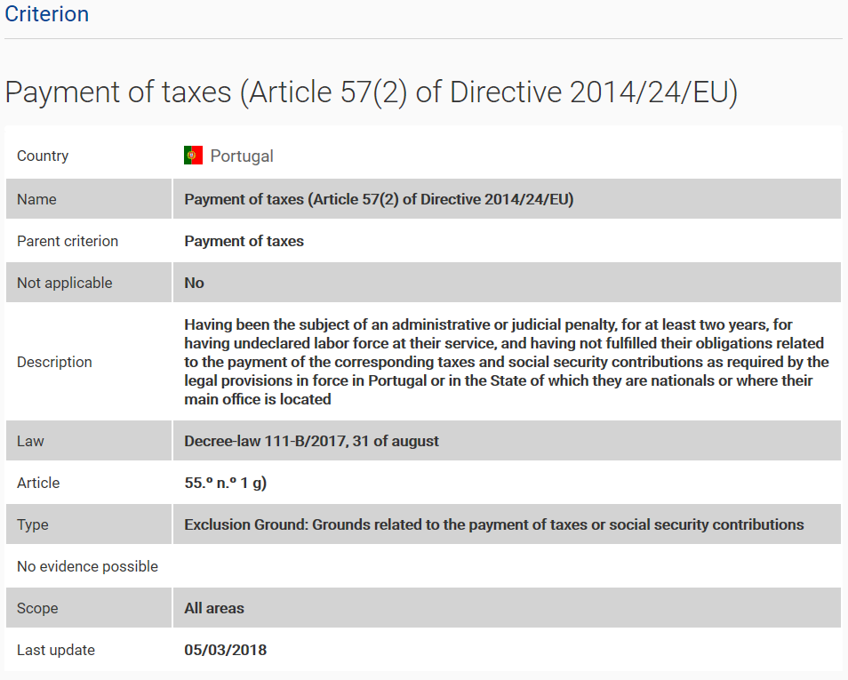
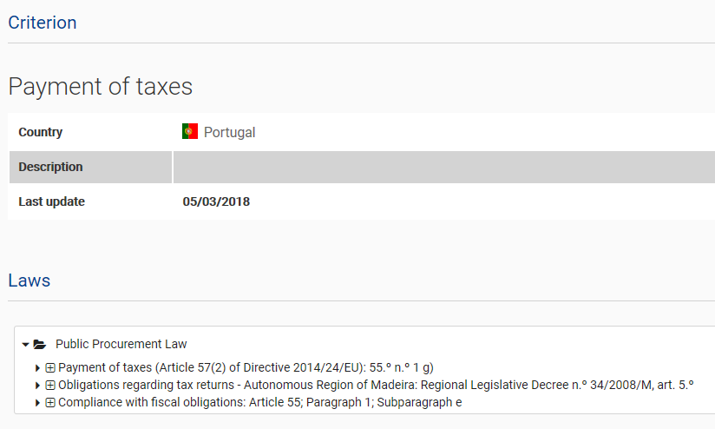
A major change: National criteria to article
Currently
Multi-Domain

Slide 9
Next steps
The current REST service will be continued for the time being (will work with the data migrated, not with new data entered)
There is be a new REST service that will take advantage of all features
The project TOOP will work with the multi-domain to pilot OOP in eProc
The new version is already live, but currently not visible for end users, as we need to do some final steps

Slide 10
Live demonstration
https://webgate.acceptance.ec.europa.eu/tools3/ecertis2

