Slide 1


Annual ESDP Seminar
European Single Procurement Document (ESPD)
3rd December 2020

Slide 2
ESPD Seminar 2020
Table of contents
Introduction
Online Workspace and documentation
ESPD Code Lists
ESPD-EDM & eForms
ESPD 2020 evolution
ESPD-EDM & eCertis / TOOP / CCCEV / ePO
Validator tool. Maven repository
Summary of the changes in ESPD v3.0.0
Questions and answers

Slide 3
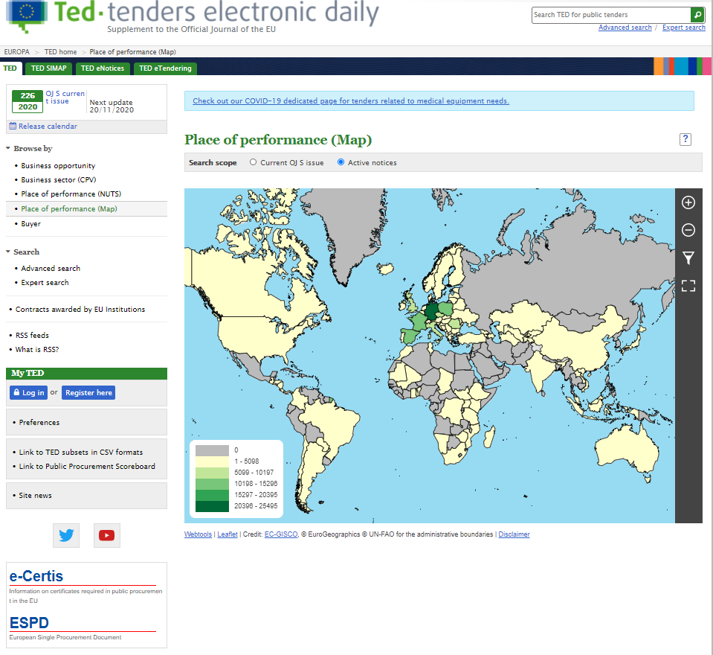
ESPD Seminar 2020
1. Introduction
https://ted.europa.eu/TED/browse/browseByMap.do
Notes:
Display this 2 minutes video before starting the introduction.

Slide 4
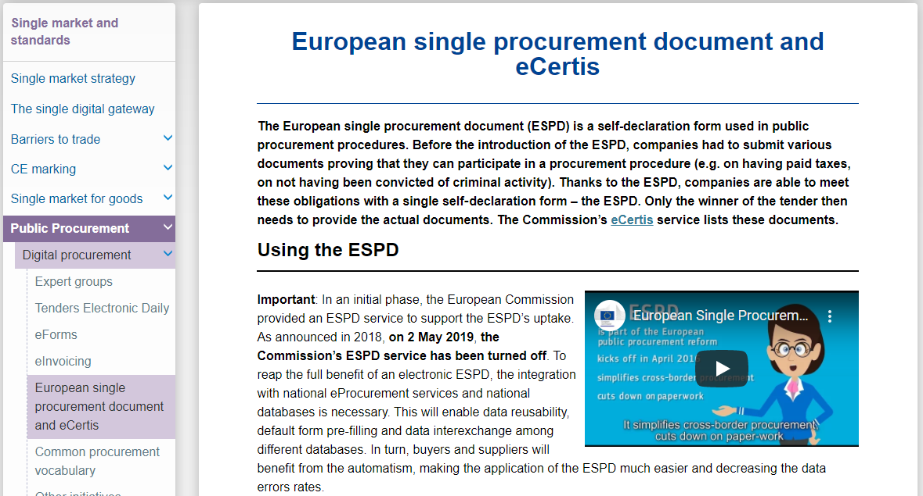
ESPD Seminar 2020
1. Introduction
https://ec.europa.eu/growth/single-market/public-procurement/digital/espd_en
Notes:
Display this 2 minutes video before starting the introduction.

Slide 5
ESPD Seminar 2020
1. Introduction
ESPD-EDM version per Member State:
There are currently three different versions v1b, v2b and v2e (“b” stands for “basic” and “e” for “extended”).
AT | BE | BG | CY | CZ | DE | DK | EE | EL | ES | FI | FR | HR | HU
v1b & v2 | v1b | v1b | - | v1b | v1b & v2 | v1b & v2 | v1b & v2e | v1b & v2b, v2e | v2 | v1b | v1b | v1b | v1b
IE | IT | LT | LU | LV | MT | NL | NO | PL | PT | RO | SE | SI | SK
v1b | v2.1e | v1b | v1b | v1b | v2.0.2 | v1b | v1b | v1b | v1b | v2 | v1b | v1b | v1b
Notes:
Display this 2 minutes video before starting the introduction.

Slide 6
ESPD Seminar 2020
Table of contents
Introduction
Online Workspace and documentation
ESPD Code Lists
ESPD-EDM & eForms
ESPD 2020 evolution
ESPD-EDM & eCertis / TOOP / CCCEV / ePO
Validator tool. Maven repository
Summary of the changes in ESPD v3.0.0
Questions and answers

Slide 7
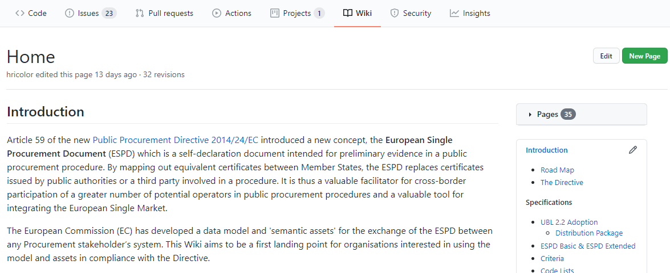
ESPD Seminar 2020
2. Online Workspace and documentation
GitHub Wiki: https://github.com/ESPD/ESPD-EDM/wiki
Hub to all the information about the ESPD, including the Governance. E.g. minutes, presentation, etc.
Notes:
Single access point of ESPD-EDM.
Public access
Summary of the whole documentation and access to the online documentation.
Presentation and reports of the WGM.

Slide 8
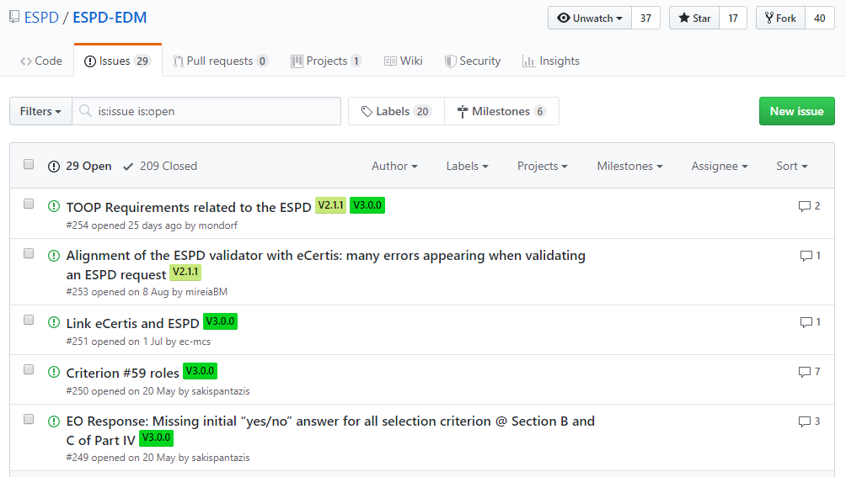
ESPD Seminar 2020
2. Online Workspace and documentation
GitHub Issues: https://github.com/ESPD/ESPD-EDM/issues
Notes:
GitHub user
Doubts / bugs, etc.
Life-cycle

Slide 9
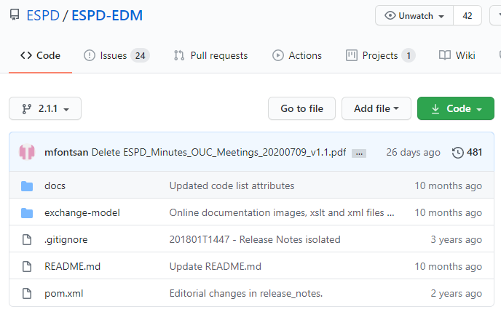
ESPD Seminar 2020
2. Online Workspace and documentation
GitHub Repository: https://github.com/ESPD/ESPD-EDM
Notes:
Access to the most important folders.
Branches

Slide 10
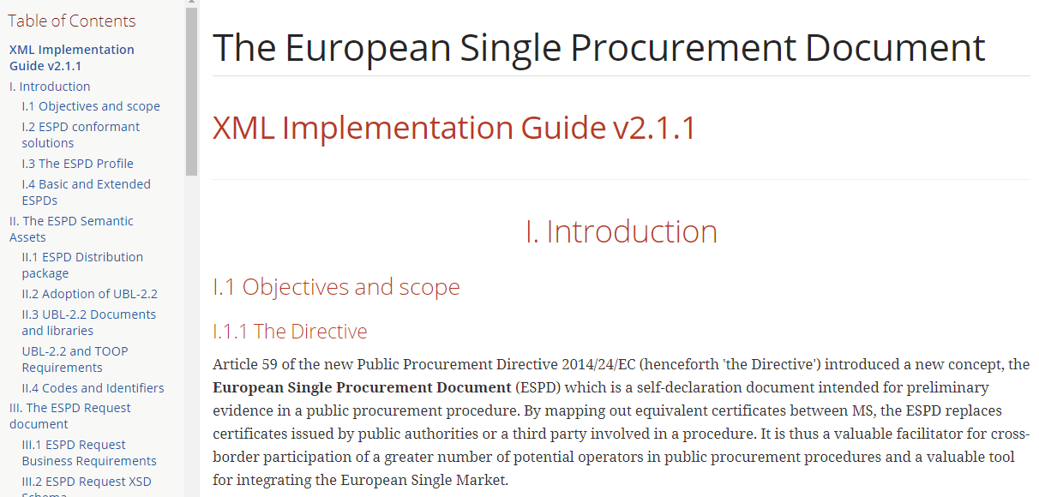
ESPD Seminar 2020
2. Online Workspace and documentation
Online documentation: https://github.com/ESPD/ESPD-EDM
Notes:
How to access
Release notes
New documentation (later)

Slide 11
ESPD Seminar 2020
Table of contents
Introduction
Online Workspace and documentation
ESPD Code Lists
ESPD-EDM & eForms
ESPD 2020 evolution
ESPD-EDM & eCertis / TOOP / CCCEV / ePO
Validator tool. Maven repository
Summary of the changes in ESPD v3.0.0
Questions and answers

Slide 12




ESPD Seminar 2020
3. ESPD Code Lists
ESPD
Cross-sector (common codes):
EU Vocabularies
Project-specific (particular to ESPD):
ESPD GitHub
Business-domain related (procurement):
EU Vocabularies
Notes:
Code lists:
Objective: harmonise the code lists used by ESPD with eForms and the eProcurement Ontology through EU Vocabularies.
Cross-sector: countries, languages, currency, CPV, created by ISO. We are going to use the ones maintained by OP (EU Vocabularies).
Business-domain related: related to the procurement – type of procedure, economic operator role, contract nature, etc.
Project-specific: code list specific for ESPD – criteria taxonomy, property group type, response data type, etc.
Remove those CL not necessary because of this alignment: Evaluation method type and Bid type.

Slide 13
The objectives of code lists
ESPD Seminar 2020
Provide a common understanding of content across applications and systems
Harmonise the input across formats, systems and applications
.
Currency
Code: EUR
Name: EURO
Code: DKK
Name: Danish Krone
Code: GBP
Name: Pound Sterling
…

Slide 14
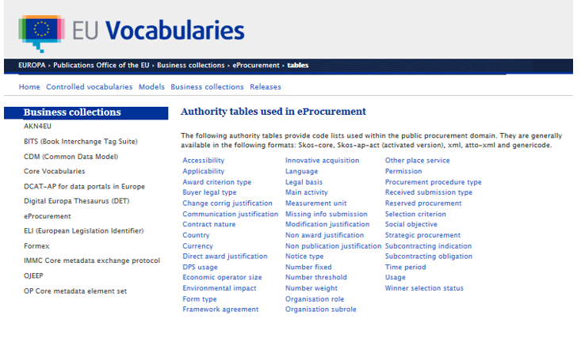
Code lists in eProcurement
ESPD Seminar 2020
Code lists used in eProcurement:
Published in EU Vocabularies by the Publications Office
Code lists = authority lists = authority tables
Constantly maintained and dynamic
Provide different use contexts within the eProcurement domain
Available in different formats

Slide 15
Codes & concepts
ESPD Seminar 2020
Codes
Code identifies a concept
Code is for machine readability
Codes are language independent
The content associated to a code may change but the code is constant
Concepts
The concept has a label/name and generally a definition
The definition generally has a source
The label/name and definition provides the human readable content
Content is available in all official languages
Concepts having a common semantic granularity (within a code list)

Slide 16
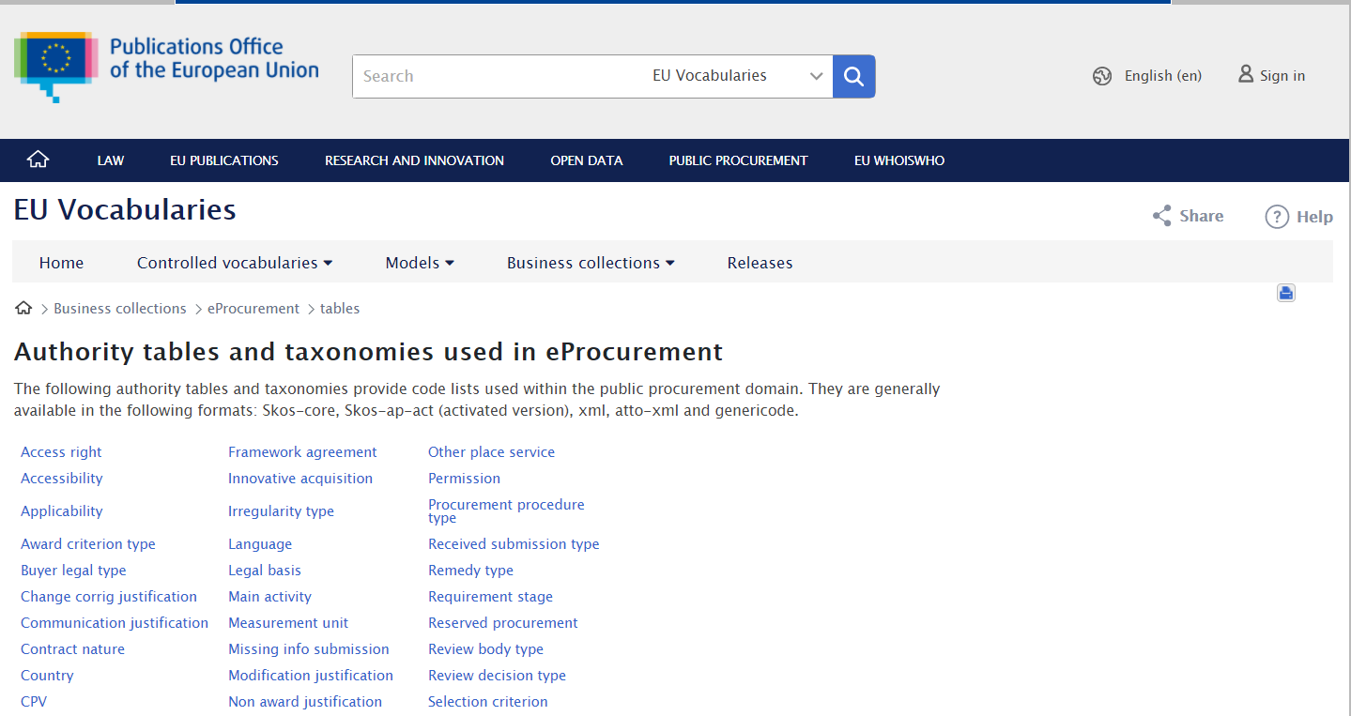
Authority tables and taxonomies used in eProcurement
ESPD Seminar 2020
https://op.europa.mmeu/en/web/eu-vocabularies/e-procurement/tables

Slide 17
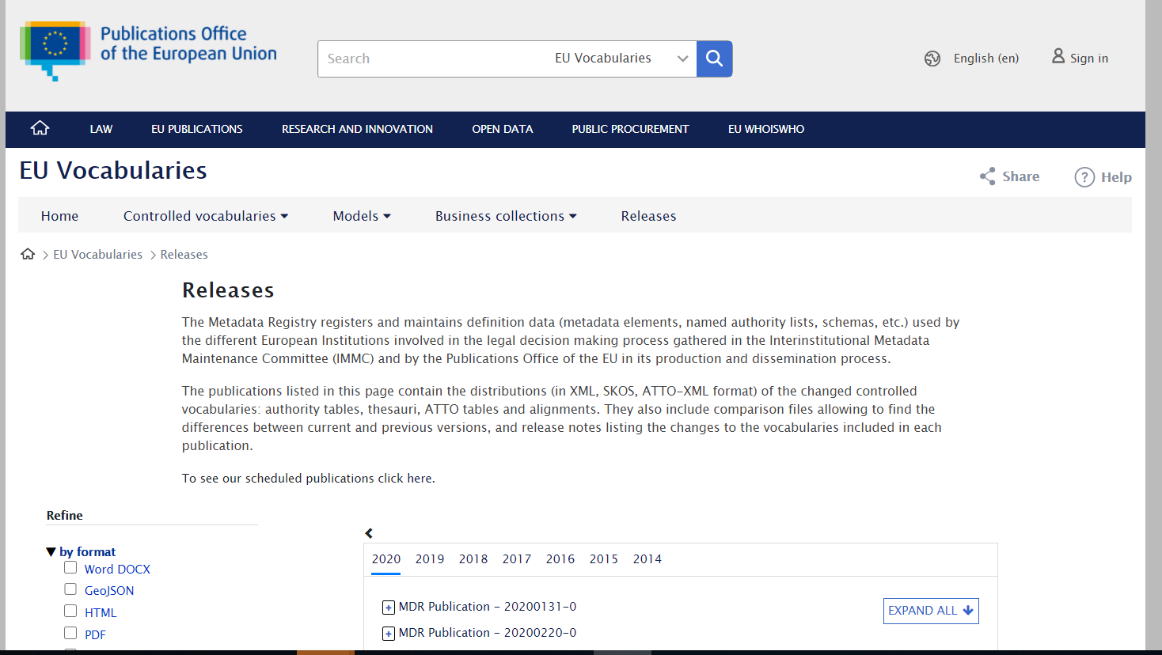
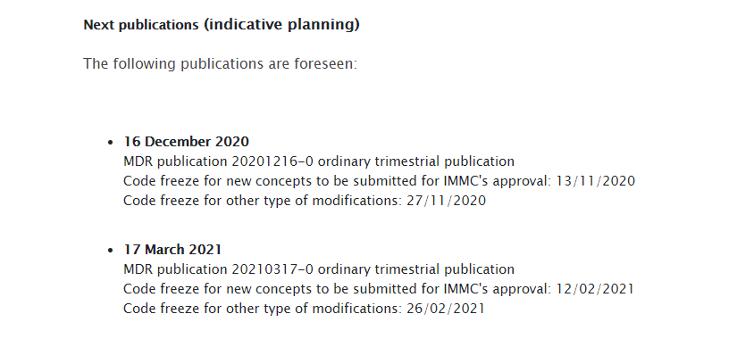
EU Vocabularies Releases
ESPD Seminar 2020
https://op.europa.eu/en/web/eu-vocabularies/releases

Slide 18
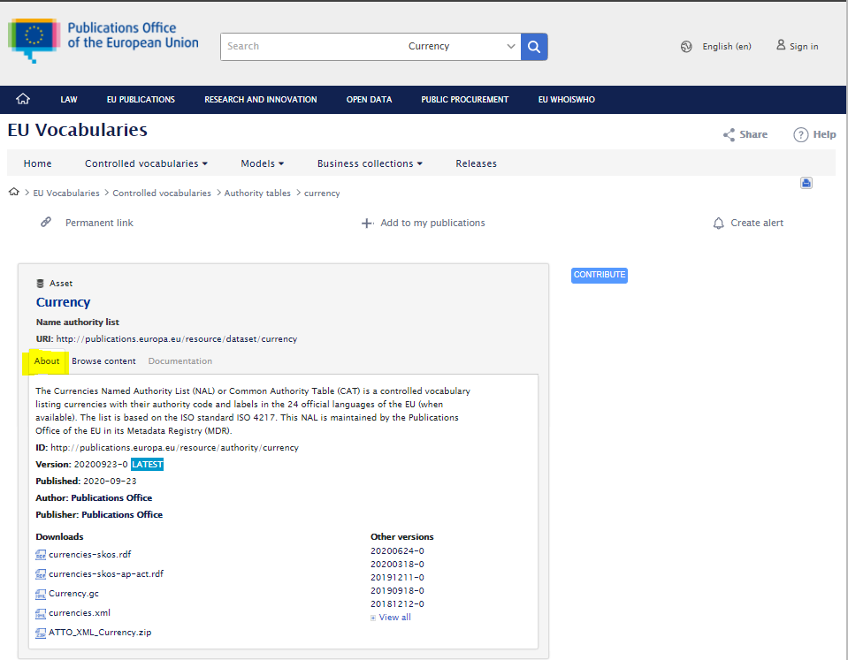
About – Currency authority table
ESPD Seminar 2020
https://op.europa.eu/en/web/eu-vocabularies/at-dataset/-/resource/dataset/currency

Slide 19
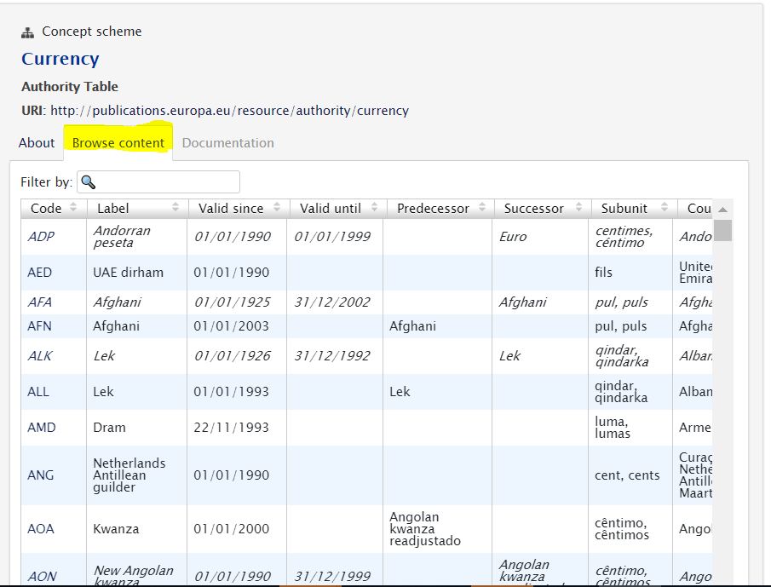
Browse Content – Currency
https://op.europa.eu/en/web/eu-vocabularies/at-concept-scheme/-/resource/authority/currency/?target=Browse&uri=http://publications.europa.eu/resource/authority/currency

Slide 20
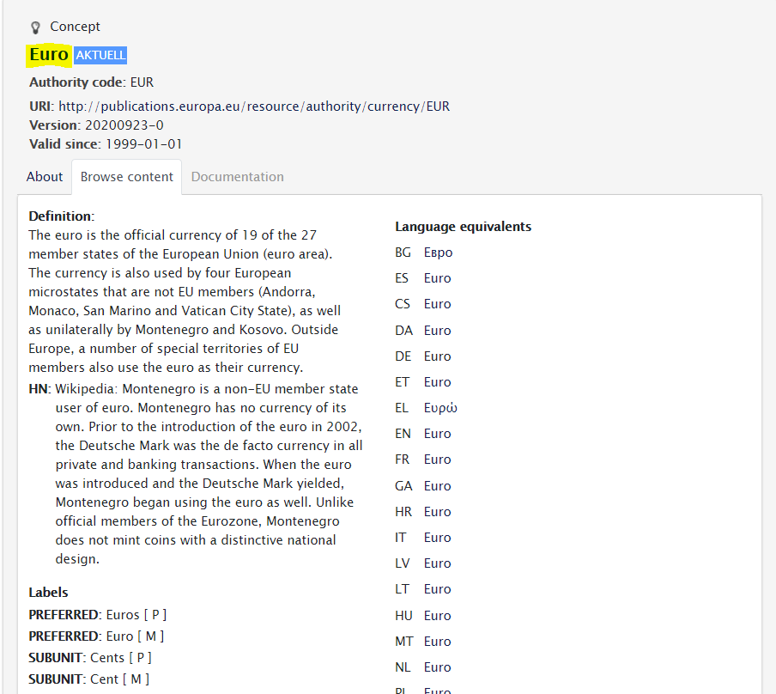
Concepts – Currency
ESPD Seminar 2020
https://op.europa.eu/en/web/eu-vocabularies/at-concept/-/resource/authority/currency/EUR

Slide 21
ESPD Seminar 2020
Table of contents
Introduction
Online Workspace and documentation
ESPD Code Lists
ESPD-EDM & eForms
ESPD 2020 evolution
ESPD-EDM & eCertis / TOOP / CCCEV / ePO
Validator tool. Maven repository
Summary of the changes in ESPD v3.0.0
Questions and answers

Slide 22

ESPD Seminar 2020
4. ESPD-EDM & eForms
Objectives:
Granting interoperability between eForms and ESDP-EDM, making them compatible.
Ensuring the simplification of the data processing.
Easing the fulfilment of the ESPD on both sides, the Contracting Authority and the Economic Operator.
How:
UBL version: upgrade current version UBL 2.2 to UBL 2.3.
Management of lots:
1..* XML Response per Procedure, EO and Lot/Group of Lots
1 XML Request per Procedure
Notes:
UBL:
eForms schemas are built based on UBL 2.3.
Simplify the management of lots.
UBL 2.3 is completely backwards compatible with earlier versions of UBL 2, as for example with all versions of ESPD based on UBL 2.2.
Management of lots:
ESPD 2.1.1: 1 XML request per procedure (same), 1..* XML Response per Procedure and EO (different: multiple lots in one XML).
The Response should contains the lot which the EO tenders to, and the link to SC and EG and their responses.

Slide 23
ESPD Seminar 2020
4. ESPD-EDM & eForms
How:
Exclusion Grounds: the same for all lots.
Selection Criteria: differ per Lot or Group of Lots.
1 XML Request per Procedure
1..* XML Response per Procedure, EO and Lot/Group of Lots
..
Lot 1..*
Lot 1
Lot n
Exclusion Grounds
Selection Criteria 1 -> Lot identifier(s)
Selection Criteria n -> Lot identifier(s)
Exclusion Grounds
Selection Criteria 1
Selection Criteria 2
Exclusion Grounds
Selection Criteria 1
Selection Criteria 2
..
Notes:
eForms:
EG: both models have the same logic and business perspective.
SC: both models have the same logic, but technically is implemented in a different way.

Slide 24
ESPD Seminar 2020
4. ESPD-EDM & eForms
How:
Lots and Group of Lots identifiers:
Object | Scheme (Normative) | Comment
Group of Lots | GLO-XXXX | XXXX: a set of 4 digits. By default the numbering should be increased by 1 from one object to the following of the same category and leading 0s should be used to satisfy the 4 digits format.
Lot | LOT-XXXX
Notes:
Lots identifiers: same logic as in eForms in order to keep the link and interaction between both models.

Slide 25
ESPD Seminar 2020
Table of contents
Introduction
Online Workspace and documentation
ESPD Code Lists
ESPD-EDM & eForms
ESPD 2020 evolution
ESPD-EDM & eCertis / TOOP / CCCEV / ePO
Validator tool. Maven repository
Summary of the changes in ESPD v3.0.0
Questions and answers

Slide 26
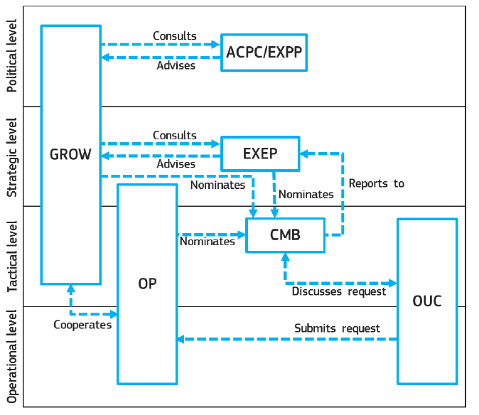
ESPD Seminar 2020
5. ESPD 2020 evolution: ESPD Governance
EXEP: Multi-Stakeholders Expert Group on eProcurement
ACPC: Advisory Committee for Public Contracts
EXPP: Commission Government Experts Group on Public Procurement
CMB: Change Management Board
OUC: Open User Community
Notes:
Currently there are 23 issues open.
19 of them are going to be solved in the next release of ESPD.
All of them have been discussed during the Open User Community meetings held during these months.
The list of issues included in v3.0.0 is currently closed.
4 will be postponed for the next releases because they are related to the future version of eCertis (not released yet).

Slide 27
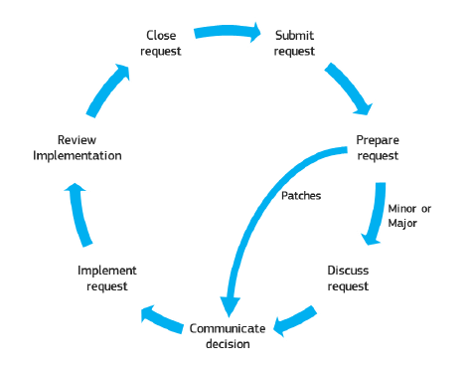
ESPD Seminar 2020
5. ESPD 2020 evolution: ESPD Governance
Open User Community
OP
GROW
Open User Community
OP
GROW
Open User Community
Notes:
Currently there are 23 issues open.
19 of them are going to be solved in the next release of ESPD.
All of them have been discussed during the Open User Community meetings held during these months.
The list of issues included in v3.0.0 is currently closed.
4 will be postponed for the next releases because they are related to the future version of eCertis (not released yet).

Slide 28
ESPD Seminar 2020
5. ESPD 2020 evolution: OUC Issues.
Issues overview:
23 issues open.
Postponed because of future deployment of eCertis
Notes:
Currently there are 23 issues open.
19 of them are going to be solved in the next release of ESPD.
All of them have been discussed during the Open User Community meetings held during these months.
The list of issues included in v3.0.0 is currently closed.
4 will be postponed for the next releases because they are related to the future version of eCertis (not released yet).

Slide 29
ESPD Seminar 2020
5. ESPD 2020 evolution: Summary of the issues to be implemented in v3.0.0
Code Lists
WeightingType CL → REMOVE
EvaluationMethodType CL → REMOVE
LOT_IDENTIFIER and WEIGHT_INDICATOR value → REMOVE from ResponseDataType code list and Criteria.
eForms Alignment
Lot Identifiers → NEW schema
Validator Tool
Exclusion Grounds mandatory → UPDATE rule
Notes:
Remove Criteria 33 (set up EO) and include it as sub criteria of generic and specific turnover.

Slide 30
ESPD Seminar 2020
5. ESPD 2020 evolution: Summary of the issues to be implemented in v3.0.0
Criteria Taxonomy Changes
BASIC version → REMOVED, it will be integrated in the extended
ESPD Request → Part III and Part IV only: Exclusion Grounds” and Part IV: “Selection Criteria”
Setup EO → SUBCRITERION instead of CRITERION
LOT_IDENTIFIER → UNNECESSARY (one ESPD per LOT)
Payment of taxes and Environmental law → FIX INCONSISTENCY
General Turnover → UPDATE PropertyDataType and common threshold question
Defence and Utilities → REMOVE
References SC → UPDATE cardinality.
Economic and financial standings → ADD ON* element type
All Selection criteria → NEW initial question “Does the EO fulfil the criteria by itself?”
Notes:
Remove Criteria 33 (set up EO) and include it as sub criteria of generic and specific turnover.

Slide 31
ESPD Seminar 2020
Table of contents
Introduction
Online Workspace and documentation
ESPD Code Lists
ESPD-EDM & eForms
ESPD 2020 evolution
ESPD-EDM & eCertis / TOOP / CCCEV / ePO
Validator tool. Maven repository
Summary of the changes in ESPD v3.0.0
Questions and answers

Slide 32
ESPD Seminar 2020
6. ESPD-EDM & eCertis / TOOP / CCCEV / ePO
Core Criterion and Core Evidence Vocabulary - CCCEV
Defines data structures for
Criteria
Evidences
Reused and extended
ESPD-EDM,
TOOP,
Implementation of the Once-Only principle
Notes:
New version CCCEV 2.0.0 (reference to GitHub).
In this version, the class Criterion is not the core entity anymore (it is now a subclass of an abstract Requirement).
The origin of this new version was, mainly, the SDG Regulation and the use of information requirements, criteria and evidences, for the implementation of the procedures identified in Annex II of the SGD Regulation.
The impact on the ESPD is ZERO.
There is an XML version of this new CCCEV 2.0.0 model based on the new SEMIC Style Guide (which is in progress).
Some examples of how to implement ESPD XML Documents using the new SEMIC-XML syntax binding are available here.
These examples were intended to demonstrate that the evolution of the CCCEV is backwards compatible with the current ESPD-EDM.
During the evolution of the CCCEV, requirements were taken in from eCertis and TOOP. Some of these were also checked against some CAMSS concepts related to the definition and contextualization of sets of Criteria (Scenario, CriterionEvaluationContext, Score, other). Conversely, eCertis readapted a couple of terms to align with the CCCEV terminology.
The ePO will reuse the CCCEV and will extend it into specific procurement criteria (Exclusion Grounds, Selection Criteria and Award Criteria). This extension will be used to produce the OWL2 syntax binding of ESPD-EDM, which will allow representation of ESPD based on an RDF model (for semantic search).

Slide 33
ESPD Seminar 2020
6. ESPD-EDM & eCertis / TOOP / CCCEV / ePO
CCCEV
New version CCCEV 2.0.0:
https://github.com/SEMICeu/CCCEV/tree/CV-2.0.0/cccev/2.0.0
Requirements were taken in from:
ePO will reuse the CCCEV and will extend it into specific procurement criteria.
SDG (TOOP)
eCertis
Naming and design rules (SEMIC)
ESPD-EDM
No impact on the ESPD data model.
CCCEV is backwards compatible with the current ESPD-EDM.
Notes:
New version CCCEV 2.0.0 (reference to GitHub).
In this version, the class Criterion is not the core entity anymore (it is now a subclass of an abstract Requirement).
The origin of this new version was, mainly, the SDG Regulation and the use of information requirements, criteria and evidences, for the implementation of the procedures identified in Annex II of the SGD Regulation.
The impact on the ESPD is ZERO.
There is an XML version of this new CCCEV 2.0.0 model based on the new SEMIC Style Guide (which is in progress).
Some examples of how to implement ESPD XML Documents using the new SEMIC-XML syntax binding are available here.
These examples were intended to demonstrate that the evolution of the CCCEV is backwards compatible with the current ESPD-EDM.
During the evolution of the CCCEV, requirements were taken in from eCertis and TOOP. Some of these were also checked against some CAMSS concepts related to the definition and contextualization of sets of Criteria (Scenario, CriterionEvaluationContext, Score, other). Conversely, eCertis readapted a couple of terms to align with the CCCEV terminology.
The ePO will reuse the CCCEV and will extend it into specific procurement criteria (Exclusion Grounds, Selection Criteria and Award Criteria). This extension will be used to produce the OWL2 syntax binding of ESPD-EDM, which will allow representation of ESPD based on an RDF model (for semantic search).

Slide 34
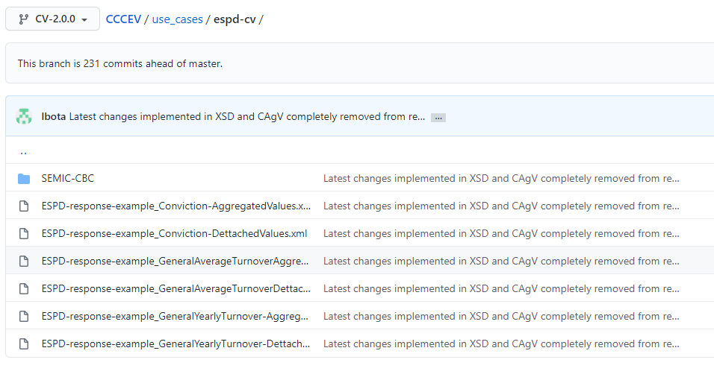
ESPD Seminar 2020
6. ESPD-EDM & eCertis / TOOP / CCCEV / ePO
XML SEMIC
ESPD Samples
Notes:
New version CCCEV 2.0.0 (reference to GitHub).
In this version, the class Criterion is not the core entity anymore (it is now a subclass of an abstract Requirement).
The origin of this new version was, mainly, the SDG Regulation and the use of information requirements, criteria and evidences, for the implementation of the procedures identified in Annex II of the SGD Regulation.
The impact on the ESPD is ZERO.
There is an XML version of this new CCCEV 2.0.0 model based on the new SEMIC Style Guide (which is in progress).
Some examples of how to implement ESPD XML Documents using the new SEMIC-XML syntax binding are available here.
These examples were intended to demonstrate that the evolution of the CCCEV is backwards compatible with the current ESPD-EDM.
During the evolution of the CCCEV, requirements were taken in from eCertis and TOOP. Some of these were also checked against some CAMSS concepts related to the definition and contextualization of sets of Criteria (Scenario, CriterionEvaluationContext, Score, other). Conversely, eCertis readapted a couple of terms to align with the CCCEV terminology.
The ePO will reuse the CCCEV and will extend it into specific procurement criteria (Exclusion Grounds, Selection Criteria and Award Criteria). This extension will be used to produce the OWL2 syntax binding of ESPD-EDM, which will allow representation of ESPD based on an RDF model (for semantic search).

Slide 35
ESPD Seminar 2020
Table of contents
Introduction
Online Workspace and documentation
ESPD Code Lists
ESPD-EDM & eForms
ESPD 2020 evolution
ESPD-EDM & eCertis / TOOP / CCCEV / ePO
Validator tool. Maven repository
Summary of the changes in ESPD v3.0.0
New Online documentation
Questions and answers

Slide 36
ESPD Seminar 2020
7. Validator tool. Maven repository
Type of validations:
The structure defined by UBL XSD.
Code list identifications, version and values.
Business rules related to the cardinality of the schema that cannot be controlled using the XSD.
Business rules of the criteria taxonomy and the data structure.
Other business rules.
URL documentation: https://espd.github.io/ESPD-EDM/v2.1.1/xml_guide.html#annex-i-xml-validation
URL business rules: https://github.com/ESPD/ESPD-EDM/blob/2.1.1/docs/src/main/asciidoc/dist/doc/ESPD_TestCases_mapping.docx
URL Interoperability TestBed: https://www.itb.ec.europa.eu/espd/upload
Notes:
Objective: the available tools to ensure that ESPD-EDM XML are correct.
Type of validations (online document).
Demo

Slide 37
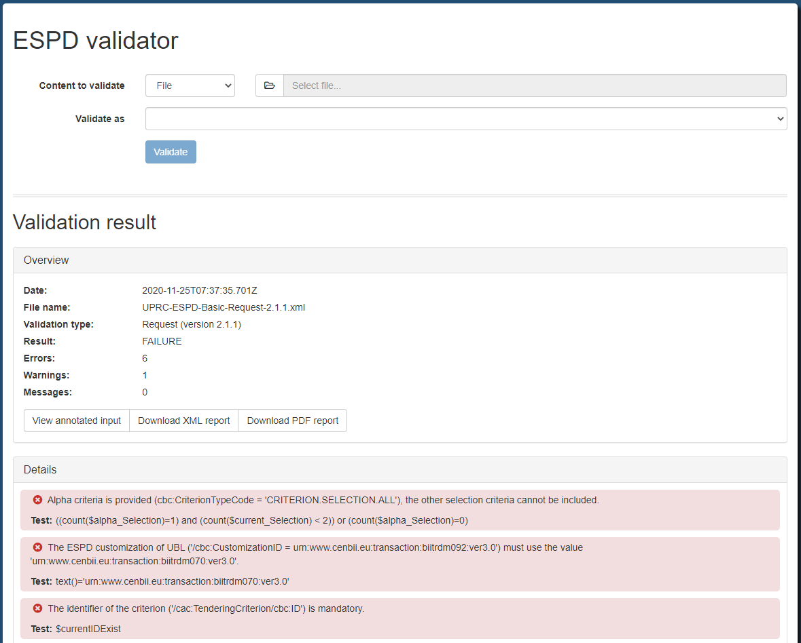
ESPD Seminar 2020
7. Validator tool. Maven repository
https://www.itb.ec.europa.eu/espd/upload
Notes:
Objective: the available tools to ensure that ESPD-EDM XML are correct.
Type of validations (online document).
Demo

Slide 38
ESPD Seminar 2020
7. Validator tool. Maven repository
The recommended way to get started using the exchange-model in your Java project is with a dependency management system.
Maven repository:
https://mvnrepository.com/artifact/eu.europa.ec.grow.espd/exchange-model2
Contains:
UBL XML Schemas
JAXB Annotated classes
<!-- https://mvnrepository.com/artifact/eu.europa.ec.grow.espd/exchange-model2 -->
<dependency>
<groupId>eu.europa.ec.grow.espd</groupId>
<artifactId>exchange-model2</artifactId>
<version>2.1.1</version>
</dependency>
Notes:
Objective: the available tools to ensure that ESPD-EDM XML are correct.
Type of validations (online document).
Demo

Slide 39
ESPD Seminar 2020
Table of contents
Introduction
Online Workspace and documentation
ESPD Code Lists
ESPD-EDM & eForms
ESPD 2020 evolution
ESPD-EDM & eCertis / TOOP / CCCEV / ePO
Validator tool. Maven repository
Summary of the changes in ESPD v3.0.0
Questions and answers

Slide 40
ESPD Seminar 2020
8. Summary of the changes in ESPD v3.0.0
Release ESPD 1.0.1
Jul 2016
Release ESPD 1.0.2
Sep 2017
Release ESPD 2.0.2 (basic)
22 May 2018
Release ESPD 2.1.1
Dec 2019
Release ESPD 3.0.0
Jan 2021
2016
2017
2018
2019
2020
2021
Release ESPD 2.0.1
24 Jan 2018
Release ESPD 2.1.0 (extended)
21 Dec 2018
Notes:
New release 3.0.0: objective

Slide 41
ESPD Seminar 2020
8. Summary of the changes in ESPD v3.0.0
eForms Alignment
UBL version: UPGRADE to UBL 2.3.
Management of lots: 1 ESPD Request -> 1 ESPD Response per Procedure, EO, Lot / Group of Lots.
Lot and Group of Lots Identifiers: GLO-XXXX / LOT-XXXX.
Criteria Taxonomy changes
EXTENDED version: keep only the EXTENDED version of ESPD, and remove the BASIC one.
ESPD Request: keep only Part III: Exclusion Grounds and Part IV: Selection Criteria.
Issues
Implement 19 issues discussed during the OUC meetings.
Online documentation
Renewal with two handbooks (business and technical oriented).
* All changes need to be approved by the CMB (Change Management Board)
Notes:
Objective: the available tools to ensure that ESPD-EDM XML are correct.
Type of validations (online document).
Demo

Slide 42
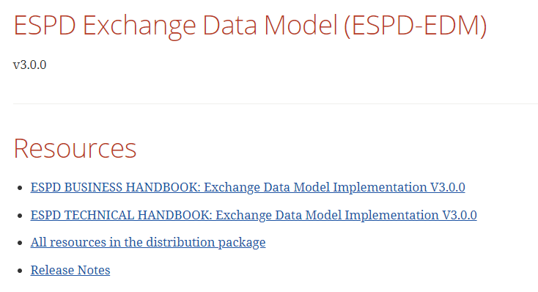
ESPD Seminar 2020
8. Summary of the changes in ESPD v3.0.0
New online documentation
Objectives:
Target audience oriented
Simplification / user friendly
Easily maintainable
Notes:
Objective: simplify the documentation, make it more user-friendly and simplify the maintenance, evolution and distribution of the documentation.
How: divide the content in 2 documents with different target audience:
Business handbook: Business owners, policy-makers, CIO, project leaders and any one interested the understanding the motivation and the impacts of the ESPD.
Technical handbook: CIO, project leaders, analyst and developers, technical implementers in general.
Adapt the content and linguistic registry to each type of audience.
Shorten the length of the documents.
Explain per each document, which information contains. -> high level

Slide 43
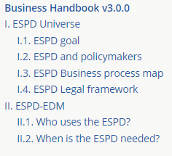
ESPD Seminar 2020
8. Summary of the changes in ESPD v3.0.0
Notes:
Objective: simplify the documentation, make it more user-friendly and simplify the maintenance, evolution and distribution of the documentation.
How: divide the content in 2 documents with different target audience:
Business handbook: Business owners, policy-makers, CIO, project leaders and any one interested the understanding the motivation and the impacts of the ESPD.
Technical handbook: CIO, project leaders, analyst and developers, technical implementers in general.
Adapt the content and linguistic registry to each type of audience.
Shorten the length of the documents.
Explain per each document, which information contains. -> high level

Slide 44
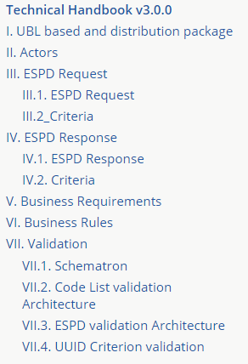
ESPD Seminar 2020
8. Summary of the changes in ESPD v3.0.0
Notes:
Objective: simplify the documentation, make it more user-friendly and simplify the maintenance, evolution and distribution of the documentation.
How: divide the content in 2 documents with different target audience:
Business handbook: Business owners, policy-makers, CIO, project leaders and any one interested the understanding the motivation and the impacts of the ESPD.
Technical handbook: CIO, project leaders, analyst and developers, technical implementers in general.
Adapt the content and linguistic registry to each type of audience.
Shorten the length of the documents.
Explain per each document, which information contains. -> high level

Slide 45

ESPD Seminar 2020
Questions

