Slide 1
Agent-Role Reifications – Conclusions
1- Roles as classes:
All roles identified so far are main business entities relevant in the domain of Public Procurement: Buyer, Economic Operator, Tenderer, Winner, Seller, etc. This includes minor roles that do not participate directly in the procurement processes, but which are needed in the global scope of a procurement (e.g. tax, environmental protection and employement information providers);
Two types of roles can be identified "active or direct" and "passive or indirect" (examples are provided below).
2- Procurement situations:
In general, the combination of Agent-Role-Thing via a "particular procurement situation reification" is sufficient to identify the function being developed by the role.
There are at least two situations identified so far where the function needs to be specified, together with the Agent and the Role: the "Procurement Terms Notification Situation" (executesPayment, usesBudgetToContract, processes Tenders, team-leader, etc.); and the [Pre]Qualification Situation (group-lead, sole-contractor, subcontractor, relied and non-relied upon EO, other).
3- Types of reifications identified so far (diferent situations involve [always) Lot and may refer to other "things"):
eAwarding -> active: Buyer; passive target role: Winner (diagram "Award Reification")
eOrdering -> active: Buyer, Originator, Deliverer; and passive roles: Deliveree (?), Invoicee
eInvoicing -> active: Buyer, Invoicee; and passive roles: (?)
eCatalogue -> active: Buyer, Seller, Catalogue Provider and passive [target] roles: (?)
eProcurement Terms Notification -> agents playing parts related to the publication of notices and procurement information (diagram “Procurement Terms Reification”) -> active: Publisher; passive : Tax/EnvironmentalProtection/Employment Information Provider
eEvaluation -> active: Evaluation Board/Jury; indirect: Tenderer
Contract signature -> active: Buyer Signatory, Winner Signatory; passive : Subcontractor (?)
Pre-Qualification -> active: Evaluator; passive: Economic Operator
4 Design decision: Roles are to be designed and implemented as classes of the ontology. The UML diagrams need to make these classes obvious to the reader. Specific roles developing different functions may use their own specific activity list; Buyer in the eProcurementTermsNotification; EconomicOperator in the e[Pre]Qualification situation (ESPD).

Slide 2
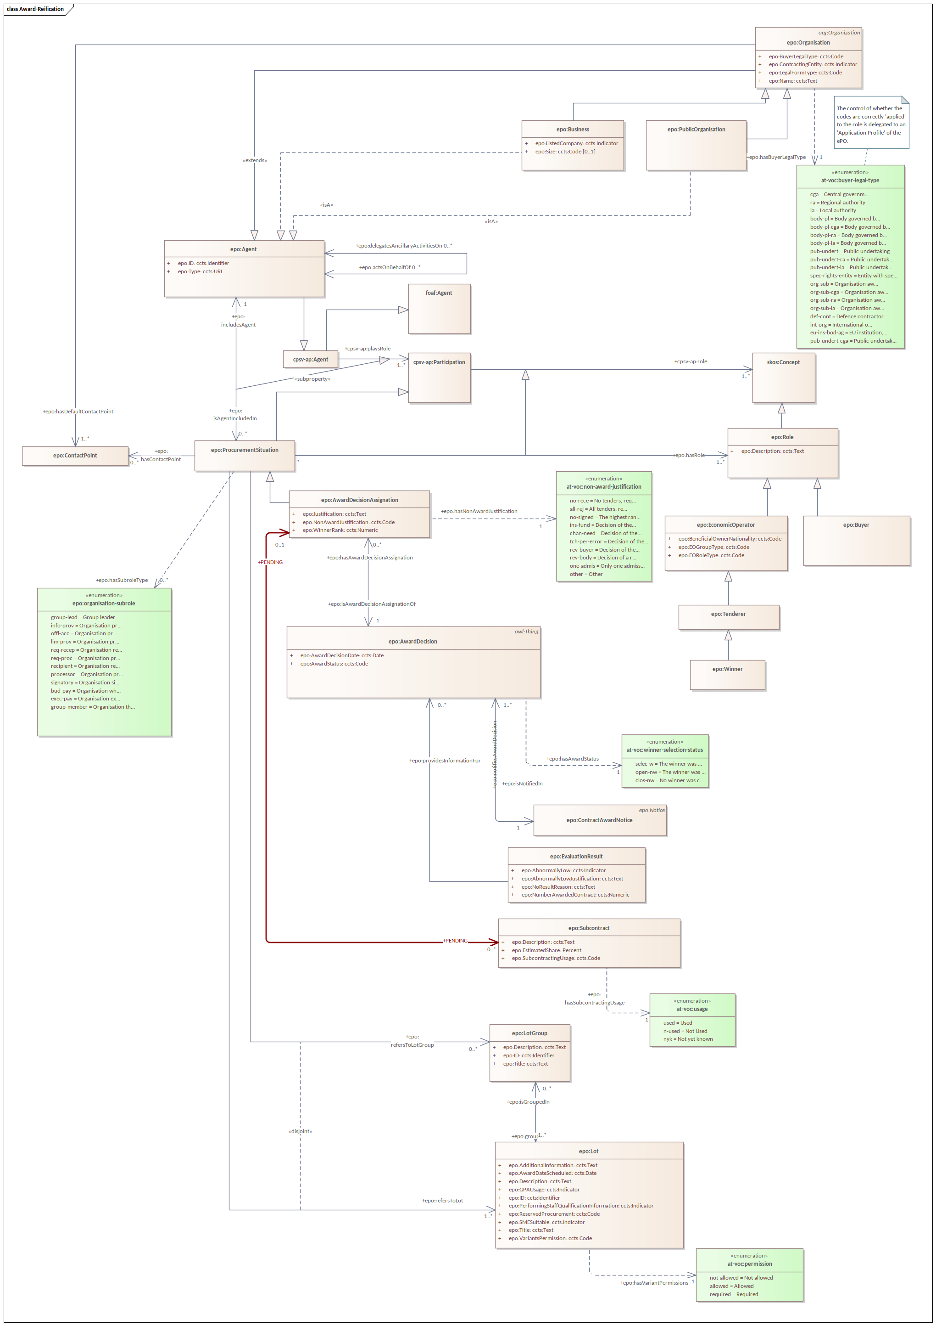
Award

Slide 3
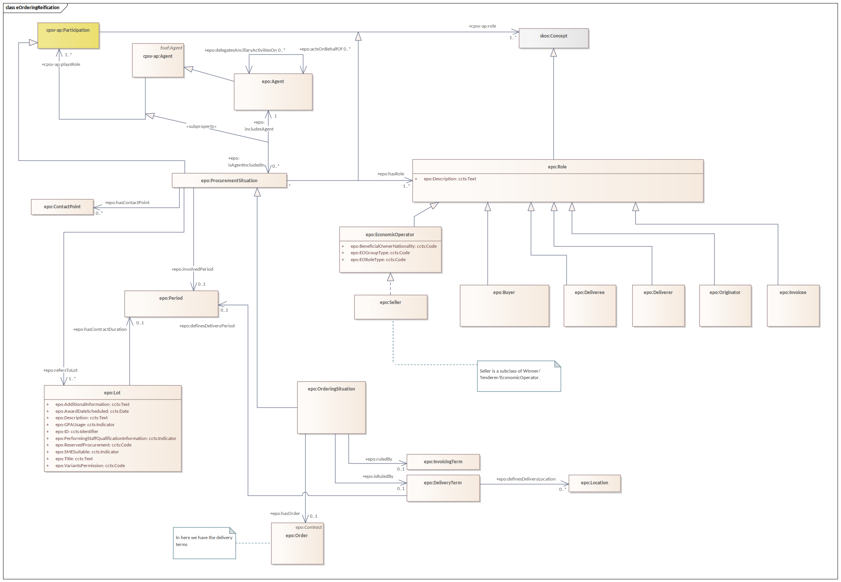
eOrdering

Slide 4
eInvoicing

Slide 5
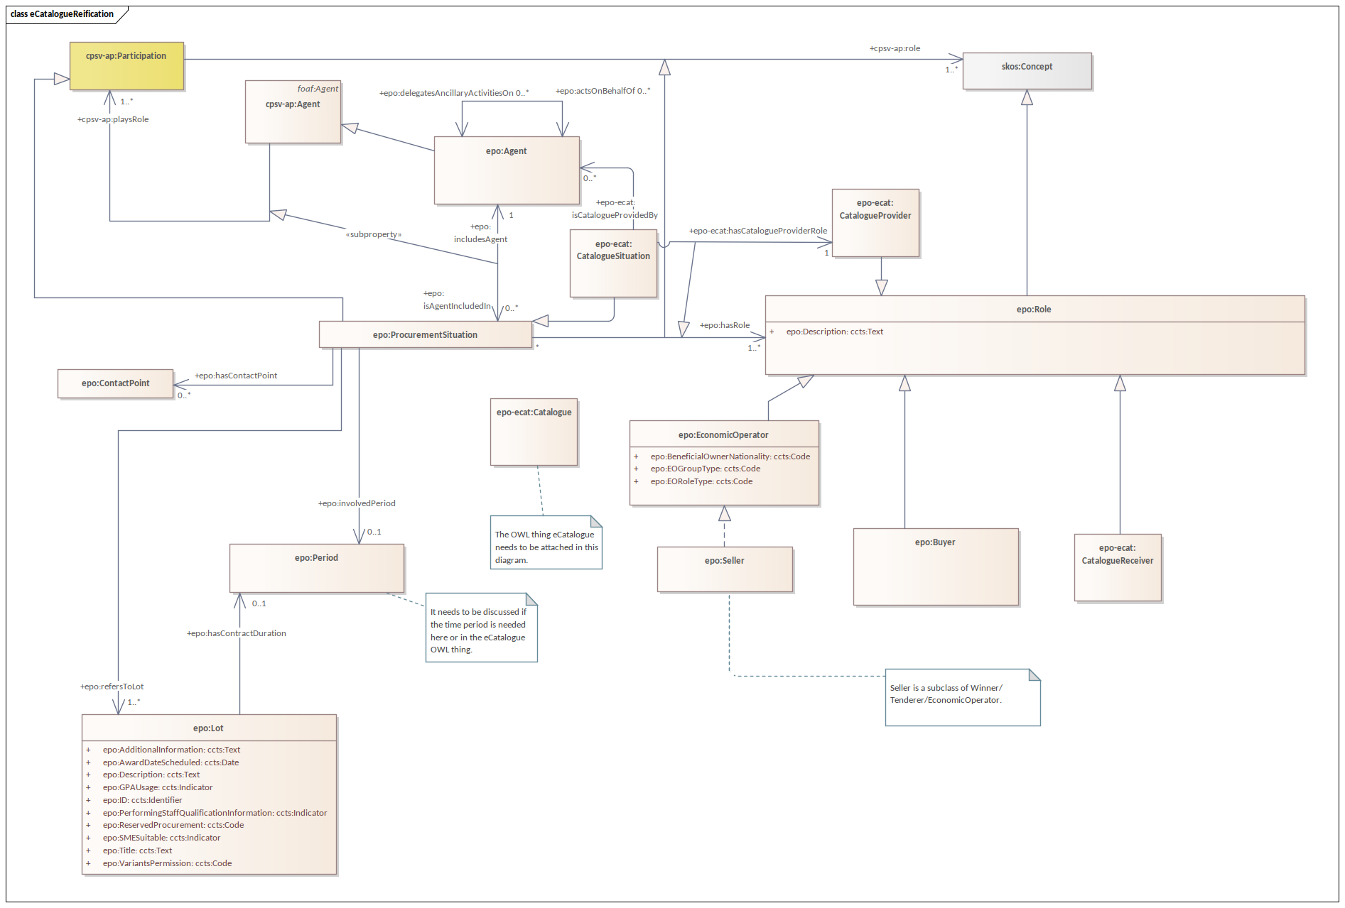
eCatalogue

Slide 6
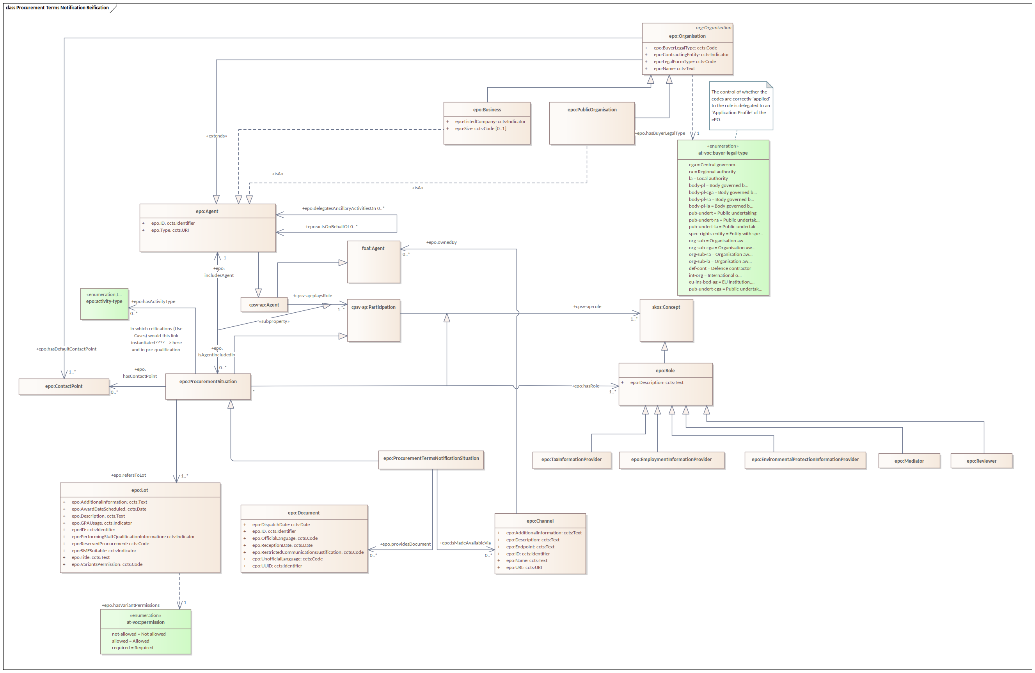
Procurement Terms Notification

