Slide 1
1. Problem description
In ePO we have identified the need for a concept termed “Document”, which was originally defined as:
“A set of interrelated Business Information representing the business facts.”
Additional Information: Documents may convey information in any language, medium or form, including textual, numerical, graphic, cartographic, audio-visual forms, etc. (ePO WG Approval 23/05/2019).
This definition covers a semantic field that goes beyond the tradional idea of document and document support (e.g. a paper-based document), as it may refer to different types of information resources created and provided by different agents via different electronic means and expressed in different ways (e.g. languages) and formats (e.g. syntaxes and codification systems);
A notable amount of metadata related to this concept of “information resource” has already been modelled in other ontologies, namely those referred to Language, médium or form, accessibility, provenance, authoring, versioning, etc. One known ontology covering these metadata is the IFLA LRM (FRBR). In ePO we do not want to reinvent the wheel and stick tight to the principle sharing and reuse. In doing so ePO would endorse, enable and enforce semantic cross-border and cross-domain interoperability.
However, when trying to reuse the IFLA LRM specification we’ve encountered at least 2 challenges:
How the ePO concept of “Document” can be implemented as an “information resource” in contrast to the “bibliographic resource”; and
How to implement “a volume resource” that aggregates or collects different “Documents”, e.g. a VCD (Virtual Company Dossier) containing different types of evidences.

Slide 2
2. ePO “Information Resource”: definitions
The reuse of the IFLA LRM has lead us to introduce new concepts and re-define other:
Resource: a well identified thing available for use.
Asset: A resource resulting from a work possibly bringing value.
Information resource: data, in a context of use. Additional information: in the case of electronic inromation resources they are accessible via a unique identifier.
Information resource: a set of interrelated data, in a context of use, that is accessible via a unique identifier. Additional Information:
The context refers to (source 2009 DAMA International© :
The Business meaning of data elements and related terms,
The format in which the data is presented,
The time-frame represented by the data,
The relevance of the data to a given usage,
The content retrieved from an information resource is to be considered an “Assset”. Thus, metadata on the provenance, authoring, versioning, etc., is also retrievable/accesible through the information resource.
Examples of IRs are “a VCD exchanged via an electronic system”; “a de-referenceable URI returning an electronic certificate on the financial standing of an economic operator”;
Document → an information resource conveying a set of interrelated business information. Additional Information: examples of Documents within public procurement are: A Contract Notice, an ESPD Reques, an electronic certificate such as a certification about the Qualification of an Economic Operator, an eInvoice, etc.

Slide 3
A distinction between (a) Taxonomy of IRs and (b) Relation of each ePIR to classes of the FRBR model needs to be done and implemented. This implies:
Developing a taxonomy of resources and documents (see next slide), and
Relating each concept of the taxonomy to the IFLA FRBR sub-model in terms of
partOf/aspectOf a Work, an Expression, a Manifestation or an Item

Slide 4
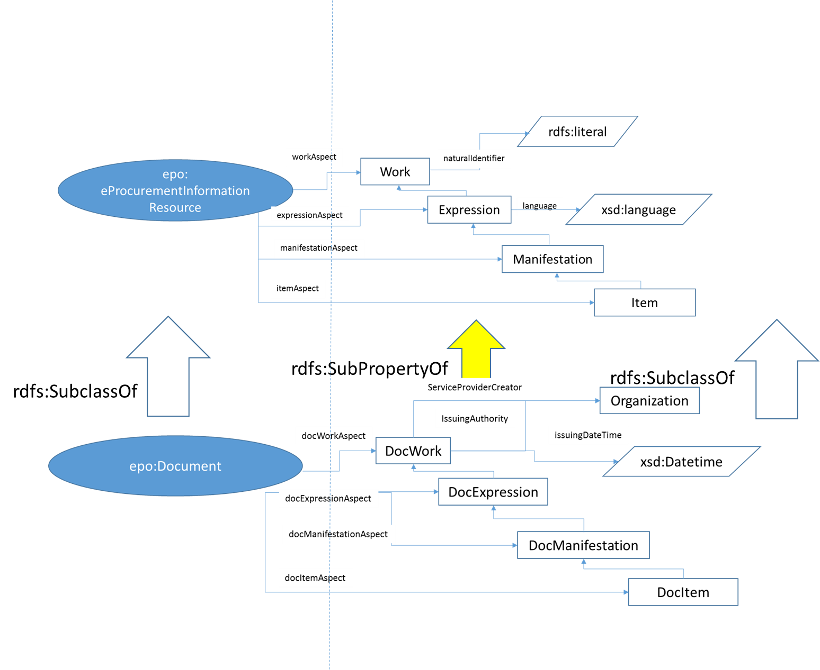
2. ePO “Information Resource”: implementation
epo:Information Resource

Slide 5
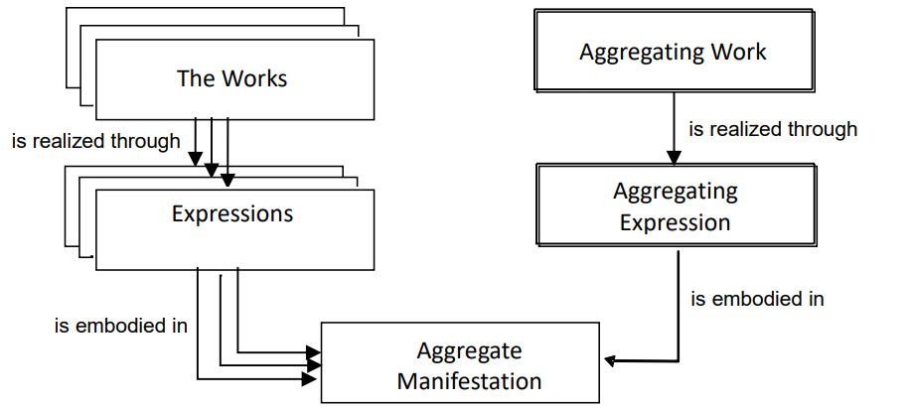
3. Information Resource containing aggregates: the IFLA LRM approaches
IFLA defines “aggregate” as “a manifestation embodying multiple expressions”, and distinguishes three types of aggregates (see the IFLA LRM for the details*):
Aggregate Collections of Expressions,
Aggregates Resulting from Augmentation, and
Aggregates of Parallel Expressions.
The concept of “volume” or “compilation” as proposed in ePO for cases such as the VCD would correspond to the idea of “Aggregate Collections of Expressions”. Notice that in the IFLA LRM data model the only N:M relationship existing is between Expression and Manifestation:
As only expressions can be combined, in creating an aggregate manifestation the aggregator creates an aggregating work. The essence of the aggregating work is the selection and arrangement criteria. It does not contain the aggregated works themselves and the whole-part relationship is not applicable. An aggregate should not be confused with works which were created with parts.
The modelling of aggregates as a manifestation embodying multiple expressions is simple and straightforward; works and expressions are treated identically regardless of their form of publication or the physical manifestation in which they are embodied. An expression may be published alone or it may be embodied in a manifestation with other expressions.
General model for aggregates
* The IFLA LRM, page 93: https://www.ifla.org/files/assets/cataloguing/frbr-lrm/ifla-lrm-august-2017_rev201712.pdf

Slide 6
4. Information Resource containing serials: the IFLA LRM modelling of serials
Serials are complex constructs that combine whole/part relationships and aggregation relationships:
the complete serial manifestation has a whole/part relationship to its individual issues published over time (even though there are serials that happen to have only one issue released);
and each individual issue is an aggregate of documents (even though there are serials that can occasionally have issues consisting of only one document).
Each issue of a serial constitutes an aggregate manifestation according to the IFLA LRM definition of aggregate as a manifestation embodying multiple expressions as each issue embodies expressions of multiple works, as well as an expression of an aggregating work which provides the plan for the aggregation of that issue. On the other hand, the manifestation constituting the complete serial as a whole is issued in a sequence of parts over time, in a whole/part relationship at the manifestation level (LRM-R26).
The work entity is defined, in IFLA LRM, as one “that permits the identification of the commonality of content between and among various expressions”

Slide 7
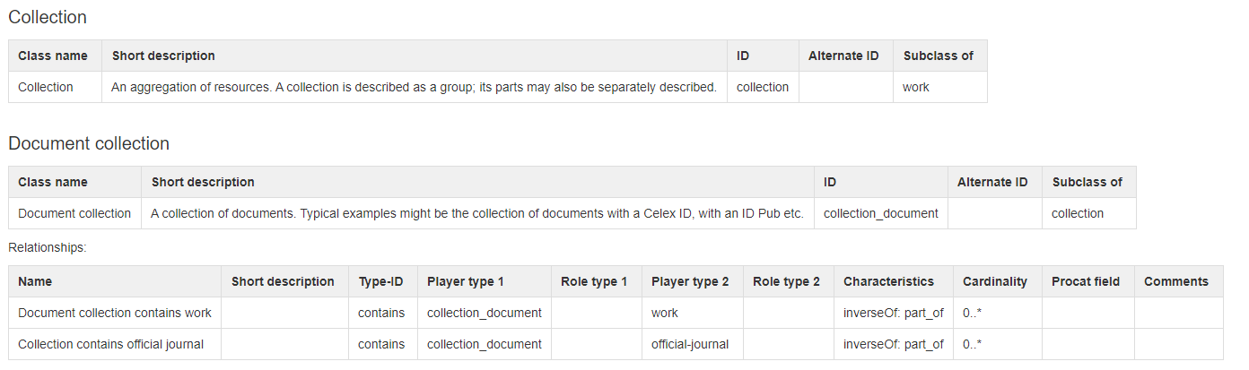
5. Implementation of collections in OP’s CDM
The work entity is defined, in IFLA LRM, as one “that permits the identification of the commonality of content between and among various expressions”

Slide 8
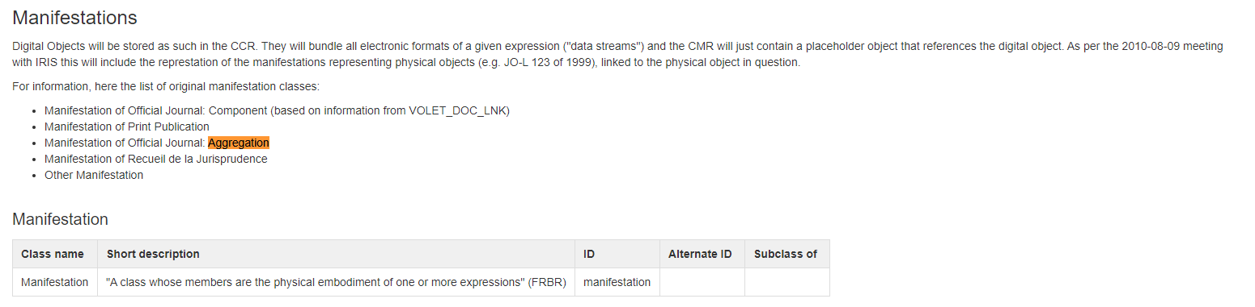
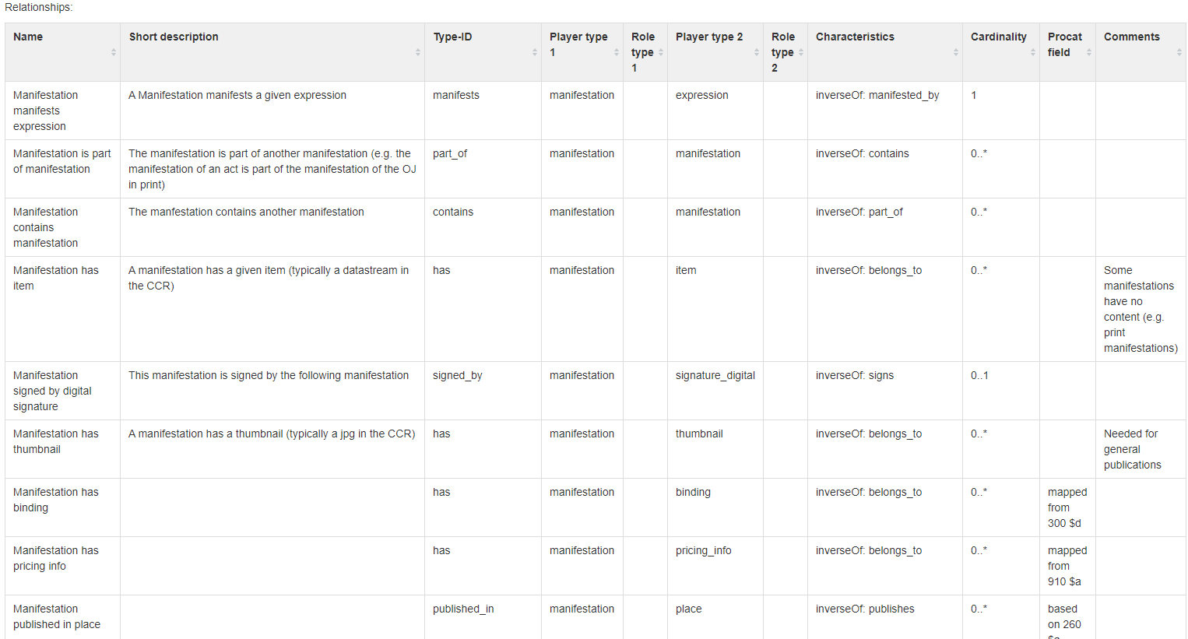
5. Implementation of aggregate manifestations in OP’s CDM

Slide 9
6. Possible implementation in ePO of an “aggregate collection”
Work
epo:Information Resource
Subclass Of
Expression
epo:Document
epo:Evidence Collection
Subclass Of
Manifestation
epo:Evidence
embodiedIn
instanceOf
VCD
ESPD
everis Tax Agency 2018
Declaration Certificate
Contains manifestation of
instanceOf
Everis Social Security Treasury
Certificate 2018
Contains manifestation of

